Slide 1
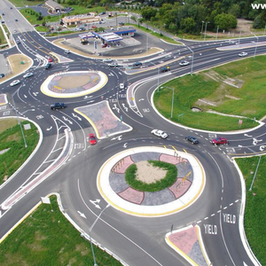

Calibration of Micro-Simulation Models
Smart, Safer, and Sustainable (S³) Transportation Lab
Zhixia (Richard) Li, Ph.D.
Assistant Professor
Dept. of Civil & Environmental Engr.
University of Louisville
April 18, 2016

Slide 2
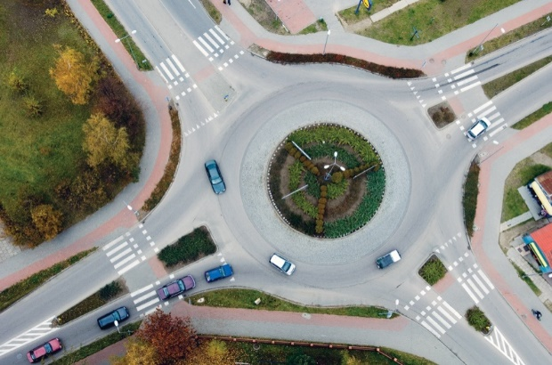
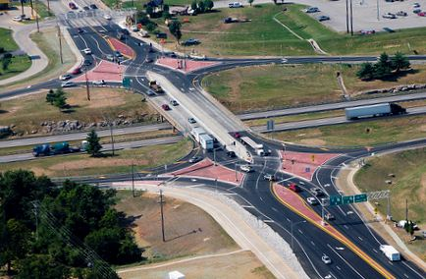
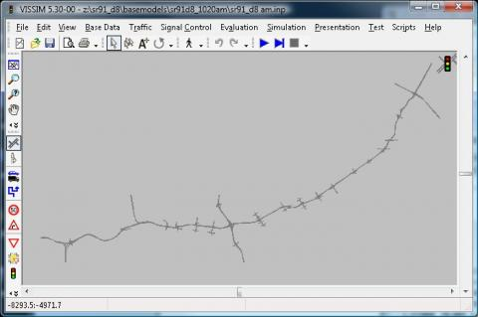
What are the Typical Microsimulation Models?
Intersections
  Signalized
  Stop Controlled (Two-Way & All-Way)
  Roundabout
Interchanges
  Diamond Interchange
  Single-Point Urban Interchange
  Diverging Diamond Interchange
  Roundabout Interchange
A Corridor (Freeway or Arterial)
A Roadway Network

Slide 3
Why Microsimulation?
What-if Analysis?
Some alternative intersection/interchange, as well as corridor analysis not well covered in the HCM/HCS 2010.
Complicated scenarios are not able to be well represented by using macro-simulation.
Stochastic (micro) vs. deterministic (macro)

Slide 4
Key to Usable Microsimulation Modeling:
Simulation Model Calibration and Validation!!
“There is a lack of quantitative calibration guidelines for various facilities”

Slide 5
Demo of Calibrated vs. Uncalibrated Roundabout Microsimulation Models

Slide 6
How to Calibrate the Microsimulation Model?
Adjust/Fine-tune simulation parameters to match the simulated MOE values to the field-observed MOE values.
  For example: To calibrate the MOE “saturation flow rate” in a freeway microsimulation, we need to adjust the car following model parameters to minimize the .
Calibration objective function:
  Min (MSE) subject to p_{m}^{Min} ≤ p_{m} ≤ p_{m}^{Max}
  Where MSE = Mean square error between the simulated and observed MOE values.

Slide 7
Demo of Calibration of Freeway Saturation Flow Rate

Slide 8
What MOEs are of Concern?
Performance MOEs
  Corridor/network models
    Travel time
    Capacity/throughput
    Average speed
    Intersection/interchange models
    Capacity/throughput
    O-D control delay
    Queue length
    If safety is a concern
    Traffic conflicts

Slide 9
What MOEs are of Concern?
Interim MOEs
  Interim MOEs impact performance MOEs
  Typical interim MOEs include:
    Saturation headway/flow rate
    Queue discharge headway
    Driver’s gap acceptance behavior (yield control, left turn)
    Driver’s car–following behavior
    Driver’s lane change behavior
    Driver’s response to traffic signals (yellow signal)
    Arrival type at intersection

Slide 10
What Parameters to Calibrate as They Impact Performance or Interim MOES?
The parameters are simulation platform-specific. Generally, they include:
  Vehicle acceleration/deceleration profiles
  Vehicle speed profile by vehicle type
  Vehicle type distribution: traffic composition
  Vehicle generation model
  Vehicle type, weight.
  Speed reduction zone: location, deceleration and speed profile
  Driver’s start-up lost time
  Driver’s perfection-reaction time
  Driver’s stopping probability model at yellow signals

Slide 11
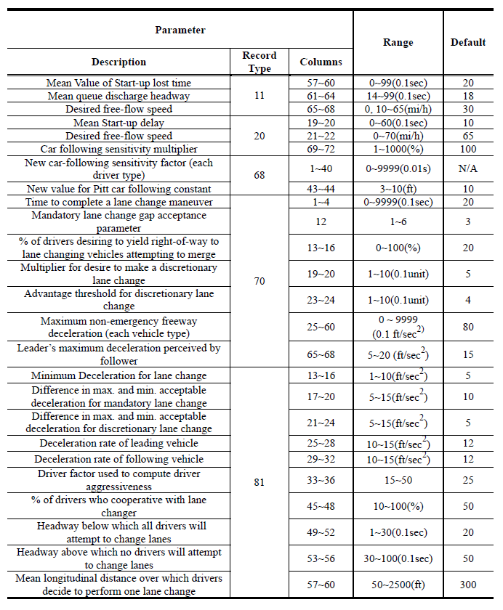
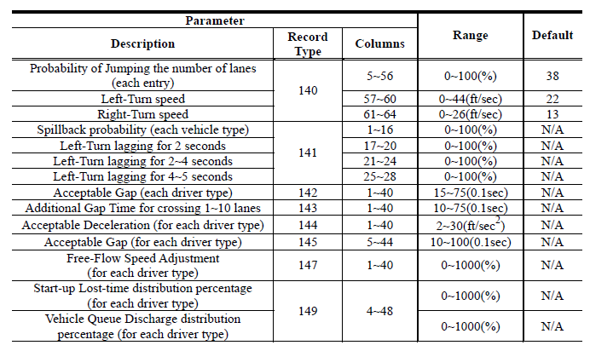
Sample CORSIM Parameter List

Slide 12
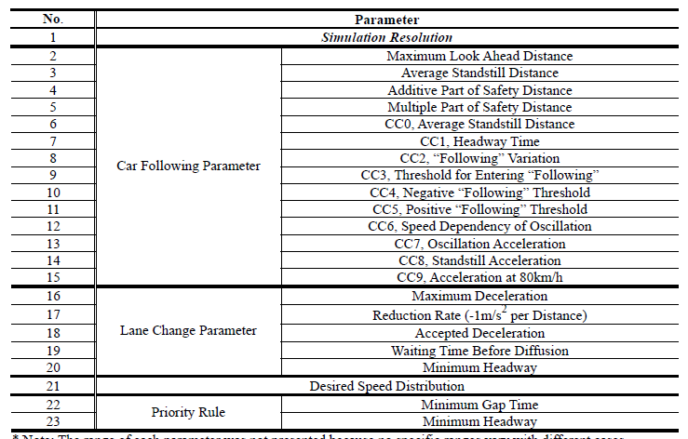
Sample VISSIM Parameter List

Slide 13
Some General Calibration Considerations
Speed profile, acceleration/deceleration profile, reaction to yellow signal, gap acceptance behaviors, need to be calibrated separately for different vehicle types. As they make substantial impact on most performance measures.
Gap acceptance will also consider follow-up headway in addition to critical headway.
  Different queue measurements (average queue length or 95th percentile queue length) for different facilities modeled.

Slide 14
Four Additional Important Considerations in Calibration:
1. How many runs needed?
2. Warm-up period?
3. How long is each run?
4. What simulation resolution should be used?

Slide 15
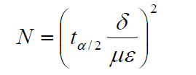
How Many Runs are Needed in the Calibration?
Every run is random. So varying values of MOEs would be obtained from different runs.
Therefor, the number of simulation runs is one of the contributing factors influencing the calibration accuracy.
The number of simulation run should be estimated by the following equation?

Slide 16
Warm-up Period in the Calibration
Warm-up period is the time measured in the simulation time to assure the simulated traffic operations are stable enough to obtain reliable MOEs from.
Typically, the warm-up period is 15-30 minutes in simulation time.
Simulation output during the warm-up period is not either recorded or used in the calibration.

Slide 17
How Long for Each Simulation Run?
Run time for each simulation is project-specific.
In most traffic engineering studies, one hour or 3600 seconds are used.

Slide 18
Simulation Resolution
Simulation resolution is measured in simulated steps per simulation second.
  For example: 10 steps/second vs. 1 step/second
Selection of simulation resolution is project-specific.
  For example: for a signalized intersection simulation model, 10 steps/second is preferred, as yellow, all red time, as well as gap acceptance behaviors are measured in fractions of a second.
  For example, for a freeway corridor application, <5 steps/second is preferred to substantially save simulation time, as that application does not need such details of simulation.

Slide 19
Case Study:
Prioritized List of Simulation Parameters (In Terms of Quantitative Impact on Simulation MOEs) for Calibrating Roundabout Simulation Models

Slide 20

Introduction and Background
Roundabout as a Safety Treatment
  Eliminate “crossing” conflicts
  Reduce speed
  Reduce crash severity
Problem and Background
  Operational impacts of installing a roundabout needs to be analyzed before recommendation
  Microscopic simulation software
    VISSIM: one of the most widely used for modeling roundabouts
  Calibration and validation of microscopic simulation model
    An essential prerequisite for a simulation model to be ready for analysis

Slide 21
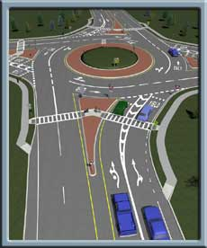
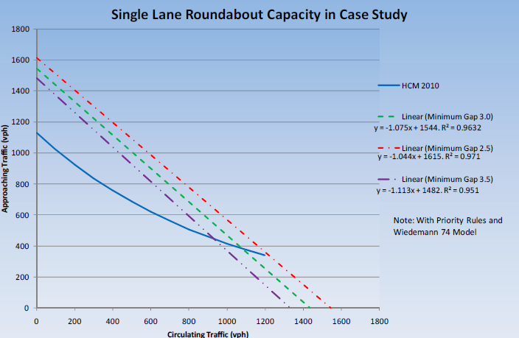
Introduction and Background
Problem and Background
  Current practice of VISSIM roundabout model calibration
    Adjust VISSM parameters repeatedly to match the output capacity curve to the field observed capacity curve
    Most research focused on qualitative investigations by sensitivity analysis of VISSIM parameters’ impact on capacity
    Lack of field data as input to building the model
  Quantitative calibration guideline is in need
    Easy-to-use monographs or equations for engineers
    Development of the guideline based on field data

Slide 22
Research Objectives
Objectives
  Establish quantitative relationships between VISSIM parameters and roundabout capacity;
  Develop an easy-to-use quantitative calibration guidance
    Recommend selection of VISSIM parameters
    Recommend field-estimated parameter values for calibration
    Recommend the whole calibration procedure

Slide 23
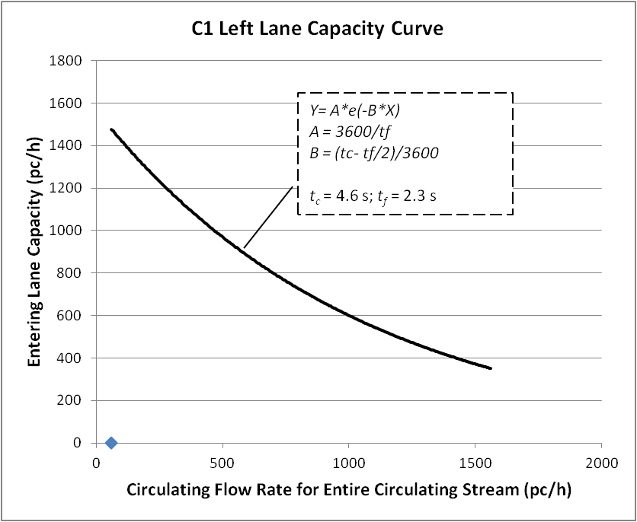
Methodology
Quantify the Roundabout Capacity
  Capacity of the critical lane of roundabout (US Model, HCM 2010)
    An exponential function of Critical Gap (t_{c}) and Follow-up Headway (t_{f})
Where,
C_{pce} = lane capacity (pc/hr)
v_{c} = conflicting flow (pc/hr),
t_{c} = critical headway (s), and,
t_{f} = follow-up headway (s) .

Slide 24
Methodology
Numerical Relationship between Capacity & VISSIM Parameters
  Solely represented by the Numerical Relationship between
    VISSIM parameter value and Critical Gap (t_{c})
    t_{c} ~ VISSIM parameter
    VISSIM parameter value and Follow-up Headway (t_{f})
    t_{f} ~ VISSIM parameter
  Method: Quantification of VISSIM parameter’s impact on capacity is simply quantifying both of the above relationships.
t_{c} and t_{f} serve as the surrogate of roundabout capacity.

Slide 25
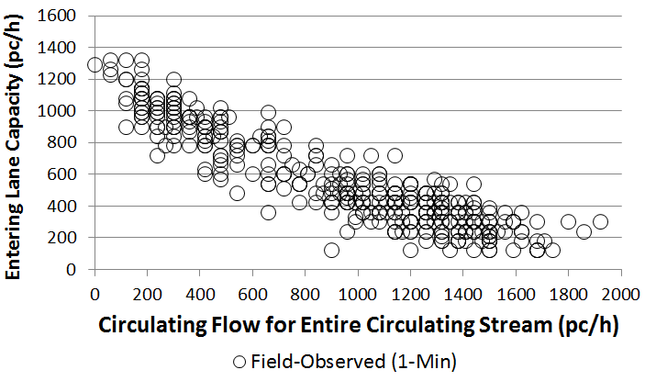
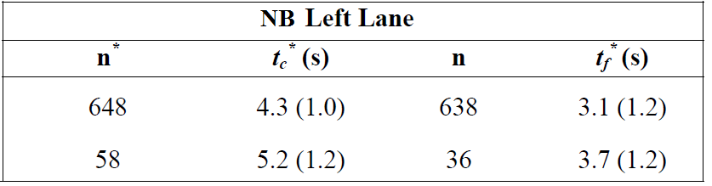
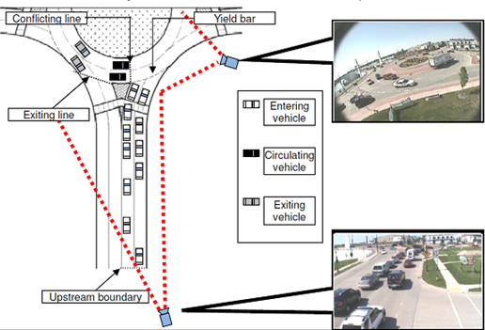
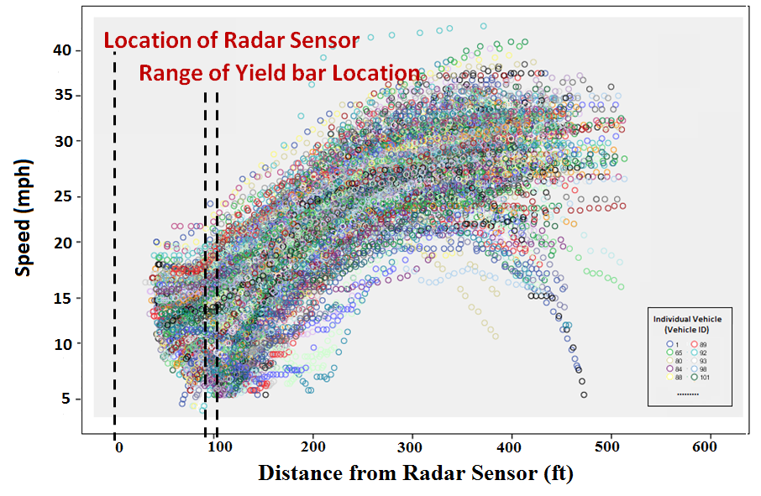
Methodology
Field Data Collection
  Capacity Data Gap Acceptance Data
  ( (Obtained using Maximum Likelihood Method)
  Speed Data

Slide 26
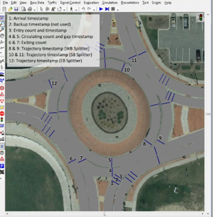
Methodology
Estimate t_{c} and t_{f} in VISSIM
  Set up data collection points
  Based on accepted gap and maximum rejected gap
  Same standard method used for
  field data
  (Maximum Likelihood Method)

Slide 27
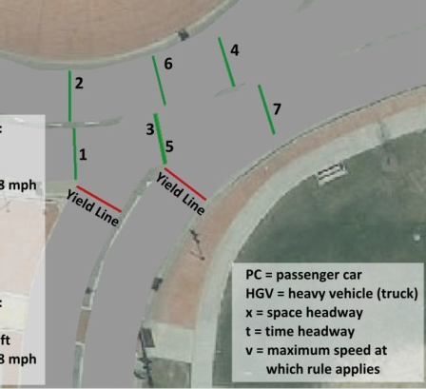
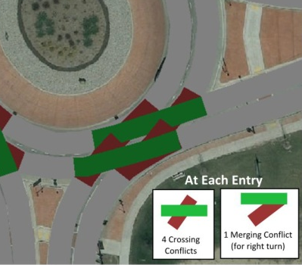
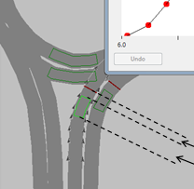
Analysis
What VISSIM Parameters Should Be
Included in the Calibration Process?
  Priority Rules (PR)
    Minimum gap
  Conflict Areas (CA)
  Reduced Speed Areas (RSA)
    Speed distribution
    Deceleration rate
  Wiedemann 74 Car Following Model
    Additive
    Multiplicative

Slide 28
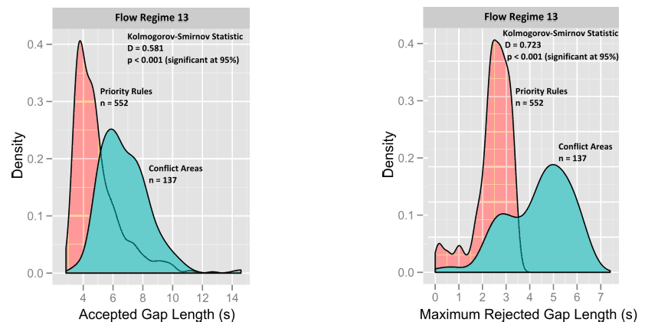
Analysis
Results on Priority Rule (PR) vs. Conflict Area (CA)
  The consistency and repeatability under PRs concurs with the field-observed normally distributed accepted and rejected gaps.
  PR produced more realistic and consistent gap acceptance behavior.

Slide 29
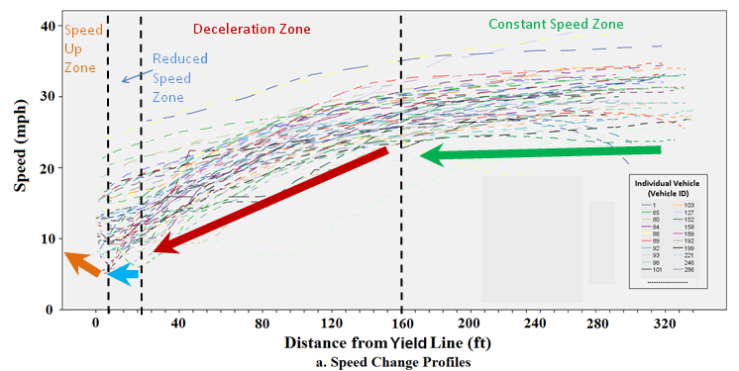
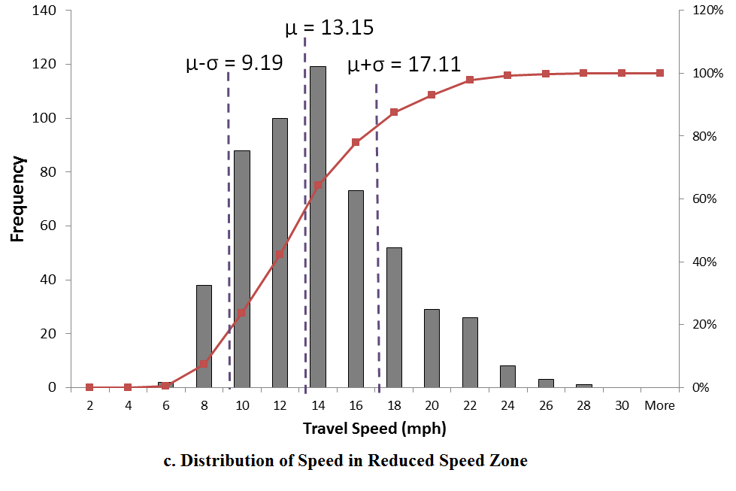
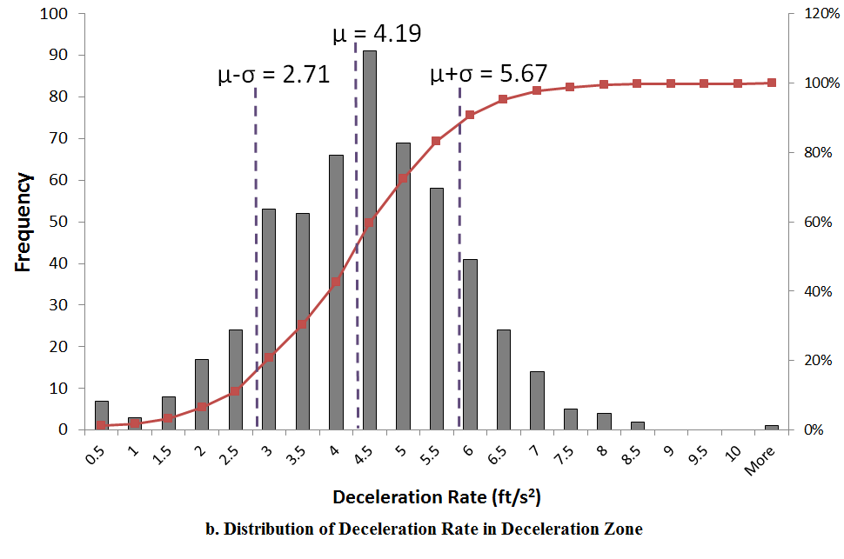
Analysis
Results on Settings of Reduced Speed Area (RSA) based on Field Data
  Location of RSA, Speed Distribution in RSA, Deceleration Rate for RSA

Slide 30
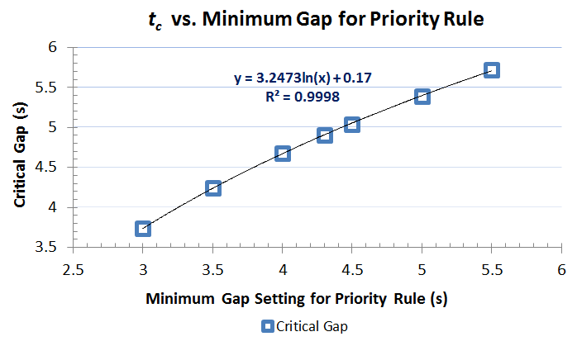
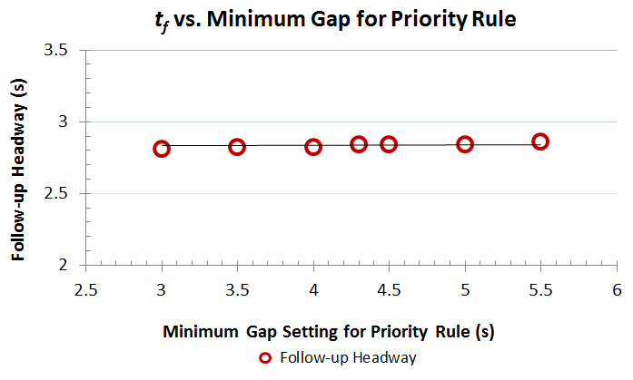
Sensitivity Analysis
Results of Sensitivity Analysis of VISSIM Parameters
  Quantification of PR’s Minimum Gap’s Impact on Critical Gap (t_{c}) and Follow-up Headway (t_{f})
  No significant impact identified
t_{c} vs. Minimum Gap of PR
t_{f} vs. Minimum Gap of PR

Slide 31
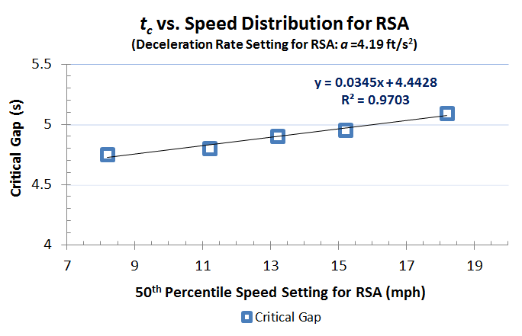
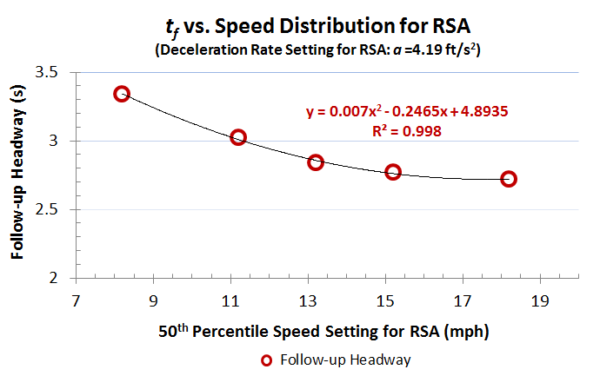
Sensitivity Analysis
Results of Sensitivity Analysis of VISSIM Parameters
  Quantification of RSA’s Speed Distribution’s impact on Critical Gap (t_{c}) & Follow-up Headway (t_{f})
t_{c} vs. 50th Percentile Speed of RSA
t_{f} vs. 50th Percentile Speed of RSA

Slide 32
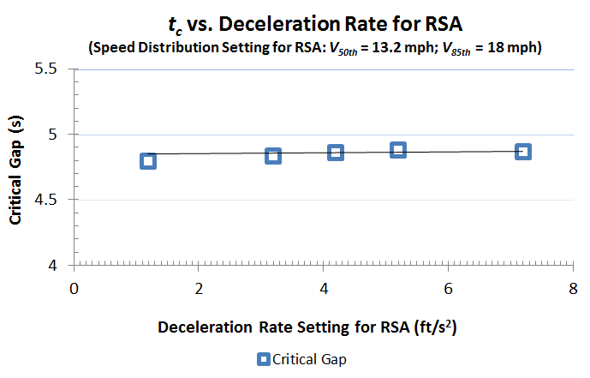
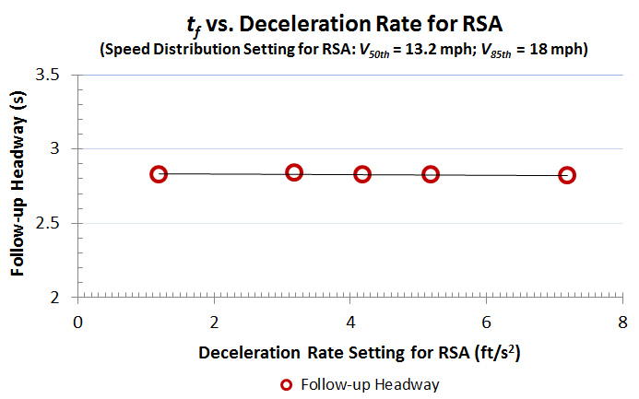
Sensitivity Analysis
Results of Sensitivity Analysis of VISSIM Parameters
  Quantification of RSA’s Deceleration Rate’s impact on Critical Gap (t_{c}) & Follow-up Headway (t_{f})
  No significant impact identified No significant impact identified
t_{c} vs. Deceleration Rate of RSA
t_{f} vs. Deceleration Rate of RSA

Slide 33
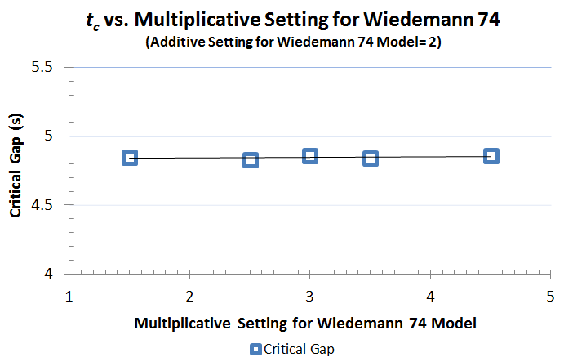
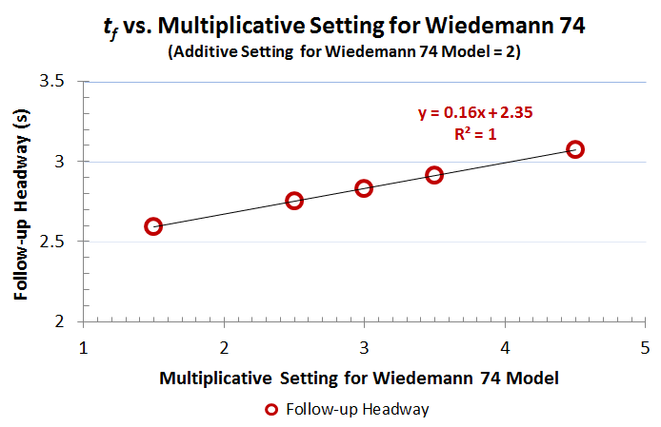
Sensitivity Analysis
Results of Sensitivity Analysis of VISSIM Parameters
  Quantification of Wiedemann 74’s Multiplicative’s impact on Critical Gap (t_{c}) & Follow-up Headway (t_{f})
  No significant impact identified
t_{c} vs. Multiplicative of W74 Model
t_{f} vs. Multiplicative of W74 Model

Slide 34
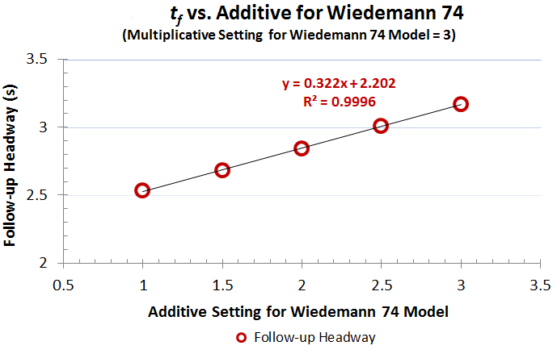
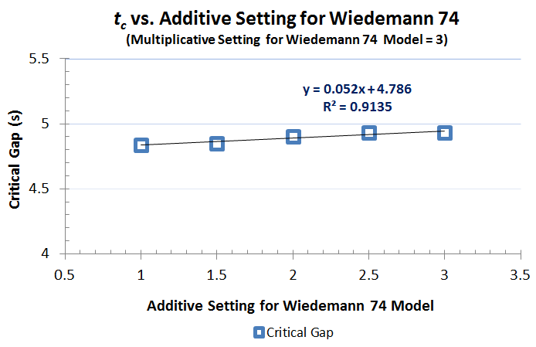
Sensitivity Analysis
Results of Sensitivity Analysis of VISSIM Parameters
  Quantification of Wiedemann 74’s Additive’s impact on Critical Gap (t_{c}) & Follow-up Headway (t_{f})
t_{c} vs. Additive of W74 Model
t_{f} vs. Additive of W74 Model

Slide 35
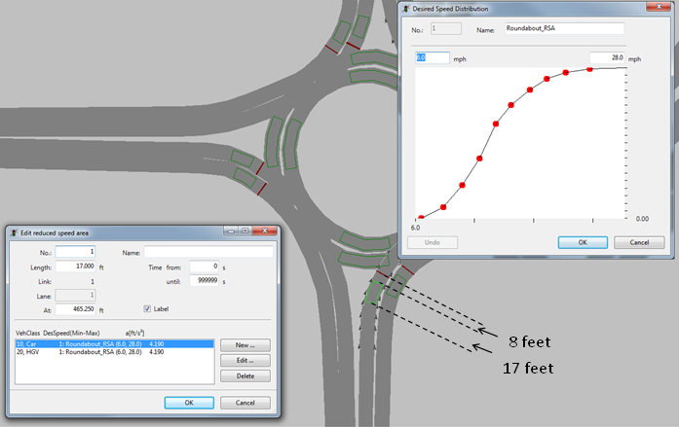
Quantitative Calibration Guidelines
Step-by-step Calibration Guideline
  Step 1: Place entrance RSA approximately at 8 feet from the yield line, with a length of 17 feet. Speed distribution setting is recommended to conform to the observed speed cumulative curve. Deceleration Rate is recommended to be 4.19 ft/s².

Slide 36
Quantitative Calibration Guidelines
Step-by-step Calibration Guideline
  Step 2: Priority Rule is recommended to model the yielding logics;
  Step 3: Minimum Gap of Priority Rule is recommended for calibrating t_{c} and can be quantitatively estimated by the following equation;
  Step 4: The Multiplicative factor of W74 model is recommended for calibrating t_{f} and can be estimated by the following equation.
Notes:
Although the curve extraction algorithm is presumed to operate optimally by applying the calibrated optimal bearing angle threshold, the algorithm’s performance still needs to be further validated by using different sets of ground truth data.

Slide 37
Quantitative Calibration Guidelines
Step-by-step Calibration Guideline
  Step 5: Speed Distribution of RSA and the Additive Factor for W74 model impact both t_{c} and t_{f}.
  Both are not recommended to be used in calibration unless applying Steps 1 through 4 cannot fulfill the calibration needs.
Notes:
Although the curve extraction algorithm is presumed to operate optimally by applying the calibrated optimal bearing angle threshold, the algorithm’s performance still needs to be further validated by using different sets of ground truth data.

Slide 38
Case Study for the Calibration Guideline
Case Study
    NB approach of a roundabout in DePere, Wisconsin
    Field observed data
      t_{c} = 4.3 s
      t_{f} = 3.1 s
    Applying the calibration guideline
      Step 1: Place the RSA accordingly.
      Step 2: Use Priority Rule;
      Step 3: Compute the required Minimum Gap to achieve the 4.3 s t_{c.}
      using the given equation;
      Step 4: Compute the required Multiplicative to achieve the 3.1 s t_{f.}
      using the given equation;
Notes:
Although the curve extraction algorithm is presumed to operate optimally by applying the calibrated optimal bearing angle threshold, the algorithm’s performance still needs to be further validated by using different sets of ground truth data.

Slide 39
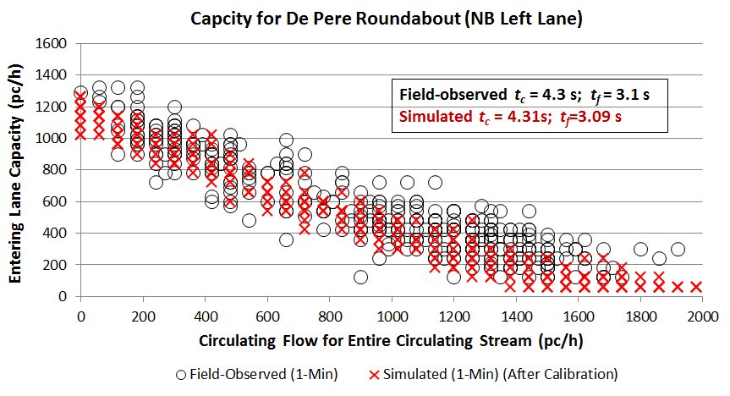
Quantitative Calibration Guidelines
Case Study
    Validation of the calibration result
Notes:
Although the curve extraction algorithm is presumed to operate optimally by applying the calibrated optimal bearing angle threshold, the algorithm’s performance still needs to be further validated by using different sets of ground truth data.

Slide 40
A Real Application of
The Roundabout Simulation Model

Slide 41
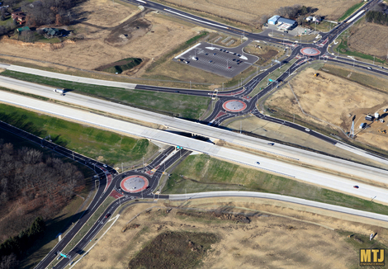
Problem Statement
  In the US, roundabouts have been constructed at ramp terminals, and more are planned.
  Potential issues with the operational performances arise and need to be studied:
    Queue spillback from roundabout off-ramps to the highway: arterial traffic is less impeded;
    Effect of heavy vehicles: larger critical gap and follow-up headway for trucks.
Source: http://www.mtjengineering.com/project/ih-94-and-county-highway-tt/
41

Slide 42
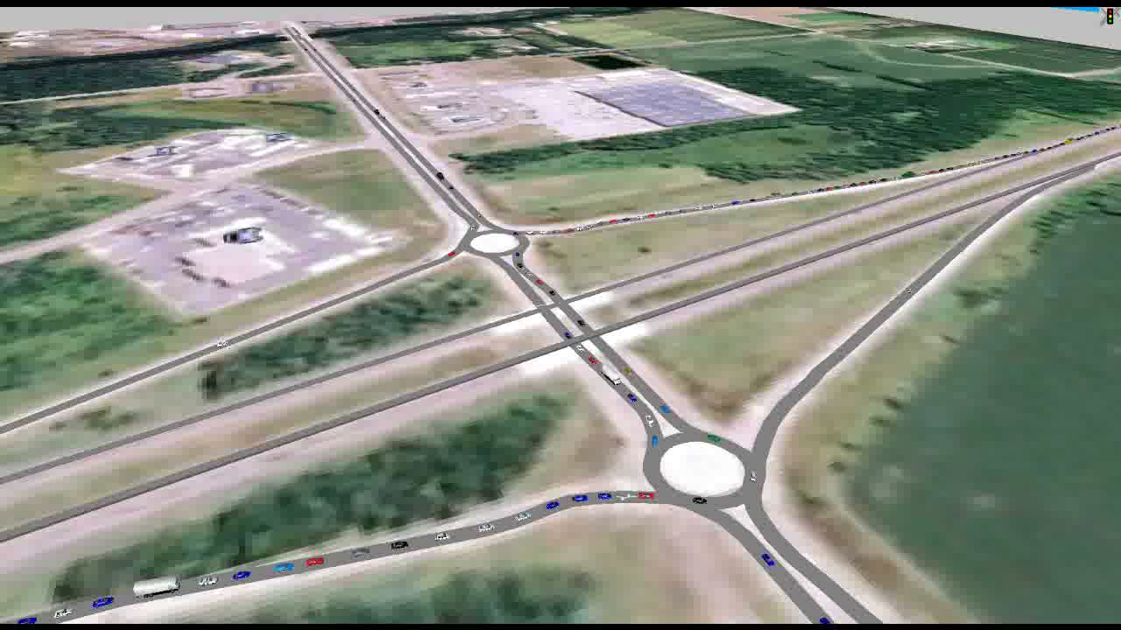
Roundabouts at Ramp Terminals

Slide 43
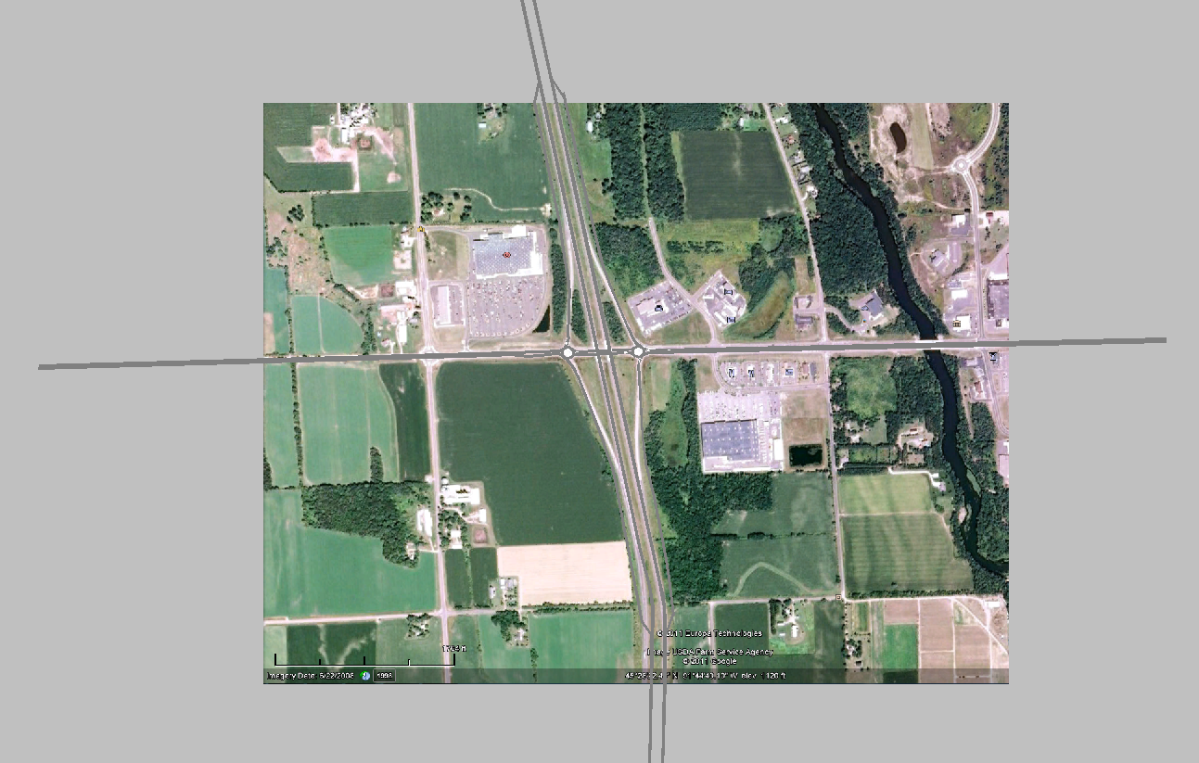
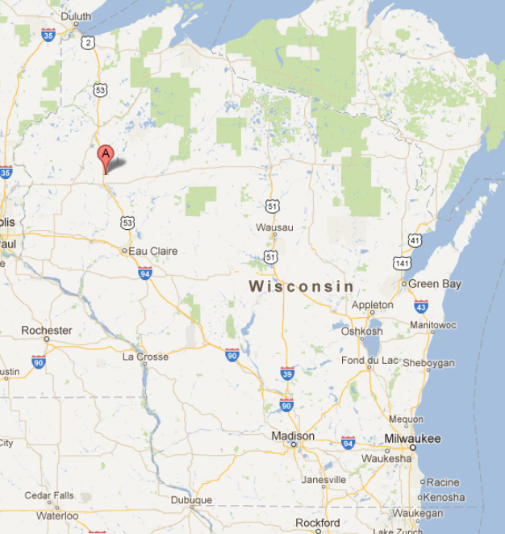
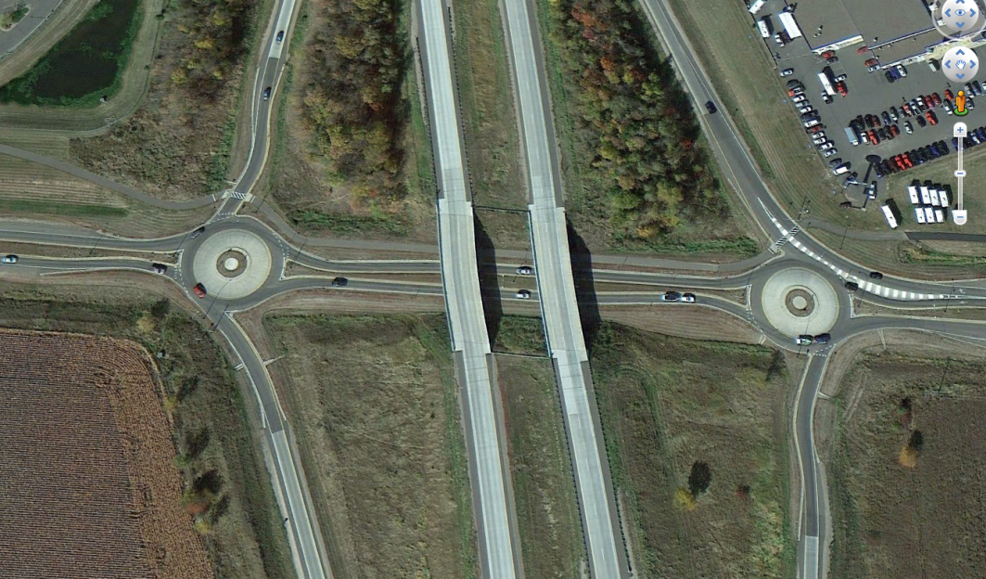
Modeling Single-Lane Roundabout Interchange
  Developed based on interchange at Hwy 53 and CTH O, Wisconsin
43

Slide 44
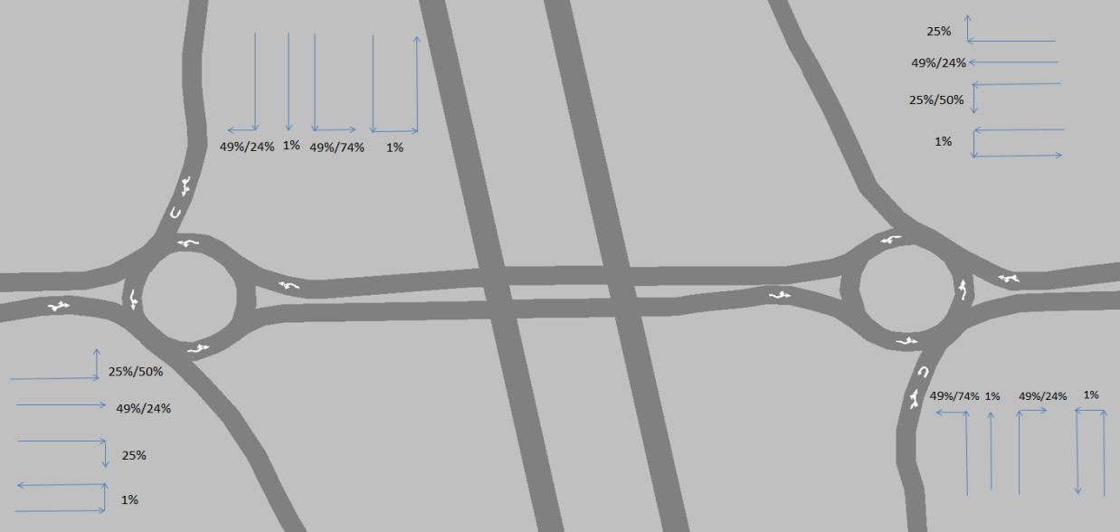
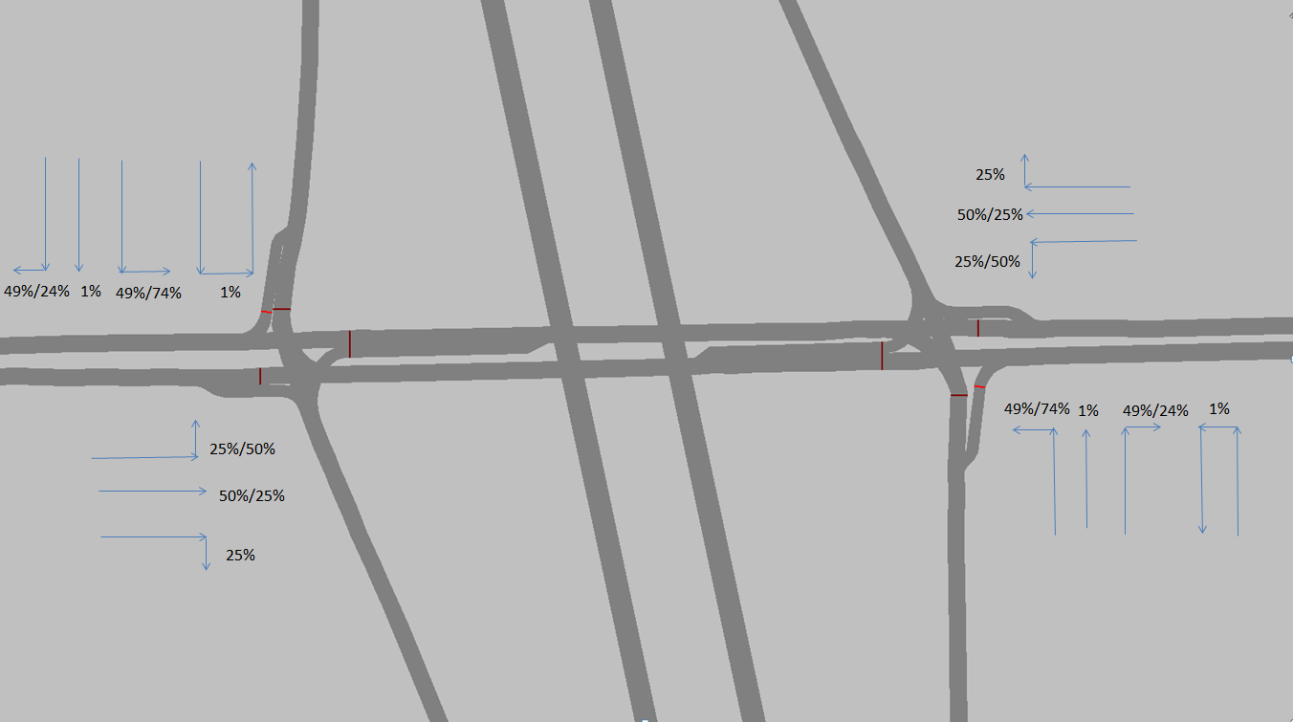
Modeling Single-Lane Roundabout and Signalized Interchanges
Characteristic |  | Value
Off ramp length |  | 2500 ft
Arterial approach length |  | 5000 ft
Distance between roundabouts |  | 700 ft / 400 ft
Arterial movement distribution | Left turn | 25% / 50% (heavy arterial left-turn mode)
 | Through | 49% / 24% (heavy arterial left-turn mode)
 | Right turn | 25%
 | U turn | 1%
Off-ramp movement distribution | Left turn | 49% / 74% (heavy off ramp left-turn mode)
 | Through | 1%
 | Right turn | 49% / 24% (heavy off ramp left-turn mode)
 | U turn | 1%
Bypass right-turn lane |  | None for both arterial and off-ramp entrance
Freeway Speed |  | 75 mph
Arterial Speed |  | 45 mph
44

Slide 45
Calibration of the single-lane roundabout interchange simulation model
  Target t_{c} and t_{f}
    Based on field observed gap acceptance data
      t_{c} for cars = 4.2 s
      t_{f} for cars = 2.8 s
      t_{c} for heavy vehicles = 5.2 s
      t_{f} for heavy vehicles = 3.8 s
Lane Calibrated |  | Target t_{c} (s) | Simulated/ Calibrated t_{c} (s) | Target t_{f} (s) | Simulated/ Calibrated t_{f} (s)
WB*Arterial (East RAB*) | PC* | 4.2 | 4.17 (0.26)* | 2.8 | 2.77 (0.04)
 | HV* | 5.2 | 5.20 (0.71) | 3.8 | 3.84 (0.08)
EB*Arterial (West RAB) | PC | 4.2 | 4.24 (0.22) | 2.8 | 2.84 (0.07)
 | HV | 5.2 | 5.24 (0.48) | 3.8 | 3.84 (0.11)
NB* Off Ramp (East RAB) | PC | 4.2 | 4.24 (0.30) | 2.8 | 2.82 (0.08)
 | HV | 5.2 | 5.19 (0.43) | 3.8 | 3.78 (0.09)
SB* Off Ramp (West RAB) | PC | 4.2 | 4.16 (0.24) | 2.8 | 2.76 (0.38)
 | HV | 5.2 | 5.21 (0.42) | 3.8 | 3.80 (0.58)
WB* Interior (West RAB) | PC | 4.2 | 4.22 (0.28) | 2.8 | 2.82 (0.11)
 | HV | 5.2 | 5.21 (0.51) | 3.8 | 3.81 (0.13)
EB Interior (East RAB) | PC | 4.2 | 4.19 (0.32) | 2.8 | 2.80 (0.06)
 | HV | 5.2 | 5.23 (0.41) | 3.8 | 3.82 (0.17)
* WB, EB, NB, SB denote westbound, eastbound, northbound, and southbound, respectively; PC denotes passenger car; HV denotes heavy vehicle; () denotes standard deviation.
45

Slide 46
Research Product:
Off-ramp Queue Length Look-up Chart for Single-Lane Roundabouts at Ramp Terminals
Notes:
Although the curve extraction algorithm is presumed to operate optimally by applying the calibrated optimal bearing angle threshold, the algorithm’s performance still needs to be further validated by using different sets of ground truth data.

Slide 47
Research Product:
Selection Table to Assist Decision Making in Choosing Between Single-lane Roundabout or Signalized Interchanges

Slide 48
Case Study for Simulation Model Customization: Microsimulation Modeling
of
Next-Generation Intersection

Slide 49
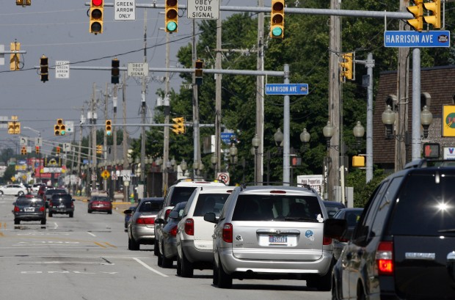
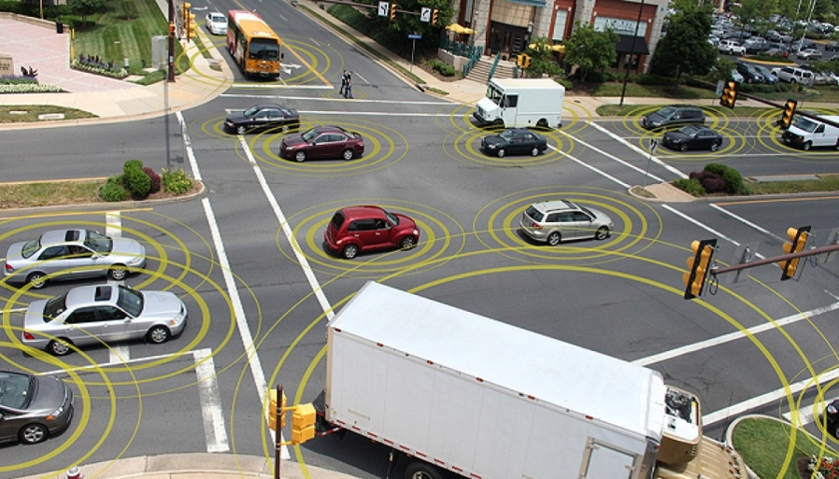
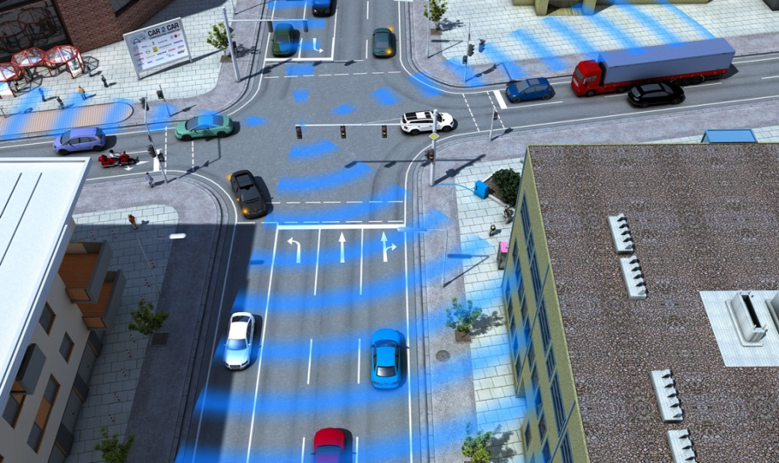
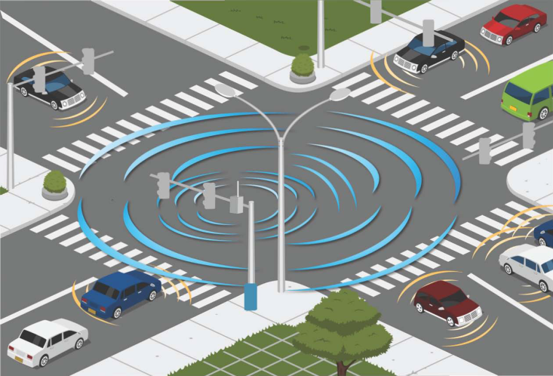
Communications Revolution
Vehicle-Vehicle Communication (V2V)
Vehicle-Infrastructure Communication (V2I)
V2I plus V2V – V2X: Connected Vehicles

Slide 50
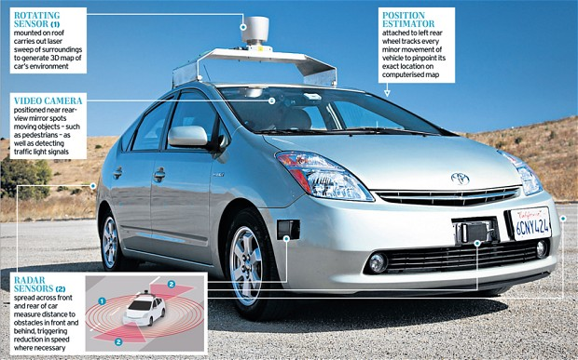

Autonomous Vehicle Era is Coming
Autonomous Vehicle: capable of sensing its environment and navigating without human input
As of today Nevada, Florida, California, Michigan, and Washington D.C. have passed laws permitting autonomous cars.
Most auto manufacturers plan to sell their autonomous cars by 2017-2020.
Google Driverless Car
Notes:
GM, Toyota, Mercedes-Benz, Volkswagen, Nissan, Volvo, and Tesla

Slide 51

Will This be Cooperative Intersections in the Future?
Notes:
GM, Toyota, Mercedes-Benz, Volkswagen, Nissan, Volvo, and Tesla

Slide 52
Possibly?!
Can we simulate that?
Notes:
GM, Toyota, Mercedes-Benz, Volkswagen, Nissan, Volvo, and Tesla

Slide 53
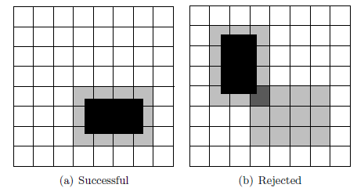

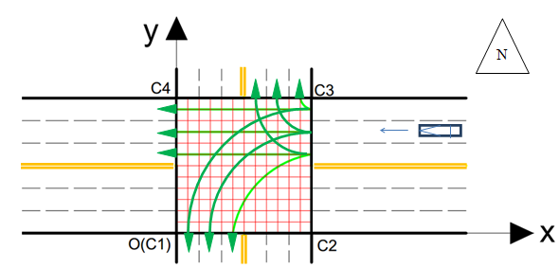
Modeling Next-Generation Intersection Control of Autonomous Vehicles
Centralized control algorithm
  Step 1: Vehicle requesting reservation
  Step 2: CIC processing a reservation request
    Internal simulation to check conflicts
    Minimum speed to allow fixed-speed reservation
  Step 3: CIC declining and approving the reservation request
Communicate
CIC’s Internal Simulation
n trials of different a
Notes:
Turn from any lane to reduce lane change delay.

Slide 54
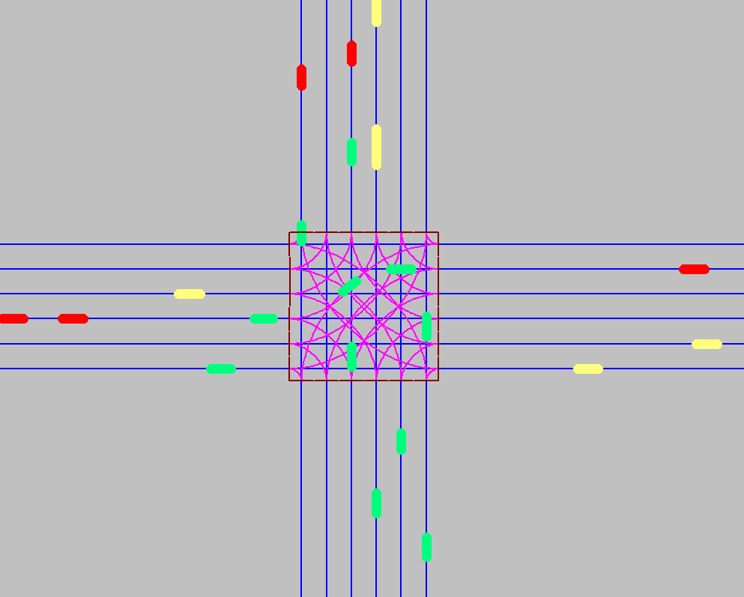
Modeled in Microsimulation Platform: VISSIM
External Driver Model
  Overriding the driver’s behavior models in VISSIM to realize centralized control

Slide 55

Agent-based Next-Generation Intersection Control of Autonomous Vehicles
Multi-tile ACUTA
Granularity = 12

Slide 56
On-going and Future
Research Efforts

Slide 57
  Develop automated calibration method that can be customized for various applications.
Develop easy-to-implement quantitative calibration guidelines for various facilities.
  Signalized intersections
  Conventional and alternative interchanges
  Corridor
  Network
Develop short courses for training of microsimulation model calibration for various facilities.
  Lecture slides
  Tutorial handouts
  Hands-on lab exercises

Slide 58

Automated Calibration
Via Excel’s VBA functions or MatLab
  Programming to access the simulation software.
  Automatically obtains MOE output from simulations.
  Automatically sets parameters in simulations.
  Iterations allowed to calibrate the simulation parameters

Slide 59

Automated Calibration
Calibration based on optimization implemented using Genetic Algorithm (GA)
  GA is widely used in transportation engineering to solve optimization problem.
  Optimization is to minimize the difference between the MOE values output from the simulation and the target MOE values observed in field.

Slide 60
Thank You!
&
Questions and discussions are very welcome!

