Slide 1
Water Transportation Advisory Board Statewide and KYTC Purchasing/Procurement Information Availability
Tuesday, June 5, 2018 1:00 PM to 3:30 PM EST Kentucky Transportation Cabinet, Room 106

Slide 2
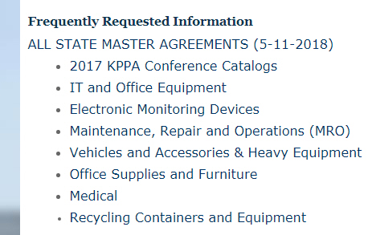
Master Agreements for Purchases
Statewide price contracts
For a specific vendor and product
Not necessary to go through bid process
Variety of products
If on a limited contract, you could request the same discount from the vendor
https://finance.ky.gov/services/eprocurement/pages/contractinginfo.aspx

Slide 3
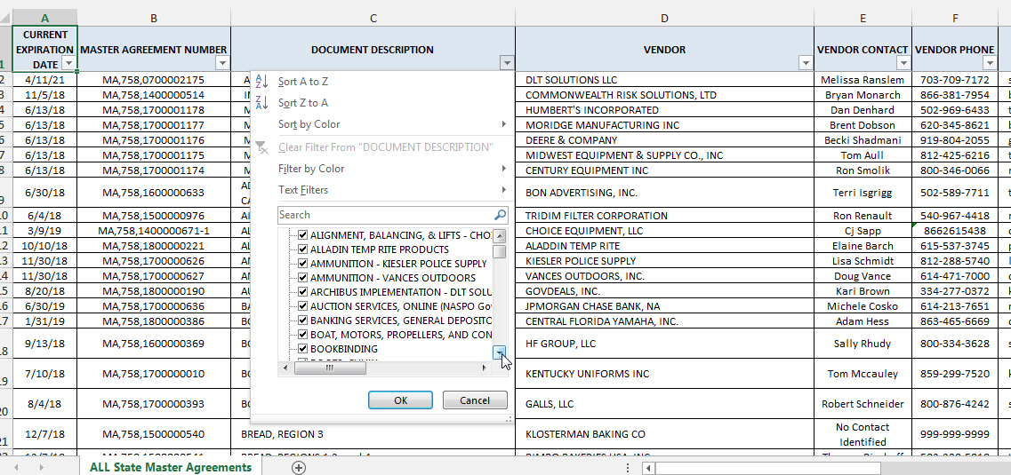
All State Master Agreements Downloadable Spreadsheet
Can filter by type of product or vendor then go to another site to get copy of the contract

Slide 4
Links to Master Agreement Information
Kentucky Finance and Administration Cabinet https://finance.ky.gov/services/eprocurement/pages/default.aspx
State Agency and Local Government Procurement https://finance.ky.gov/services/eprocurement/Pages/contractinginfo.aspx
ALL STATE MASTER AGREEMENTS - all master agreements valid throughout Kentucky – Excel version – download https://finance.ky.gov/services/eprocurement/Documents/ALL%20State%20Master%20Agreements%20as%20of%205-11-2018.xlsx

Slide 5
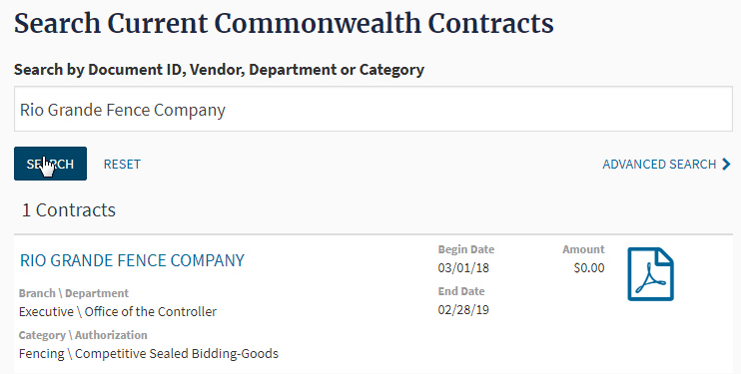
Transparency.ky.gov
Full contract (pdf format) of items listed in Master Agreement file
Search by Contract, Salary, Spending

Slide 6
Pre-Qualified Contractors and Materials
Part 3 KRI Guidance for Project Initiation and Commencement, Initiating the Project, Milestone 1:
If the type of project being done is on the list of KYTC work items, the proposed contractor must be pre-qualified for that type of project;
Materials, specified by brand name or vendor, must be approved prior to use

Slide 7
Pre-Qualified Contractors
Contractors are qualified for specific types of work
Type of work identified in the list of contractors by work code: https://transportation.ky.gov/Construction-Procurement/Documents/Work%20Item%20%20List.pdf
Examples: Grade and Drain = A; Bridge deck repair = I17; Concrete repairs = I28; Asphalt Paving C1 or C2; Concrete paving = B
Work Item list is also the last 2 pages of Pre-Qualified Contractors list
List of all prequalified contractors :
https://transportation.ky.gov/Construction-Procurement/Documents/Prequalified%20Contractors%20List.pdf

Slide 8
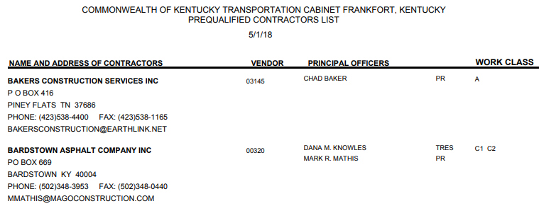
Pre-Qualified Contractors
Sample partial page of list
https://transportation.ky.gov/Construction-Procurement/Documents/Prequalified%20Contractors%20List.pdf

Slide 9
Materials
Approved materials have been verified as to quality and applicability
List of approved materials, updated daily: http://transportation.ky.gov/materials/pages/List-Of-Approved-Materials.aspx

Slide 10
Sample partial page of list for a single material
http://transportation.ky.gov/materials/pages/List-Of-Approved-Materials.aspx

