Slide 1
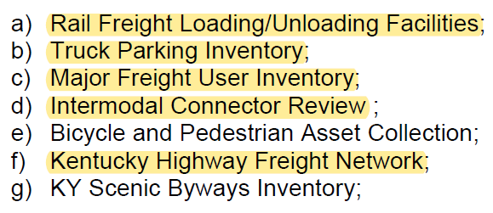
Intention
This will be a quick training to help familiarize ADD Planners and GIS staff to successfully fulfill the requirements of the deliverables for Work Element 3, specifically items A, B, C, D, and F.

Slide 2
Purpose of the data
Rail Freight Loading/Unloading Inventory: used to identify rail transload facility locations, informs decisions to update the list of intermodal connectors, aids in the statewide Rail Plan and rail studies, and helps to understand the movement of goods using rail transport.
Truck Parking Inventory: used to identify locations of truck parking facilities, aids in development of the statewide Freight Plan, provides essential information for truck parking studies, and identifies corridors where parking demand might not be met.
Major Freight Users Inventory: used to identify locations of facilities that generate large amounts of freight traffic, aids in traffic forecasting and modeling, assists in development of the statewide Freight Plan, informs decisions to update the KHFN and intermodal connectors, and provides critical information for freight studies.
Intermodal Connectors: used to help identify major freight generating facilities and transload facilities, allows eligibility for NHS funding for designated roadway segments, and supports FHWA in maintaining an official inventory.
Kentucky Highway Freight Network: designated in 2015 as suggested by the FAST Act, it’s used for informed decision making in the SHIFT process, acts as a reference for the National Highway Freight network, supports statewide freight analysis for the Freight Plan and freight studies, and identifies corridors that support the movement of freight and goods across Kentucky.

Slide 3
What needs to be submitted for each deliverable? (Two formats)
A GIS Shapefile consisting only of updates that are needed to the current dataset. Updates include adding new records, deleting current records, or making a change to a current record. Applicable to the following:
Rail Loading/Unloading Facilities
Truck Parking Inventory
Major Freight Users Inventory
An Excel Spreadsheet consisting only of updates needed to the current dataset. Updates include adding new records, deleting current records, or making a change to a current record. Applicable to the following:
Kentucky Highway Freight Network
Intermodal Connectors
Notes:
You must use the shapefile and spreadsheet templates that KYTC has created for your submission. This ensures consistency among deliverables and enables faster processing on our end. For the shapefile, you can query out records that pertain to your ADD from the master shapefile, then export those selected records to a new shapefile to begin your review. Non-standardized shapefiles will not be accepted. The shapefile and spreadsheet templates are available on KYTC’s website.

Slide 4
Major vs. Minor Update Cycles
Major
An in-depth and thorough review in which every record in an existing inventory is reviewed for accuracy and validity. Meeting with stakeholders, RTC’s, and local officials is key.
FY 23 major update cycle includes Intermodal Connectors, Major Freight Users, and Kentucky Highway Freight Network datasets.
Minor
A more passive, less in-depth review in which an ADD can make KYTC aware of vital updates to an inventory. Typically, a smaller submission.
FY 23 minor update cycle includes Rail Freight Loading/Unloading and Truck Parking datasets.
Notes:
Schedules for major and minor updates for each fiscal year can be found in the ADD work program document.

Slide 5
What if updates are not needed?
You must review the entire current dataset for each item during a major update cycle or a broad stroke review during a minor update cycle.
Upon completion of the review, if it’s determined that no updates are needed, send an email stating that you have reviewed the most current version of the applicable dataset and there are no changes to report.
For example: “Staff at the Pennyrile Area Development District have reviewed the current truck parking inventory dataset and there have been no changes since the last submission.”
Do NOT send a copy/snapshot of the current inventory that KYTC already has. If you do not have any changes to submit, there is no need to submit old copies of PDF maps, spreadsheets, or shapefiles.

Slide 6
Rail Freight Loading/Unloading Facilities
Facility must be an active rail loading/unloading facility
During review process, report any new, expanded, or closed facilities
Report any attribute changes as well; be sure to note in the comment field which attributes changed
Place polygon feature around facility’s boundary
Populate each attribute field to the best of your ability

Slide 7
Rail Freight Loading/Unloading
Notes:
Cimarron rail facility near the southeast side of Hopkinsville

Slide 8
Truck Parking Facilities
Facility must contain at least 5 truck parking spaces where trucks can safely park
Provide total number of spaces; can be marked or unmarked
Place point feature at exact location of facility (on top of structure in aerial view)
Route field should be attributed as nearest adjacent interstate or parkway; retrieve mile point from interchange using route log layer
If facility is not located along an interstate or parkway, the route should be attributed as the nearest State Route or US Highway it’s located on; retrieve mile point from nearest intersection using route log layer
Populate all fields for each record to the best of your ability

Slide 9
Truck Parking Example
Notes:
This Flying J Travel Center truck parking facility in Christian County on the northside of Oak Grove has its route field attributed as I-24 and mile point location is derived from the route log layer at the nearest interchange; in this case 85.608

Slide 10
Major Freight Users
Place point feature at exact location of facility (on top of structure in aerial view)
Consult with the Regional Transportation Committee and local governmental and planning agencies for input on which facilities might need to be added to the inventory
Populate all fields for each record to the best of your ability
To be added to the inventory, a facility must meet at least one of the following criteria:
Daily truck traffic is 100 or more trucks per day during peak seasons
Facility under roof square footage is ≥100,000
Facility has 5 or more truck bays

Slide 11
Major Freight Users
Examples of types of facilities to include in the inventory
Manufacturing Facilities
Warehousing Facilities
Cargo Airports
Grain Elevators/Bulk Commodity Compounds
Quarries
Steel/Lumber Mills
Distribution Centers
Cross Dock Facilities
Notes:
Do not include big box stores, such as Lowe’s, Wal-Mart, Home Depot, etc. as well as call centers and office buildings in the inventory.

Slide 12
Major Freight Users
For large warehouses with multiple tenants, follow this procedure:
Create one point feature and one name for the building
Enter the range of street addresses at the building
Enter all applicable NAICS codes for the entire building
Enter the total square footage of the entire building
Sum the total number of employees for the entire building
Sum the total number of truck bays for the entire building
Sum the total number of trucks per day for the entire building
Follow this combined format for all other fields
List the names of the individual businesses in the comments field
Notes:
NAICS = North American Industry Classification System

Slide 13
Major Freight Users Example
Notes:
Facilities located in northwest Lexington that meet criteria to be included in the Major Freight Users inventory.

Slide 14
Intermodal Connectors
Must be a route(s) that provide access between major intermodal facilities and the National Highway System
Must meet the specific FHWA criteria for inclusion; the criteria can be found on this webpage
If a facility no longer meets the FHWA criteria or has closed, it may need to be removed
Review current intermodal connectors inventory and provide any changes needed to existing records
Reference the major freight users inventory and rail loading/unloading facilities to identify any possible missing links between MFU and transload facilities to the NHS
Notes:
Examples of meeting the intermodal connector criteria include truck/rail facilities that have 50,000 or more TEU’s (twenty equipment unit) for year OR 100 or trucks per day in each direction on the principal connecting route. Amtrak facilities with 100,000 passengers or more per year.

Slide 15
Intermodal Connectors Example
Notes:
Intermodal connector KY-194 in Pike County. Route mile points 17.931 to 18.979 on KY-194 comprise this intermodal connector. It provides access for McCoy Elkhorn Coal Corporation to the NHS (shown in purple). Think of intermodal connectors providing “first and last mile access.”

Slide 16
Kentucky Highway Freight Network
Review the current network in your region and seek input from stakeholders; MPO’s, HDO’s, RTC’s, freight industry leaders, and other local agencies for additions or alterations to the network
Things to keep in mind during the review process are conformity to KHFN criteria, 5 year planned freight activities, new developments in an area (new industrial parks, manufacturing facilities, or highway characteristic changes), and changes in truck traffic counts
Indicate type of change: new route, alteration to an existing route, or removal of a route from the network
Mileage additions and subtractions of route segments should balance within 10% of miles allotted for each tier

Slide 17
Kentucky Highway Freight Network
Tier Designations
Tier 1 – 638 miles, Primary Freight Network, AADTT >7,000
Tier 2 – 885 miles, remaining Interstates & Parkways, AADTT 4,000-7,000
Tier 3 – 3,600 miles, arterial and collector functional classification, regional connectivity, AADTT 500-4,000
Tier 4 – 1,653 miles, local access or regional connectivity, AADT under 500
Submissions should only typically be for tier 3 or 4 segments
Submissions with alterations of tier 1 or 2 segments require prior approval from KYTC
Notes:
Tier 1 consists of interstates on the Primary Freight Network. Tier 2 consists of parkways and any remaining interstates not in tier 1. Tier 3 consists of routes with a functional classification of principal and minor arterials, and major and minor collectors that provide regional connectivity. Tier 4 consists of routes that provide local or regional connectivity.

Slide 18
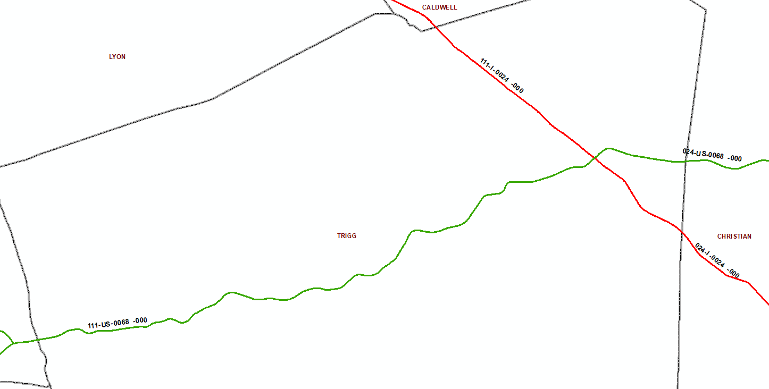
Kentucky Highway Freight Network Example
Notes:
US-68 (tier 3 segment) and I-24 (tier 1 segment) going through Trigg County. Entire routes or sections of routes can be added to the network.

Slide 19
Data Downloads
KHFN, NHS, road centerline, route log, and state/local road milepoints (every 1/10 mile) can be found here:
https://transportation.ky.gov/Planning/Pages/Centerlines.aspx
Major freight users, rail loading/unloading, truck parking, and intermodal connectors can be found here:
https://transportation.ky.gov/MultimodalFreight/Pages/ADD-Shapefile.aspx
Intermodal Connectors list can be found here:
https://www.fhwa.dot.gov/planning/national_highway_system/intermodal_connectors/kentucky.cfm
Intermodal Connectors FHWA criteria:
https://www.ecfr.gov/current/title-23/chapter-I/subchapter-E/part-470/subpart-A/appendix-Appendix%20D%20to%20Subpart%20A%20of%20Part%20470

Slide 20
Contact Information
Jake Rice
jacob.rice@ky.gov
502-782-5077
Jeremy Edgeworth
jeremy.edgeworth@ky.gov
502-782-5095
Jacob Huber
jacob.huber@ky.gov
502-782-5061

