Slide 1
SIGN MANAGEMENT UPDATE
Tracy Nowaczyk
Pavement Management and Operations
Section Engineer Meeting Fall 2013

Slide 2
FHWA Final Rule
Agencies must have in place assessment or management plan in place by June 13, 2014
Elimination of compliance dates
Does not relieve retroreflectivity standards

Slide 3
KYTC Need
Comply with MUTCD retroreflectivity standards
Accurate, reliable and cost effective method to evaluate traffic signs
Objective is to minimize costs, reduce liability, improve safety

Slide 4
Sign Management System Goals
Identify worn out signs
Minimize requirements for field inspections
Plan and budget resources properly
Useable as liability defense
Compliment existing inventory sets
Anticipate future needs

Slide 5
Sign Management Components
Existing sign inventory
Sign manufacture
New sign installation
Retroreflectivity inspection

Slide 6
Existing Inventory Collection
Every district has at least one county collected
Contract field collection with ADDs 90% complete
Next phase will utilize photos from Mandli collection vehicles
Projected 100% completion March 2014

Slide 7
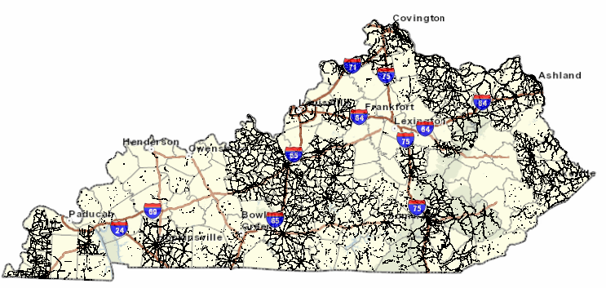

Slide 8
Sign Manufacture
Barcodes hold sign attributes
All district sign shops have barcodes
Central sign shop manufacturing signs with barcodes
Master agreements require barcodes
Special note for construction projects

Slide 9
Special Note Permanent Signs
Installation of permanent signs
Department provides barcode to contractor
Contractor must record barcode, sign attributes, and coordinates of location
Contractor must submit data electronically prior to inspection
Complete sign inventory before payment

Slide 10
New Sign Installation
Mobile devices record sign location and date of installation
All districts have mobile devices
Software update in testing
New version release date end of October
Increased functionality
Bug fixes

Slide 11
Retroreflectivity
Nighttime visual inspection can begin
Trained inspectors in each district
NTVI training offered in spring
Two year cycle
Sheeting test banks active
Barcode + Mobile Device = End of Inspections

Slide 12
KYTC Sign Inventory Map
http://kytcmaps.kytc.ds.ky.gov/signviewer/
Signs from inventory contract (ADD)
Barcode begins with 9
No installation date available
Signs installed with mobile device
Barcode begins with KY or PILOT
Installation and manufacture data available
Photolog points

Slide 13
Operations Management System (OMS)
Web link
Nighttime visual inspection forms
Nighttime visual inspection results
Detailed sign installation reports

Slide 14
SMS Quarterly Updates
Contains program updates
Updated roadside inventory numbers
Activity summaries for each district
Signs manufactured with barcode
Signs installed with mobile device
Next update: December 2013
Email tracy.nowaczyk@ky.gov to be included on SMS distribution list

Slide 15
Thank You
tracy.nowaczyk@ky.gov
OMS Helpdesk 502-564-6818

