Slide 1
Maintenance Rating Program Training
2014
KYTC Division of Maintenance
Tracy Nowaczyk, P.E.

Slide 2
MRP Data Purpose
Maintenance Quality Assurance Program
Identifies level of service delivered to the general public
Communicates value of maintenance work
Helps determine budgets

Slide 3
Roadway Sampling
Between 300 and 400 roadway segments per district
Sample four road types: Interstates, Other NHS, Other SP SS, Rural Secondary
Randomly selected by software program
Provides snap shot of existing conditions

Slide 4
MRP Format
Annual data collection June-September
Inspections performed with mobile GIS application
Performed by district personnel

Slide 5
Quality Assurance
Program and mobile application training offered each spring
Mini manuals available for each inspector
Central office inspects 10% of completed sections

Slide 6
Procedure
Each roadway section is 500 feet
Inspect pavement and right of way
Sections should be free of bridges, intersections, or construction zones.

Slide 7
Current Data Collection

Slide 8
General Aesthetics
General appearance of roadway and roadside
Includes potholes, cracking, grass, weeds, patching, striping, signs, litter, guardrail, shoulders, etc.
1=Excellent
2=Good
3=Acceptable
4=Poor
5=Unacceptable

Slide 9
Roadway/Shoulder Obstructions
Is there roadway or shoulder with less than 15’ vertical clearance?
Should be free of canopy (tree or other vegetation) or other obstructions for minimum height of 15’

Slide 10
Visual Obstructions
Are there visual obstructions of intersections, curves or signs, etc.?

Slide 11
Fence Not Providing Barrier
Is there fence not providing a positive barrier?
Fences should deny access to roadways
Check for breaks, holes, rusting out, downed fence, or missing fence
Covered in vines may still be effective

Slide 12
Guardrail Outside Specification
Is there guardrail outside height specifications (25” to 29”)?
Measured with respect to near edge of road or shoulder
Outdated end treatments do not count

Slide 13
Guardrail With Damage
Is there guardrail with post or accident damage?
Due to vehicular hits or other factors
Structural integrity or functionality is lost

Slide 14
Damaged Attenuators/Rail Ends
Count and record the total number of attenuators/rail ends that are damaged
Due to vehicular hits or other factors
Structural integrity or functionality lost

Slide 15
Pavement Potholes
Bowl shaped hole or depression in surface
Broken into smaller pieces due to cracking or localized disintegration
Count each pothole that measure 6”x6”x1” or larger
Record 20 as max

Slide 16
Rutting
(p2)Outside wheel path at 0 feet
(p3) Outside wheel path at 100 feet
Surface depression of pavement in wheel path
Lay straight edge across wheel path and measure rut depth
Circle closest measurement

Slide 17
Pavement Drop Off to Shoulder
Is there pavement drop off to shoulder greater than or equal to 1.5”?
Decrease in elevation between traffic lane and shoulder or absence of shoulder

Slide 18
Shoulder Drop Off to Ground
Is there shoulder drop off to ground greater than or equal to 3.0”?
Elevation decrease between improved shoulder and adjacent ground at outside edge of shoulder
Due to consolidation, erosion or run-off
Measure at edge of shoulder

Slide 19
High Shoulder
Is there high shoulder?
Opposite of pavement drop off to shoulder
Due to frost heave, swelling soils, unmowed grass
Creates ponding of water on pavement

Slide 20
Shoulder Potholes
Bowl shaped hole or depression in surface
Broken into smaller pieces due to cracking or localized disintegration
Count each pothole that measure 6”x6”x1” or larger
Record 20 as max

Slide 21
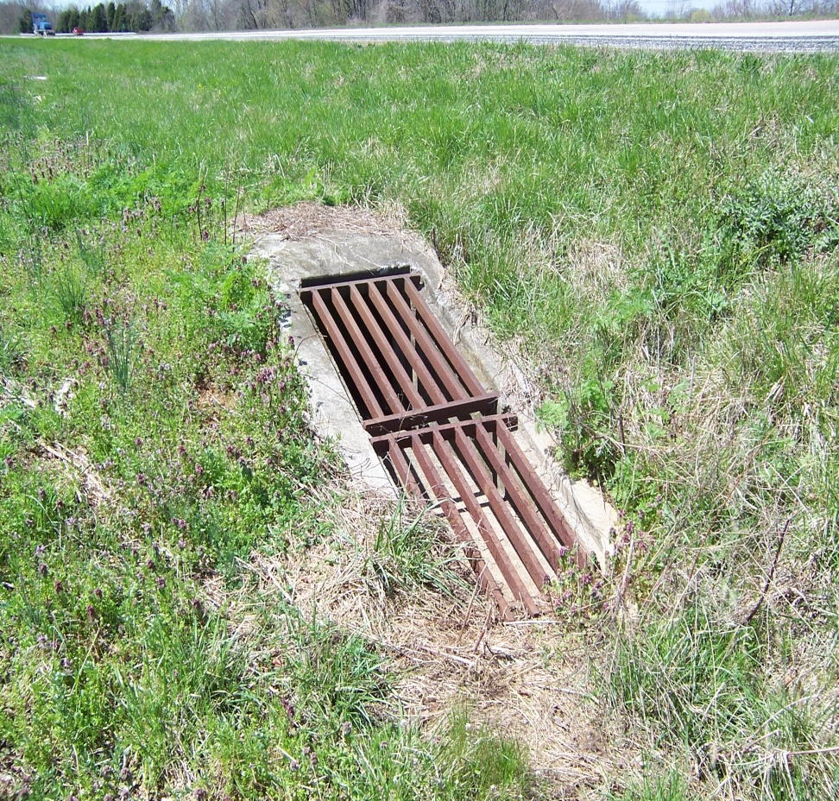
Drainage Structures Inhibited
Count and record the number of drainage structures with 25% or greater flow inhibited
Should be free of obstruction and in good working order

Slide 22
Ditches With Flow Inhibited
Are there ditches with flow inhibited?
Water flow should be unobstructed by blockages or damage
Blocked entrance pipes along the ditch should be included as a ditch obstruction

Slide 23
Curbs and Gutters Inhibited
Are there curbs and gutters with flow inhibited?
Water flow should not be obstructed by blockages or damage

Slide 24
Striping Reflectivity
Reflectivity provides positive guidance to motorists at night
Take 3 readings per section per color with LTL 2000 Reflectometer
Priority order edge line, center line, lane line
Solid lines ten pace intervals
Skip lines have 3 readings, one per skip

Slide 25
Signs Not Conforming
Count and record the number of signs not conforming to face specifications
Damaged sign face, faded, vandalized, etc.
Free from obvious visible defects that would detract from effectiveness at night

Slide 26
Sign Assemblies Not Conforming
Should not be leaning more than 22.5 in any direction
No bolts or rivets missing
No sign face turned more than 45 from the line of sight of traffic flow
Sign posts should not extend from top of sign face
Min height from pavement edge extended to bottom of lowest sign face should be no less than 5’ in rural areas or 7’ in urban areas and fully controlled access highways

Slide 27
County Level Data Analysis
Combine inspection data with rideability data
Features evaluated with importance weight
Combine three years MRP data
Statistical validity varies with size of samples (min 80% +/- 10%)

Slide 28
Customer Survey
Calibrates importance weights and performance goals
Highest perceived maintenance: signs, guardrail, striping
Lowest perceived maintenance: pavement surfaces, shoulders, drainage
Customer priorities: pavement surfaces, signs and markings, roadside drainage

Slide 29
County Level Report
Produced on odd years
Level of service graphic
Report cards with feature scores
RURAL SECONDARY

Slide 30
Contact
Tracy Nowaczyk
Operations and Pavement Management Branch
Division of Maintenance
tracy.nowaczyk@ky.gov
502-782-5595
Reports available
http://transportation.ky.gov/Maintenance/Pages/Pavement-and-Operations.aspx

