Slide 1
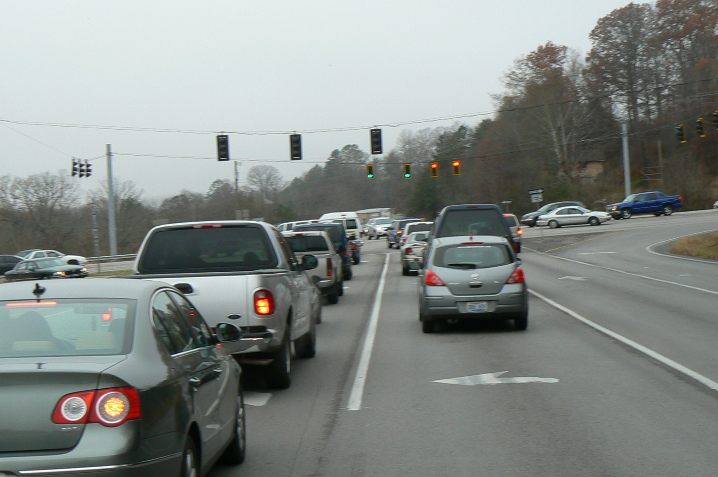
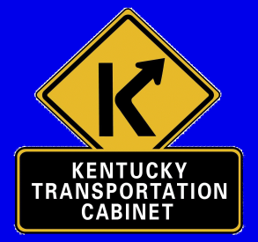
US 25 Corbin to London
Citizens Advisory Committee Meeting #4
April 2013
Notes:
Hello and welcome once again
Thanks for coming
Introduce the Team (us)

Slide 2
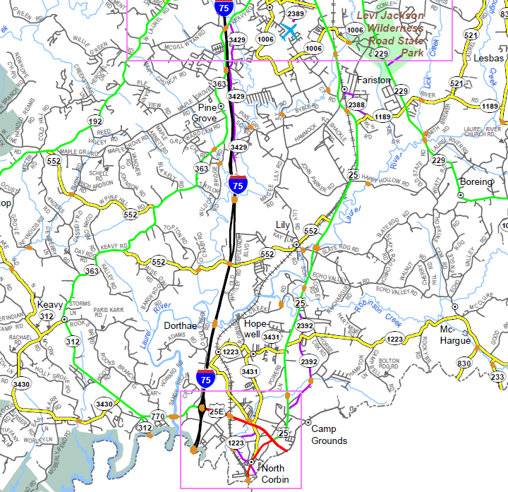
Project Limits
End Project
Begin Project
Notes:
-Project limits map
-For those of you involved in the other project.

Slide 3
US 25 - Project Flow
1st Citizen Advisory Group meeting
1st Public Meeting
2nd Citizen Advisory Group meeting
3rd Citizen Advisory Group meeting
**4th Citizen Advisory Group meeting**
2nd Public Meeting
5th Citizen Advisory Group meeting
6th Citizen Advisory Group meeting
Public Hearing
Notes:
Where we are in the process

Slide 4
Project Goals & Objectives
Accommodate increasing capacity demands
Improve safety
Increase Connectivity
Provide a safe alternative to I-75 during emergencies
Purpose & Need Statement
“Address highway capacity and growth needs in Laurel County, improve safety by providing an improved route that complies with current design standards, and provide an alternative route during incidents or closures on I-75”

Slide 5
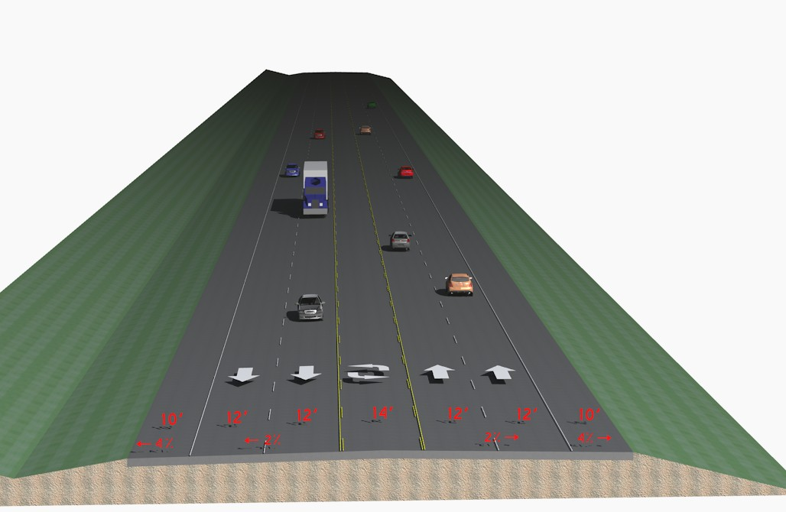
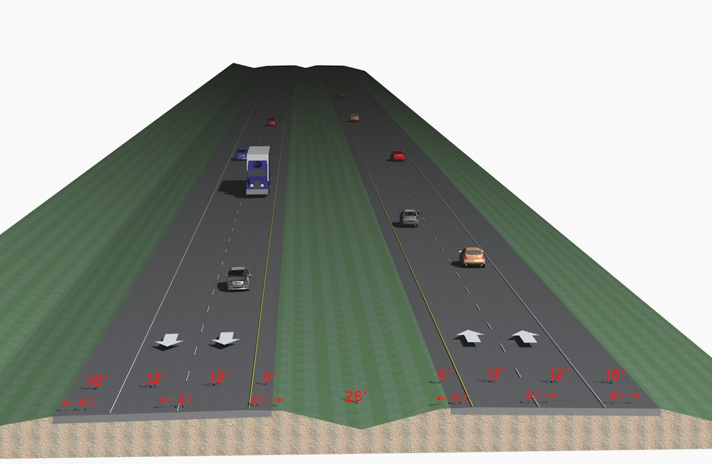
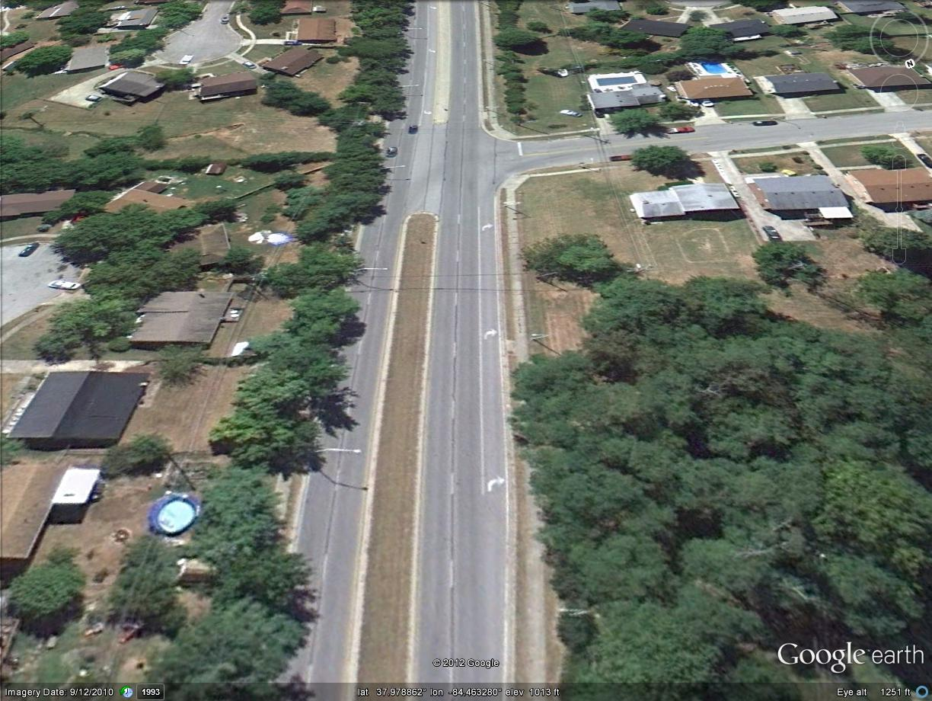
How do we accomplish these goals?
Increase Capacity
Provide unobstructed connection
Increase the number of through lanes
Decrease the number of stopped motorist (vehicles waiting to turn in the through lanes) Add Turn-lanes
Increase the free-flow speed (average speed through the area; reduced travel time)

Slide 6
How do we accomplish these goals?
Increase Safety

Slide 7
Recent Crashes

Slide 8
Recent Crashes
Notes:
AISIN employee killed in crash Rodney Byrd

Slide 9
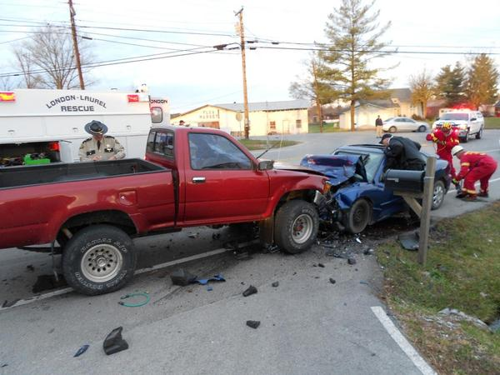
Recent Crashes
http://www.wkyt.com/wymt/mobile/headlines/BREAKING-NEWS-Serious-crash-closes-US-25-in-Laurel-County-200448961.html
Notes:
AISIN employee killed in crash Rodney Byrd

Slide 10
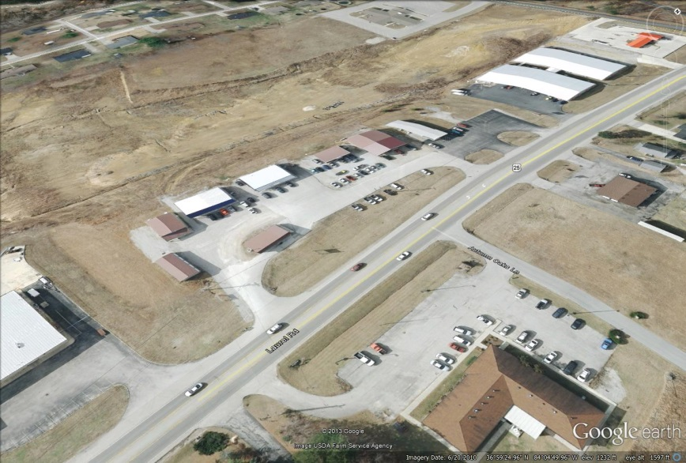
How do we accomplish these goals?
Increase Safety
Separate traffic (divided highway)
Decrease the number of stopped motorist (vehicles waiting to turn in the through lanes)
Reduce the number of access points
Decrease speed
Reconfigure intersections

Slide 11
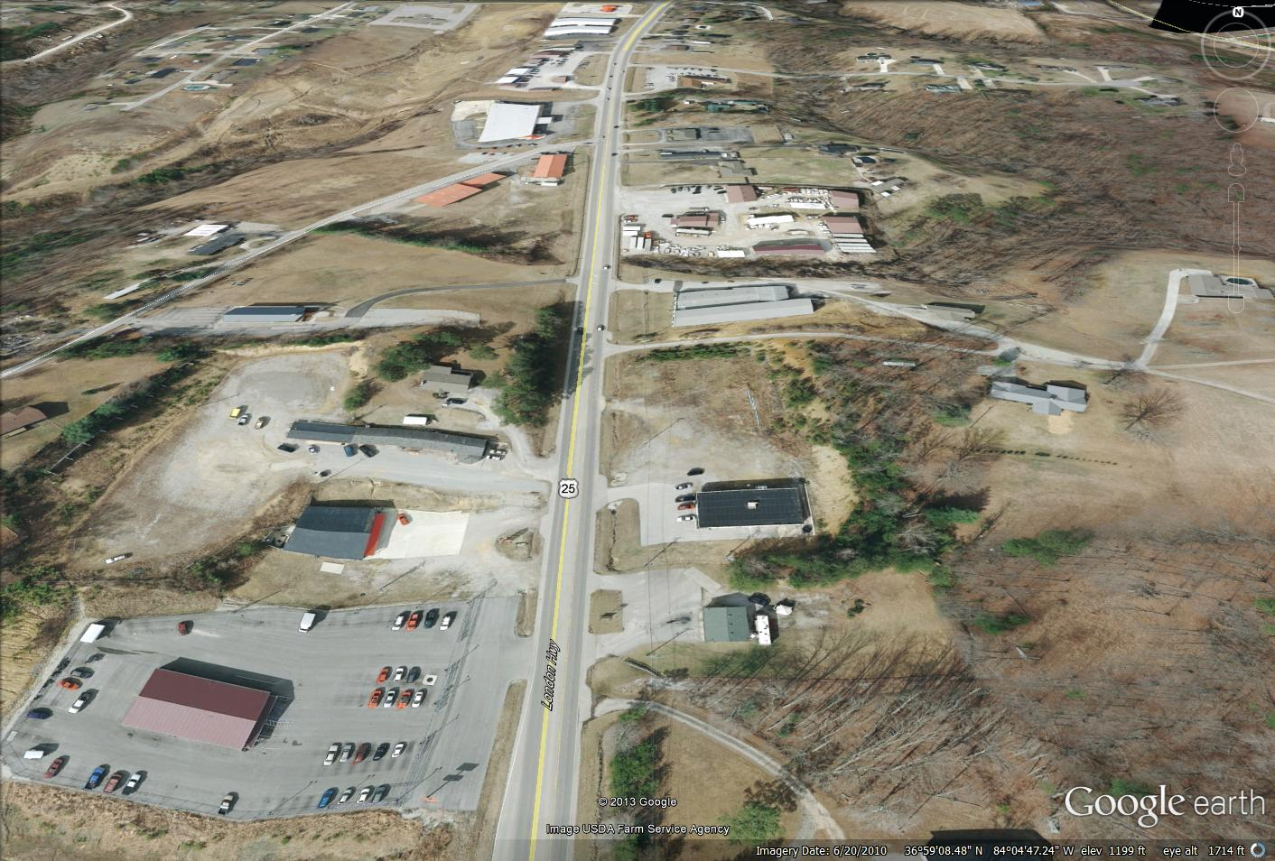
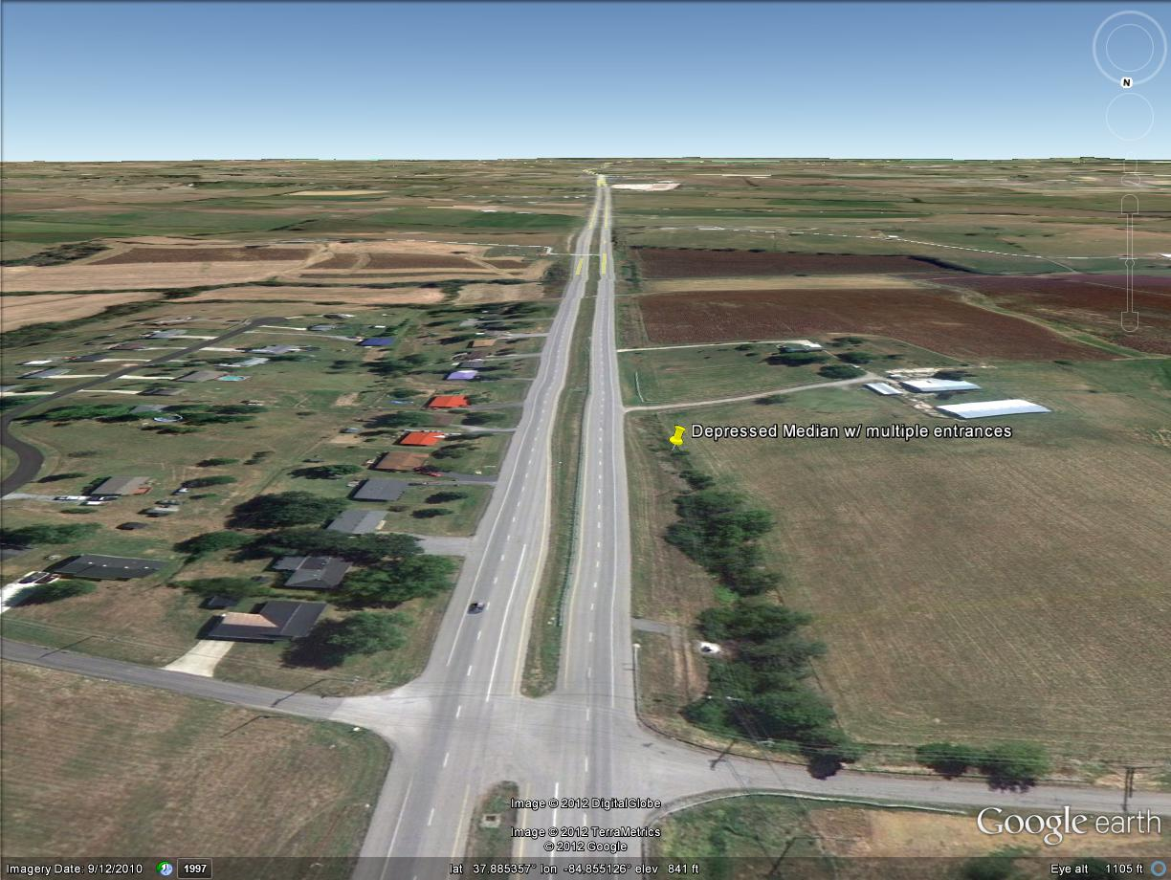
How do we accomplish these goals?
Provide an emergency alternative to I-75
Try not to decrease safety along US 25
Should move through motorist along the corridor
Coincides with many of our capacity goals
This… …into this

Slide 12
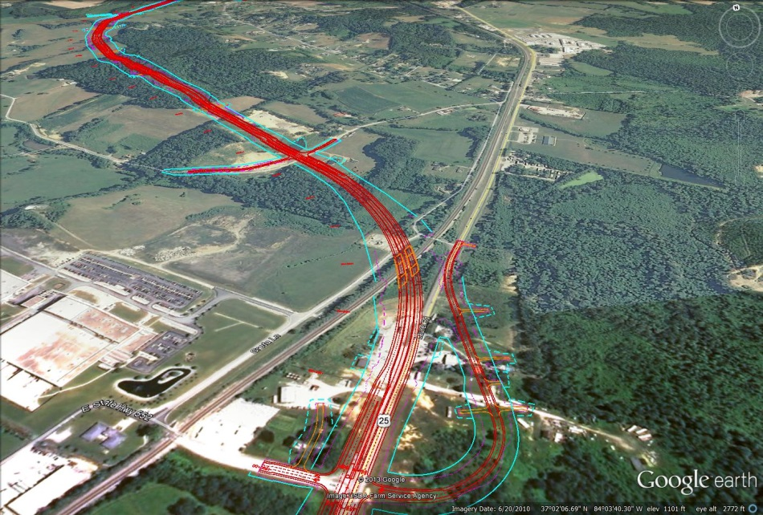
Conclusions We Came to as a Committee
5-Lane roadway represents the narrowest possible
5-Lane roadway still does not accomplish all our project goals
4-Lane Depressed median is desirable
Cross country alternates need to be investigated where possible
Continue to develop frontage roads and combine entrances

Slide 13
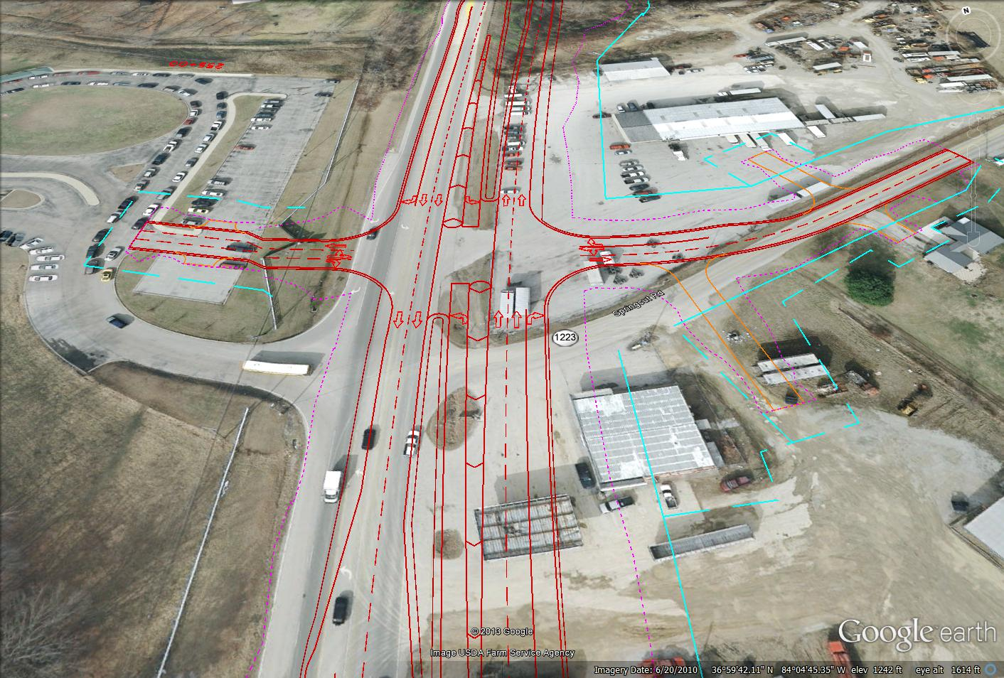
Lets Take a Look at
What We’ve Developed…

Slide 14
Alternate Comparison

Slide 15
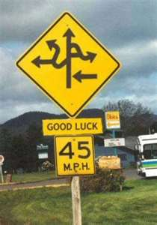
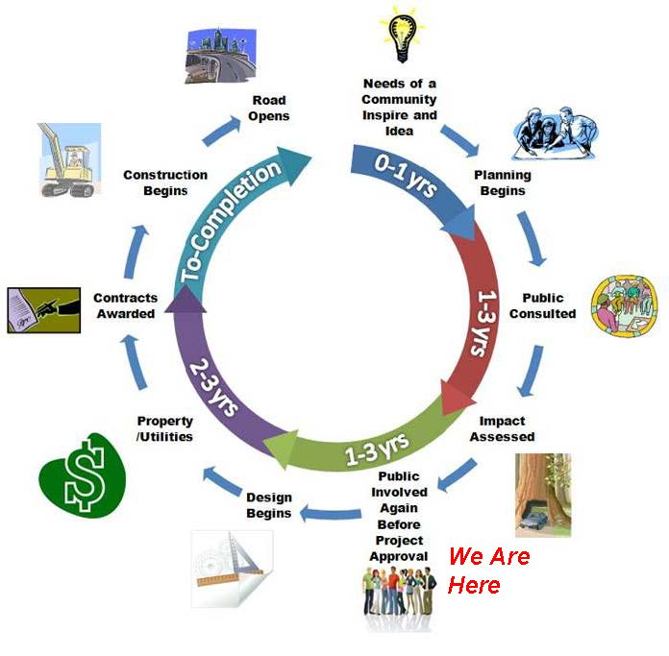
Where Do we Go From Here?
Remember our
Project Life Cycle

Slide 16
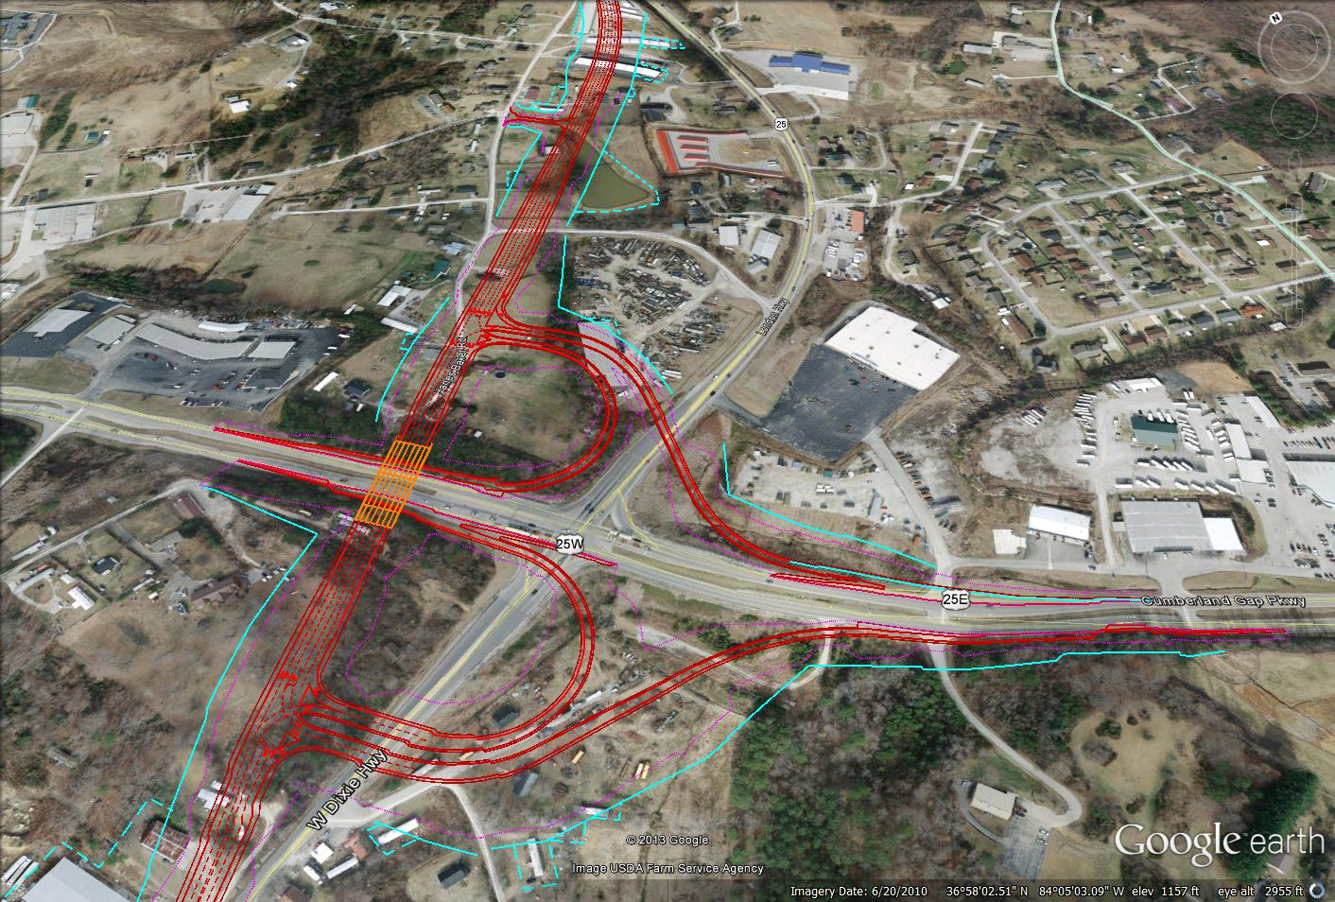
Next Steps
Conduct A Public Meeting
Promote the Project
Meet with Individuals along the Corridor
Gauge the Public’s Opinion
Develop an “Access Management Plan” Document

Slide 17
What Does this all Mean?
Remember our
Project Goals & Objectives:
Accommodate increasing capacity demands
Improve safety
Provide a safe alternative to I-75 during emergencies

Slide 18
Thank You!
Brad Gregory – Municipal Engineering Co.
bgregory@mecconsultants.com
502-875-3787
David Fields – KY Transp0rtation Cabinet - Manchester
David.Fields@ky.gov
606-598-2145

