Slide 1
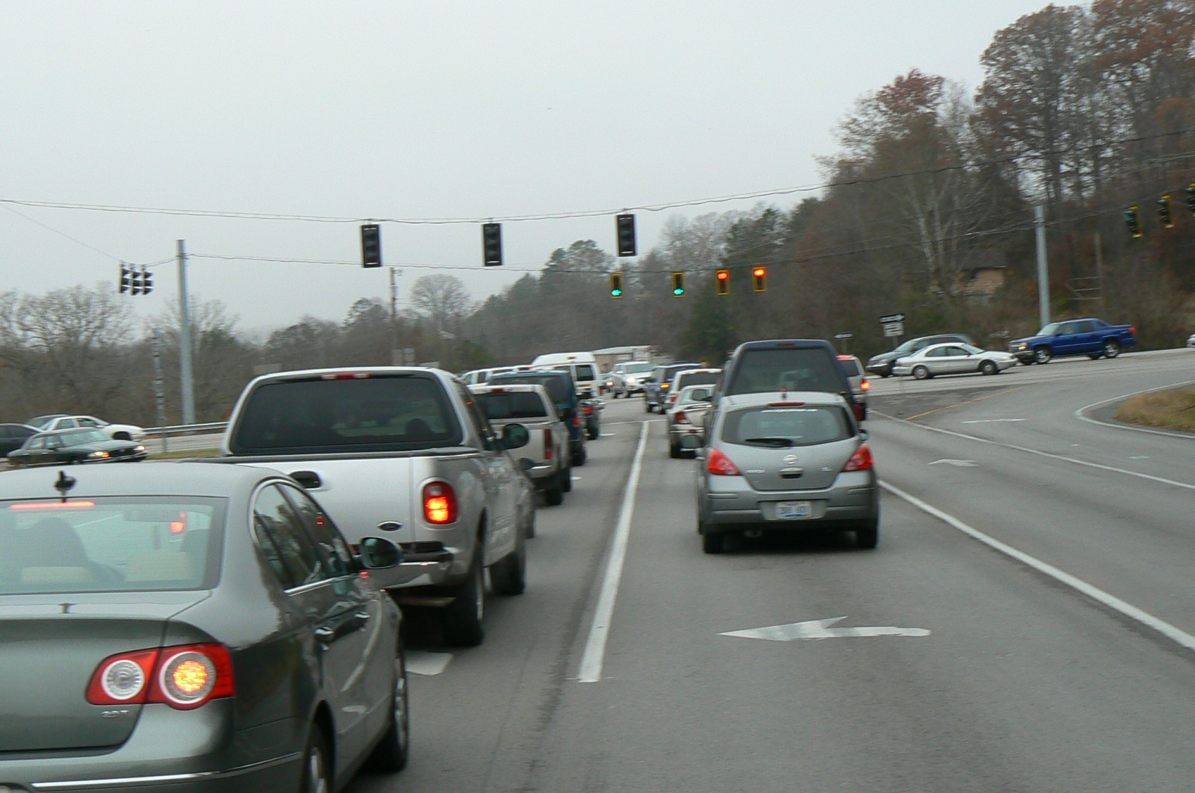
US 25 Corbin to London
Citizens Advisory Committee Meeting #3
May 2012
Notes:
Hello and welcome once again
Thanks for coming
Introduce the Team (us)

Slide 2
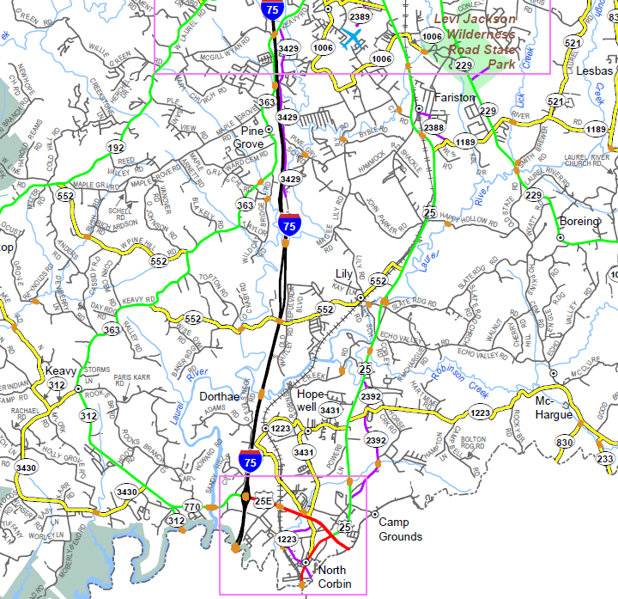
Project Limits
End Project
Begin Project
Notes:
-Project limits map
-For those of you involved in the other project.

Slide 3
US 25 - Project Flow
1st Citizen Advisory Group meeting
1st Public Meeting
2nd Citizen Advisory Group meeting
**3rd Citizen Advisory Group meeting**
4th Citizen Advisory Group meeting
2nd Public Meeting
5th Citizen Advisory Group meeting
6th Citizen Advisory Group meeting
Public Hearing
Notes:
Where we are in the process

Slide 4
Project Goals & Objectives
Accommodate increasing capacity demands
Improve safety
Provide a safe alternative to I-75 during emergencies
Purpose & Need Statement
“Address highway capacity and growth needs in Laurel County, improve safety by providing an improved route that complies with current design standards, and provide an alternative route during incidents or closures on I-75”
Notes:
-The public seemed to identify these as the main concerns for the project also.
-The purpose and need statement is kind of like our project summary statement that we develop to guide the decisions for the project throughout it’s life.

Slide 5
How do we accomplish these goals?
Increase Capacity
Provide unobstructed connection
Increase the number of through lanes
Decrease the number of stopped motorist (vehicles waiting to turn in the through lanes) Add Turn-lanes
Increase the free-flow speed (average speed through the area; reduced travel time)
Notes:
What are some of the ideas that you have to increase the capacity of the roadway?
Less stoplights etc, by-pass methodology?
Adding lanes is self explanatory
Add auxiliary lanes for turners
Increased speed results in higher capacity
Think of what makes and interstate efficient versus a small county road – no stopped cars, more lanes, higher speed from point A to B, not as curvy
Another way to think of this is how can we increase the number of vehicles through the corridor over a given amount of time

Slide 6
How do we accomplish these goals?
Increase Safety
Separate traffic (divided highway)
Decrease the number of stopped motorist (vehicles waiting to turn in the through lanes)
Reduce the number of access points
Decrease speed
Reconfigure intersections
Notes:
What are some of the things you think can be done to increase safety?
By providing the positive separation of the travel directions – ie. Medians (raised, depressed, or flush)
Providing auxiliary turn lanes gets cars out of the through lanes and reduces rear-end crashes
Reducing the number of places where a person can turn into can also improve safety
Obviously, the reduction in speed speaks for itself
*****Notice some things that are not necessarily complimentary or they are more contradictory
This is the most significant issue for a project this complex
Like Joey said, “It’s like this project has all these spinning plates that we are trying to satisfy…”
Trying to identify a happy median for all the issues
Significant number of angle collisions at intersections

Slide 7
How do we accomplish these goals?
Provide an emergency alternative to I-75
Try not to decrease safety along US 25
Should move through motorist along the corridor
Coincides with many of our capacity goals
Notes:
What are some of the important factors for an I-75 alternative or ways to improve this situation?
No matter what type of facility we develop, during emergency situations, officials will use this route for a diversion around the interstate
We need to make sure that our end product tries to accommodate this as best as possible

Slide 8
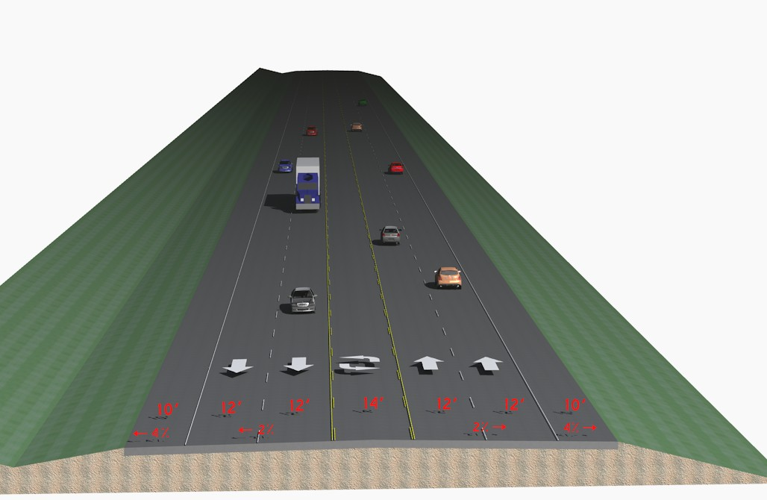
Tools and Methods at our Disposal
Increase the number of lanes
Positives
Increases the amount of vehicles the road can carry
Provides passing opportunities
Negatives
Increases the impacts to the surrounding area
More difficult to turn out of entrances
Notes:
One of the first things we talked about for capacity was adding lanes
This is just one example of an added lane configuration. We will see a couple more…
With every thing we attempt to use on this project, there will usually be a tradeoff
Some things may compliment our other goals, and some may aggravate
Show typical sections from HMB

Slide 9
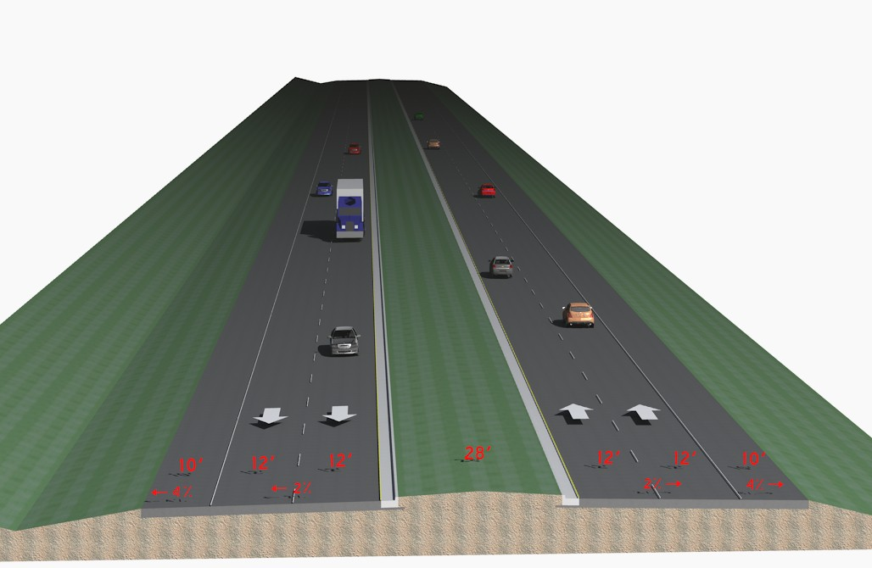
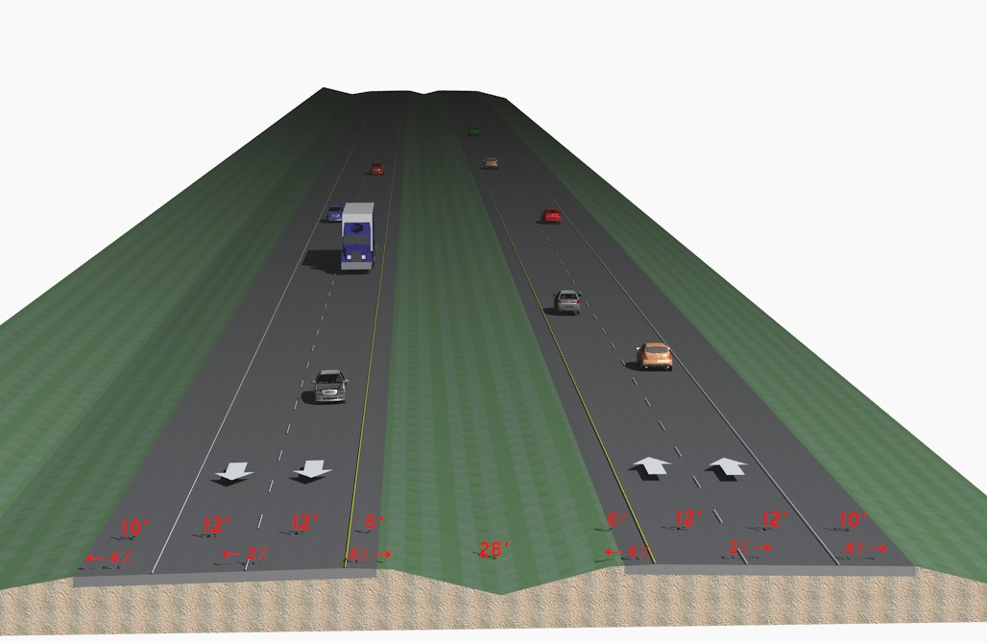
Tools and Methods at our Disposal
More lanes
Notes:
-More added lane examples

Slide 10
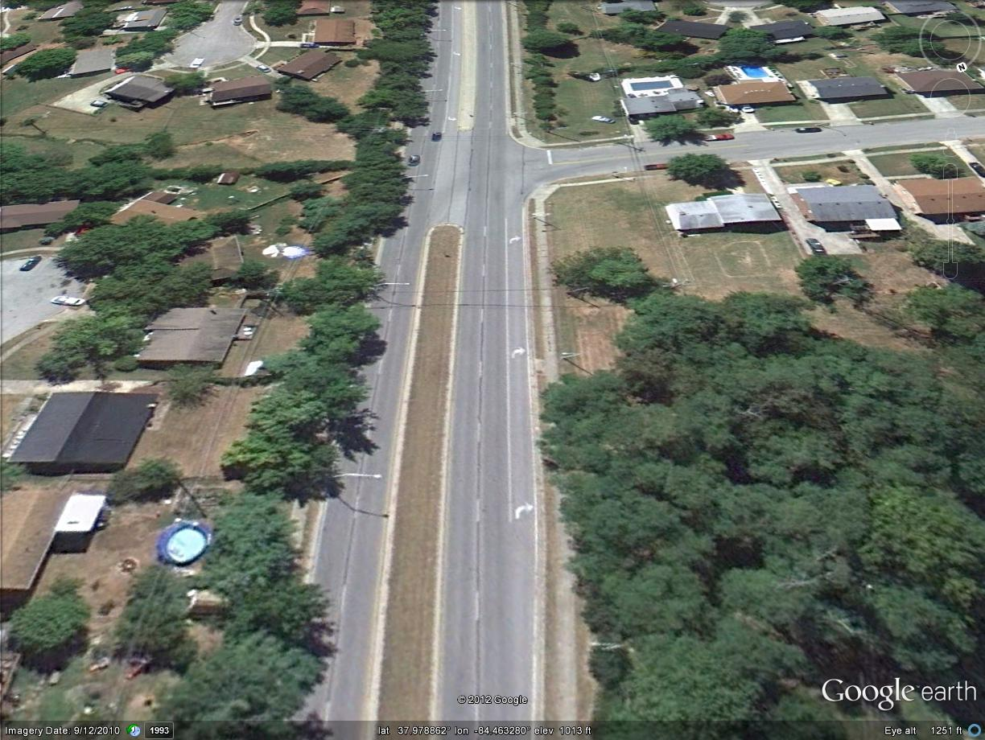
Tools and Methods at our Disposal
Turn Lanes
Positives
Cars are stopped out of the way
Works for right and left turns
Negatives
Multiple turn lanes end-to-end
Additional width for turn lanes
Notes:
The next thing to increase capacity and safety was turn lanes
This is an example along Man-O-War in Lexington

Slide 11
Tools and Methods at our Disposal
Access Management (reduce number of accesses)
------Take a look at these examples------
Positives
Consolidate, Eliminate multiple entrances
Better Define Entrances
Provides fewer conflicts
Negatives
Usually takes more Right of Way
Losing individual entrance may upset owners
Notes:
Show Ryan’s frontage road in Google Earth
Show Ryan’s frontage road in Microstation

Slide 12
Tools and Methods at our Disposal
Two-Way Left Turn lane (TWTL)
Positives
Turners out of through traffic
Unlimited Location
Provide separation between through lanes
Narrowest width
Negatives
Can increase Head-on crashes
Limited to < 45 mph
Maximum traffic and number of access points
Notes:
I mentioned earlier that too many turn lanes back to back can create one continuous turn lane
Limited to 45 mph
Should not be used for ADT greater than 24,000 – We have 21,000 – 25,000 ADT
Are to be used when access points > 10/mile and < 85 per mile – We are at 30 per mile
Show 5 lane versus depressed median limits

Slide 13
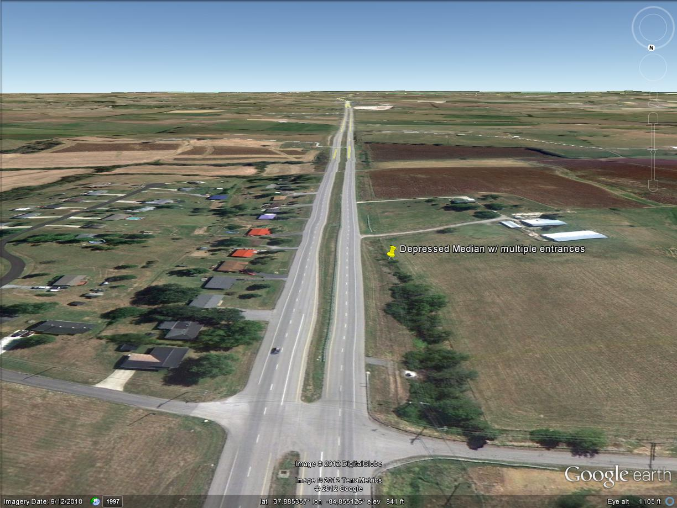
Tools and Methods at our Disposal
Non-Traversable Medians
-----Take a closer look-----
Positives
We can dictate where left turns will occur
Provides separation for traffic
Not as easily defeated by future development
High speed or >55 mph
Negatives
Wider Depressed Medians = More Right of Way
Raised medians = $
Forces more “Right-in, Right-outs” only
U-turn locations need to be signalized
Notes:
-Show HMB median examples
-Show Google earth at Salvisa example
-Show Ryan’s example of divided w/ turn-a-round
Requires buy-in from locals
Show difference between flush and depressed median limits

Slide 14
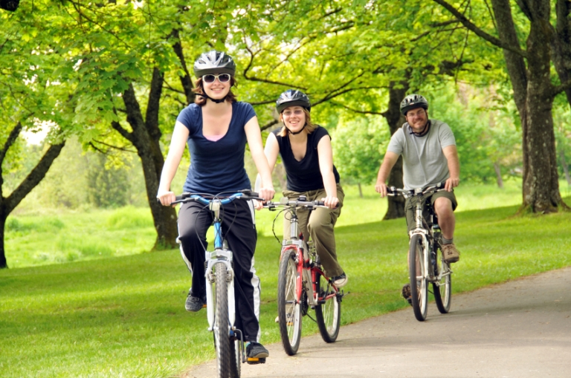
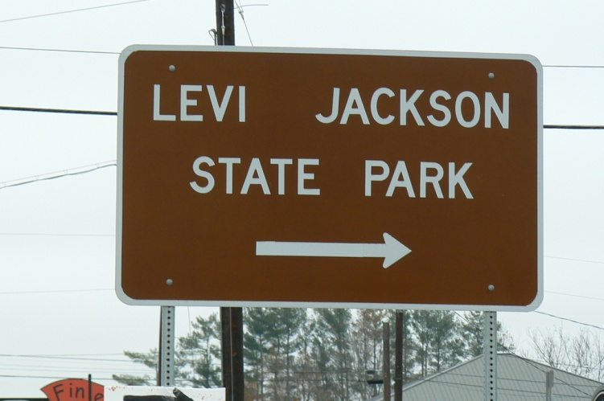
Other Goals and Concerns
Enhance Tourism
Potential Commercial & Industrial Development
Bicycle friendly
Notes:
Some of what you’re about to see may incorporate these additional goals
Show Fariston New alignment area
This satisfies all our goals
Eliminates an at grade RR Crossing
Very restrictive on future access (partial control)
Show interchange layouts
What Combinations of what you’ve seen come closest to satisfying our goals?
What other things should we consider?

Slide 15
What Does this all Mean?
Remember our
Project Goals & Objectives:
Accommodate increasing capacity demands
Improve safety
Provide a safe alternative to I-75 during emergencies
Notes:
We have lots of conflicting goals and solutions
Like all these spinning plates
What combinations of the things you have seen help accomplish the goals for the project
Not just “now what do you want us to design you?”, but what are the features or things that you have seen that you would like to see applied to the project.

Slide 16
Thank You!
Brad Gregory – Municipal Engineering Co.
bgregory@mecconsultants.com
502-875-3787
David Fields – KY Transp0rtation Cabinet - Manchester
David.Fields@ky.gov
606-598-2145

