Slide 1
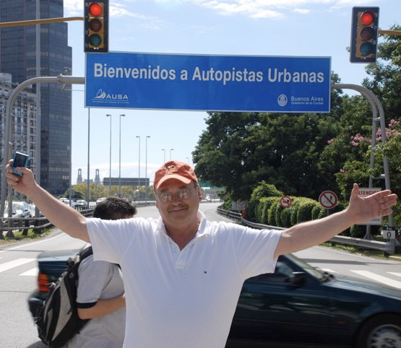
Bachelor’s Engineering Stevens Institute of Technology 1973
34 years at the New Jersey Department of Transportation
8 Years Director of Transportation Initiatives at PPS
Invested Career working at the community/agency interface
PROJECT FOR PUBLIC SPACES
2

Slide 2
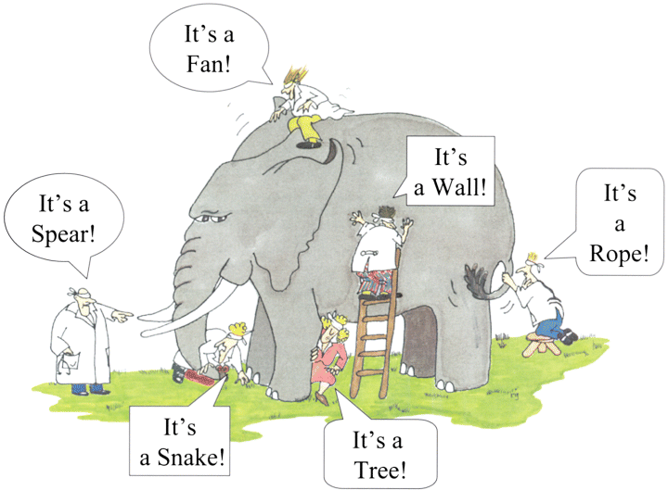
No One Sees the Big Picture
Slide courtesy of Leigh Lane
Notes:
2
.

Slide 3
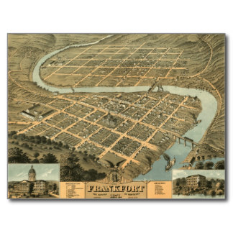
Is a Collaborative Framework a New Idea?
Our Communities Used to be Planned to Accomplish Many Purposes
PROJECT FOR PUBLIC SPACES
Notes:
We can work with Township officials on plans to infill a suburban environment

Slide 4
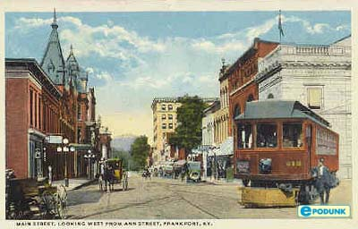
Pre-Automobile Era We Had a Different Problem to Solve
Street design HAD to accommodate all users
Relationship of land use to streets was critical for survival
PROJECT FOR PUBLIC SPACES

Slide 5
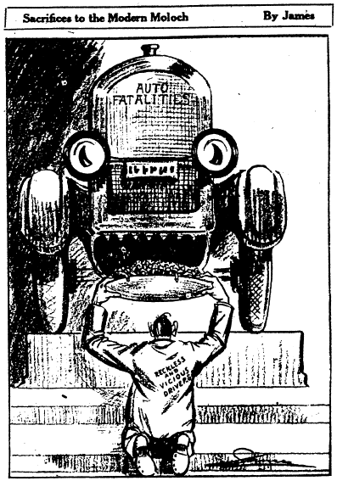
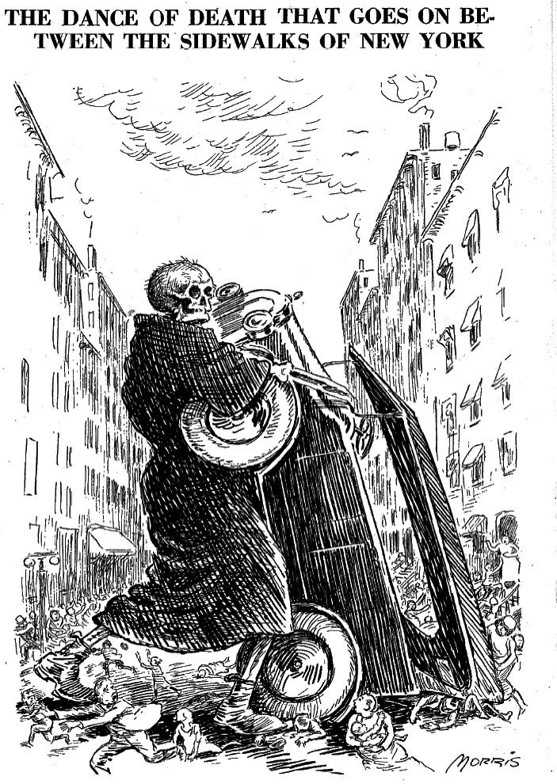
St. Louis 1923
New York 1928
Slide Courtesy of Peter Norton
Notes:
New York City, 1926.

Slide 6
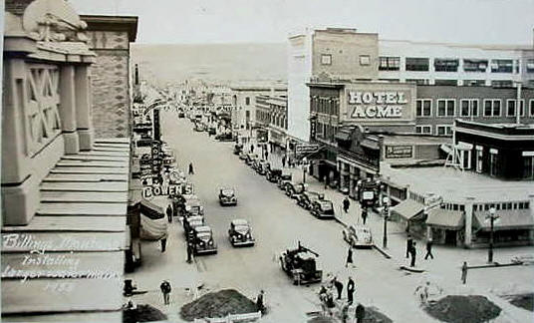
The Multi Purpose Street Lasted Until the 1920s
PROJECT FOR PUBLIC SPACES

Slide 7
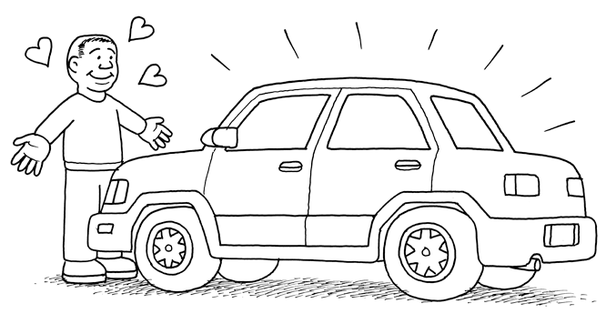
Graphic courtesy of Andy Singer
PROJECT FOR PUBLIC SPACES

Slide 8
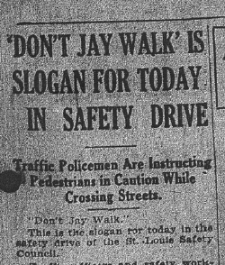
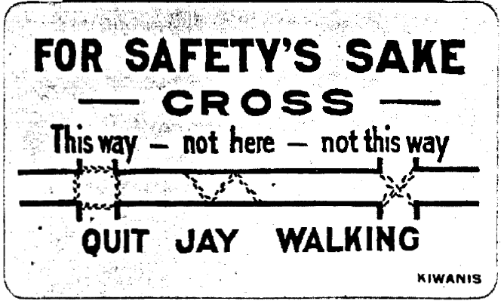
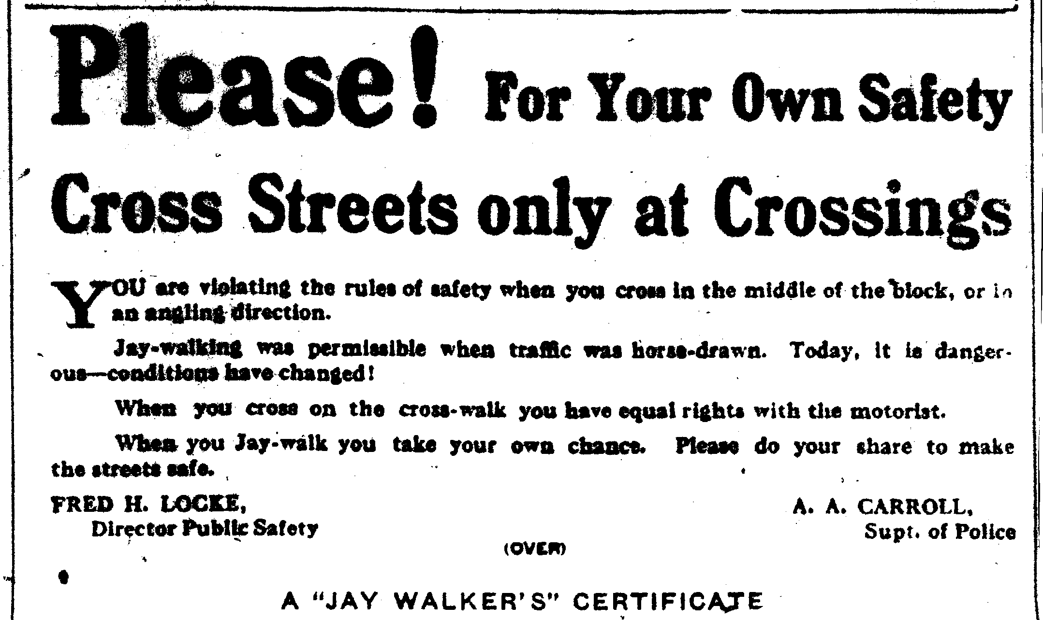
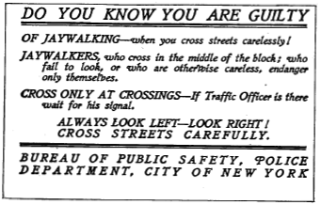
Slide Courtesy of Peter Norton
Notes:
“Boy Scouts and Kiwanis Club of Hartford Put on Anti-Jay Walking Campaign” National Safety News 3 (February 7, 1921), p. 4.

Slide 9
The Automobile Age
The mobility provided by the automobile removed the need for those exchanges to be made in compact, mixed use cities and towns
Once we could drive to access goods, employment, education and recreation, we were free to locate those uses in distant and specialized locations…and we did
PROJECT FOR PUBLIC SPACES

Slide 10
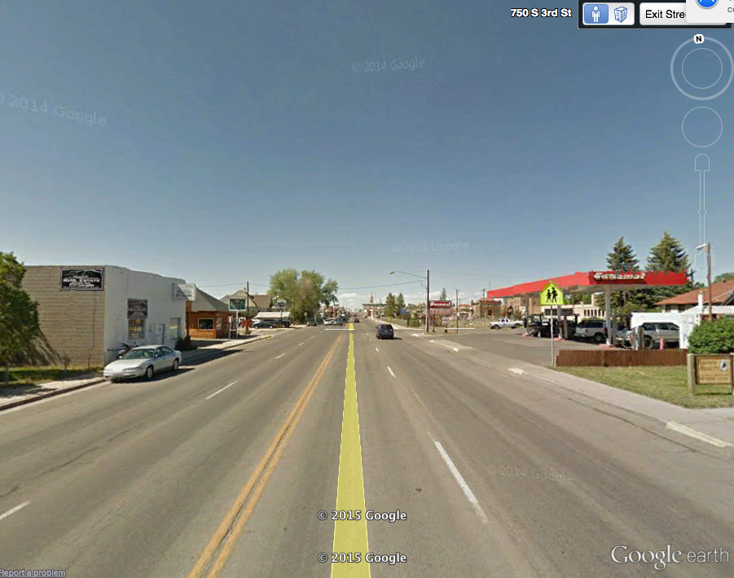
The Detachment of Other Goals from Transportation
PROJECT FOR PUBLIC SPACES

Slide 11
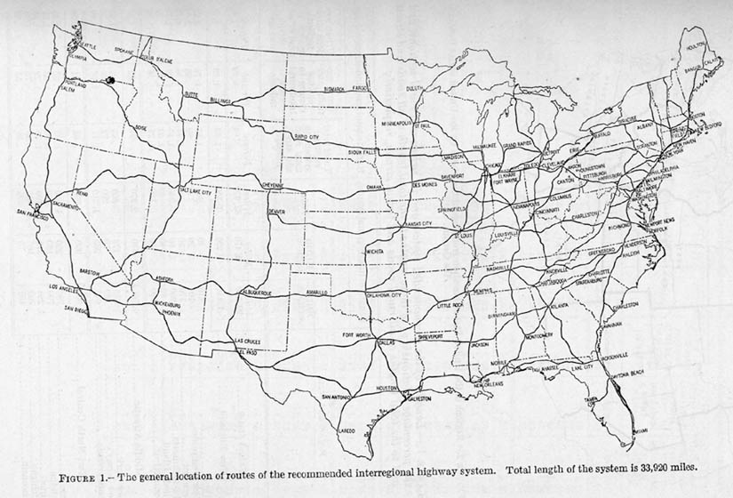
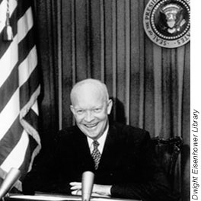
The Interstate Era Begins
PROJECT FOR PUBLIC SPACES

Slide 12
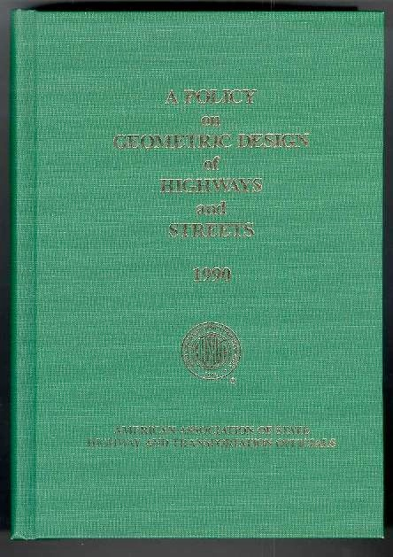
Transportation as a separate discipline flourished
PROJECT FOR PUBLIC SPACES

Slide 13
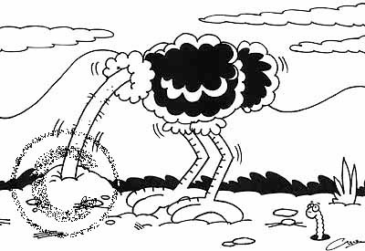
Building communities is not our business
PROJECT FOR PUBLIC SPACES
Notes:
But if we want to help our customers have the mobility and the quality of life that they have come to expect, maybe, just maybe, we will need to start thinking about land use

Slide 14
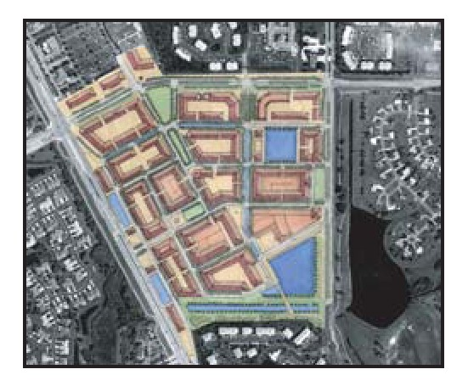
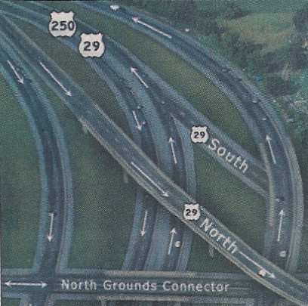
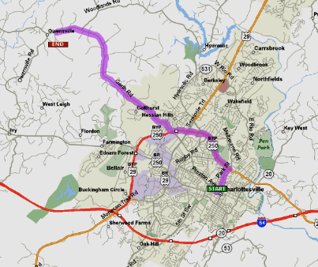
Focus on high speed mobility
Proximity
Speed
Accessibility
Slide Courtesy of Chris Sinclair, Renaissance Planning Group
PROJECT FOR PUBLIC SPACES

Slide 15
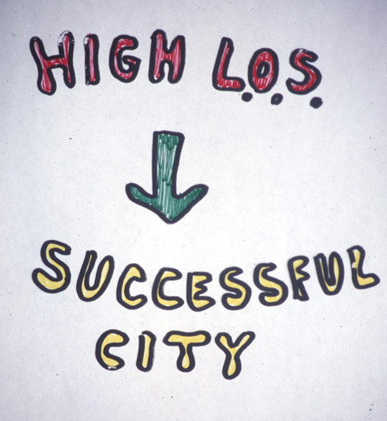
PROJECT FOR PUBLIC SPACES
Slide courtesy of Ian Lockwood, Glatting Jackson

Slide 16
Has This Been 100% Successful?
PROJECT FOR PUBLIC SPACES

Slide 17
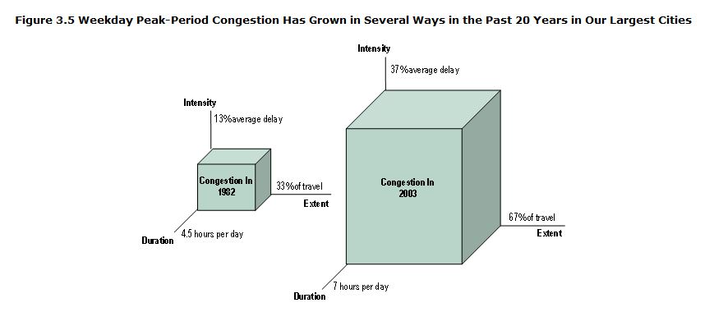
Congestion in 80 US Cities
US Department of Transportation Report on Traffic Congestion, 2004
2005 Annual Urban Mobility Report, Texas Transportation Institute

Slide 18
Congestion in Louisville Metro
2014 1982 Increase
Population 1,110,000 770,000 1.44
VMT 21,198,000 9,890,000 2.97
Congestion Costs 860 million 465 million 1.84
Annual Delay/commuter 43 hrs 17 hrs 4.33
2015 Annual Urban Mobility Report, Texas Transportation Institute

Slide 19
Is it working?
672 Fatalities on Kentucky Roads in 2014

Slide 20
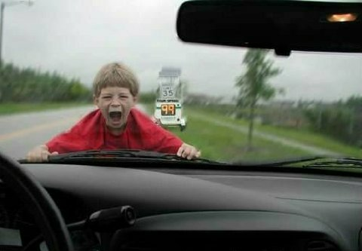
Health Outcomes
225,000 die annually due to sedentary lifestyle
Childhood obesity epidemic
Type 2 diabetes on the rise – in children!
Notes:
Childhood obesity has more than tripled in the past 30 years. The prevalence of obesity among children aged 6 to 11 years increased from 6.5% in 1980 to 19.6% in 2008. The prevalence of obesity among adolescents aged 12 to 19 years increased from 5.0% to 18.1%.

Slide 21
Auto dependence locks the poor into inescapable poverty.
Slide Courtesy of Mark Gorton
Notes:
In an auto dependent world, those who can't afford a car are unable to work.

Slide 22
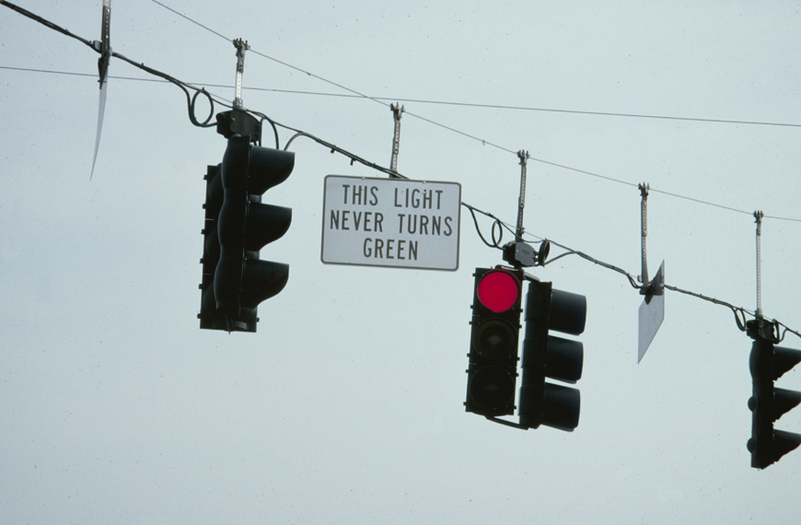
Slide courtesy of Tim Jackson, Glatting Jackson
PROJECT FOR PUBLIC SPACES

Slide 23
So what do we do
and
How do we do it?
PROJECT FOR PUBLIC SPACES

Slide 24
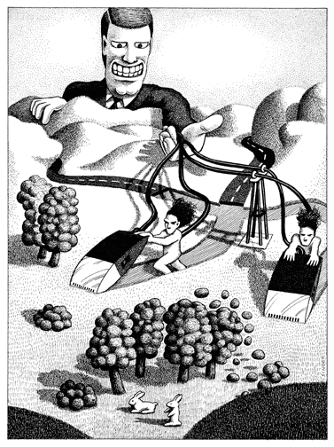
Blame the DOTs!
PROJECT FOR PUBLIC SPACES

Slide 25
It’s not just because of the focus on high speed mobility.

Slide 26
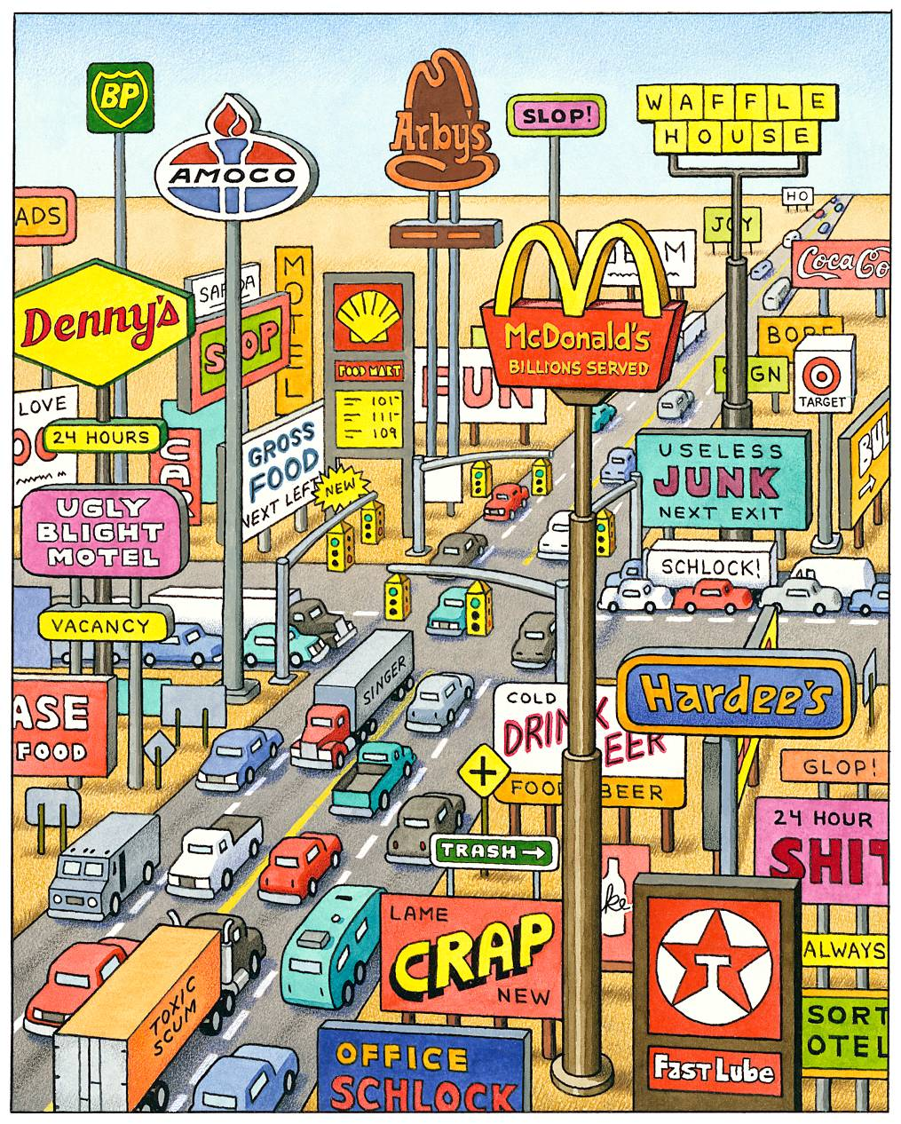
Graphic courtesy of Andy Singer

Slide 27
Everyone Works Together to Accomplish Multiple Agency Goals
Corridor/Community
Place
Architecture
Roadways
Buildings
Parking
Institutions
Markets
Notes:
Key Message:
Network and corridor-level planning can help set the context for addressing more specific street design issues.
Background Information:
Network planning can occur as part of the regional and community-level visioning and planning processes, as discussed in Lessons 5 and 8. The design of the network (connectivity, spacing of arterials, etc.) has implications for the design of individual roadway segments.
Network level solutions – for example, where major traffic routes go in relationship to activity centers – are the first step in establishing street-land use compatibility.
Corridor visioning and planning, as discussed in Lesson 6, determines how a community wants a corridor to develop. It may include conceptual plans for street cross-sections and local road networks.
Roadway design includes three distinct aspects – the traveled way, intersections, and the roadside (e.g., sidewalks and planting strips)
Interactivity:
Notes:
Adapted from: Institute of Transportation Engineers (2006). Context Sensitive Solutions in Designing Major Urban Thoroughfares for Walkable Communities: A Proposed Recommended Practice. RP-036. Washington, D.C.

Slide 28
For Transportation
Corridor/Community
Place
Roadway
Traveled Way
Intersections
Roadside
PROJECT FOR PUBLIC SPACES
Notes:
Key Message:
Network and corridor-level planning can help set the context for addressing more specific street design issues.
Background Information:
Network planning can occur as part of the regional and community-level visioning and planning processes, as discussed in Lessons 5 and 8. The design of the network (connectivity, spacing of arterials, etc.) has implications for the design of individual roadway segments.
Network level solutions – for example, where major traffic routes go in relationship to activity centers – are the first step in establishing street-land use compatibility.
Corridor visioning and planning, as discussed in Lesson 6, determines how a community wants a corridor to develop. It may include conceptual plans for street cross-sections and local road networks.
Roadway design includes three distinct aspects – the traveled way, intersections, and the roadside (e.g., sidewalks and planting strips)
Interactivity:
Notes:
Adapted from: Institute of Transportation Engineers (2006). Context Sensitive Solutions in Designing Major Urban Thoroughfares for Walkable Communities: A Proposed Recommended Practice. RP-036. Washington, D.C.

Slide 29
New Approaches Can Solve Multiple Problems
PROJECT FOR PUBLIC SPACES

Slide 30
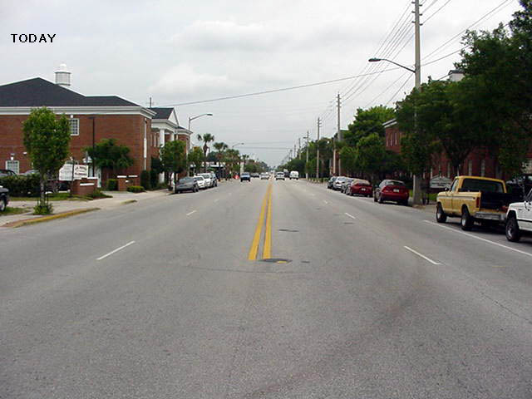
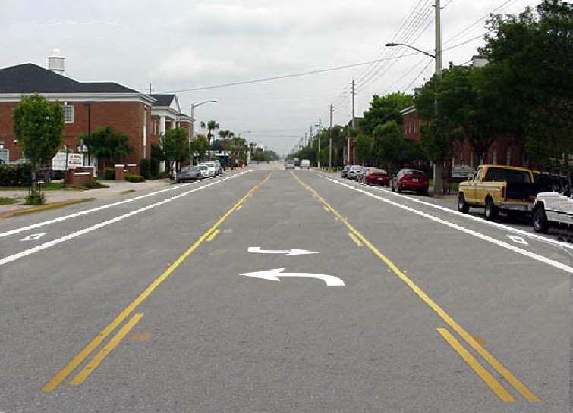
Reinvented Edgewater Drive
Orlando, Florida
Concept
PROJECT FOR PUBLIC SPACES

Slide 31
Safety and Other Results
 | Before | After
Crash Rate | 12.6/ MVM | 8.4/MVM
Injury Rate | 3.6/MVM | 1.2/MVM
On Street parking | 29% | 41%
Pedestrians | 2136 | 2632
Bikes | 375 | 486

Slide 32
Speeding Analysis
Before
After
Before
After
Before
After
North End
Middle
South End
PROJECT FOR PUBLIC SPACES

Slide 33
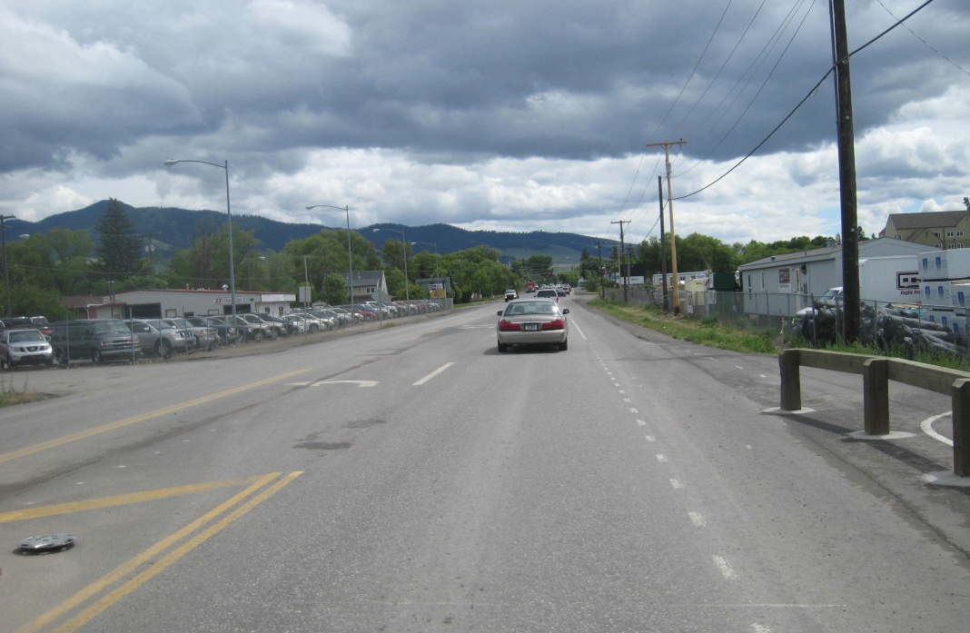
Russell Street, Missoula
73

Slide 34
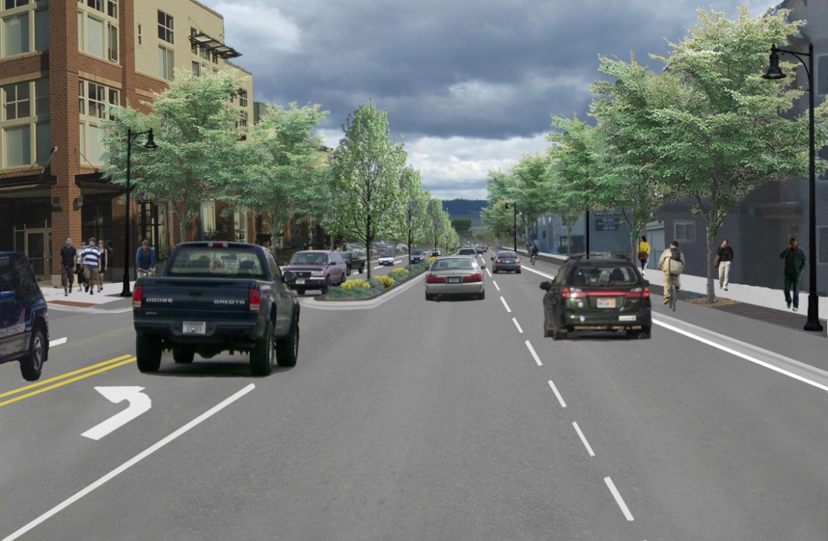
Russell Street, Missoula
74

Slide 35
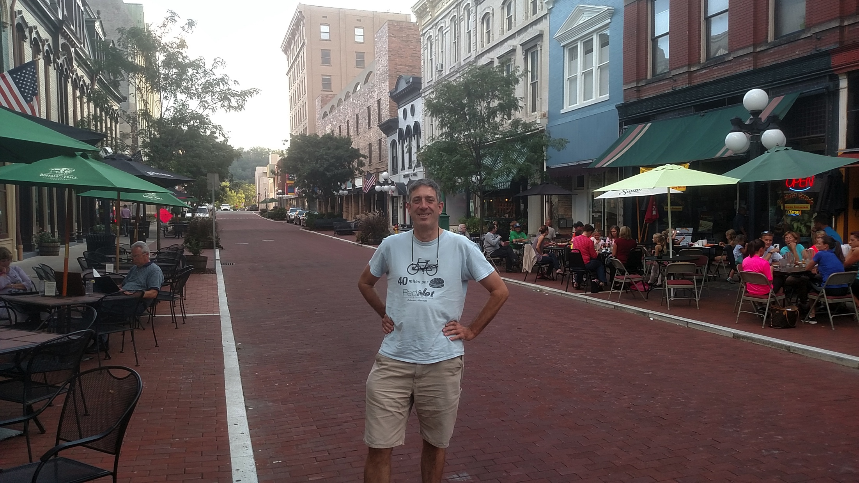

Slide 36
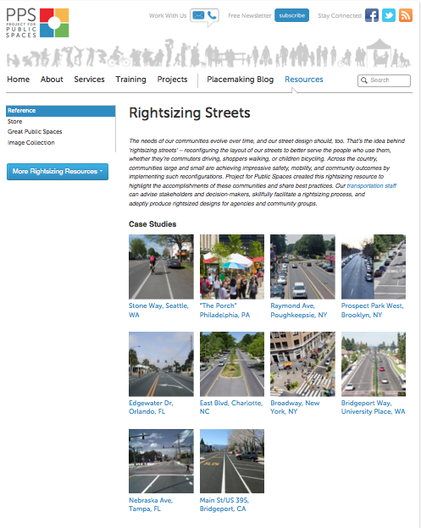
Dozens of Case Studies
http://www.pps.org/reference/rightsizing/
PROJECT FOR PUBLIC SPACES

Slide 37
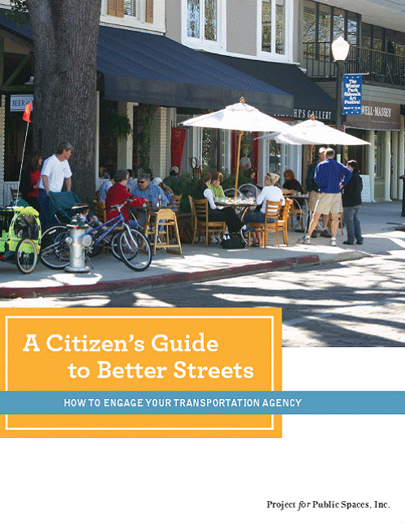
http://www.pps.org/pdf/bookstore/How_to_Engage_Your_Transportation_Agency_AARP.pdf
Gary Toth
Director of Transportation Initiatives
Project for Public Spaces
609-397-3885
Gtoth@pps.org
PROJECT FOR PUBLIC SPACES
PROJECT FOR PUBLIC SPACES
Notes:
In our 30 years of work, we have found that people have never really lost their craving for great civic gathering spaces. People flock to civic spaces when they want to be with other people, to share ideas or become part of the collective expression of an idea or point of view. Uptown Waterloo’s public square has the potential to become such a great civic place and destination for the people of this City. As a parking lot, it’s opportunity to become a defining place for the city is quite limited. However, in either case, the space needs to be carefully planned and designed. But more than that, to be successful it must e actively programmed and managed on an ongoing basis and funds need to be set aside for that purpose NOW. That is why most if not all public spaces fail to realize their potential. Why parks sit empty; while plazas in the middle of busy commercial districts are unused except by skateboarders and the homeless; if you build it they will come, only if there is something to do there and a comfortable place to sit while you do it!

Slide 38
Engineers are not bad people!
PROJECT FOR PUBLIC SPACES
PROJECT FOR PUBLIC SPACES

Slide 39
Engineers as problem solvers!
It is the time of French Revolution and the guillotine was hard at work everyday. Today they're leading a priest, a drunkard and an engineer to the guillotine.
PROJECT FOR PUBLIC SPACES
PROJECT FOR PUBLIC SPACES

Slide 40
Engineers as problem solvers!
They ask the priest if he wants to face up or down when he meets his fate. The priest says that he would like to face up so he will be looking toward heaven when he dies. They raise the blade of the guillotine, release it, it comes speeding down and suddenly stops just inches from his neck. The authorities take this as divine intervention and release the priest.
PROJECT FOR PUBLIC SPACES
PROJECT FOR PUBLIC SPACES

Slide 41
Engineers as problem solvers!
Next the drunkard comes to the guillotine. He also decides to die face up hoping that he will be as fortunate as the priest. They raise the blade of the guillotine, release it, it comes speeding down and suddenly stops just inches from his neck. So they release the drunkard as well.
PROJECT FOR PUBLIC SPACES
PROJECT FOR PUBLIC SPACES

Slide 42
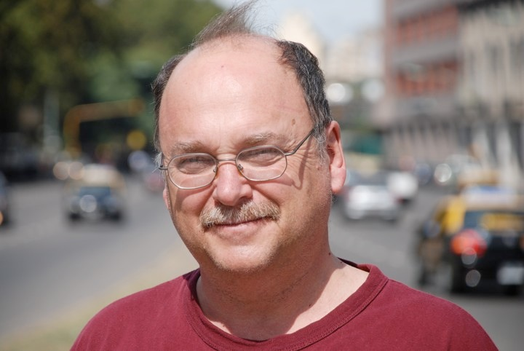
Engineers as problem solvers!
The engineer is next. He too decides to die facing up. They slowly raise the blade of the guillotine, when suddenly the engineer says: "Hey, I see what your problem is."
PROJECT FOR PUBLIC SPACES
PROJECT FOR PUBLIC SPACES

