Slide 1
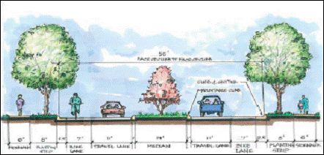
P l a n for Improved Walking and Bicycling
Notes:
Every great project starts with a plan!
Walking is a fundamental part of an integrated transport system. Most everyone’s journey starts and ends with walking, and almost all Kentuckians will spend some of their time during the day travelling on foot.

Slide 2
Why do you need a plan for walkers? They can walk anywhere, can’t they?
Notes:
Every great project starts with a plan!
So, what IS a pedestrian plan?
Pedestrian Plans are the first step to making communities more walkable.
Elaine: These detailed plans engage community members to identify priorities for creating a safe, attractive walking and biking environment for people of all ages and abilities. A pedestrian plan adopted by local government will serve as official documentation of your community’s need and readiness for improvements to pedestrian facilities. Having these plans developed to a certain level of readiness provides opportunities to apply for funding to design and/or complete these projects.

Slide 3
How to PLAN for Your Community
P People (Professionals
& Partners) and Places
L Locate Places on a Map
A Assess priority
N Network your plan

Slide 4
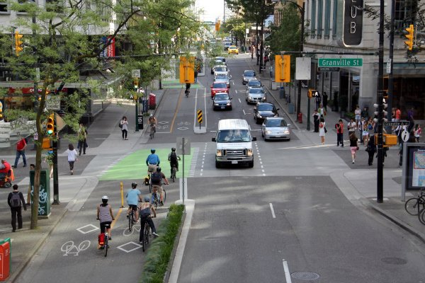
People and Places: Connections Matter
Connect all people to all places
using all possible modes of
transportation
Notes:
Walking is a low cost, low barrier, and key transport mode. Improving the experience of those who already walk and encouraging more people to travel on foot more often will better connect communities, bring health benefits to individuals, and free up capacity on our roads and public transport system.
People—Involve Elected City and County Gov, Planners Engineers, Highway district offices, Cyclist, business owners, civic groups, seniors, children, parents, health groups and on and on and on
Places– Plan to connect places…homes, schools, businesses, parks … walking, biking, etc.

Slide 5
PEOPLE: Who needs to be served?
Know the people who can benefit in your community
Children
Seniors
People using canes, walkers or wheelchairs
Economically disadvantaged
Active walkers or runners
College students
Tourists and visitors
Local business patrons
You and me
Notes:
People who need assistance from the community: folks from the fragile community- those that are in wheelchairs, use walkers, blind or low sighted, seniors, children, economically or health challenged/disadvantaged)

Slide 6
PEOPLE: Planning Committee Members
Know the people who can help with planning in your community
Local/Regional Health Departments & Hospitals
Cooperative Extension
City/County Officials, Planners and Engineers
Area Development District
Tourism/Economic Development
Chamber of Commerce
Local Citizens, Parents, Business Owners
Advocates
Notes:
You will need as much help as possible and the more diverse in knowledge, experience or viewpoint the better. Start your work with the smaller focus area, refine your pedestrian planning and assessment skills, then move to another or bigger area.
The first task for the Committee is to select a focus area for your project. That can be done either by the committee itself deciding on the focus are or the committee developing the survey and the plan for administration of the survey.

Slide 7
PEOPLE:
Small Project Assistants
Know the groups of people who can help with projects in your community
Provide assistance with information gathering or project support
Church groups
Civic groups: Rotary, Civitan/Ruritan, Chamber of Commerce
Accomplish small projects such as area cleanups or bench building
School groups
Scout and 4-H groups
Notes:
Reminder: these actions are probably involved in other steps and may also be in different orders of priority or completion
Decide what parts of this project/task that each group can help with or is best equipped to accomplish

Slide 8
PEOPLE: Meeting with Your Committee
Involvement + Coordination + Communication
=SUCCESS!
Notes:
This is an example of the Walk/Bike Frankfort public meeting. When it’s warm, they have the meetings outside in public places. When it’s cooler, they meet at the local coffee shop. People walk and ride bikes to the meetings year around!

Slide 9
How to PLAN for Your Community
P People and Places
L Locate places on a map
A Assess priority
N Network your plan

Slide 10
KYTC Pedestrian & Bicycle Travel Policy
Adopted in 2002
Provides checklists for locations requiring accommodations for pedestrians or bicyclists
The Kentucky Transportation Cabinet (KYTC) shall consider the accommodation of bicycles and pedestrians on all new or reconstructed state-maintained roadways.
Notes:
Resources/ KY has a very well written Bike/Ped Transportation Policy. This can be the check lists for the start of the community planning process
KYTC will also consider accommodating bicycle transportation when resurfacing of roadways, including shoulders.
Check list for consideration:
* A pedestrian facility already exists on the current roadway
* A state locally, or regionally adopted pedestrian or bicycle network or policy has designated pedestrian/ bike
improvements in the area of the specific roadway project or for that classification of roadway.
* Pedestrian traffic exists along the current roadway: This may be determined by the
observation of pedestrian traffic or by the public-involvement process.
* Public interest in and demand for pedestrian facilities are determined at the planning and
preliminary engineering public-involvement stages
* KYTC project-level decisions will complement local pedestrian plans to the maximum
reasonable extent
* KYTC project-level decisions will evaluate future connections to close gaps in parallel
connectivity between projects and developed areas/community destinations or existing
pedestrian facilities within 300 feet beyond normal project limits within existing publicly
owned rights of way.
· KYTC project-level decisions will evaluate future connections to close gaps in
perpendicular connectivity to developed areas/community destinations or existing
pedestrian facilities within 100 feet of the roadway edge of pavement within existing
publicly owned rights of way.
· KYTC project-level decisions will consider pedestrian access to existing and planned
transit stops.

Slide 11
LOCATE: Survey the Community for WHERE
METHOD
PARTNERS
TARGET AUDIENCE
RESPONSES
Online—Survey Monkey
Facebook
QR Code
Door-to-door
Postcard
Paper-pencil
Churches
Schools
Social Media
Local Business
General public
Specific project area
Parents of students
Business owners
How many do you need? (Estimate)
How many did you get? (Actual)
Notes:
How to choose WHERE to do your Study/PLAN
Try to keep it simple--
Collect data: names, emails, addresses (or geographic area)
Set specific time lines (for example: 2 weeks) and target goals
Reminder: you may be able to pick a focus area before you create the survey based on previous work or perceived need. OR, you may want to use the survey results to help determine your starting focus area.
Remember; you are just getting your feet wet with this project. Once you develop the skills to better help plan, develop, and provide pedestrian accommodations here, then you can repeat the process throughout your town or region.

Slide 12
LOCATE: Sample WHERE Survey Questions
For all or part of your trips to work, shopping, parks or other destinations, do you currently travel by foot?
Yes (what percentage _____)
No
Are any of the following destinations within 2 miles of your home: workplace, shopping place, school or park?
Yes (which ones?_________________________)
No
Please list the locations where pedestrian facilities need to be provided or improved:
a)
b)
c)
Notes:
See the sample survey from the City of Frankfort
To choose WHERE to do your Study/PLAN
Keep survey SIMPLE 5-10 questions.
TEST your survey on members of your office or family NOT involved in the project.
Change the questions that are not clear for them. TEST AGAIN.
Unless you are doing a face to face survey…expect less than 10% response rate.

Slide 13
LOCATE: Map the Focus Area
Get a map (Google, ADD, Chamber of Commerce)
Add or mark origin and destination points (homes, schools, recreation/parks, businesses, etc.)
Notes:
To refine your study area… then create a MAP for you and others to use…..Use Chamber of commerce map, state map, Google map….. The bigger the map the better.
Get out your stickers and or different colored highlighters to show locations of “pedestrian generators”: schools, neighborhoods, recreation/parks, businesses, churches, etc.
Knowledge is Power
Get our your stickers of different colored highlighters to show locations of “pedestrian generators”: schools, neighborhoods, recreation/parks, businesses, churches, etc. - Easy to add layers of the projects, needs, priorities later
Information for local government, bike clubs, citizens, and tourist
Remember.. You are looking for 4-6 blocks ONLY for your final study area. Your plan will connect the pedestrian generators.
Elaine: Identify priority area to survey. Consider where people live and places that people access (parks, stores, churches, schools, apartments, neighborhoods etc. )
Priority area can be identified with the input of a diverse committee, more public input may be necessary.
Highlight – where people live, business, current paths, potential projects
Consider safety, connectivity, health, economic development (Lynn’s community goals)
I was going to use the word termini for any engineers out there.

Slide 14
LOCATE: Identify Local Priority
Health
Safety
Connectivity
Economic Development
Start small: zero in on an area of 4 to 6 blocks
Consider community’s goals, such as safety, connectivity, health, etc.
Identify the area with input from your diverse planning committee and/or survey responses
Notes:
Pick a focus area… start small and have great success.
Knowledge is Power
Mark with a highlighter - Easy to add layers of the projects, needs, priorities
Information for local government, bike clubs, citizens, and tourist

Slide 15
How to PLAN for Your Community
P People and Places
L Locate Places on a map
A Assess priority
N Network your plan
Notes:
You now have your focus location picked, you have your survey results back; now what?
Use the survey results to assess which projects have the highest priority in your area.
What places or projects should be the highest priority? GOALS, needs, and opportunities all play a role in this part of the process. (will discuss over the next few slides)

Slide 16
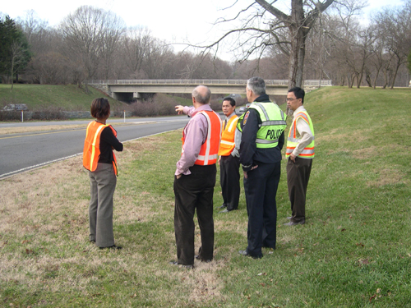
ASSESS PRIORITY: Review Focus Area Data
Assess the community survey results
Assess walkability in the focus area
Notes:
Assess Develop Build
Ranking new plans, projects, or improvements based on the responses to the walkability assessment and the survey
Assess the results from the survey to see where the perceived priority areas are
Assess the walkability for the focus area / there are many different ways and formats to do this (see examples)
We will work on the building part (engineering) stuff later. Just listing the most basic roadway information is enough for the transportations planners (you’ll meet later in the process) to help and prepare.

Slide 17
ASSESS PRIORITY: What Does Your City Need?
Develop project(s) to respond to identified needs:
Project must meet community goals
Project must have a “purpose and need statement”
Notes:
Assess Develop Build
Develop new plans, projects or improvements as needed to respond to walkability assessment and survey responses. Rank them by importance to the community and ability to meet community goals
Develop a plan for projects for the community - include purpose and need statement
Prioritize projects, improvements, education programs, enforcement programs, and encouragement/marketing ideas based on community goals

Slide 18
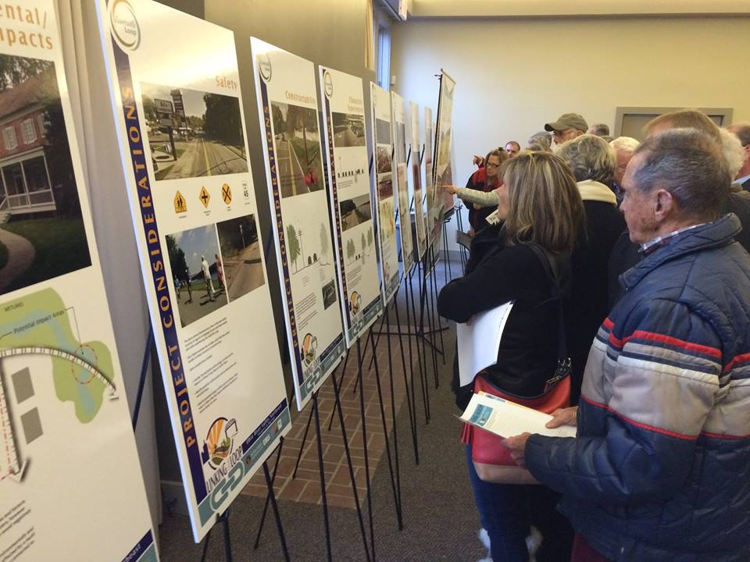
ASSESS PRIORITY: Customize for Your City
Prioritize plan items based on meeting community goals such as health, safety, mobility, connectivity, etc.
Prioritize plan items with input from your diverse planning committee and/or survey responses
Add the priority to the map
Notes:
Assess Develop Build
rank new plans or projects or improvements needed to respond to walkability assessment
Develop a plan for projects for the community - include purpose and need statement
Prioritize projects, improvements, education programs, enforcement programs, and encouragement/marketing ideas based on community goals
Add to map
We can help you get started with a wealth of resources and contacts
Some aspects of your planning are:
Recommended (getting healthier, economic growth, tourism, needed alternative transportation (younger, older, low income, new citizen, and much more)
Best practices/guidance (KYTC & FHWA Policies, AASHTO, NACTO, and more)
Required (ADA compliant / transition plans)

Slide 19
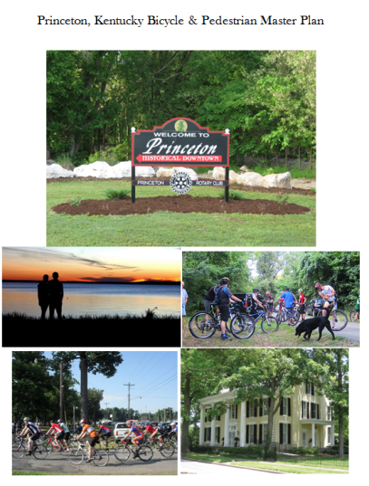
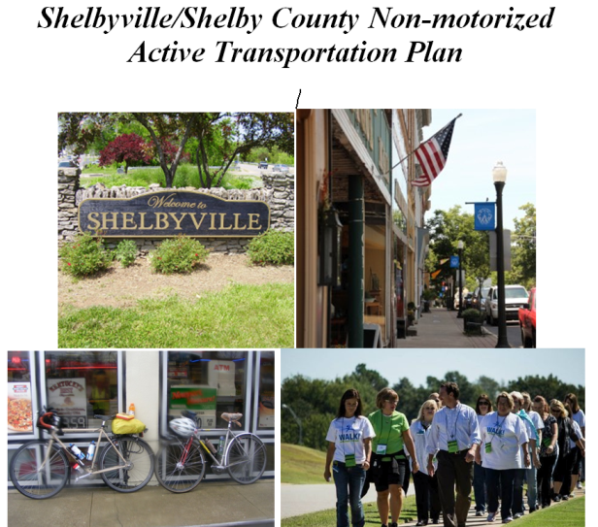
ASSESS PRIORITY: Use Other Communities for Examples
The KYTC Bicycle & Pedestrian program has links to numerous pedestrian and bicycle plans on its website for you to use as templates
Notes:
We can help with this as you get to this point!...
Go to our website. BikeWalk.ky.gov look under Statewide Information

Slide 20
ASSESS PRIORITY: Assemble Your Plan
Your plan should include:
Discussion of community goals
Process and criteria used to select focus area
Process and criteria used to prioritize projects
Short project description together with a Purpose and Need statement
Summary map of all prioritized projects and individual project maps

Slide 21
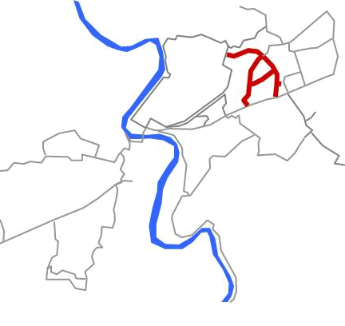
ASSESS PRIORITY: Sample Plan Items
Vision:
Existing roadways and an abandoned rail bed are upgraded to allow safe pedestrian and bicycle connections through the Crestwood neighborhood. The project links to an existing overpass, offering commuters and school children safe crossing over Wilkinson Blvd.
Project Specs:
Total length: 3.25 miles
Hard surface multi-use trail: 1.25 mile
Marked road with sidewalks: 1 mile
Bike lanes: 1 mile
Notes:
One project example from the Walk/Bike Frankfort group. Note the level of engineering (very simple specs)

Slide 22
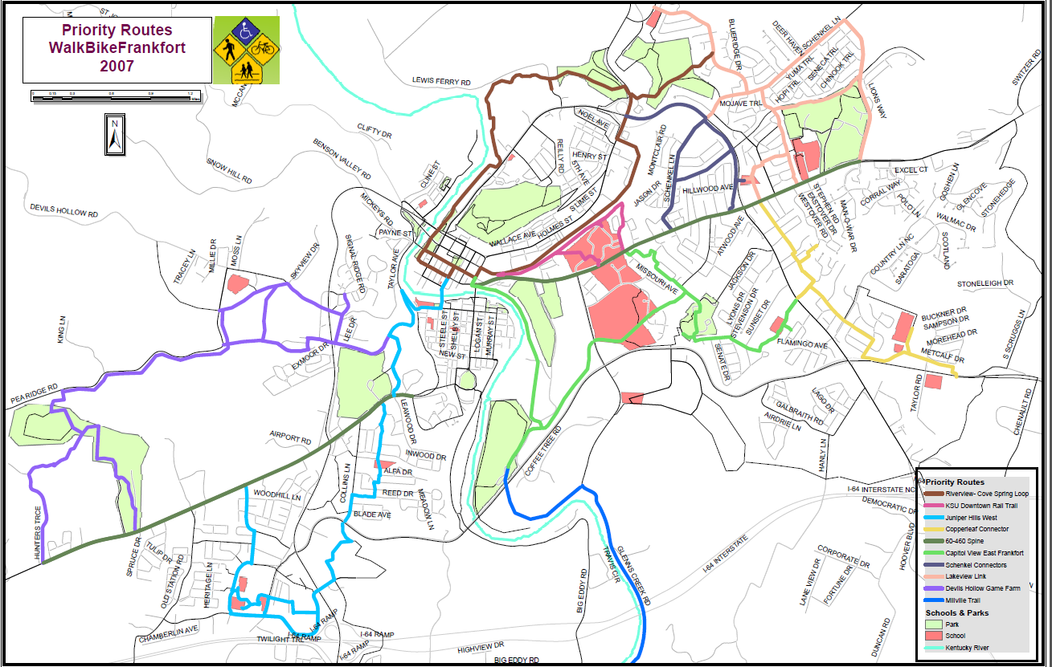
ASSESS PRIORITY: Your Plan Priority Map
Notes:
Knowledge is Power
Get our your stickers of different colored highlighters to show locations of “pedestrian generators”: schools, neighborhoods, recreation/parks, businesses, churches, etc. - Easy to add layers of the projects, needs, priorities later
Information for local government, bike clubs, citizens, and tourist

Slide 23
How to PLAN for Your Community
P People and Places
L Locate Places on a map
A Assess priority
N Network your plan
Notes:
Once you start to gather your material (survey results, proposed projects list, priority map) be sure to share with everyone. Local elected officials, Local Highway District Office, Transportation Planner at the ADD Office, and the list goes on and on

Slide 24
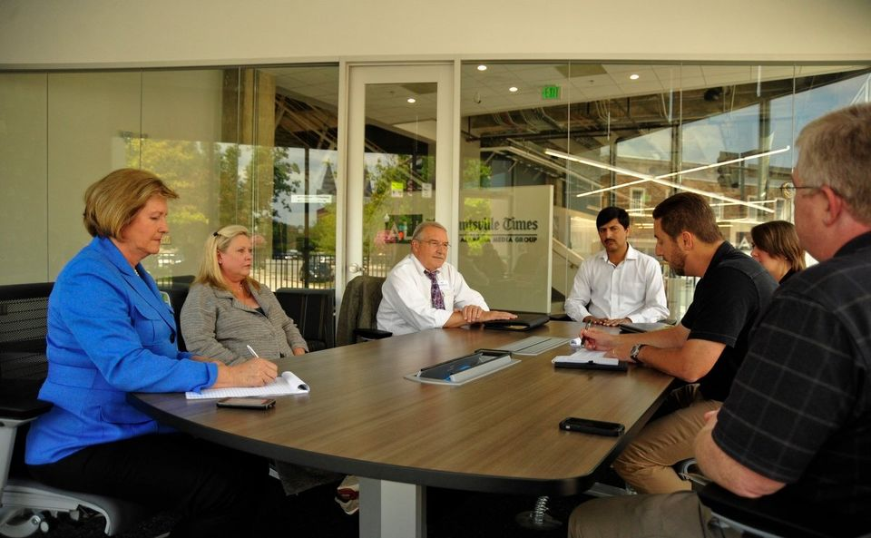
NETWORK Your Plan: Get Your Plan APPROVED
Grant Success = Approval By Local Officials!
Talk it up in the community
Committee member(s) discuss with local officials
Take plan to city council/county fiscal court or other responsible local body for consideration
Get a Resolution of Approval
Notes:
REMEMBER YOUR PEOPLE SLIDE FROM EARLIER….
Schools, clubs, hospitals, etc.

Slide 25
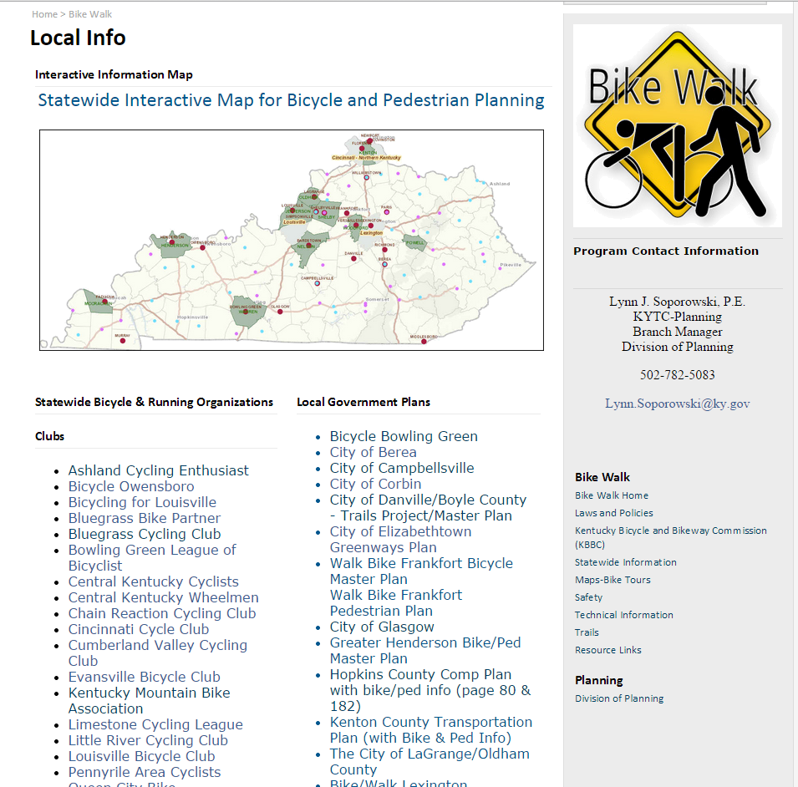
NETWORK Your Plan: Publish
Publish your plan:
Put it on a local web page
Provide the link to TROY and KYTC
Notes:
Final steps / reminder
Use existing web page for anyone in your community or set up new page– can be in web format or pdf format – whatever is easiest and cheapest for you
Once the plan (can be one project or many) is ready, resolution adopted by the local government, and promoted (placed on one of many web sites; city, county, downtown association, or ADD Office); then we can share on the KYTC statewide bike/ped planning map for use in future transportation planning/projects) refer to the Bicycle and Pedestrian Travel Policy / http://transportation.ky.gov/Bike-Walk/Documents/Task%20Force%20FINAL%20June%2018_02%20policy%20rec%20to%20Sec%20Codell.PDF

Slide 26
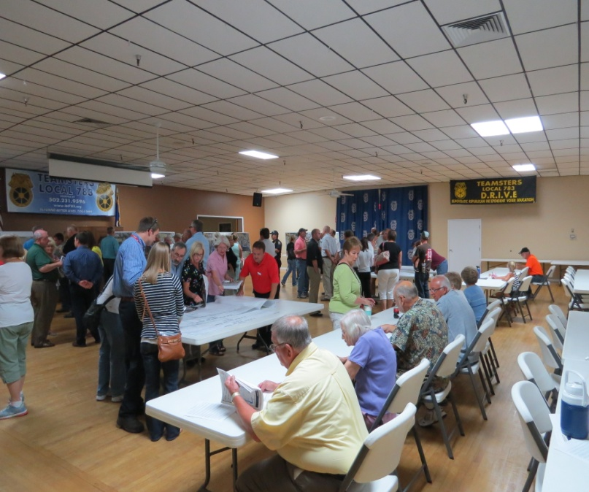
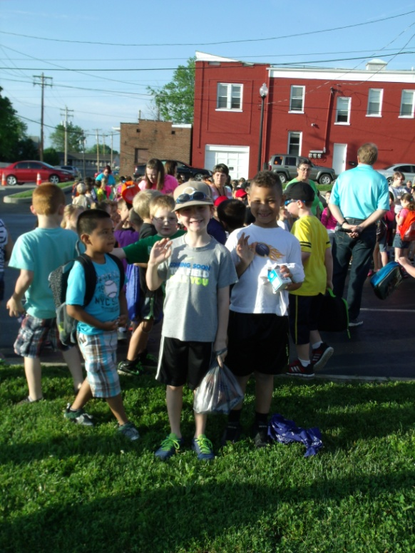
NETWORK Your Plan: Tell EVERYONE
Share your plan with:
TROY /KYTC Bike Ped Program Office
Planning staff at your Highway District Office
Transportation planners at your MPO
Transportation planners at your ADD
ALL other local and regional government staff
Other regional bike/ped groups/clubs
Local colleges
Anyone else you can think of
Notes:
The folks that need to know about and see you plan. Many of these folks can and will provide assistance with the engineering, building, and other needs associated with the facilities projects.

Slide 27
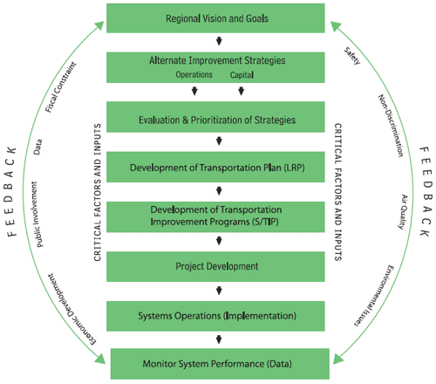
NETWORK Your Plan: Highway Plan
Ask the Transportation Planners (Highway District and ADD) to:
Develop a Project Information Form so the project can be included in the next Highway Plan project prioritization process.
Notes:
What happens to your hard work now? The folks you share the plan with can now start the process of taking your hard work and making it a reality.
Throughout the project planning process, there are opportunities for involvement in the project and for feedback from the local community. These are your opportunities to get your plans into the statewide highway plan.

Slide 28
NETWORK Your Plan: Funding $$Sources
FHWA -Transportation Alternatives Program
USDOT-TIGER grants
FHWA- CMAQ in Air Quality Areas
Tourism
Parks Departments
KYTC-Paula Nye Grants for Bike Safety
Sell it a Foot at a Time…
Private individuals or organizations
Corporate Sponsors
Notes:
Ways to get the projects funded.
Having the “shovel ready” plan is the first (and probably the most important) step. Watch for grant announcements and apply, apply, apply
Show me the money!!!!

Slide 29
Bike/Ped Planning Provides Opportunity
Notes:
For the cyclists, the pedestrian, the local businesses, the whole community to some degree.

Slide 30
Questions?

