Slide 1
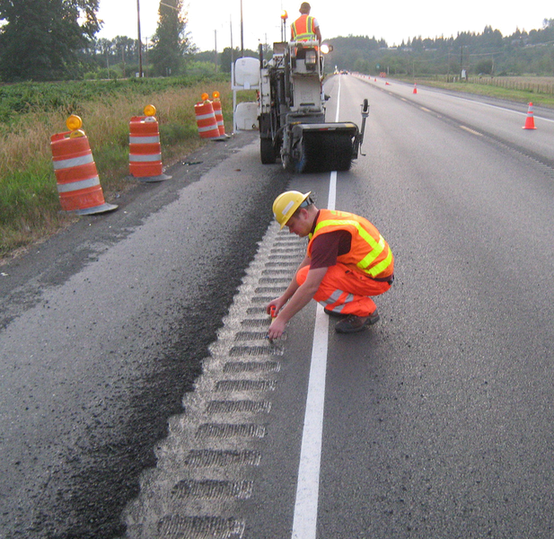
Bicycle & Pedestrian Safety with Rumble Strips/Stripes
KYTC Bicycle & Pedestrian Program
February 24, 2015
Notes:
Rumble strips work! Many reports confirm that rumble strips reduce crash rates.
But milled rumble strips/stripes can adversely effect cycling movement on shoulders; making safe for drivers, but causing crashes for cyclists.
ACCOMMODATION OF ALL ROAD USERS: Safe accommodation of all road users should be considered when designing and applying rumble strips. This includes passenger and commercial vehicle drivers, bicyclists, pedestrians, and others. Flexibility is provided within this advisory to address the needs of these users based on the existing and projected use in the specific corridor.
Bicyclists: While bicyclists will rarely need to cross a center line rumble strip, the presence of the rumble strip may cause passenger and commercial vehicles to shy away from the center. This effectively moves these vehicles closer to bicyclists and pedestrians who may be traveling on the outer edge of the lane. It is recommended that agencies maintain 14 feet of pavement beyond the edge of the center line rumble where vehicles and bicycles are expected to share the lane.
This is what we are talking about today

Slide 2
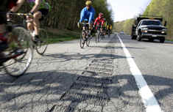
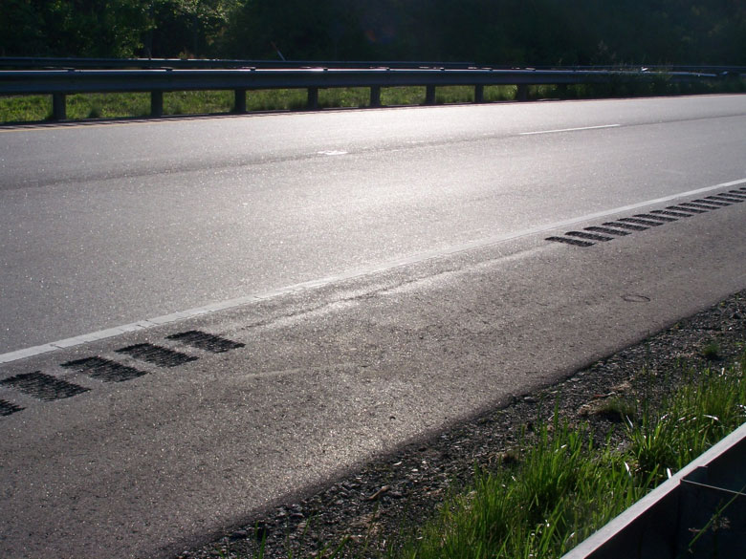
Problem & Solutions
Rumble strips are great for reducing auto crash rates, but not so good for bicycle and wheelchair travel.
Space allows for safer movement of cyclists and wheelchairs.
Notes:
Milled rumble strips pose a problem to wheelchair users and road cyclists.
When users need to make left turns
Need to avoid debris or obstacles in the shoulder
One solution to this starts with is providing the space pattern for all shoulders over 6 feet.
Issue: few, if any cyclists report crashes as a result of crossing a rumble strip or debris in the shoulder (unless extremely bad). There for data is limited. However if one visits various cycling social media sites, blogs, or websites; you’ll soon see this is becoming a major issue with the new milled rumbles.

Slide 3
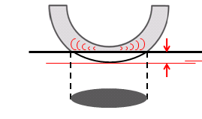
The Standard Road Bicycle Tires
Width: 23 mm 28mm 32 mm 44 mm 50 mm
.93 inch 1.1 inch 1.25 inch 1.7 inch 1.9 inch
Designed Contact Depth is 0.15 inch.
Notes:
These examples are of the average bicycle tires that will be riding on these roadway shoulders. The average bicycle tire profile crossing over the rumbles can adversely impact the movement of the riders.
The two tires on the far left represent the two most common road bike and wheel chair tires (standard wheel chair is 25mm wide or about 1 inch)
The specs for the rumble strip are .5 inches deep (max), you can see how this can be an issue with the most common tires and the design for these tires (refer to example on slide).

Slide 4
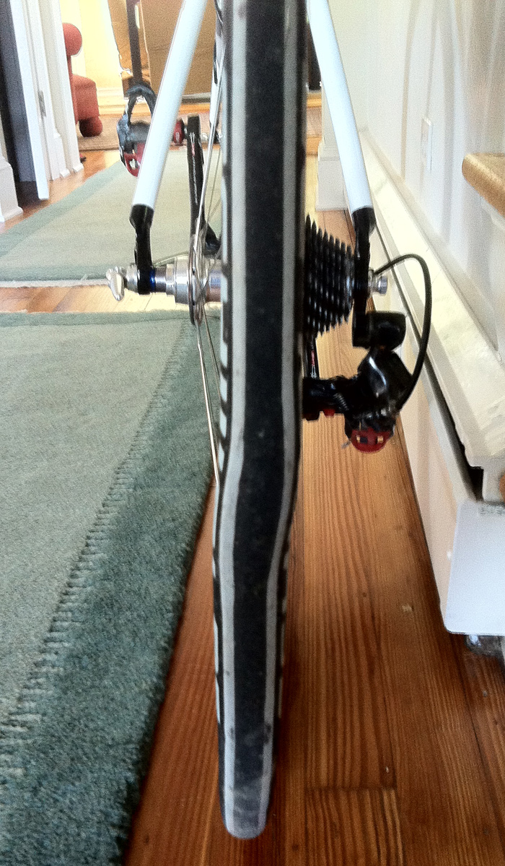
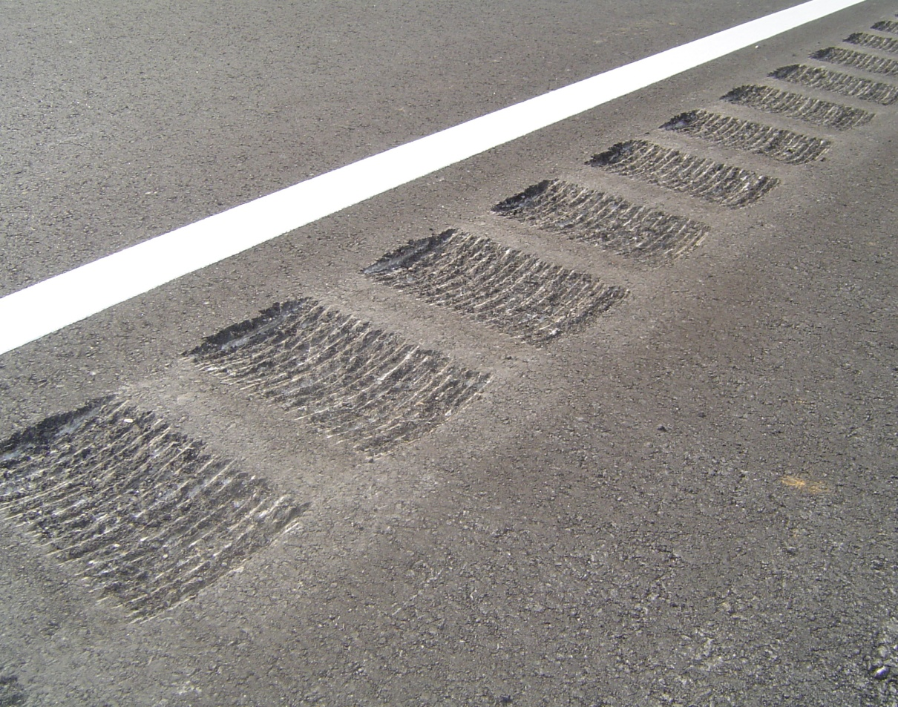
Impact Damage
Notes:
You can see what can happens to an average road bike tire when the impact to a milled rumble strip is extreme. (FYI; a tire like this cost about $50-$75).

Slide 5
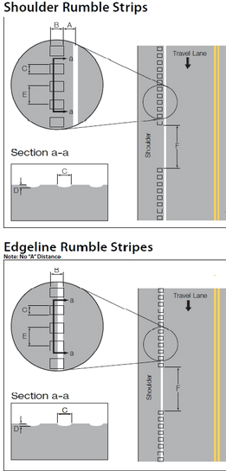
Mainline Solutions
FHWA Guidance for
Shoulder or edge line rumble gaps:
Allow users to cross between the shoulder and the travel lane without having to ride on the rumbles
Systematic gaps shall be included in the run of rumble strips. The gaps should be 10’long (longer if traveling downhill) and spaced at 40-60’intervals
http://safety.fhwa.dot.gov/roadway_dept/pavement/rumble_strips/
Notes:
FHWA guidance states: / http://safety.fhwa.dot.gov/roadway_dept/pavement/rumble_strips/
This is for the milled rumbles (edge line or shoulder).
Wide Shoulders= constructed shoulder 6 feet or more
Gap Pattern = providing a 10 foot space every 40 feet (with edge line and shoulder)

Slide 6
Guidance Checklist
http://safety.fhwa.dot.gov/roadway_dept/research/exec_summary.htm
Notes:
Just in case someone ask:
RECOMMENDATIONS:
Installation: On new and reconstruction projects, four feet of paved shoulder should extend beyond the rumble strip. Continuous, milled edge line or shoulder rumble strips should be considered:
System-wide on all rural freeways and other rural highways with posted or statutory speeds of 50 mph or greater (i.e. systemic safety projects).
Along rural or urban corridors where significant numbers of run-off-road crashes that involve any form of motorist inattention have been identified (i.e. location-specific safety improvement projects).
During any highway project with a history of run-off-road crashes or where shoulder or edge line rumble strips were overlaid during the paving process (e.g. reconstruction or resurfacing projects).

Slide 7
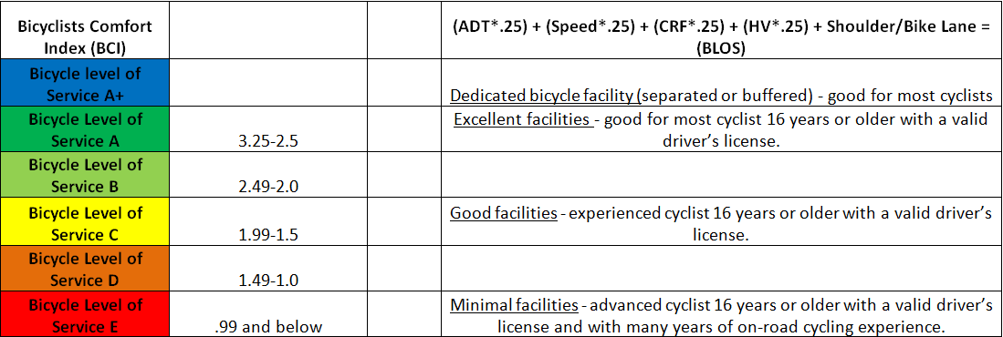
KYTC Bike/Ped Program Data
The presence of shoulders (6 foot or wider) in KYTC Bicyclists Comfort Index
http://transportation.ky.gov/Bike-Walk/Documents/Metadata%20Page%20updated%202014.pdf
Notes:
Just as a reference; many cyclists feel more comfortable using the shoulder space to ride. This is why we use the shoulders in our formula. By showing this as a possibly “better” place to ride we are encouraging more cyclists to use these roads. We want to make these as safe and as accommodating as possible.

Slide 8
Entrances & Turning Scenarios
Across entrances and turning lanes: These gaps should start 10’ to 20’ prior to the driveway opening or tuning lane approach.
http://safety.fhwa.dot.gov/roadway_dept/research/exec_summary.htm#designs
Most important for users
Notes:
Gaps for intersections and access points include:
FHWA guidance / Across driveways and turning lanes anticipated to have more than 100 vehicles per day exiting, so that users do not have to cross rumble strips when passing in front of a vehicle that has blocked the shoulder while waiting for a break in traffic. These gaps should start 10’ to 20’ prior to the driveway opening or tuning lane approach.

Slide 9
Other Scenarios
Through highway intersections or where the rumble strips would be crossed by merging lanes, as vehicles should not have to encounter shoulder rumble strips within the normal traveled way.
http://safety.fhwa.dot.gov/roadway_dept/research/exec_summary.htm#designs
Notes:
FHWA Guidance / Through highway intersections or where the strips would be crossed by turning or merging lanes, as vehicles should not have to encounter shoulder rumble strips within the normal traveled way.

Slide 10
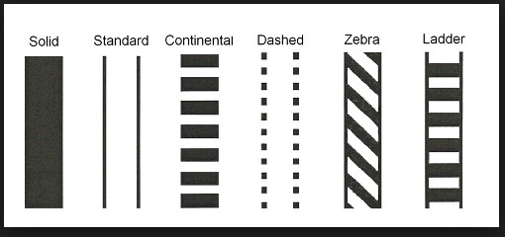
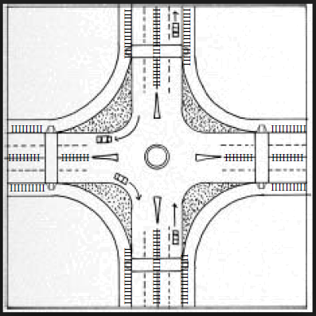
Crosswalk Scenarios
Through marked or unmarked crosswalks, Rumble strips may create difficulties for persons in wheelchairs or with sight limitations. The center line rumble gaps should be placed no less than 10’ to 20’ prior to any roadway intersection.
Notes:
Both the shoulder and center line rumbles pose an issue for using the crosswalks (wheelchairs, slow walkers, persons using a walking aid device, and children). This is for sidewalk to sidewalk or trail to trail connections.
Special Note: Not all marked crosswalks are at signalized intersections. Some occasions you may have a mid block crossing

Slide 11
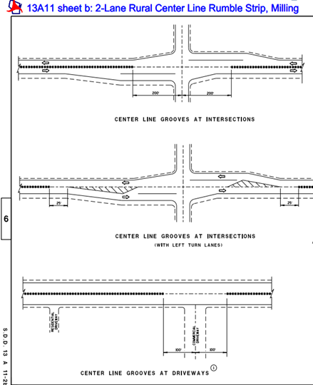
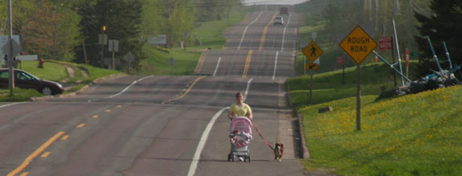
Center Line Rumbles
http://roadwaystandards.dot.wi.gov/standards/fdm/SDD/13a11.pdf
http://safety.fhwa.dot.gov/roadway_dept/pavement/rumble_strips/t504040/
http://safety.fhwa.dot.gov/roadway_dept/pavement/rumble_strips/concerns_bike.cfm
Notes:
This drawing is from Wisconsin DOT / please note the space provided as you exit the cross streets.
ACCOMMODATION OF ALL ROAD USERS: Safe accommodation of all road users should be considered when designing and applying rumble strips. This includes passenger and commercial vehicle drivers, bicyclists, pedestrians, and others. Flexibility is provided within this advisory to address the needs of these users based on the existing and projected use in the specific corridor.
Bicyclists: While bicyclists will rarely need to cross a center line rumble strip, the presence of the rumble strip may cause passenger and commercial vehicles to shy away from the center. This effectively moves these vehicles closer to bicyclists and pedestrians who may be traveling on the outer edge of the lane. It is recommended that agencies maintain 14 feet of pavement beyond the edge of the center line rumble where vehicles and bicycles are expected to share the lane.

Slide 12
Questions ?

Slide 13
Thank You !
Troy Hearn
Bicycle and Pedestrian Program- Statewide Coordinator
Division of Planning ~ Kentucky Transportation Cabinet
200 Mero Street ~ Frankfort, KY 40622
P 502/782-5060~~ C 859-967-8359 ~~ F 502/564-2865
Troy.Hearn@ky.gov
http://bikewalk.ky.gov/

