Slide 1
Traffic Engineer’s Meeting
Tort Liability
Kenneth R. Agent, P.E.
Transportation Research Engineer
Kentucky Transportation Center

Slide 2
Case Studies
Tort Liability Definitions
Summary of Board of Claims Cases

Slide 3
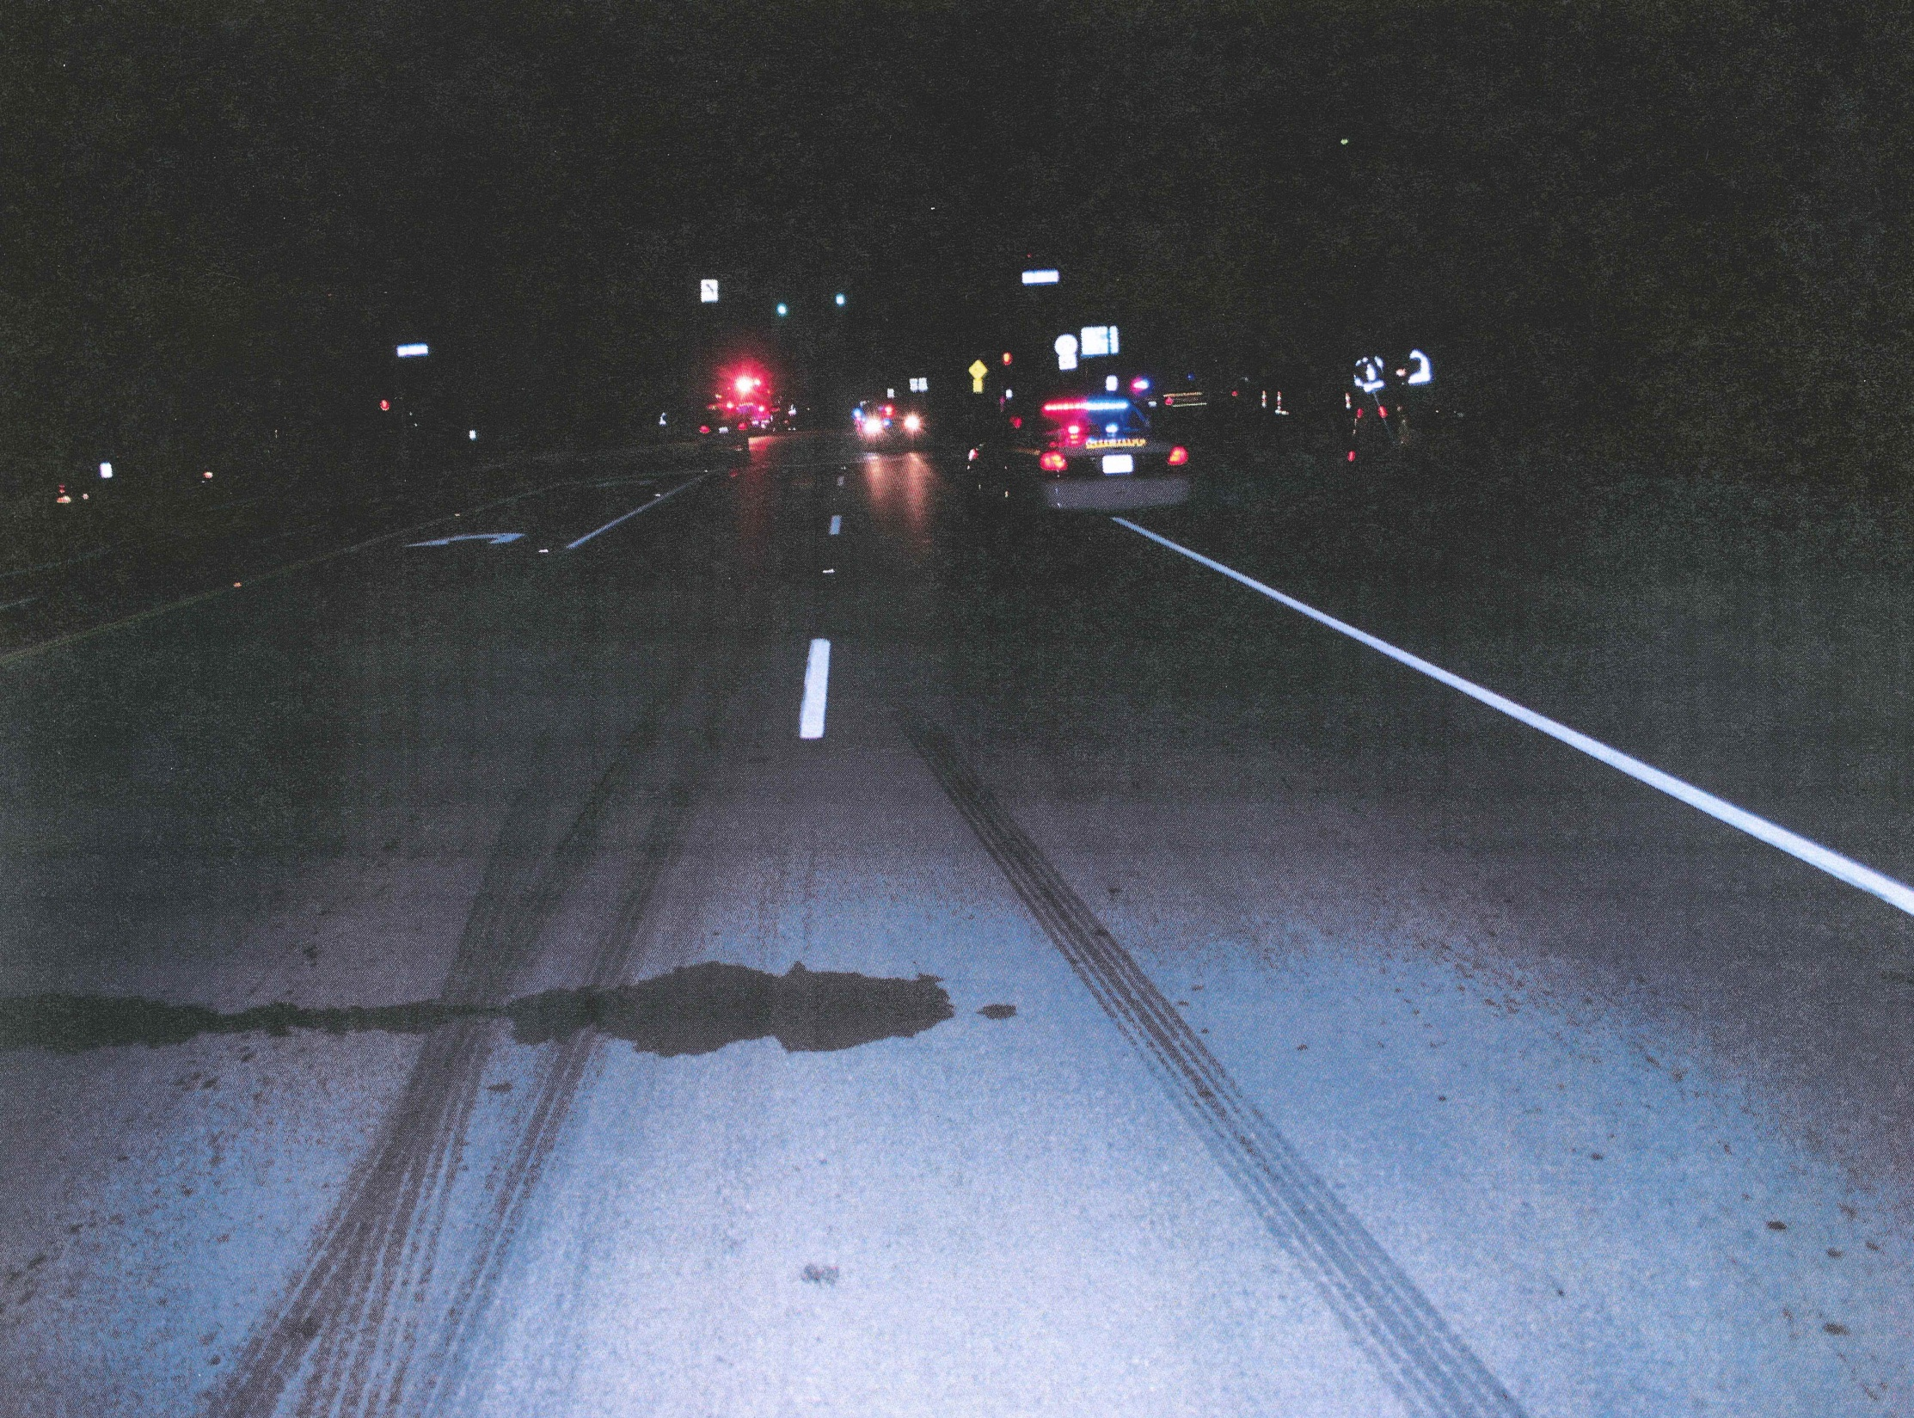

Slide 4
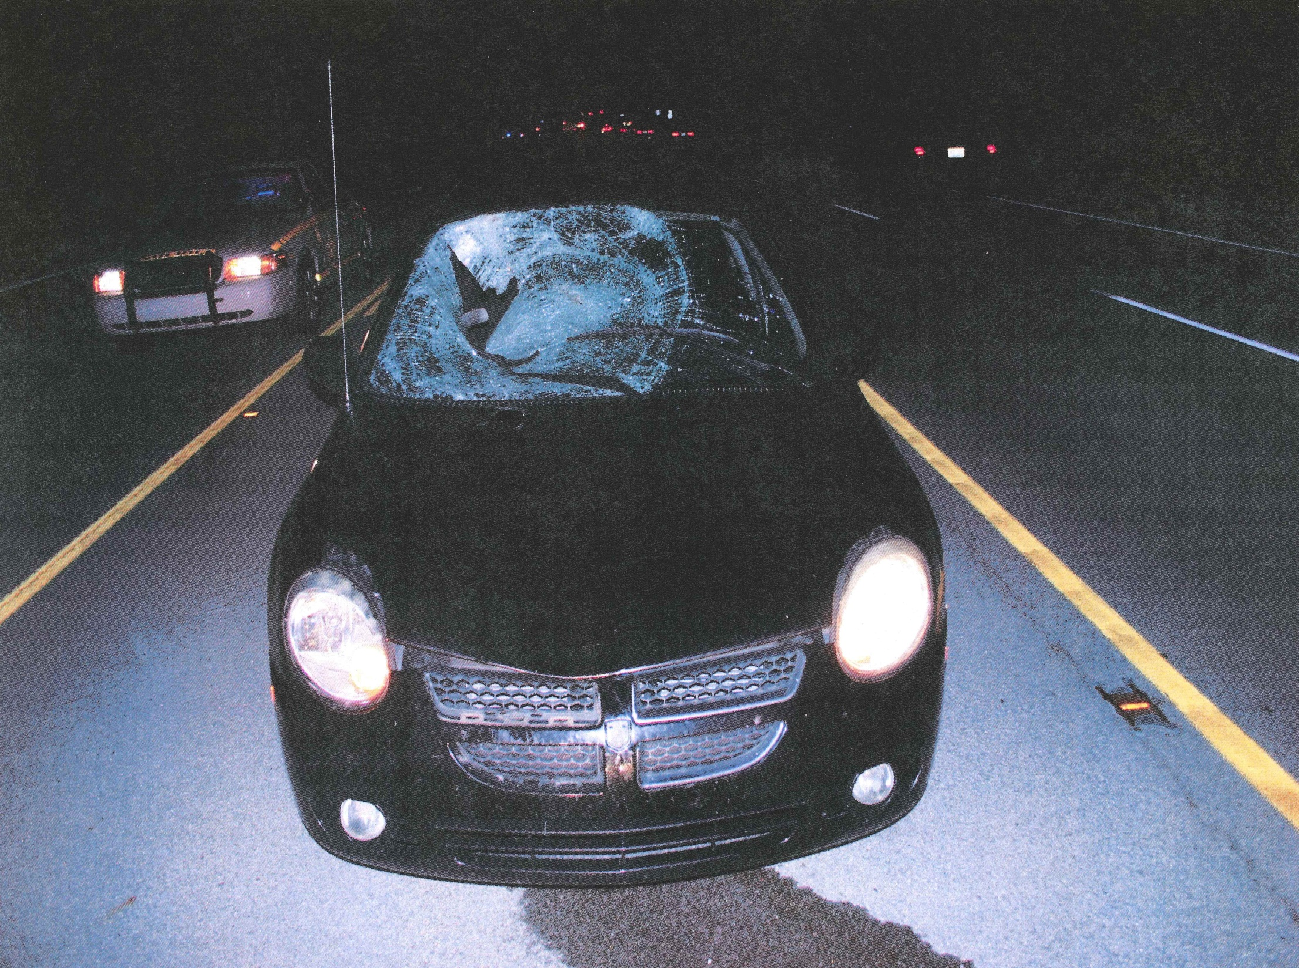

Slide 5
Claim
Negligently maintained pedestrian call button
Failed to provide pedestrian sufficient time to cross road with traffic signal
Failed to provide adequate lighting at intersection

Slide 6
Recommended Order
Conclusions of Law
Cabinet exercised engineering judgment in designing phasing at traffic signal (discretionary function)
No MUTCD requirement that Cabinet provide time for pedestrians to cross road (even with no use of pedestrian call button)
Pedestrian crossed road against pedestrian signal

Slide 7
Conclusions of Law (cont.)
Cabinet had ministerial duty to repair pedestrian button but was not cause of accident since pedestrian did not allow sufficient time for a pedestrian phase to be activated prior to crossing
If Cabinet responsible for intersection lighting, decision is discretionary
Recommends finding in favor of Cabinet

Slide 8
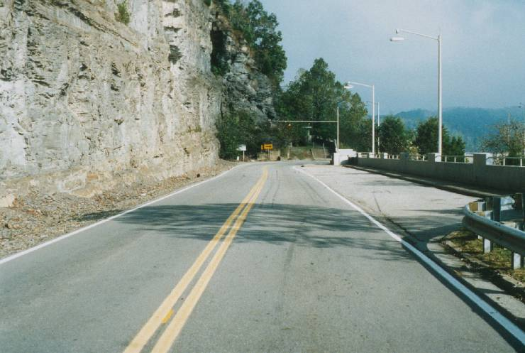
Notes:
Inadequate signing; superelevation; Pic 146, BOC #94-348,439, Amt. Paid $97,500

Slide 9
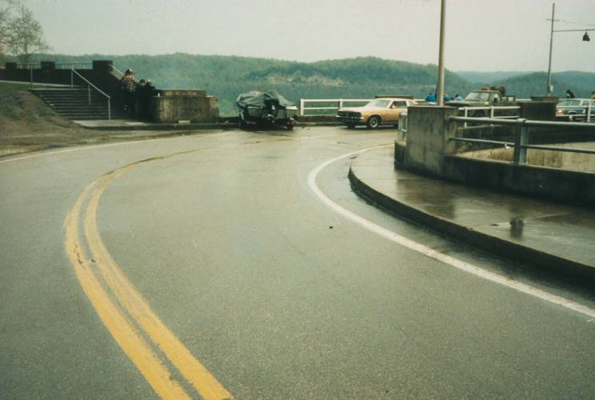
Notes:
Inadequate signing; superelevation; Pic 146, BOC #94-348,439, Amt. Paid $97,500

Slide 10
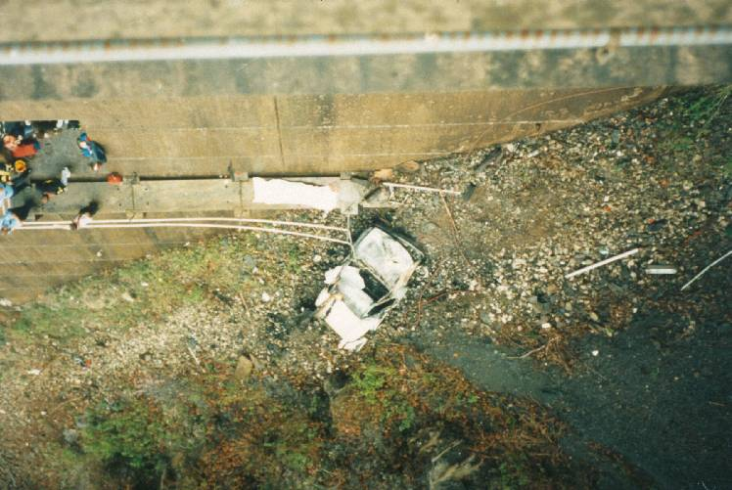
Notes:
Inadequate signing; superelevation; Pic 146, BOC #94-348,439, Amt. Paid $97,500

Slide 11
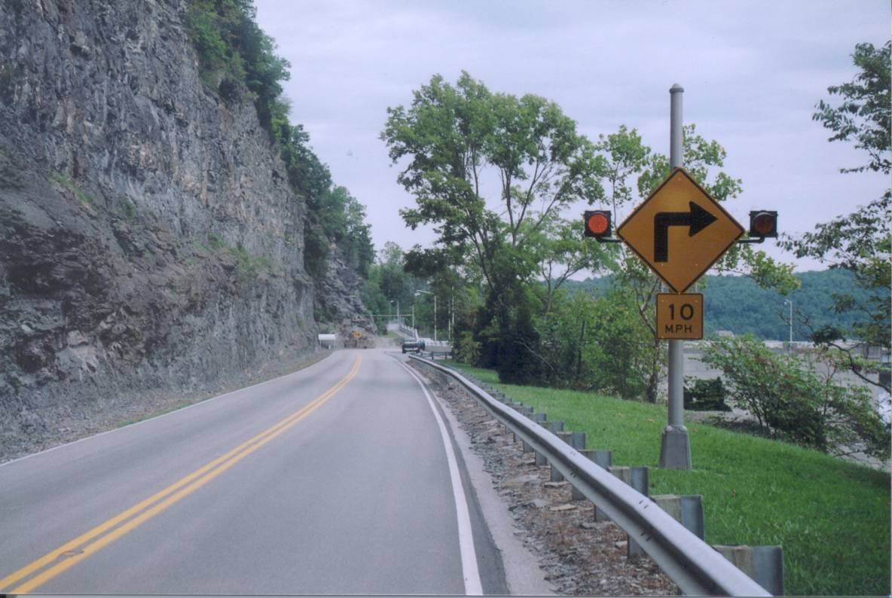
Notes:
Inadequate signing; superelevation; Pic 146, BOC #94-348,439, Amt. Paid $97,500

Slide 12
Negligence
Failure to use the same standard of care that a reasonably prudent person would

Slide 13
Standard of Care
Agency directives and policies
Directives of superior agency
Guidelines and policies of similar agencies
Guides developed by national and professional organizations
Textbooks and professional journals
Research results
Expert witnesses

Slide 14
Comparative Negligence
(Depending upon the law)
A Plaintiff who contributed to the plaintiff’s own injury can still collect weighted damages

Slide 15
Notice (Actual)
Public entity is given specific notice of a defect in the highway system

Slide 16
Notice (Constructive)
After a reasonable amount of time, the public entity should be aware of a highway defect

Slide 17
Constructive Notice
Reasonable time between occurrence of defect and when agency becomes aware of defect.
Routine inspection.
Reasonable amount of time?

Slide 18
Discretionary/Ministerial Acts
Discretionary acts require choice among valid alternatives using judgment
Ministerial acts involve clearly defined tasks not permitting exercise of discretion

Slide 19
Sovereign Immunity
Began in England where King would not allow suit against himself
No one can sue the government without its permission
Government not responsible for acts of its employees

Slide 20
Elements Necessary
For Negligence
Duty
Breach of Duty
Causal connection between negligent conduct and resulting injury
Actual damages

Slide 21
Proximate Cause
Cause that leads to the result
Probable consequences of the Negligent Act
Duty and violation of duty
Element of foreseeability
More than one proximate cause

Slide 22
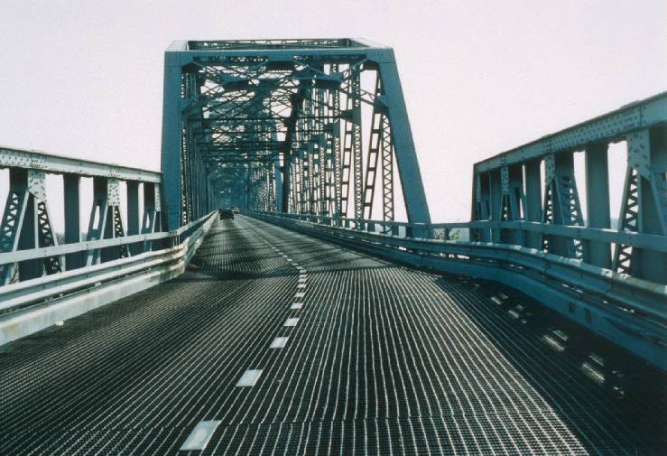
Notes:
Lack warning sign; Pic. 152, BOC # 95-703, Amt. Paid $0

Slide 23
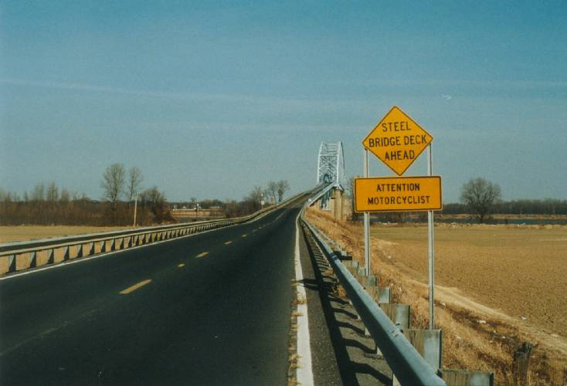
Notes:
Lack warning sign; Pic. 152, BOC # 95-703, Amt. Paid $0

Slide 24
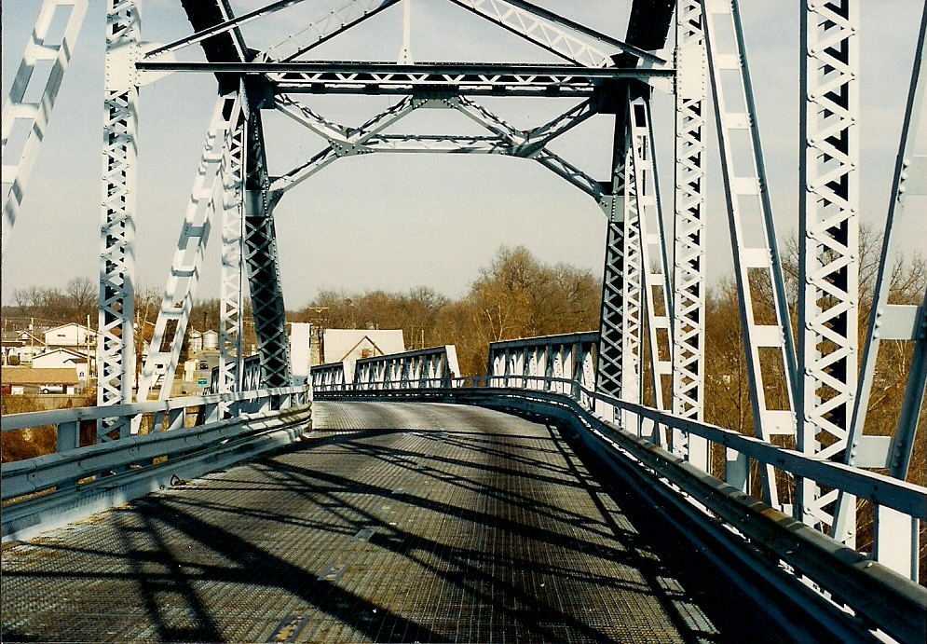
Notes:
Lack warning sign; Pic. 152, BOC # 95-703, Amt. Paid $0

Slide 25
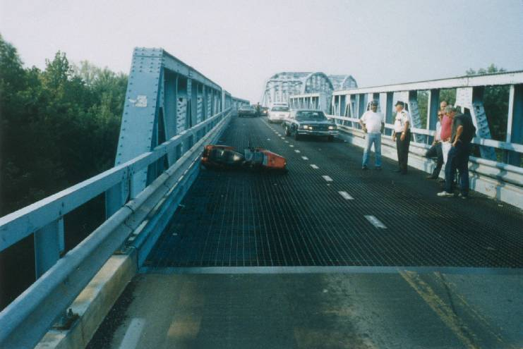
Notes:
Lack warning sign; Pic. 152, BOC # 95-703, Amt. Paid $0

Slide 26
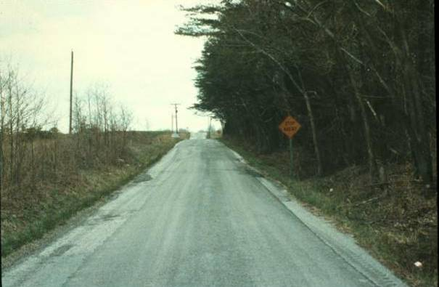
Notes:
Indiana

Slide 27
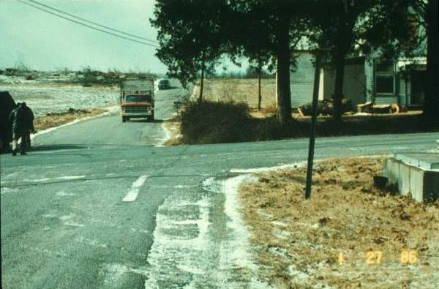

Slide 28
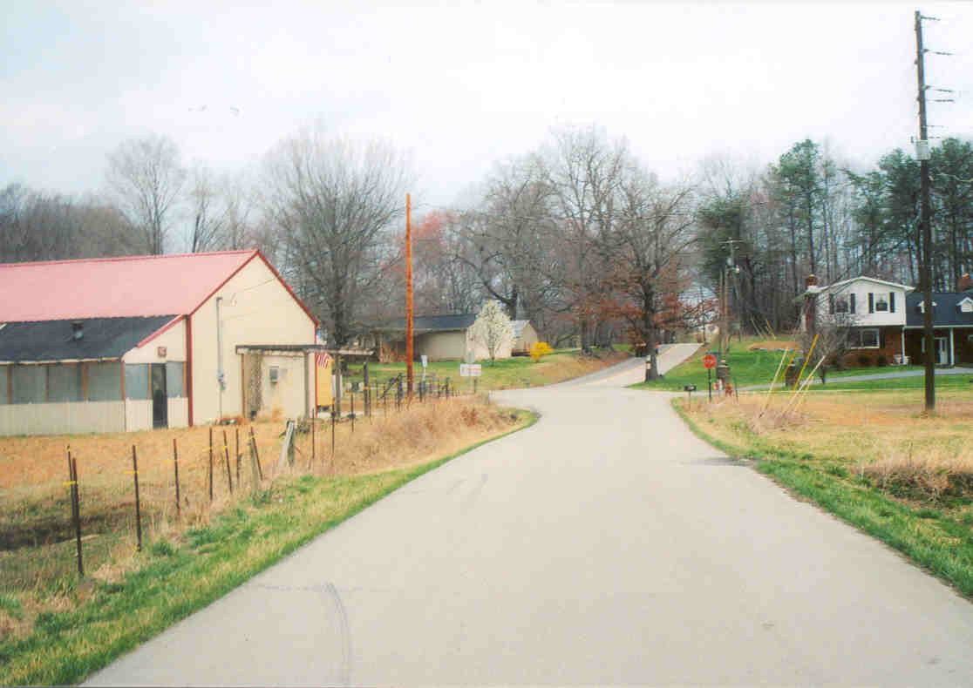
Notes:
Individual dimissed

Slide 29
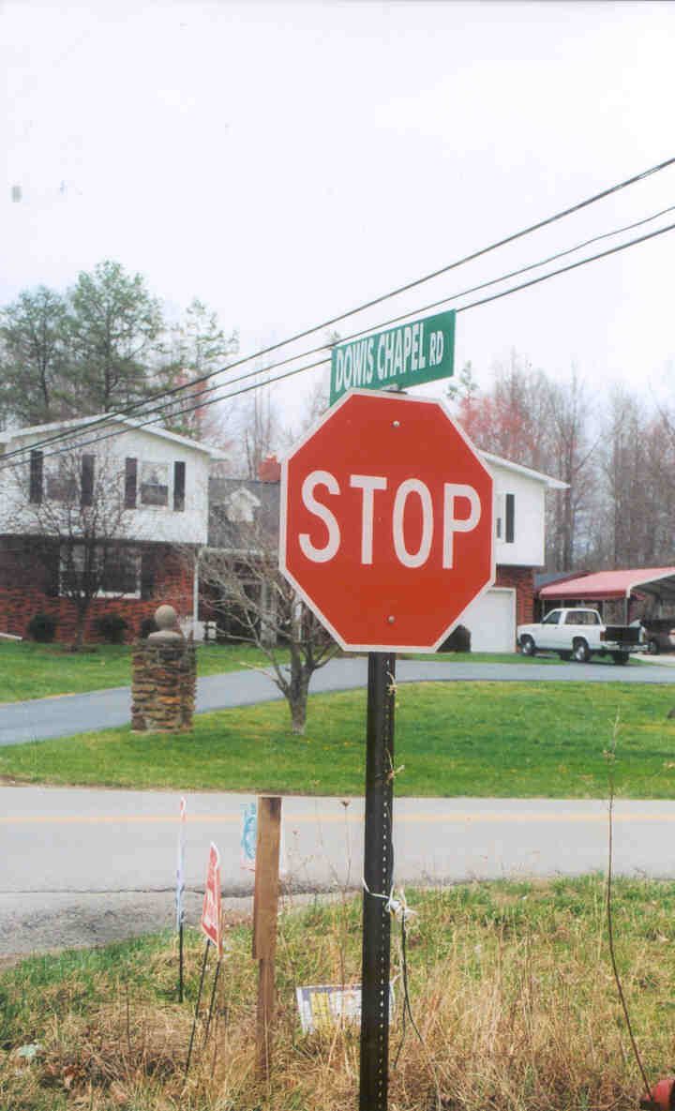

Slide 30
Summary
1981-2009
Number of claims | 15,460
Total amount claimed | $123,068,082
Percent decided | 99
Percent with payment | 49
Total payment | $16,617,604
Percent paid (decided) | 15
Notes:
Table 3-1

Slide 31
Notes:
Table 3-1

Slide 32
Notes:
Table 3-1

Slide 33
*decided claims filed in given year
Notes:
Table 3-2

Slide 34
Notes:
Table 3-7

Slide 35
Reasons for Highest Number of Claims
Notes:
Table 3-9

Slide 36
Reasons for Highest Amounts of Claims

Slide 37
Amount Claimed
$50,000 and above
$millions
Notes:
Table 4-1

Slide 38
Claim Amount Paid of $50,000 or More
Notes:
Table 4-1

Slide 39
Districts with Most Claims by Reason
$50,000 and Above
Reason | District
Traffic Control Devices | 7
Drainage | 12
Barrier | 2
Road Surface Related | 12
Shoulder Related | 7
Construction Zone-Traffic Control | 6
Geometric Feature | 1
State Vehicle Operation | 2
Maintenance Activity | 12
Construction Activity | 5
Fixed Object | 11
Notes:
Table 4-2

Slide 40
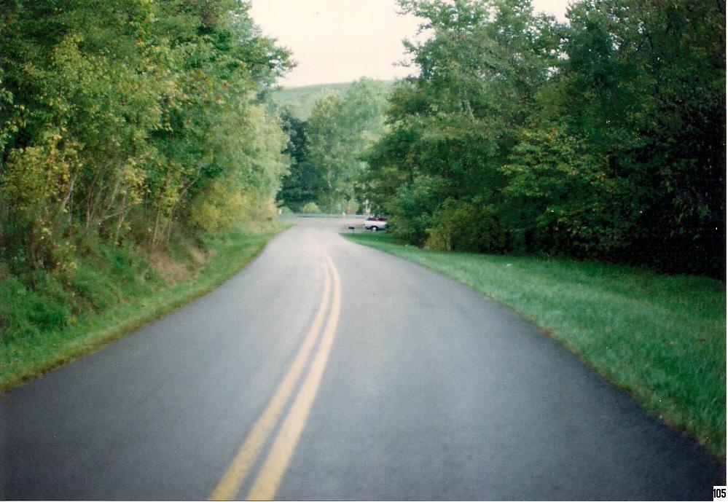
Notes:
Signing on stop approach; Pic 105; BOC #90-581, Amt. Paid $15,000

Slide 41
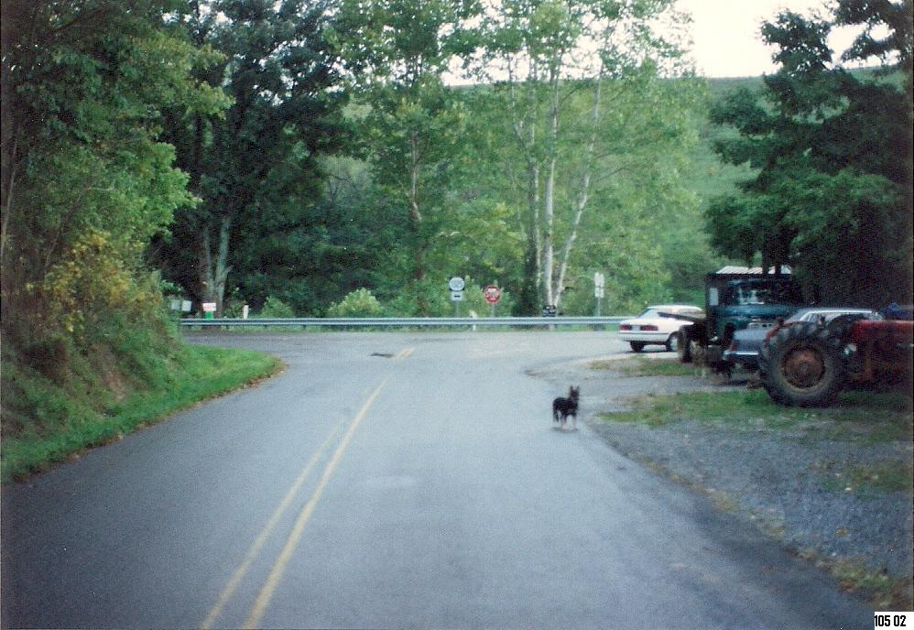
Notes:
Signing on stop approach; Pic 105; BOC #90-581, Amt. Paid $15,000

Slide 42
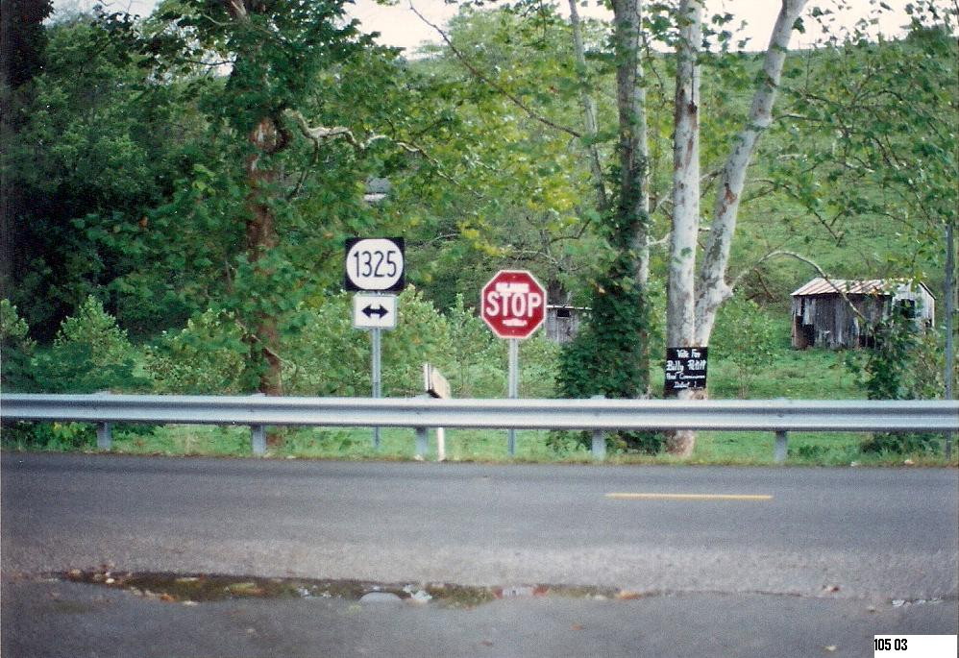
Notes:
Signing on stop approach; Pic 105; BOC #90-581, Amt. Paid $15,000

Slide 43
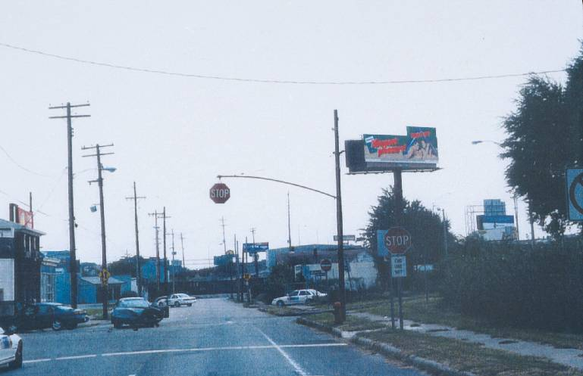
Notes:
Sight distance at intersection; Pic 211, BOC #99-969, Amt. Paid $12,500

Slide 44
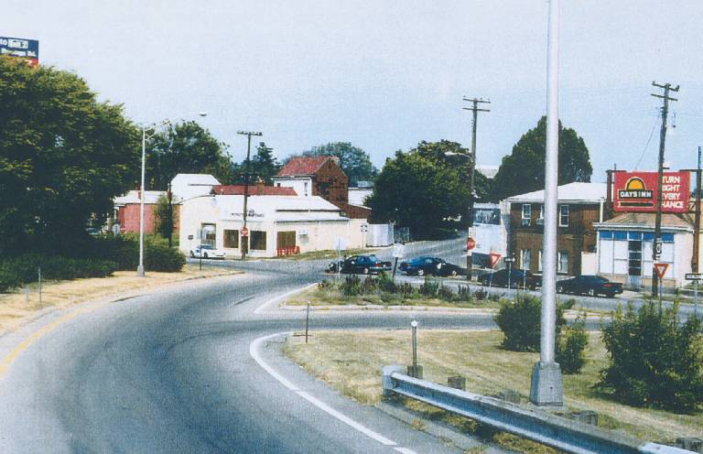
Notes:
Sight distance at intersection; Pic 211, BOC #99-969, Amt. Paid $12,500

Slide 45
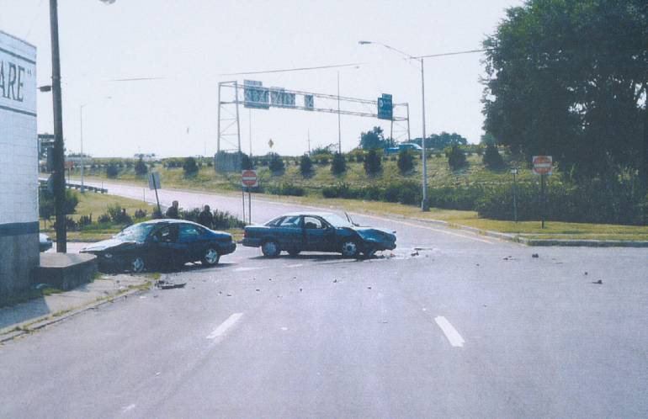
Notes:
Sight distance at intersection; Pic 211, BOC #99-969, Amt. Paid $12,500

Slide 46
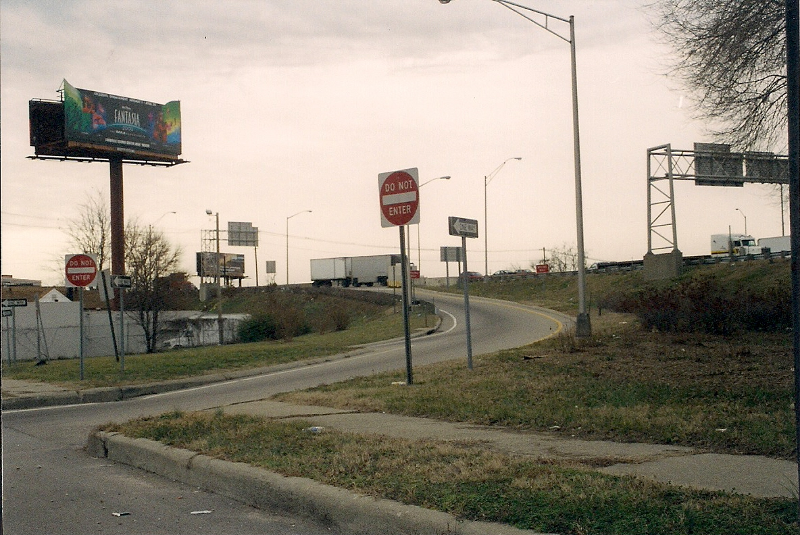
Notes:
Sight distance at intersection; Pic 211, BOC #99-969, Amt. Paid $12,500

Slide 47
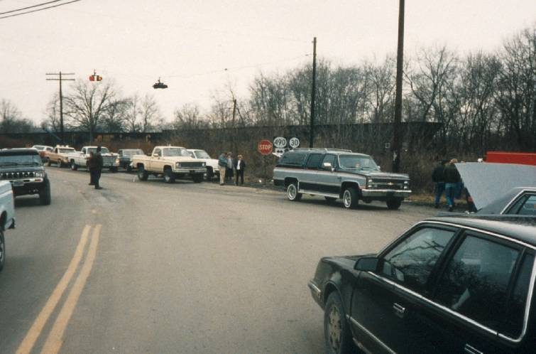
Notes:
Traffic control at intersection; Pic 39, BOC #88-1120, Amt. Paid $73,394

Slide 48
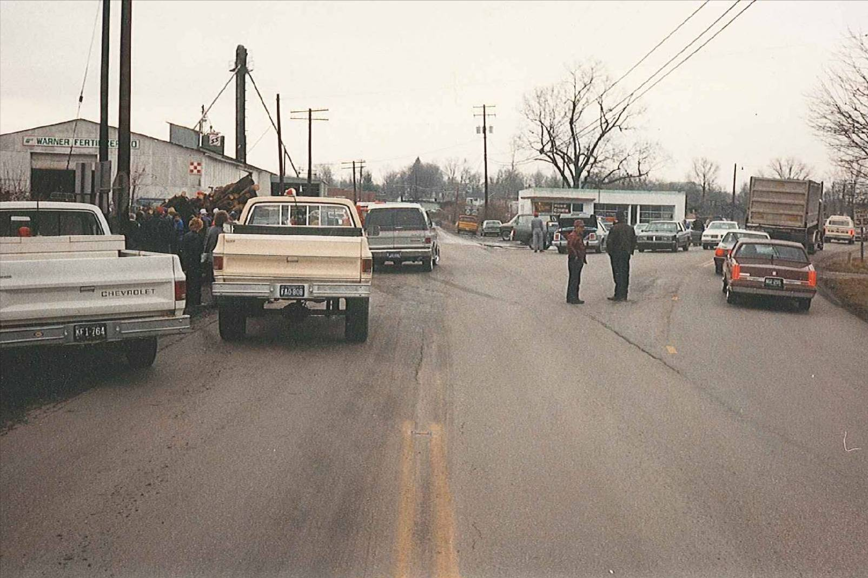
Notes:
Traffic control at intersection; Pic 39, BOC #88-1120, Amt. Paid $73,394

Slide 49
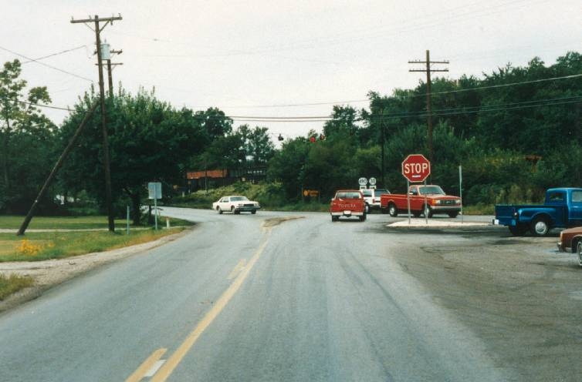
Notes:
Traffic control at intersection; Pic 39, BOC #88-1120, Amt. Paid $73,394

Slide 50
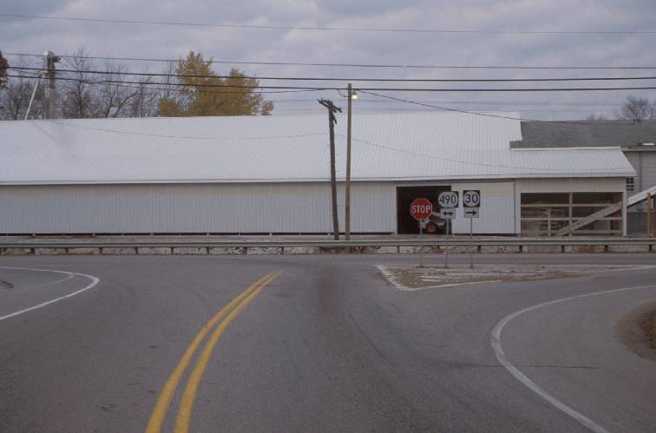
Notes:
Traffic control at intersection; Pic 39, BOC #88-1120, Amt. Paid $73,394

Slide 51
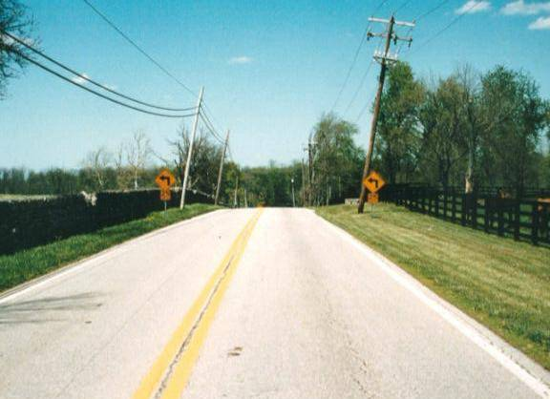
Notes:
Improper warning signs for curve; Pic 171, BOC #92-531, Amt. Paid $0

Slide 52
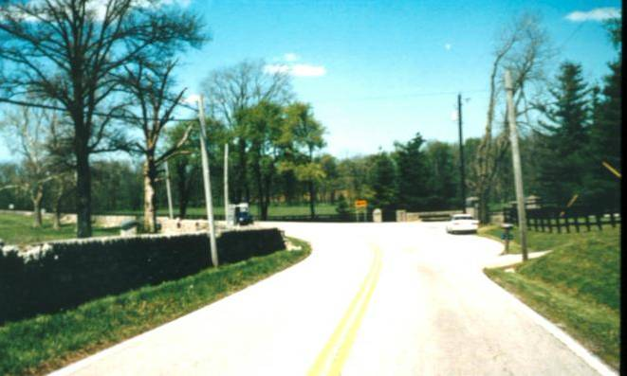
Notes:
Improper warning signs for curve; Pic 171, BOC #92-531, Amt. Paid $0

Slide 53
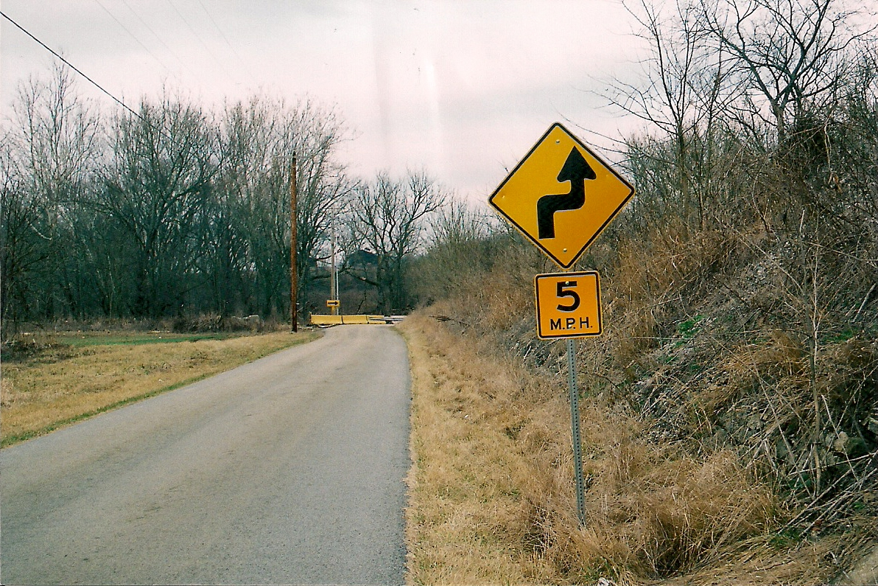
Notes:
Car ran off road into creek (no GR or signs); Pic 277, BOC #08-1195/1199

Slide 54
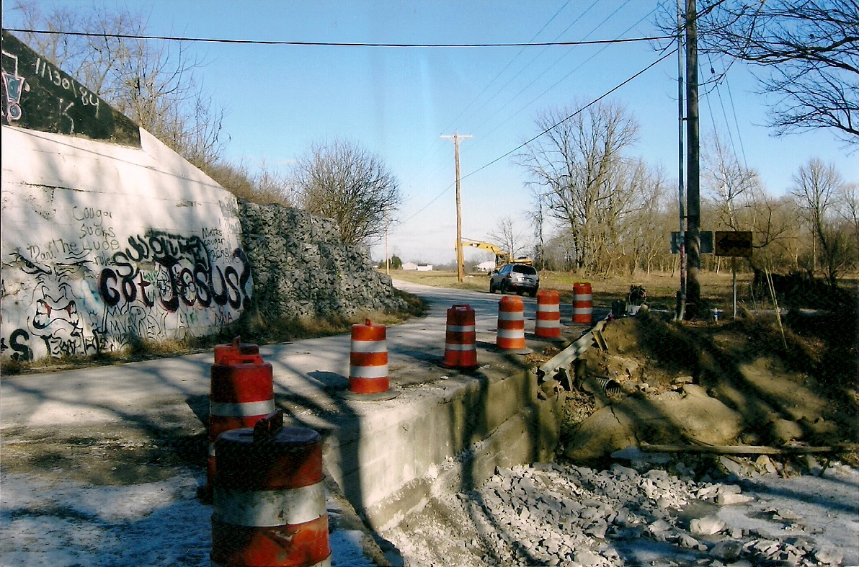
Notes:
Car ran off road into creek (no GR or signs); Pic 277, BOC #08-1195/1199

Slide 55
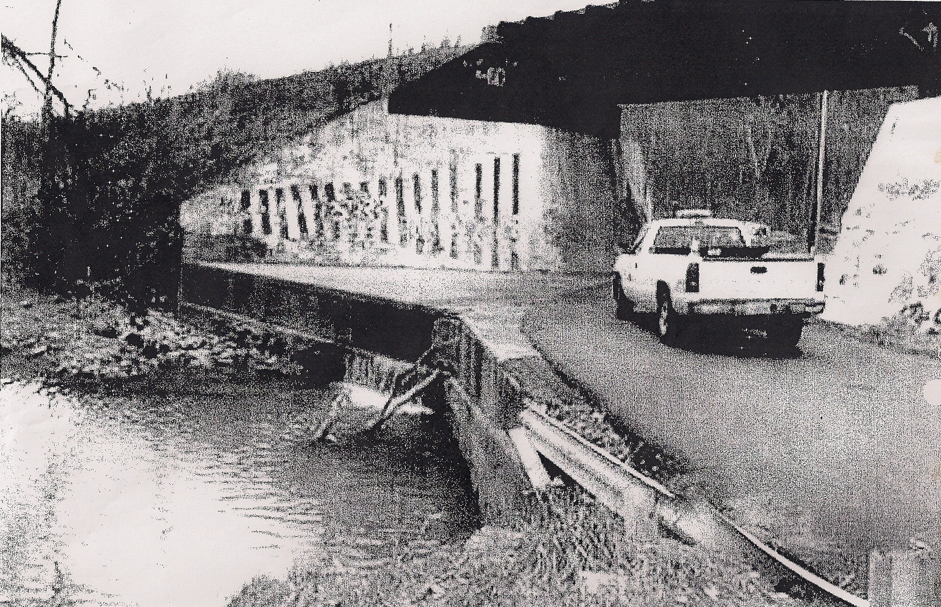
Notes:
Car ran off road into creek (no GR or signs); Pic 277, BOC #08-1195/1199

Slide 56
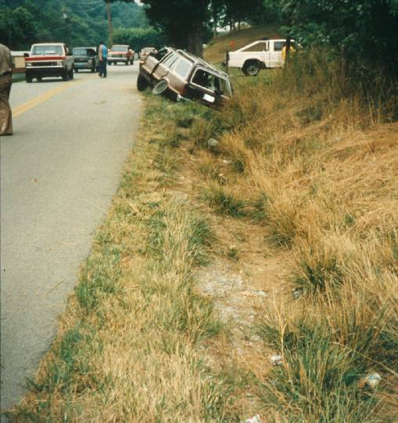
Notes:
No warning sign; no signs (police photos); Pic 156, BOC #94-594, Amt. Paid $0

Slide 57
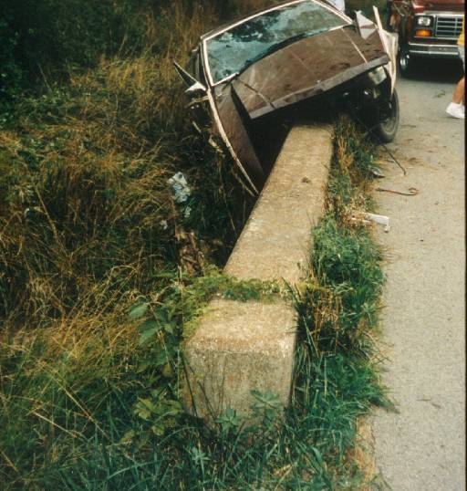
Notes:
No warning sign; no signs (police photos); Pic 156, BOC #94-594, Amt. Paid $0

Slide 58
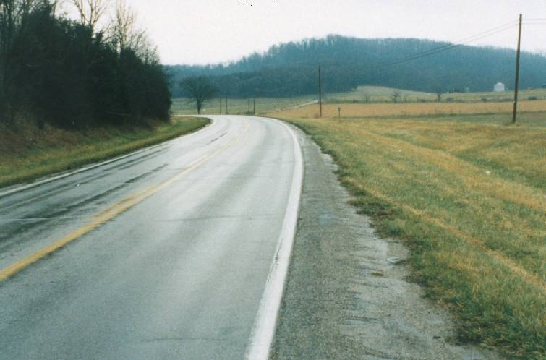
Notes:
Object marker; Pic 131, BOC #93-637, Amt. Paid $$25,000

Slide 59
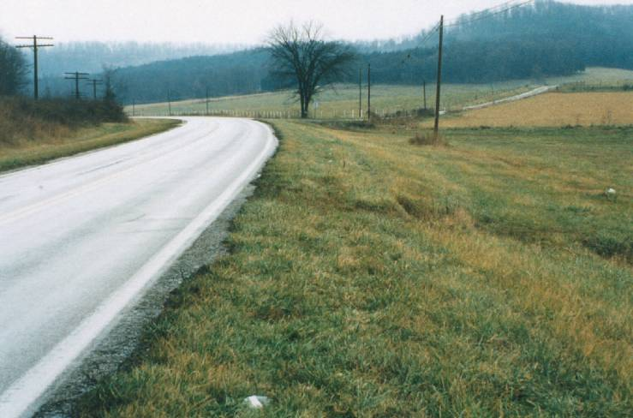
Notes:
Object marker; Pic 131, BOC #93-637, Amt. Paid $$25,000

Slide 60
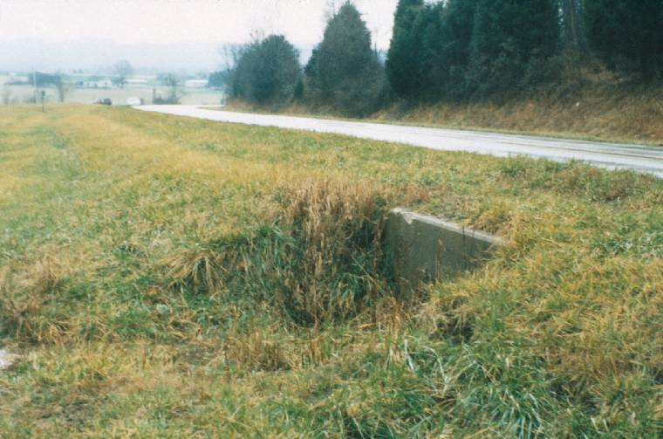
Notes:
Object marker; Pic 131, BOC #93-637, Amt. Paid $$25,000

Slide 61
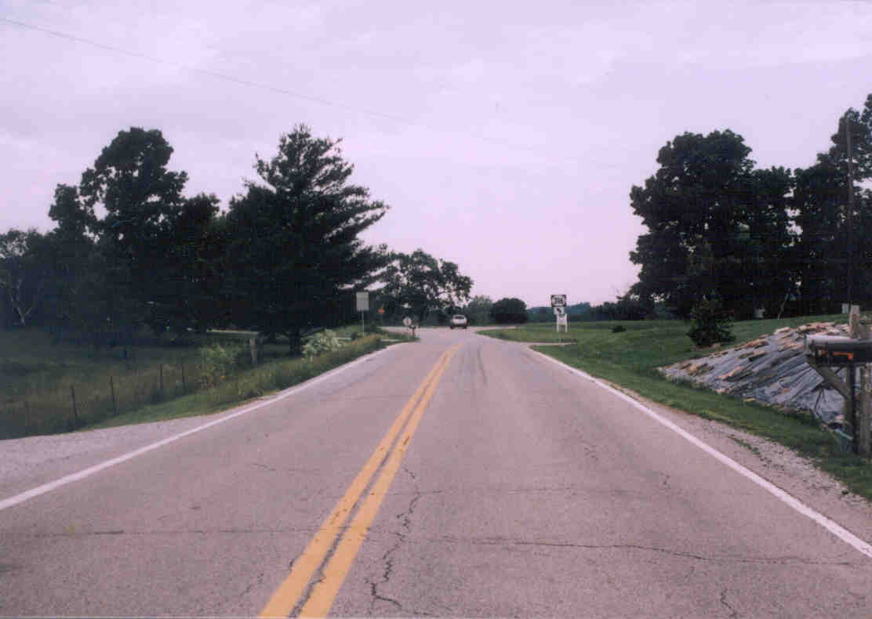
Notes:
Lack of signing; Pic 258; BOC #05-786

Slide 62
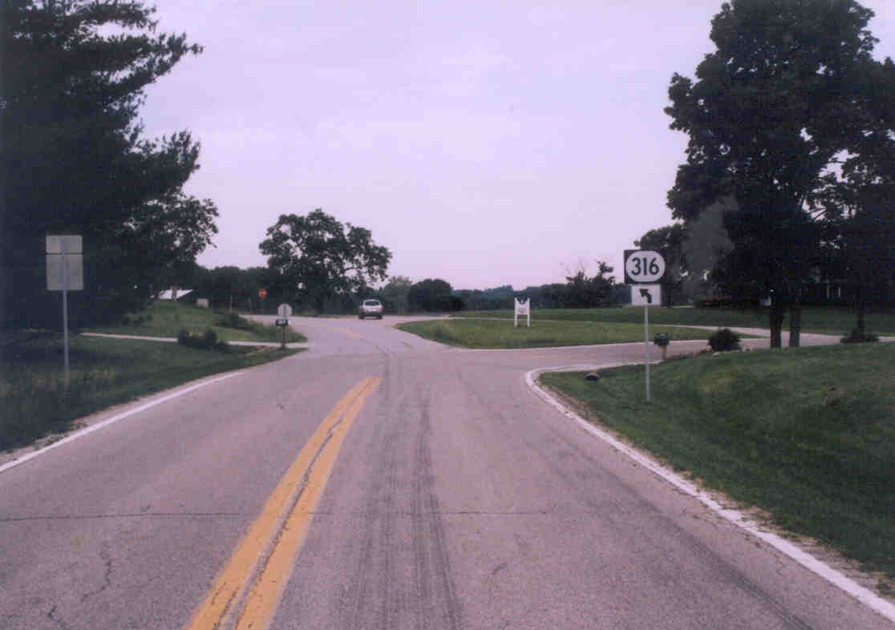
Notes:
Lack of signing; Pic 258; BOC #05-786

Slide 63
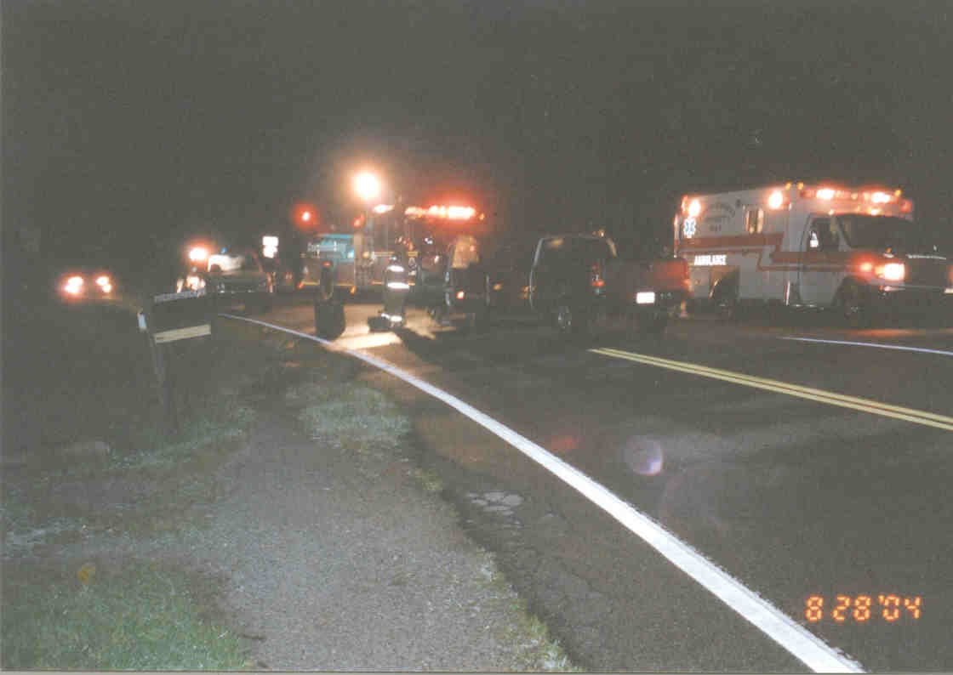
Notes:
Lack of signing; Pic 258; BOC #05-786

Slide 64
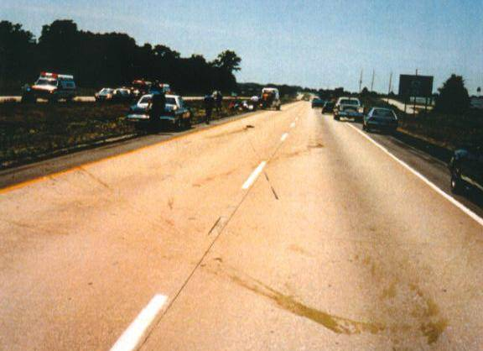
Notes:
Sign (deer); Pic 142, BOC #93-479, Amt. Paid $0

Slide 65
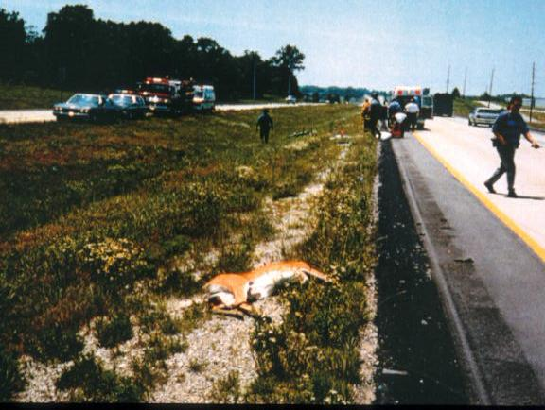
Notes:
Sign (deer); Pic 142, BOC #93-479, Amt. Paid $0

Slide 66
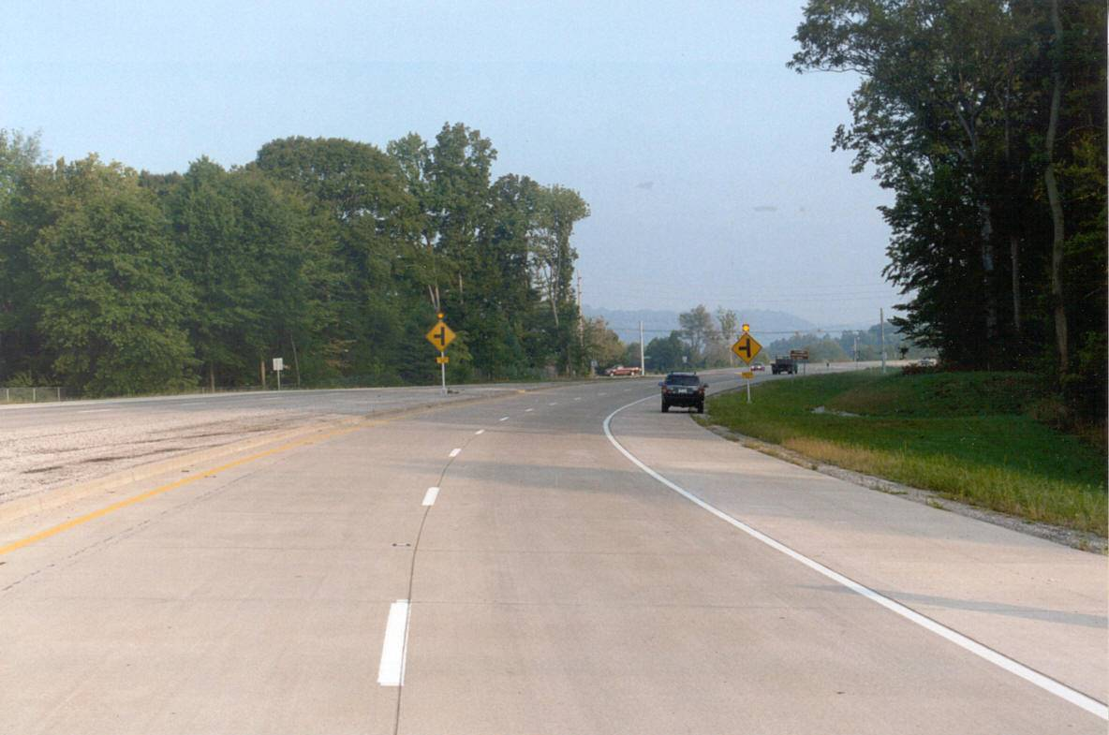
Notes:
Sign placement; Pic 229, BOC #02-373; Amt. Paid $0

Slide 67
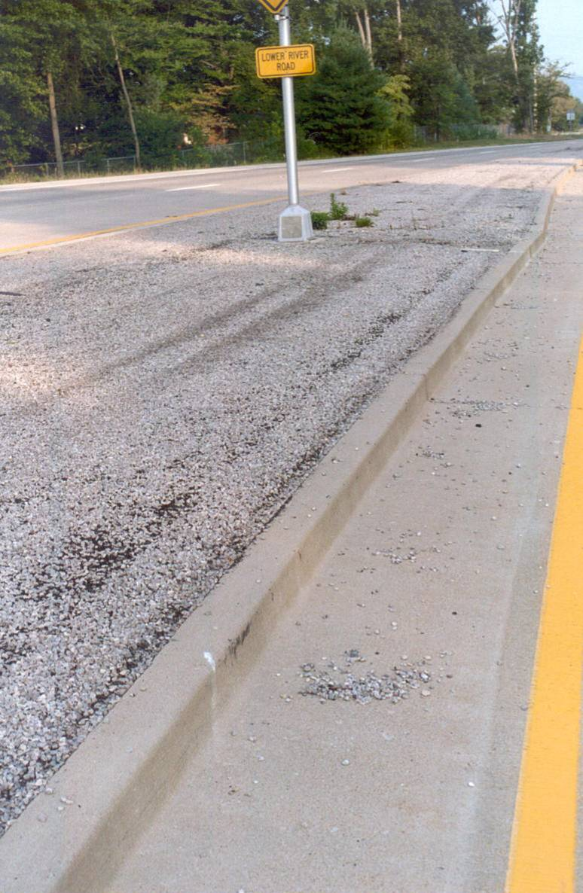
Notes:
Sign placement; Pic 229, BOC #02-373; Amt. Paid $0

Slide 68
Kenneth R. Agent, P.E.
Transportation Research Engineer
Kentucky Transportation Center
University of Kentucky
176 Raymond Building
Lexington, KY 40506
(859) 257-4507
ken.agent@uky.edu

