Slide 1
System Operations Miscellaneous topics
Traffic Engineer’s Meeting
November 29, 2012
Joe Thompson
502-564-3020
Joe.thompson@ky.gov

Slide 2
Current Staff
Timing Engineers - Telma Lightfoot, Joe Carter, Amanda Bilberry
ITS - Tina Swansegar
Communications - Glenn Anderson, Joe Thompson
Electronic Shop – Danny Goebel, Mike Pearce, Ryan Miller, Ric Nooner (part-time)

Slide 3
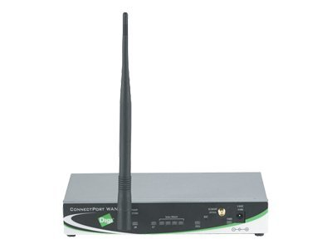
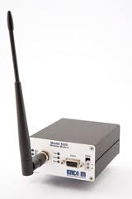
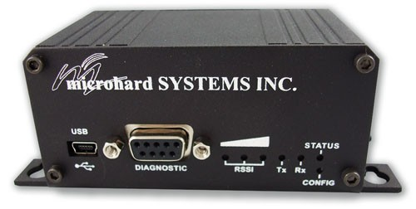
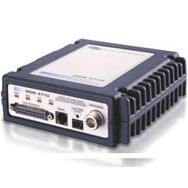
Communications
MDS and Encom radios vs. IP radios
Hope to install more routers, especially in trouble areas, which will improve reliability
Running 2 maintenance crews and getting 90+% communications reliability
Notes:
As Glenn mentioned, we are transitioning to IP radios because of their versatility.
Currently we have around 300 installed.
In an effort to improve reliability, we hope to install more routers, IF THEY ARE AVAILABLE, in areas where signals are on the edge of reliable communications.
We still need to try to optimize the use of routers and avoid installing routers that will only communicate with 1 or 2 signals.
We have 2 maintenance crews working now and are getting 90+% communications reliability.

Slide 4
Timing differences
On 11-25-2012 we communicated with 772 signals. (MDS & Encom Serial Radios only)
492 (63.7%) had 0 timing differences
280 (36.3%) had 1 or more timing differences
Minimum # of differences – 1
Maximum # of differences – 126
Syscan Report – Sent out 3 times each day, shows # of differences (also have one for IP radios)
Timescan Report – Shows specific timing differences per table in the controller, runs twice a week
Notes:
- On 11-25-12 we communicated with 772 signals. This only includes serial radios, MDS and Encom.
- 492 (63.7%) had no timing differences.
280 (36.3%) had at least 1 timing difference.
- The minimum number of differences was 1.
The maximum number of differences was 126.
The Syscan report is sent out 3 times each day. It shows the signals that have been out for extended periods of time (the AWOL list) and also lists all of the signals that have timing differences.
At the top of the Syscan report is a link to the Timescan report. This report runs twice a week and shows all of the specific differences per table.
These are good tools that I encourage you to use to keep up with timing.

Slide 5
red signal monitoring
Monitoring red signals is critical to the safety of an intersection
Is an issue that has been talked about for several years
Still a lot of cabinets out there without the cable attached
Notes:
We have talked about monitoring red signals for several years.
We highly recommend you monitor red signals using the cable monitoring cable in each cabinet.

Slide 6
Timing consultants
Currently working in some districts
Questions – call or email Telma Lightfoot
Notes:
Telma wanted me to let you know she currently has some consultants working on signal timing in some districts.
If you have any questions about what they are doing please contact Telma.

Slide 7
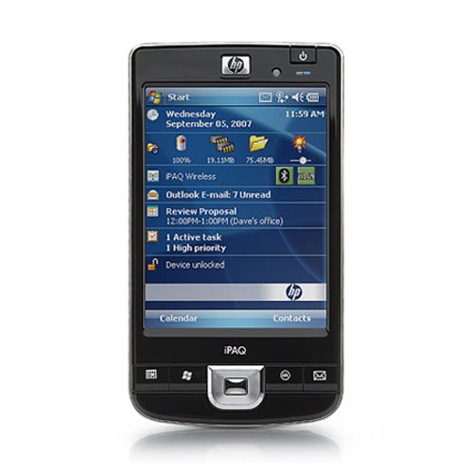
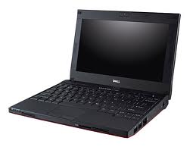
netbooks
The last one has been given out
Will have to go through OIT or COT to order one at this point
We no longer support the PDA’s
Notes:
The last netbook has been given out and, as far as we know, they haven’t reordered.
If you want one, you will need to go through the IT request process.
As you know, we have not been supporting the PDA’s for a while now, so if you will have to have a Netbook or Laptop to work on signals.

Slide 8
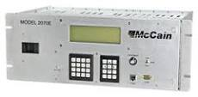

controllers
Have looked at a few different 2070 controllers
Will look to use them at more complex intersections
Will also require a new version of Wapiti firmware
Notes:
We have had a few manufacturer’s come by and demonstrate 2070 controllers.
While we like the simplicity and ease of using the 170, they are becoming outdated.
It is getting harder and harder to find parts and there are situations where we could use something more powerful.
When we do begin using them I envision them being installed at complex signals, at least in the beginning.
The 2070 will also require a newer version of Wapiti firmware and all new user licenses, which is being worked on now.

Slide 9
Guidance manual
Currently working on chapter 6 of the TOGM
Hope to have a draft copy by the end of the year

Slide 10


Training classes
The Transportation Center (KTC) has developed a Traffic Signal Technician training course that should be ready in the Spring
Series of modules to provide basic information, particularly for newer employees
Working on a Signal Timing class (will be a least a year)
Notes:
The KYTC has developed a training class that covers a lot of the information that IMSA goes over in their training.
It is on-line training and consists of a series of modules with information on numerous topics such as Personal Protective Equipment, necessary tools and equipment, and traffic control, and goes as far as providing information on signal phasing, controller cabinets, and basic troubleshooting.
This is the first course developed and further classes are in the works, such as a Signal Timing Class.
Along with the class they have developed a small Reference Manual that can be a handy field tool.

Slide 11
Adaptive signals
Tried Rhythm InSync on a couple of corridors in Lexington
  Winchester Rd. and Nicholasville Rd.
Did not perform as expected
  Lots of reprogramming and tweaking
  Had to take it out of the system at times
  No better than a well-timed signal system
KTC plans to do a formal evaluation to see how the system works after full implementation and optimal configuration
Very expensive
Notes:
Tried on a couple of corridors in Lexington
Winchester Rd. and Nicholasville Rd.
Did not perform as expected
Lots of reprogramming and tweaking
Had to take it out of the system at times
No better than a well-timed signal system
KTC plans to do a formal evaluation to see how the system works after full implementation and optimal configuration
Very expensive

