Slide 1
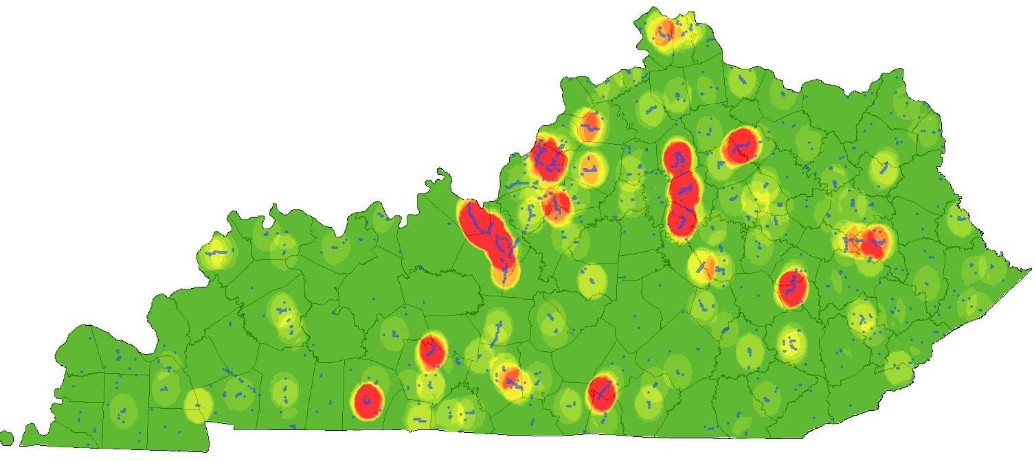

gINT KYTC Guidance Class
Clayton Cook
Kytc TCOB Building Room 404, September 30th, 2016

Slide 2
Updates to gINT
New version of gINT database structure to help with automated drafting and correct some errors
New Database Structure (.gpj file)
New Library File (kytc library version 5.0.glb file)
More specific training on gINT Input
KYTC Geotechnical Resources
http://transportation.ky.gov/Structural-Design/Pages/Geotech-Shared-Resources.aspx
Online Class Files on KYTC Geotechnical Website
KYTC Geotechnical gINT Guidance Manual

Slide 3
Class Overview
Don’t have time to go in detail gINT entry specifics so,
Important aspects of gINT
New Outputs
Reviewing common problems with input and general guidance
Common Problems Broken Into:
General
Drilling Input
Geology Input
Laboratory Input

Slide 4
gINT Software
KYTC gINT Development
Started Using gINT in 2007
Developed KYTC Specific Database Structure and Coding with the Help of Kentucky Geological Survey
≈ 18,500 holes currently in gINT database

Slide 5
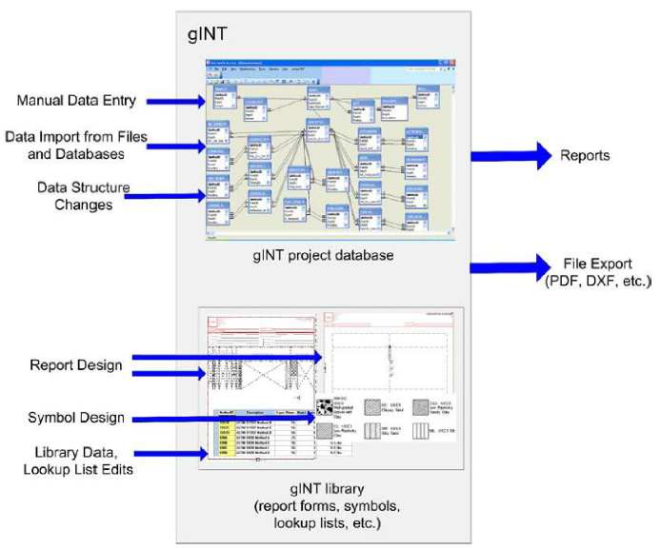
gINT Software
Types of Files
Project Database file (.gpj)
Library File (.glb)
Data Template File (.gdt)
Correspondence File (.gci)

Slide 6
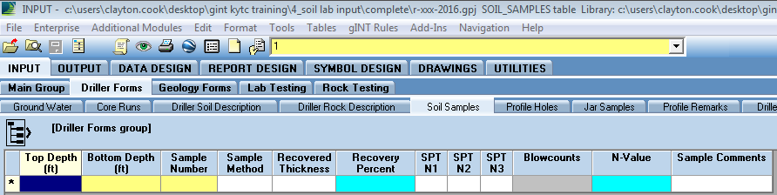
gINT Software
Interface and Coloring
Current Selected Hole
Tabs
Dark Blue:
Selected Cell
Yellow:
Must Be Entered Before Save
Light Blue:
Can Be Auto Filled on Save
Grey:
Non-Selectable and Auto-Fills

Slide 7
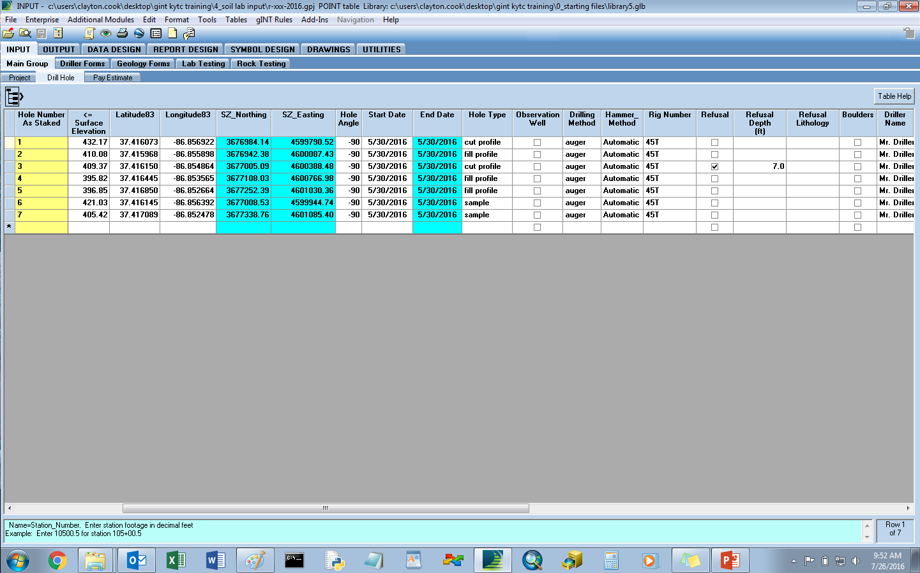
gINT Software
Current Project, Table, and Library

Slide 8

gINT Software
Where to Find Help?
Table Help in gINT or Text box at bottom of gINT screen
KYTC Geotechnical Resources
http://transportation.ky.gov/Structural-Design/Pages/Geotech-Shared-Resources.aspx
Bentley gINT Wiki ( http://communities.bentley.com/products/geotechnical1/w/wiki/ )

Slide 9
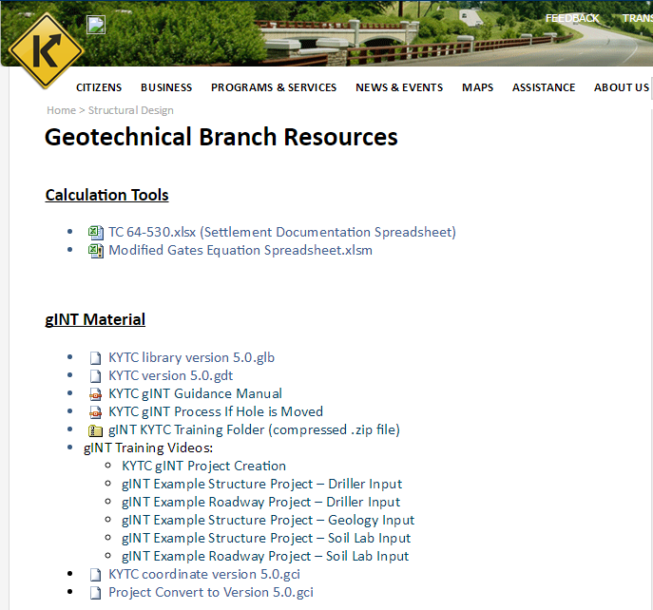
KYTC Geotechnical Resources
http://transportation.ky.gov/Structural-Design/Pages/Geotech-Shared-Resources.aspx

Slide 10
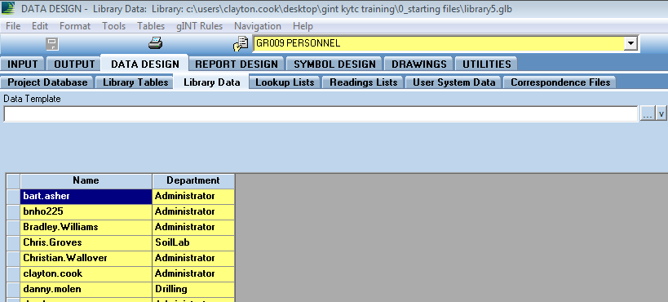

gINT Software
Who Can Update Which Tables?
Department
Levels
Computer Name
Set Access

Slide 11
gINT Software
gINT Rules
Rules within library file (.glb) that help with and control data entry
  Lots of these controls happen at save, Ex: Automated filling in of SZ_Northing and SZ_Easting values from Latitude83 and Longitude83 field values
  Important to save regularly
  If Error Occurs, use Restore Button to Go Back to Before Error

Slide 12
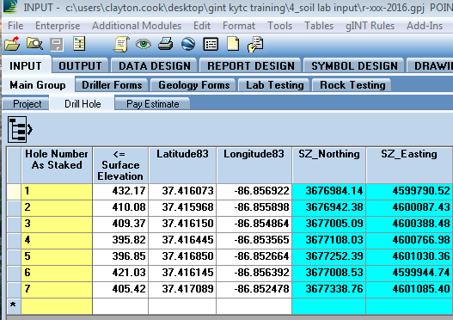
Coordinate Update
Update: Boring location Information
Kentucky Single Zone fields were added to the Point table and will be calculated from the Latitude and Longitude Values upon save
Input Lat. and Long. Values
When Saved, Northing and Easting will be calculated

Slide 13
Old Project Updates
Update: Boring location Information
Since boring locations were updated and new field added to the database structure, to use the new library and drafting updates will have to update old projects to new format using a .gci file
Can Find File for Update on KYTC Geotechnical Resources Page (http://transportation.ky.gov/Structural-Design/Pages/Geotech-Shared-Resources.aspx )
Project Convert to Version 5.0.gci
KYTC Will update Old Projects, Contact Me if want to update projects
Clayton.Cook@ky.gov

Slide 14
Future Updates
All People who attended the gINT class will be notified of future gINT updates by e-mail

Slide 15
Fence Output Update
Update: Fence Diagram Output

Slide 16
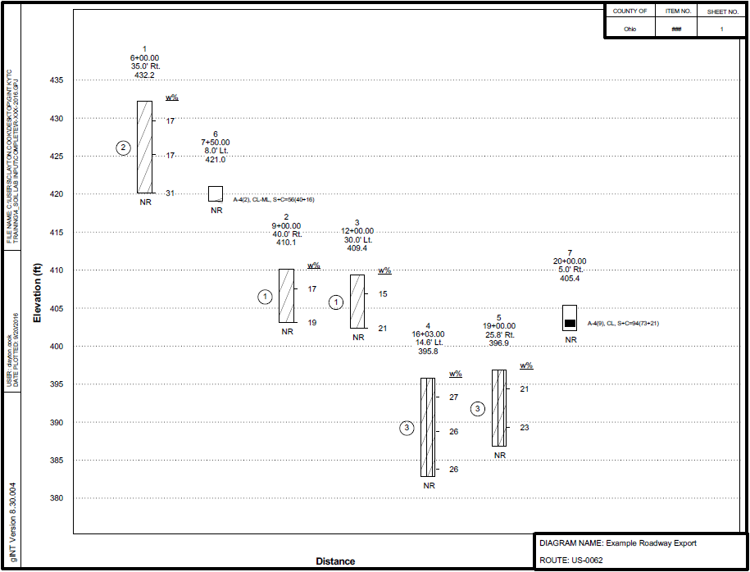

Slide 17
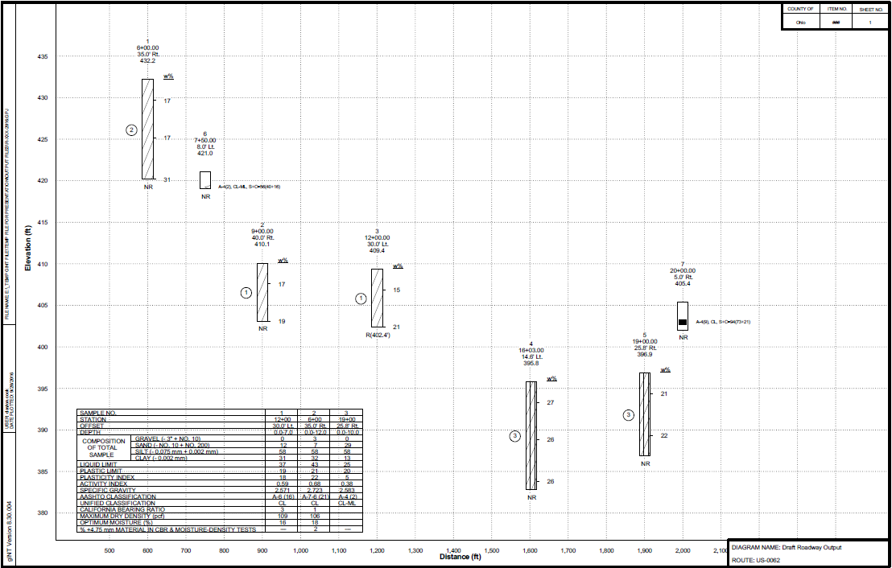

Slide 18
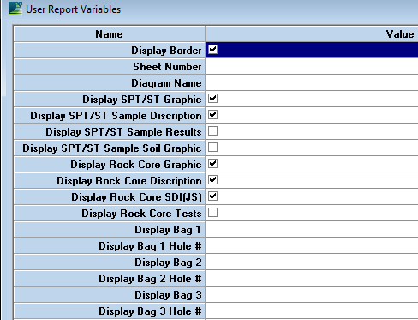

Slide 19
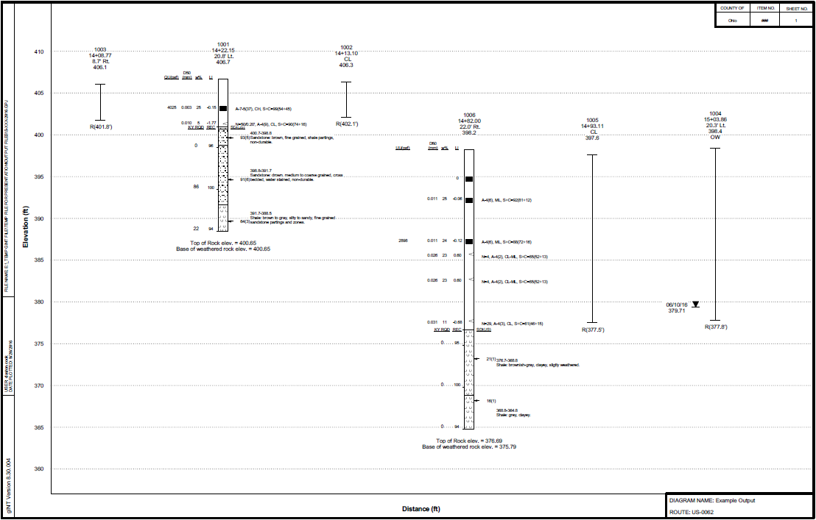

Slide 20
Fence Output Update
Update: Fence Diagram Output
Demo New Fence Output

Slide 21
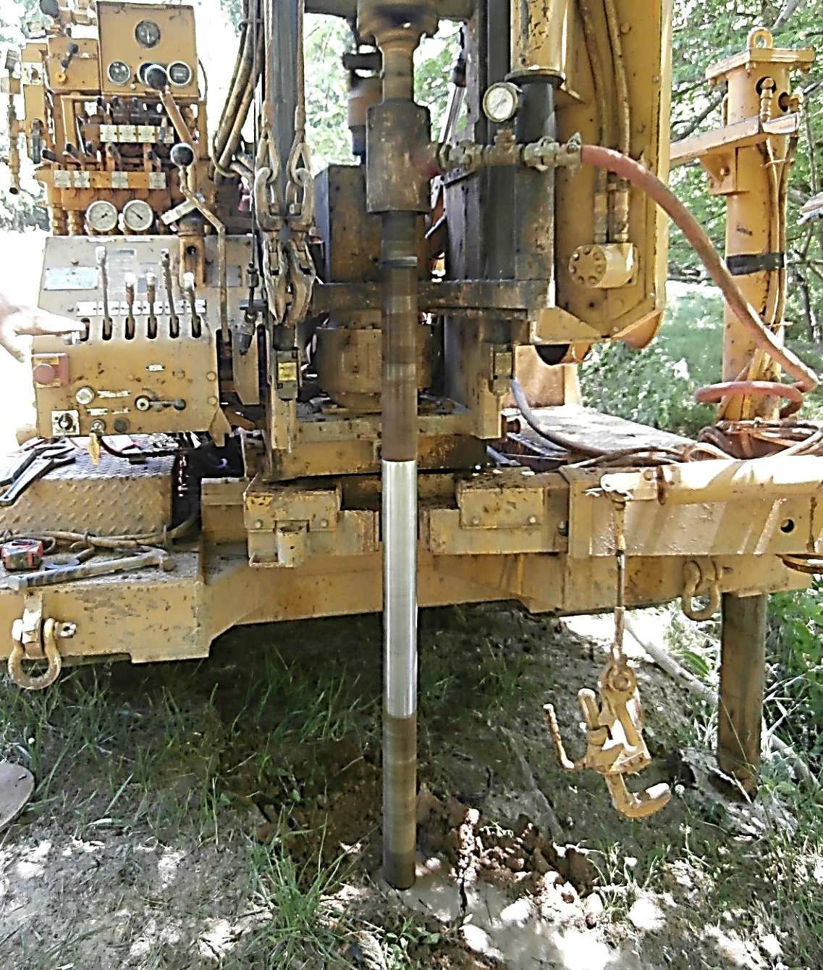
Driller
Section

Slide 22
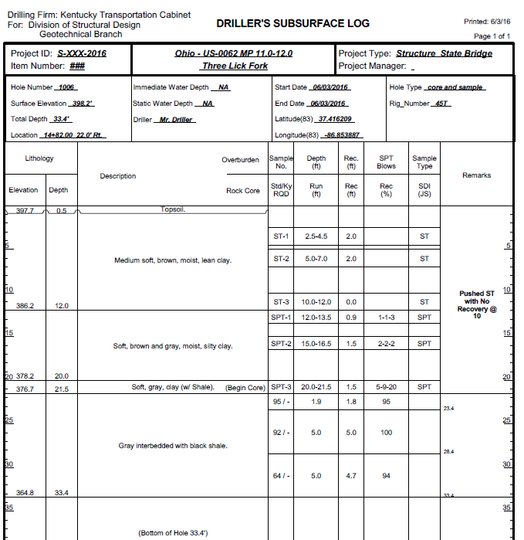
Drillers
Log Overview
Which Table Data is
From
Drill Hole
Ground Water
Driller Soil Description
Driller’s Remarks
Driller Comments

Slide 23
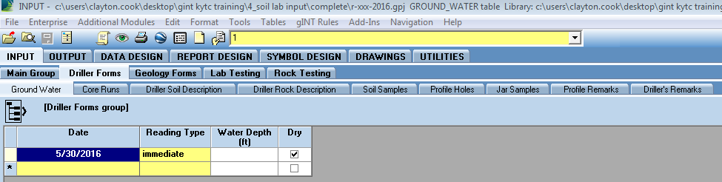
Drillers
gINT Entry best practice is to move from Left to Right in Tabs and Fields one hole at a time
Save Regularly

Slide 24
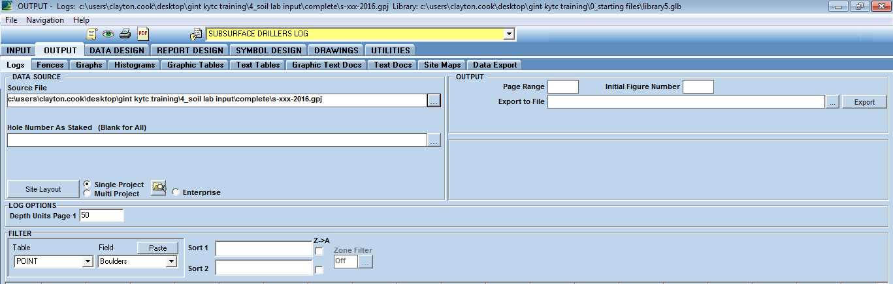
Drillers
Update: Drillers Logs Can Use Just the Subsurface Drillers Log Output

Slide 25
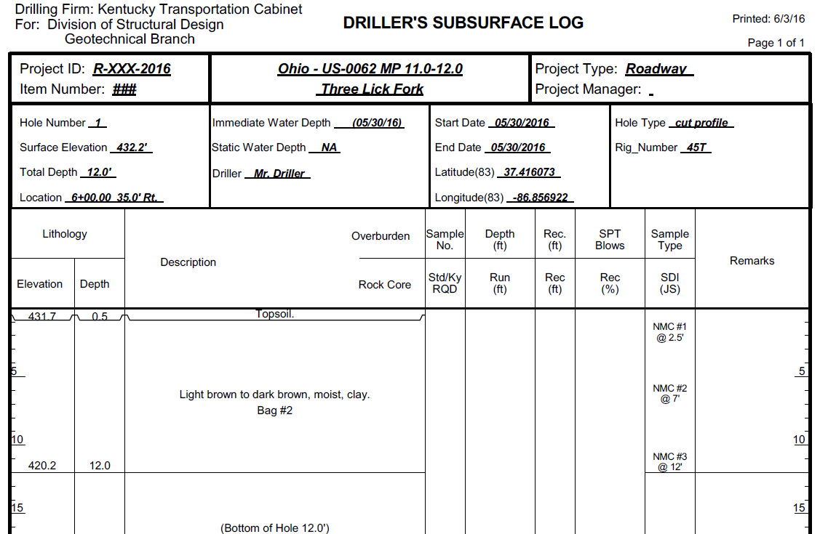
Drillers
Update: Drillers Logs Can Use Just the Subsurface Drillers Log Output
Bag Numbers and NMC were added so that separate logs do not need to be generated for profile and other hole types

Slide 26
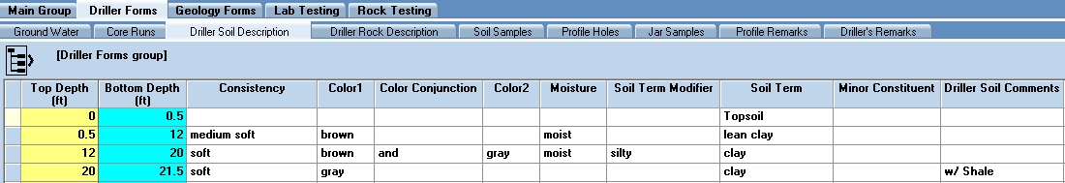
Drillers
Update: Drillers Logs Can Use Just the Subsurface Drillers Log Output
Soil Descriptions built using the Soil Term Builder Fields will show up with Bag Numbers and NMC’s, so use Soil Term Building fields to help with typo’s

Slide 27
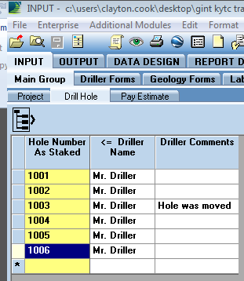
Drillers
Fields for Drillers Comment Entry
Driller Comments
Any Information entered here about the hole will appear at the bottom of the driller’s log report.
This field should include any information specific on if the hole was moved and reason for moving and any hole that is not drilled or deleted and the reason as specific in GT-303-1 in the KYTC Geotechnical Manual.
Additionally, this field should include Profile Remarks for profile borings to describe points of interest (such as locations and magnitudes of sinkholes, ponds, creeks, wet areas, springs, wells, talus deposits, existing landslides, limits of wooded areas, crop intervals, etc.) with the point of interest station, feature description, and offset direction from centerline.

Slide 28
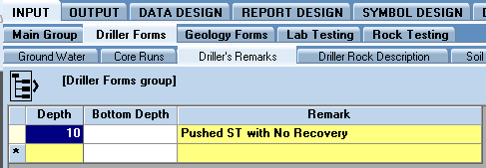
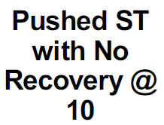
Drillers
Fields for Drillers Comment Entry
Driller’s Remarks
Enter in a remark that will display in the Remarks section on the right hand side of the Driller’s Subsurface Log. These comments need to include a depth value that the comment is relevant and will display at that depth.
Include any information that involves samples, cores, or general notes that involve depth values.
How Comment is Displayed in Drillers Subsurface Log:

Slide 29
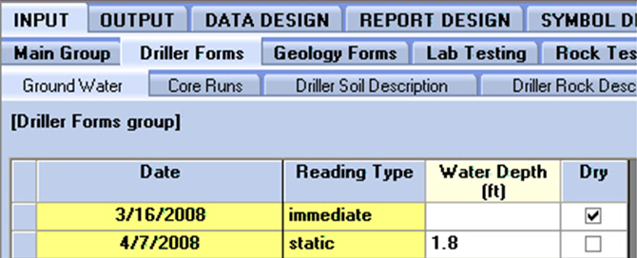
Drillers
Ground Water Table Input
For each date, enter the water depth in the hole (in feet) and whether it is an immediate or static reading. If more than one static reading is taken, the most recent is used on log reports. If the hole is dry, check the Dry field and leave the Water Depth blank. Holes with groundwater readings should have the Observation Well box checked in the Drill Hole table.
This allows for the Data to be displayed at the top of the Drillers Subsurface Log.
How Comment is Displayed on Drillers Subsurface Log:

Slide 30
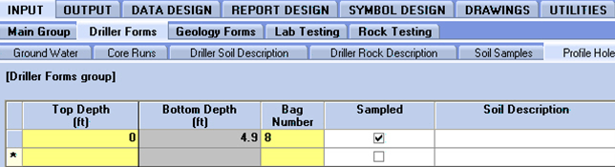
Drillers
Profile Holes Entry
To add a profile hole, enter the top depth of each soil horizon and its bag (soil) number. If a bag sample was taken from the interval, check the “sampled” box and enter the bag number. If an interval was not sampled, enter the bag number from a previous hole with the same soil type, but don’t check the “sampled” box.

Slide 31
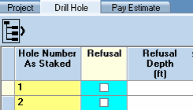
Drillers
Update: Refusal Entry and Check Box in Drill Hole Table
When a refusal depth is entered, upon save, the refusal check box will be checked

Slide 32
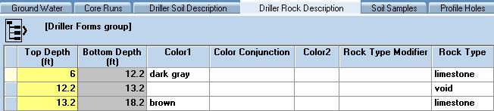
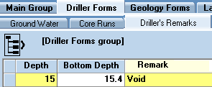
Drillers
Voids Recording In Driller Rock Description
More than a foot void put in as Rock Type
Less than a foot void put in Drillers Remarks with appropriate depth values

Slide 33
Drillers
Hole Accuracy Drop Down Menu
Have Appropriate Hole Accuracy
HiResGPS (< .5 ft), Transit (.5 ft), Handlevel (.5 – 4 ft), Topo (> 4ft)
HiResGPS (< 1 ft), Tape Measure (1 – 15 ft), Handheld GPS (15-30 ft), Topo (>30 ft)
Vertical Accuracy
Horizontal Accuracy

Slide 34
Drillers
Hole Being Moved gINT Procedure
The current guideline is if the hole is moved less than five feet then resurveying of station, offset, and elevation by the drill crew can be done, without requirement of new latitude and longitude coordinates done by a surveying crew. If a hole is moved more than five feet then resurveying of new station, offset, elevation, longitude, and latitude should be acquired. Given this guideline, site specific information can be a reason for not following the more or less than five foot guidance.

Slide 35

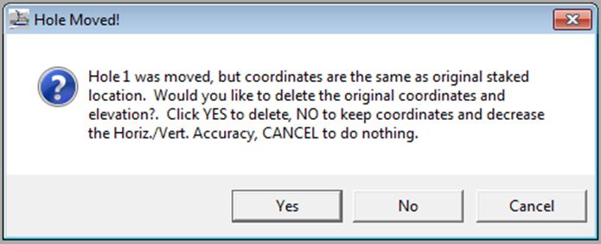
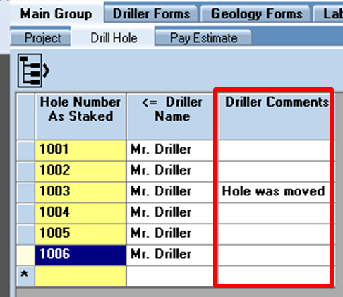
Drillers
Hole Being Moved gINT Procedure
Less than five feet (point not GPS resurveyed)
Hole Moved Check Box should be checked
New Station, Offset, and elevation should be measured in the field and input into the Station Footage, Offset, and Surface Elevation fields (overwriting the original values)
The Horizontal Accuracy field should be reduced to Tape Measure and Vertical Accuracy should be reduced to Transit. This can be done with the pop-up menu when project is saved after Hole Moved box is checked by clicking “No” in pop-up menu.
Comment should be made in the Driller Comments field that states the hole was moved and why that holes was moved so that that information is printed on the bottom of the Driller’s Subsurface Log.

Slide 36
Drillers
Hole Being Moved gINT Procedure
More than five feet (GPS Relocated)
Hole Moved Check Box should be checked
The gINT file should be saved and then a Hole Moved pop-up menu will be generated. The “Yes” option should be selected so that the old Surface Elevation, Latitude83, Longitude83, SZ_Northing, and SZ_Easting will be deleted for that hole.
The hole should be resurveyed by a survey crew and the new latitude, longitude, and elevation values should be input into the gINT file.
  Note: Once the new latitude and longitude values are input and the file is saved, the SZ_Northing and SZ_Easting values will be calculated.
Comment should be made in the Driller Comments field that states the hole was moved and why that holes was moved so that that information is printed on the bottom of the Driller’s Subsurface Log.

Slide 37
Drillers
Example Driller Entry
We will be entering in drillers logs generated by gINT so that you know where information is coming from in gINT

Slide 38
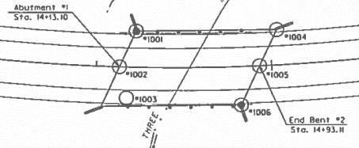
Drillers
Example Projects
S-XXX-2016

Slide 39

Drillers
Example Projects
R-XXX-2016
Looking At
Soil Profile View

Slide 40
Drillers
Structure Entry
Hole 1006

Slide 41
Drillers
Roadway Entry
Hole 1

Slide 42
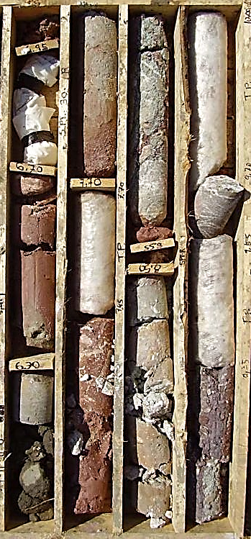
Geologist Section

Slide 43
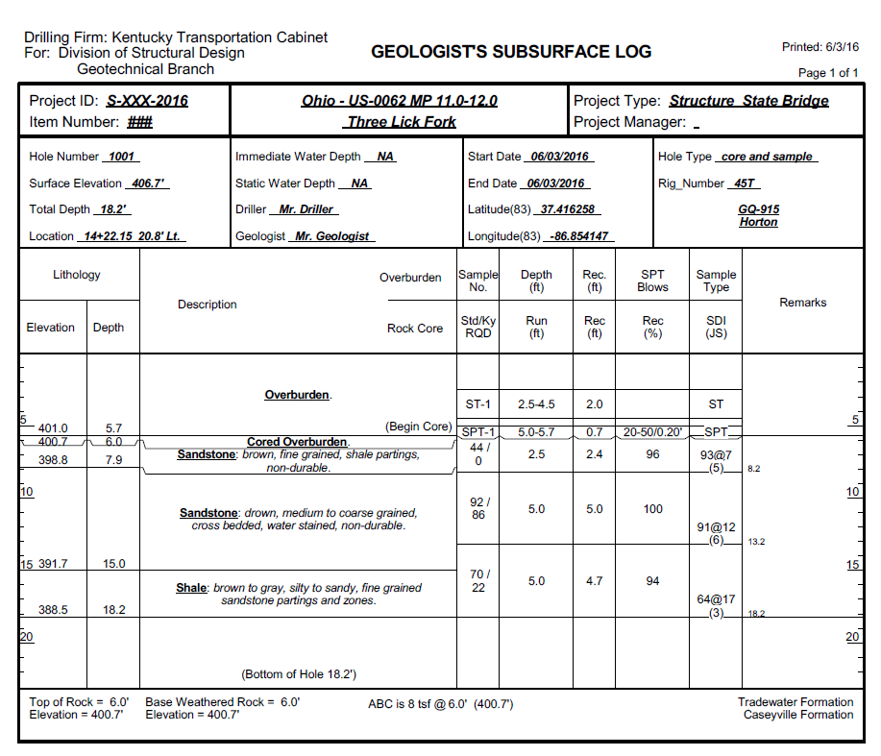
Geologist
Logs Overview
Tables
Core Runs (not in Geology Forms)
Geologist Lithology
Core Hole Geology
Hole Remarks
SlakeDurability/Rock Durability
ABC

Slide 44
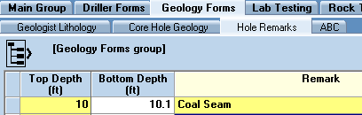
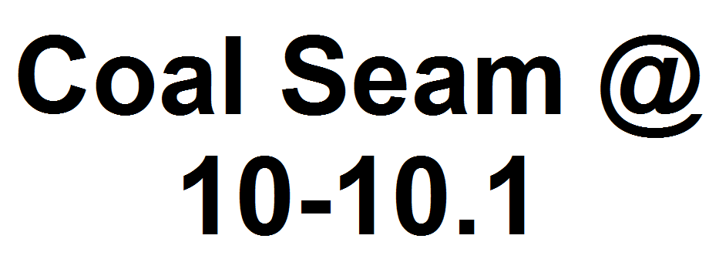
Geologist
Geologist Comment Placement
Hole Remarks Table
How Comment is Displayed in Geologist Subsurface Log:

Slide 45
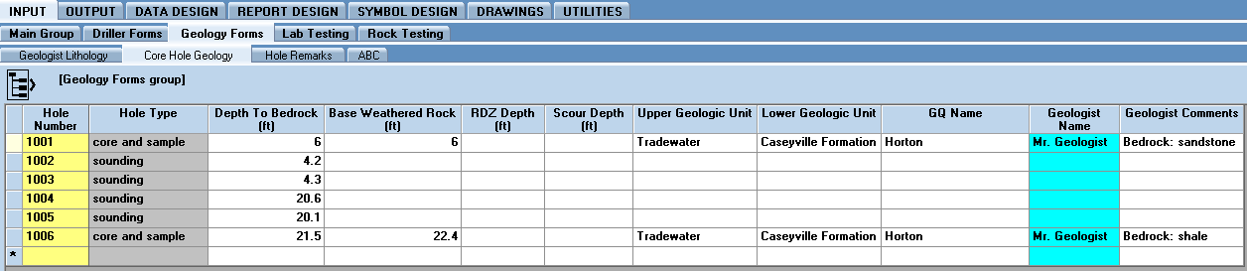
Geologist
Core Hole Geology Table
Hole Type Is Populated When Hole Type is Saved in Drill Hole Table

Slide 46
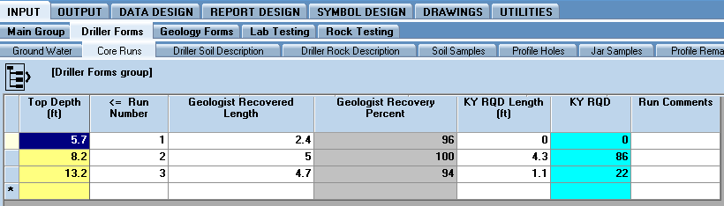
Geologist
Core Runs Geology Table
Only Table that has information need to be entered for Geologist not stored in Geology Forms

Slide 47
Geologist
Example Geologist Entry
We will be entering in geologist log generated by gINT so that you know where information is coming from in gINT

Slide 48
Geologist
Structure Entry
Hole 1006

Slide 49
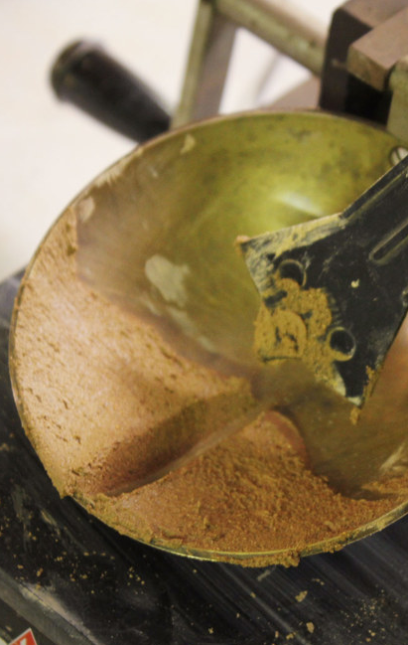
Laboratory Section

Slide 50
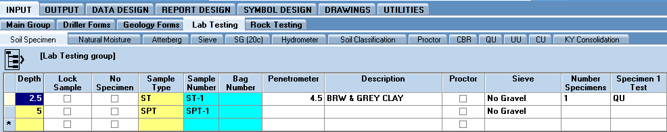
Laboratory
gINT Entry best practice is to move from Left to Right in Tabs and Fields one hole at a time
The soil specimen is the most important table for laboratory work to set up correctly, this table updates other tables upon save through the gINT Rules in the library

Slide 51

Laboratory
Soil Specimen Table: Upon saving of the table records can be created in the Sieve, Soil Classification, Proctor, CBR, QU, UU, CU, and KY Consolidation tables based on the information input for the sample.
Number of Specimens: refers to the number of samples created from the Shelby Tube, not the number of tests conducted
Specimen # Test: input the type of test done for a single specimen(CU, UU, QU, or Consol.) and only add Trixial Set Letter is part of CU testing set

Slide 52
Laboratory
Soil Specimen Table: Sample Entry Example
One Specimen – One Test
Three Specimen – Two Tests
UC Tests: Three Specimen – Two Tests – One Set

Slide 53
Laboratory
Sieve Data Entry
Three Type of Sieve Entry for raw sieve data: With Gravel, No Gravel, and Wash Gravel
This selection, upon save, inputs default values in other tables so very important to select the correct sieve type

Slide 54
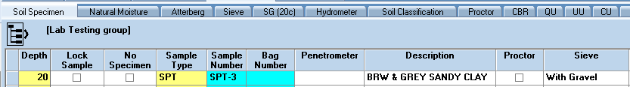
Laboratory
Sieve Data Entry
With Gravel:
Select in Soil Specimen Table
1

Slide 55
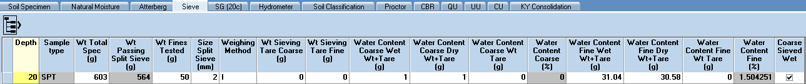
Laboratory
Sieve Data Entry
With Gravel:
Select in Soil Specimen Table
Fill in Wt Total Spec
Fill in Wt Fines Tested
Fill in Water Content Fine Wet and Dry
4
2
3

Slide 56
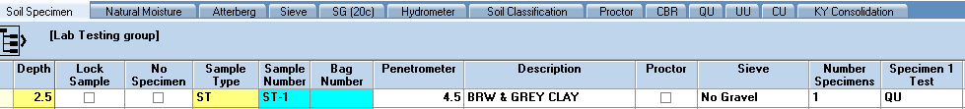
Laboratory
Sieve Data Entry
No Gravel:
Select in Soil Specimen Table
1

Slide 57
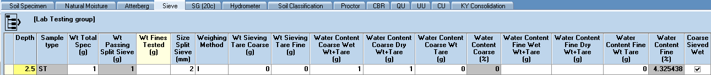
Laboratory
Sieve Data Entry
No Gravel:
Select in Soil Specimen Table
Fill in Wt Fines Tested (Hydrometer Dry weight)
Fill in Water Content Fine Wet and Dry
3
2

Slide 58
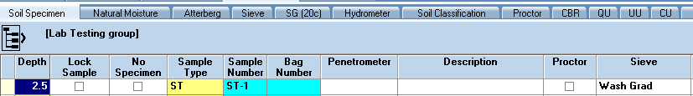
Laboratory
Sieve Data Entry
Wash Grad:
Select in Soil Specimen Table
1

Slide 59
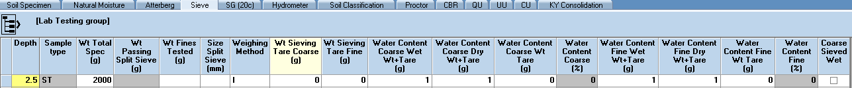
Laboratory
Sieve Data Entry
Wash Grad:
Select in Soil Specimen Table
Fill in Wt Total Spec
Leave Wt Fines Tested and Size Split Sieve Blank
Coarse Sieve Wet Unchecked (Should be Automatic from step 1)
4
2
3

Slide 60
Laboratory
Sieve Data Entry
Sieve Entry Overview Table
 | Wt. Total Spec. | Wt Fines Tested | Size Split Sieve | WC Coarse Wet | WC Coarse Dry | WC Fine Wet | WC Fine Dry | Coarse Sieved Wet
With Gravel | actual | actual | 2 | 1 | 1 | actual | actual
No Gravel | 1 | actual | 2 | 1 | 1 | actual | actual
Wash Grad | actual | - | - | 1 | 1 | 1 | 1 | No

Slide 61
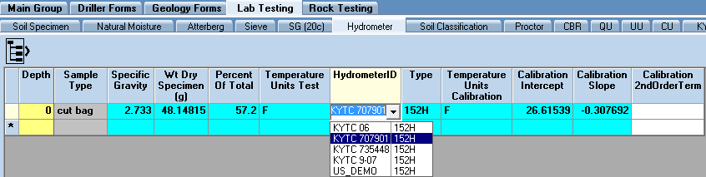
Laboratory
Hydrometer Drop Down Menu Creation
Values of type, Temperature Units, Calibration Intercept and Slope have to be populated based on dropdown selection.

Slide 62
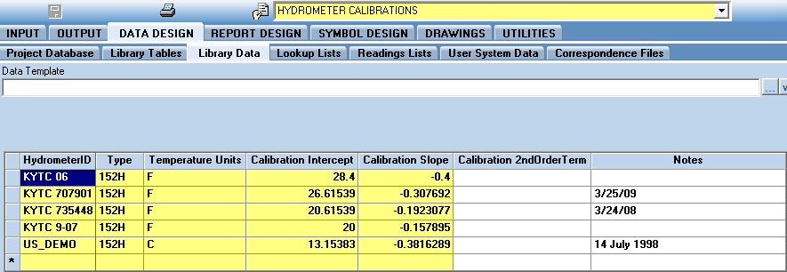
Laboratory
Hydrometer Drop Down Menu Creation
Can update the dropdown list under Data Design, Library Data, Hydrometer Calibrations.

Slide 63
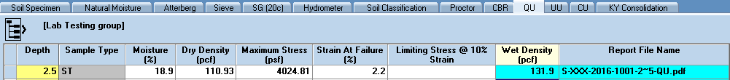
Laboratory
Updates: Density Entry
Both Dry and Wet Density field have been added to the QU, UU and KY Consolidation tables so that wither will be calculated upon save
Either Dry or Wet Density be calculated upon save
From the other value

Slide 64
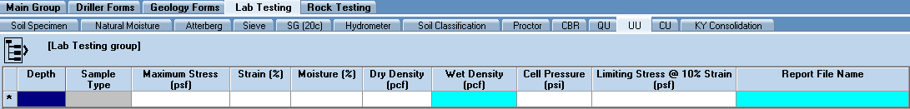
Laboratory
Updates: Cell Pressure Entry for UU table
The cell pressure will need to be entered for UU tests since it was added to the table fields
Cell Pressure Needs to be Entered

Slide 65
Drillers
Example Lab Entry
We will be entering in raw lab data into gINT so that you know where information needs to be input

Slide 66
Laboratory
Structure Entry
Hole 1006

Slide 67
Laboratory
Roadway Overview
Hole 1

