Slide 1
Vulnerable Road User Safety Assessment Overview
10/18/23

Slide 2
What is a Vulnerable Road User (VRU)
Government Definition
Simplified Definition
Non-motorist with a fatality analysis reporting system (FARS) person attribute code for pedestrian, bicyclist, other cyclist, and person on personal conveyance or an injured person that is, or is equivalent to, a pedestrian or pedalcyclist as defined in the ANSI D16.1-2007. (See 23 U.S.C. 148(a)(15) and 23 CFR 490.205). A vulnerable road user may include people walking, biking, or rolling.
Pedestrian
Bicyclist
Other non-motorized roadway user
Notes:
This definition does not include motorcyclists, even though some other VRU definitions do (SHSP).

Slide 3
VRU Safety Assessment
Memorandum from FWHA on October 21, 2022 provides requirements and guidance for VRU Safety Assessment
23 U.S.C. 148(1), amended in the Bipartisan Infrastructure Law (BIL)
All states required to complete initial assessment by November 15, 2023
States must update the VRU Safety Assessment as a part of subsequent SHSPs
Notes:
The initial assessment will be considered an appendix to the 2020-2024 SHSP
Will be done again next year for Kentucky’s updated SHSP

Slide 4
VRU Safety Assessment: Requirements
Use a data-driven process to identify areas of high-risk for VRU
Use (at a minimum) data from the most recent 5-year period for which data is available
Perform a quantitative analysis of VRU fatalities and serious injuries that includes:
Data such as location, roadway functional class, design speed, speed limit, time of day, etc. Could also include indicators of where VRU fatalities or serious injuries are likely to occur, such as land use and infrastructure indicators
Consider demographics of the locations of VRU fatal and serious injuries (including race, ethnicity, income, and age)
Identify areas as “high-risk” to VRU
Consult with local governments, metropolitan planning organizations, and regional transportation planning organizations in high-risk areas
Develop a list of strategies to reduce safety risks to VRUs in areas that have been identified as high-risk (using the Safe Systems Approach)
Notes:
Kentucky uses the KABCO scale for injury severity with Fatal injuries being coded as K and serious injuries coded as A

Slide 5
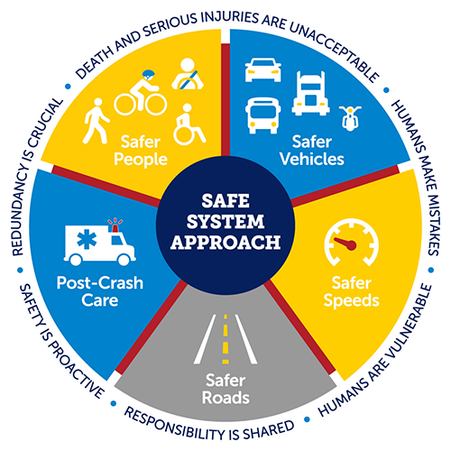
Safe System Approach
Systems
Principles
Users
Roads
Speeds
Vehicles
Post-crash Care
Death and Serious Injuries are Unacceptable
Humans Make Mistakes
Humans Are Vulnerable
Responsibility is Shared
Safety is Proactive
Redundancy is Crucial
Notes:
Key component of the VRU Safety Assessment.
U.S. DOT adopted the Safe System Approach as guide to address roadway safety in the effort to reach zero deaths and serious injuries. This approach is seen as an effective way to mitigate the risks in the overall transportation system. It works by building and reinforcing multiple layers of protection to both prevent crashes and minimize harm when crashes do occur.
This is a shift from a conventional safety approach because it focuses on both human mistakes AND human vulnerability and designs a system with many redundancies in place to protect everyone.

Slide 6
Demographics: USDOT Justice40 Transportation Disadvantaged Communities (DACs)
Disadvantaged Communities Factors
Data Sources
Transportation access
Health
Environmental
Economic
Resilience
Equity
CDC Social Vulnerability Index
Census America Community Survey
EPA Smart Location Map
HUD Location Affordability Index
EPA EJ Screen
FEMA Resilience Analysis & Planning Tool
FEMA National Risk Index
DACs account for 27.3% of the state’s population and 25.1% of its area, yet 37.4% of VRU KA crashes and 29.8% of all other KA crashes
Notes:
The other key component of the VRU safety assessment considering demographics when analyzing VRU Risk.
There were several demographic databases suggested by FHWA to use for this component of the assessment and Kentucky has chosen USDOT’s Transportation disadvantaged communities database.
Evaluates census tracts in 6 different factors to assess disadvantaged status.
22 indicators make up the 6 factors.
Each tract is ranked against others in the country on each indicator to determine a percentile rank
Percentile ranks of each indicator for a factor are averaged
An average rank of 50th percentile of disadvantage or higher is considered disadvantaged for a factor
Disadvantaged in 4+ factors = Overall Transportation Disadvantaged.
280 of 1115 Census tracts in KY are disadvantaged

Slide 7
Bicycle and Pedestrian Fatality and Serious Injury Trends

Slide 8
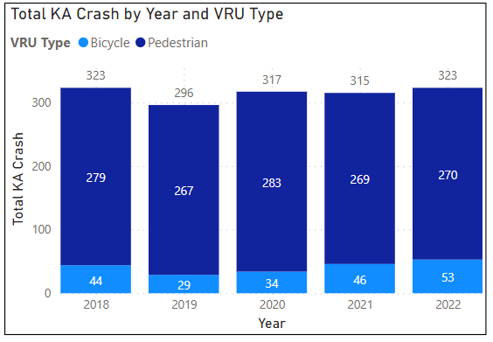
Statewide VRU KA Crash Statistics 2018-2022
478 fatal VRU crashes, 1096 serious injury VRU crashes
81.9% of VRU KA crashes occur in urban/suburban areas
59.5% of VRU KA crashes occur outside of daylight hours
More than 50% of VRU KA crashes occur where the speed limit is 35mph or less
44.9% of VRU KA crashes occur at intersections
18.7% of VRU KA crashes are hit and run
Notes:
Kentucky uses the KABCO scale for injury severity with Fatal injuries being coded as K and serious injuries coded as A
To understand what makes VRU KA crashes unique from all other KA crashes, crash and roadway factors for each group were analyzed and compared to each other to identify trends specific to VRU crashes.
13,574 non-VRU KA and 1,574 VRU KA crashes.
VRU crashes account for 478 of the total 3,525 roadway fatality crashes in Kentucky between 2018 and 2022, roughly 13.5%.
81.9% VRU KA are urban/suburban
Difficult to understand more detailed risk factors without site visits (limited to HIS and crash report data)

Slide 9
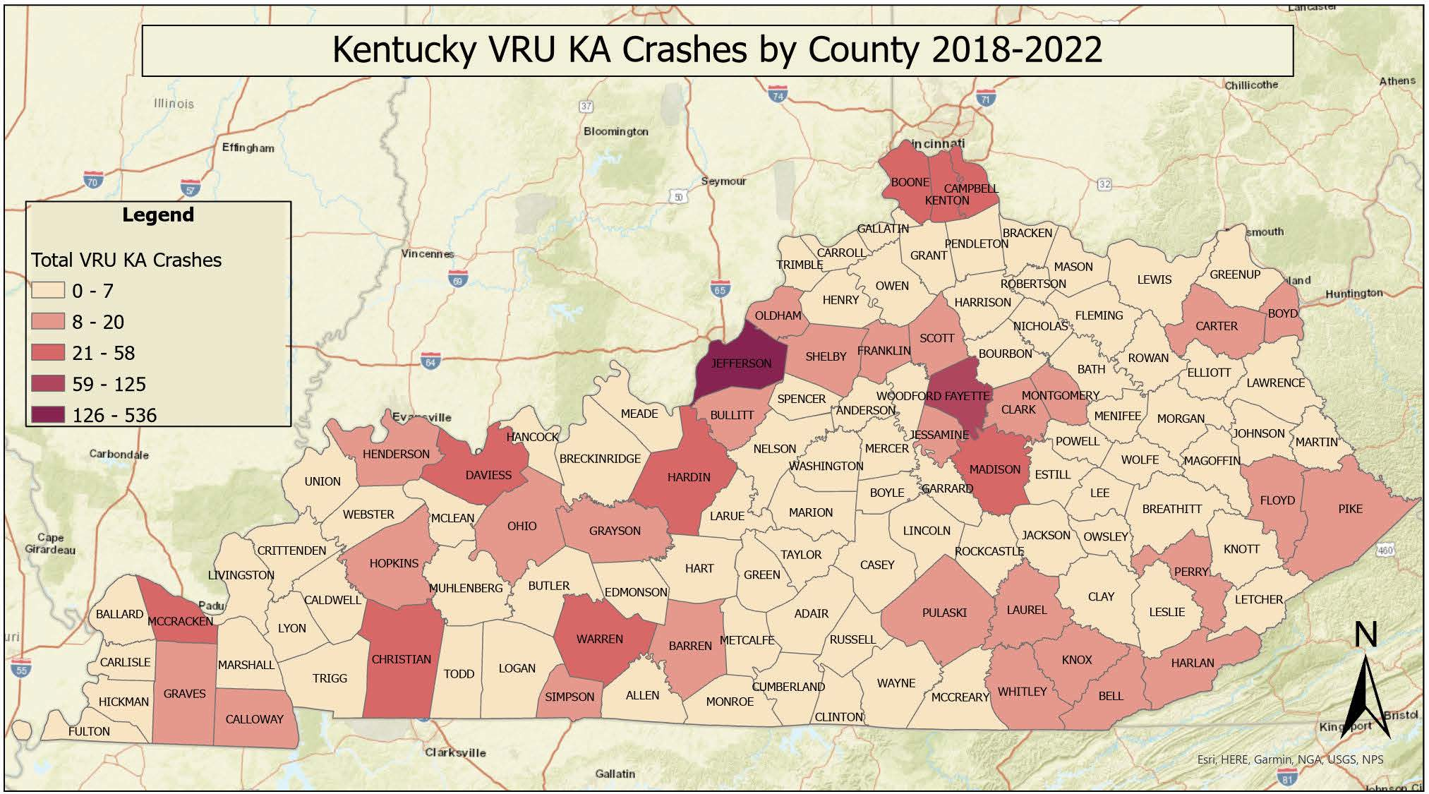
Notes:
No other county is close to Jefferson and Fayette by total magnitude of VRU KA crashes.
41.9% of VRU KA crashes occur in these two counties. (34% Jefferson and 7.9% Fayette)

Slide 10
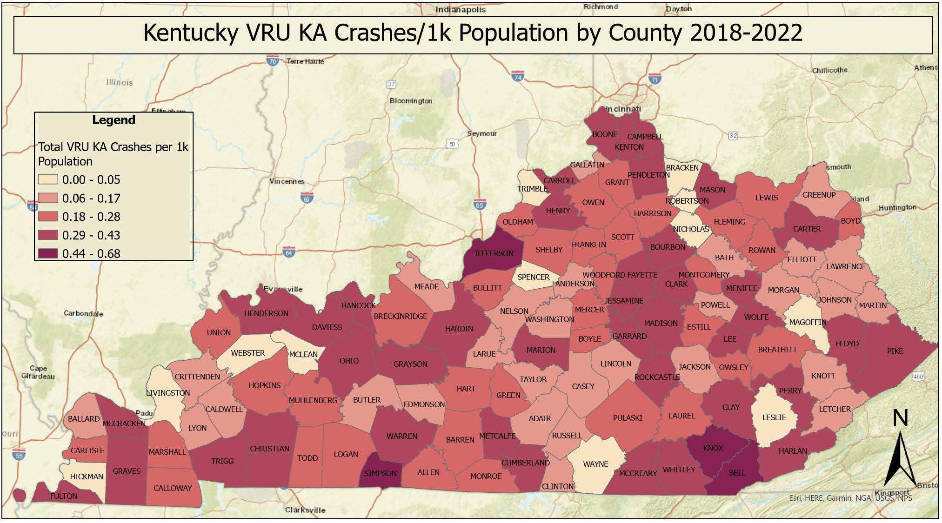
Notes:
Jefferson county is still the highest risk county for VRU/population. Fayette county “risk” is reduced, but still elevated
Simpson, Knox, Bell counties all had fewer than 10 VRU KA crashes each in the last 5 years, but their populations are low enough to make their rates high.
Because of the total number of VRU crashes in Fayette county, there is more potential to reduce the state’s overall VRU crashes by focusing on this area.

Slide 11
Priority Ranking Method
VRU KA crashes are overrepresented by 25% in DACs statewide compared to non-VRU KA crashes
An adjustment factor of 25% is applied to the risk scores for all locations inside a DAC to account for the overrepresentation of VRU crashes in these areas
Census tracts ranked by VRU KA crashes/population with a 25% adjustment for DAC status
Routes ranked by VRU KA crashes with 25% adjustment for routes in a DAC
Intersections ranked by VRU KA crashes with 25% adjustment for intersections in a DAC
Notes:
DACs account for 27.3% of the state’s population and 25.1% of its area, yet 37.4% of VRU KA crashes and 29.8% of all other KA crashes

Slide 12
High-Risk Locations
21 of top 25 high-risk census tracts were in Jefferson and Fayette Counties
21 of top 25 high-risk routes were in Jefferson and Fayette Counties
23 of top 25 high-risk Intersections were in Jefferson and Fayette Counties

Slide 13
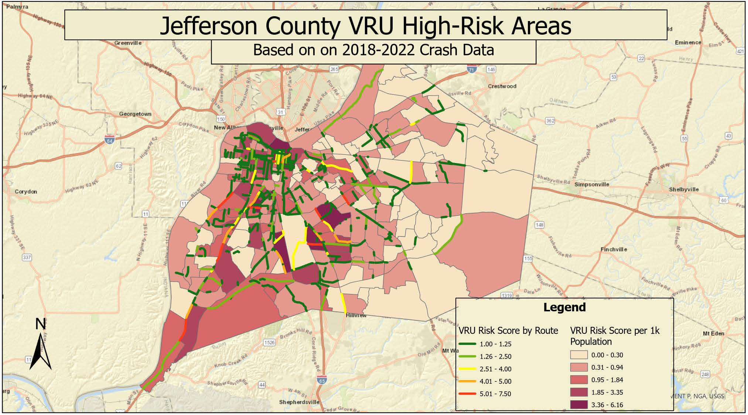
Notes:
Fern Valley
Bardstown
Poplar Level
Dixie Hwy
Cane Run Rd. Hwy
Lots of individual downtown

Slide 14
Jefferson County High-Risk Locations
Routes
Intersections
Route Name | BMP | EMP | DAC | VRU KA | Score | Rank
Fern Valley Rd. | 0.76 | 1.94 | Yes | 6 | 7.5 | 1.5
Dixie Highway | 11.30 | 12.53 | Yes | 6 | 7.5 | 1.5
Broadway | 1.94 | 2.70 | No | 7 | 7 | 4
Dixie Highway | 4.57 | 6.24 | No | 7 | 7 | 4
Berry Blvd. | 0.60 | 1.58 | Yes | 5 | 6.25 | 6.5
Poplar Level | 10.25 | 11.33 | Yes | 5 | 6.25 | 6.5
Bardstown Rd. | 11.12 | 12.03 | No | 6 | 6 | 8.5
Cane Run Rd. | 8.78 | 10.48 | No | 6 | 6 | 8.5
Preston Hwy | 5.73 | 6.34 | Yes | 4 | 5 | 15.5
I 65 | 135.25 | 136.11 | Yes | 4 | 5 | 15.5
7th St. | 8.71 | 9.62 | Yes | 4 | 5 | 15.5
Cane Run Rd. | 7.77 | 8.78 | Yes | 4 | 5 | 15.5
Dixie Highway | 6.38 | 7.54 | No | 5 | 5 | 15.5
Dixie Highway | 12.53 | 13.80 | Yes | 4 | 5 | 15.5
Poplar Level | 7.42 | 8.88 | No | 5 | 5 | 15.5
Primary | Secondary | CLASS | DAC | VRU KA | Score | Rank
Preston Hwy | E Indian Trail | U3uS | Yes | 3 | 3.75 | 1
Taylor Blvd. | W Kenwood Dr. | D4uS | Yes | 3 | 3.75 | 1
National Turnpike | Tolls Ln. | U3uP | Yes | 3 | 3.75 | 1
Dixie Highway | San Jose Ave. | U3uP | Yes | 3 | 3.75 | 1
Broadway | 6th St. | U4uS | No | 3 | 3 | 6
W Hill St. | 12th St. | U4uS | Yes | 2 | 2.5 | 8
Dixie Highway | Youngland Ave. | U4uP | Yes | 2 | 2.5 | 8
Berry Blvd. | Algonquin Pkwy. | U4uS | Yes | 2 | 2.5 | 8
Preston Hwy | Lorette St. | U4uP | Yes | 2 | 2.5 | 8
Fern Valley Rd. | Preston Hwy. | D4uS | Yes | 2 | 2.5 | 8
2nd St. | Market | D4uS | No | 2 | 2 | 16
W Liberty St. | 4th St. | U4uS | No | 2 | 2 | 16
Broadway | 1st St. | U4uS | No | 2 | 2 | 16
Garland Ave. | 28th St. | U4uS | No | 2 | 2 | 16
Dixie Highway | Garland Ave. | U4uS | No | 2 | 2 | 16

Slide 15
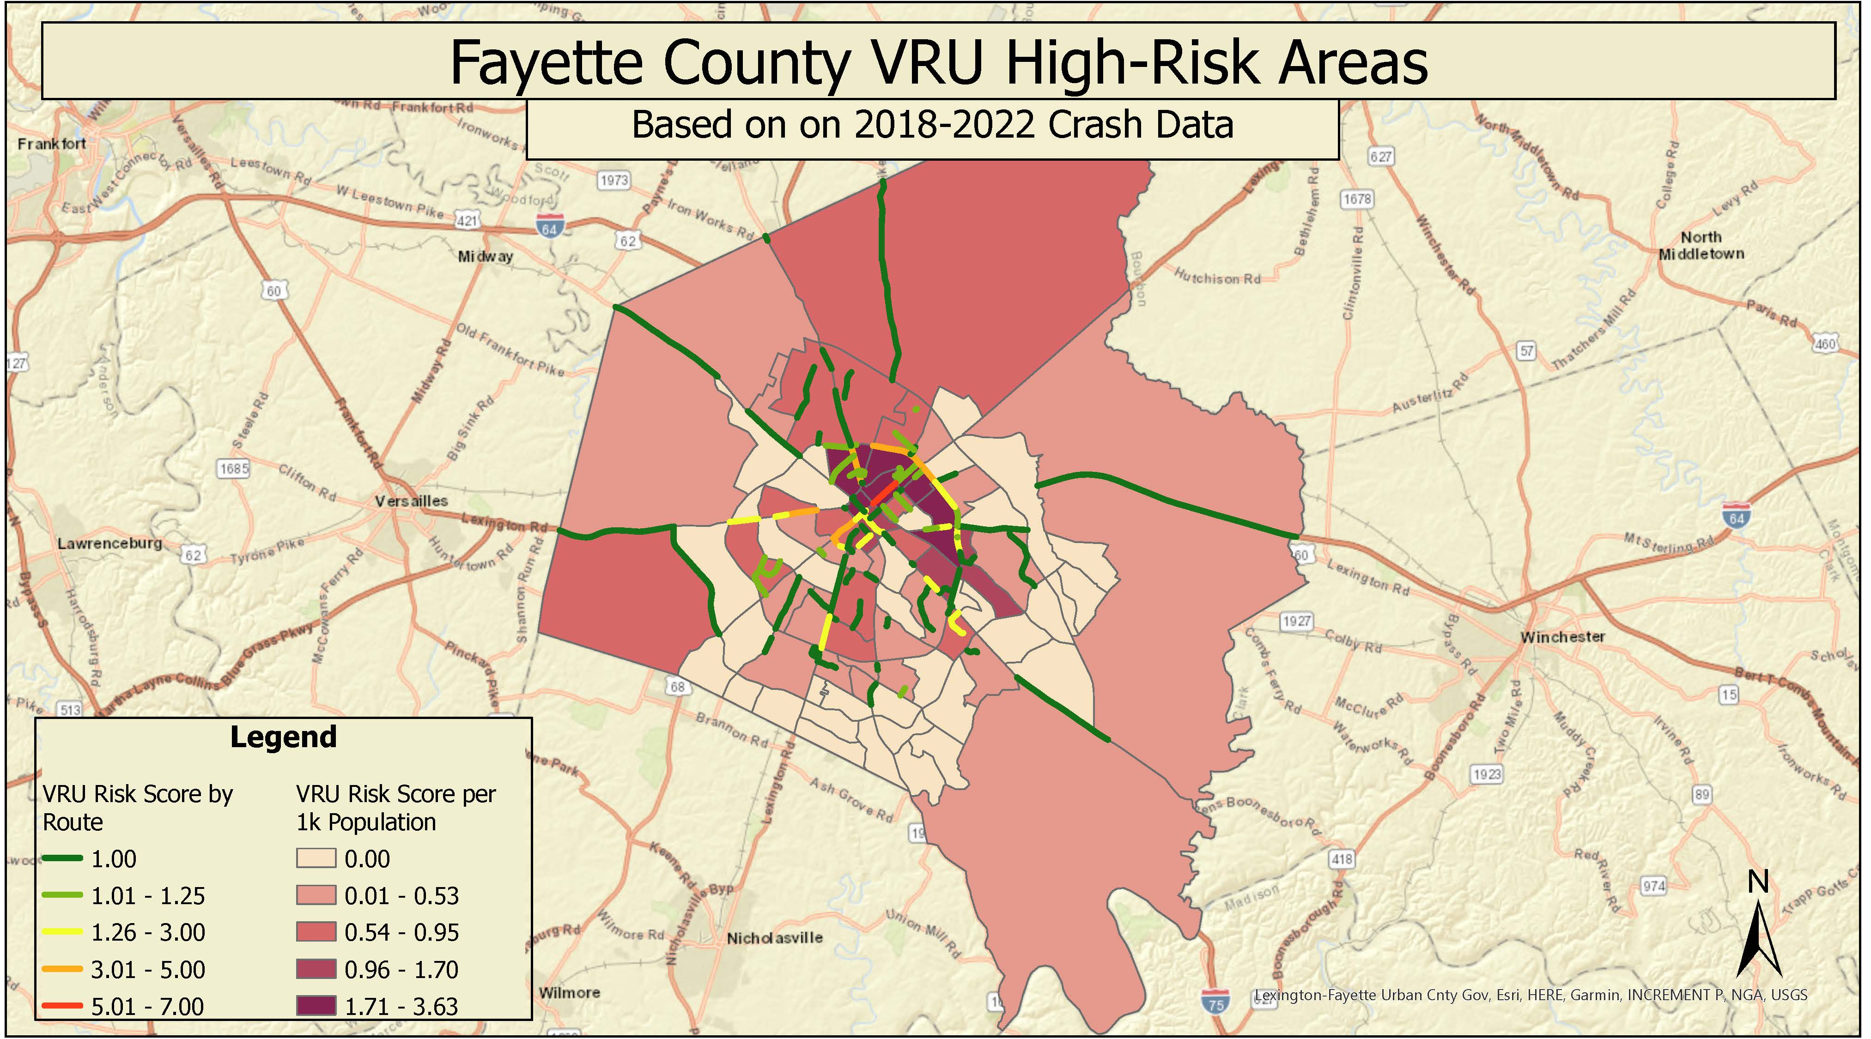
Notes:
Broadway
North/East New Circle
Versailles Rd
Nicholasville
Richmond
Cyclist crashes in rural areas

Slide 16
Fayette County High-Risk Locations
Routes
Intersections
Route Name | BMP | EMP | DAC | VRU KA | Score | Rank
N Broadway | 7.06 | 7.85 | No | 7 | 7 | 4
E New Circle | 10.90 | 11.34 | Yes | 4 | 5 | 15.5
S Broadway | 5.49 | 6.43 | No | 4 | 4 | 23
Versailles Rd. | 6.16 | 6.97 | Yes | 3 | 3.75 | 30
Georgetown St. | 15.13 | 16.16 | Yes | 3 | 3.75 | 30
W New Circle | 9.33 | 10.90 | Yes | 3 | 3.75 | 30
Nicholasville Rd. | 2.41 | 3.34 | No | 3 | 3 | 48
Virginia Ave | 5.16 | 5.37 | Yes | 2 | 2.5 | 82.5
Versailles Rd | 5.87 | 6.16 | Yes | 2 | 2.5 | 82.5
Winchester Rd. | 9.52 | 9.86 | Yes | 2 | 2.5 | 82.5
E New Circle | 12.73 | 13.43 | Yes | 2 | 2.5 | 82.5
Versailles Rd | 4.66 | 5.42 | Yes | 2 | 2.5 | 82.5
E New Circle | 11.34 | 12.20 | Yes | 2 | 2.5 | 82.5
S Broadway | 6.43 | 6.79 | No | 2 | 2 | 142.5
Richmond Rd. | 11.31 | 11.73 | No | 2 | 2 | 142.5
Primary | Secondary | CLASS | DAC | VRU KA | Score | Rank
E New Circle | Russell Cave Rd. | D4uS | Yes | 3 | 3.75 | 1
E New Circle | Golden Way | D3uP | Yes | 2 | 2.5 | 8
Virginia | S Limestone | U4uS | Yes | 2 | 2.5 | 8
Richmond | Old Todds Rd | D4uS | Yes | 2 | 2.5 | 8
N Broadway | Elsmere Park | U3uP | No | 2 | 2 | 16
Winburn Dr. | Mikan Ct. | U3uN | Yes | 1 | 1.25 | 42
Georgetown St. | W New Circle | U4uS | Yes | 1 | 1.25 | 42
Georgetown St. | Lima Dr. | U3uP | Yes | 1 | 1.25 | 42
Georgetown St. | Keller Ct. | U3uP | Yes | 1 | 1.25 | 42
Price Rd. | Cantaloupe St. | U3uN | Yes | 1 | 1.25 | 42
Legacy Crossing | Ash St. | U3ux | Yes | 1 | 1.25 | 42
N Limestone | Broadview Dr. | U3uN | Yes | 1 | 1.25 | 42
Russell Cave Rd. | Kees Rd. | U3uN | Yes | 1 | 1.25 | 42
N Limestone | Paris Ave. | U3uN | Yes | 1 | 1.25 | 42
E 7th St. | N MLK Blvd | U3uN | Yes | 1 | 1.25 | 42
Notes:
Most are in disadvantaged areas.

Slide 17
Stakeholder Involvement
Meetings
Agenda
Jefferson County: 10/06/23
Fayette County: 10/12/13
Introductions
Overview of the VRU Safety Assessment Requirements
VRU safety trends Statewide
VRU safety trends in County
Kentucky’s progress with VRU safety
Breakout room discussion of VRU safety countermeasures
Conclusion
Notes:
Inform the stakeholders of the high VRU risk in their area
Connect local stakeholders with KYTC personnel to build relationships
Inform stakeholders of ongoing efforts in the state to enhance VRU safety
Seek input from stakeholders on strategies and countermeasures to increase VRU safety in their area

Slide 18
Stakeholders
Jefferson County
Fayette County
Open Mobility Foundation
Parks Alliance of Louisville
Louisville Metro Transportation Planning
Kentucky Transportation Cabinet Central Office: Traffic safety and Strategic Planning Divisions
Kentucky Transportation Cabinet District 5 Office
Louisville Metro Public Works
Institute of Transportation Studies
Louisville Metro Department of Public Health and Wellness
Louisville Metro Police Department
Louisville City Council: Metro Council District 21
Louisville Parks & Recreation
WSP
Burgess & Niple
FHWA Kentucky Office
Norton Children’s ER
Transit Authority of River City (TARC)
University of Louisville Civil Engineering Department
Matthew's Bridge Inc. (501c3)
Metro Louisville Emergency Services
University of Kentucky Civil Engineering Department
Kentucky Transportation Center
Lexington Area Metropolitan Planning Organization
University of Kentucky Civil Engineering Department
Kentucky Transportation Center
Kentucky Transportation Cabinet District 7
Kentucky Transportation Cabinet Central Office: Traffic Safety and Planning Divisions
Kentucky Office of Highway Safety
FHWA Kentucky Office
Lexington Police Department
Studio Jesse James Architects Inc.
Lexington-Fayette Urban County Government Environmental Quality and Public Works
Lexington City Council
University of Kentucky Student Government
University of Kentucky Police Department
Fayette County Public Schools

Slide 19
Stakeholder Brainstorming: How Can We Improve VRU Safety?
Safer Users
Safer Vehicles
Safer Roads
Safer Speeds
Post-Crash Care
Intuitive transit stop placement
Education and outreach programs addressing user behavior
Automated vehicle pedestrian detection and auto-braking
Crosswalk visibility enhancements
Medians and pedestrian refuge islands
Increased enforcement in high-crash areas
Speed humps
Enhanced 911 services
Phone-based automatic crash detection
Notes:
Split into breakout groups with around 10 people including a facilitator from KTC.
Encouraged stakeholders to focus on the safe systems approach

Slide 20
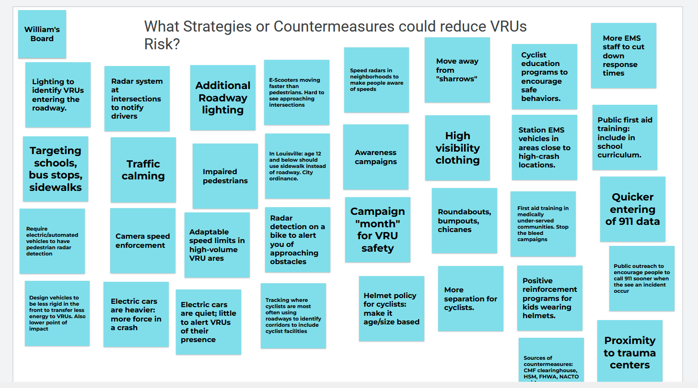
Notes:
Used Google Jamboard to document suggestions from stakeholders and promote further discussion of similar topics.

Slide 21
Stakeholder Suggestion Highlights
Statewide policy and guidance on lighting warrants and standards. Guidance is also needed on the use of solar lighting versus hardwired lighting.
Legislative changes to allow for automated speed enforcement.
Leverage resurfacing projects to implement road diets and reassign right-of-way for sidewalks, lighting, and bike lanes.
Marketing campaigns to change public perception of VRUs to enhance empathy and reduce tension between users of different transportation modes.
Enhance landscape to improve the appeal/comfort of VRU facilities. Use landscaping to create barriers between vehicles and VRUs
Target first aid training in medically under-served communities.
Improving transit opportunities to reduce the number of single-occupancy vehicles on the roads network and provide another mode of transportation for VRUs.
Notes:
Many stakeholders desired more guidance from the state regarding VRU strategies.
One deliverable of this assessment is a spreadsheet of VRU countermeasures and strategies sourced from various Kentucky documents, FHWA guidance, CMF clearinghouse, and the local stakeholder meetings.

Slide 22
Kentucky’s Progress with VRU safety
Strategic Highway Safety Plan: VRU Action Plan
Complete Streets, Roads, and Highways manual
KY Pedestrian and Bicyclist Safety Program Assessment (NHTSA)
Statewide Bicycle and Pedestrian Master Plan
KYTC ADA Transition Plan
Louisville Vision Zero Program
VRU Taskforce safety assessments in Louisville
KOHS VRU Dashboard
Lexington Safety Action Plan
Lexington Complete Streets Policy
SHIFT Bike/Ped component
KOHS TV/social media ads promoting non-motorized road user safety

Slide 23
VRU Safety Assessment: Next Steps
Draft report will be submitted to the study advisory committee this week: 10/20/23
One week for feedback: 10/27/23
One week for revisions: 11/03/23
Resubmit for final KYTC approval: 11/06/23
Published to the KOHS website on or before 11/15/23

Slide 24

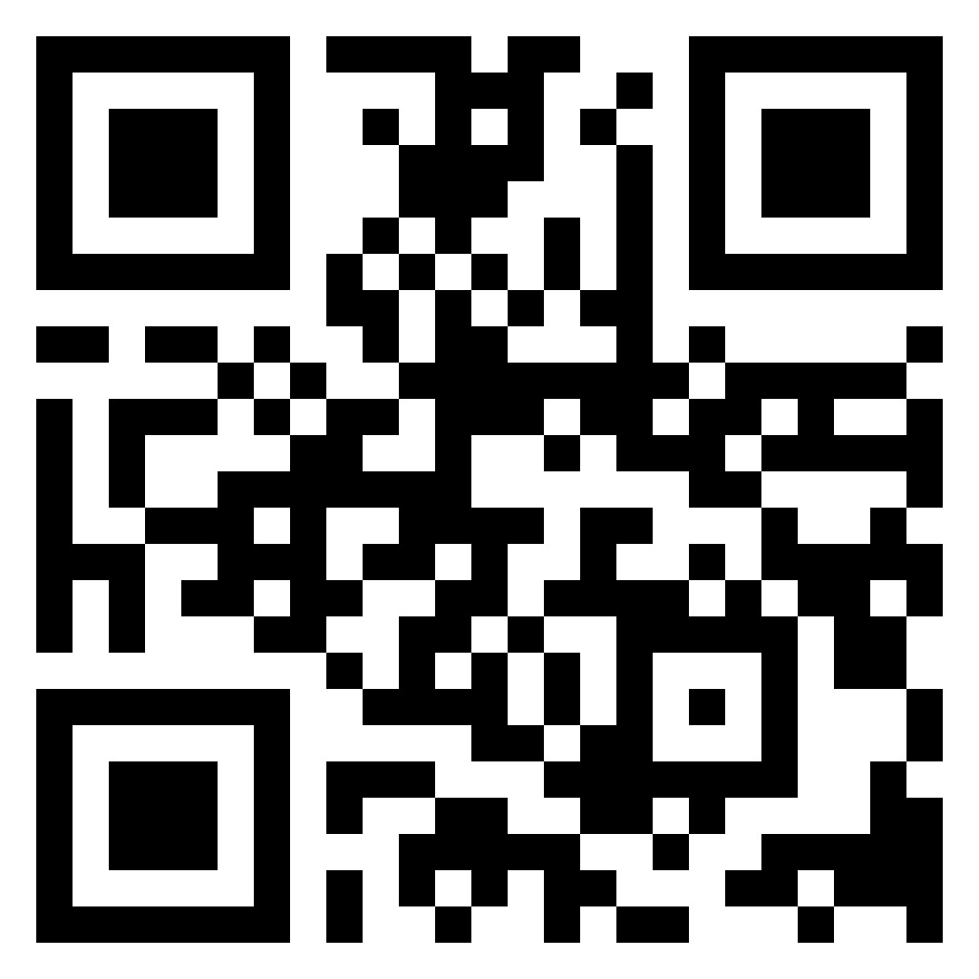
2024 Road Safety & Simulation Conference
October 28-31, 2024 at the Hilton in Downtown Lexington
Visit the website for more details
https://ktc.uky.edu/rss2024/

Slide 25
William Staats
Research Engineer
Kentucky Transportation Center
william.staats@uky.edu

