Slide 1
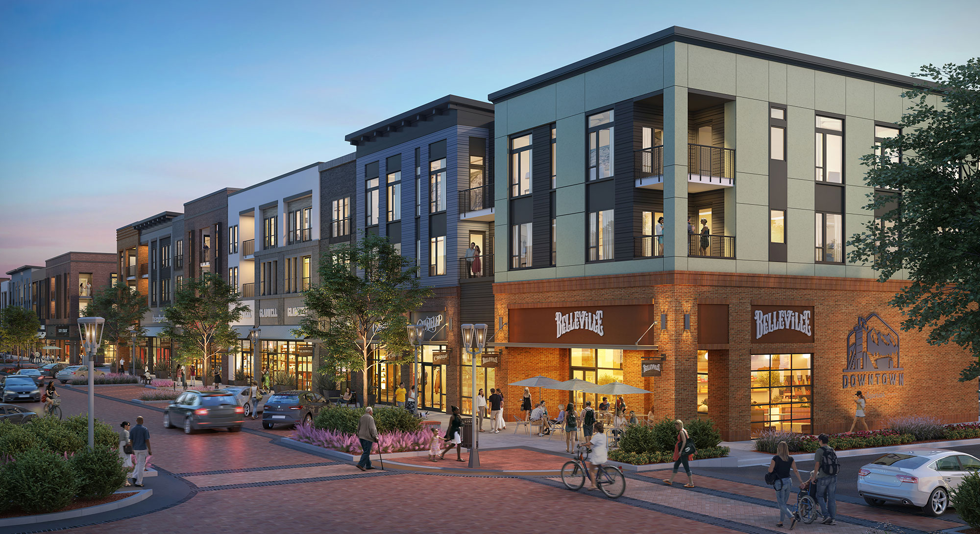
CREATING VIBRANT
COMMUNITIES
KYTC TRANSPORTATION DEVELOPMENT PLANNING ASSISTANCE PROGRAM
Notes:
Since that time, we at KYTC have been working with our consulting team of TSW, WSP, and HDR to craft and prepare the program.
Today, I want to go over some of the specifics of the program and why we think it has the potential to be revolutionary to the cities that get selected to participate.

Slide 2
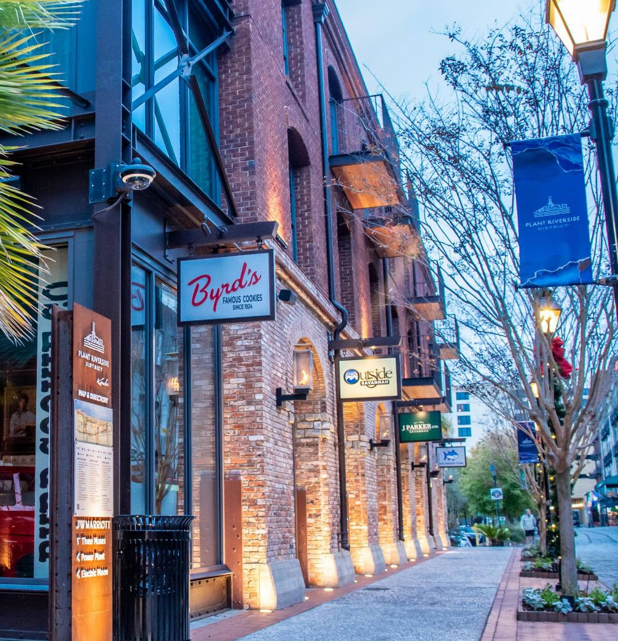
What is this Program?
Aims to help communities proactively plan for land use, transportation, and future development options for a targeted small area.
The goal is to create a transformative and unique destination for the community!
Communities will create a plan that will outline the vision, conceptual development plan, and actionable next steps.
Local officials, staff, developers, and the public will work directly with KYTC’s team of consultants to create this plan.
Creating Vibrant Communities | KYTC Transportation Development Planning Assistance Program
Notes:
Normally, these three things are done in a very disjointed manner. If an area has a comprehensive plan, the most land-use planning that typically been done is the coloring large areas of the future land use map with a single land use. Transportation planning – we normally just plan a road or road improvements without addressing future land use directly. Often times, we’re doing a project in a more reactive fashion. And development typically happens one parcel at a time and often does not tie-in or relate to the adjacent properties. We’re trying to turn these very isolated process into one that forms integrated, unified plan.
The goal is to help a community dream of how it can be a better self! Create a plan that ties the three elements of transportation, land-use planning, and development together to build a destination that is special and long lasting using smart growth principles. The community will have a new and clear vision of what that targeted area can be.
Not just a vision plan, but will have a list of actionable steps on how to move this plan toward reality. Might include how to get funding for road improvements. Setting up a TIF district. Modifying zoning code. How to get other infrastructure improvements. Need to acquire certain pieces of property or consolidate properties to make more attractive. How to attract developers to the project. Setting up staff or an oversight group responsible for implementing plan.
We have our highly qualified consultant team who will help.

Slide 3
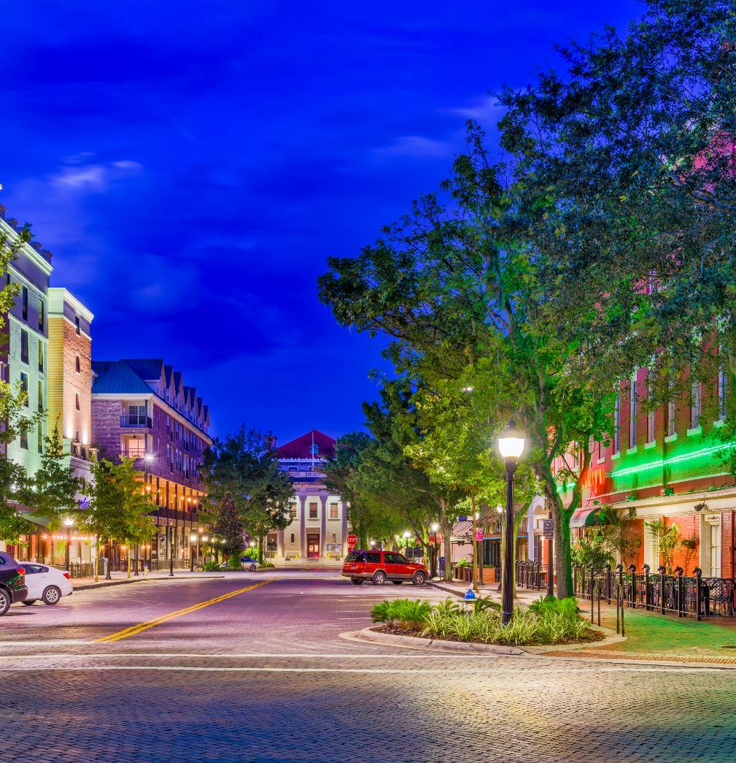
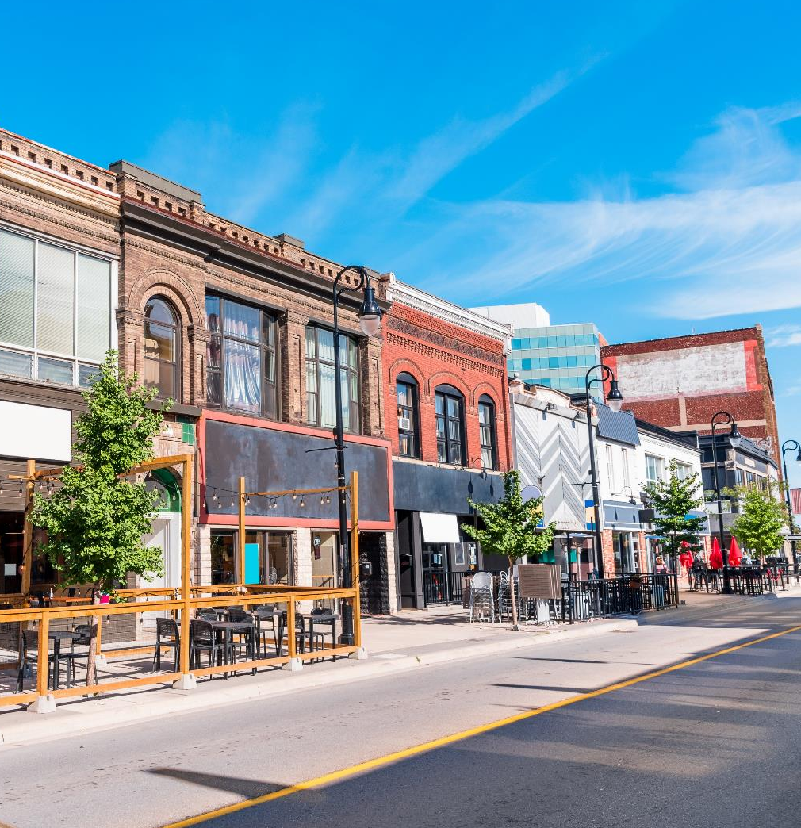
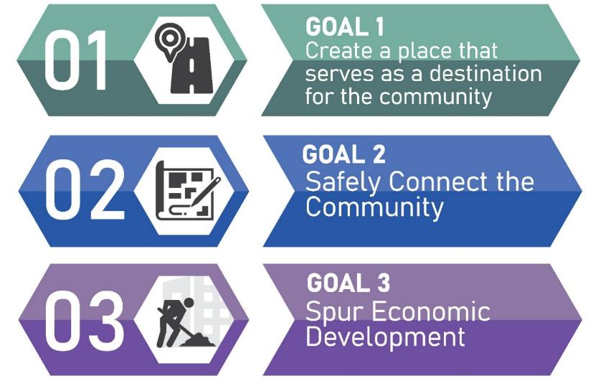
Program Goals
This program is intended to leverage and coordinate transportation with land use and economic development initiatives in a way that builds better and more vibrant communities.
Creating Vibrant Communities | KYTC Transportation Development Planning Assistance Program
Notes:
Destination
Something special – you don’t need to go on vacation to find these places
Mixture of land uses, including different types of residential – many good reasons for this including reduced driving distances or ability to walk places
Spaces that are public – parks, squares, even along the street itself
Preference on redeveloping existing, blighted commercial, industrial, officesland uses. – many benefits for this including making more attractive and reducing sprawl.
Safely connect
How can we improve and tie into existing state roadways
Plan for connections throughout the targeted area and adjacent properties
Plan for a walkable and bikable environment
Make transit a viable option
Design for safe speeds
Spur economic development
Re-using existing sites – build stronger tax base for the local government without need for additional infrastructure and services.
Provide different levels and types of housing that is affordable so people can live there
Attract people to visit for activities, shopping, restaurants

Slide 4
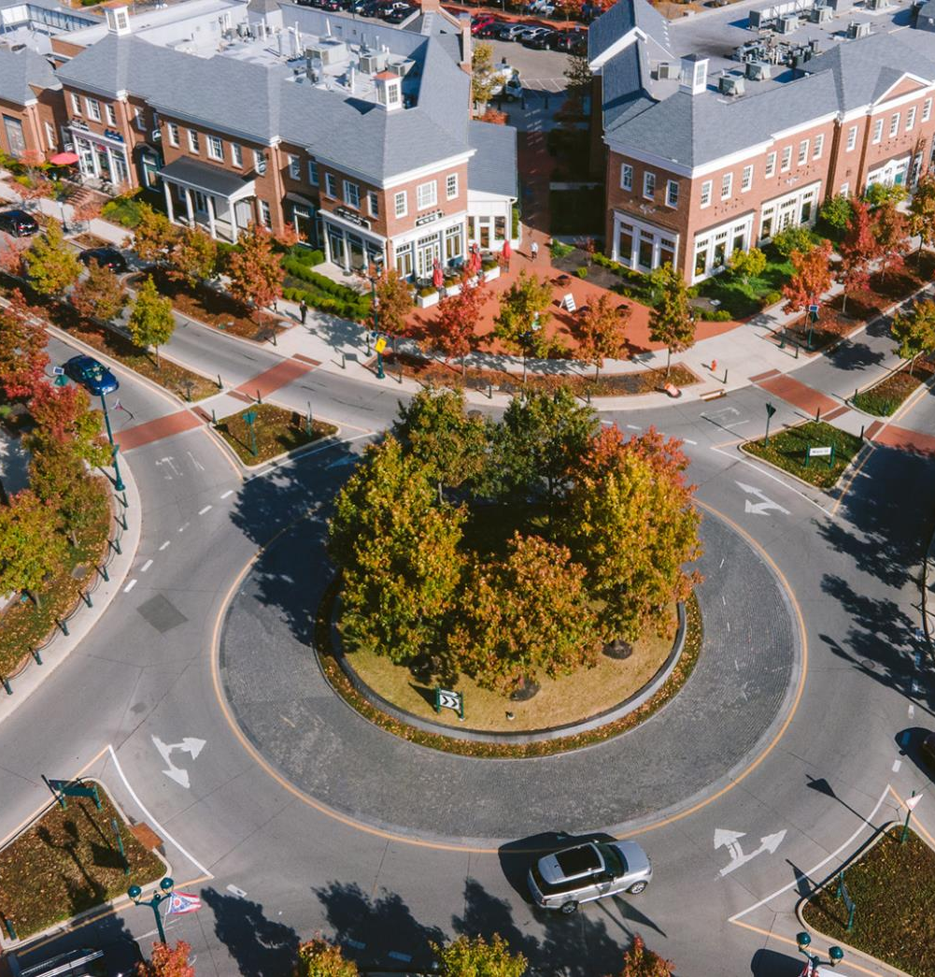

Best practices
Mixture of land uses
Compact building design
Range of housing choices
Walkable neighborhoods and places
Distinctive, attractive, sense of place
Preserve open space & environmentally sensitive areas
Direct development toward existing communities
Variety of transportation choices that make connections
Public stakeholder collaboration
Creating Vibrant Communities | KYTC Transportation Development Planning Assistance Program

Slide 5
What not to submit
Standalone shopping centers
Standalone residential subdivisions
Industrial park
Single land-use development
Isolated properties not adjacent to other development
Auto-centric development
Projects with major environmental impacts
Projects with large public opposition
Creating Vibrant Communities | KYTC Transportation Development Planning Assistance Program

Slide 6
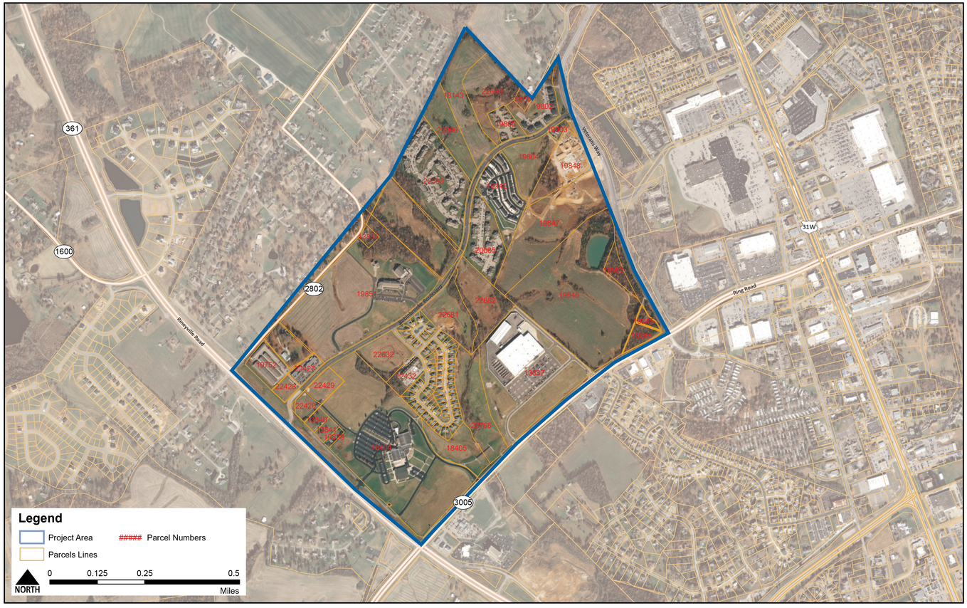
Notes:
30-150 acres expected range – could be smaller or slightly bigger.

Slide 7
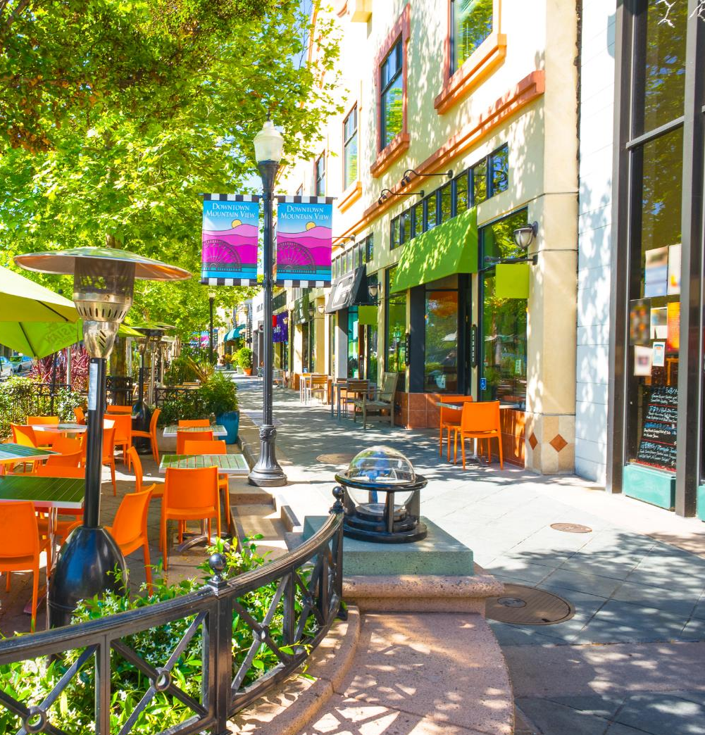
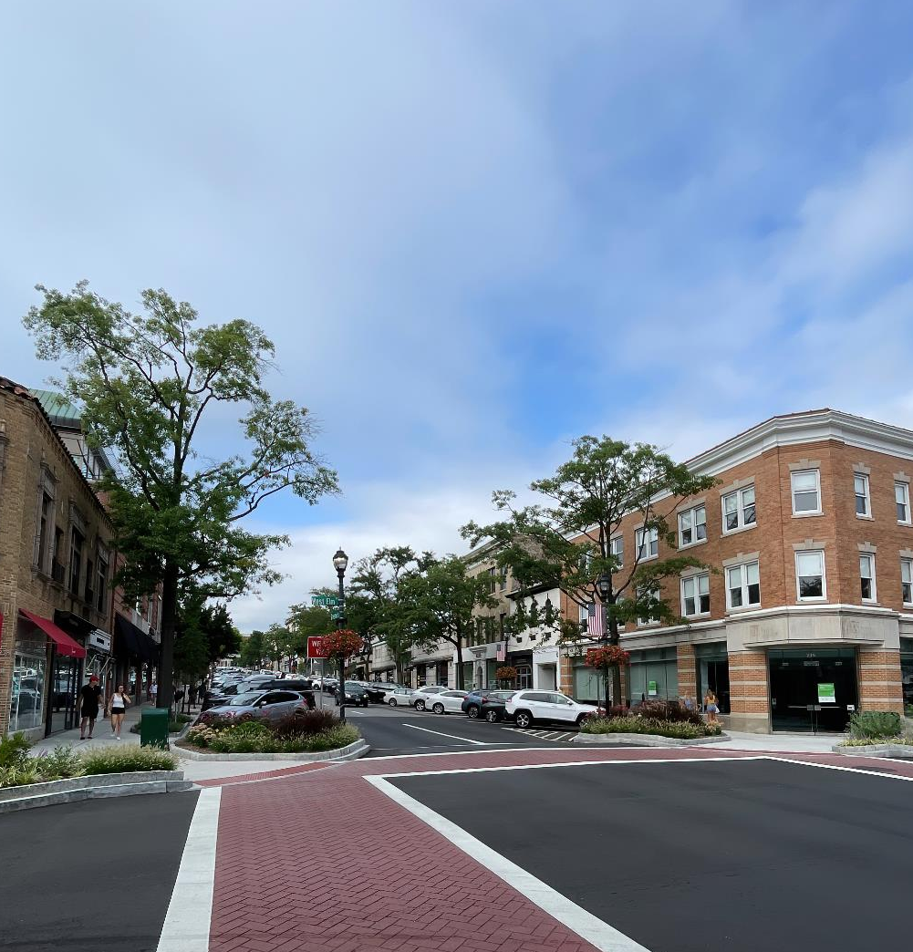
Who is Eligible?
Applicant must be a Local Public Agency (LPA)
The LPA must have a population of less than 200,000 population (according to the 2020 Census)
There must be a defined area or site with development potential
Your community DOES need to play an active role in attracting development to the site
You do NOT need detailed plans, a developer, or control of the property
You do NOT need a local match!
Creating Vibrant Communities | KYTC Transportation Development Planning Assistance Program
Notes:
LPA – city or county
Population <200,000 – many cities don’t have the staffing or funding to this level of planning
Define an area
Along a state-maintained roadway
Planning & zoning is not an eligibility requirement, but will give a leg up for those who have ability for zoning.

Slide 8
Evaluation Criteria
70% - Ability to meet program outcomes
10% - Project readiness
20% - Community readiness
Creating Vibrant Communities | KYTC Transportation Development Planning Assistance Program

Slide 9
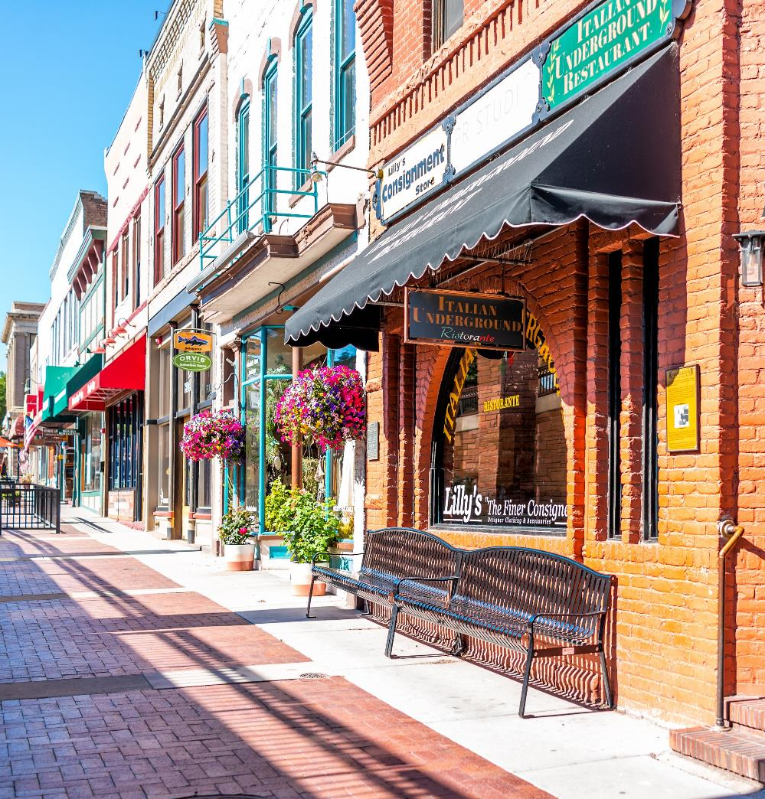
Evaluation Criteria
70% - Ability to meet program outcomes
Outcome 1: Does the community intend to create a place that will serve as a unique destination within the community?
Outcome 2: Does the community intend to provide or require better connections to adjacent sites and the larger community?
Outcome 3: Does the community feel development of this site will encourage or bolster economic development activities?
10% - Project readiness
20% - Community readiness
Creating Vibrant Communities | KYTC Transportation Development Planning Assistance Program

Slide 10

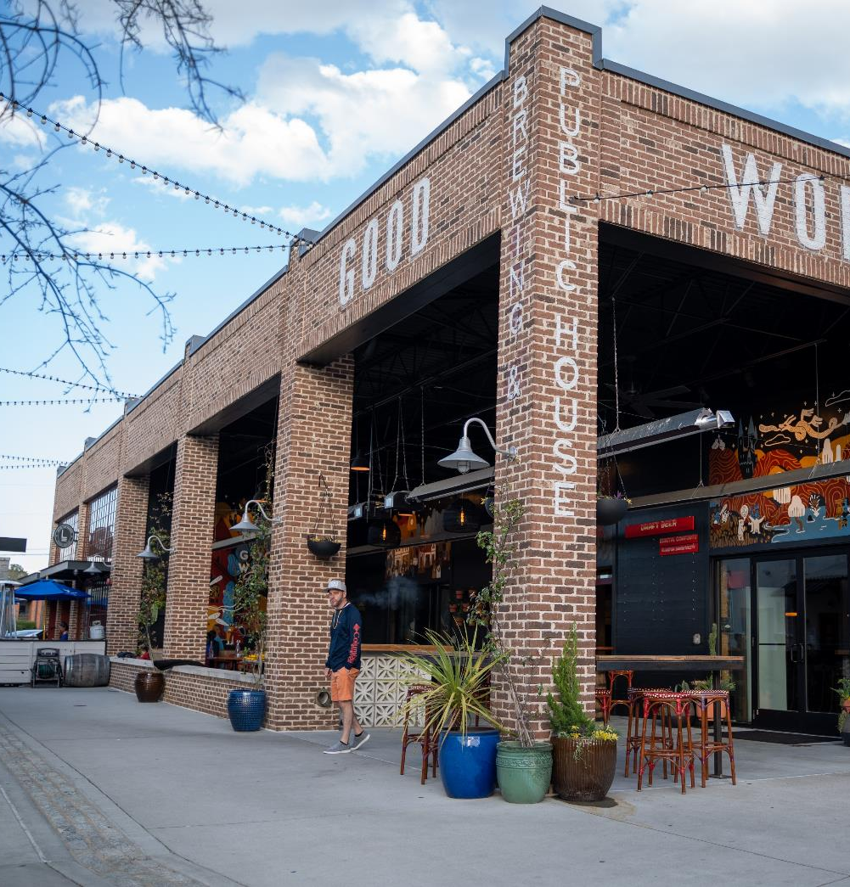
Evaluation Criteria
70% - Ability to meet program outcomes
10% - Project readiness
How ready is the site to begin the visioning process for development?
20% - Community readiness
Creating Vibrant Communities | KYTC Transportation Development Planning Assistance Program
Notes:
Site size appropriate for size of community
Have zoning code or willingness to modify zoning code to make work
Property owners willing or interested?
Site features support development potential
Utilities available – sewer, electric, water

Slide 11
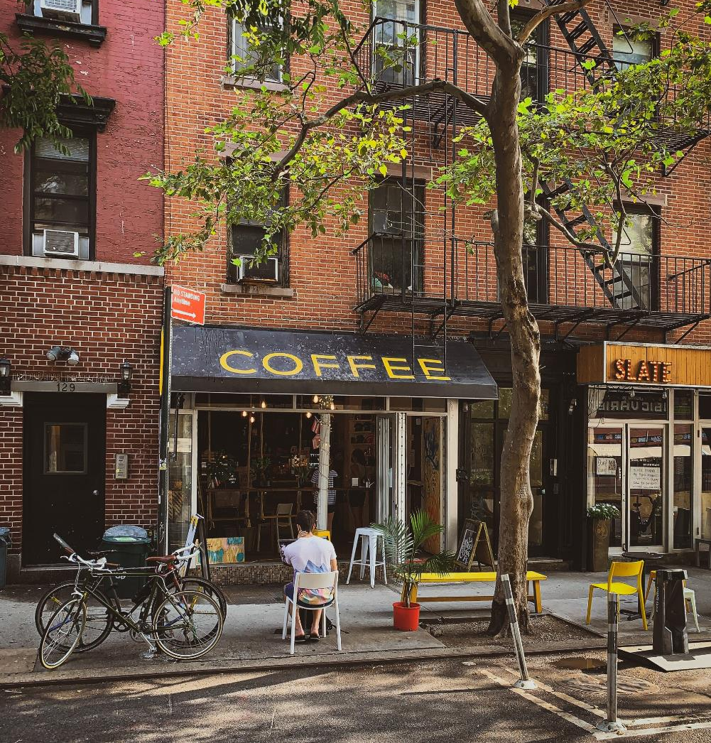
Evaluation Criteria
70% - Ability to meet program outcomes
10% - Project readiness
20% - Community readiness
How ready is the community to begin the visioning process for development?
Creating Vibrant Communities | KYTC Transportation Development Planning Assistance Program
Notes:
Previous planning efforts?
Public support
Local orgs support?
Local government support
Ability for local officials to be a part of this process
A plan for public engagement

Slide 12
Evaluation Criteria
(70%: Ability to Meet Outcomes)
Outcome 1:
Does the community intend to create a place that will serve as a unique destination within the community?
Examples of showing this could include a proposal that prioritizes or wants:
A site layout that focuses on the pedestrian to create a sense of place (not just another “average” development such as a strip mall or subdivision)
Integrate multiple types of compatible land uses within the site, including residential
A transition in use, scale, and massing to adjacent parcels and uses that does not create significant land use conflicts
Quality design of the buildings (form and architecture) and a street design that is not only focused on cars
A development that incorporates public or semi-public spaces where people can gather and interact
A development that protects environmental features and community points of interest
Creating Vibrant Communities | KYTC Transportation Development Planning Assistance Program
70% - Ability to meet program outcomes

Slide 13
Evaluation Criteria
(70%: Ability to Meet Outcomes)
Outcome 2:
Does the community intend to provide or require better connections to adjacent sites and the larger community?
Examples of showing this could include a proposal that prioritizes or wants:
Better site access that does not create vehicular congestion or safety issues
A pedestrian and bicycle network that allows people to walk to different areas safely and easily within the site
Connections for users of all modes of travel to existing roads, trails, and sidewalks on adjacent sites as well as the larger existing transportation network Equitable access for everyone within the community through a site location that is walkable to other places within the community or connected to some form of public transportation
Previous interest by private investors for development
Creating Vibrant Communities | KYTC Transportation Development Planning Assistance Program
70% - Ability to meet program outcomes

Slide 14
Evaluation Criteria
(70%: Ability to Meet Outcomes)
Outcome 3:
Does the community feel development of this site will encourage or bolster economic development activities?
Examples of showing this could include a proposal that demonstrates:
Leveraging private dollars based on public incentives offered
Creating momentum for additional sites to develop
Developing sites that are abandoned, underutilized, or not the best and highest use of the property
Prioritizing redevelopment of existing sites versus undeveloped land
Increasing or improving the tax base
Stabilizing or improving the value of adjacent properties or neighborhoods
Attracting uses that appear realistic given the local economic market and ability to implement local regulations (such as zoning)
Creating Vibrant Communities | KYTC Transportation Development Planning Assistance Program
70% - Ability to meet program outcomes

Slide 15
Evaluation Criteria
(10%: Project Readiness)
How ready is the site to begin the visioning process for development?
Examples of showing this could include a proposal that demonstrates:
Willingness that property owners within the study area are open to development occurring
Previous interest by private investors for development
Existing regulations (such as zoning) that are in place or could reasonably be adopted that would be needed for development to occur
Site size could be reasonably developed based on the size of the community
Existing site features (such as slope) support development potential
Existing utility connections and capacities support Development
Creating Vibrant Communities | KYTC Transportation Development Planning Assistance Program
70% - Ability to meet program outcomes

Slide 16
Evaluation Criteria
(20%: Community Readiness)
How ready is the community to begin the visioning process for development?
Examples of showing this could include a proposal that demonstrates:
The ability of local officials to play an active role in implementation, such as the ability to evaluate redevelopment incentives, adopt local regulations, actively market the site, coordinate necessary utilities, etc.
Previous planning efforts that discussed this site or area
Public support for the project or openness for development to occur
Relationship to any other local, regional, or state initiatives or projects that this would support
LPA plan to engage the public, partners, and property owners throughout the planning process
A plan for engagement of the public, local officials, and stakeholders during the planning phase and implementation
Creating Vibrant Communities | KYTC Transportation Development Planning Assistance Program
70% - Ability to meet program outcomes

Slide 17
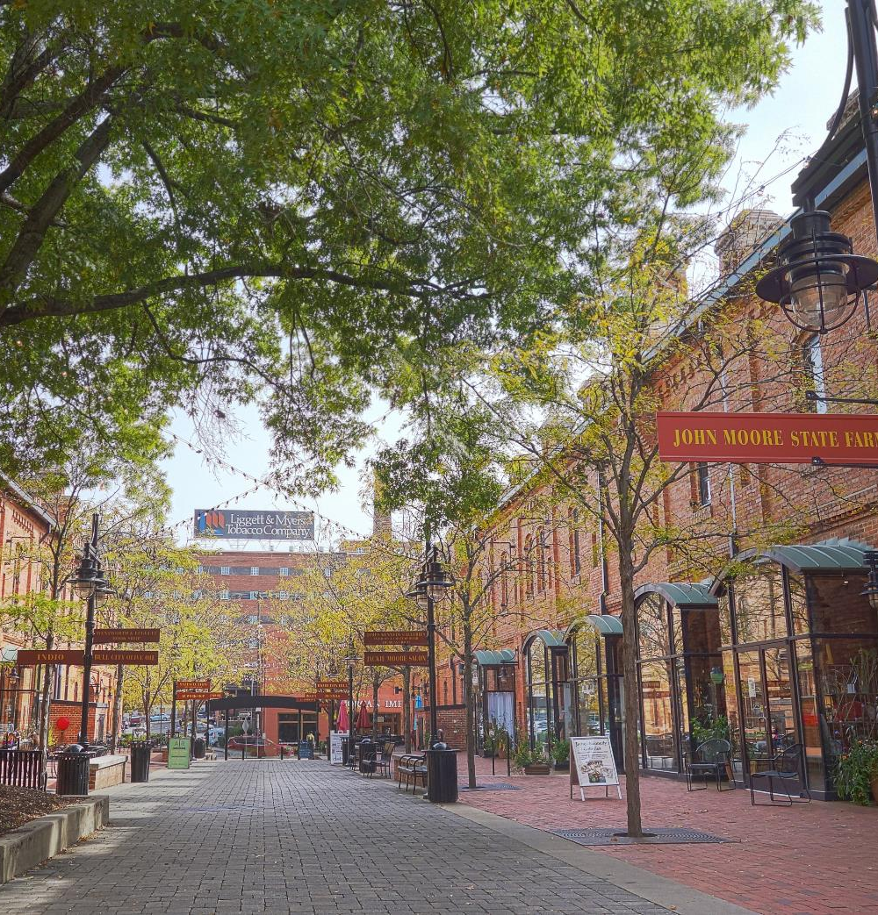
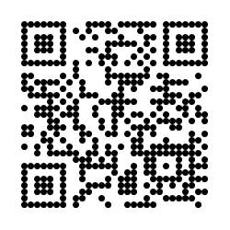
How Do I Apply?
Project website:
  Online application
  FAQ and Project Overview
Applications due December 11
Questions: Brent.Sweger@KYTC.gov
Creating Vibrant Communities | KYTC Transportation Development Planning Assistance Program

