Slide 1
TRAK
Transportation Report and Analysis for Kentucky
Chris Lambert, Business Intelligence Architect
January 21, 2026

Slide 2

Transportation Report & Analysis for Kentucky
Transforms complex data into actionable insights.
https://trak.kytc.ky.gov/

Slide 3

Platform Capabilities
330 Data Connections
40 million records updated each night
Over 100 Datasets or Views
Assets
Contracts
Six Year Plan
Change Orders
Snow and Ice
Resources
Exploratory Data

Slide 4
TRAK Components
Written Report
Editorialized
Dashboard
Executive Dashboards
Exploratory Data Analysis
Supporting Data Sets
Datahub
Overall Trends
Executive Leadership and Legislative Audience
Detailed Views
Data Tables
Cabinet Staff Audience
Clean Visualization
Ability to Filter and Perform Aggregations
Downloads for Further Analysis
Data Catalogue
Description of Contents
Ability to Download for Further Analysis

Slide 5
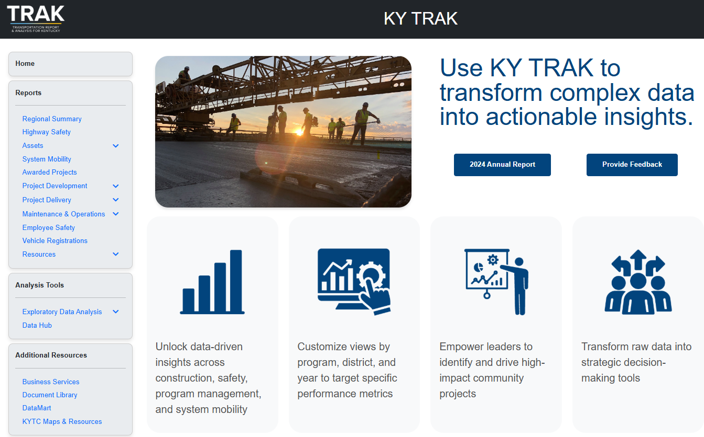
trak.kytc.ky.gov

Slide 6
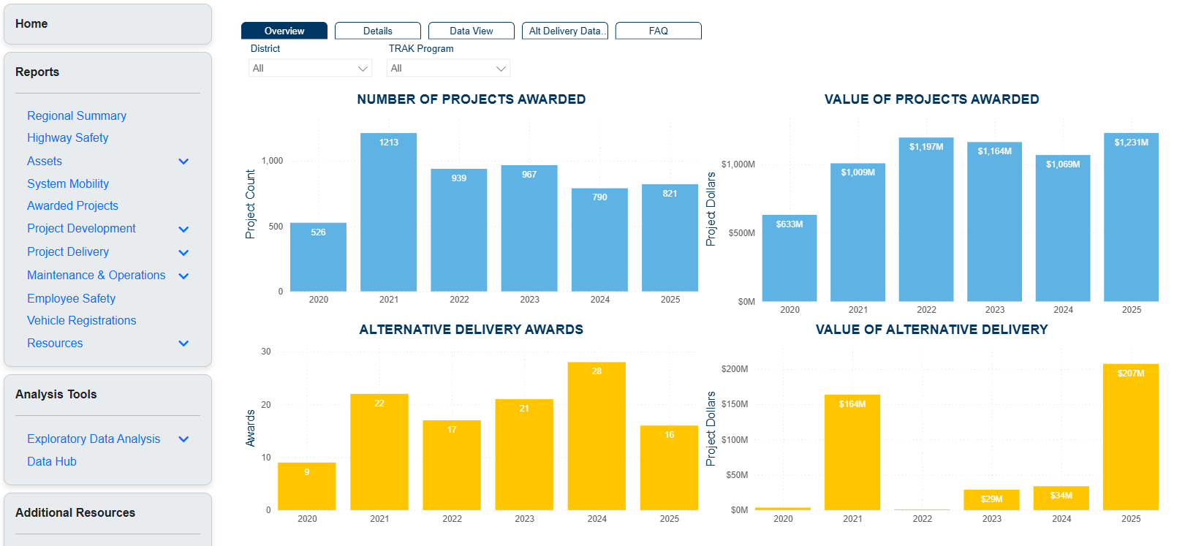
Reports: Overview

Slide 7
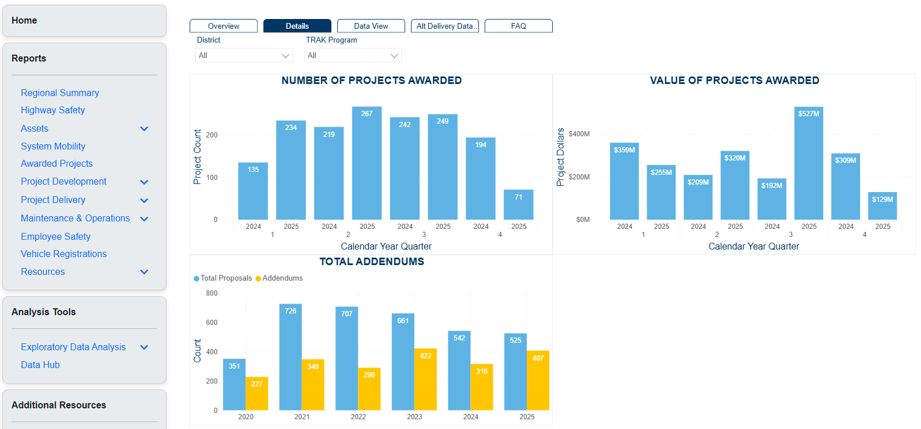
Reports: Details

Slide 8
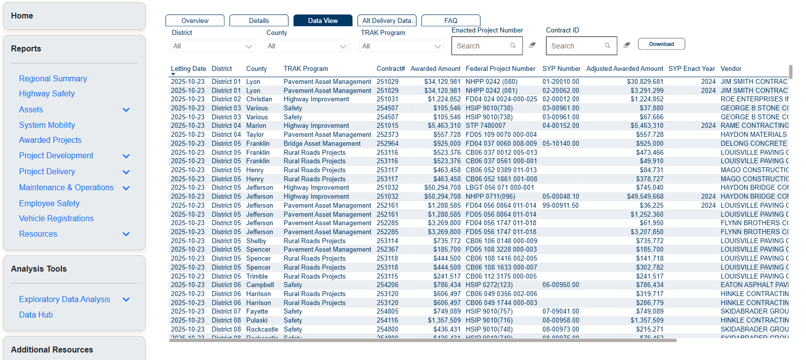
Reports: Data View & Downloads

Slide 9
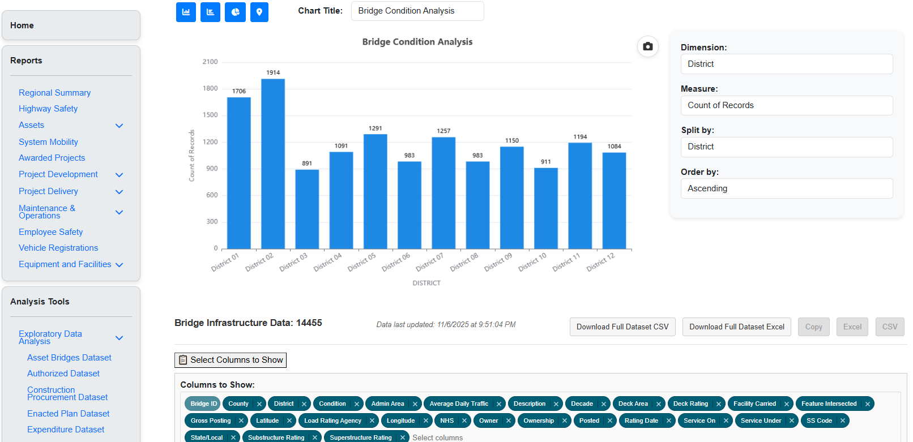
Exploratory Data Analysis

Slide 10
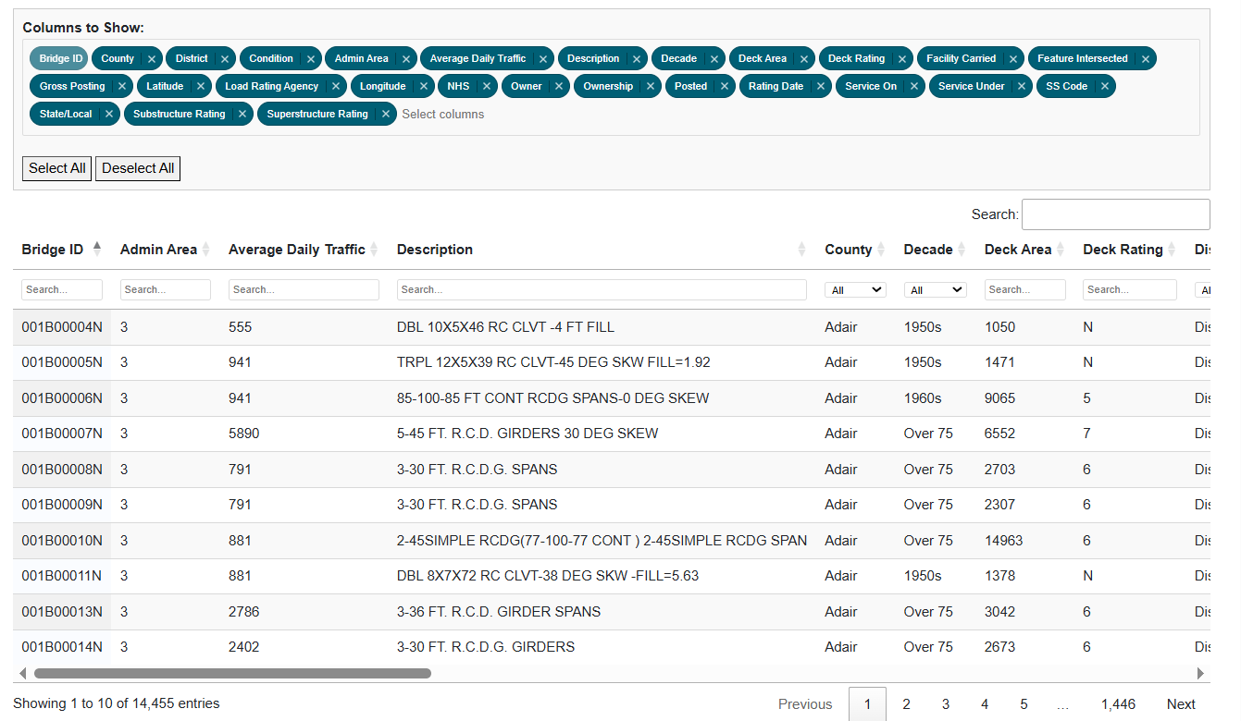
Exploratory Data Analysis

Slide 11
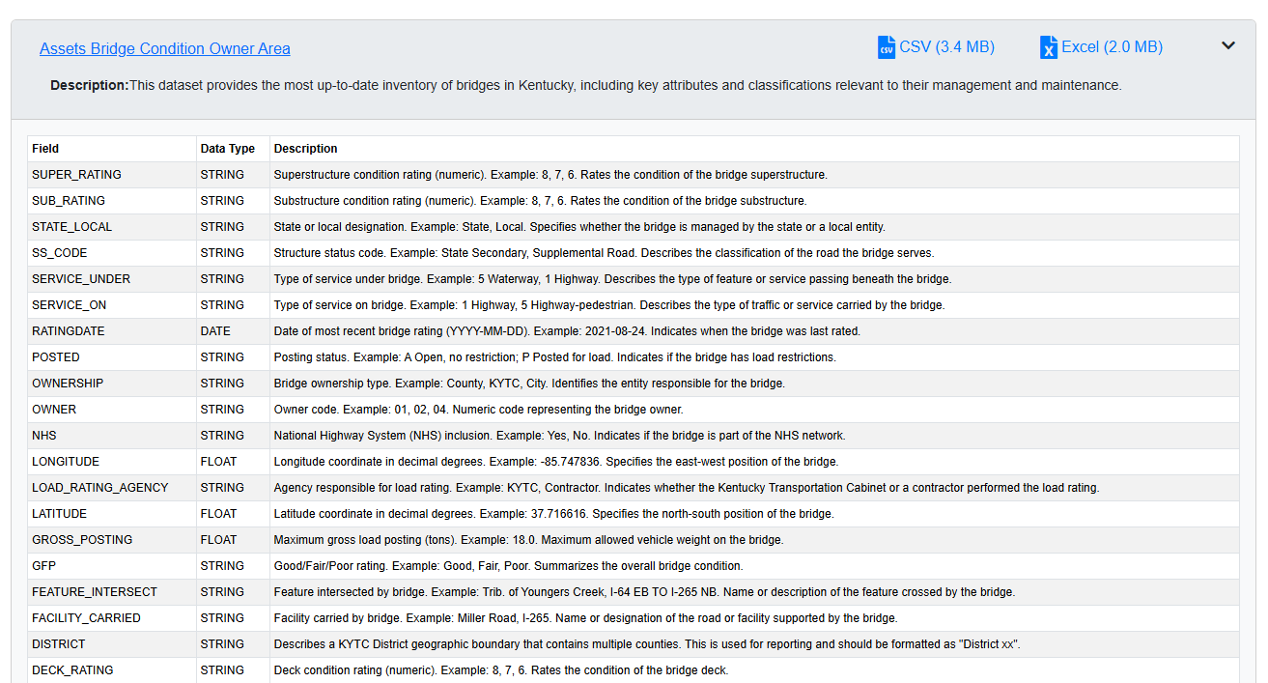
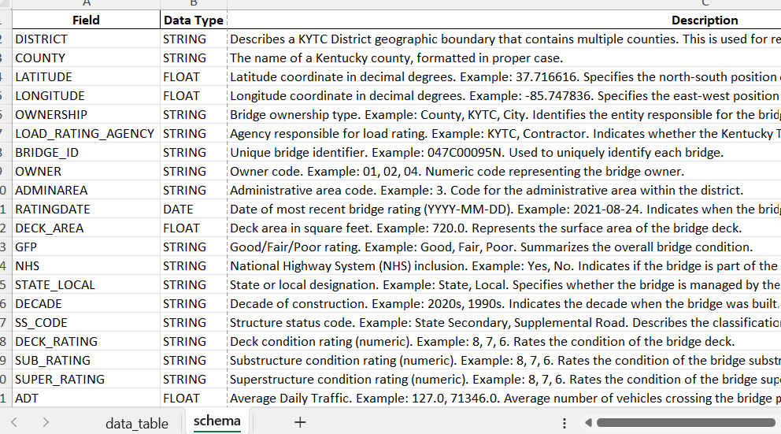
Data Hub

Slide 12
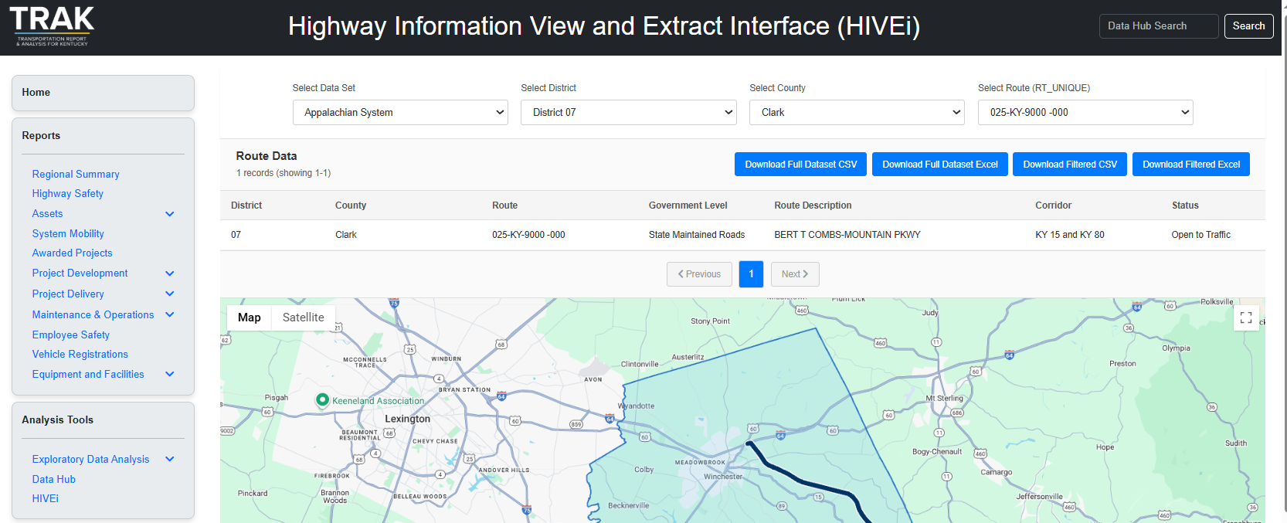
Coming Soon: HIVEi and CTS

Slide 13

Next Steps
Increased data sets and functionality
Refreshed look
Spatial components
Connecting to processes
Increased presence
World Domination
Notes:
I hope they have a sense of humor.

Slide 14
https://trak.kytc.ky.gov/
Tracy Nowaczyk, P.E.
Assistant State Highway Engineer
tracy.nowaczyk@ky.gov
Chris Lambert
Business Intelligence Architect
chris.lambert@ky.gov

