Slide 1
Federal Performance Reporting
Tracy Nowaczyk, P.E.
Assistant State Highway Engineer
January 2026

Slide 2

Why Performance?
Connects programs to mission
Maximizes the impact of dollars
Evaluates progress
Empower staff to use available data
Knowledge management
Communication
Notes:
Fosters conversations around the needs of communities
Brings together high-quality data and insight from subject matter experts and local leaders
Allows for fair and balanced resource management that makes a difference in each of the 12 districts

Slide 3

Performance Is Not
Report carding
Data only decision making
Only for management

Slide 4
Federal Performance Reporting
Transportation Performance (TPM)
KYTC Role
Complete
Accountable
Consistent
Identify available data
Provide discussion of performance, progress, investments
Provide discussion of how targets support national goals
Collect and submit required data
Document extenuating circumstances

Slide 5
Reporting Period
October 2022
Full Performance Period Report/Baseline Performance Period
October 2024
Mid Performance Period Progress Report
October 2026
Full Performance Period Report/Baseline Performance Period Report
MPOs have 180 days after state target setting to support or set their own targets

Slide 6
Performance Reporting
CONTENT | BASELINE | MID PERIOD | FULL PERIOD
2 Year Targets | X
4 Year Targets | X
Basis for Targets | X
Baseline Conditions | X
Ties to Other Plans | X
Actual Conditions |  | X | X
Progress Discussion |  | X | X
Investment Strategy Discussion |  | X | X
Adjusted 4 Year Targets |  | X
Extenuating Circumstances |  | X | X
Target Achievement Discussion |  | X | X

Slide 7
Performance Measures
PM | SUBPART | CATEGORY
1 | B | SAFETY
2 | C | PAVEMENT CONDITION
2 | D | BRIDGE CONDITION
3 | E | SYSTEM PERFORMANCE
3 | F | FREIGHT
3 | G | CMAQ
3 | H | CMAQ

Slide 8
Safety
  Crash data is pulled from the Crash Facts book produced annually by KTC for all available years. The most recent previous year is based on preliminary crash data from the CRASH database.
  VMT data is pulled from the Division of Planning’s webpage for all available years. The most recent previous year is based on preliminary VMTs
  If any of the future targets are predicted to be higher than the most recent actual 5 year average, then the most recent actual 5 year average will be the recommended safety target to establish a cap number

Slide 9
Pavement
Reported Measures:
  International Roughness Index (IRI)
  Percent Cracking
  Rutting (Asphalt)
  Faulting (Concrete)
For a pavement section to be rated “Poor” two of the three measures must fail
For a pavement section to be rated “Good” all three measures must pass

Slide 10
Pavement Rating Thresholds
MEASURE | POOR | FAIR | GOOD
IRI | > 170 | 95 - 170 | < 95
CRACKING % (Asphalt) | > 20% | 5% - 20% | < 5%
CRACKING % (Concrete) | > 15% | 5% - 15% | < 5%
RUTTING | > 0.4" | 0.2" - 0.4" | < 0.2"
FAULTING | > 0.15" | 0.1" - 0.15" | < 0.1"

Slide 11

Bridge
Bridge Condition is determined by the lowest rating of National Bridge Inventory (NBI) condition ratings for Item 58 (Deck), Item 59 (Superstructure), Item 60 (Substructure), or Item 62 (Culvert). All Items are rated from 0 to 9.
If the lowest rating is greater than or equal to 7, the bridge is classified as Good
If it is less than or equal to 4, the classification is Poor.
Bridges rated 5 or 6 are classified as Fair.

Slide 12
System Performance and Freight
Three different measures are needed for target setting:
  Subpart E – Interstate Travel Time Reliability
  Subpart E – National Highway System (Non-Interstate) Travel Time Reliability
  Subpart F – Interstate Truck Travel Time Reliability
Each measure was calculated by KYTC and RITIS.
  RITIS is part of a pooled fund study that KYTC participates in that calculates these measures for each State and MPO

Slide 13

Considerations for Target Setting
Is there a specific cause of prior congestion such as a major construction project, change in traffic patterns, etc.?
Will the cause be present in future years?
Will any linear or exponential trend line likely continue into the future?
TRANSPORTATION.KY.GOV

Slide 14
Trends
 |  |  |  | 2022 | 2024 | 2024 | 2026
PM | Subpart | Category | Measure | Baseline | 2 Yr Target | Actual | 4 Yr Target
2 | C | Pavement Condition | % Interstates on NHS in Good Condition | 66.2 | 55 | 70.9 | 60
2 | C | Pavement Condition | % Interstate on NHS in Poor Condition | 0.9 | 4 | 1.4 | 3
2 | C | Pavement Condition | % Non-Interstate NHS in Good Condition | 58.6 | 35 | 61.1 | 40
2 | C | Pavement Condition | % Non-Interstate NHS in Poor Condition | 1.3 | 6 | 0.7 | 5
2 | D | Bridge | % NHS Bridge Deck Area in Good Condition | 28.6 | 31 | 26.3 | 25
2 | D | Bridge | % NHS Bridge Deck Area in Poor Condition | 3.8 | 3.7 | 4 | 4
3 | E | System Performance | % of Person Miles Traveled on Interstate that is Reliable (LOTTR) | 97.6 | 95 | 96.3 | 93
3 | E | System Performance | % of Person Miles Traveled on Non-Interstate that is Reliable (LOTTR) | 93.7 | 91 | 93.2 | 91
3 | F | Freight | TTTR - sum of max TTTR for each reporting system/total interstate system | 1.26 | 1.3 | 1.26 | 1.35

Slide 15
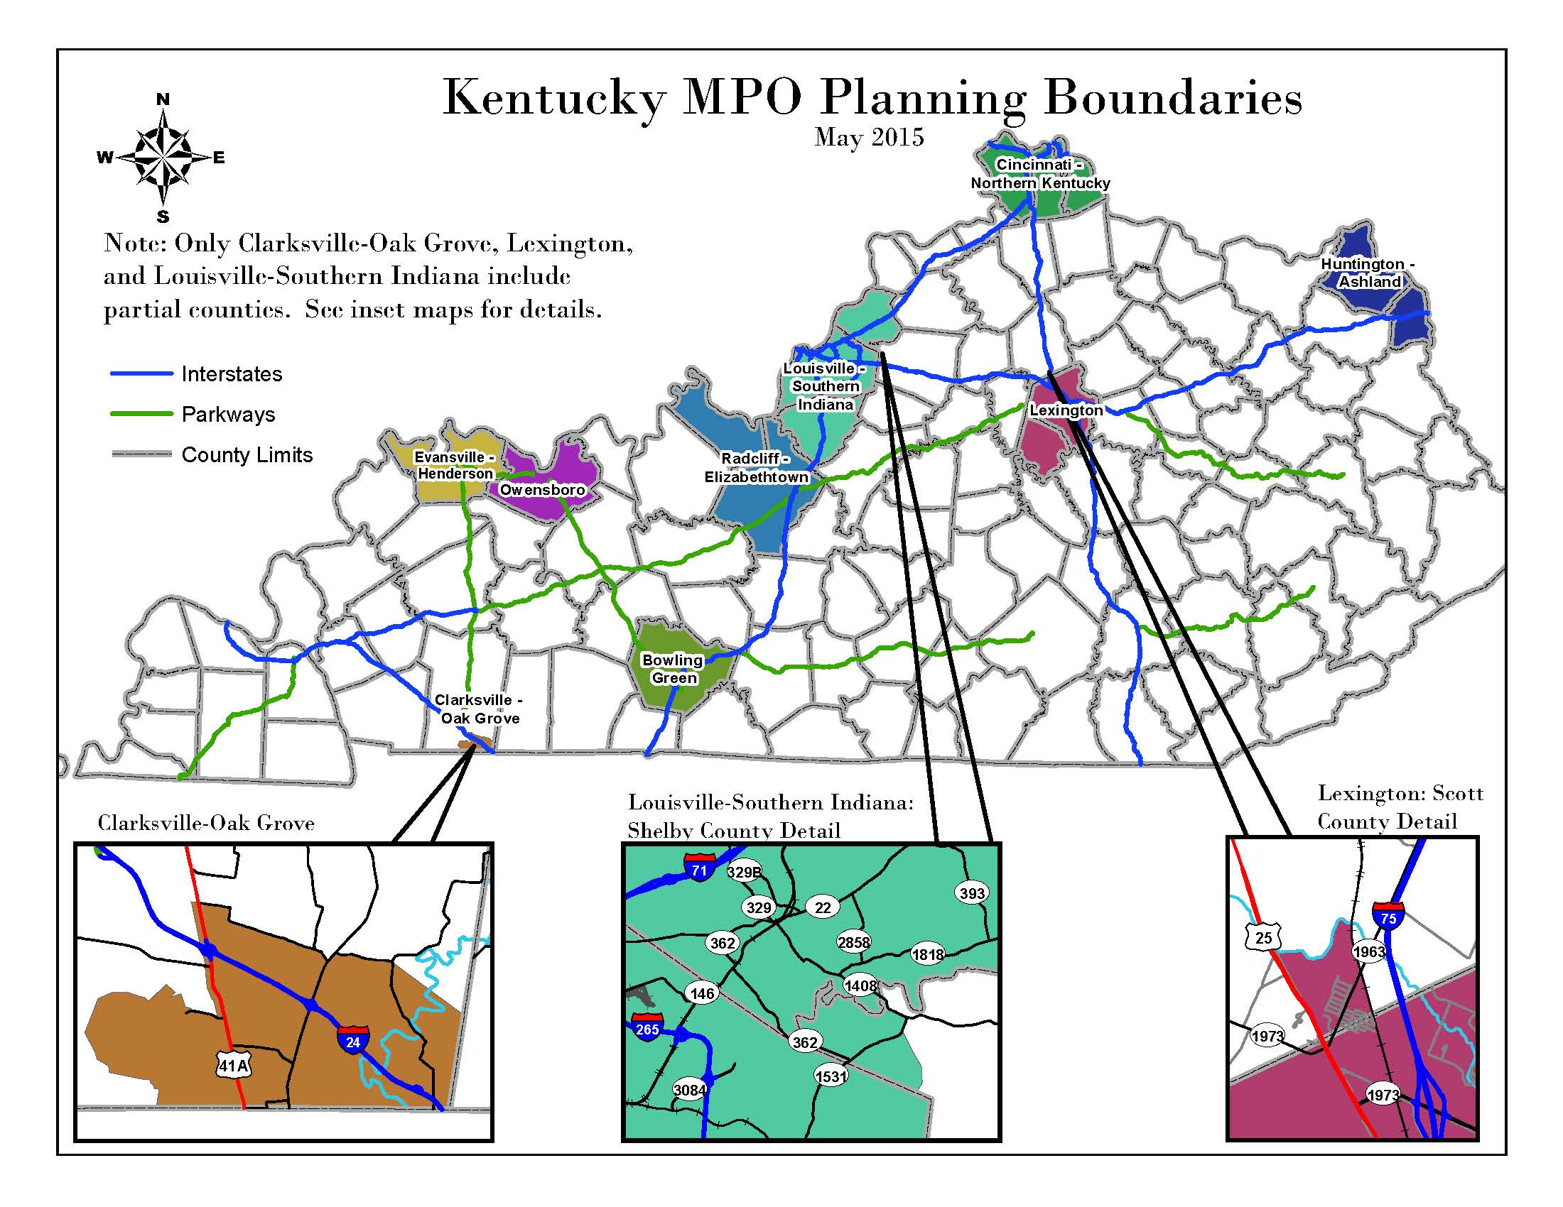
Coordination with MPOs
KYTC shares inventory and their performance measures annually.
MPOs may support KYTC’s 4-year target or establish their own.

Slide 16

Transportation Report & Analysis for Kentucky
Transforms complex data into actionable insights.
https://trak.kytc.ky.gov/
Notes:
Improve decision-making and performance tracking with timely and accurate data

