Slide 1
Transportation Resiliency
State Transportation Planning Meeting
Tracy Nowaczyk, PE
Frankfort, Kentucky | January 15, 2025

Slide 2
Vision
Striving to be national leaders in transportation who provide transportation infrastructure and services for the 21st century that deliver new economic opportunities for all Kentuckians.
Mission
To provide a safe, efficient, environmentally sound and fiscally responsible transportation system that delivers economic opportunity and enhances the quality of life in Kentucky.

Slide 3
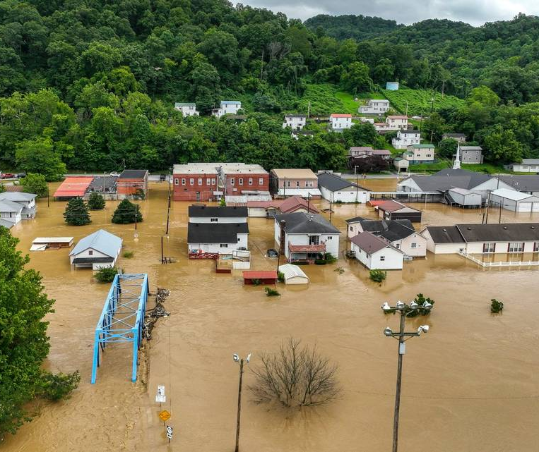
Resiliency
Ability to anticipate, prepare for, and adapt to changing conditions and withstand, respond to, and recover rapidly from disruptions.

Slide 4
Natural Hazard Risks
Flood
Snow
Wind
Earthquake
Heat

Slide 5
Understanding Risk

Slide 6
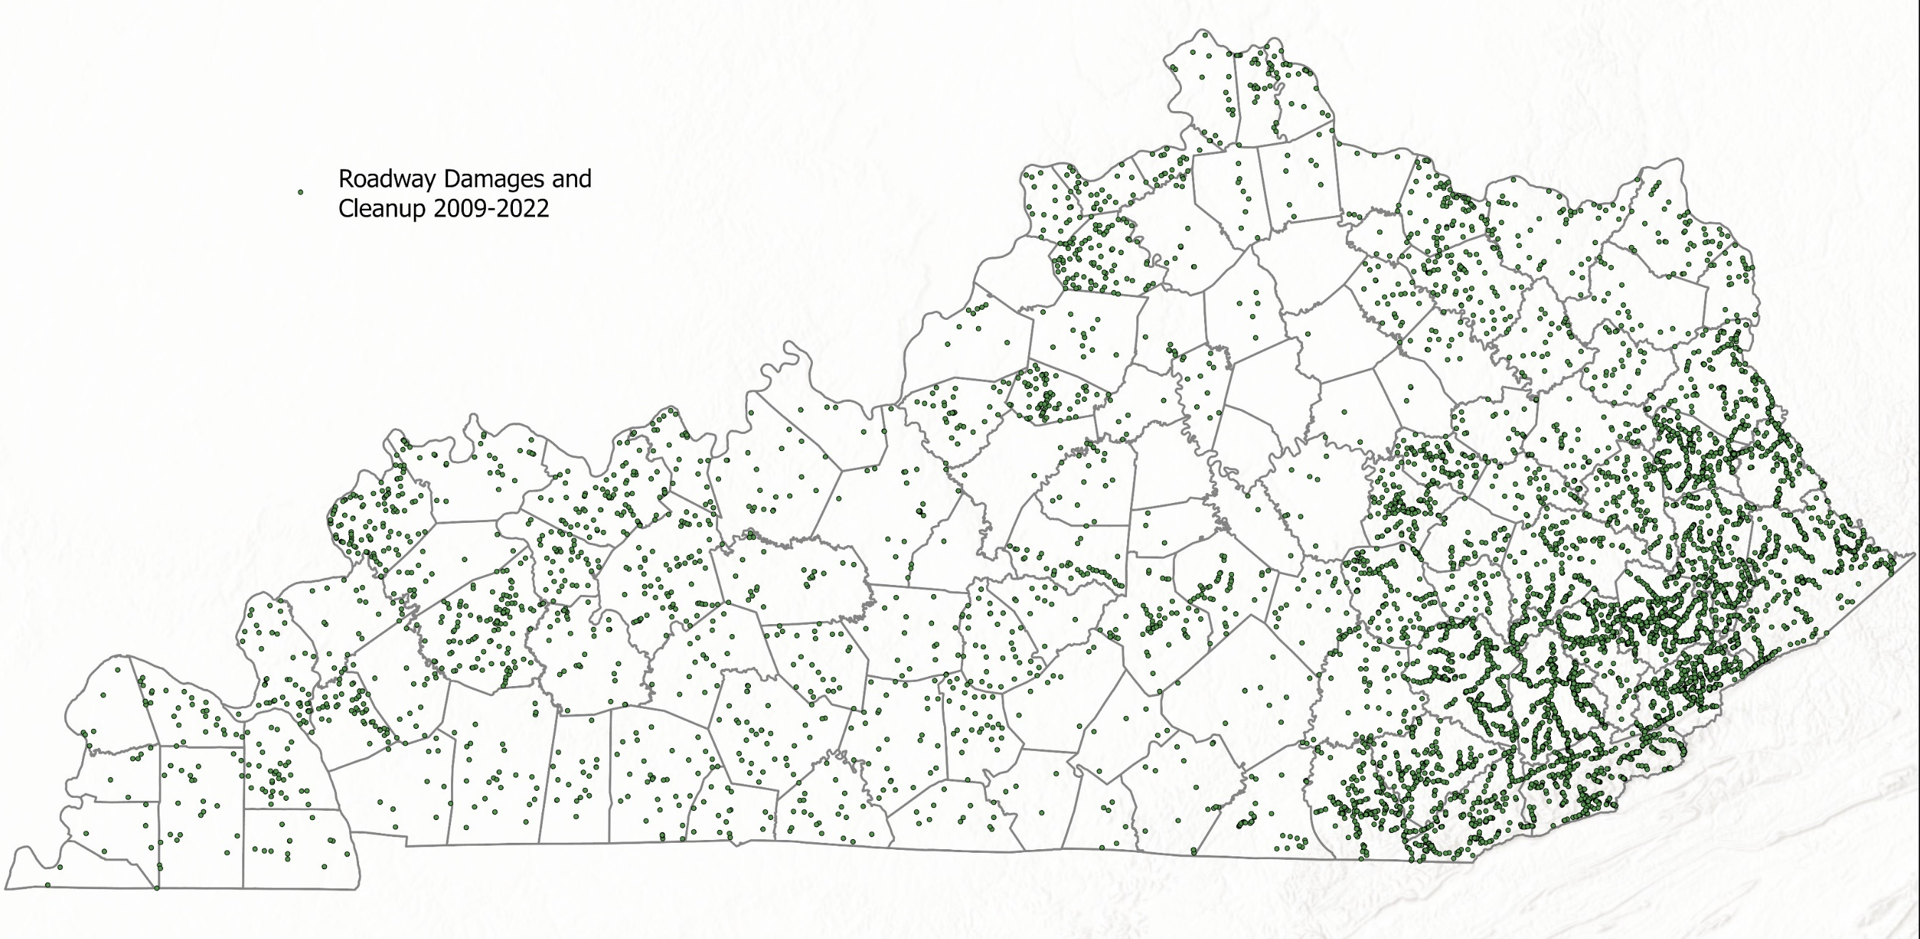

Slide 7
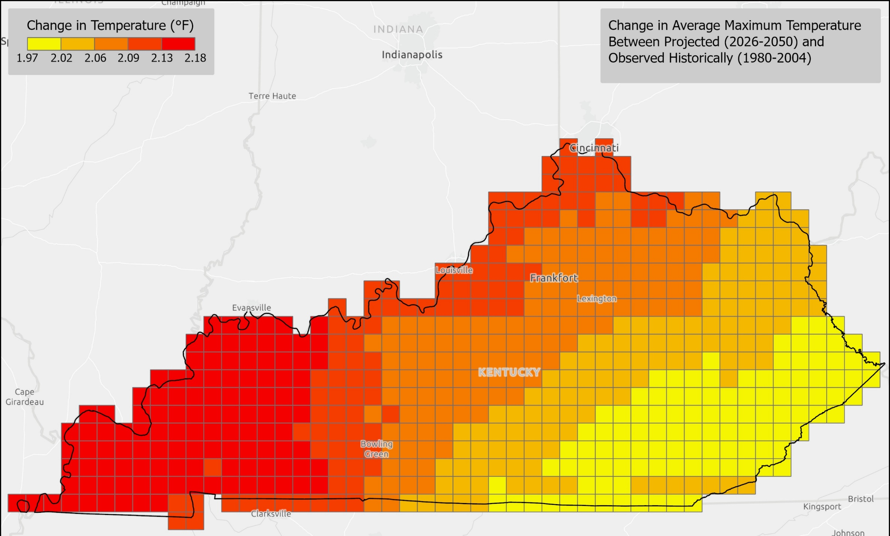

Slide 8
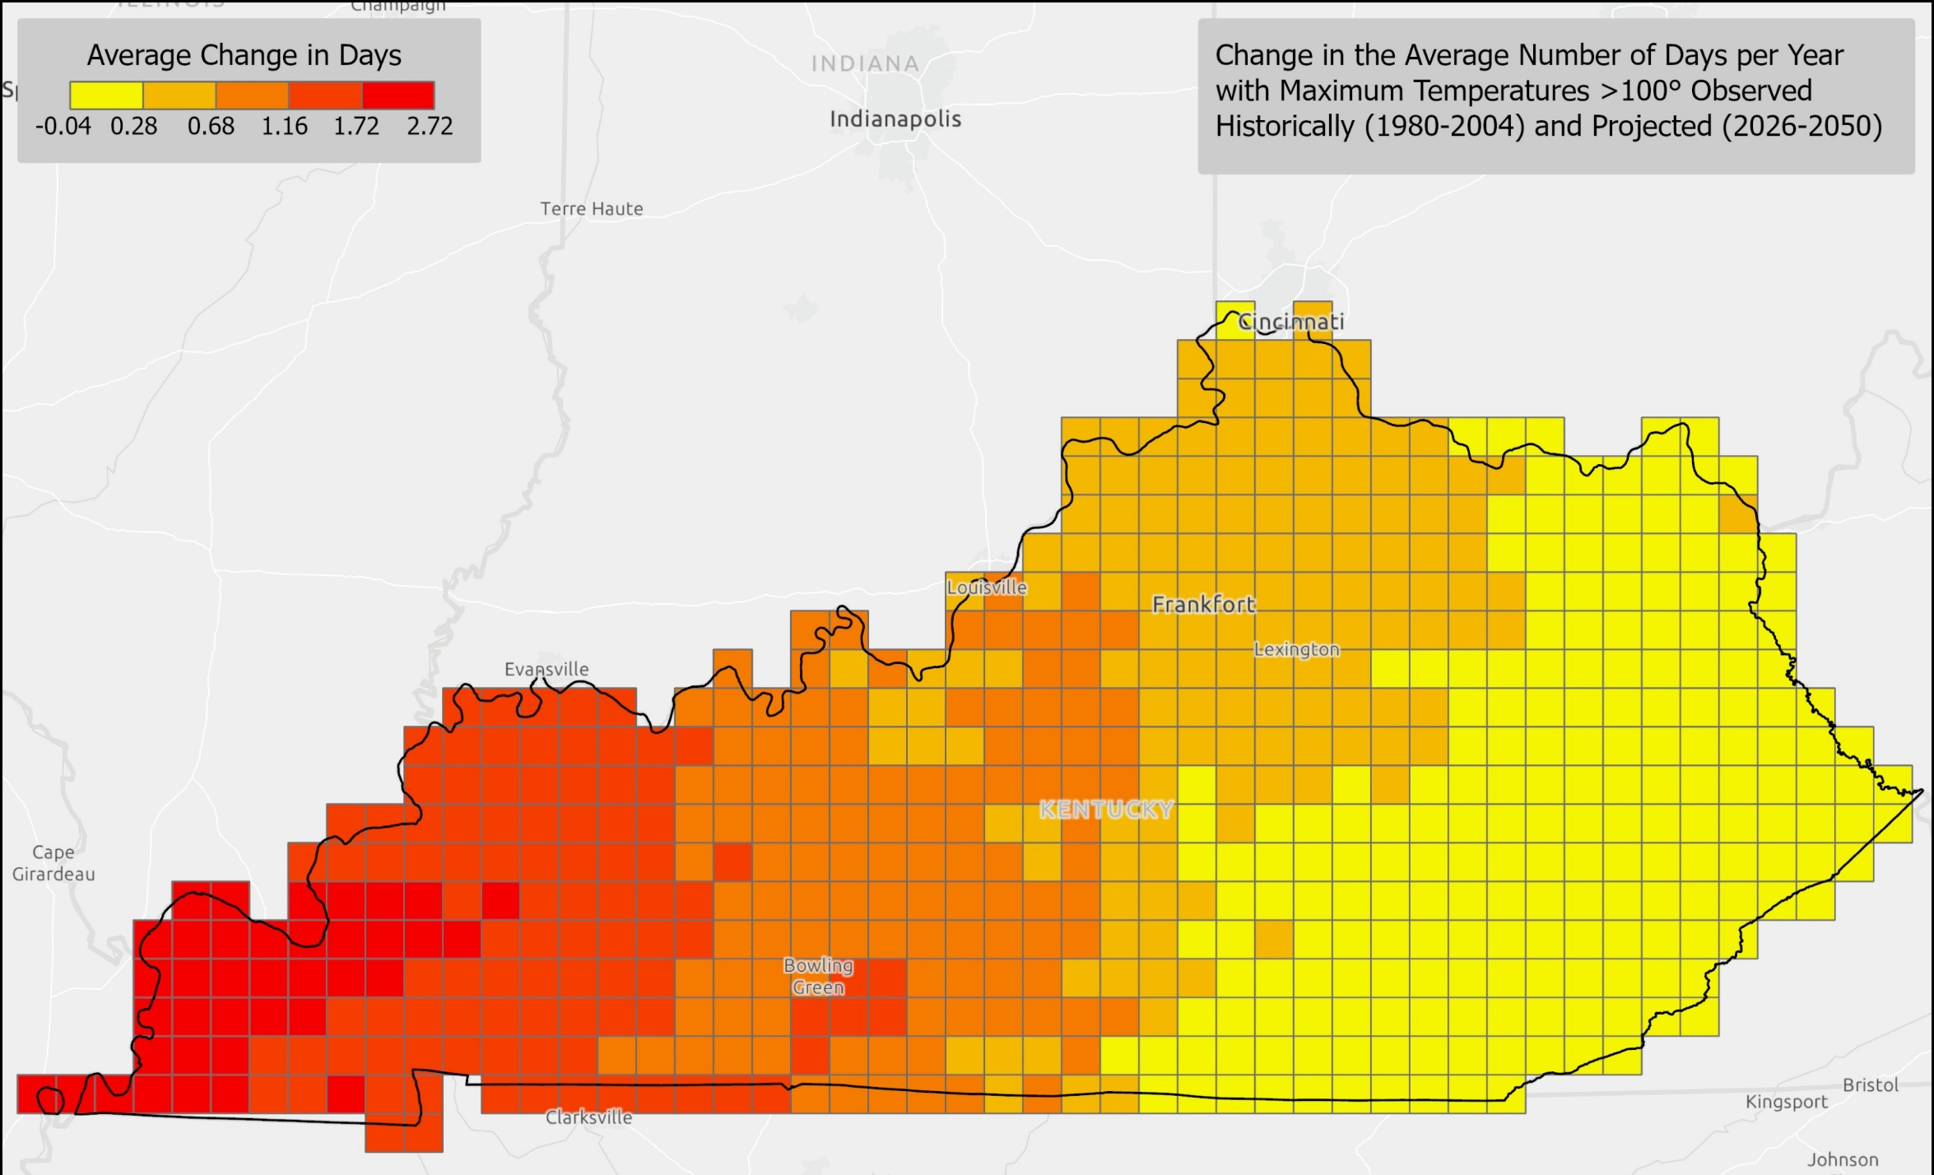

Slide 9
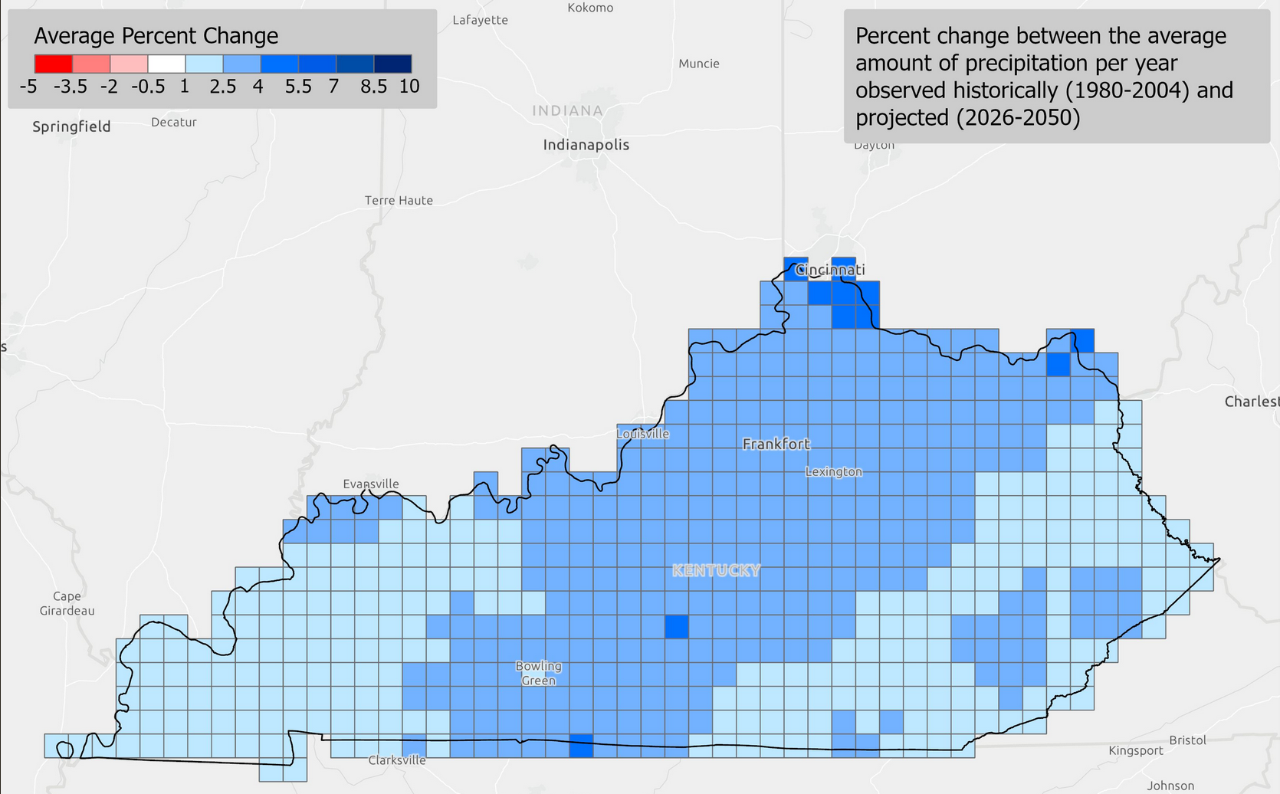

Slide 10
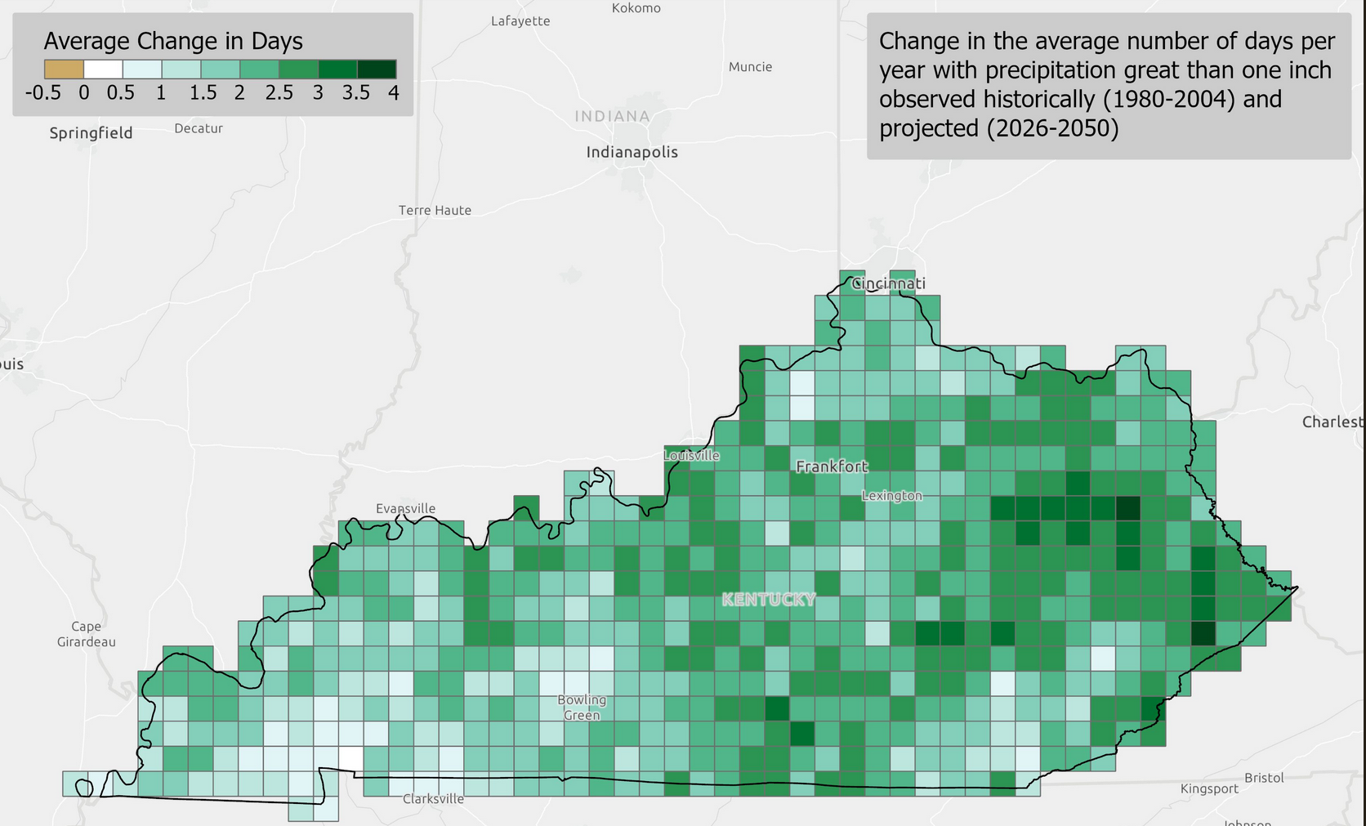

Slide 11
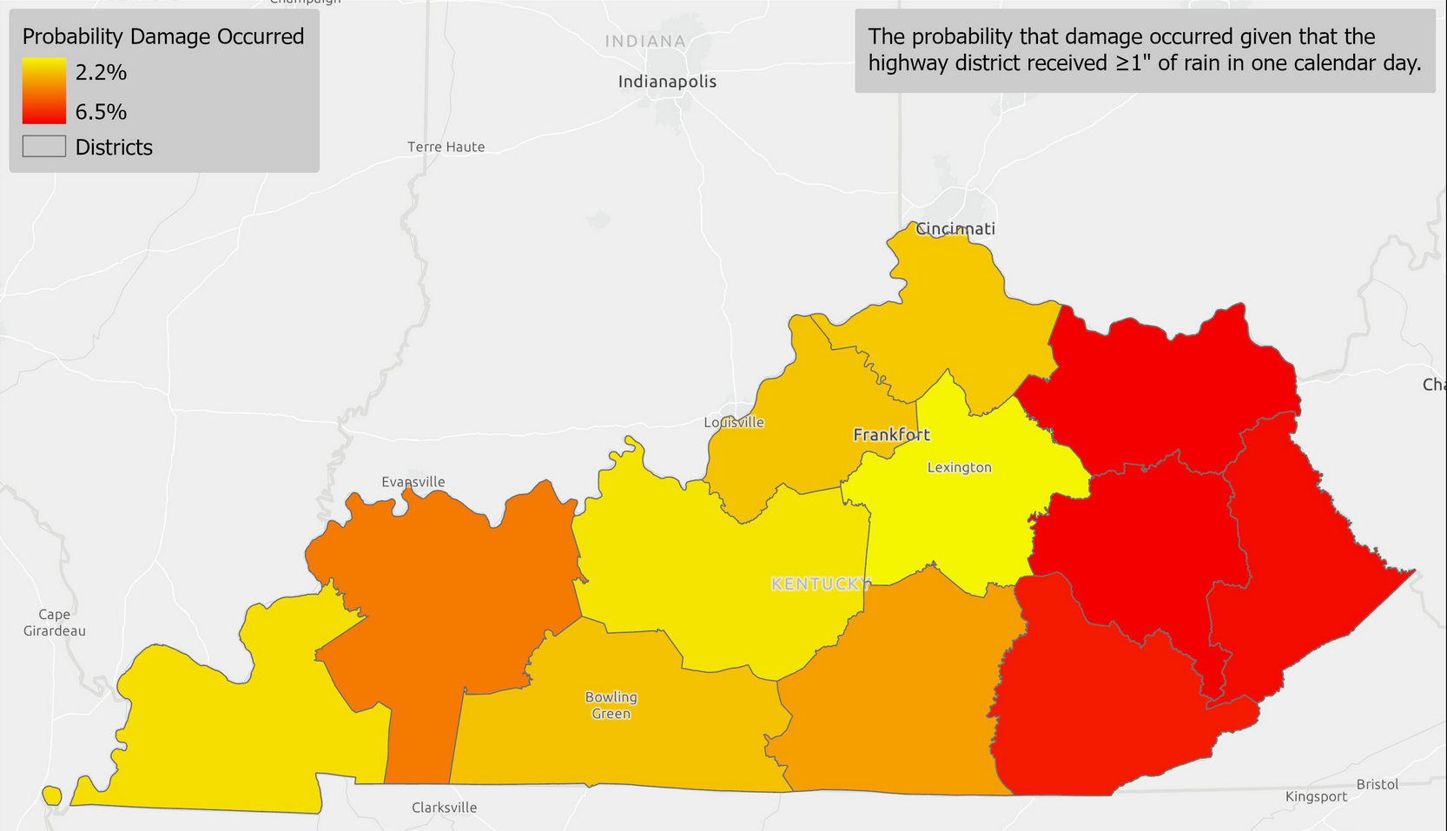

Slide 12
KYTC Investments
Mitigation
Resilience Criteria in SHIFT
Response
Debris Removal
Resiliency Criteria in Asset Management
PROTECT projects
Emergency Personnel
Emergency Supplies and Equipment
Preparation
Vulnerable Assets
Recovery
Infrastructure Projects
Climate Impact Research
Transportation Resiliency Improvement Plan
Grants
FEMA/ER Reimbursements

Slide 13
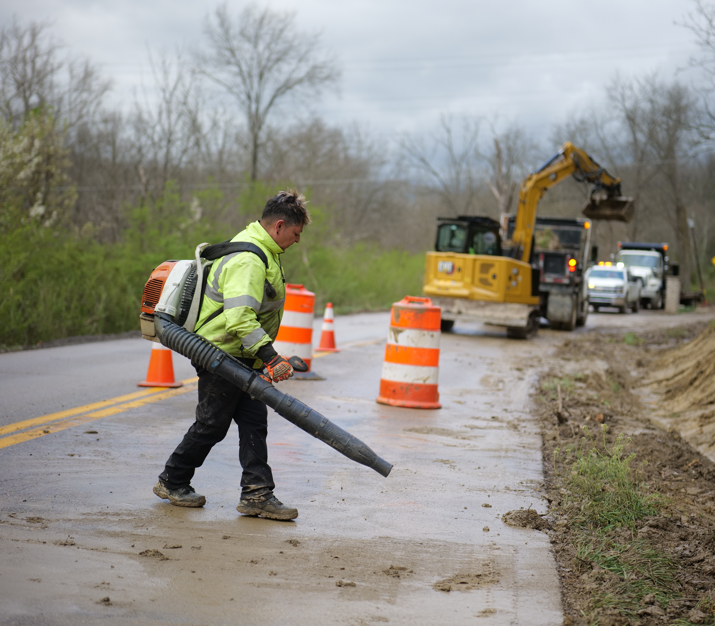
Transportation Resiliency Improvement Plan (TRIP)
Better place Kentucky to prepare for, respond to, and withstand future extreme weather and natural hazard events in order to provide a more resilient transportation system
Climate Hazards
Historic Damages
Vulnerability
Strategies

Slide 14
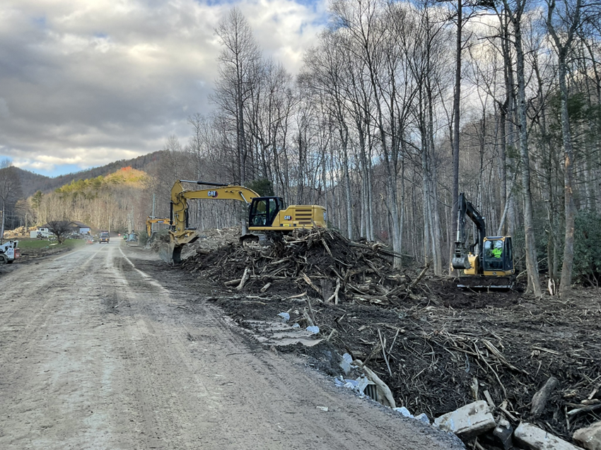
Next Steps
Policy and Planning
Strategic Connections
Investment
Prioritization Research
Communication
Develop Agency Understanding
Performance Measures
Emergency Support Considerations
Contract Structures

Slide 15
Resources
Transportation Asset Management Plan (TAMP)
Long Range Statewide Transportation Plan (LRSTP)
Commonwealth of Kentucky Enhanced Hazard Mitigation Plan (EHMP)
Transportation System Vulnerability and Resilience to Extreme Weather Events and other Natural Hazards (2016/2018)
Asset Management, Extreme Weather, and Proxy Indicators (2019)
Transportation Resiliency Improvement Plan (2023)

Slide 16
Tracy Nowaczyk, PE
Assistant State Highway Engineer

