Slide 1

KYTC’s
S.H.I.F.T
Strategic Highway Investment Formula for Tomorrow

Slide 2
2026 Updates & Changes

Slide 3
SHIFT Process
Sponsorship
Review and Statewide Scoring
Statewide Priorities
Project Boosting
Regional Priorities
Recommended State Highway Plan
Project Identification
Regional Scoring

Slide 4
Project ID and Sponsorship
Sponsorship is now live!!

Slide 5
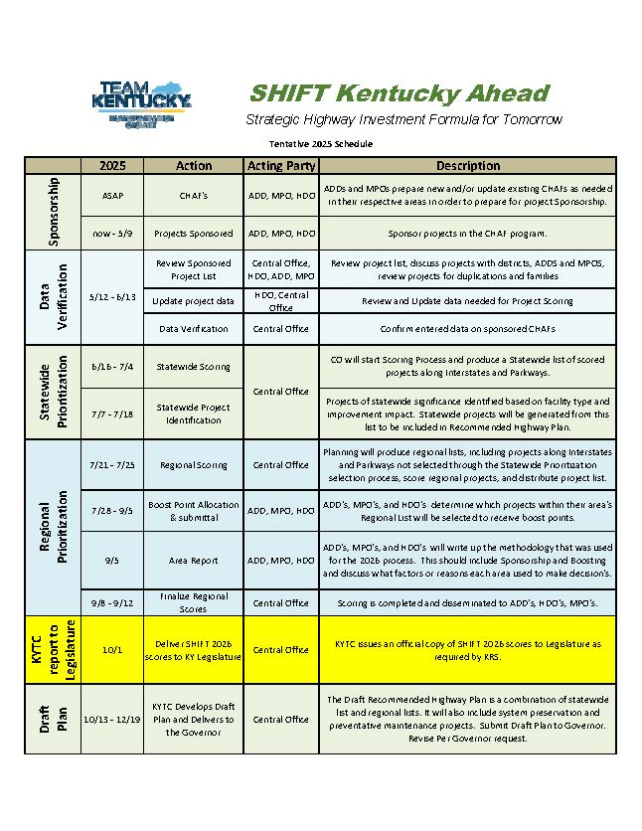

Slide 6
Statewide Scoring
Projects on Interstates and Parkways eligible for Statewide Priority

Slide 7
Formula Components & Objectives
SAFETY
Evaluate the project’s previous 5 yr. Crash information.
CONGESTION & RELIABILITY
ECONOMICE GROWTH
Quantify the project’s economic competitiveness or accessibility/connectivity at a countywide level.
ASSET MANAGEMENT
BENEFIT/COST
NON-MOTORIZED MOBILITY
RESILIENCE
Measure to prioritize most critical roadways to ensure the continued flow of people and goods during both regular and extraordinary times of need.
Evaluate the roadway characteristics of the project area.
Measure the impact on the freight network within the project area.
Measure on a Project’s potential to create new jobs. (STATEWIDE)
The ratio of a projects expected financial societal improvements (currently safety and congestion relief) to its total cost.
A maximum of two complex measures indicating distress or functional deficiencies for bridges and pavements.
A measure of the potential benefits (Health, Auto Trip Reduction, Community) that bicycle and pedestrian facilities proposed could provide to the project.
A measure equally combining the value of hours of delay and extra time required to allow for on time arrival

Slide 8
SHIFT 2024 Approach
Allocated the max of the two scores on a 5 point scale
Score | Bicycle Project
5 | New bicycle multi- or shared-use path, buffered bicycle lane, separated bicycle lanes, rail-trail
4 | New bicycle lane
3 | Improve bicycle facility (create buffer on existing lanes, widen bicycle lanes, pave shoulder, …)
2 | Signalization for bicycles; Sharrows
1 | Bicycle amenities (parking, signing, etc.)
0 | No project defined
Score | Pedestrian Project
5 | New pedestrian multi- or shared-use path, sidewalk or trail
4 | Sidewalk Improvement (widening, major repair/replacement of discontinuous or poor condition); Trail improvement
3 | Crossing island, curb extensions, streetscape
2 | Signalization improvements
1 | Wayfinding
0 | No project defined

Slide 9
Ped-Bike Benefit Estimation
Estimate Existing Commuters and Recreational Non-Motorized Users
Use facility buffers and ACS data to estimate current users
Forecast Demand
Estimate future user demand for proposed facility
Calibrate Demand
Adjust demand for location and weather impacts
Estimate Annual Benefits
Monetize mobility, recreational, health, and auto reduction benefits

Slide 10
RESILIENCE
Criticality
Maintenance
(OMS)

Slide 11
SHIFT 2024 OMS Score Calculation
The scoring method was based on whether certain OMS activities occurred more than once in the 10 years maintenance period (Either 0 or 2 points).
C010 ROCK FALLS AND DEBRIS (hours),
C020 SLIDES/SINKHOLES & DEBRIS (hours),
M010 MR REPAIR TO ROCK FALLS (hours),
A010 SUR-POT HOLE PATCH (tons),
A140 TOTAL CONTRA PATCH (tons),
A710 MILLING (sq. yds.),
A990 MISC SURF MAINT (hours),

Slide 12
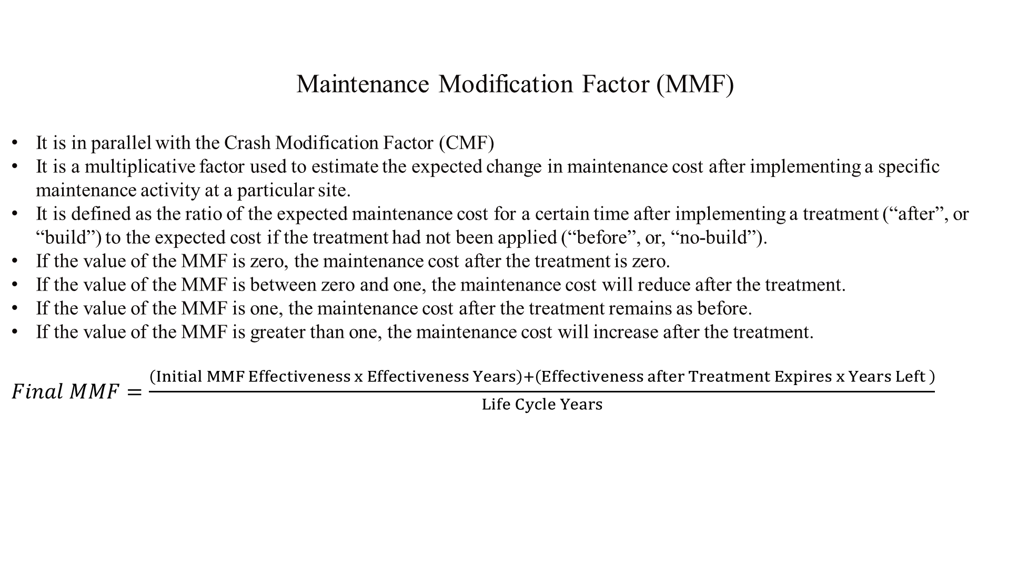
SHIFT 2026 OMS Proposed Method
Maintenance Modification Factor (MMF)
It is in parallel with the Crash Modification Factor (CMF)
It is a multiplicative factor used to estimate the expected change in maintenance cost after implementing a specific maintenance activity at a particular site.
It is defined as the ratio of the expected maintenance cost for a certain time after implementing a treatment (“after”, or “build”) to the expected cost if the treatment had not been applied (“before”, or, “no-build”).
If the value of the MMF is zero, the maintenance cost after the treatment is zero.
If the value of the MMF is between zero and one, the maintenance cost will reduce after the treatment.
If the value of the MMF is one, the maintenance cost after the treatment remains as before.
If the value of the MMF is greater than one, the maintenance cost will increase after the treatment.
$Final MMF=\frac{\begin{aligned}\left(Initial MMF Effectiveness x Effectiveness Years\right)+\left(Effectiveness after Treatment Expires x Years Left \right) \\ \end{aligned}}{Life Cycle Years}$

Slide 13
Statewide Component Weights
Component | Weight
SAFETY | 20
CONGESTION & RELIABILITY | 15
ECONOMIC GROWTH | 15
BENEFIT/COST | 20
ASSET MANAGEMENT | 20
RESILIENCE | 10
TOTAL | 100
Notes:
We will score projects using two formulas – one for projects of statewide impact, including interstates and projects on main roadways
This formula relies solely on quantitative data, again information such as crashes, project benefit to cost ratios, etc.

Slide 14
District Component Weights
Component | Weight
SAFETY | 15
CONGESTION & RELIABILITY | 10
ECONOMIC GROWTH | 10
BENEFIT/COST | 15
ASSET MANAGEMENT | 15
BICYCLE/PEDESTRIAN | 5
RESILIENCE | 10
SUBTOTAL | 80
DISTRICT BOOST | 10
LOCAL BOOST | 10
TOTAL | 100
Notes:
The second formula will be used to prioritize the use of regional funding
This formula includes significant qualitative data (the informed opinion of KYTC district staff, and local leaders in ADDs and MPOs)
In this formula, 70 percent of the score relies on quantitative data and 30 percent on qualitative data

Slide 15
SPONSORSHIP
HDO | # |  | ADD | # |  | MPO | #
1 | 45 |  | Barren River | 36 |  | Bowling Green | 9
2 | 51 |  | Big Sandy | 21 |  | Cincinnati-Northern Kentucky | 25
3 | 44 |  | Bluegrass | 61 |  | Clarksville-Oak Grove | 3
4 | 47 |  | Buffalo Trace | 15 |  | Elizabethtown-Radcliff | 11
5 | 67 |  | Cumberland Valley | 35 |  | Evansville-Henderson | 6
6 | 48 |  | FIVCO | 15 |  | Huntington-Ashland-Ironton | 9
7 | 62 |  | Gateway | 17 |  | Lexington | 21
8 | 41 |  | Green River | 21 |  | Louisville-Southern Indiana (KIPDA) | 49
9 | 36 |  | KIPDA | 27 |  | Owensboro | 9
10 | 32 |  | Kentucky River | 20 |  | Paducah | 8
11 | 34 |  | Lake Cumberland | 39
12 | 28 |  | Lincoln Trail | 27
 |  |  | Northern Kentucky | 21
 |  |  | Pennyrile | 37
 |  |  | Purchase | 33

Slide 16
BOOST
HDO | # |  | ADD | # |  | MPO | #
1 | 22 |  | Barren River | 18 |  | Bowling Green | 6
2 | 27 |  | Big Sandy | 9 |  | Cincinnati-Northern Kentucky | 13
3 | 23 |  | Bluegrass | 25 |  | Clarksville-Oak Grove | 1
4 | 24 |  | Buffalo Trace | 9 |  | Elizabethtown-Radcliff | 5
5 | 29 |  | Cumberland Valley | 16 |  | Evansville-Henderson | 2
6 | 24 |  | FIVCO | 6 |  | Huntington-Ashland-Ironton | 3
7 | 28 |  | Gateway | 8 |  | Lexington | 10
8 | 18 |  | Green River | 9 |  | Louisville-Southern Indiana (KIPDA) | 18
9 | 18 |  | KIPDA | 9 |  | Owensboro | 3
10 | 9 |  | Kentucky River | 9 |  | Paducah | 3
11 | 15 |  | Lake Cumberland | 18
12 | 13 |  | Lincoln Trail | 13
 |  |  | Northern Kentucky | 8
 |  |  | Pennyrile | 17
 |  |  | Purchase | 18

Slide 17
NEW TOOLS
PM ToolBox
UK SHIFT component map

Slide 18
THE END
(OR IS IT JUST THE BEGINNING)

