Slide 1

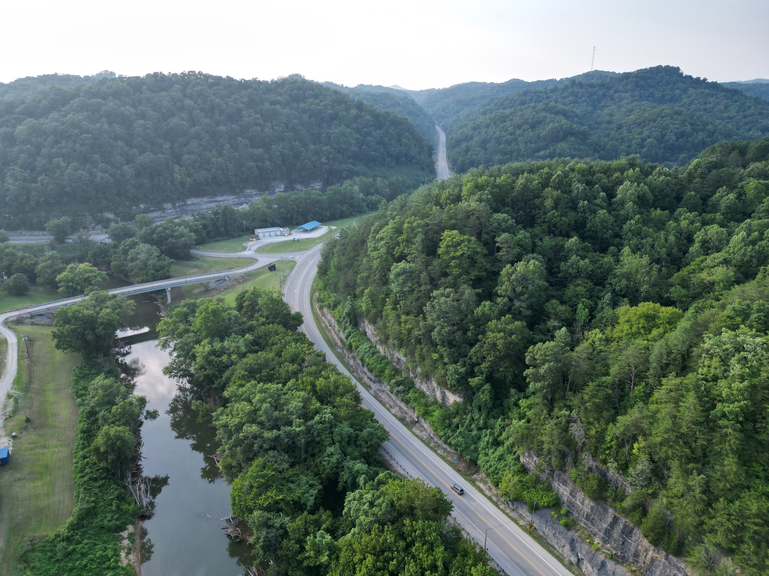
KYTC RESILIENCE Project Process, Recommendations, and Communications Toolkit

Slide 2
Project Purpose
Provide guidance on expanding the RIP to include more strategic considerations beyond research
Formalize language used for resilience
Assist in developing resilience-related goals
Notes:
guiding the Cabinet through an expansion of the document to include more strategic considerations beyond research, formalizing the language used for resiliency, and developing Cabinet goals.

Slide 3
Deliverables
Evaluation of current resilience efforts
Discussions with KYTC leadership and directors
Recommendations for:
Goals, objectives, and performance measures
Design policy and nature-based design solutions
Approaches to identifying resilience-oriented projects and funding mechanisms
Enhancements for FHWA ER and FEMA funding
Notes:
guiding the Cabinet through an expansion of the document to include more strategic considerations beyond research, formalizing the language used for resiliency, and developing Cabinet goals.

Slide 4
Discussions with KYTC Leadership
Round 1: Perspectives on past resilience efforts at KYTC, current status, and ideas on future directions.
Round 2: Feedback on recommendations for policy/planning, project development, performance monitoring, and communications

Slide 5
Key Takeaways
KYTC already does a lot in the resilience sphere
Communication
  common vocabulary and understanding
  Show how resilience is related to disaster response
  More than flooding
  consistency
Incremental approach to build resilience into KYTC’s operations holistically
  Consider the range of hazards and impacts and plan a robust response
  Understand investment factors where not considering resilience will cost more.
  Start with the long-range plan, being internally consistent for application throughout the project development and delivery process and keep outcomes in mind.
  When communicating, make sure to keep in mind all natural hazards. Be clear that it is more than just flooding (e.g., tornado alley is now western Kentucky).
  Prepare written internal documentation stating KYTC’s definition of resilience, resilience goals, and an established means of exchanging information amongst staff and coordinating resilience efforts where necessary.

Slide 6
Preliminary Recommendations
Policy/Planning
Add resilience statements and goals in strategic planning documents during next updates (e.g. Long-Range Statewide Transportation Plan)
Include resilience in corridor and small urban area planning guidance

Slide 7
Preliminary Recommendations
Project Development/Investments
Add a resilience category to the scoping analysis that highlights potential resilience concerns due to extreme weather and other natural hazards
Consider modifying SHIFT “critical” roadway indicator as KYTC progresses in undertaking risk assessments for individual projects

Slide 8
Preliminary Recommendations
Performance Monitoring
Adopt resilience performance measures
Communications
Internal documentation communicating KYTC’s definition of resilience, resilience goals, and an established means of exchanging information amongst staff and coordinating resilience efforts where necessary.
Promote KYTC successes through internal and external communication
Disseminate resilience information through central webpage

Slide 9
Communications Toolkit
To establish a baseline understanding of what resilience means and the benefits of considering resilience practices in transportation.
To outline the problem, including the types of impacts that threaten the resilience of Kentucky’s transportation system.
To communicate how KYTC incorporates resilience into its work, now and potentially in the future.

Slide 10
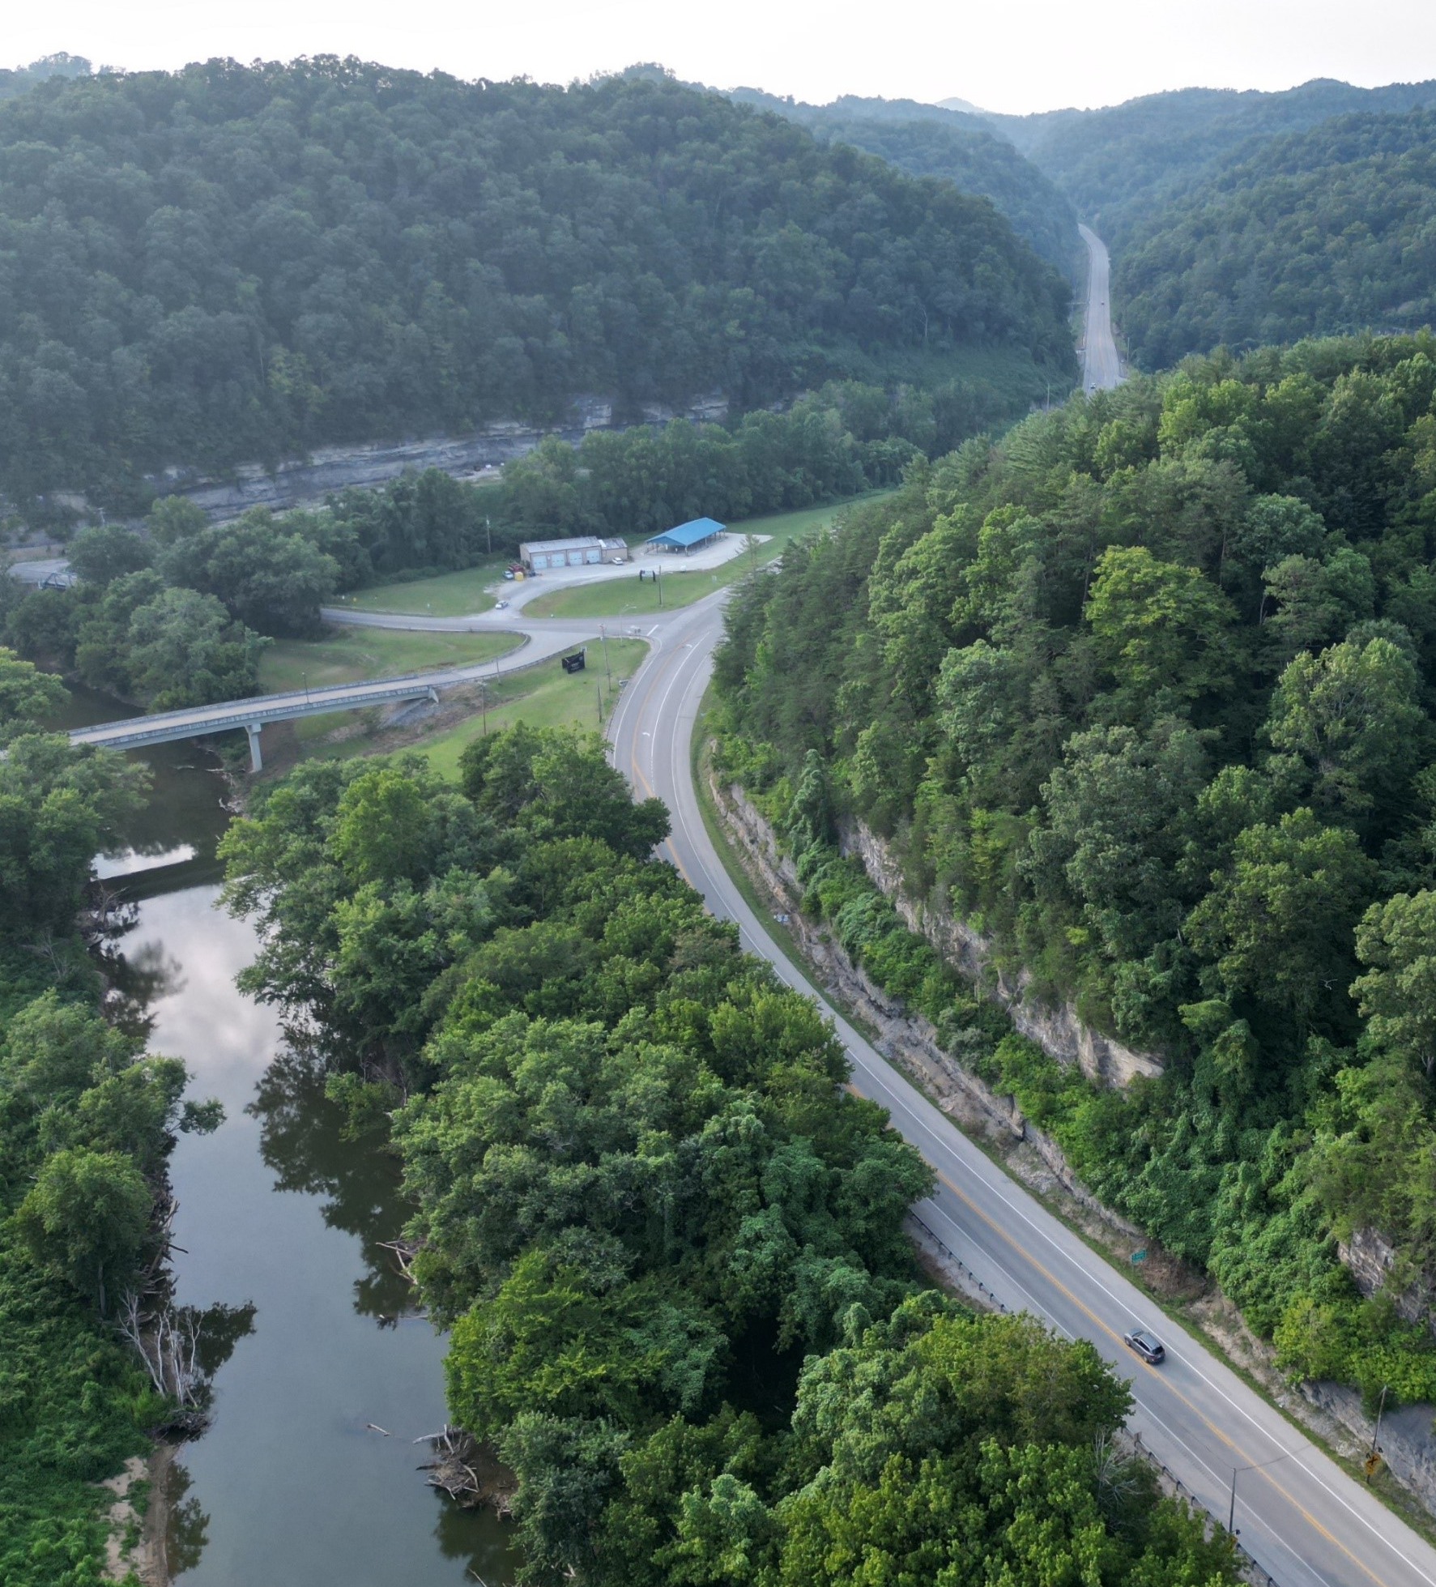
Toolkit Organization
Resilience Explained
Extreme Weather and Other Hazards Impacting Kentucky Transportation
KYTC’s Resilience Efforts
Enhancing KYTC’s Resilience Efforts for the Future

Slide 11
RESILIENCE EXPLAINED

Slide 12
RESILIENCE
The ability to anticipate, prepare for, and adapt to changing conditions and withstand, respond to, and recover rapidly from disruptions.
Notes:
Definitions Located Here: https://www.fhwa.dot.gov/environment/sustainability/resilience/adaptation_framework/climate_adaptation.pdf

Slide 13
Other Key Terms
TERM | DEFINITION
Adaptive Capacity | The ability of a transportation asset or system to adjust, repair, or flexibly respond to damage caused by climate variability or extreme weather.
Impacts | The physical damage to the asset and disruptions to transportation system users that happen should exposure occur.
Extreme Weather | Extreme weather events can include significant anomalies in temperature, precipitation and winds and can manifest as heavy precipitation and flooding, heatwaves, drought, wildfires and windstorms.
Natural Hazard | A natural event with the potential to cause substantial damage, such as hurricanes, extreme precipitation, flash flooding, wildfire, droughts, sea level rise, loss of permafrost, and high heat.
Risk | A combination of the likelihood that an asset will experience a particular climate impact, and the severity of consequence of that impact.
Vulnerability | The degree to which a system is susceptible to, or unable to cope with adverse effects of climate change or extreme weather events.
Notes:
Definitions Located Here: https://www.fhwa.dot.gov/environment/sustainability/resilience/adaptation_framework/climate_adaptation.pdf
https://www.fhwa.dot.gov/environment/sustainability/resilience/publications/Integrating_Natural_Hazard_Resilience_into_Transportation_Planning%20Handbook.pdf

Slide 14



BENEFITS OF RESILIENCE
Reduced Losses:
Having assets that can withstand increasingly variable and extreme natural and anthropogenic (human-created) hazards helps minimize down time or avoid damages to infrastructure.
Improved Safety:
Reduced damage to roads allows access for people and emergency services during extreme weather events and other hazards.

Slide 15
EXTREME WEATHER & OTHER HAZARDS IMPACTING KENTUCKY TRANSPORTATION

Slide 16


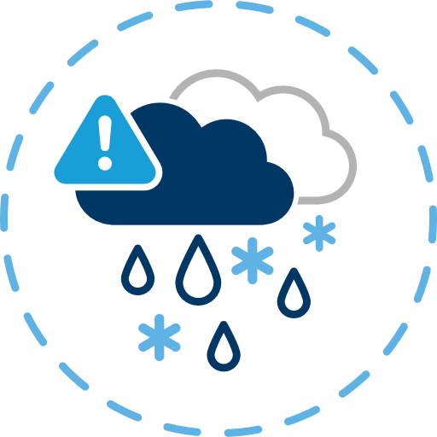
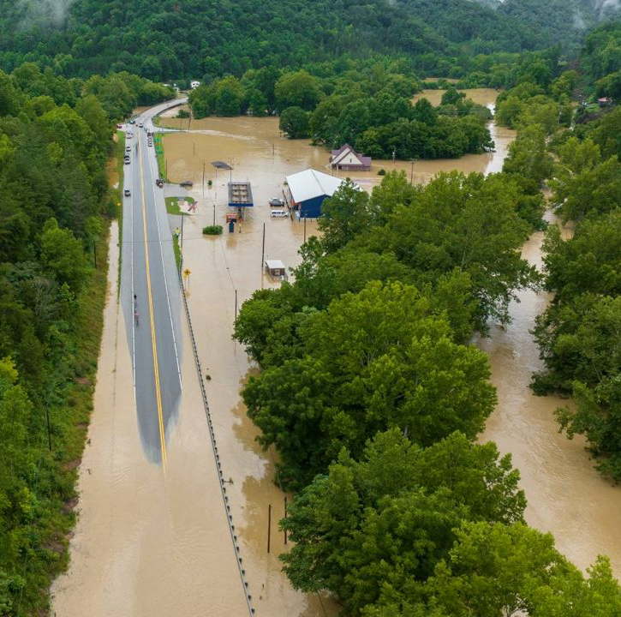
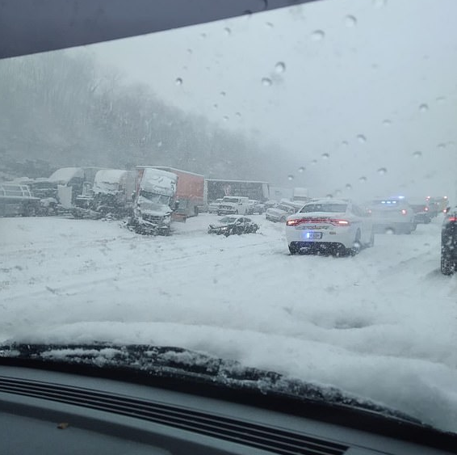
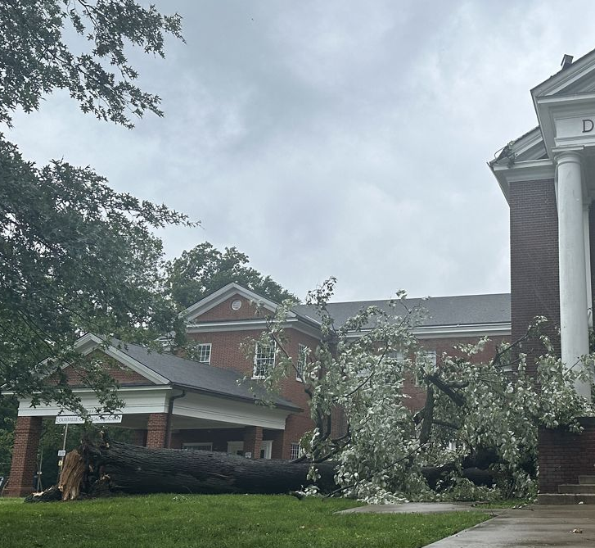
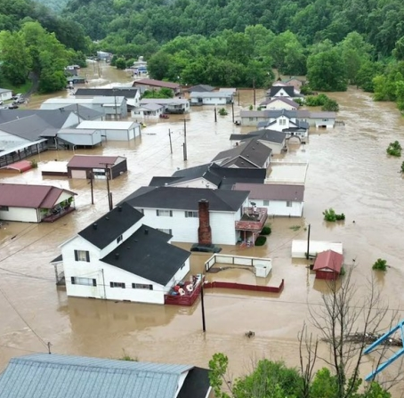
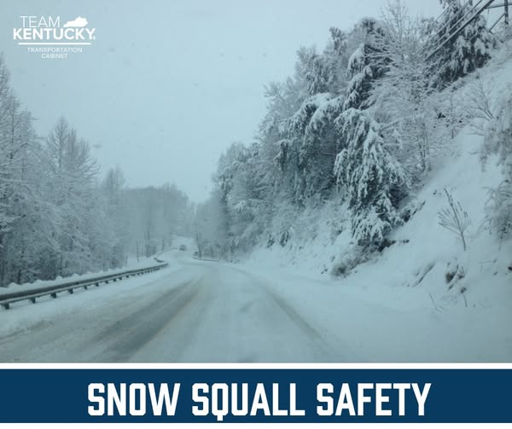
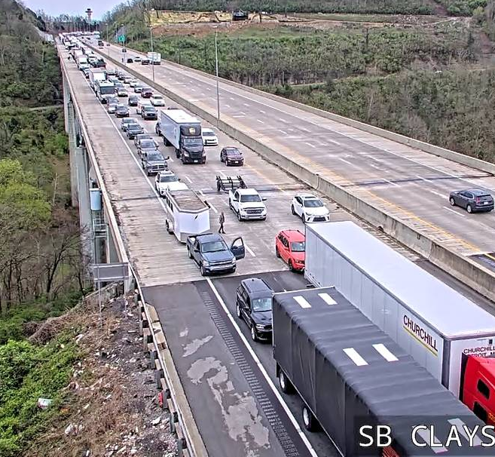
Key Present-Day Hazards
Flooding
Severe Thunderstorms
Severe
Winter Storms
Louisville, Kentucky – 2024 severe thunderstorm impacts
Southeastern Kentucky - 2022 floods
Lexington, KY 2022 winter storm pileup
Traffic impacts in southbound lanes of I-75 at Clays Ferry Bridge due to interstate closures because of storm debris and downed wires
Notes:
Photo Sources:
Southeastern Kentucky – 2022 Floods (https://www.naco.org/articles/kentucky-counties-dig-out-after-devastating-floods & https://spectrumnews1.com/ky/louisville/news/2024/08/15/kentucky-flood-recovery-august-2024-)
A fallen tree outside of Douglass Boulevard Christian Church in Louisville after severe storms hit the area May 26, 2024. (Spectrum News 1/Jordan Grantz) - https://spectrumnews1.com/ky/louisville/news/2024/05/26/kentucky-severe-weather-storms
Severe Thunderstorms Traffic Impacts: https://www.kentucky.com/news/weather-news/article287308805.html
Social Media Post: https://www.facebook.com/kytc120

Slide 17



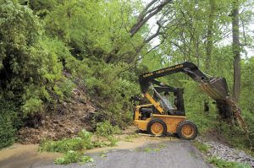
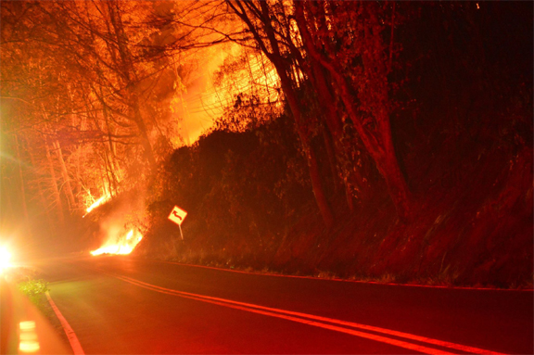
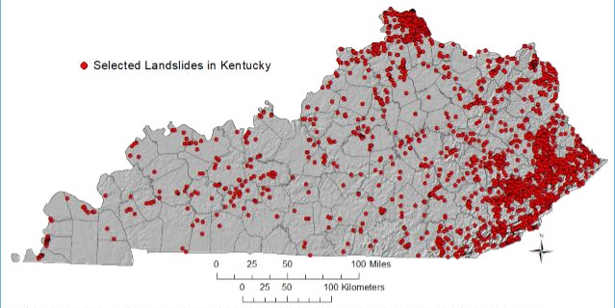
Key Present-Day Hazards (cont.)
Extreme Temperatures
Wildfires
Landslides
Landslide in Four Mile
Wildfire crossing a road from Kentucky Emergency Management
Locations of selected landslide occurrences from the Kentucky Geological Survey landslide inventory.
Notes:
Photo Sources:
Wildfire across a road – Kentucky Emergency Management, https://kyem.ky.gov/KentuckyWildfires/Pages/default.aspx
Landslide - KYTC

Slide 18
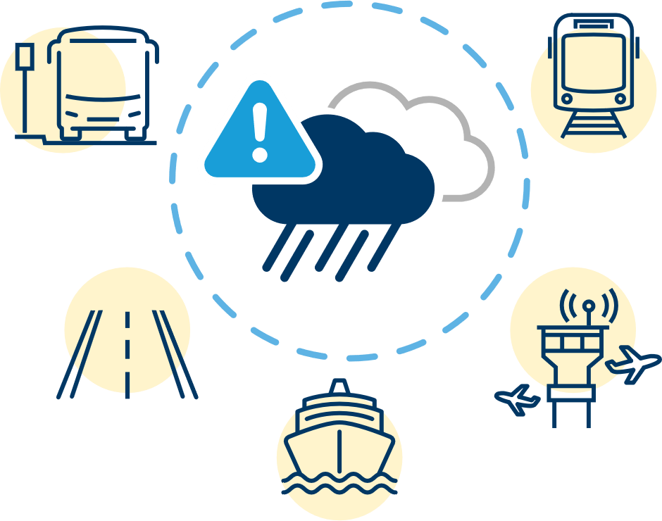
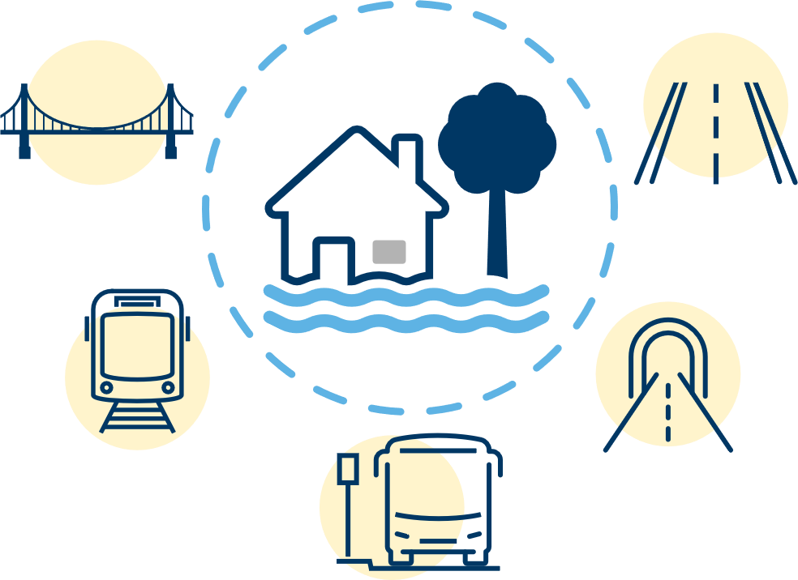
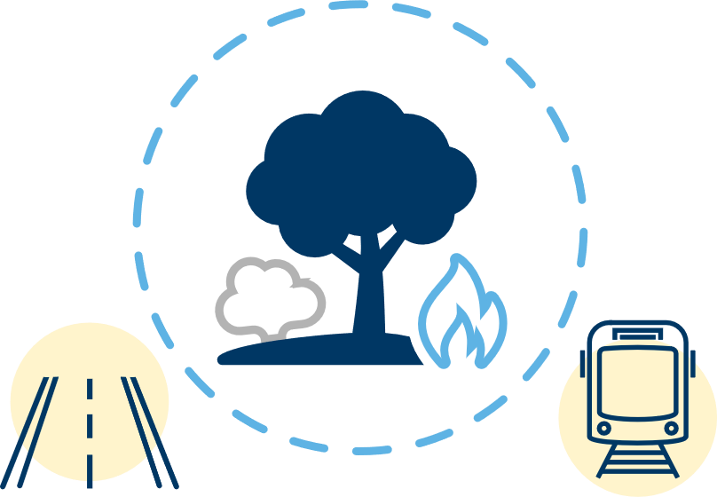
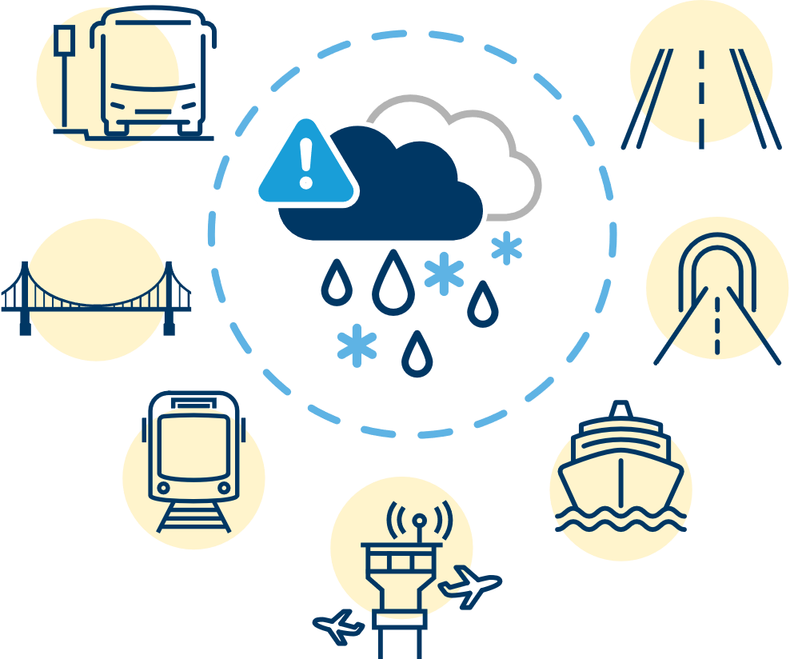
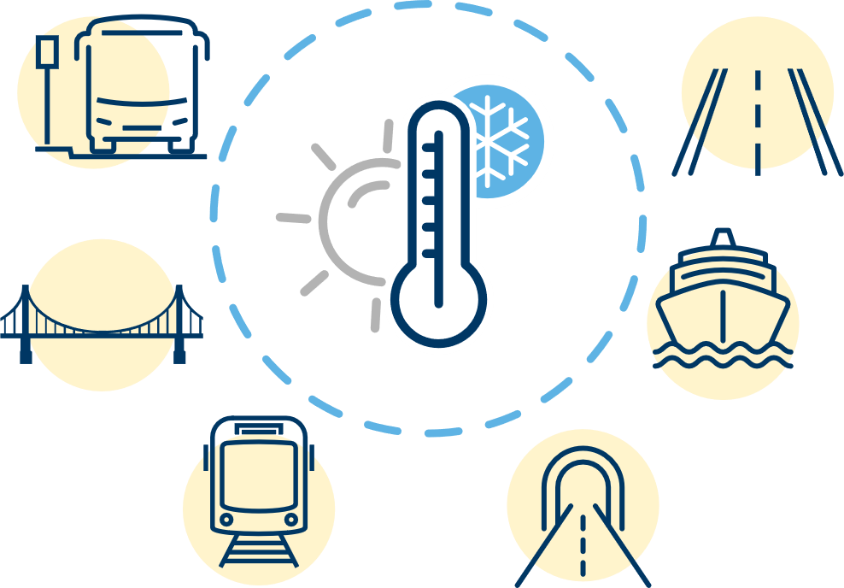

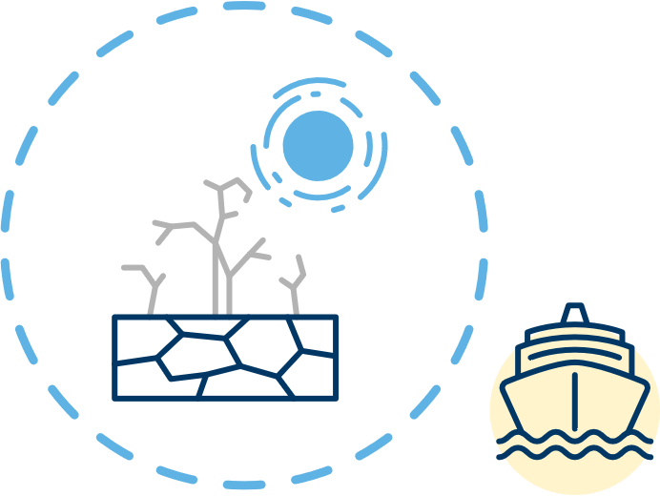
Future Hazards and Impacts on Transportation
More Intense Precipitation
Higher Flood Flows
Increased Wildfire Chances
Increased Intensity of Ice Events
Extreme Temperatures
Increased Landslide Potential
Increased Drought Potential
Notes:
Most Significant Impacts Anticipated
Increased road and rail closures in affected areas.
Compromised pavement integrity
Deformation of rail lines
Thermal expansion of bridge joints
Damage to airline infrastructure/Canceled flights
Decrease in river transportation
Decrease in electricity production from hydroelectric plants
Higher incidents of flooding for communities located on or near waterways.
Poorer air quality

Slide 19


Collective Hazard Impacts
Compromised system reliability, public safety and increased costs on taxpayers.
Impacts on System Users
Increased rerouting and delays
Traffic shutdowns
Economic impact from reduced access to places
Decreased driving conditions
Decreased transit conditions
Decreased public health
Increased debris flow
Impacts on KYTC
More frequent maintenance/repairs
Less safe conditions during emergency response
Increased costs for maintenance and repairs
Notes:
Most Significant Impacts Anticipated
Increased road and rail closures in affected areas.
Compromised pavement integrity
Deformation of rail lines
Thermal expansion of bridge joints
Damage to airline infrastructure/Canceled flights
Decrease in river transportation
Decrease in electricity production from hydroelectric plants
Higher incidents of flooding for communities located on or near waterways.
Poorer air quality

Slide 20
KYTC RESILIENCE EFFORTS & INVESTMENTS

Slide 21






KYTC Resilience Efforts
MITIGATE:
Before Hazard
PREPARE:
Before Hazard
RECOVER:
After Hazard
RESPOND:
During Hazard

Slide 22
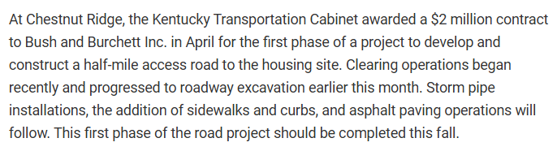
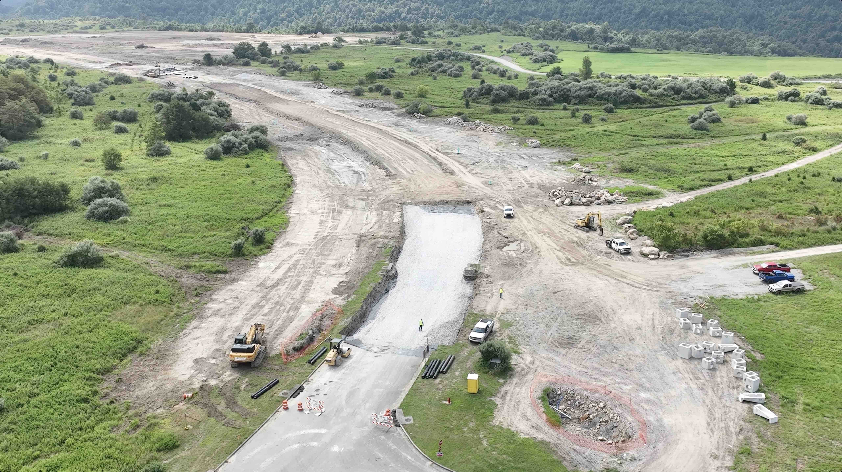
Examples of Mitigation
Resilience “criticality” criteria in SHIFT
Integrating resiliency in the administration of construction contracts
Structure design, inspection, testing, and regular maintenance, retrofits and rehabilitation
  Panbowl Lake Stabilization Project in Jackson
  Constructing road access to new high-ground housing sites
Road access to high-ground housing site
Photo: KYTC Staff

Slide 23
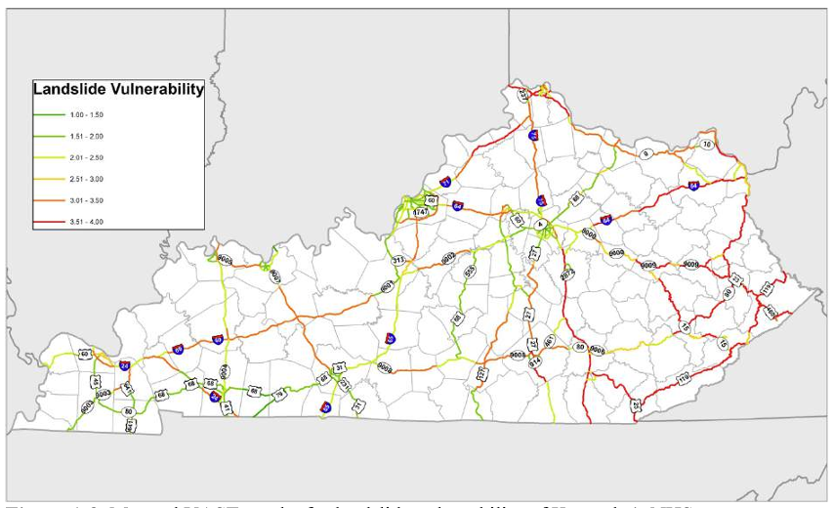
Examples of Preparation
Kentucky Transportation Center research projects:
  Transportation System Vulnerability and Resilience to Extreme Weather Events and Other Natural Hazards – All KYTC Districts (2018)
  Asset Management, Extreme Weather, and Proxy Indicators (2019)
Planning studies:
  KYTC Transportation Resilience Improvement Plan (2023)
  District 10 Rockfall/Roadslide Study (ongoing)
Mutual Aid Agreements
Mapped results for landslide vulnerability of Kentucky’s NHS

Slide 24
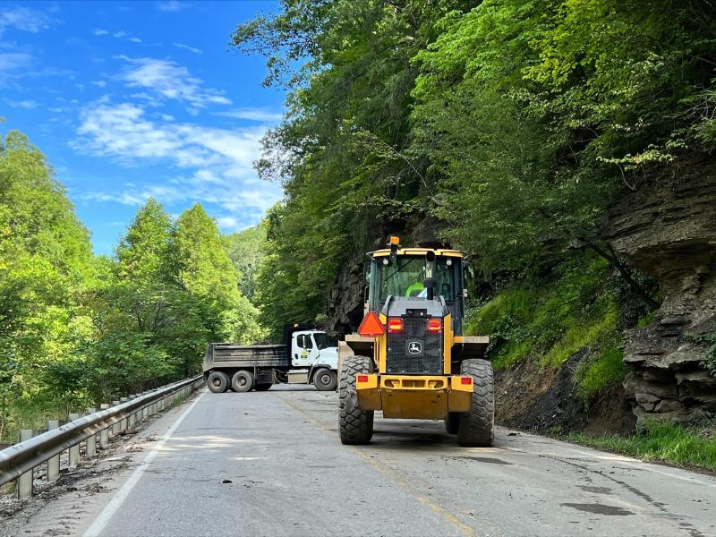
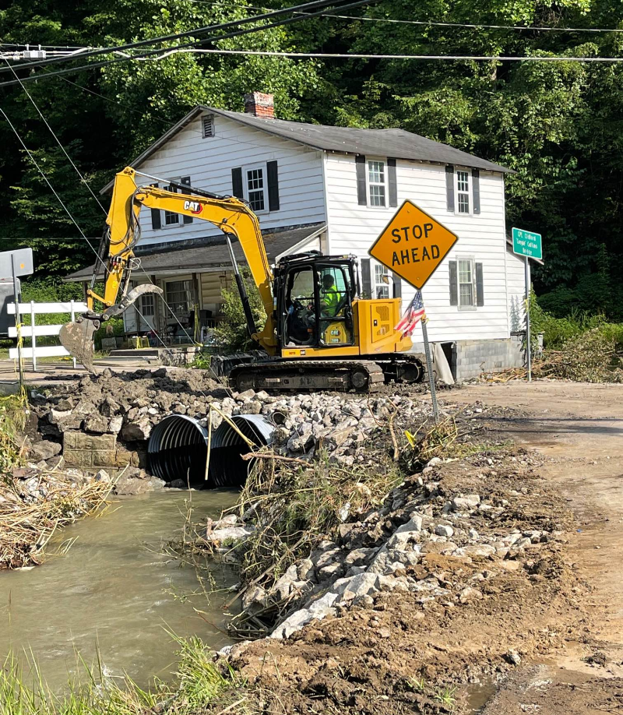
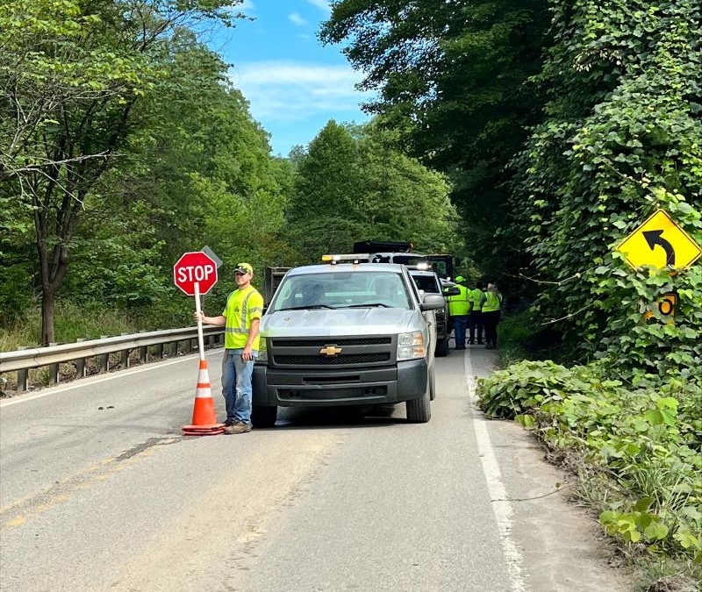
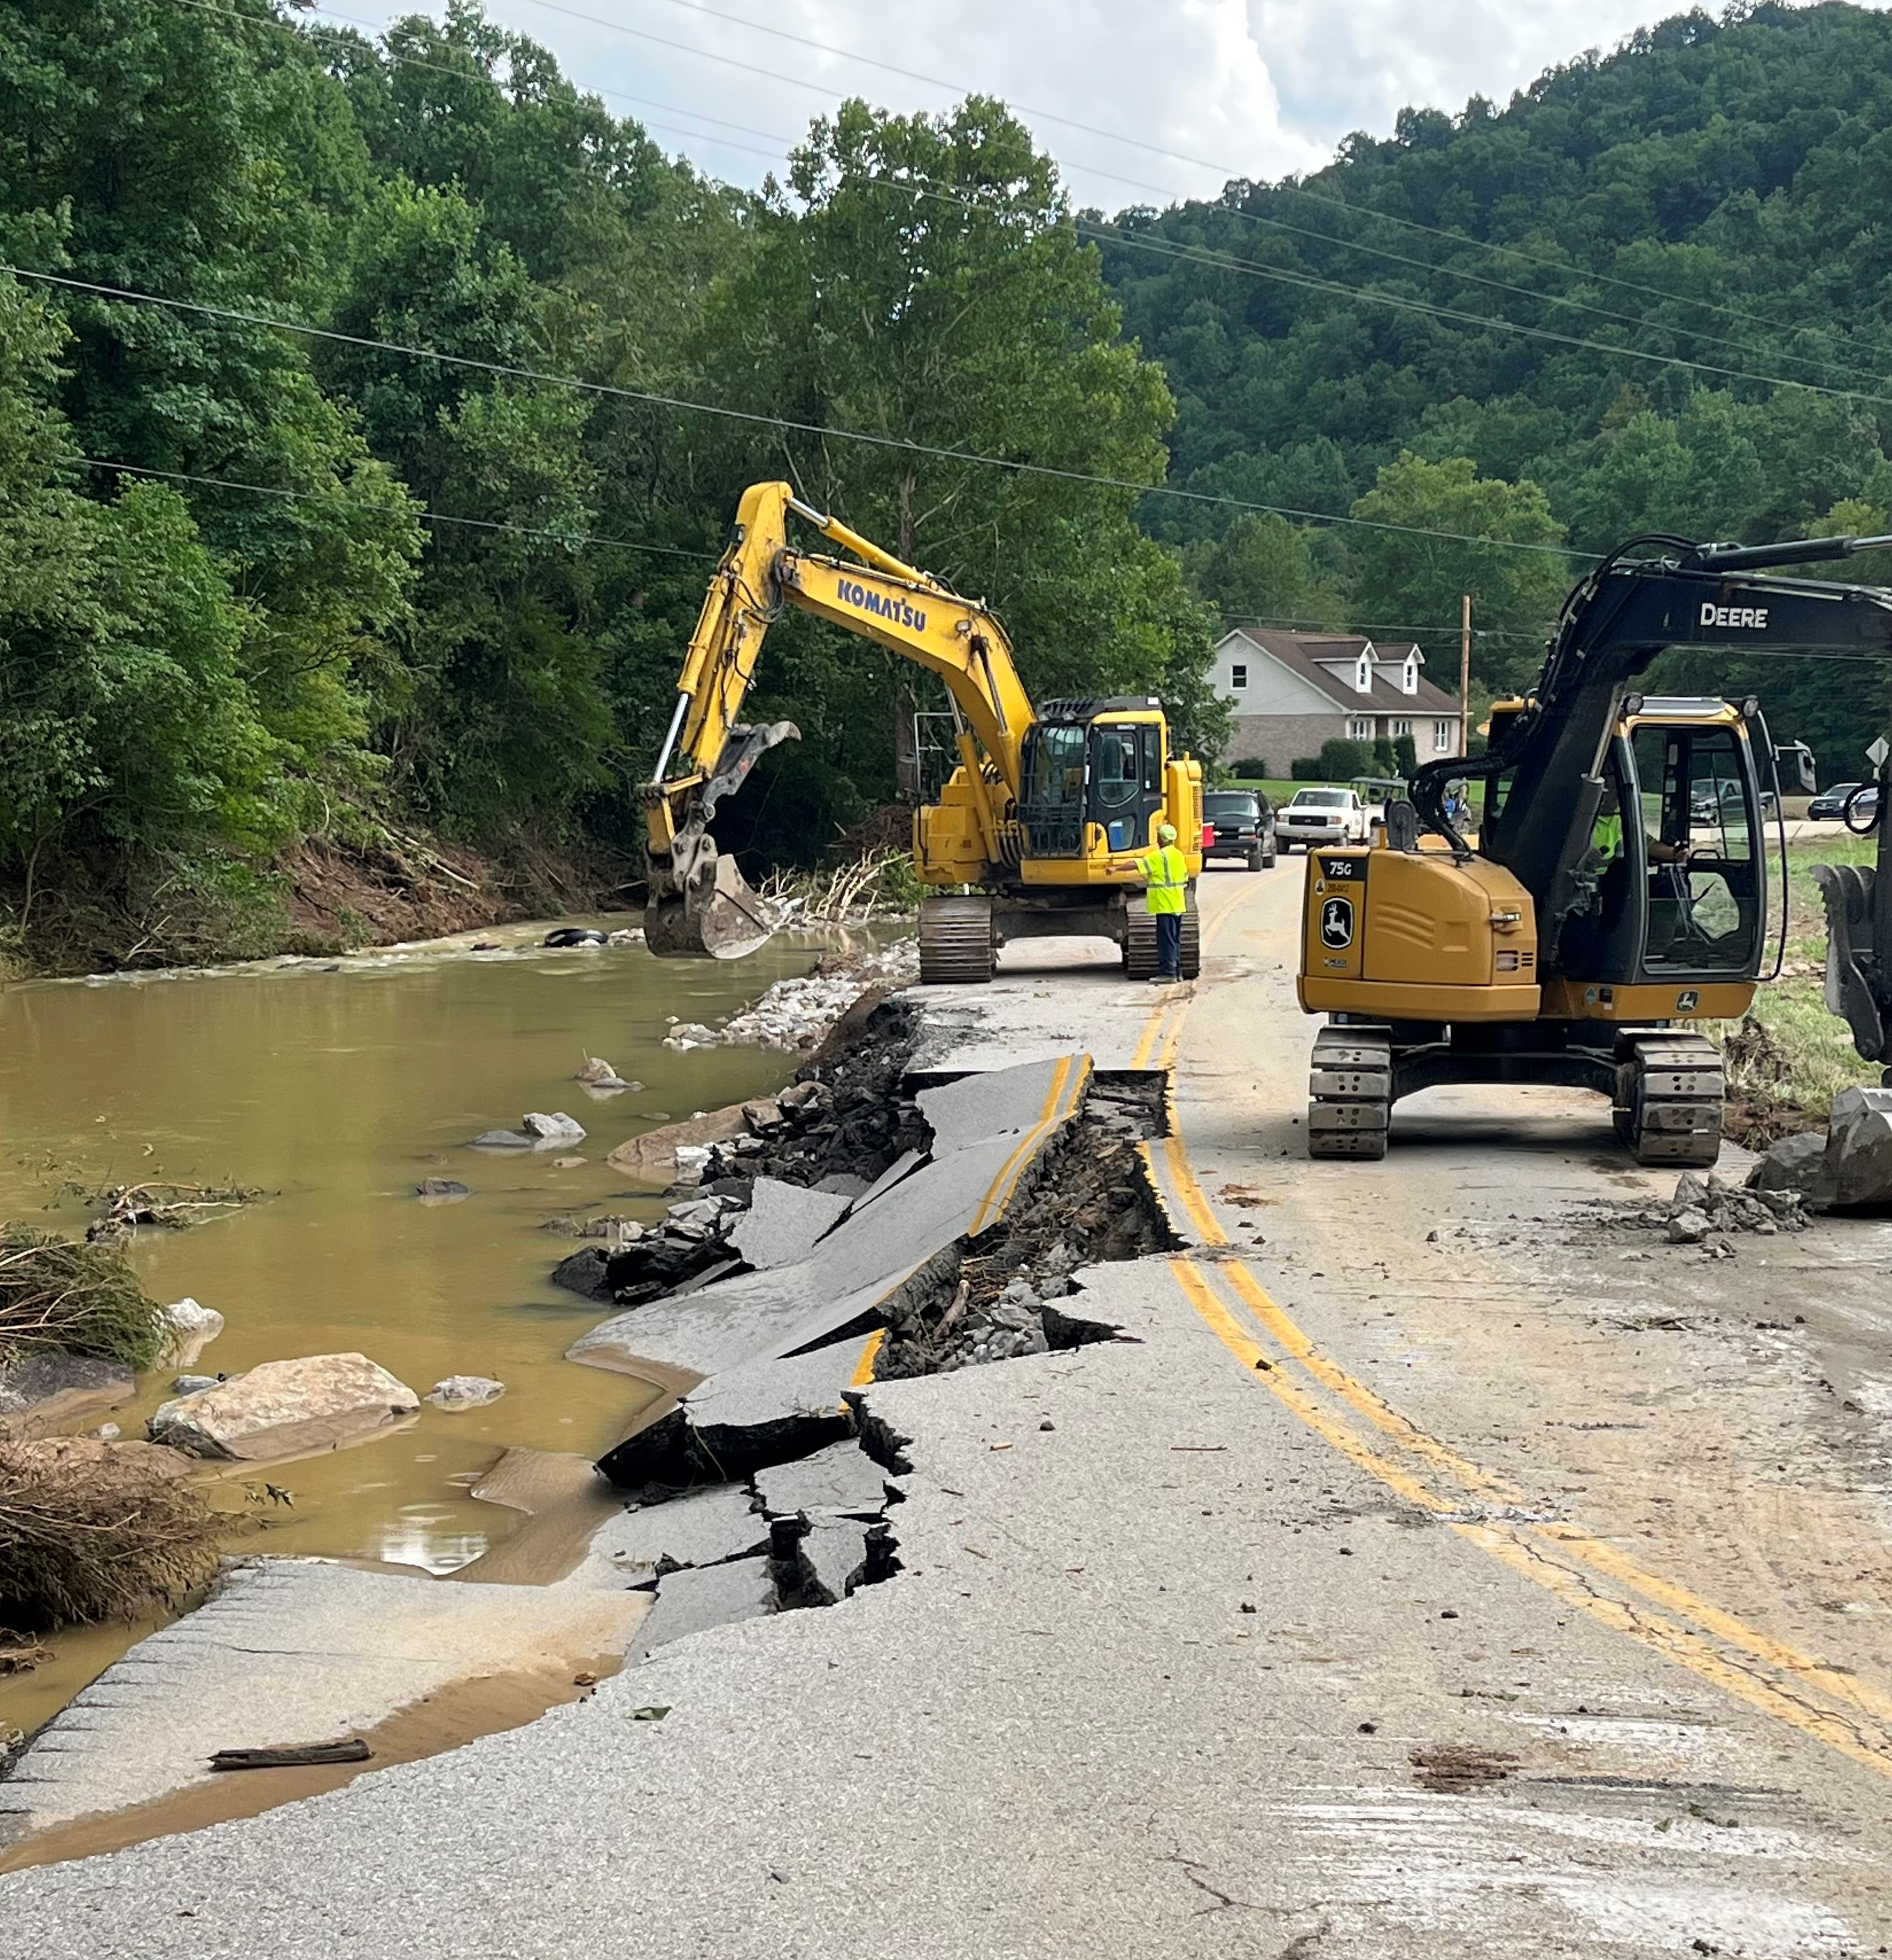
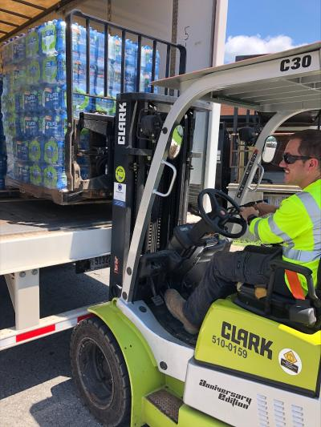
Examples of Response
Provide personnel, vehicles, and equipment to assist in infrastructure repair, searches, damage assessment, transportation of resources, and road and debris clearing during recent major natural disasters (Eastern KY flooding)
KYTC Maintenance department staffs the Emergency Operations Center (EOC)
Kentucky Emergency Management (KYEM)
July 2022 Eastern Kentucky Flooding
Photos: KYTC Staff

Slide 25
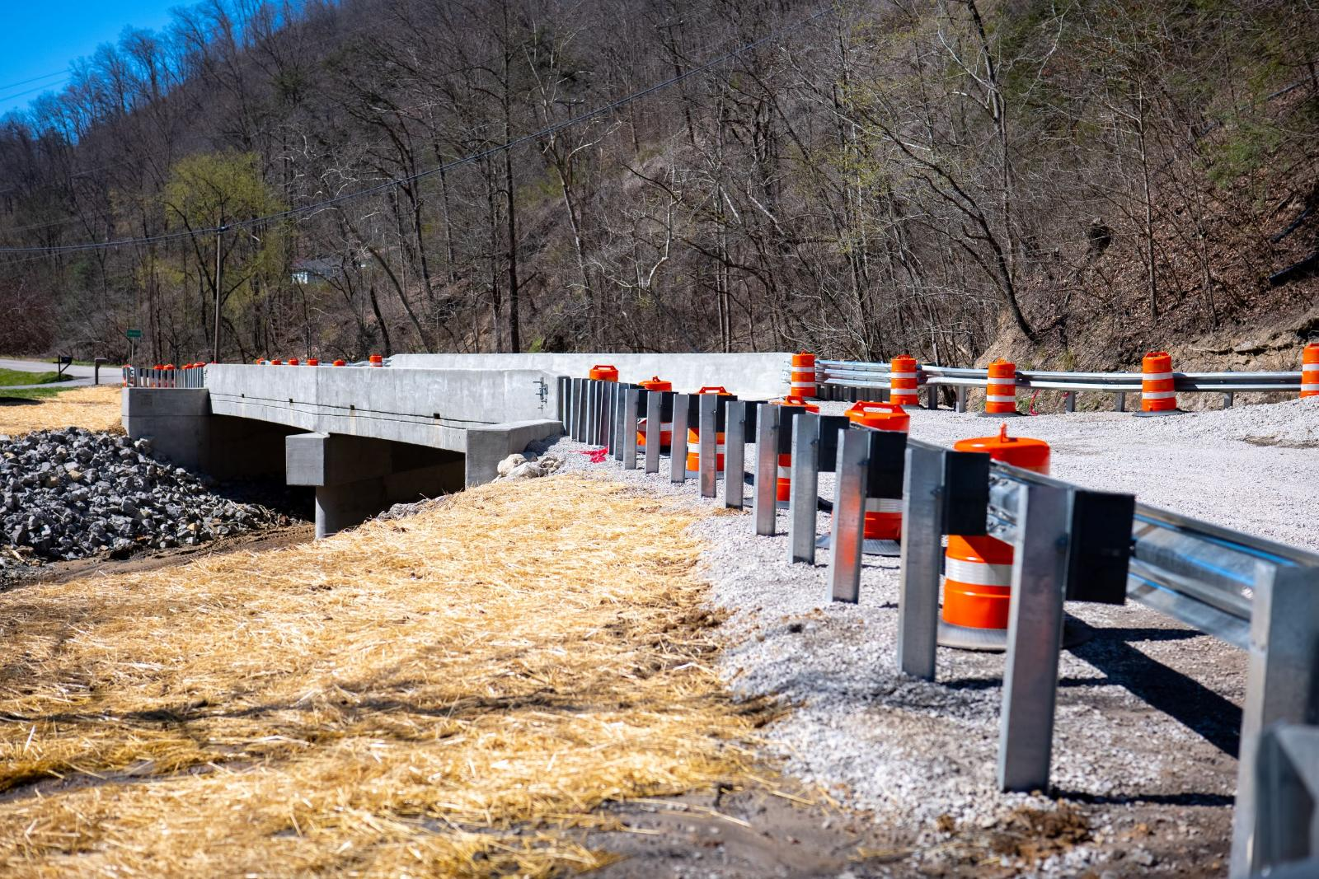
Examples of Recovery
Administer special funding or grants for repair or reconstruction of transportations system infrastructure damaged during hazards
  Provided funds to counties to rebuild bridges to KYTC’s design standards. A bridge that was upgraded with these funds was still standing after the E. KY floods.
Signage replacement
Photo: KYTC Staff
New bridge, replacing one damaged in flooding, on KY 610

Slide 26
ENHANCING RESILIENCE EFFORTS IN THE FUTURE

Slide 27
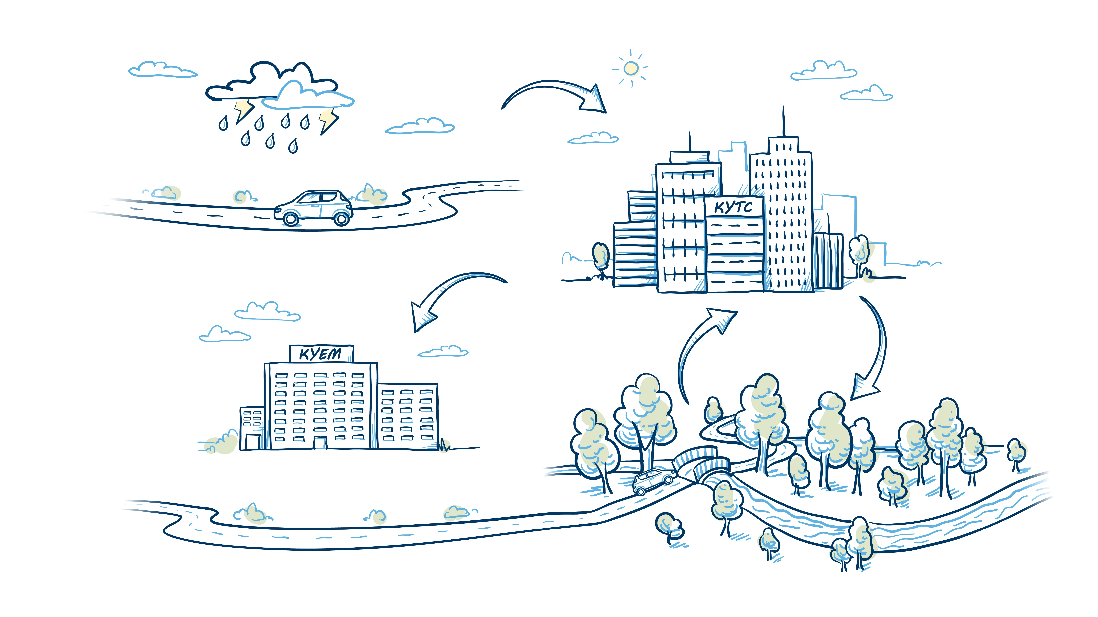
ASSESS RISK AND DEVELOP COST-EFFECTIVE SOLUTIONS for high-risk assets
UNDERSTAND EXPOSURE of assets and people to hazards in Kentucky
MAINTAIN ASSETS AND MONITOR PERFORMANCE to inform future resilience actions
UPGRADE AT-RISK INFRASTRUCTURE with resilient designs and materials
COORDINATE EMERGENCY RESPONSE PLANS for when hazardous events occur

Slide 28
MITIGATE:
How can KYTC eliminate or reduce the probability of hazards and vulnerabilities?
Develop risk-based analysis tools and methodologies to support decision-making
Develop list of nature-based design solutions appropriate to Kentucky
Performance measures
Establish process to consider cost/benefit of resilient materials on specific arterials
KTC is developing an approach to identify and prioritize resilience projects.

Slide 29
PREPARE:
How can KYTC enhance planning, training, and communications to support and improve response to hazard events?
Adopt policy statement
Add resilience to goals/objectives in Operational Plan and/or Long-Range Statewide Transportation Plan
Add resilience to corridor planning guidance
Modify SHIFT resilience criteria

Slide 30
RESPOND:
How can KYTC strengthen the response to immediate and short-term effects of an emergency hazard event?

Slide 31
RECOVER:
How can KYTC enhance efforts to restore the transportation system to normal status?

Slide 32


THANK YOU!
Questions?
Contact Tracy Nowaczyk
  Tracy.nowaczyk@ky.gov

