Slide 1
KYTC Mission
To provide a safe, efficient, environmentally sound and fiscally responsible transportation system that delivers economic opportunity and enhances the quality of life in Kentucky.
To provide a safe, efficient, environmentally sound and fiscally responsible transportation system that delivers economic opportunity and enhances the quality of life in Kentucky.
To provide a safe, efficient, environmentally sound and fiscally responsible transportation system that delivers economic opportunity and enhances the quality of life in Kentucky.
Notes:
Take advantage of every opportunity you have to speak to staff about not only what we do but why we do it.
Building Cathedrals: The power of purpose.
Christopher Wren rebuilt St. Paul’s Cathedral after London fire of 1666.
Met 3 bricklayers working on building and asked what they were doing:
Laying bricks.
Building a wall.
Building a cathedral to the Almighty.
JFK was touring NASA during his presidency. He came across two gentlemen sweeping floors.
He asked the first what he was doing and the man said sweeping floors.
He asked the second and he said the he was helping him put a man on the moon.
“The most productive people in life are those with purpose.” -Greg Coker
Give our staff purpose.
What do we do at the Transportation Cabinet?
“We save lives.”
“We enhance the quality of life for every Kentuckian.”

Slide 2
Today’s Topics
Highway Plan Summary
Data Needs Analysis
Project Need
Notes:
We must take a different approach to transportation spending.
The previous approach made too many promises that couldn’t be kept.
We have already begun a different way of thinking – as evidenced by Pause 50.

Slide 3

Approach to Developing
Recommended Highway Plan FY 2019-2024
STATEWIDE pLANNER‘s
April 18, 2018

Slide 4
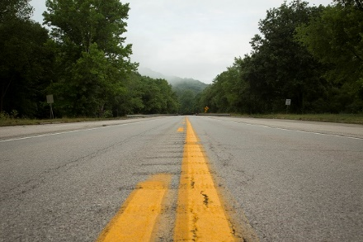
The Road Behind Us
Overpromising created expectations that cannot be met
Current Highway Plan has nearly 1,200 projects – fewer than half with even partial funding
Pause 50 has helped better balance revenues and spending
Notes:
We must take a different approach to transportation spending.
The previous approach made too many promises that couldn’t be kept.
We have already begun a different way of thinking – as evidenced by Pause 50.

Slide 5

The Road Ahead
Revenues have stabilized but needs are growing
Without credits to match federal funds, state revenues won’t go as far
Backlog of needed bridge and road repairs exceeds $2 Billion
Economic growth demands transportation improvements
Notes:
Our revenues have stabilized with changes in the gas tax formula, but greater challenges are ahead.
The end of toll credits means we will have to use state gas tax dollars to match federal funds, and that will leave less for state projects.
Meanwhile, our backlog of maintenance needs are growing, and we must invest in expansion to fuel business growth and economic development.

Slide 6
2016 SYP Funding Allocations
Notes:
Historic Hwy Plans shows an heavy emphasis on safety and mobility projects over Asset Management.

Slide 7
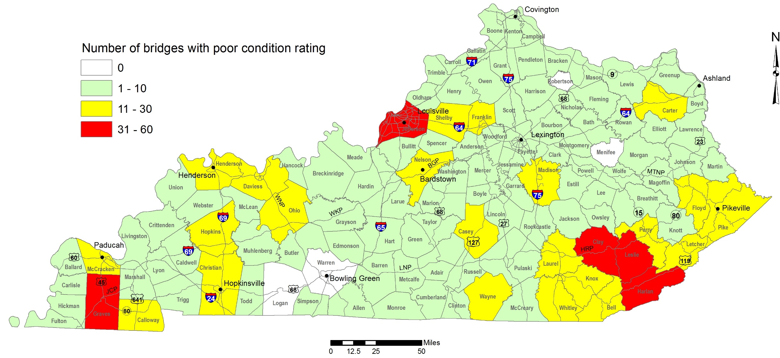
Bridge Repair Needs
Each day, about 2 million vehicles cross 977 bridges and overpasses with poor condition ratings
Notes:
It’s time to focus on the backlog of maintenance needs.
We have nearly 1,000 bridges across the state that are rated in poor condition impacting movement of freight and commercial traffic.
The average age of bridges in Kentucky is 49 years and is increasing at a rate of 0.75 “years per year.”
There are needs in virtually every county with the greatest volume concentrated in southeastern Kentucky, the Louisville-Frankfort corridor and western Kentucky.

Slide 8
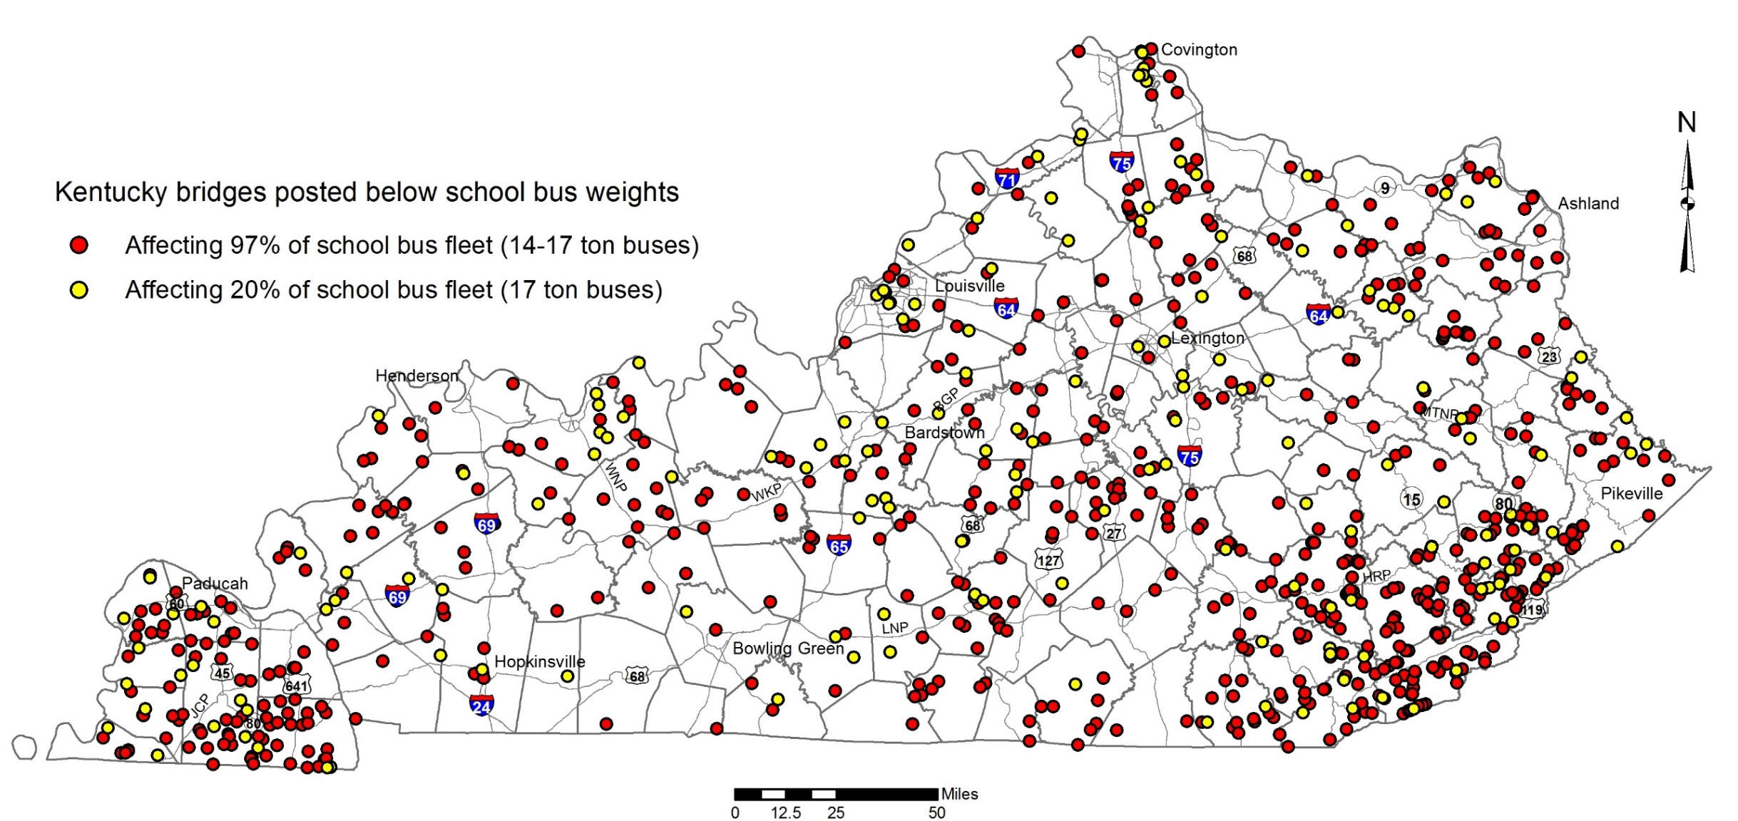
Bridges That School Buses Can’t Cross
Kentucky has 822 bridges in 114 counties that aren’t safe for school buses to cross
Notes:
In fact, the problem is so pervasive that all but six counties have bridges that school buses cannot cross because the buses exceed posted weight limits.
More than 800 bridges are potential impediments to providing convenient access to education for KY’s children.
This forces school districts and parents to find work-arounds to ensure kids are educated.

Slide 9
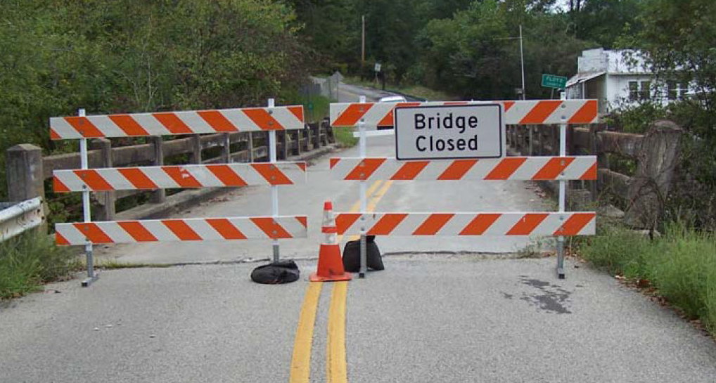
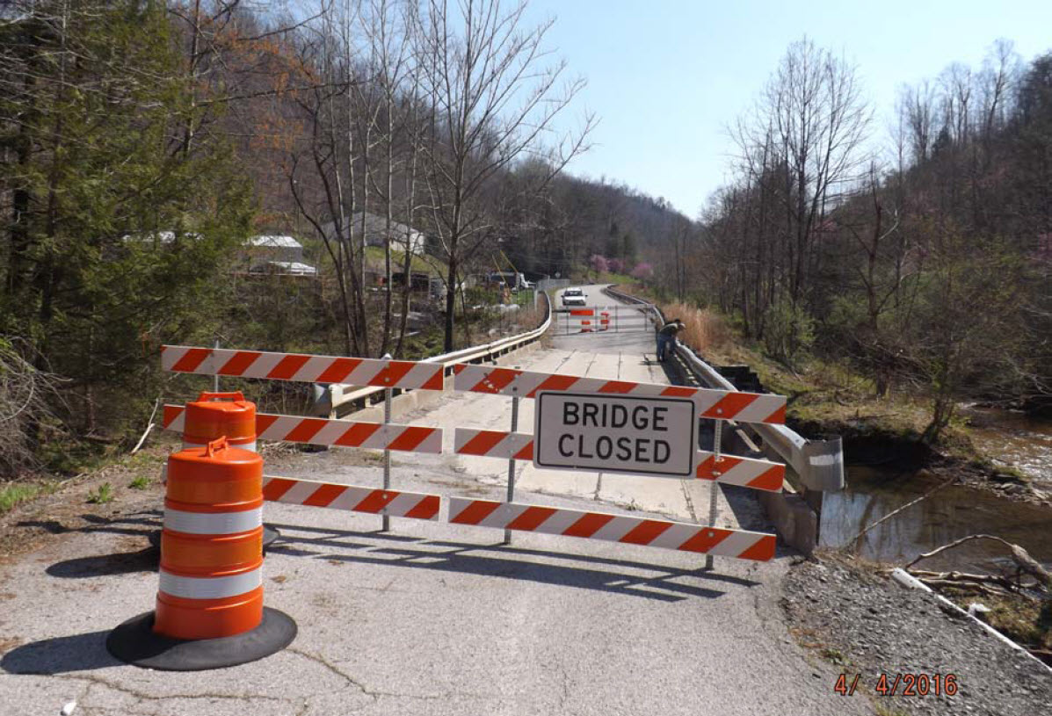
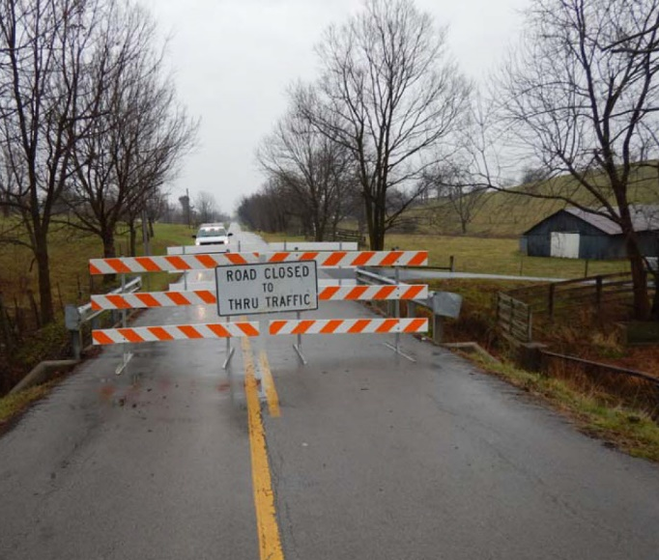
Bridges Closed Across Kentucky
More than 60 bridges are closed in 37 counties because they are unsafe and need major repairs
Notes:
We also have more than 60 bridges and overpasses that are closed – many have been closed for years – because they are unsafe.
Nearly one-third of Kentucky counties have at least one unsafe bridge that’s closed and needs major repairs.

Slide 10
Pavement Ratings
Inspectors evaluate pavement on Kentucky highways on a three-point scale – good, fair and poor
Good Pavement
Meets the “good” IRI threshold (0-80)
Has a smooth ride
Minor to no pavement distress
Not in need of resurfacing
Fair Pavement
Meets the “fair” IRI threshold (81-150)
Moderately smooth ride
Moderate pavement distresses
May need pavement resurfacing within two to five years
Poor Pavement
IRI exceeds “poor” threshold (151+)
Pavement has rough ride
Moderate to severe pavement distress
Needs resurfacing or rehabilitation within one year
Notes:
Pavement is another major maintenance need across the state.
Inspectors evaluate the road surfaces on a regular basis using a three-point scale – good, fair and poor.
Poor pavements have a rough ride and may pose safety problems if not resurfaced within a short time.
In addition, poor pavements result in increased maintenance costs and traffic delays due to frequent repair needs.

Slide 11
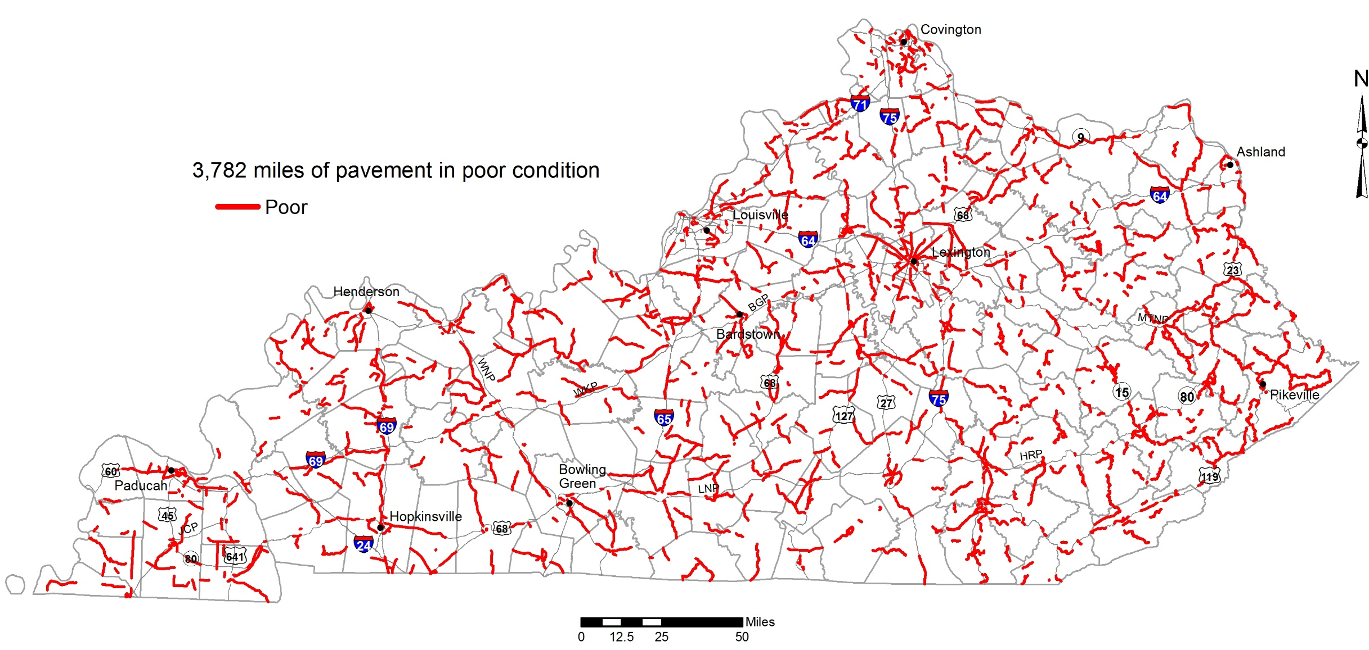
Pavement Repair Needs
Nearly 3,800 miles of pavement statewide is rated in poor condition
Notes:
Kentucky has nearly 3,800 miles of pavement that’s in poor condition.
As you can see, rough-riding roads are found in every county and the number of miles will continue to increase without an infusion of asset management funding.
Poor pavement mileage is growing at ~500 miles/yr.

Slide 12
Priority #1: Safety First
Overdue investment in fixing what we’ve got
$205 M increase in asset management each year (2019-2024)
Total six-year investment in Fix It First: more than $3.0 Billion
Includes all funds in millions (SYP and Operational Budget)
Notes:
That’s why we will propose a major boost in asset management funding in the State Highway Plan.
We call it Safety First. It is really a focus on taking care of what we have to ensure the roads and bridges are safe for everyone travelling our highways.
We will recommend spending an additional $205 million each year for the next six years -- $1.2 billion – to catch up on all the deferred maintenance needs that affect the safety and mobility of our transportation system.
That’s on top of the $1.9 billion that are part of our base funding for asset management and resurfacing from all fund sources.
SafetyFirst represents a 40 percent increase in funding to take care of the roads and bridges that desperately need attention.

Slide 13
Proposed Funding Allocation – FY 18-24
(in millions)
Category | FY 18 | FY 19-20 | FY 21-22 | FY 23-24 | TOTAL
Pause 50 / Lettings | $235 | $0 | $0 | $0 | $235
Transition | $99 | $122 | $60 | $15 | $296
SHIFT |  | $293 | $642 | $919 | $1,854
Other* |  | $59 | $59 | $59 | $59
TOTAL | $808 |  | $761 | $993 | $2,562
Notes:
This chart shows how we propose to allocate the remaining available funds over the next six years.
As you can see, we’re proposing to hold the line on operations expenses.
We are in the process of letting a number of projects that we’ve been delaying due to Pause 50. Those will begin in FY 18 in addition to a number of federally funded projects that are ready to be delivered..
We’ll talk more about the next two categories in a moment. But what this shows is that we’re planning to move from the current spending approach to a data-driven approach that we call SHIFT – Strategic Highway Investment Formula for Tomorrow.
In the out years of the SYP, we propose allocating an increasingly larger share of dollars through this prioritization model as we finish projects from the current model.
Operational Costs include ferry operations, structural inspections, and other non Asset Management ZVarious allocations.

Slide 14

Priority #2: Use SHIFT to Prioritize Funding
Collect objective data
Prioritize using SHIFT formula
Invite input, adjustments by local, district leaders
Provide transparency
Deliver reliable, dependable plan for spending
Notes:
SHIFT is a data-driven, objective approach to determining the best use of our limited dollars.
SHIFT is a guide that helps decision makers.
It includes hard data but also provides input and adjustments at the local level.
It’s a blend of quantitative and qualitative methods that’s similar to successful approaches that other states have implemented.
It reduces subjectivity in the process, which will provide greater confidence in the system.

Slide 15
SHIFT Priorities
Manage existing assets
Improve safety
Reduce congestion
Fuel economic growth
Spend dollars wisely
Notes:
The SHIFT formula was developed to measure how each project compares on five key priorities:
Asset management
Safety
Congestion
Economic growth
And cost-benefit ratios, in other words, making dollar-wise investments

Slide 16
SHIFT Statewide and Regional Scores
Statewide Scoring
Data-driven formula based on priorities
Focus on most pressing statewide needs
Regional Scoring
Adjustments to SHIFT scores by local, district leaders
Strategic boosts allow regional priority setting for limited funds
SHIFT Prioritization
Blend of quantitative and qualitative data better balances allocations
Statewide / regional funding split
Notes:
This simplifies a more complex formula and a six- to nine-month process of prioritization.
All projects on the major arterial network were evaluated and scored using the statewide model. Those projects were ranked according to how they scored and the list was released this summer.
Then district and local officials (ADDs and MPOs) had the opportunity to weigh in and boost projects that weren’t set associated with the Interstates or Parkway systems.
These two lists will be used to help develop the SHIFT projects in the SYP.
Some of the factors beyond the SHIFT score that we’re also using include:
-The overall cost of the project (e.g. does one project require a large portion of available funds?)
-Program balance (e.g. ensuring project progress along all stages of project development)
-Investment to date on active projects (e.g. have residents been displaced)
-Is there a better approach (e.g. Perhaps another solution is more appropriate.)

Slide 17
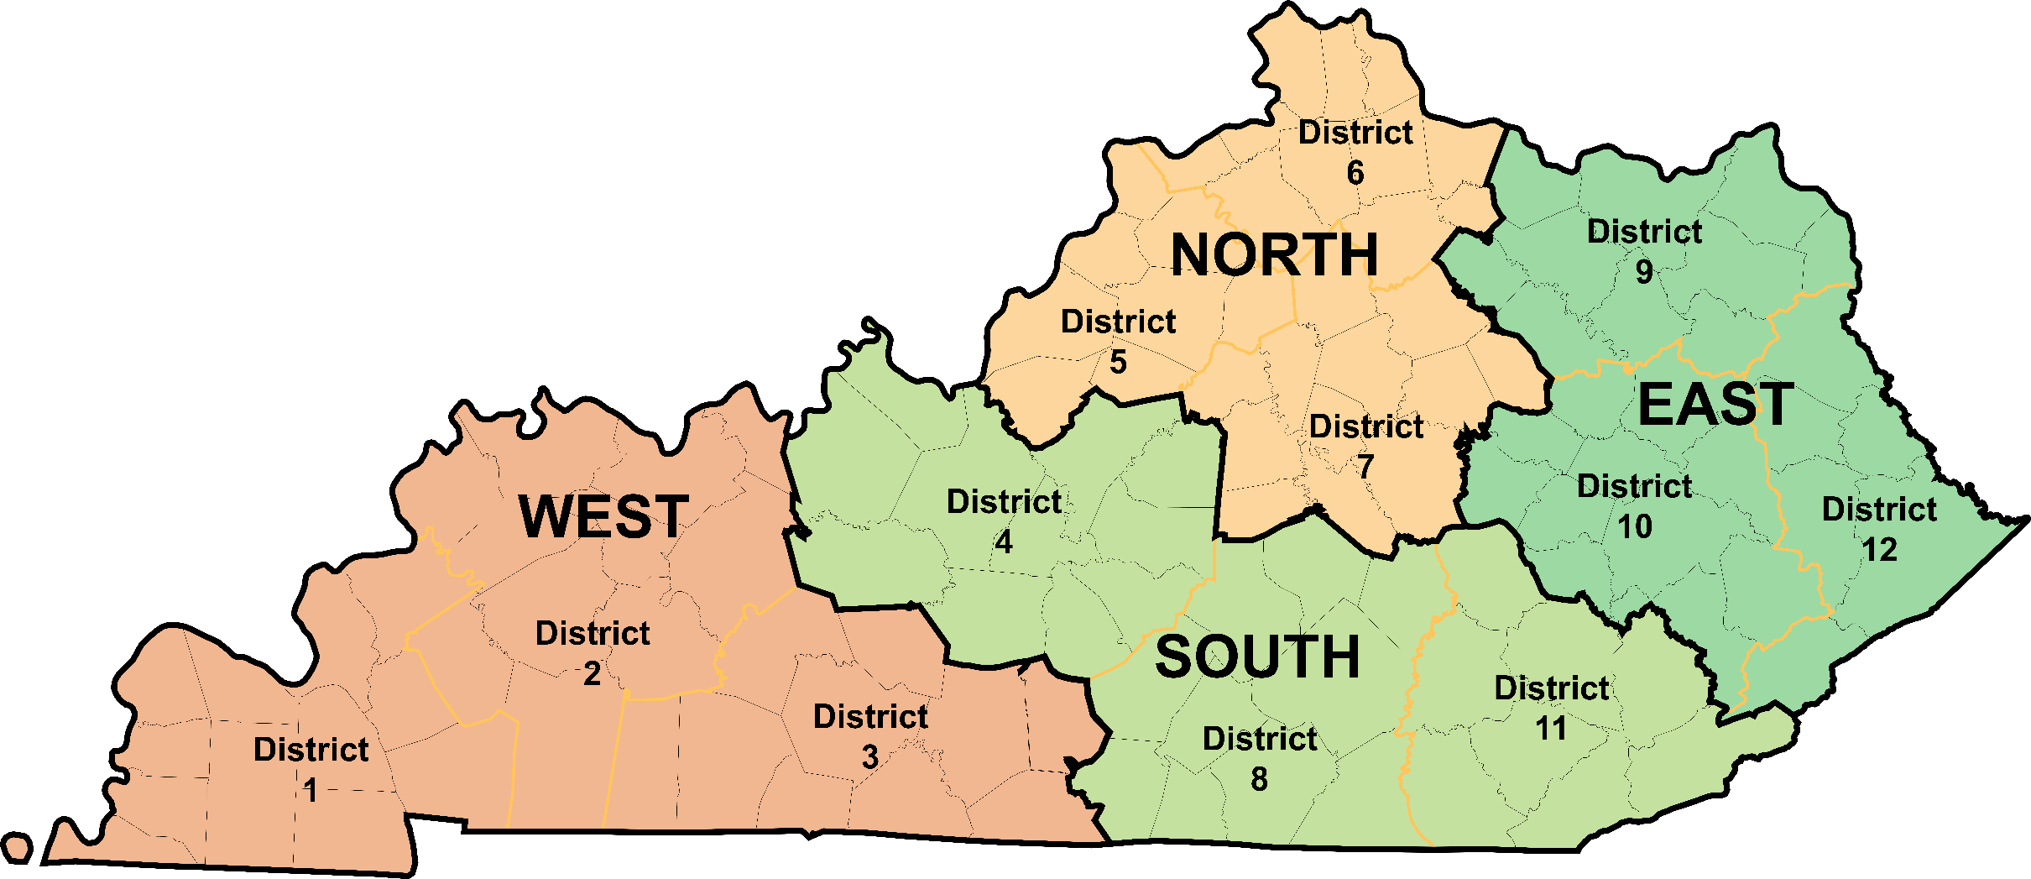
SHIFT Regions
Notes:
The regional component of SHIFT groups the state’s 12 KYTC districts into four regions.
These regions have similar challenges and needs.
This approach also helps balance rural and urban spending.
As you might expect, a larger share of statewide projects are in the most populous areas, where congestion, economic impact and accident rates increase their priority ranking.
Putting Louisville-Lexington and NKY in one region helps with the overall balance.

Slide 18
SHIFT Proposed Funding Allocation
In Millions
50% Statewide
50% Regional
40% Statewide
60% Regional
~$37M/Region
~$96M/Region
~$138M/Region
Notes:
Another way to ensure balance between urban and rural projects is to adjust the percentage of dollars that go to statewide projects and regional projects.
In the SYP, we propose allocating SHIFT dollars on a 50-50 basis in the first biennium.
In the second and third biennia, we recommend putting a larger share (60%) into regional projects and 40% into statewide projects.

Slide 19
So About the 2018 Plan…
 | 2018-2020 | 2018-2024
Debt
Asset Management
Dedicated Funds
Mobility and Safety

Slide 20
2016 SYP Funding Allocations
Notes:
Historic Hwy Plans shows an heavy emphasis on safety and mobility projects over Asset Management.

Slide 21
FY 18-20 Enacted Funding Allocations
Notes:
Putting more money into asset management means that we propose spending nearly half of our available funds on asset management in the next biennium.
That percentage will decrease in the following years but will still be a dominant share of spending over the next six years.

Slide 22
2018 Highway Plan – Biennium
Total Investment $2.68 Billion
Bridge Improvements $548 Million
Pavement Improvements $356 Million
Debt Payments $275 Million
Federally Dedicated Funds $495 Million
Mobility and Safety Projects $1,017 Million
Over-programmed $150 Million
Notes:
Mobility Projects in biennium 230 Projects in 87 counties.
6% over-programmed.
Compare to ~$3B Over-programmed in 2016

Slide 23
2018 Highway Plan – Entire Plan
Total Investment $8.49 Billion
Bridge Improvements $1.116 Billion
Pavement Improvements $1.153 Billion
Debt Payments $0.600 Billion
Federally Dedicated Funds $1.042 Billion
Mobility and Safety Projects $4.576 Billion
Over-programmed $1.80B
Notes:
Mobility Projects in biennium 230 Projects in 87 counties.
28
Compared to ~$7B in 2016!

Slide 24
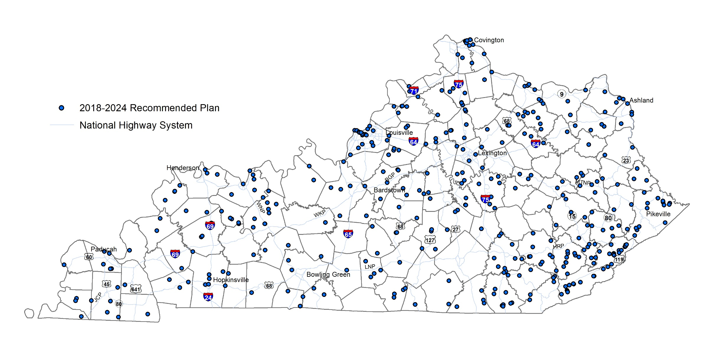
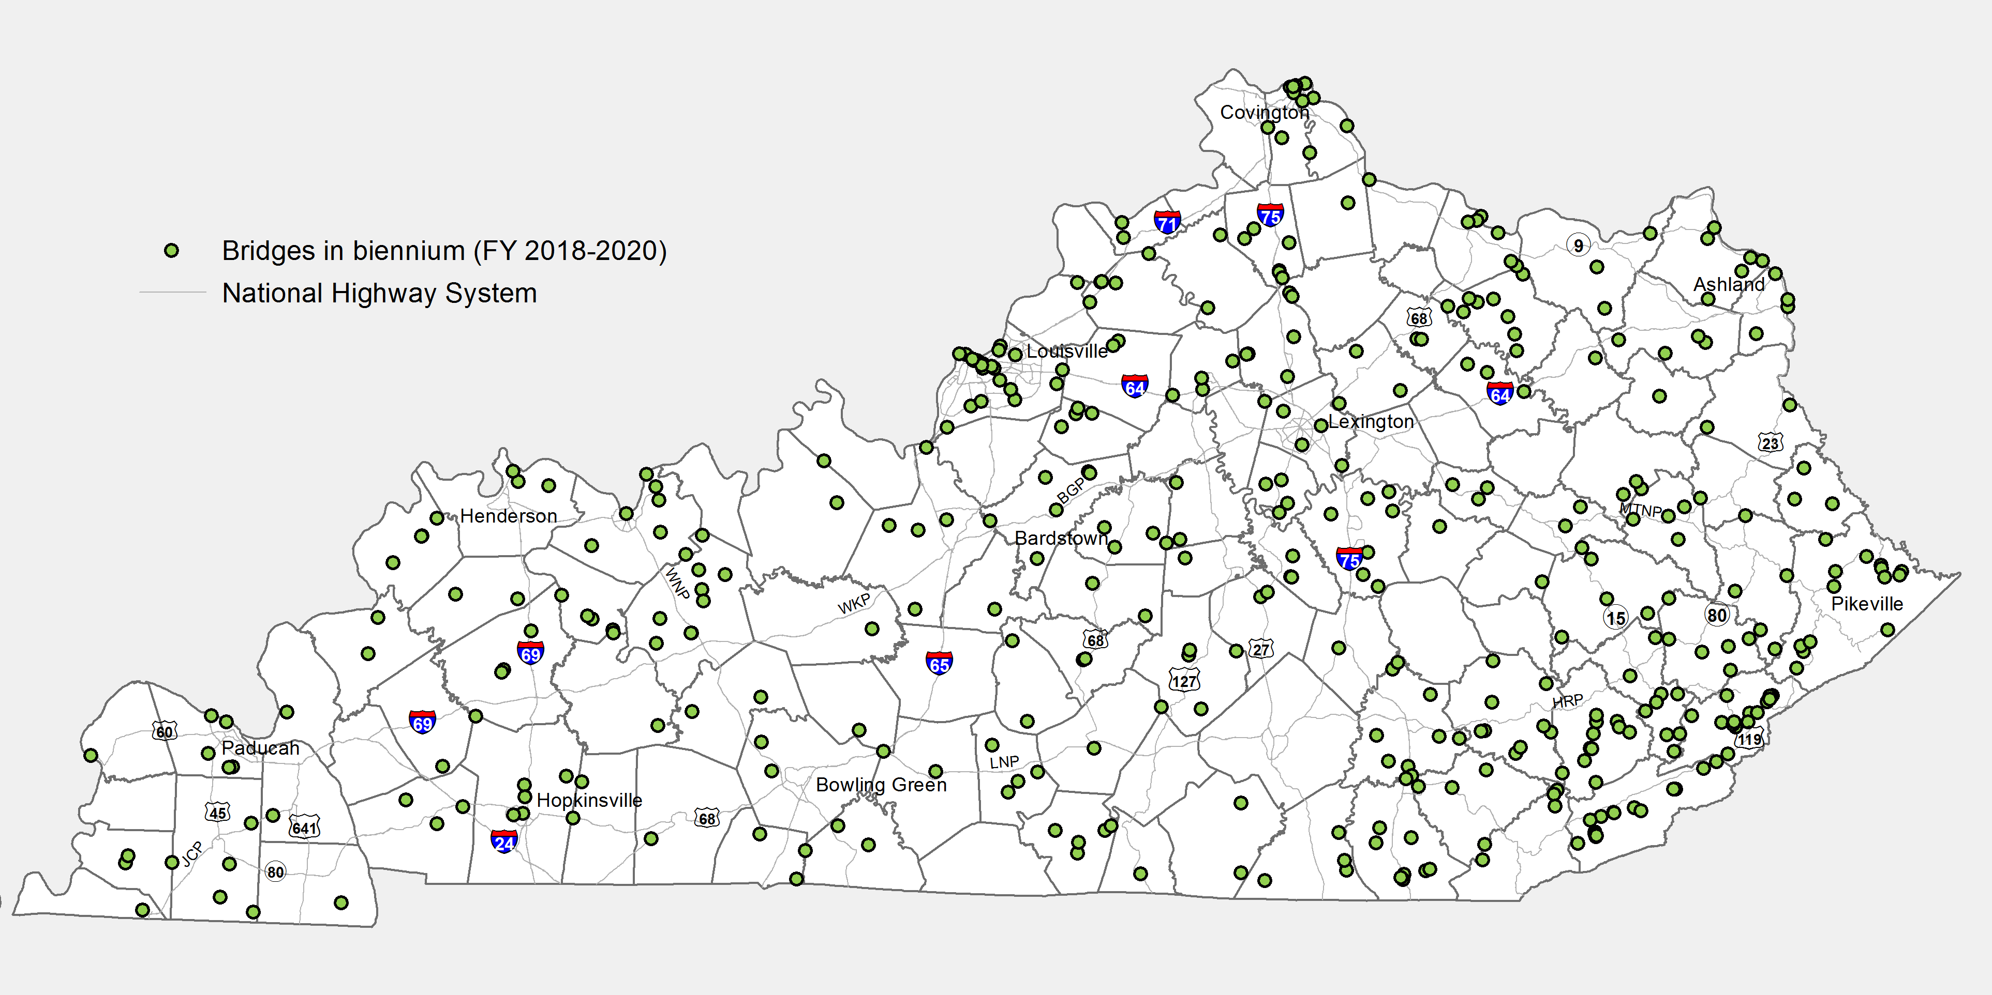
Safety First: Bridge Repairs
Six Year Plan includes 393 projects to address bridges in 100 counties - more than a third of the poor bridges
Notes:
Safety First will repair or replace over bridges across the state with over 100 of those being completed due to Fix It First funding.
More than 85 percent of counties and every transportation district will get needed bridge improvements.
This investment will help ensure more children can ride the bus from home to school and workers can get to their jobs.

Slide 25
Safety First: Pavement Repairs
Six Year Plan projects and annual resurfacing efforts will touch all 120 counties and arrest the growth of pavement needs.
Notes:
Without Safety First funding mileage of poor pavements will grow to over 6000 miles over 6 years.
Safety First will allow us to address all existing needs and keep our backlog level over the same timeframe.
These treatments range from preventive maintenance of fair pavements to prevent them becoming poor to re-building poor pavements that need more substantial rehabilitation.

Slide 26
Safety First: Mobility & Safety Improvements
495 Projects
  85 Relate to Ferry Operations and ZVarious Funding
  303 Originate from SHIFT
State Funds Over-programmed
  Biennium 120%
  Total Plan 300%
Silver Lining
  Flexibility
Notes:
74% of the Mobility Projects originated via SHIFT!

Slide 27

Performance Based Flexible Solutions
  How can a project address an existing need?

Slide 28
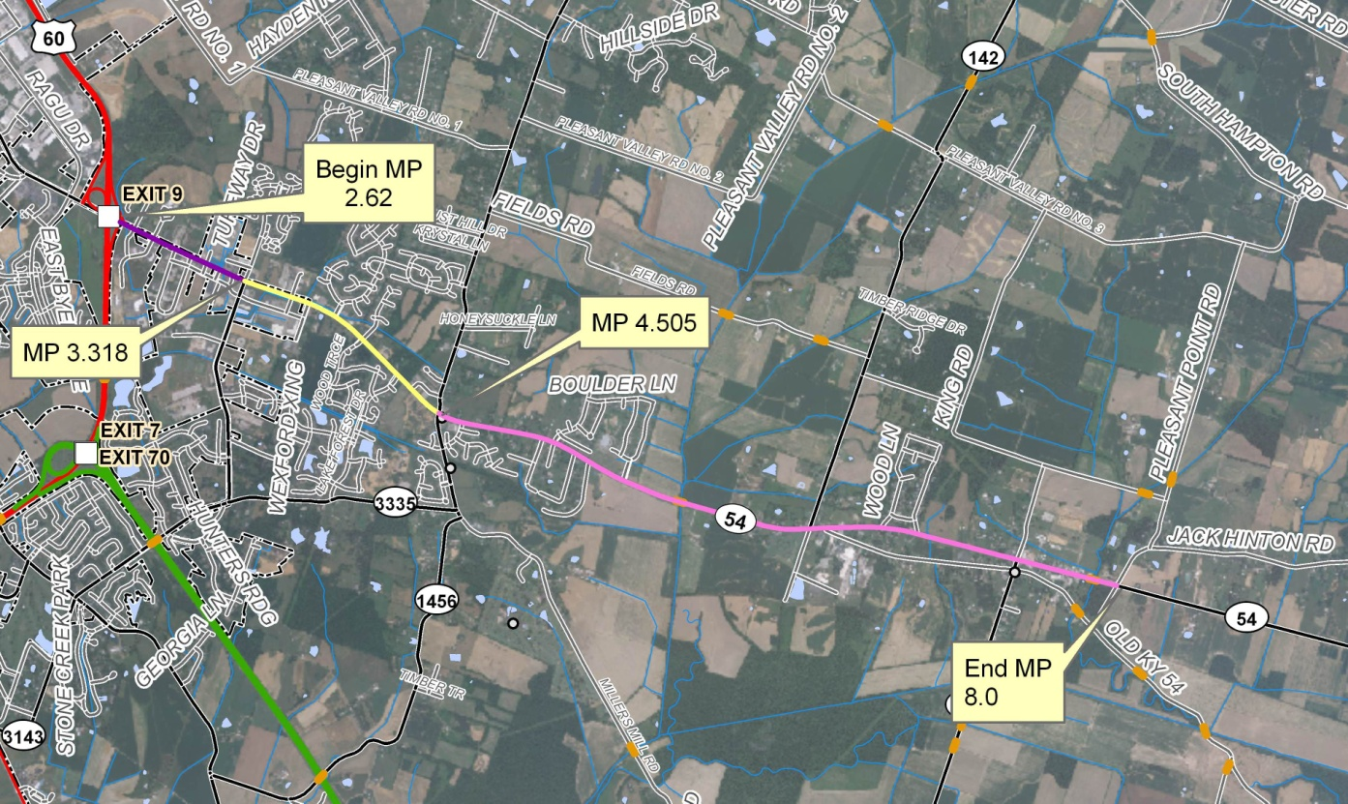
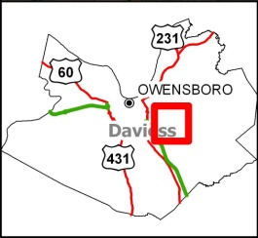
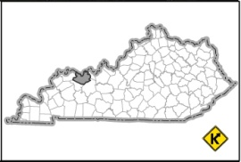
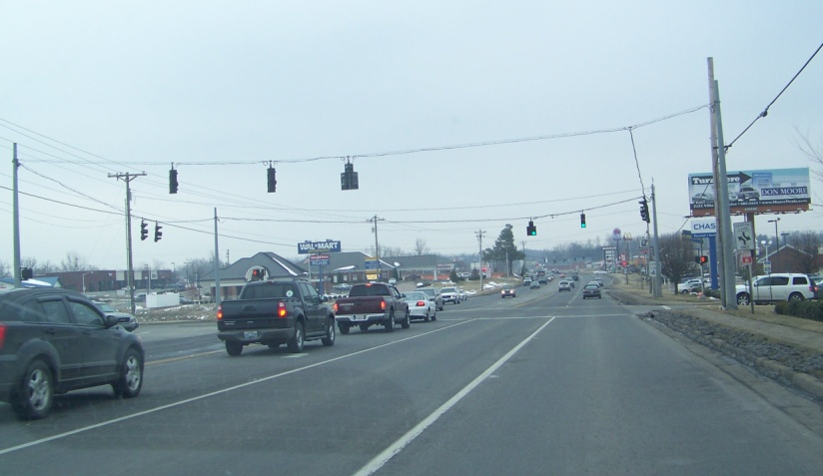
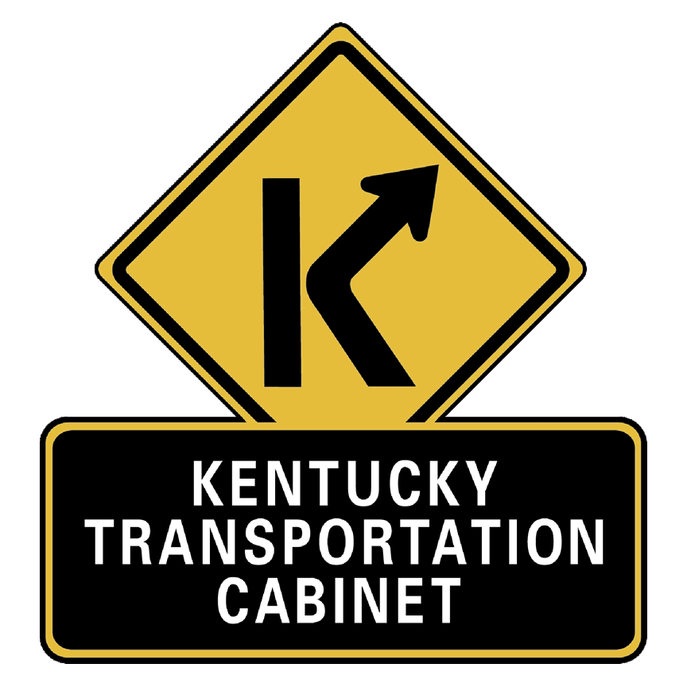

Data
Needs
Analysis
Scoping Study
KY 54, Daviess County
From US 60 to Whitesville
Item No. 2-8888.00
Prepared by the KYTC
Division of Planning and
KYTC District 2
September 2011

Slide 29
Why Data Needs Analysis?
Data Gathering
Red Flag Identification
Project Background
Need Identification
Purpose Identification
Scope
Early Assessment of Environmental Concerns

Slide 30
Data Needs Analysis
Begin DNA efforts on
  ALL Projects without documented Planning Effort
  Included in Governor’s Recommended Plan
  Design Starts
  Bridges beyond Pull and Replace
Not Required
  Royce’s Bridges

Slide 31
DNA Changes
Scoping & Need – Split into separate fields.
Completed DNA will trigger Design Funding Authorization
Coordination between Planning Liaison and District Planner regarding the needs statement.
Coordination between Location Engineer and Project Manager regarding the scope.

Slide 32
Project Need
Project Status
Transportation Demand
Legislation
System Linkage
Capacity
Safety
Roadway Deficiencies
Modal Interrelationships
Social Demands or Economic Development

