Slide 1
HIVEi – Highway Information View and Extract Interface
Statewide Transportation Planner Meeting 2018-04-18
Presenters: keith Dotson and Ed Harding

Slide 2
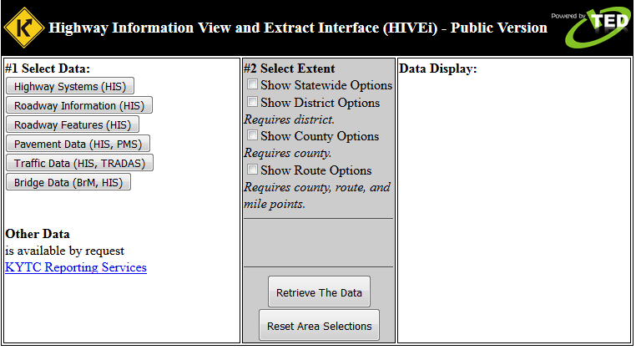
HIVEi
Take a Closer Look

Slide 3
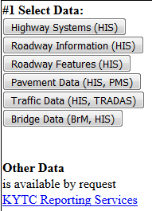
HIVEi – how it works
Select the Data to Extract
  Highway Systems
  Roadway Information
  Roadway Features
  Pavement Data
  Traffic Data
  Bridge Data
Other Data

Slide 4
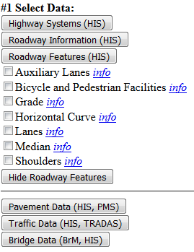
HIVEi – how it works
Select the Data to Extract
  Click Header to Expand
  Check Item to Query
  Click Info for Details
  Click Hide to Collapse

Slide 5
HIVEi – how it works
Highway Systems
  Appalachian System
  Coal Haul System
  Extended Weight System
  Forest Highways System
  Federal System
  KY Highway Freight Network
  National Highway Freight Network
  National Highway System
  National Truck Network
  Scenic Byway System
  State Highway System
  Strategic Highway Network
Roadway Information
  Access Control
  Evaluation Sections
  Posted Speed Limit
  Route Log
  Truck Weight Class
  Type of Operation
Roadway Features
  Auxiliary Lanes
  Bicycle and pedestrian Facilities
  Grade
  Horizontal Curve
  Lanes
  Median
  Shoulders
Pavement Data
  IRI Roughness
  Pavement Management
Traffic Data
  Traffic Flow
Bridge Data
  Bridges

Slide 6
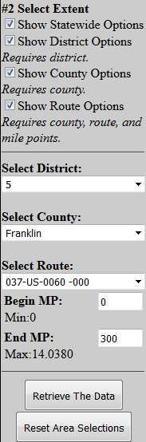
HIVEi – how it works
Select the Extent
  Statewide
  District
  County
  Route
    Beginning MP
    Ending MP
Choices Cascade
  District
  County
  Route
    Based on Through Lanes

Slide 7
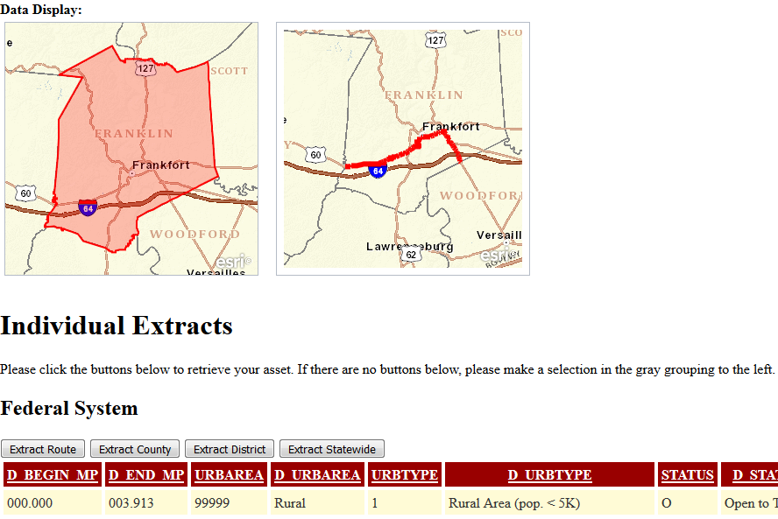
HIVEi – how it works
Data Display
  Thumbnail Maps
    Shows Finest extent
    Shows 2nd Finest extent

Slide 8
HIVEi – how it works
Data Display
  Extract Buttons
    Shows All Checked
    Shows Only Checked
    CSV
    Intelligent Names
  Display Grid
    For Route Only
    Not all the Attributes
    All Columns in Extracts
  Fields
    LRS (2 spaces)
    Codes + Descriptive

Slide 9
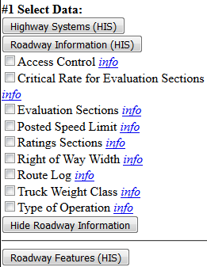
HIVEi – other flavors
HIVEiPublic
  Slides Pull from up to this point
HIVEiKYTC
  Adds Critical Rate for Evaluation Sections
  Adds Ratings Sections
  Adds Right of Way Width

Slide 10
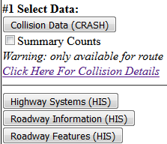
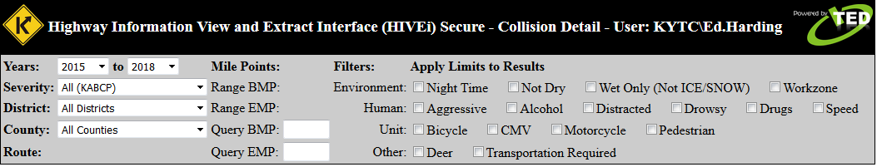
HIVEi – other flavors
HIVEiSecure
  Adds Collision Data
    Summary Counts for Collisions
    Using KABCO Scale
  Detail Query Page
    View Collision PDF
    Display GPS on Map

Slide 11

HIVEi - Sources
Highway Information
System
Weekly
Snapshot
HIGHWAYS
CHAF
FMIS
HIS
SYP

Slide 12
HIVEi
Questions?

Slide 13
HIVEi
Contact
  Keith Dotson
    Keith.Dotson@ky.gov
  Ed Harding
    Ed.Harding@ky.gov

Slide 14
HIVEi - Addresses
HIVEiPublic
  http://datamart.business.transportation.ky.gov/EDSB_SOLUTIONS/HISEXTRACTS/
  Linked off the Planning / Planning Highway Information / Roadway Queries and Reports
  Linked off the DataMart
HIVEiKYTC
  http://dashboard.intranet.kytc.ky.gov/edapps/highway_information/
HIVEiSecure
  http://dashboard.intranet.kytc.ky.gov/edapps/hiveisecure/
  Visit intranet page and search for “CRASH at KYTC” site

