Slide 1


The KY Transportation Cabinet’s Bike/Ped Program
2018 Updates from Troy HearN
Notes:
Cabinet’s Mission To provide a safe, efficient, environmentally sound and fiscally responsible transportation system that delivers economic opportunity and enhances the quality of life in Kentucky. As a state agency, we must satisfy our customers. For the Kentucky Transportation Cabinet, this translates into listening to their needs so that we can effectively meet their expectations. Of course in my world of pedestrian and bicycle transportation I translate the mission statement a bit differently than say a maintenance manager or bridge designer. Bicycle travel seems pretty darn safe and environmentally friendly. The bicycle is one of the most efficient forms of transportation ever invented. Economic opportunity; how about a 233$ Billion Dollar industry a year in the US. How about lower health care (my dad’s example). Quality of life example; and on and on. Well, here is what we have been up to in the Bike/Ped Program Office.

Slide 2

Overview for KY Bike/Ped
Changes/Updates to the Bike/Walk Website
“Official” Local Bike/Walk Plans
Better Local Projects (LPA)
Continued Partnerships
More Bike/Ped Activity & Demand
Results
Notes:
These are the main topics I will go over today

Slide 3
Update for the Bike/Walk Website
All new web addresses
https://transportation.ky.gov/BikeWalk/Pages/Home
Planning/Resource information (more and better)
https://transportation.ky.gov/BikeWalk/Pages/Bicycle-and-Pedestrian-Travel-Planning-Resources.aspx
Listing of all known Bike/Ped Organizations and local government Bike/Ped plans
https://transportation.ky.gov/BikeWalk/Pages/Bicycle-_-Pedestrian-Plans-and-Clubs.aspx
Notes:
If you have heard or noticed, KYTC has migrated or integrated all of the web pages to a new platform. Of course this means all of the addresses and hyperlinks have been changed. we have a whole page devoted to listing all of the plans and organization relating to walking and bicycling transportation/travel.
Have you visited the KYTC Bike/Walk web pages in a while? New look and web address. We are now located under citizen services. When in doubt, just Google KYTC Bike Walk or Bike Walk KY.

Slide 4
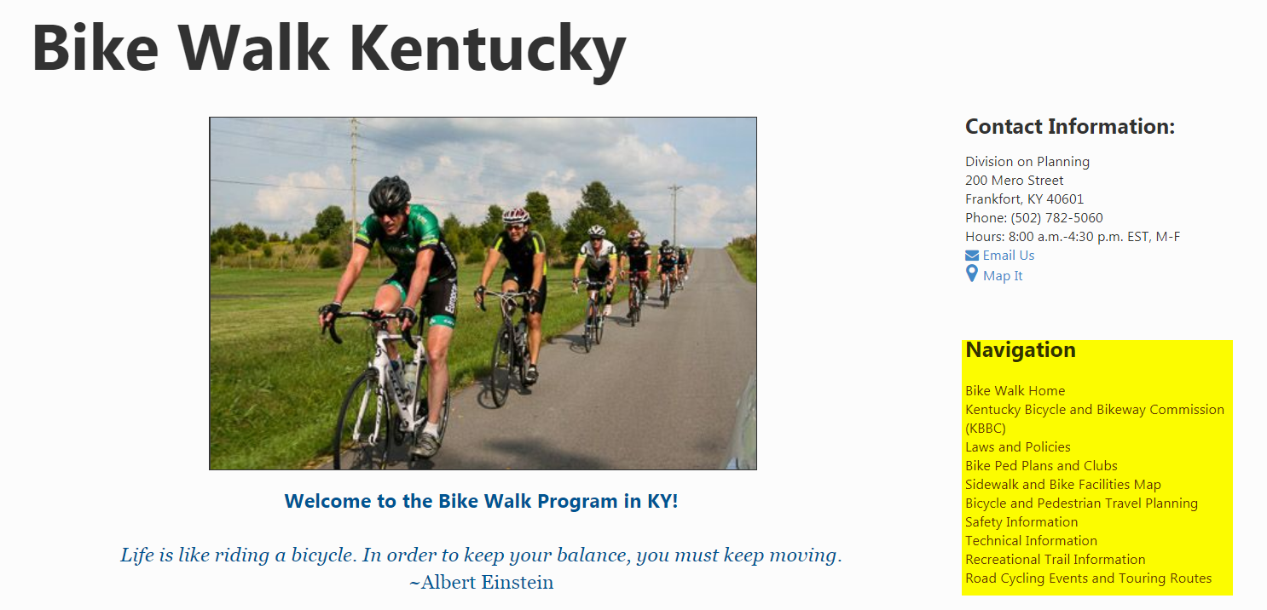
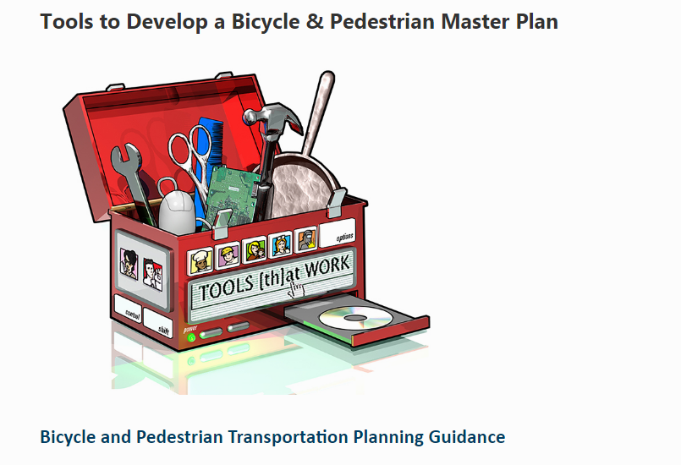
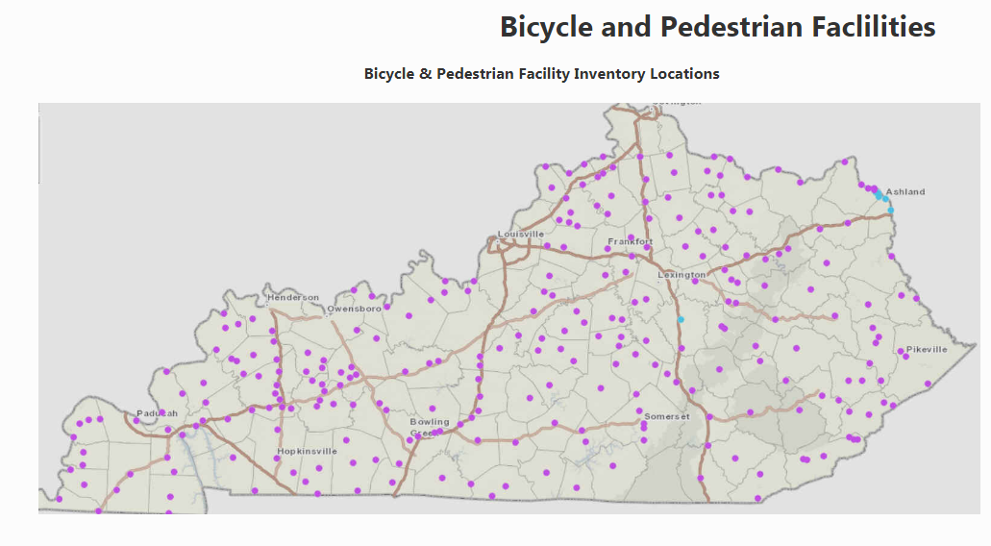
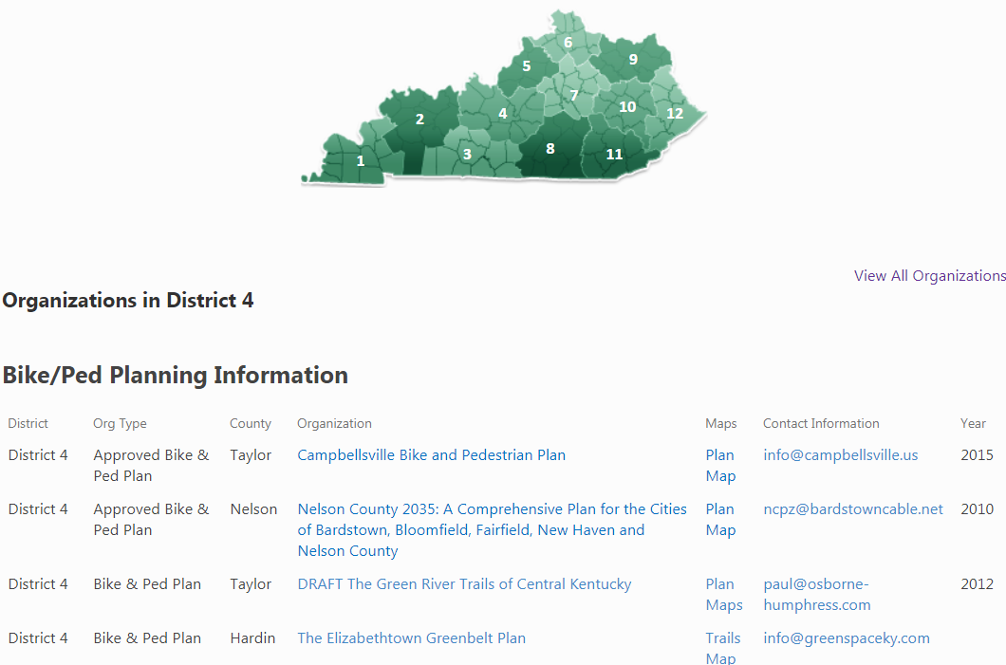
Notes:
You can still search by putting bike walk KYTC, or just about any other combination of the words bike, bicycle, walk, walking, pedestrian and Kentucky; we should be in the top three results.
The website should be much easy to navigate through and is certainly much friendlier for smart phones and I pads. Please take a moment to view the updated pages and information. I know I certainly think it’s great and the information is valuable.

Slide 5
Local Government Planning
54 Complete “official” community/local government bicycle and pedestrian master plans
18 communities are developing bike/ped master plans for the first time
8 communities have recently started or completed updates to their bike/ped master plans
https://transportation.ky.gov/BikeWalk/Pages/Bicycle-_-Pedestrian-Plans-and-Clubs.aspx
Notes:
We have listened to our customers and provided resources and workshops for the things they have asked for; bicycling and pedestrian infrastructure planning. More, accommodating, and safer. We have seen a 700% increase in community planning for bike/ped travel since 2012 (6 short years).

Slide 6
Local Projects (LPA)
Project planning in every highway district
Continued coordination with Federal, Private, and other funding sources
https://transportation.ky.gov/BikeWalk/Pages/Bicycle-and-Pedestrian-Travel-Planning-Resources.aspx
Notes:
Who here works with or for a LPA? If you work on the project planning, design, applications, or funding; then you are indeed some of my favorite people.
Hopefully you have noticed there have been more bike/ped facility projects lead by LPA’s. We also hope that you have noticed these project quality are improving.
If not, then hopefully you will very soon.
Bikeways projects in Pikeville, Mayfield, and many others.
Sidewalk rehab jobs in too many cities to mention
Large TIGER projects in several cities (Frankfort & Lexington)
Working to create a better funding experience for local governments (expectations and early planning) and higher quality applications
Cabinet’s Mission To provide a safe, efficient, environmentally sound and fiscally responsible transportation system that delivers economic opportunity and enhances the quality of life in Kentucky. As a state agency, we must satisfy our customers. For the Kentucky Transportation Cabinet, this translates into listening to their needs so that we can effectively meet their expectations. Of course in my world of pedestrian and bicycle transportation I translate the mission statement a bit differently than say a maintenance manager or bridge designer. Bicycle travel seems pretty darn safe and environmentally friendly. The bicycle is one of the most efficient forms of transportation ever invented. Economic opportunity; how about a 233$ Billion Dollar industry a year in the US. How about lower health care (my dad’s example). Quality of life example; and on and on. Well, here is what we have been up to in the Bike/Ped Program Office

Slide 7
Continued Partnerships
The State Heath Department
The KY Main Street Program
America Walks
Adventure Cycling Association
Notes:
Outside of our work with KYTC folks, we work a lot with other state agencies, state groups, and several national organizations. These organizations provide additional resources, community and project funding opportunities, and to help spread the work of our awesome work we have been doing the past 6 years (my tenure here).
These are just the main groups we have been working with for multiple years, there are many many more. Don’t be surprised if you see something in other national or state news about the KYTC Bike/Ped Program work; cause that’s what we do! We spread the word and share the message of the importance of bike/ped planning.

Slide 8
Statewide Projects & Activities
Statewide Bike/Ped Summit in Lexington (August 16 & 17)
Bicyclists Comfort Index (BCI) has been used for 4 years now (updated and improvements)
Pedestrian Comfort Index (PCI) has been developed for state maintained roadways (new this year)
Continued partnerships with the State Health Dept & the Main Street Program
Statewide National Interscholastic Cycling Association (NICA) League starts in 2020
Statewide increase for on-road bicycling events (participation and # of events)
US Bike Route Planning and AASHTO Submittal
Notes:
Planning for a true statewide event to show case what we have done (quality successes) and provide tools to do more well planned quality projects
The BCI has been used in project forecast, small urban studies, corridor studies, with Share the Road Sign request, and much more
Hopefully the PCI will be used much the same, or more
Partnerships with other state agencies have provide additional insight, resources ($$$), and help spread the word for the importance of good planning
Statewide high school and middle school bicycle club/ race teams league starts (TN now has 26 teams in just three years). Pilot in 2019, full KY in 2020
There has been a steady increase in the participation of the large on-road bicycle event rides like the Horsey Hundred in Central KY, The Old KY Home ride in the Louisville area, and much more. These event coordinators and communities have started collecting economic data from these events to measure the positive impacts and to help folster support for having these types events. The Horsey Hundred (the largest event of it’s kind in KY) generated approximately $700,000 in 3 days for the Scott County/Central KY area in 2016.
USBR 21 and 23 are in the final stages of development and review for submittal to AASHTO. Both routes are north/south. The eastern route (21) travels from the Cumberland Gap, through sections of D11, 8, through central KY (D 7), a corner of D-6, then ends in Mason County (D). The planning for this route is further along than the western route. The West route travels from Simpson County, Warren, and on north to the current US-76 Bike Route. We will continue to coordinate with our HDO partners as these planning activities continue.

Slide 9
Results Speak for Themselves
Increase in community bike/ped planning
Memberships statewide in local bicycle groups have increased
The amount of on and off-road bike/walk facilities has increased
National recognition for KY’s bike/walk activities
Growth of Bike Share programs
Notes:
We now have an official bike/ped plan in every highway district! There are now 54 communities with official community bike/ped plans
We surveyed the 6 largest bike clubs in KY to see if the memberships numbers have grown. (See separate document for this and other activities)
We are continuing to collect inventories for bike/ped facilities with help of our ADD’s and HDO’s. One of the biggest challenges is that KY keeps building more! For me, this is a good problem to have.
Our planning work with our other KY partners have received National Recognition. The CDC, America Walks, The Adventure Cycling Association, and The Alliance for Walking/Biking have all given recognition in the past few years to our work done to plan, document, coordinate, and help communities develop bike/ped plans and ultimately construct or improve bike/ped facilities (and more).
Who has a bike share program in their area? We have seen the growth of bike share across the state; both big and medium size cities. Northern KY, Louisville, EKU, and UK all have bikes on the ground, and many more communities area in the planning process for more.

Slide 10




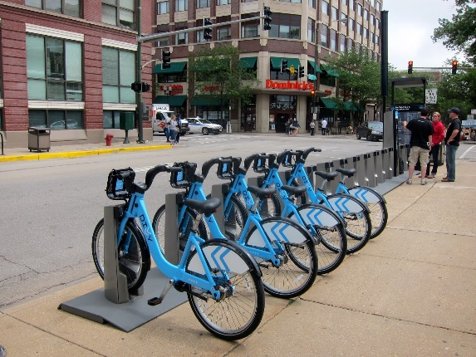
Questions?
THANK YOU!
Troy Hearn
Bicycle & Pedestrian Program
Troy.hearn@ky.gov
502-782-5060
https://transportation.ky.gov/BikeWalk

