Slide 1
Kentucky Alternative
Fuel Corridors
FHWA Application
Submitted on 11/28/2017
Justin Harrod

Slide 2
A Little Background…
Section 1413 of the FAST Act required the Secretary of FHWA to designate alternative fuel corridors for DOTs.
  Signed into law on December 4, 2015
  Enacted on December 4, 2016
  Took affect on December 4, 2017

Slide 3
Alternative Fueling Stations for...
Compressed Natural Gas (CNG)
Liquefied Natural Gas (LNG)
Electric Vehicles (EV)
Liquefied Petroleum Gas (Propane/LPG)
Hydrogen (HYD) – None in KY

Slide 4
Compressed Natural Gas (CNG)
Station Requirements:
  150 miles between stations
  5 miles or less from highway
  Public stations only
KY has 5 stations meeting these requirements.

Slide 5
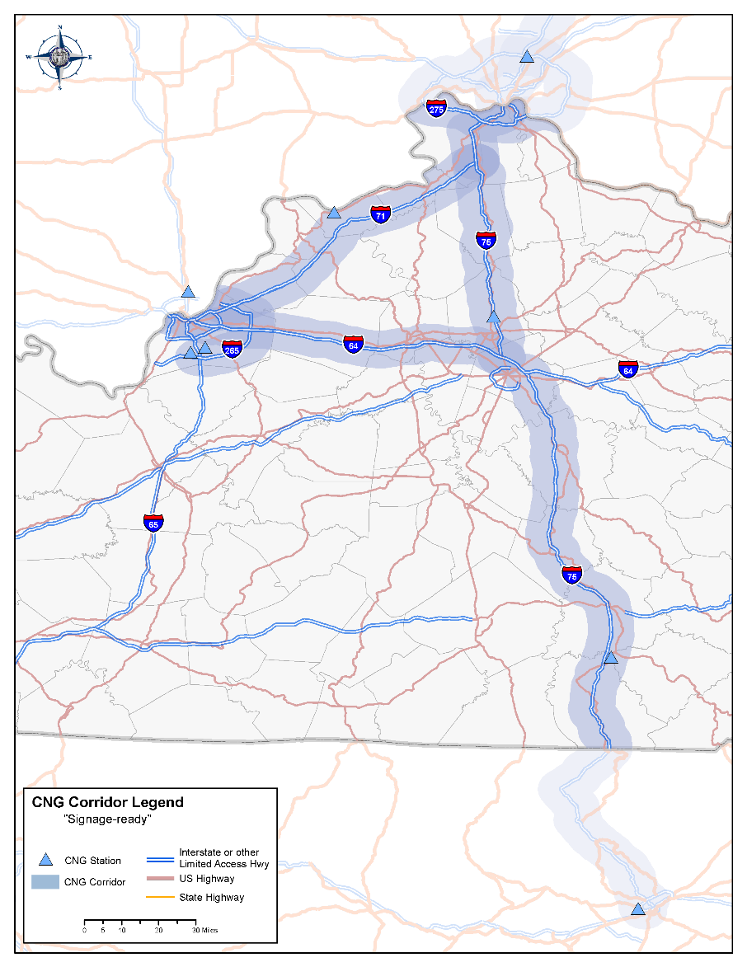
CNG
All of I-75*
  MP 0.00 to MP 191.78
All of I-275*
  MP 0.00 to MP 13.71 and
  MP 73.10 to MP 83.78
All of I-71*
  MP 0.00 to MP 95.51
All of I-265
  MP 10.20 to MP 34.70
Portion of I-64
  MP 0.00 to MP 74.50
*Coordinated with OKI MPO
  MPOs – Dayton, Columbus, Springfield

Slide 6
Liquefied Natural Gas (LNG)
Station Requirements:
  200 miles between stations
  5 miles or less from highway
  Public stations only
KY has 1 station meeting these requirements.

Slide 7
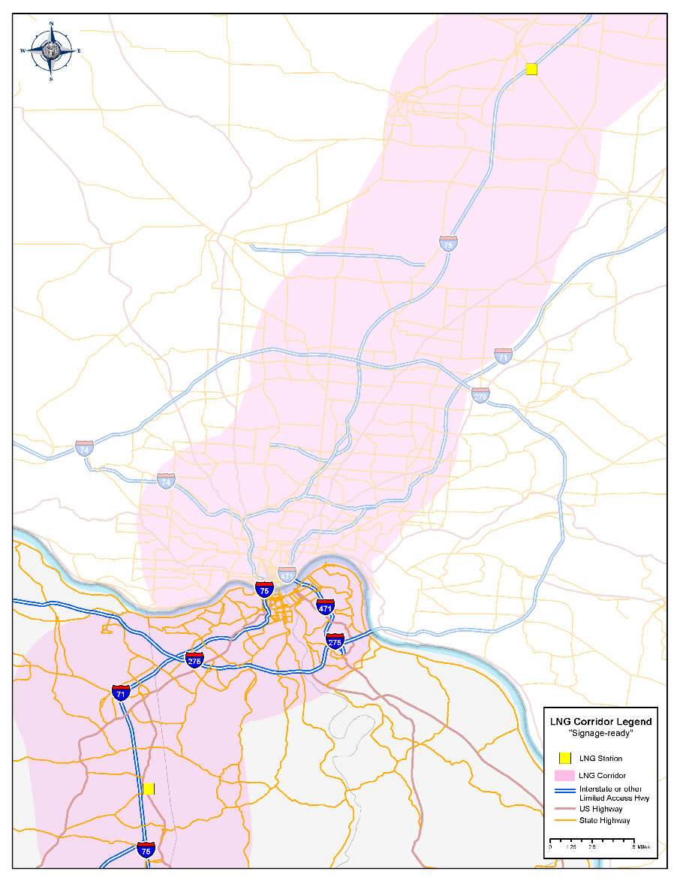
LNG
Portion of I-75*
  MP 173.5 to MP 191.78
*Coordinated with OKI MPO
  MPOs – Dayton, Columbus, Springfield

Slide 8
Electric Vehicles (EV)
Station Requirements:
  50 miles between stations
  5 miles or less from highway
  Public stations only (no Tesla)
  Level 3 (DCFC)
KY has 2 stations meeting these requirements.

Slide 9
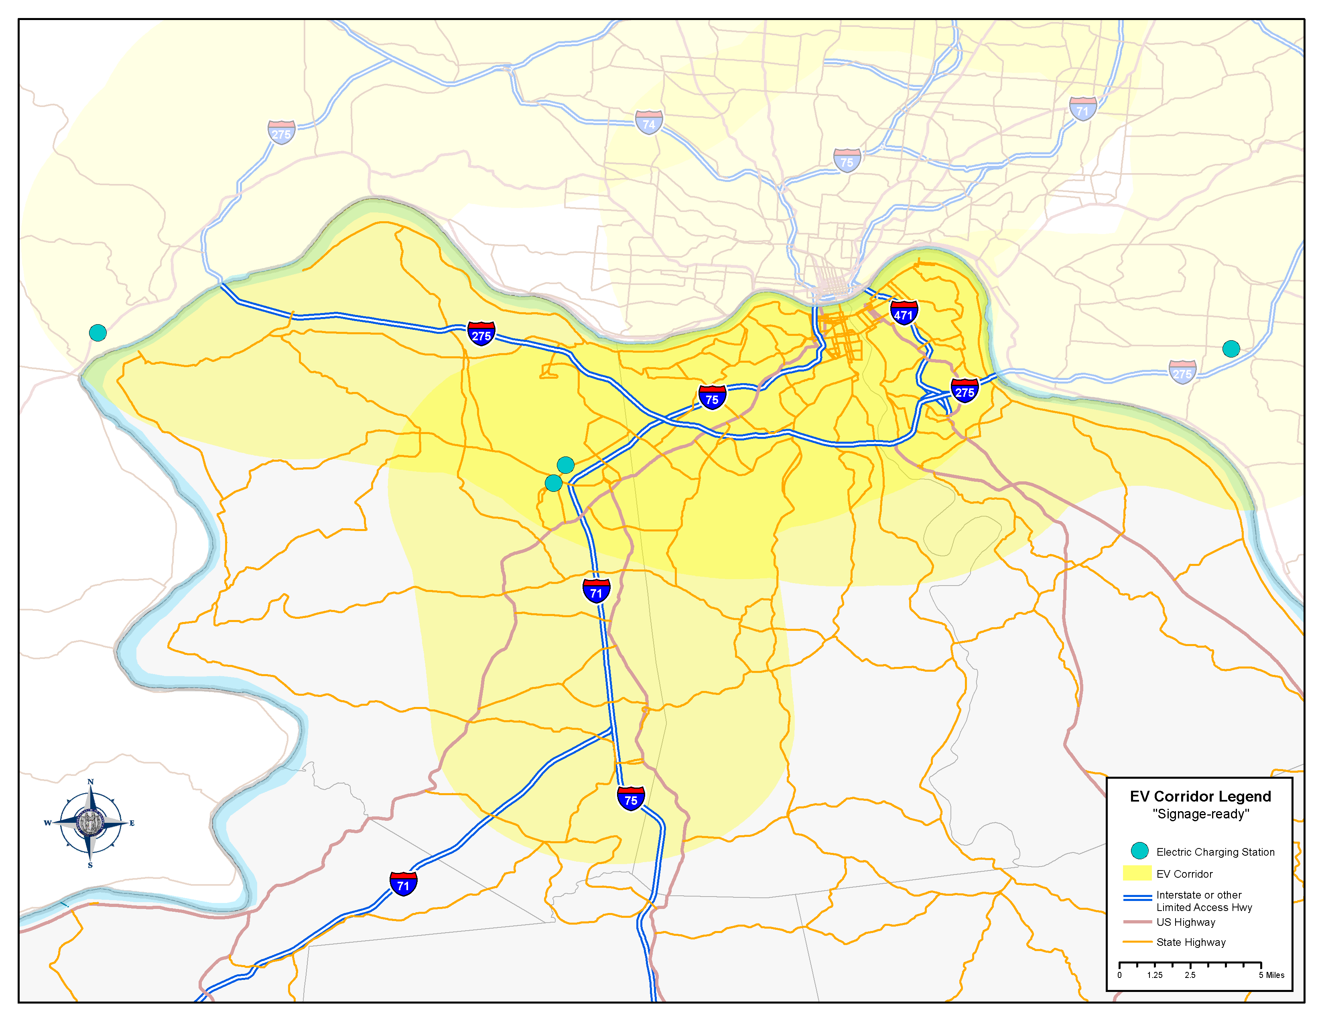
EV
All of I-275*
Portion of I-75*
  MP 173.50 to MP 191.78
Portion of I-71*
  MP 77.70 to MP 95.51
*Coordinated with OKI MPO
  MPOs – Dayton, Columbus, Springfield

Slide 10
Liquefied Petroleum Gas (Propane/LPG)
Station Requirements:
  150 miles between stations
  5 miles or less from highway
  Public stations only
KY has 2 stations meeting these requirements.

Slide 11
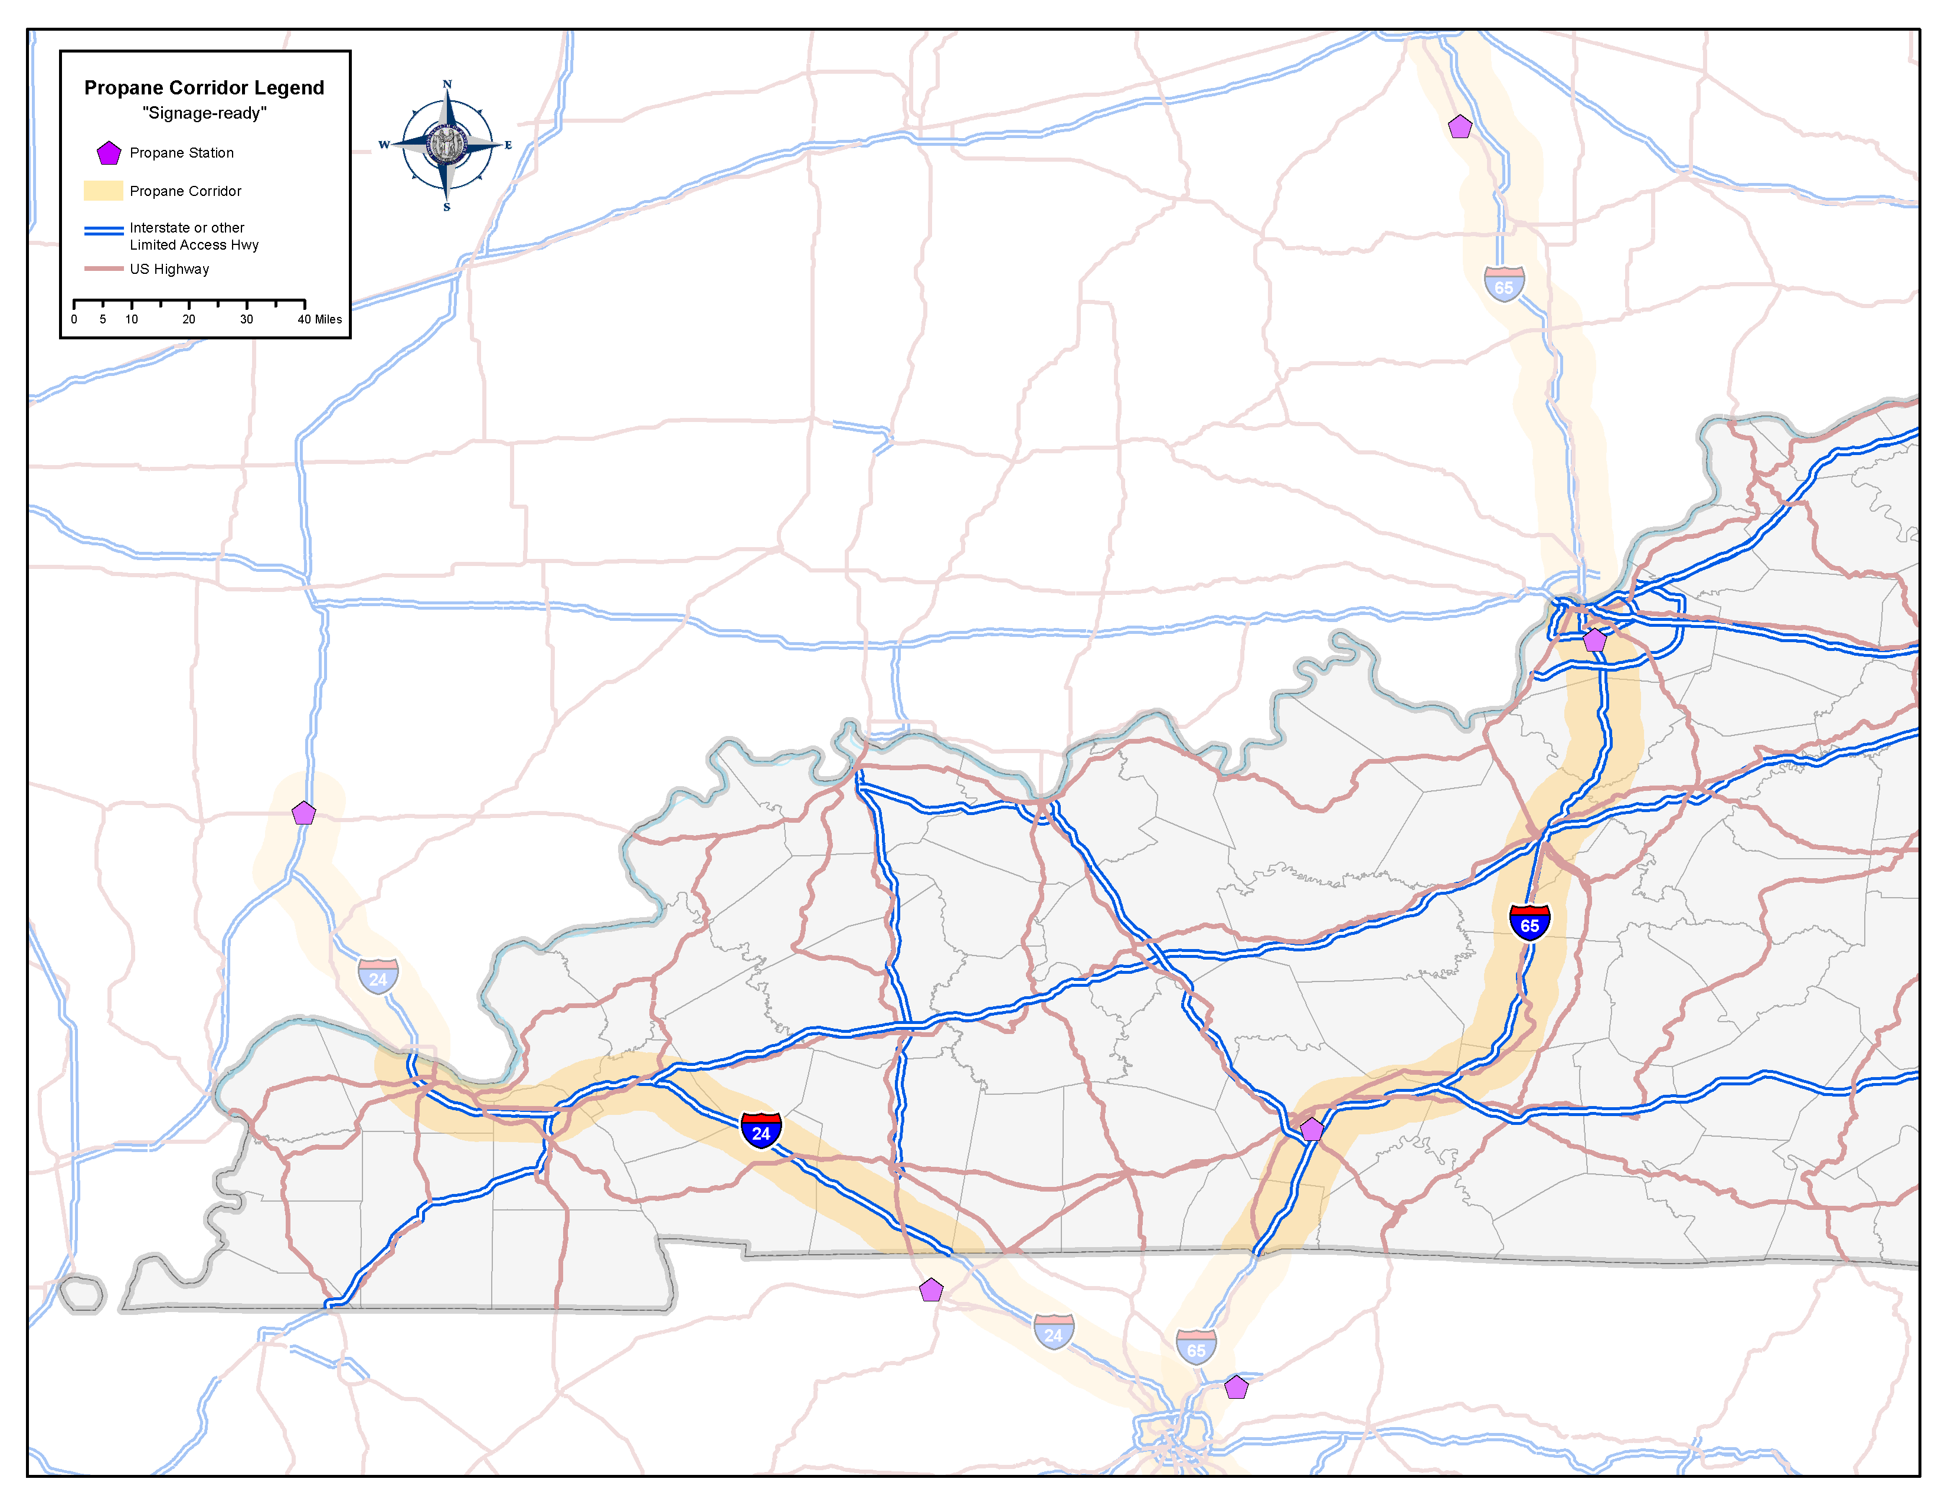
LPG
All of I-65
  MP 0.00 to MP 137.32
All of I-24
  MP 0.00 to MP 93.37

Slide 12
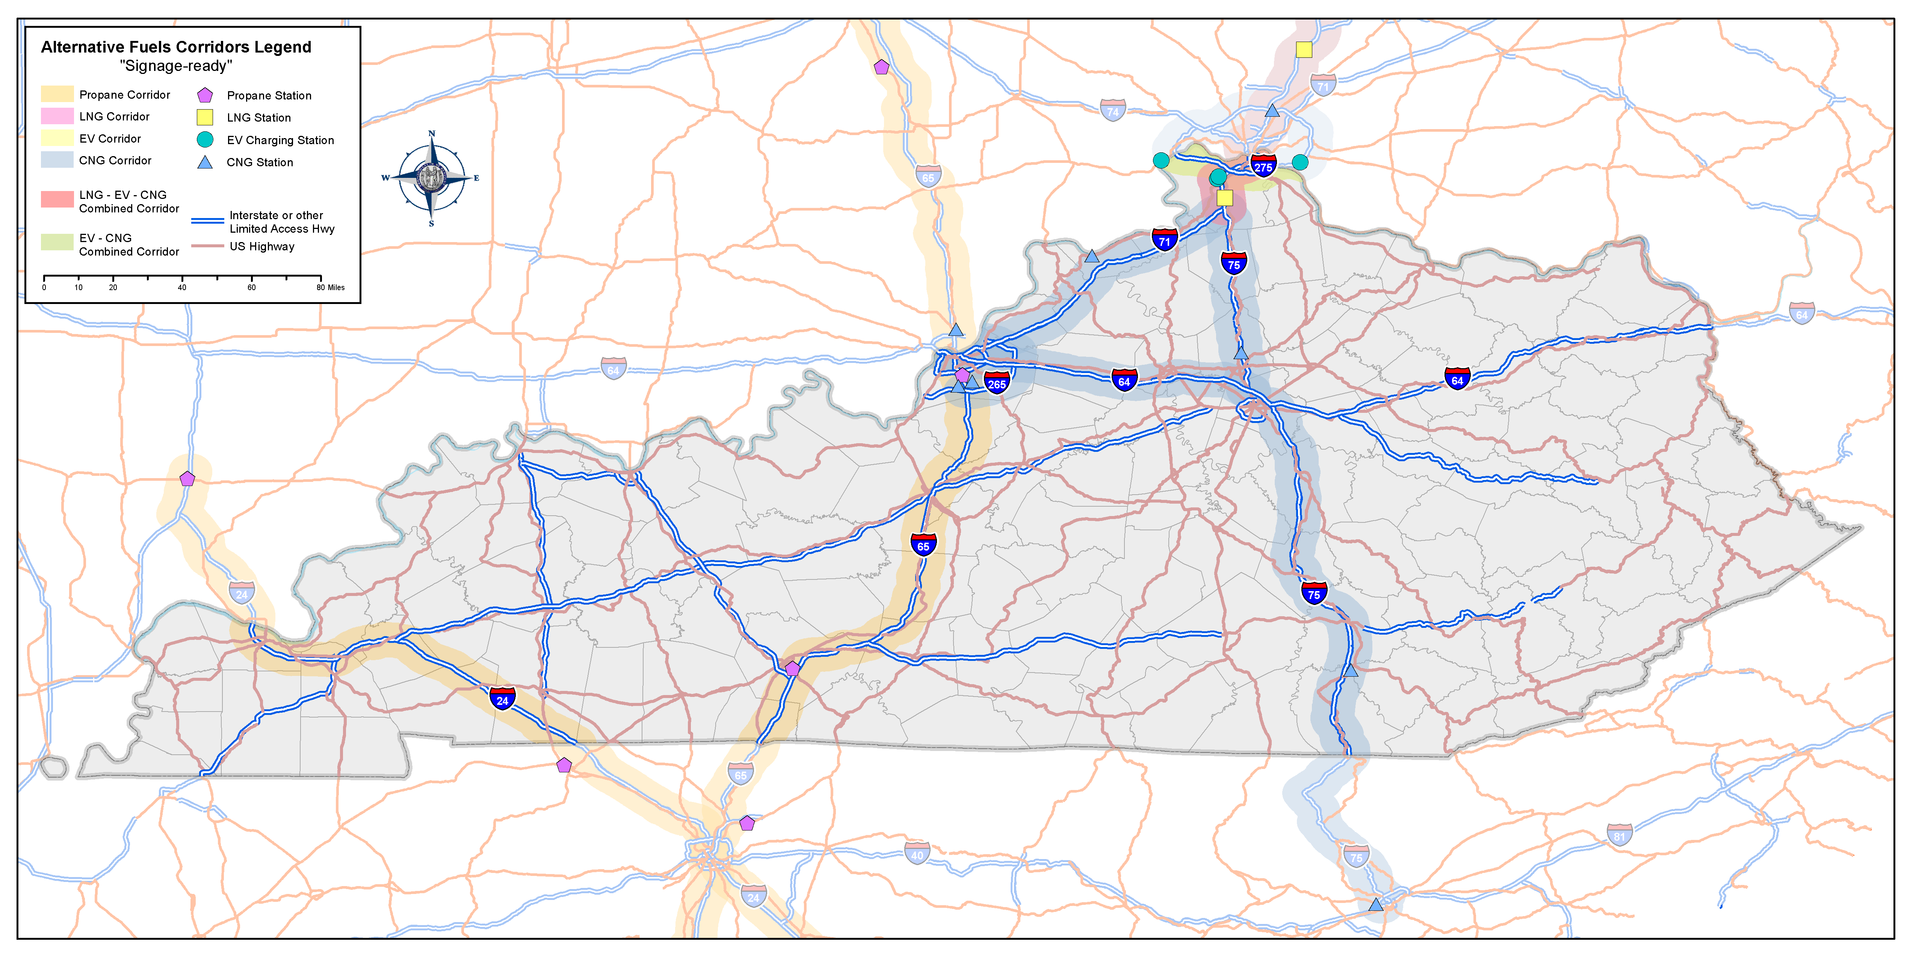

Slide 13
Results are in!!!
On March 8th, FHWA sent KYTC what they approved for “corridor-ready” and “corridor-pending” for our state.
Ready – signage can be placed on the corridor
Pending – a few more facilities are needed in order to meet the requirement(s) to have the corridor ready for signage, but is close.

Slide 14
Corridor-ready
CNG
  I-75: From KY/OH border to KY/TN border
  I-71: From KY/OH border to Carrollton, KY
LNG
  I-75:From KY/OH border to KY/TN border
EV
  I-275: From KY/OH border to KY/IN border
  I-71 and I-75: From KY/OH border to Florence, KY
LPG
  I-65: From KY/IN border to KY/TN border

Slide 15
Corridor-pending
CNG
  I-265: From Louisville, KY (@I-71) to Louisville, KY (@I-65)
  I-71: From Carrollton, KY to Louisville, KY
  I-275: From KY/OH border to KY/IN border
EV
  I-71: From Florence, KY to Louisville, KY
  I-75: From Florence, KY to KY/TN border

Slide 16
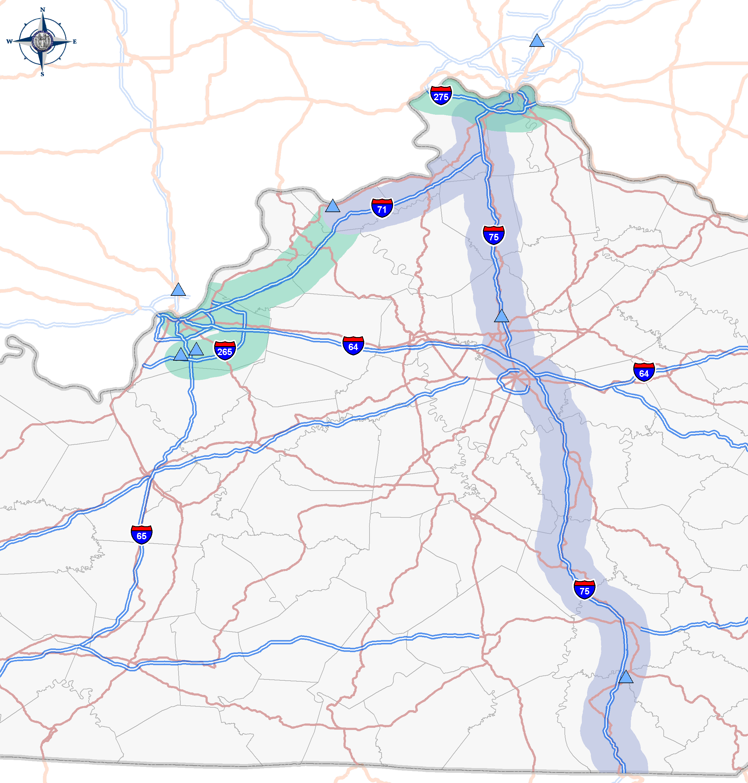
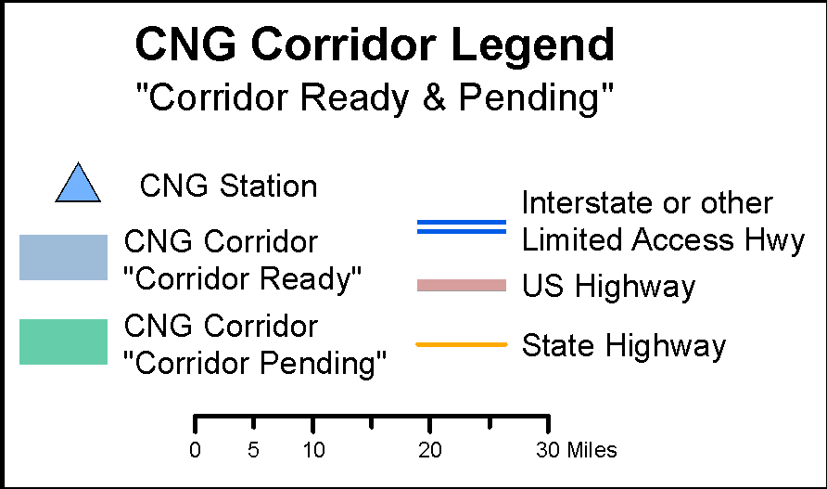
CNG

Slide 17
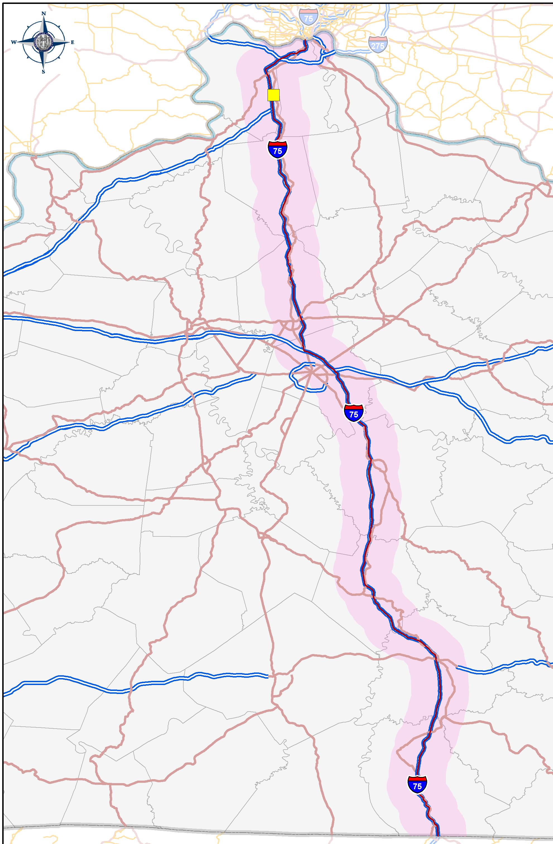
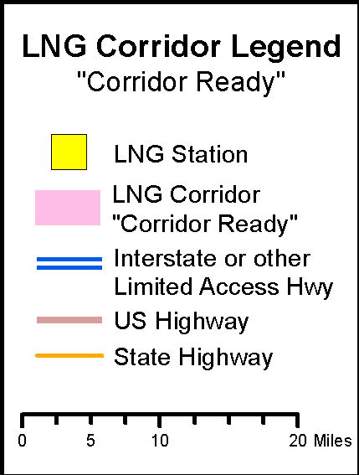
LNG

Slide 18
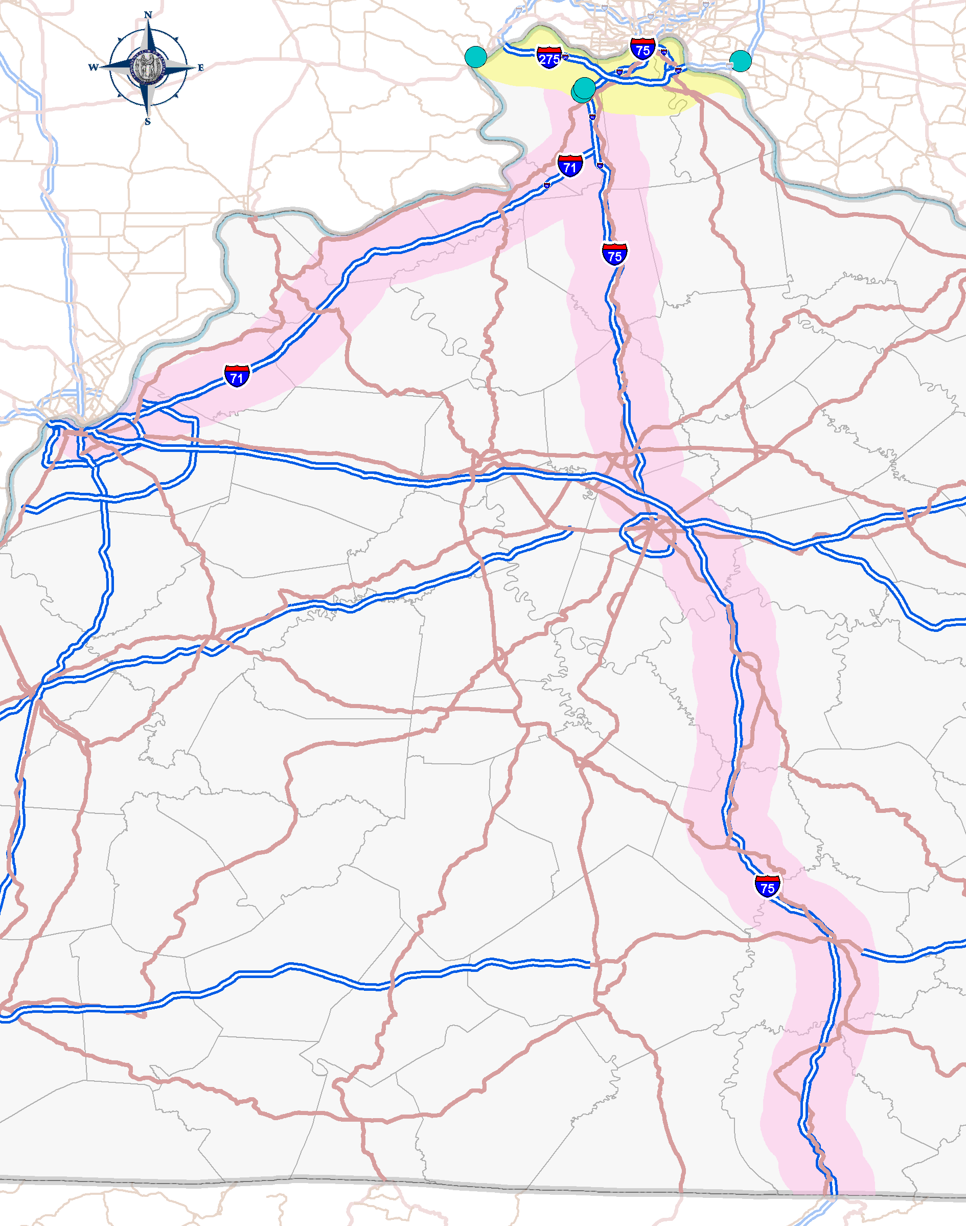
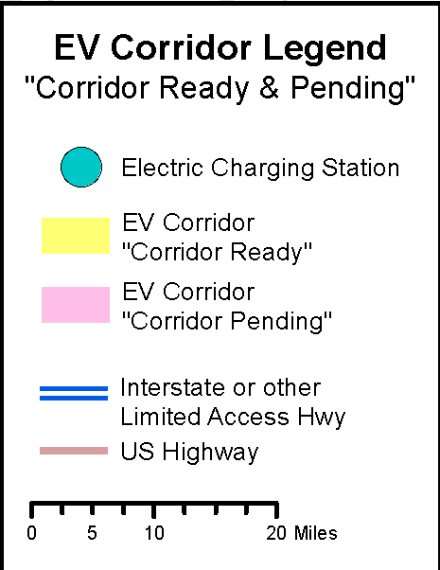
EV

Slide 19
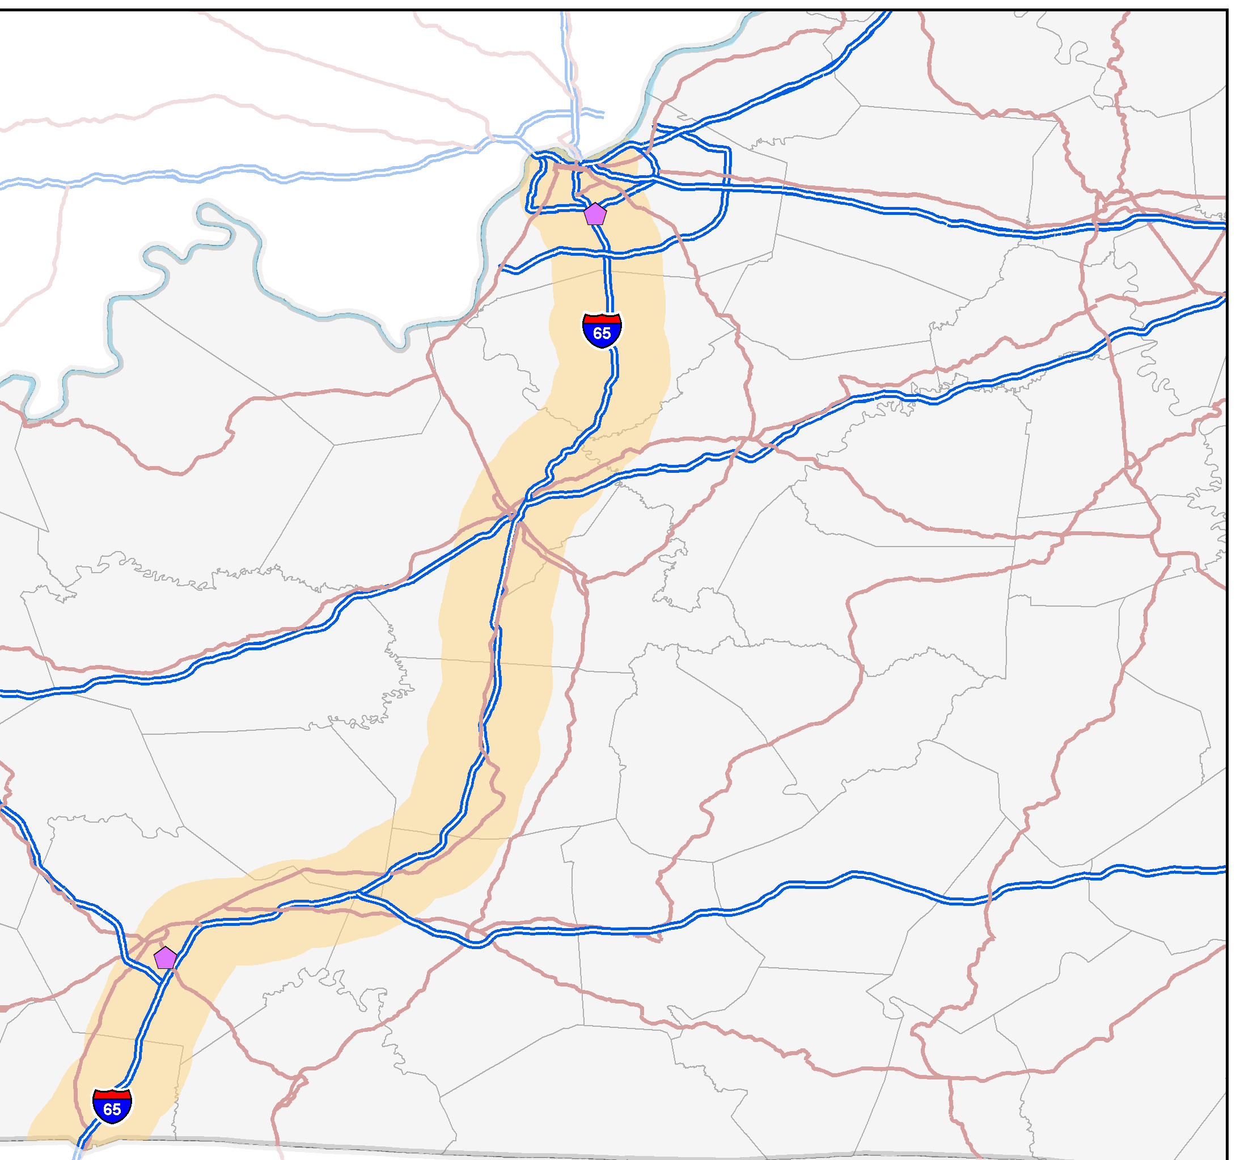
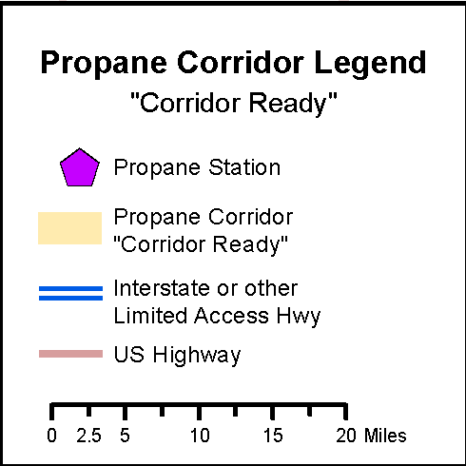
LPG

Slide 20
Next Steps…
How to go about signing the corridors that are “corridor-ready”.
  KYTC primarily envisions signing by the “Blue LOGO Signs” exit services signs
    https://transportation.ky.gov/TrafficOperations/Pages/Sign-Programs-and-Standards.aspx
    https://mutcd.fhwa.dot.gov/resources/policy/alt_fuel_corridors/index.htm

Slide 21
Next Steps…Cont’d
Future funding may to be tied to these Alternative Fuel Corridors.
Providing the public with more awareness related to alternative fuels.
Continuing to add more corridors when possible.

Slide 22
Questions???
Useful websites:
US DOE: Energy Efficiency & Renewable Energy:
  https://www.afdc.energy.gov/locator/stations/results
Manual on Uniform Traffic Control Devices (MUTCD)
  https://mutcd.fhwa.dot.gov/resources/policy/alt_fuel_corridors/index.htm
FHWA: Alternative Fuel Corridors:
  https://www.fhwa.dot.gov/environment/alternative_fuel_corridors/

