Slide 1
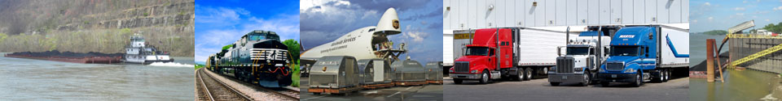
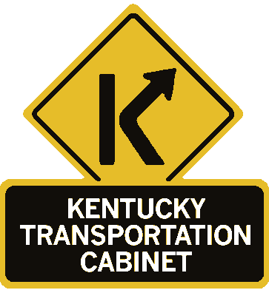

Water Transportation Advisory Board
KY Riverport Improvement Program
Tuesday, June 5, 2018
1:00 PM to 3:30 PM EST
Kentucky Transportation Cabinet, Room 106

Slide 2
Agenda
Welcome and Introductions
Public Comment Period
Presentation of Minutes from May 23, 2017 meeting
Discussion of statewide and KYTC Purchasing/Procurement information availability
FY 2018 awardees update WTAB on status/success of FY 2018 KRI projects
Discussion of FY 2019-2020 Transportation Budget Bill changes in project eligibility criteria
Review and Prioritization of FY 2019 Kentucky Riverport Improvement applications
Deadline and Guidance changes for next round of FY 2019 call for projects
Other business
Adjourn

Slide 3
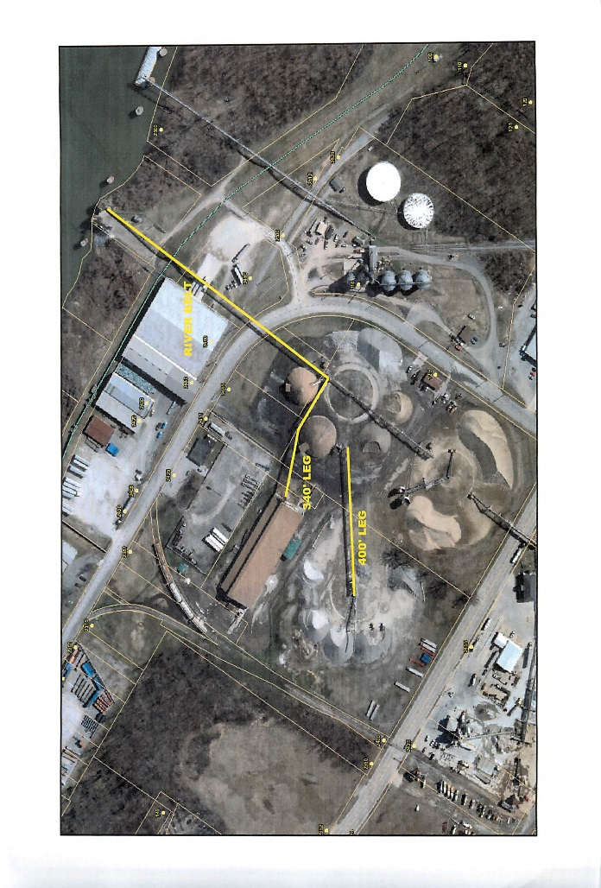
Paducah Riverport – Conveyor Refurbishment
Total Cost $196,000 – Request $98,000
Status: Complete
Replaced approximately 3,360 feet of 30-36 inch belts and rollers on the riverport conveyor system.
FY2018

Slide 4
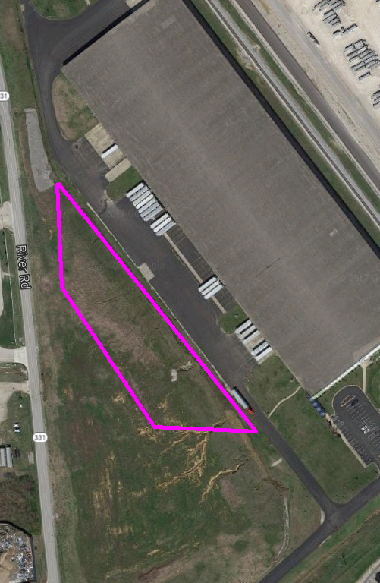
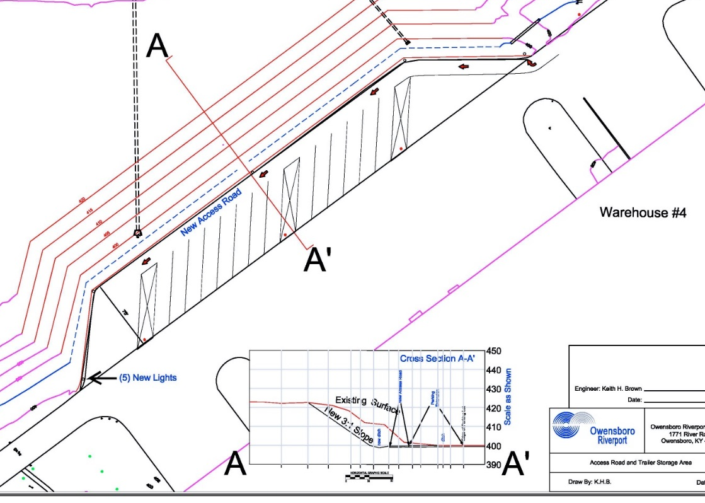
Owensboro Riverport – Truck/Trailer Staging Area –
Total Cost $403,436 – Request $201,718
Status: In Progress
Handling materials from both inbound and outbound trucks from Warehouse #4 by providing on-site storage of the trailers.
FY2018

Slide 5
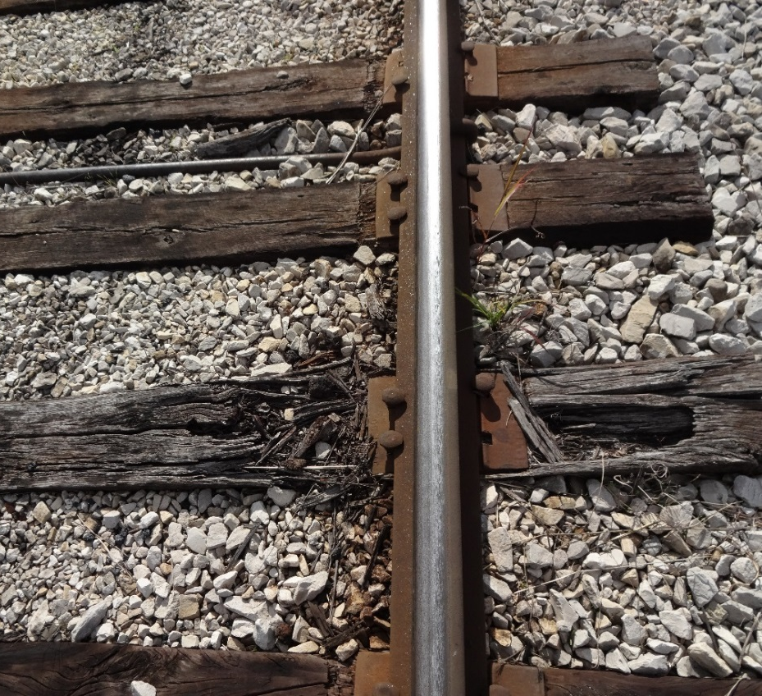
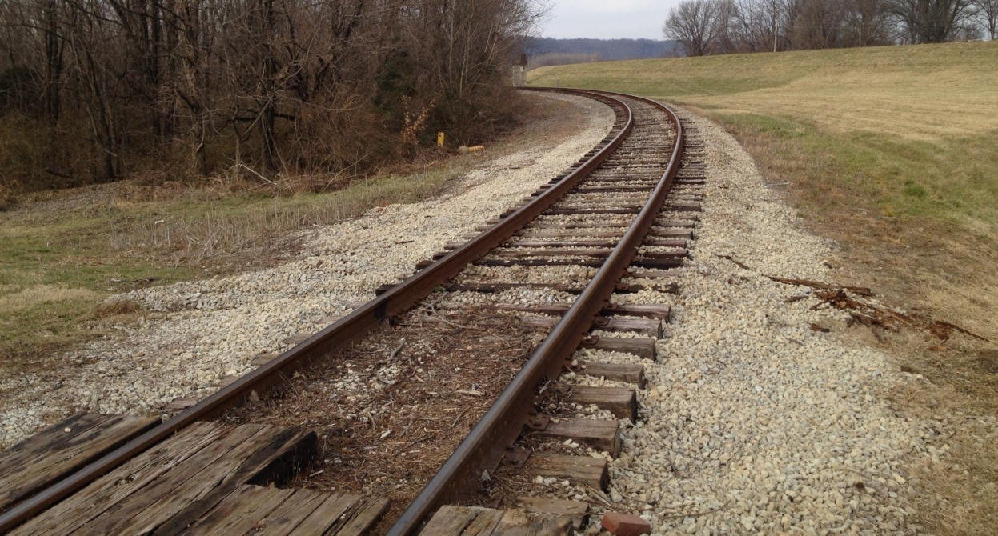
Louisville Riverport – Railroad Tie Replacement
Total Cost $215,000 – Request $107,500
Status: Complete
Replace 2,000 deteriorated ties in select areas along the Riverport track.
FY2018

Slide 6
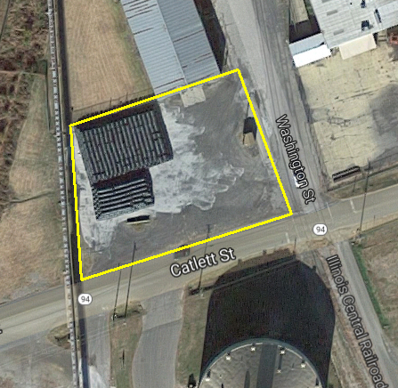
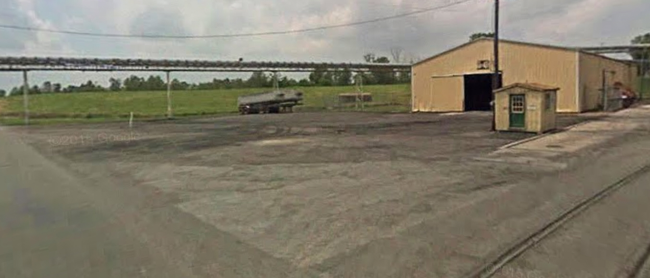
Hickman Riverport – Warehouse Access
Total Cost $301,437 – Request $150,718
Status: Complete
Concrete an area of 190’ x 140’ along the port entrance for trucks entering the port and storage for the conveyor warehouse.
FY2018

Slide 7

Applications for Fiscal Year 2019 Funds Available Funds: $500,000
Riverport | Project | Total Cost | KRI Requested
Hickman | Dock Dredging | $64,800 | $32,400
Hickman | Dock Forklift | $58,050 | $29,025
Louisville | Railroad Rehab #5 | $212,050 | $106,025
Owensboro | Improve Access Roads | $192,660 | $96,330
Paducah | Equipment & Accessories for COB Project | $427,000 | $87,500
 | Total | $954,560 | $351,280

Slide 8
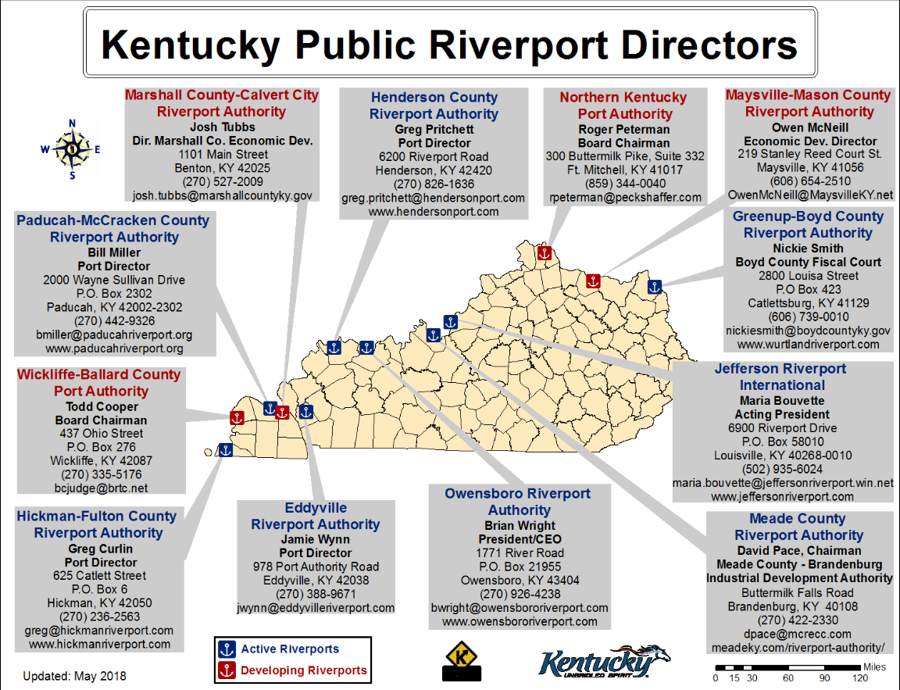
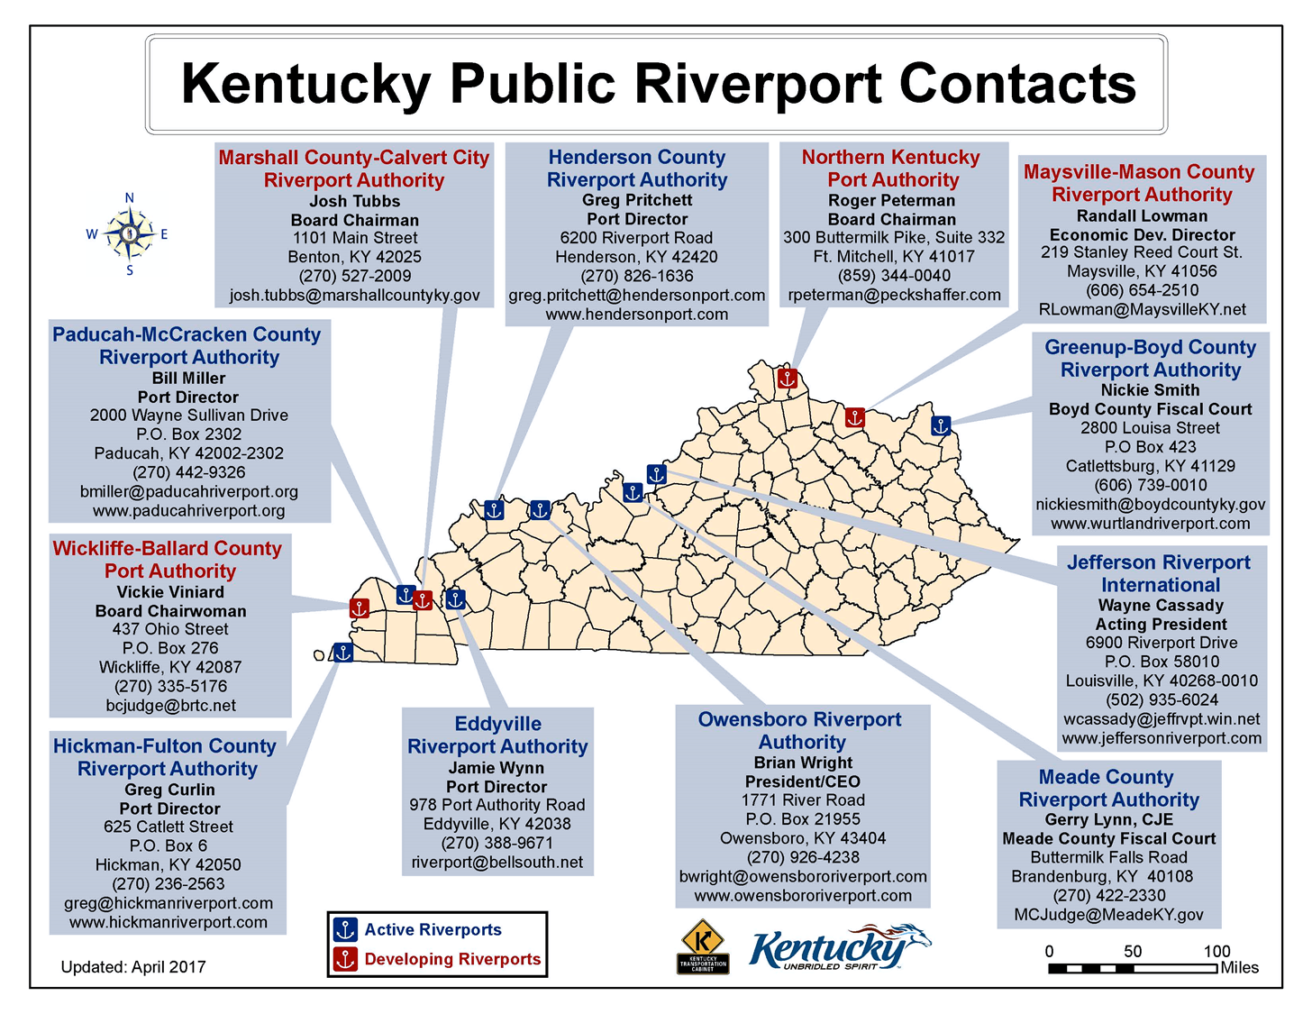
Jefferson Riverport International
Michell Whitehas
Port Program Manager
6900 Riverport Drive
P.O. Box 58010
Louisville, KY 40268
(502) 935-6024
mwhitehas@jeffrvpt.win.net
www.jeffersonriverport.com

Slide 9
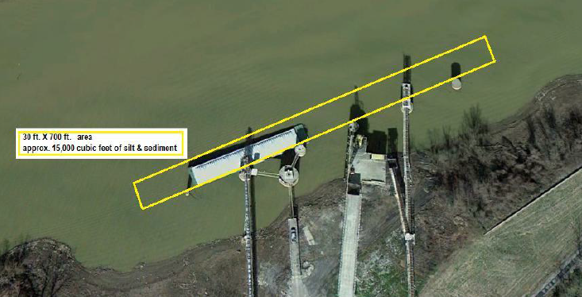
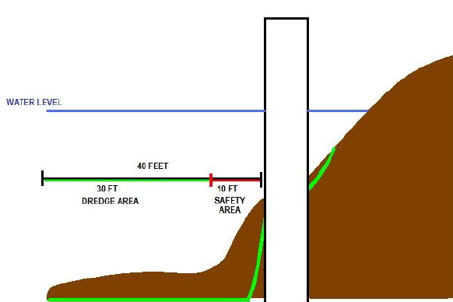

Hickman-Fulton County Riverport: Dredging #4
Project Total Cost: $64,800 – Requested: $32,400
Proposed dredging project will dredge a 700 ft. by 30 ft. area around the docks and will require the removal of approximately 15,000 cubic yards of material.
FY2019

Slide 10
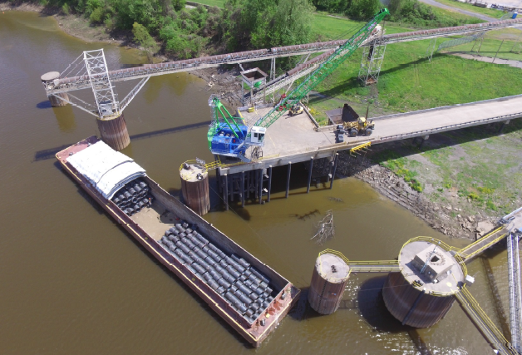
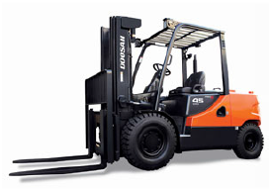
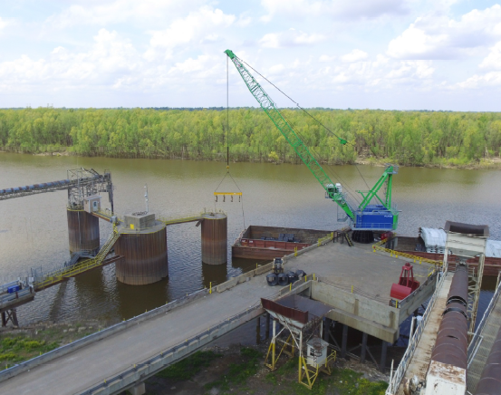
Hickman-Fulton County Riverport : Dock Forklift
Project Total Cost $58,050 – Requested $29,025
Purchase a new forklift for handling wire rod coils and can handle at least 9,000 lbs. The funds will replace the current forklift that is 18 years old.
FY2019

Slide 11
Louisville and Jefferson County Riverport Authority:
Riverport Access Railroad
Total Cost: $212,050 – Requested: $106,025
Replace deteriorate rail ties throughout the park. The rails lines allow CSX, NS, and P&L to service companies in the park.
Riverport/Port Authority Railroad
FY2019

Slide 12
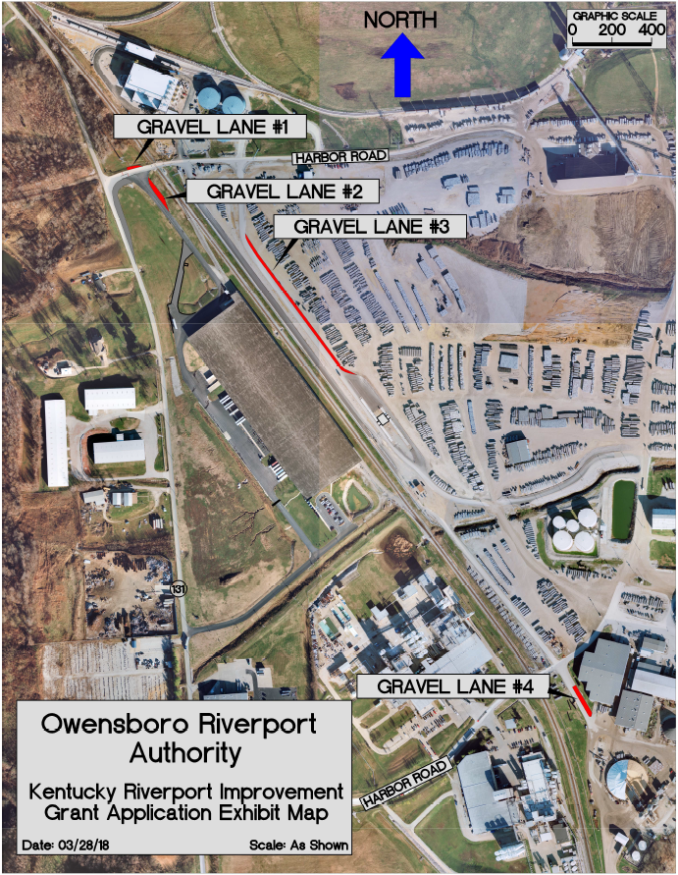
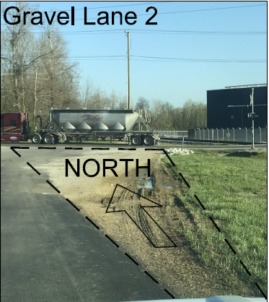
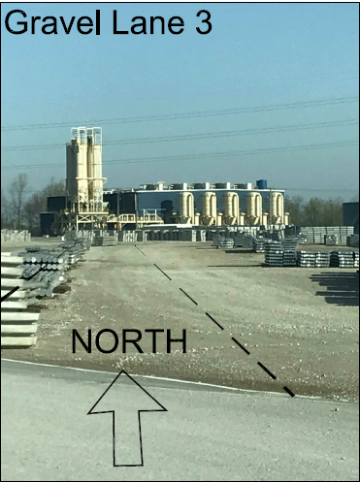
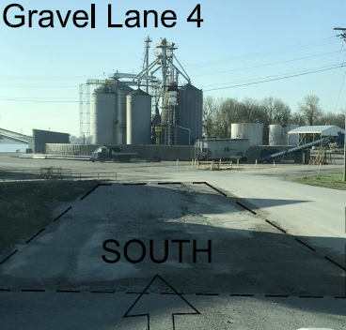
Owensboro Riverport Authority: Improve Access Roads
Total Cost: $192660.00 – Requested: $96,330
Main exit lane, Gravel Lane #1 and #2, from Warehouse 4 has two graveled swing lanes
Paving of Gravel Lane #3 would allow the port to convert the exiting outbound pave lane into a dedicated inbound truck lane and provide a queuing area.
Gravel Lane #4 would allow a third complete turn lane at a busy intersection at the port, and additional benefits.
FY2019

Slide 13
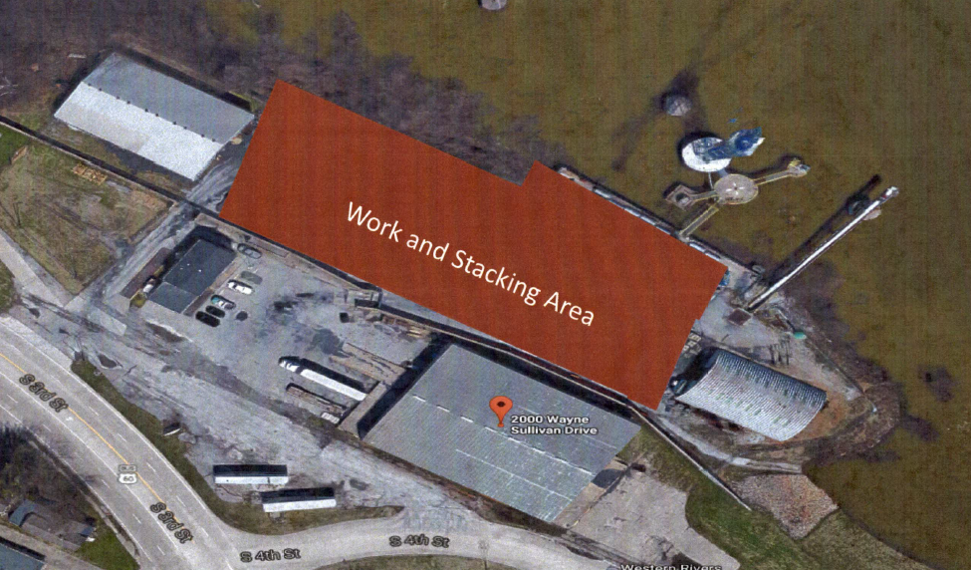
Paducah-McCracken County Riverport Authority: Equipment and Accessories for Container on Barge Project
Total Cost: $427,000 – Requested: $87,500
Provide funds for equipment, spreader bar, reach stacker, yard hustler and bomb cart, and accessories for the first Container on Barge service in the Commonwealth of Kentucky.
FY2019

Slide 14
Applications for Fiscal Year 2019 Funds – Available Funds: $500,000
Riverport | Project | Total Cost | KRI Requested
Hickman | Dock Dredging | $64,800 | $32,400
Hickman | Dock Forklift | $58,050 | $29,025
Louisville | Railroad Rehab #5 | $212,050 | $106,025
Owensboro | Improve Access Roads | $192,660 | $96,330
Paducah | Equipment & Accessories for COB Project | $427,000 | $87,500
 | Total | $954,560 | $351,280

Slide 15
WTAB Ranking of Applications and Funding for Fiscal Year 2019
For review by KYTC Secretary Thomas
Riverport | Project | Total Cost | KRI Requested | WTAB Score | WTAB Rank | WTAB Funding Recommendation
Hickman | Dock Dredging | $64,800 | $32,400
Hickman | Dock Forklift | $58,050 | $29,025
Louisville | Railroad Rehab #5 | $212,050 | $106,025
Owensboro | Improve Access Roads | $192,660 | $96,330
Paducah | Equipment & Accessories for COB Project | $427,000 | $87,500
 | Total: | $954,560 | $351,280 |  | Total:

Slide 16
Thank you for your attendance and participation…
Tentative Next Meeting
November 2018
Paducah Riverport
Jeremy Edgeworth
Freight, Rail, & Waterways
Division of Planning - Modal Programs
Kentucky Transportation Cabinet
200 Mero Street, Frankfort, KY 40622
e: Jeremy.Edgeworth@ky.gov
o: (502) 782.5095
Lynn Soporowski, P.E.
Multimodal Programs Branch Manager
Division of Planning
Kentucky Transportation Cabinet
200 Mero Street, Frankfort, KY 40622
e: Lynn.Soporowski@ky.gov
o: (502) 782.5083
Carol Brent
Freight Data and Reporting
Division of Planning - Modal Programs
Kentucky Transportation Cabinet
200 Mero Street, Frankfort, KY 40622
e: Carol.Brent@ky.gov
o: (502) 782.5048

