Slide 1
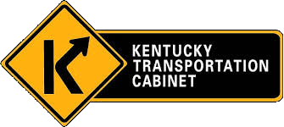

Kentucky Riverports, Highway & Rail Freight Analysis Study
POLICY
SUMMARY
Notes:
The Kentucky Riverports, Highway & Rail Freight Analysis Study occurred from 2020 to 2022 to assess the role of Kentucky’s Riverports.

Slide 2
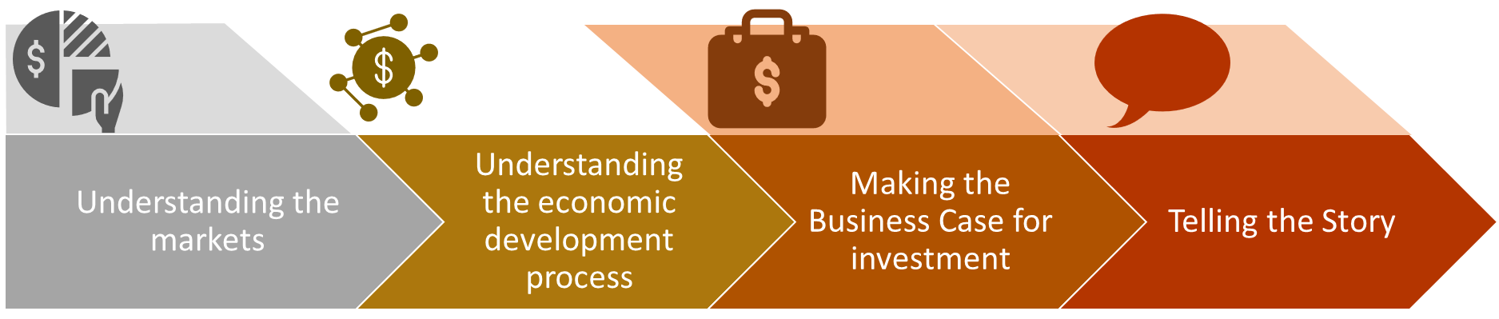
How Was the Study Conducted?
Notes:
The Riverports Highway & Rail Freight study entailed two rounds of site visits to Kentucky’s public riverports, three virtual statewide summits, a series of technical memoranda and a final report. The report assesses the waterborne commerce markets in Kentucky, the riverport’s current state and potential future directions for riverport investment in the Commonwealth. These activities have provided an understanding of today’s waterborne commerce market, the role that the public riverports play in future economic development and the potential benefits of investing in Kentucky’s public riverport infrastructure.

Slide 3



What Have We Learned About Riverports?
=
=
1
15-Barge Tow
216
Rail Cars
1,050
Trucks
Notes:
While every Kentucky community may not be adjacent to a river or have a riverport, all of Kentucky benefits from the efficiency of waterborne transportation. ONE 15 barge tow and towboat, which is commonly seen working our inland waterway network, moves the freight equivalent of two hundred and sixteen railcars. This same 15 barge tow moves the equivalent to one thousand and fifty large semis and tractor trailers. Looking specifically at the freight moved by waterways in Kentucky in 2018, 108 million tons of freight valued at $11.9 billion moved on Kentucky’s inland waterways. This would be the equivalent of adding 3.5 million trucks annually to our roadway network without the contribution of the waterways. So the question becomes, how do we more effectively use our waterways?

Slide 4




What Have We Learned About the Riverport Market?
Riverports connect Kentucky to the national and global economy
Kentucky’s waterways carry over 80 million tons of freight each year, worth over $18 Billion
80M
Approximately 19% of Kentucky’s tonnage moves by water, but only 3% of the value
59% of new jobs in Kentucky in 2020 were from new business locations, suggesting opportunities and new markets
19%
59%
Growth potential includes manufacturing, food & beverage, trade/logistics, aluminum
Kentucky’s current funding level lags behind other ports
Notes:
Kentucky’s riverports connect Kentucky to the nation and the world through the Ohio and Mississippi River Systems. The riverports represent an opportunity to affordably move a significant tonnage of inexpensive freight across a wide range of commodities. While the market for waterborne coal is declining in Kentucky, other commodities are growing with newly locating businesses in Kentucky representing potential future markets for public riverports.

Slide 5

What Have We Learned About the Commodity Mix?
Growth in Oils, Plastics, Warehouse/Distribution and Grain, but offset by reductions in Coal
Petroleum & Crude (29%)
Coal (19%)
Aggregate (16%)
Grains (15%)
Chemicals (10%)
The top 5 commodities comprise 89% of today’s Kentucky Riverport Market
18% Freight growth is expected by 2045 , but slight decline in use of waterways
More than 50% of Kentucky’s freight could be carried by water on some portion of its journey
Notes:
Only five commodities comprise the majority of today’s riverport traffic. However, as Kentucky’s freight market grows, and other commodities such as oils, plastics and grain account for more tonnage, there is potential for the riverports to carry a more diverse commodity mix if the infrastructure can be prepared for this change.

Slide 6
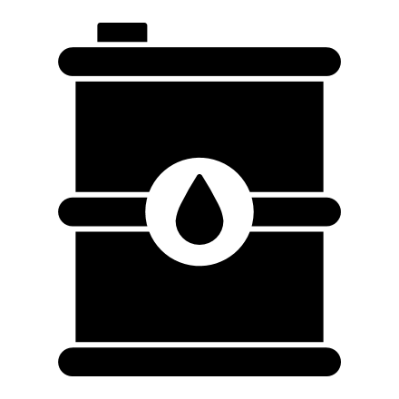
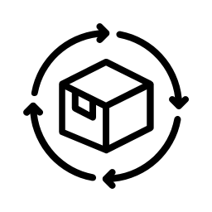
What is Changing in the Riverport Economy?
Reduction in energy market will increase competition among riverports
Riverports will have to capture more than their share to stay in business
Attracting ‘Anchor Clients’ to riverport hinterland will be vital
Plastics, metals and chemicals can support automotive and advanced manufacturing supply chains
Notes:
The overall shift to new energy sources will reduce the size of the coal market currently being served by many of Kentucky’s private riverports. The public riverports, which currently carry many of Kentucky’s non-coal commodities will play a key role in equipping the Commonwealth to trade in new commodities. However, to capture a more diverse commodity mix, the riverports will have to attract new businesses to Kentucky and actively promote the cost efficiency of waterborne transportation for these new commodities.

Slide 7

Demand is Shifting Away from Long-Standing Markets
Fuels
Minerals
National market increased by 67%
National market unchanged
Fuels declined by 48%
in Kentucky
Minerals declined by 95%
in Kentucky
additional 62% by 2045
Expected to lose an
additional 26% by 2045
Expected to lose an
Notes:
Overall, Kentucky’s long standing waterborne commerce markets in coal, fossil fuels and minerals have declined at a rate faster than the nation as a whole. Moreover, these waterborne commerce markets are projected in the future to shift even more away from these long-standing commodities. The changes highlight the importance of modernizing Kentucky’s public riverports to compete for new, more diverse markets.

Slide 8



Smaller, Different Markets Will Increase
Plastic & Machinery
Food & Livestock
National increased by 17 X
144% Increase in
food projected
Kentucky increased by 11 X
Plastic/rubber, textiles and machinery
81% Increase in
livestock projected
1997-2017
2018-2045
Notes:
Inputs to advanced manufacturing and high technology industries such as plastics, rubber and chemicals as well as food and livestock are growing markets for waterborne commerce in Kentucky. While these markets are smaller than today’s mineral and fossil fuel markets, they are rapidly growing and the public riverports are already working to keep up with this growth.

Slide 9
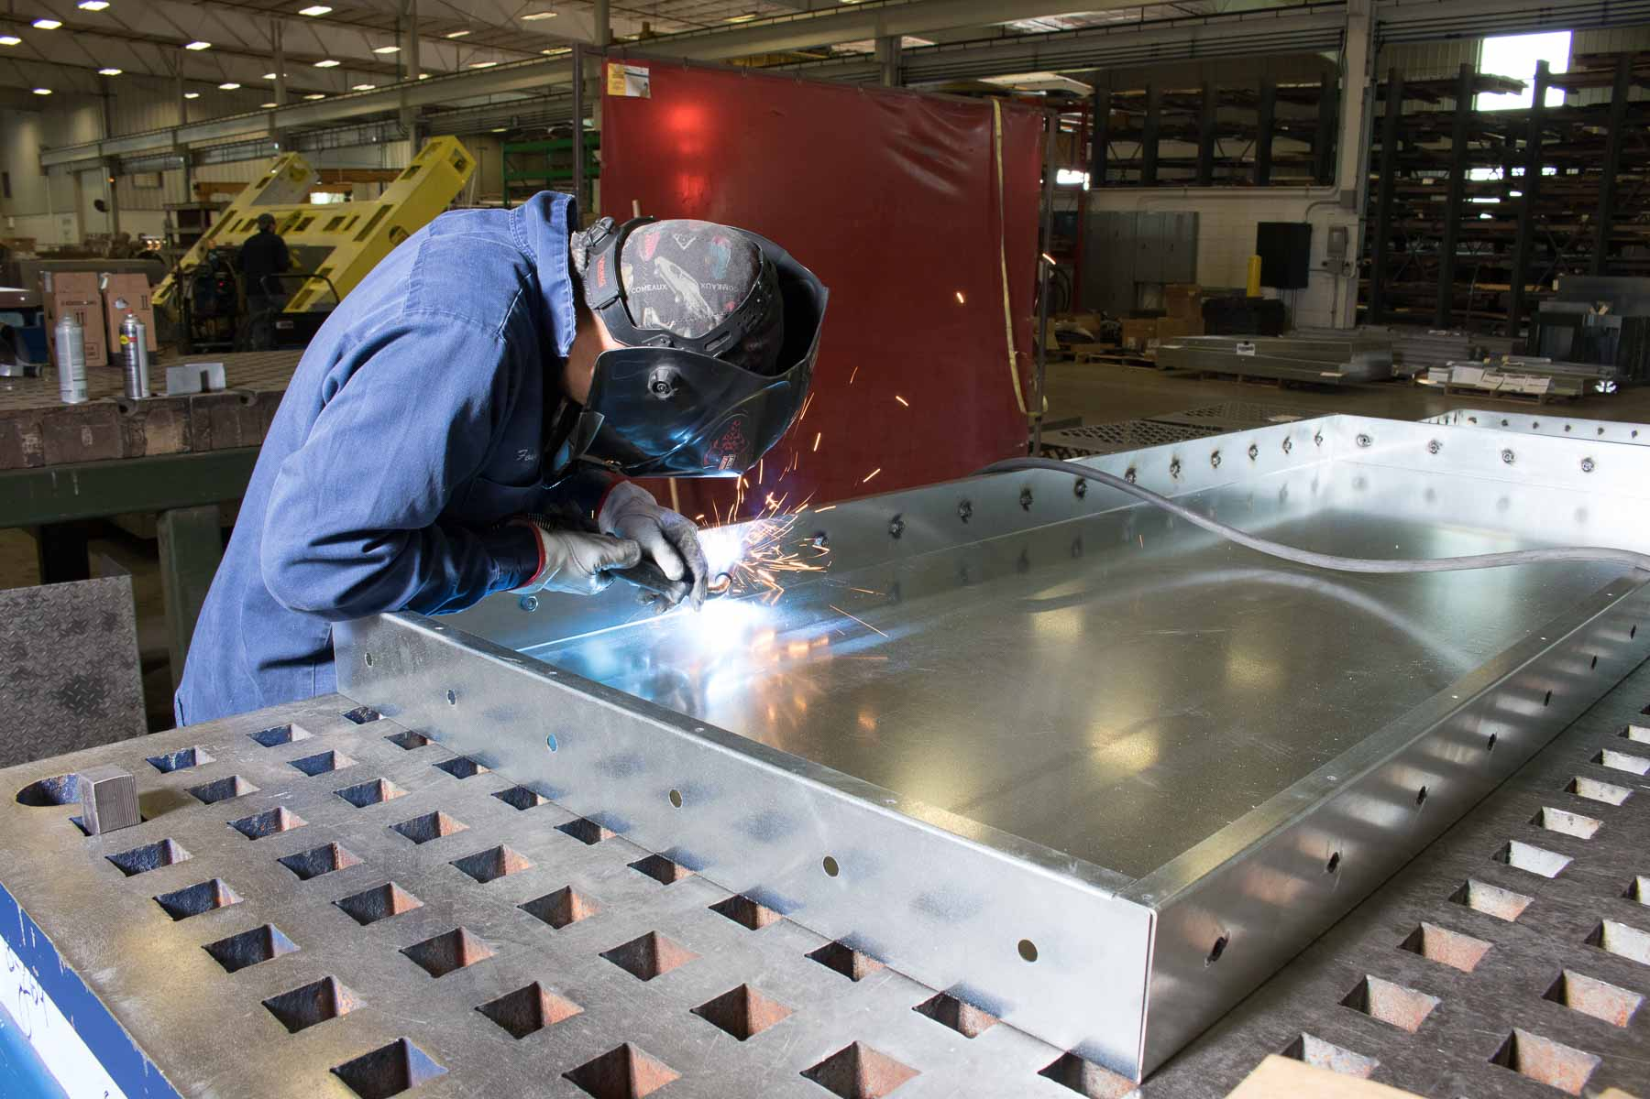
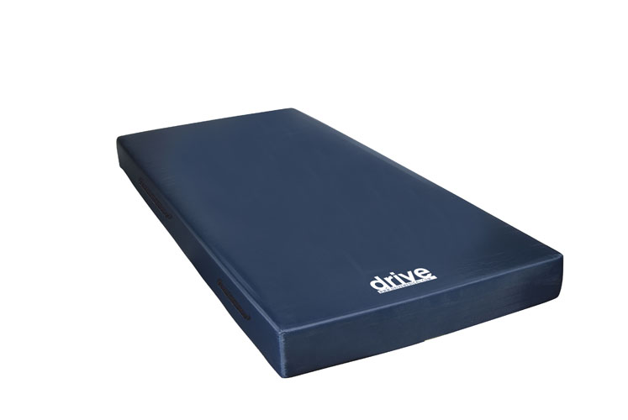
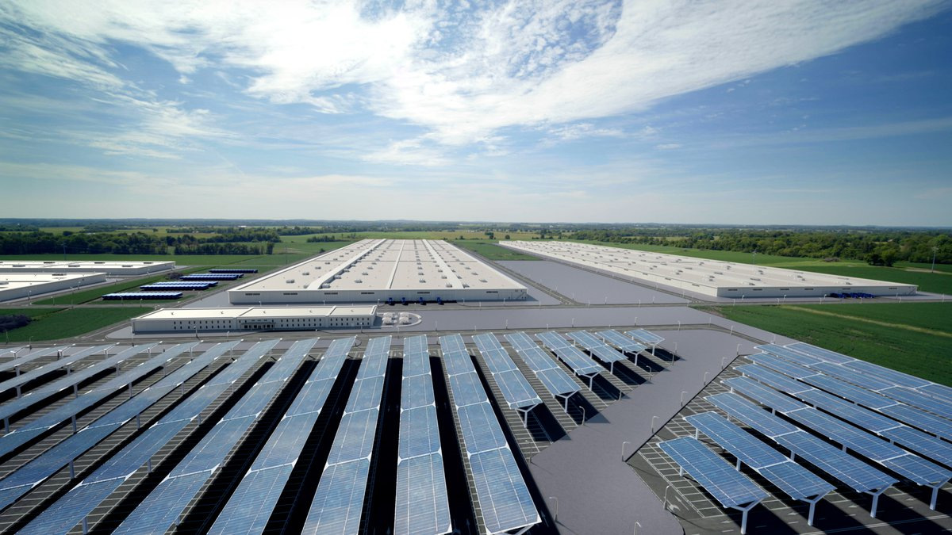
Opportunities in the Supply Chain:
Metal, Plastic, Rubber, Chemicals
Notes:
The supply chains of Kentucky’s growing auto manufacturing, medical devices and other high-wage sectors can utilize components that arrive in Kentucky by water.

Slide 10
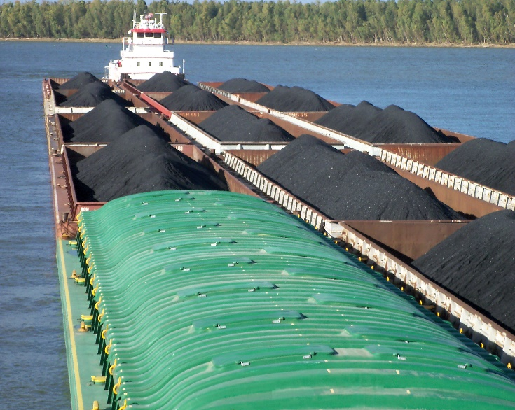

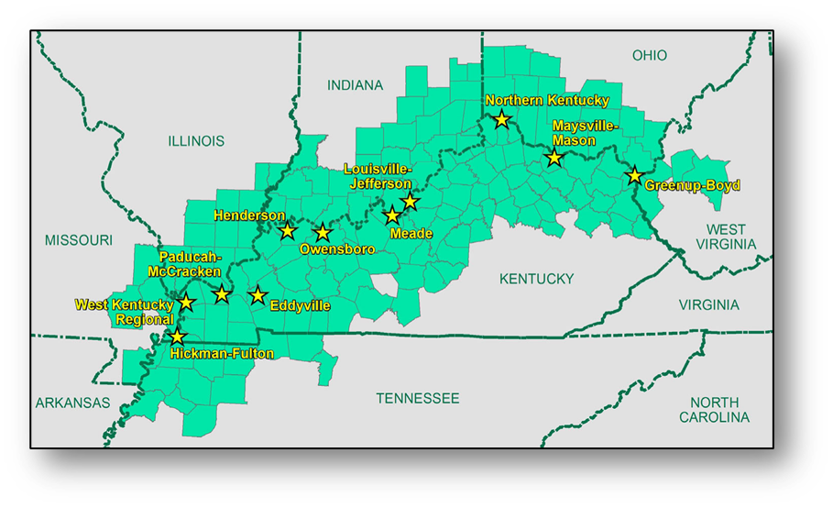
What Choices Do We Face?
Invest in Restructuring vs. Scaling Back
Build Home Markets Around Ports?
Collaboration vs. Competition
Notes:
Kentucky today faces a critical choice of whether to invest in modernizing the public riverports and their capacity to handle a new and increasingly diverse market, or see waterborne commerce play less of a role in Kentucky’s economy. Kentucky is also able to choose the degree to which its business attraction and economic development strategies will play a role in building markets for highly efficient waterborne transportation. The changes in the overall waterborne commerce markets also introduce a meaningful choice about how the riverports will collaborate with each other and with neighboring states sharing the rivers to ensure that overall waterborne commerce plays a vital role in a changing economy.

Slide 11



What Does the Future Hold?
Aggressive Strategies for Client Attraction, Creation, Retention And Expansion
Smaller but Strategic Placement of Riverports in Hinterland Value-Chain
Emergent Hinterland Focus for Funding, Business and Infrastructure Priorities
Notes:
If the recommendations of the Riverports, Highway and Rail Freight Analysis study are implemented, Kentucky will be well positioned to undertake more aggressive business attraction, creation, retention, and expansion activities involving the hinterland. That will strategically position the riverports to support supply chains for Kentucky’s growing manufacturing and technology sectors. In addition, riverports can attract much more federal funding than in the past.

Slide 12
Riverport Hinterlands are
Multi-State Development Markets
Notes:
The 90-mile driving distance around Kentucky’s riverports can be understood as the “hinterland” - or the primary market area for a riverport. The hinterland markets for Kentucky’s riverports extend into West Virginia, Ohio, Indiana, Illinois, Missouri and Tennessee. For this reason, multi-state cooperation in building the local waterborne commerce market can be a significant opportunity to support viable waterborne commerce. However, attracting riverport clients may not be the primary objective of any one state’s economic development strategy.

Slide 13
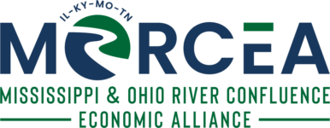
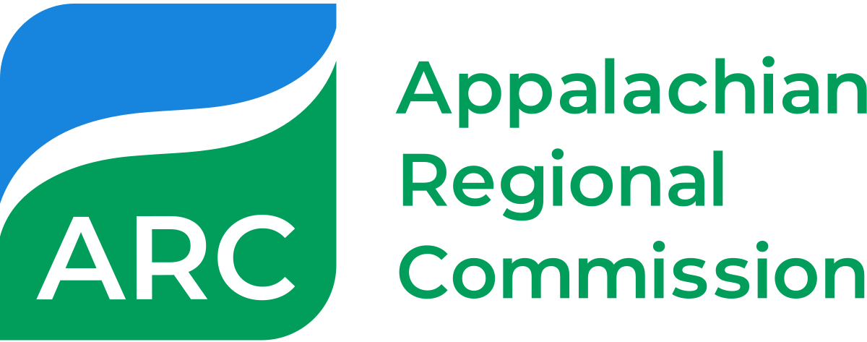
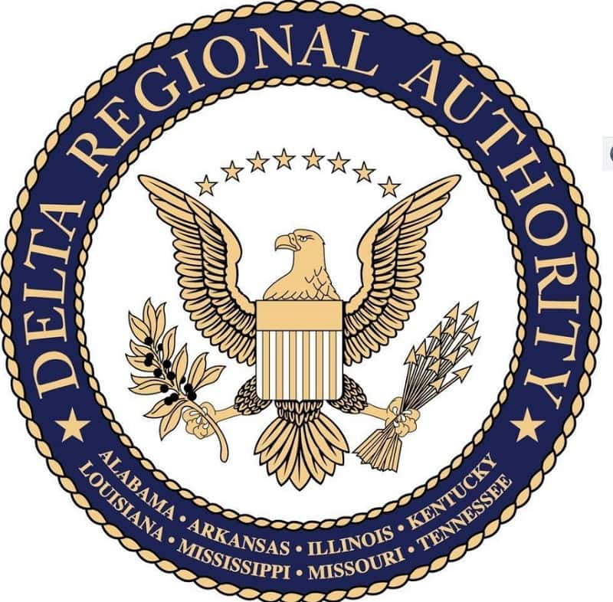
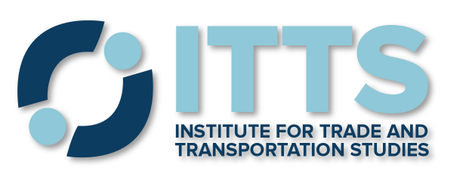
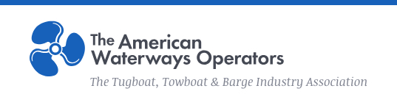
Restructuring of the
Ohio River Market is a National and
Regional Issue
Notes:
Multi-state regional organizations like the Mississippi & Ohio River Confluence Economic Alliance, the Appalachian Regional Commission, the Mid-America Freight Coalition, the American Waterways Operators, the Delta Regional Authority and the Institute for Trade and Transportation Studies provide a community of multi-state entities that can support and participate in infrastructure and market development for Kentucky’s hinterland public riverport markets.

Slide 14
What Will Riverport Investment Cost?
$622 M
Benefits
Notes:
Kentucky’s riverports currently have a $12.3 Million backlog in unmet preservation needs to simply get the existing infrastructure into a state of good repair. The ports have identified an additional $51.6 Million in modernization needs and $158.2 Million in expansion needs to successfully compete for business and serve new markets in the long-term.

Slide 15
How Much Should the State Invest?
Investment Category | Annual Cost | 5-Year Capital Costs | Benefits to 2045
Preservation | $12.3 M (one time) | $ 12 M | $ 29 M
Modernization | $6.7 M (yearly for 5 years) | $ 52 M | $ 153 M
Expansion |  | $ 158 M | $ 834 M
TOTAL | $58 M (5 years) | $222 M | $1.02 B
Notes:
It is recommended that Kentucky make a one-time allocation of $12.3 million for the Riverport Financial Assistance Trust Fund dedicated to preserving existing ports. It is also recommended that Kentucky expand the KRI Grant program to an annual level of $6.7 million. By designation $12.3 million for preservation needs in a one-time appropriation, Kentucky can fully utilize the expanded KRI program to address riverport expansion and modernization for new commodities. If state funds are matched at 80% by Federal grants, this level of funding would fully meet the $222 million in investment needs identified in the study.

Slide 16
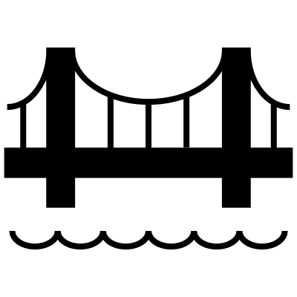



How Can Statewide Investment Leverage Federal Dollars?
  BUILD (RAISE)
  INFRA
  PIDP
  ATCMDTP
  Farm Storage
  Marine Highway
  RRIF
  Transp Alts Set Aside
  WIFIA
  Wetland Program Dev Grants
  Clean Diesel
  CMAQ
  Endangered Species
  Marine Debris
  Pollution Prevention
  SRA
  Targeted Airshed
Infrastructure
Environment
Total Potential Federal Funding Pool > $40 Billion, 1% > $400 Million
Economic Development
Resiliency
  Econ Dev Assistance
  Planning Grant
  APRA-E
  Emergency Relief
  HSGP
  PSGP
  SaTC
  TSGP
  Disaster Loan Assistance
Notes:
There is over $40 billion available through various federal programs that can support modernization and expansion of Kentucky’s riverports. However, to qualify for most federal programs a state or local match is needed. Kentucky’s $500 thousand annual grant program leaves the riverports with very little leverage to access these programs. Also, many of the programs are aimed at modernization and expansion, making it difficult for Kentucky’s public riverports to access funds to simply preserve aging aspects of their infrastructure.

Slide 17
What Are the Benefits of Investing?
Investment Category | Five-Year Capital Costs | Benefits to 2045 | Benefit-Cost Ratio
Preserve | $12.3 M | $29 M | 2.4
Modernize | $51.6 M | $153 M | 3.0
Expand | $158.2 M | $834 M | 5.3
Combined Total | $222.1 M | $1.02 B | 4.6
Business as Usual
Optimize Port Efficiency
New Market Positioning
Notes:
Investing to meet these needs will create benefits to Kentucky’s economy far exceeding the costs. These benefits are experienced in travel time and shipping cost savings for Kentucky businesses utilizing highly affordable waterborne transportation instead of more costly truck or rail options.

Slide 18
How Can Investing Make Kentucky’s Economy Stronger?
Investment Category | 5-Year Capital Costs | Business Sales | GDP | Household Earnings
Preservation | $ 12 M | $ 37 M | $ 17 M | $ 11 M
Modernization | $ 52 M | $ 154 M | $ 71 M | $ 47 M
Expansion | $ 158 M | $ 473 M | $ 216 M | $ 144 M
TOTAL | $ 222 M | $ 665 M | $ 304 M | $ 201 M
Business as Usual
Optimize Port Efficiency
New Market Positioning
Notes:
Fully investing in Kentucky’s riverports will reap benefits of more than $1 Billion. This will encourage Kentucky’s businesses to make and sell over $660 Million worth of products, enabling Kentucky’s households to earn over $200 Million. As a result, Kentucky’s cumulative gross domestic product could increase by more than $300 Million by 2045.

Slide 19
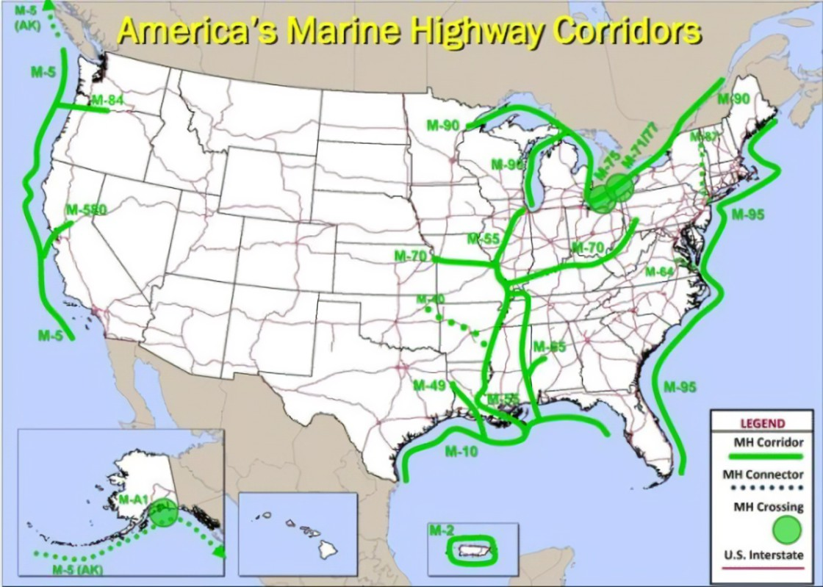

Ohio River is a Multi-State Marine Corridor of National Significance
Infrastructure Investment & Jobs Act:
Section 21106.
$2 million for a new Multi-State Compact and
$1 million for an existing Multi-State Compact
Notes:
The Bipartisan Infrastructure Law (BIL) passed in 2021 makes up to $2 Million available for inter-state compacts managing freight corridors. This resource could be a significant resource for modernizing Kentucky’s riverports if Kentucky collaborates with other states sharing the Ohio and Mississippi river hinterlands to form a compact focusing on changes in the riverport market.

Slide 20


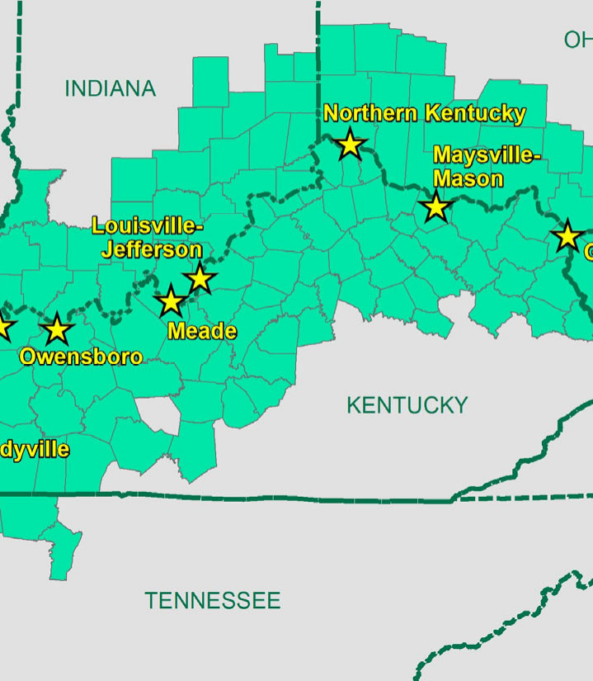
What’s Next for Kentucky Riverports?
Funding
Create RHC
Market Ports
Preservation
+ Modernization + Expansion
Notes:
These key policy actions are recommended in the study. Dedicated funding will preserve today’s riverports. Expanded grant funding will expand and modernize the public riverports for changing markets. Creating a multi-jurisdictional Riverport Hinterland Compact (RHC) will focus infrastructure and market development initiatives on the riverport markets. That will support the active promotion of the riverports to new users.

Slide 21
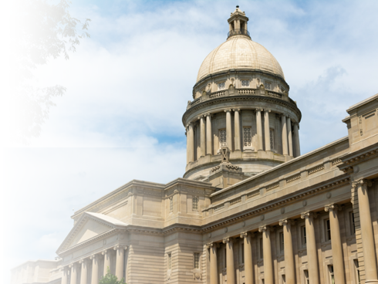
Waterways Legislative Caucus
Frame Issues of Riverport Hinterland Market in State Economic & Infrastructure Policy
Support Resolutions for Inter-Governmental and Inter-State Collaboration
Assess Grant Programs, Development Priorities, Workforce and Funding Priorities
Facilitate Kentucky Participation in
Hinterland Compact
Notes:
A recommendation to make these changes possible is the creation of a legislative Waterways Caucus in the Kentucky General Assembly.

Slide 22

Riverport Hinterland Compact
Use Riverport Study to Seek EDA or Other National Funding Partners
Involve State and Regional Entities
Focus on Riverport Hinterland as Top Priority
Initiation Study Creates Concept of
Operations & Funding Sources
Recruitment of Core Waterway Clients
Ongoing Review of Capacity &
Modernization Needs
Establishment of Multi-State Funding
Make Business Intelligence Available
Notes:
The recommendation to create a riverport hinterland compact involves obtaining grant funding for an initiation study, developing a concept of operations for the compacts’ membership, ongoing funding and role in business attraction and infrastructure funding across all the jurisdictions in the riverport hinterland. The compact can also make private/subscription based databases and other business intelligence available for riverports to identify and capture new customers.

Slide 23
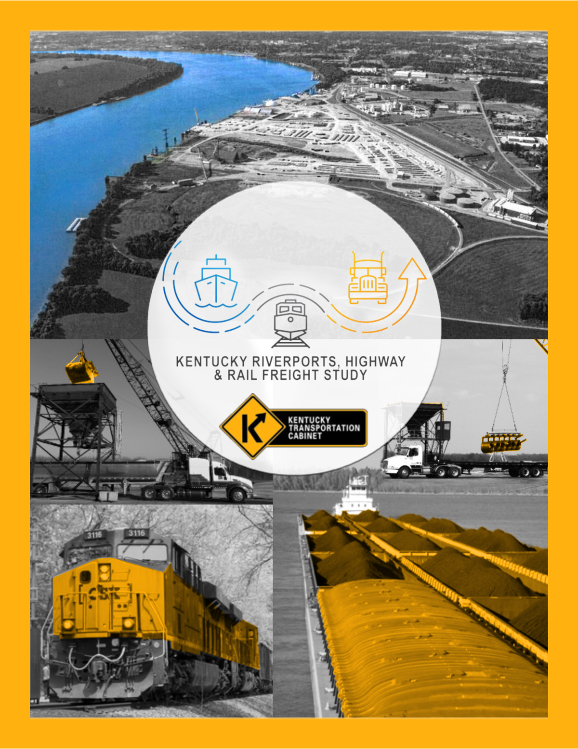
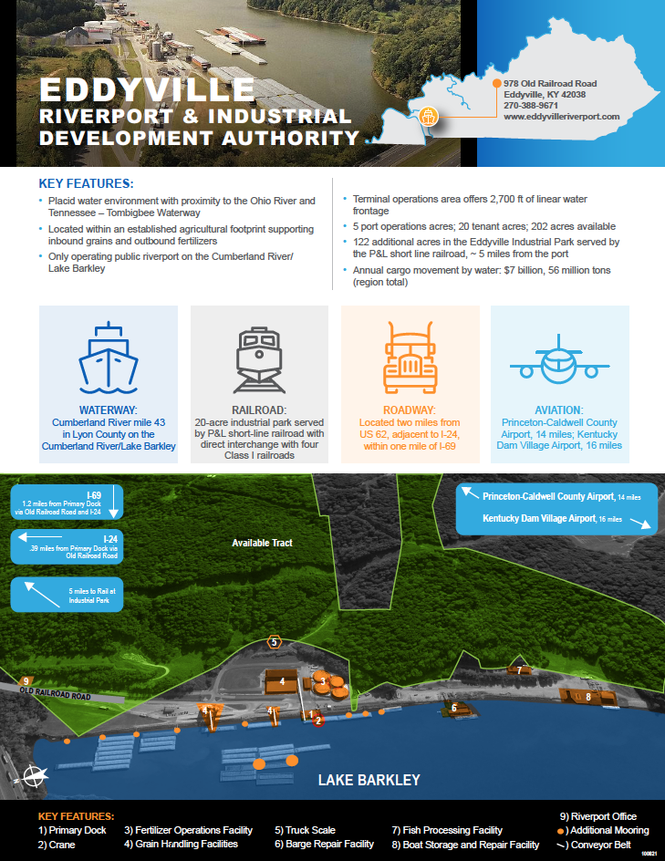
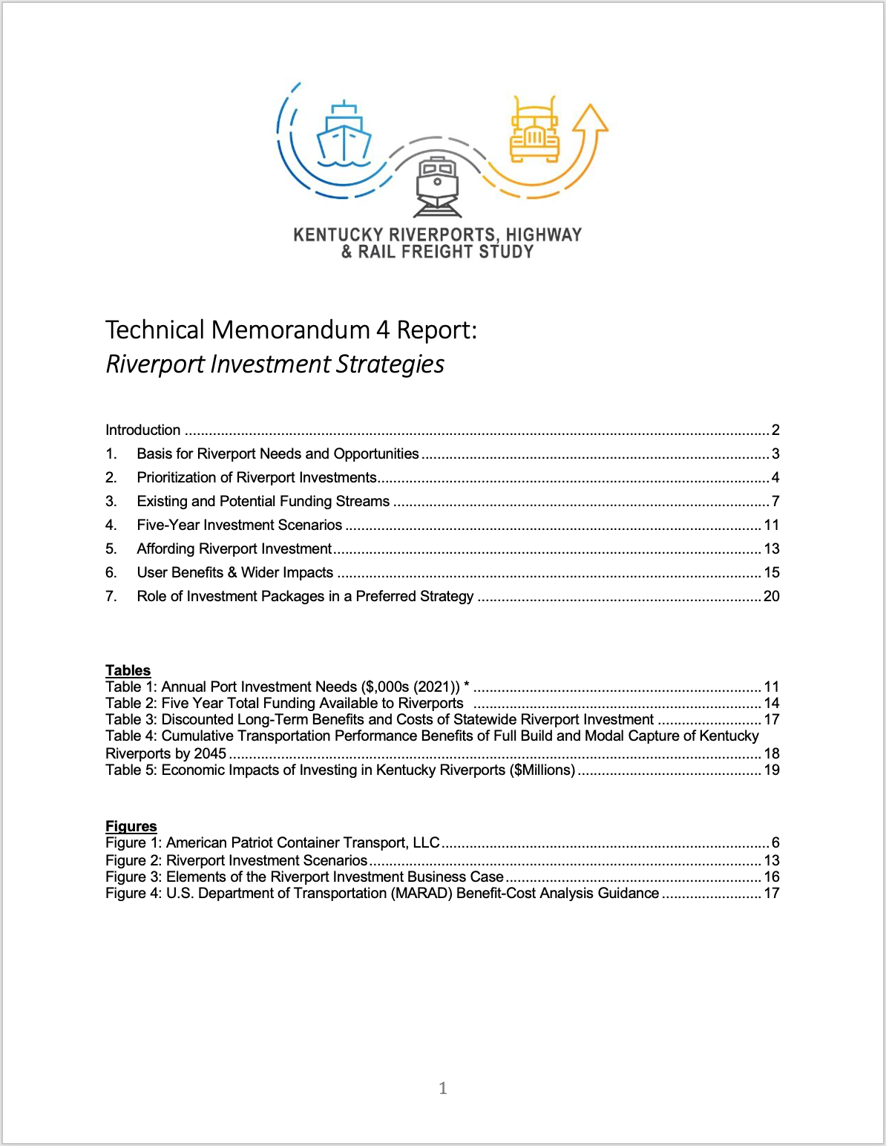

For More Information
REPORT
PORT PROFILES
TECH MEMOS
https://transportation.ky.gov/MultimodalFreight/Pages/Kentucky-Riverports,-Highway-and-Rail-Freight-Study.aspx

