Slide 1


Integrating Mobile Observations in Maintenance Management Tools
&
Road Weather Management Program Update
AASHTO Standing Committee on Maintenance, Louisville, Kentucky
July, 2011
Gabriel Guevara, P.E.
Federal Highway Administration
Road Weather Management Program
Notes:
Transportation Weather Applications: An Update on MDSS
Session 53, ITS America Annual Meeting

Slide 2
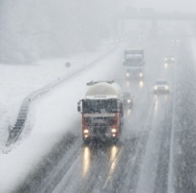


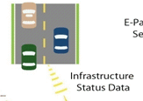

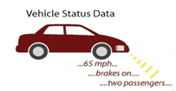
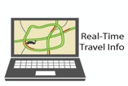







Connected Vehicles & Road Weather
Real-time Data Capture and Management
Dynamic Mobility Applications
Reduce Speed 35 MPH
Transit Signal Priority
Weather Application
Data Environment
Fleet Management/ Dynamic Route Guidance
Truck Data
Transit Data

Slide 3
Connected Vehicles & Weather
– Vision
Obtain a thorough picture of current weather and road conditions by including vehicles as a source of data
  Higher resolution observations that spatially augment fixed sensors
  Take advantage of existing standards and on-board sensors
Improve weather-related decision support tools to mitigate safety and mobility impacts of weather
  Based on ability to better detect and forecast road weather and pavement conditions

Slide 4
Connected Vehicles & Weather
– Research Goals
Identify and explore a range of mobile platforms as a source of robust data
Develop algorithms and processing capabilities to translate the mobile data into useable weather and road condition observations
  Is the probe data of sufficient quality?
  What are the minimum # of samples and minimum sampling period per road segment to get valid obs?
  What QC algorithms are needed?
  What are the best ways to package/disseminate the obs?
Incorporate these observations into effective mgmt. systems and decision support tools (e.g., MDSS, weather-responsive traffic management strategies)
  What is gained by utilizing mobile observations?
  What are the resultant data and communications requirements?

Slide 5
Vehicle-based Probe Data
Accelerometer
Data (steering
& yaw)
Windshield Wiper
State & Speed
Barometric
Pressure
GPS Position, Heading,
Elevation &
Vehicle Speed
Brake Status
& Boost
Headlight
Status
External Air
Temperature
Anti-lock
Braking
System
Tire
Pressure
Vehicle
Traction
Control
Vehicle
Stability
Control
Notes:
VII Consortium/OEM Participants
BMW, Chrysler, Ford, GM, Honda, Nissan, Toyota, VW

Slide 6
Work Completed to Date
Noblis conducted two analyses along the Dulles Toll Road (2006)
  Exploratory look at mobile observing
National Center for Atmospheric Research (NCAR) was tasked to develop the Vehicle Data Translator (VDT)
  Feasibility study (2007)
  VDT Ver1.0 completed in July, 2009
  VDT Ver2.0 completed in July, 2010
  VDT Ver3.0 development underway
Development Test Environment in Detroit
  Source of most of the probe data for the VDT development
New work will use data from State DOTs and NCAR Vehicles

Slide 7


Vehicle Data Translator (VDT) 3.0
Ancillary: Radar, Satellite, RWIS, Etc.
VDT 3.0
Stage I
Stage II
Stage III
Mobile data ingesters
Ancillary data ingesters
Segment module
Inference Module
QC Module
QC Module
Output data handler
QC Module
Output data handler
Output data handler
Parsed mobile data
Basic road segment data
Advanced road segment data
Apps and Other Data Environments
7

Slide 8
Solicitation for Partnership with States
NCAR issued the solicitation last fall (2010)
  Scope of Work
  Funding assistance / Grant
Pool Funds and Consortia were targeted: Aurora, IntelliDrive, Clear Roads, MDSS
Just a handful of states expressed interest:
  Idaho
  Minnesota
  Nevada
  South Dakota

Slide 9
Partnership with States…
Selection based on
  Fleet
  Maturity of the maintenance ITS program
  Integration of mobile obs into state’s application – MMS, MDSS, MODSS, TIS….
  Other factors/synergies (multi-state, corridor, etc.)
  Willingness to make data and lessons learned widely available /open source

Slide 10
Selected States
Minnesota
Nevada

Slide 11
Minnesota
Why
  Mature AVL/MDSS program
  Relatively new fleet
  Strong upper management support
  Strong proposal
    Significant # of vehicles fitted for the test
    Proposed integration with MDSS, MMS, TIS
    Ability to collect desired data parameters (from CAN-Bus and add-on sensors)
Level of Funding: $675K granted via an allocation memo

Slide 12
Why MN….
Project Team
  Champion: Steve Lund
  Project Manager: Curt Pape
  Consultant: Ameritrak, LLC
  NCAR: Sheldon Drobot & Mike Chapman
  FHWA: Paul Pisano & Gabe Guevara

Slide 13
Project Status / Details
  Ameritrak is the AVL provider; has already developed and tested the prototype system:
  Mounting brackets
  Wiring harnesses
  Mobile Computing Device
    AVL/GPS
    CAN-Bus Interface
    Interface with external sensors, sander/controller, etc.
  MN uses Cellular as its communication platform
By October, 2011: 140-160 Snowplow vehicles collecting and sending data

Slide 14

FHWA / NCAR / MnDOT
Parameter List
External air temperature | Accelerometer
Pavement temperature | Impact sensor
Atmospheric pressure | Steering angle
Rain (rain sensor) | Yaw rate
Relative humidity | Anti-lock braking system
Wiper status | Brake boost status
Headlight status | Brake status
Pavement wetness | Stability control system
Sun (sun sensor) | Traction control status
Notes:
14

Slide 15
FHWA / NCAR / MnDOT
Parameter List (continued)
Differential wheel speed | Emission data (NOx, HC, CO, CO2, particulate matter, etc)
Short-range wide beam radar | Date and time
Adaptive cruise control | Vehicle location, heading
Camera imagery | Vehicle velocity
 | Elevation
Notes:
15

Slide 16
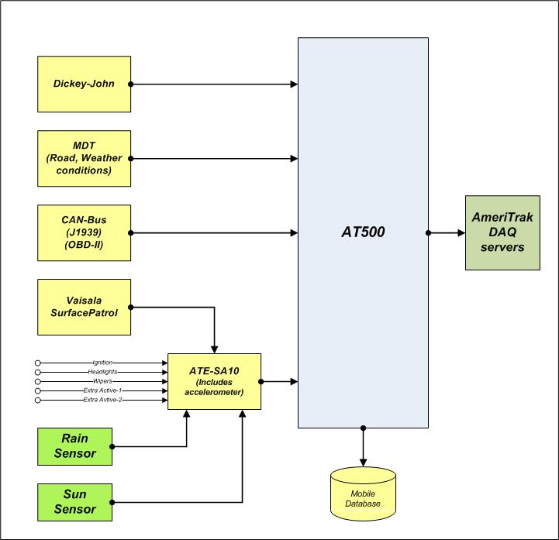
AT500 Transponder
Data Acquisition (DAQ)
The AT500 in-vehicle
transponder hardware and software has been modified to accept data from many different
in-vehicle sources.

Slide 17
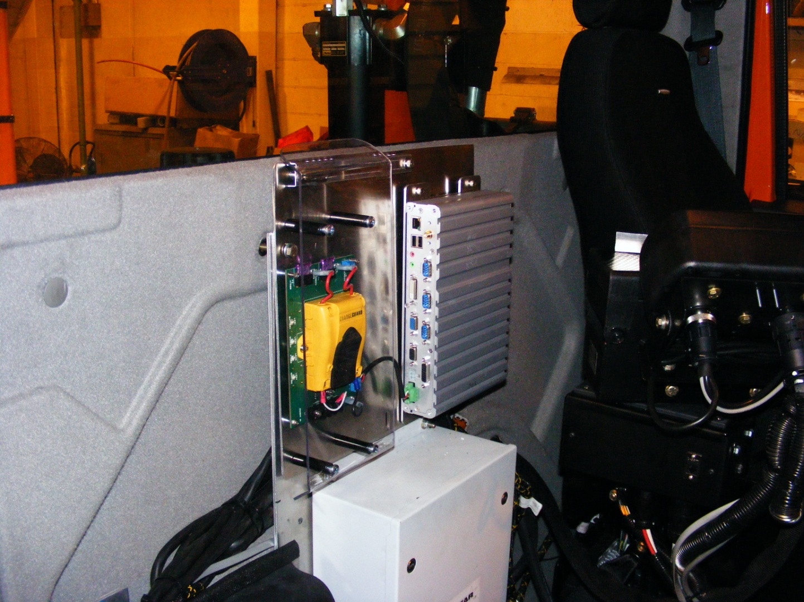
2010 International
MaxxForce Truck Fleet
The AT500 prototype mount for the 2010 International MaxxForce trucks. Our project will include these 40 new MaxxForce vehicles.
Notes:
17

Slide 18
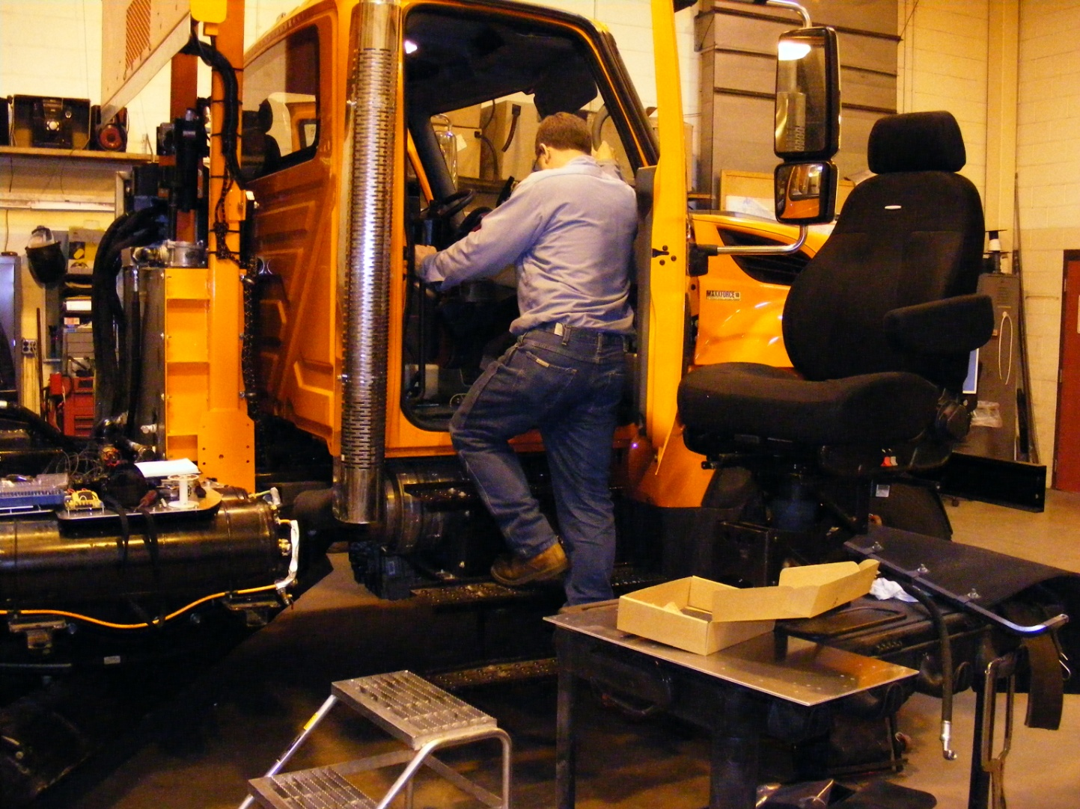
2010 International
MaxxForce Truck Fleet
Prototype mechanical packages being worked on for the new MaxxForce trucks.
Notes:
18

Slide 19
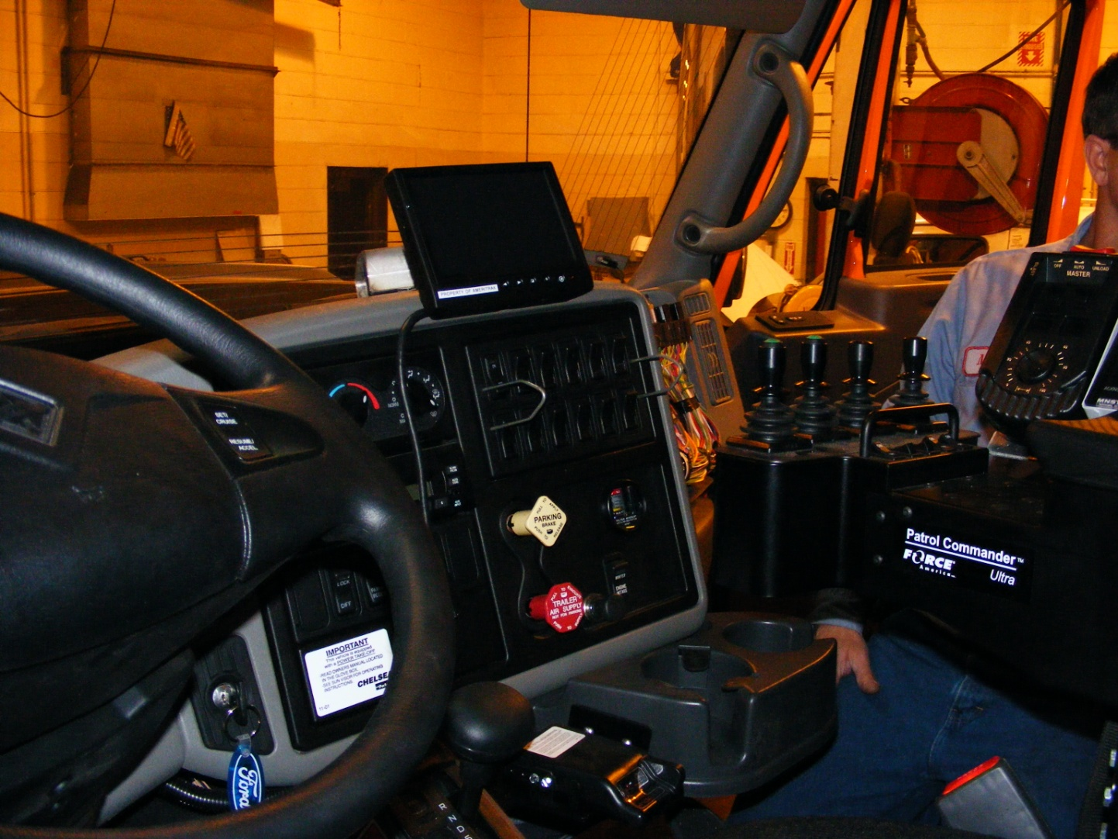
2010 International
MaxxForce Truck Fleet
The Mobile Data Terminal (MDT) will feature a custom dash mount for the new MaxxForce trucks.
Notes:
19

Slide 20
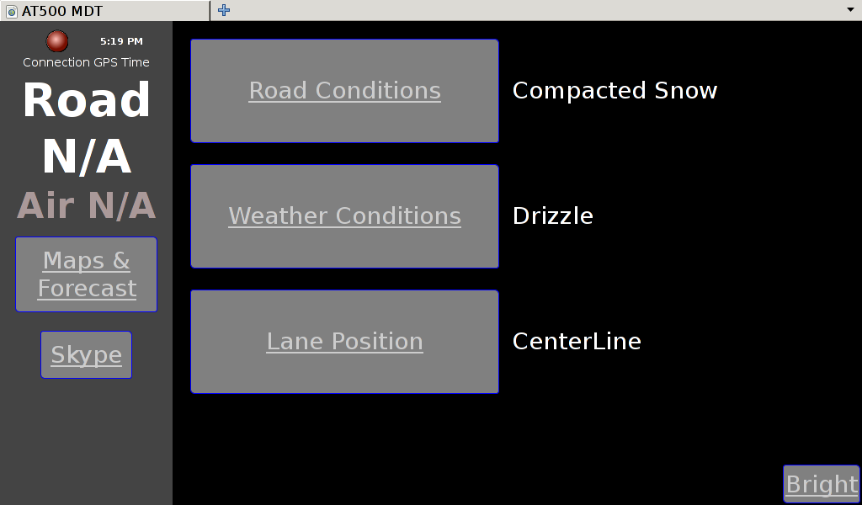
AT500 MDT
Main Screen

Slide 21
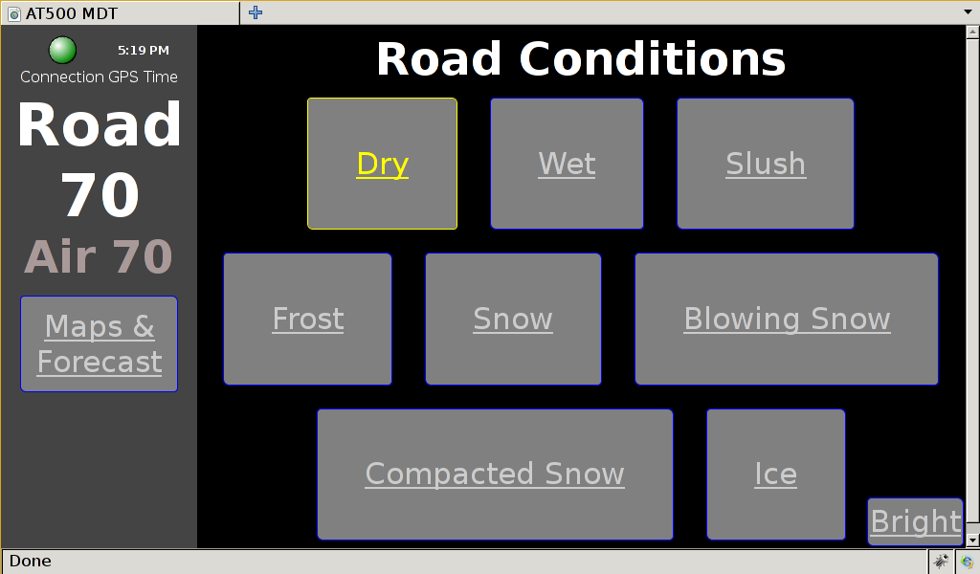
AT500 MDT
Road Conditions Input

Slide 22
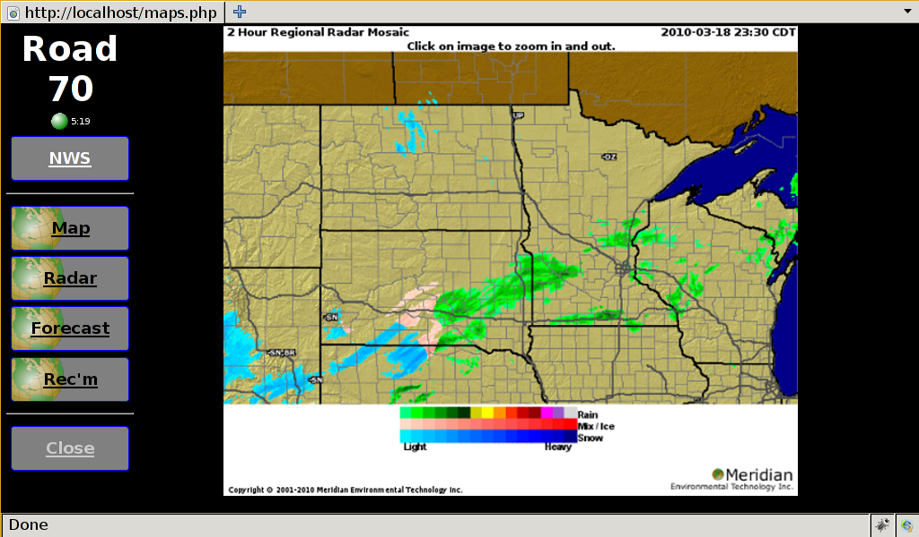
AT500 MDT
Maps: Meridian General Radar

Slide 23
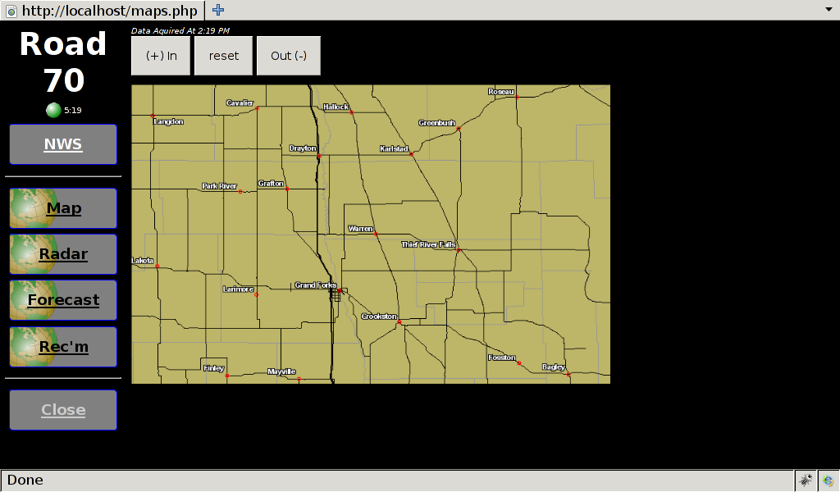
AT500 MDT
Maps: Truck-Centered Radar

Slide 24
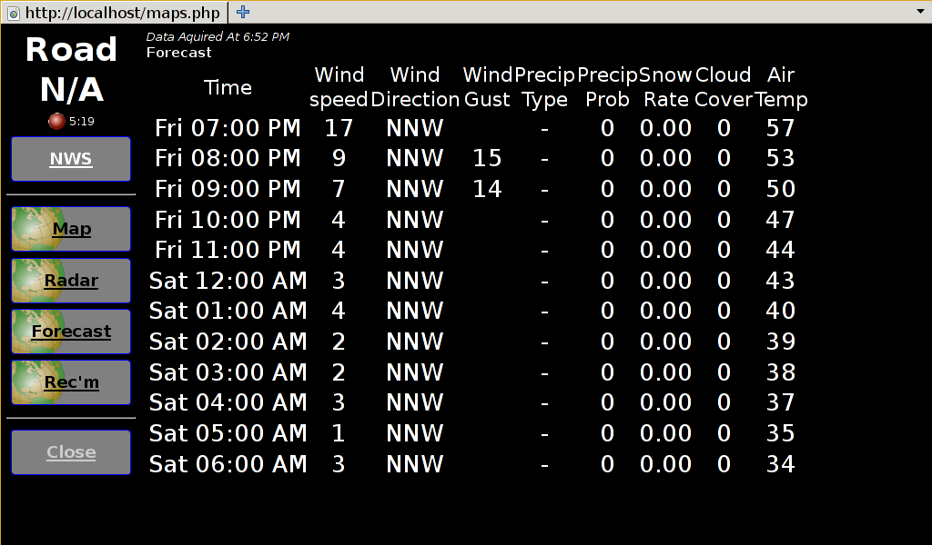
AT500 MDT
Maps: Meridian Forecast

Slide 25
Nevada
Why
  Actively pursuing an AVL/MDSS program
  Fleet adds variety to the study (different manufacturer)
  Strong upper management support
  Strong proposal
    Potential corridor-wide participation (I-80 corridor)
    Strong partnership with academia (Univ. Nevada-Reno)
    Proposed integration with MDSS, MMS, TIS
    Ability to collect desired data parameters (from CAN-Bus and add-on sensors)
Level of Funding: $263K granted via an allocation memo

Slide 26
Nevada
Project Team
  Champion: Rick Nelson
  Project Manager: Denise Inda
  Consultant: University of Nevada Reno
    Dr. Jeff LaCombe
    Dr. Eric Wang
  NCAR: Dr. Sheldon Drobot & Mike Chapman
  FHWA: Paul Pisano & Gabe Guevara

Slide 27
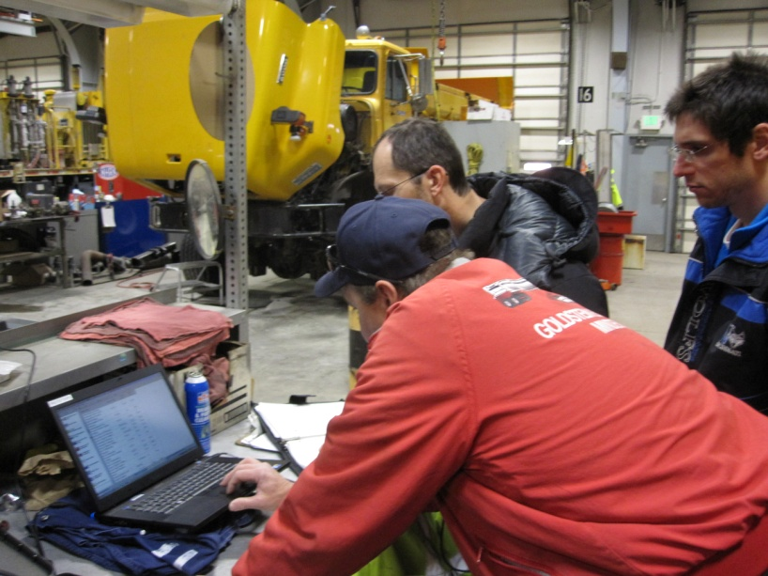
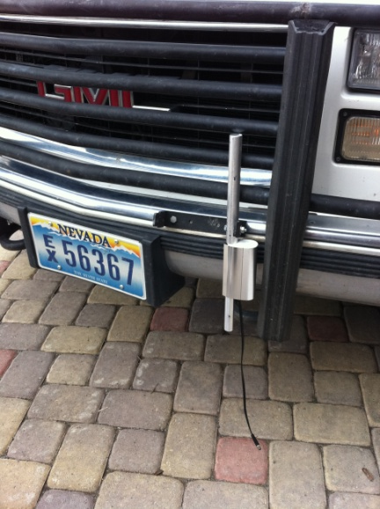
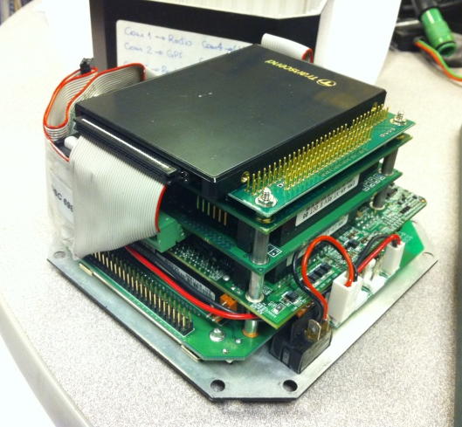
Various Weather & MDSS Data Parameters
Numerous sensors and devices are controlled or monitored by a vehicle-mounted computer.
Data is logged in-vehicle as well as sent via radio to UNR in near-real-time using the NDOT EDACS radio network.
All instrument and equipment installations are being done by UNR &NDOT teams who are familiar with the vehicles (NDOT) and instrumentation (UNR).
Collaborative NDOT & UNR Installation teams
Road and weather sensors
In-vehicle computer

Slide 28
Data Being Gathered
NV IMO Project (UNR/NDOT)
General Data
  GPS Date, time, location, bearing, speed, altitude, accuracy
Road Conditions
  Road surface temperature
  Vehicle accelerations (surface friction)
  Road condition images (camera)
Atmospheric Conditions
  Pressure, temperature, relative humidity, dew point
  Wind speed and direction
Vehicle & Equipment Data
  Speed, brake status, engine intake air temperature & pressure
  Spreader and plow status
  Steering, traction control, ABS, yaw, accelerations, emissions data, engine data, headlight and wiper status
Blue denotes parameter being implemented
Gray denotes parameter “under study”

Slide 29
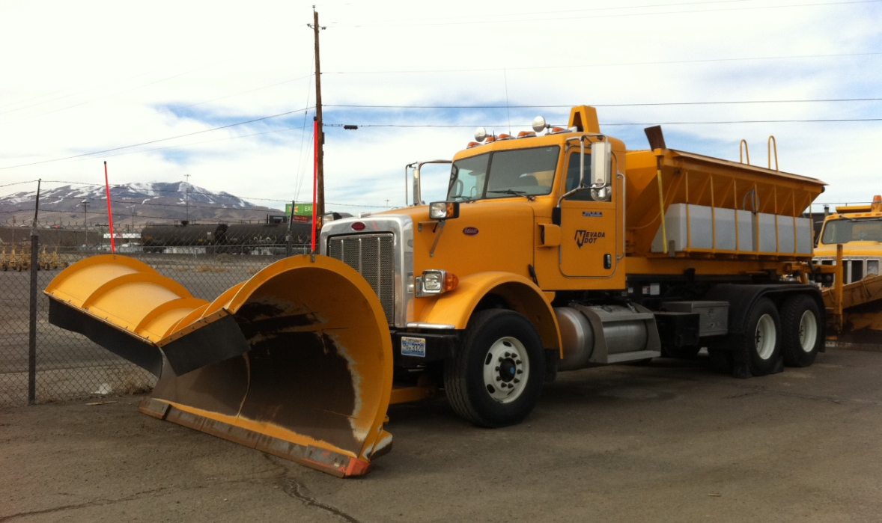
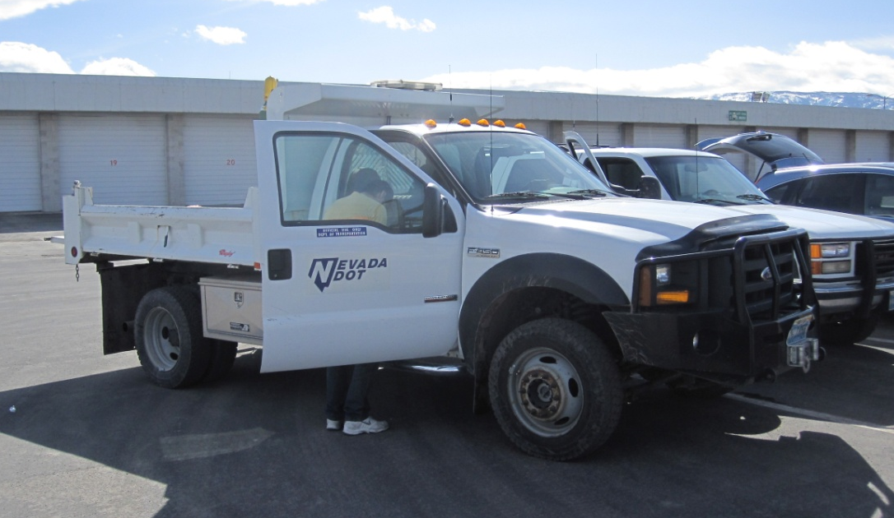
Two Vehicle Types
Based in NV Districts 2 & 3 Along I-80 Corridor
Snowplows
Light Duty Vehicles (Crew, general purpose)
Vehicles with winter assignments along I-80 were selected.
Makes & models are presently limited to vehicles with compatible CANBus or OBDII vehicle data formats.

Slide 30
What is next…
This project will be completed April 2012
  Interim update will be given at the Road Weather Management Stakeholder Meeting in September
  Update at this TWG next year in Seattle (envisioned)
Further refinements to the VDT
Seek additional states to partner with
Refinement of Standards and communication protocols
Work with the OEM’s to be able to access the metadata for the parameter ID’s

Slide 31
FHWA Road Weather Research Team
Paul Pisano, Team Leader Dale Thompson
FHWA Office of Operations USDOT RITA, JPO
202-366-1301 202-366-4876
Roemer Alfelor C.Y. David Yang
FHWA Office of Operations FHWA Off. of Operations R&D
202-366-9242 202-493-3284
Gabriel Guevara Ray Murphy
FHWA Office of Operations FHWA Resource Center (IL)
202-366-0754 708-283-3517

