Slide 1
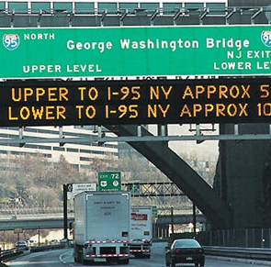
NCHRP REPORT 685 Implementing Strategies to Attract and Retain a Capable Transportation Workforce ICF International and Venner Consulting, Inc. Review of Final Guidebook
July 20, 2011
Beth Heinen, Ph.D.
ICF International

Slide 2
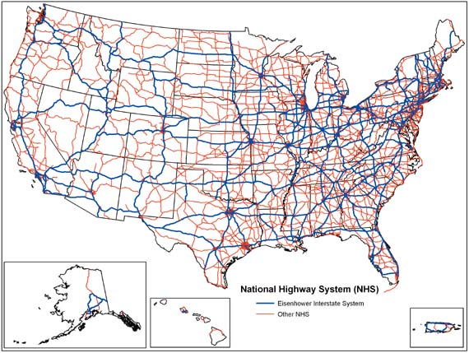
Roadmap
Introduction
Overview of Method
Overview of Guidebook Materials
Questions

Slide 3
Final Report Full Text
The full text of the final report has been published and is now available online
Cronin, B., Anderson, L., Heinen, B., Blair Cronin, C., Fien-Helfman, D., & Venner, M. (2011). NCHRP Report 685: Strategies to Attract and Retain a Capable Transportation Workforce. Washington D.C.: Transportation Research Board.
Available at : http://www.trb.org/Main/Blurbs/Strategies_to_Attract_and_Retain_a_Capable_Transpo_164747.aspx

Slide 4
Overview of Method

Slide 5
Summary of Method
Task 1: Conduct a comprehensive literature review
Task 2: Identify and document practices to attract and retain employees
Task 3: Conduct full case study analyses of best practices identified
Task 4: Prepare a draft outline of proposed guide based on findings
Task 5: Prepare and submit an interim report
Task 6: Fully develop a guide of effective workforce strategies
Task 7: Submit final report
Task 8: Present key findings and recommendations

Slide 6
Overview of Guidebook for Implementing Strategies to Attract and Retain a Capable Transportation Workforce

Slide 7
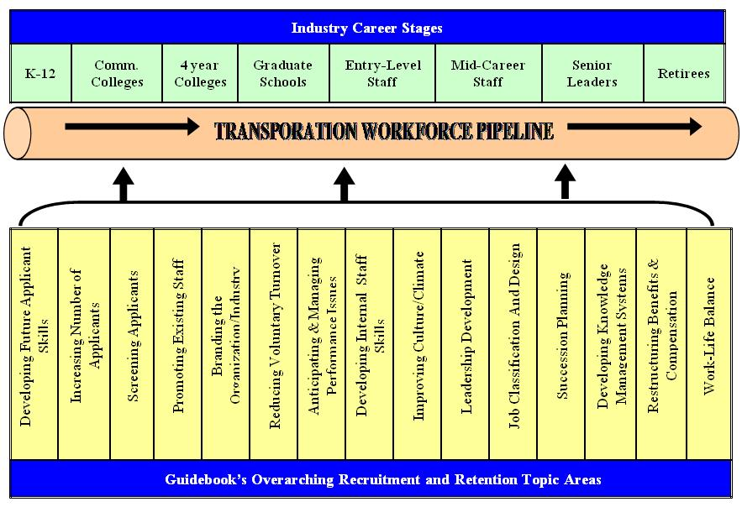
Guidebook Organization
Notes:
Examples on following slides.

Slide 8
Chapter 4: Increasing Number of Applicants Overview
Concept
Partnering with under-graduate institutions and minority organizations to increase number of applicants, specifically those applicants who are young and from non-traditional labor pools.
Definition:
Goal is to increase awareness of and attract more job-seekers to the transportation industry. As a result, these practices help to establish a solid applicant pool of potential employees for available transportation jobs.

Slide 9
Chapter 4: Increasing Number of Applicants Key Points
Workforce Challenges
Geographic challenges
National disasters creating competitive labor market
Lack of diversity
Aggressive Recruiting
Difficulty finding applicants with in-demand skills
Industry Strategies
Expand the recruiting horizon
Host career days
Implement employee referral programs
Tailor advertising efforts
Consider non-traditional hires
Advertise in foreign languages
Partner with source organizations to increase numbers
Integrate with source organizations
Harness technology
Utilize social networking

Slide 10
Chapter 4: Increasing Number of Applicants Key Points (cont.)
Workforce Practice – Kentucky Transportation Cabinet
Civil Engineering Scholarship Program
Scholarships given to college students in exchange for a full year of employment for each year of scholarship money received
Workforce Practice – Minnesota DOT
Community Advisors on Recruitment and Retention Solutions (CARRS)
Partnerships are formed with minority organizations, which helps the agency recruit and maintain a diverse employee base

Slide 11
Chapter 7: Branding the Organization/Industry Overview
Concept:
Improving agency and/or industry image as well as awareness of the diverse jobs available at DOTs through more accessible media and re-branding of transportation jobs.
Definition:
Involves positively marketing the organization and industry in an effort to communicate the benefits of a career. As a result, these practices help to establish a larger and more diverse applicant pool.

Slide 12
Chapter 7: Branding the Organization/Industry Key Points
Workforce Challenges
Employee age, generational gap
Misperceptions of the job
Misperceptions of the gender/cultural barriers
Industry Strategies
Advertise the strengths of the organization
Get involved in the community and advertise it
Use real employees in advertisements
Make the jobs appealing
Improve image as “diversity friendly”
Use a comprehensive marketing campaign
Capitalize on social networking technology
Communicate a message and target an audience

Slide 13
Chapter 7: Branding the Organization/Industry Key Points (cont.)
Workforce Practice – Iowa State University
Institute for Transportation (InTrans) Go! Magazine
Magazine informs teens about the transportation industry and possible career paths and is printed in both English and Spanish
Workforce Practice – Washington State DOT
Branding through Social Media
Social media tools (e.g., YouTube, Facebook, Google Groups, etc.) are used to present employees and their roles; helps to build trust and educate the public

Slide 14
Chapter 8: Reducing Voluntary Turnover Overview
Concept
Many transportation agencies are realizing that reducing voluntary turnover is a cost-effective approach to retaining a strong workforce, particularly in challenging economic times.
Definition:
Involves efforts to monitor and increase employee job satisfaction as well as organizational commitment.

Slide 15
Chapter 8: Reducing Voluntary Turnover Key Points
Workforce Challenges
Short-term turnover
Differences in job expectations
Better location
Deficiency in top management support
Workforce Practice – Regional Transportation District (RTD)
Champions of Transit Program
Integrates community involvement and employee wellness and recognition
Industry Strategies
Removing obstacles to employee growth
Rewarding citizenship behavior
Keeping former employees close
Rewarding employees
Taking care of employees
Focusing on retention early and learning from mistakes
Workforce Practice – Missouri DOT
Employee Solutions at Work (SAW)
Collects and distributes best practices

Slide 16
Chapter 12: Leadership Development Overview
Concept:
Innovative Transportation organizations have begun to provide managers with not only technical training, but leadership training regarding how to motivate, evaluate and provide recognition to employees.
Definition:
Involves sound training and management skill development. Also, should consider the unique needs of female and minority staff to help remove obstacles to their development as leaders. These practices help organizations to better develop leaders throughout the agency.

Slide 17
Chapter 12: Leadership Development Key Points
Workforce Challenges
Interviewing skills
Difficulty choosing leaders
Lack of training for leaders/ supervisors
Workforce Practice – Maryland State Highway Administration
Advanced Leadership Program
Ensures that employees are identified and prepared as leaders before leadership positions are vacated
Industry Strategies
Providing leadership training
Implementing leadership development to support specific demographic groups
Emphasizing follower development in leader training
Mentoring and coaching leaders
Workforce Practice – Santa Clara Valley Transportation Authority
Joint Workforce Investment (JWI) program
Combination of programs resulted in increased skill and commitment

Slide 18
Chapter 13: Job Classification and Design Overview
Concept:
Job Classification and Design allows organizations to better manage jobs to maximize the recruitment and retention of employees.
Definition:
Involves designing jobs to possess the appropriate scope of tasks and skills required allows for employees to stay interested and challenged without being consistently overburdened.

Slide 19
Chapter 13: Job Classification and Design Key Points
Workforce Challenges
Aversion to manual outdoor labor
Lack of flexibility and autonomy
Lack of learning opportunities
Workforce Practice – Minnesota DOT
Transportation Specialist Series
Focus on workforce planning and professional development to target current and future skill needs
Industry Strategies
Creating dual career tracks for managers and technical experts
Emphasizing job enrichment
Creating advancement within positions
Workforce Practice – Pennsylvania DOT
Position Analysis Workbooks
Provides proper training and career direction to employees and helps improve organizational efficiency and effectiveness

Slide 20
Questions?

Slide 21
Contact Information
For more information, please contact:
Dr. Beth Heinen
Senior Associate
ICF International
(314) 918-0373
BHeinen@icfi.com

