Slide 1
Pipe Lining by the Centrifugally Cast Concrete Pipe Lining Process (Centri-Pipe)
APM/PERMAFORM

Slide 2
How Many Times Have You Seen This

Slide 3
Where is the Bottom of the Pipe?

Slide 4
HISTORY
• Action Products Marketing Corporation (AP/M) began
rehabilitating manholes in 1985 with its patented
PERMAFORM system for the replacement of manholes
without digging and without interrupting flows.
• AP/M recognizes that not all manholes needed complete
replacement. So, we developed a cast in place sealing and
reinforcing system using the high strength, centrifugally
cast PERMACAST specialty mortars.
• This same system was adapted for use in storm and
sanitary sewer pipe from 30 inches to 120 inches in
diameter.

Slide 6
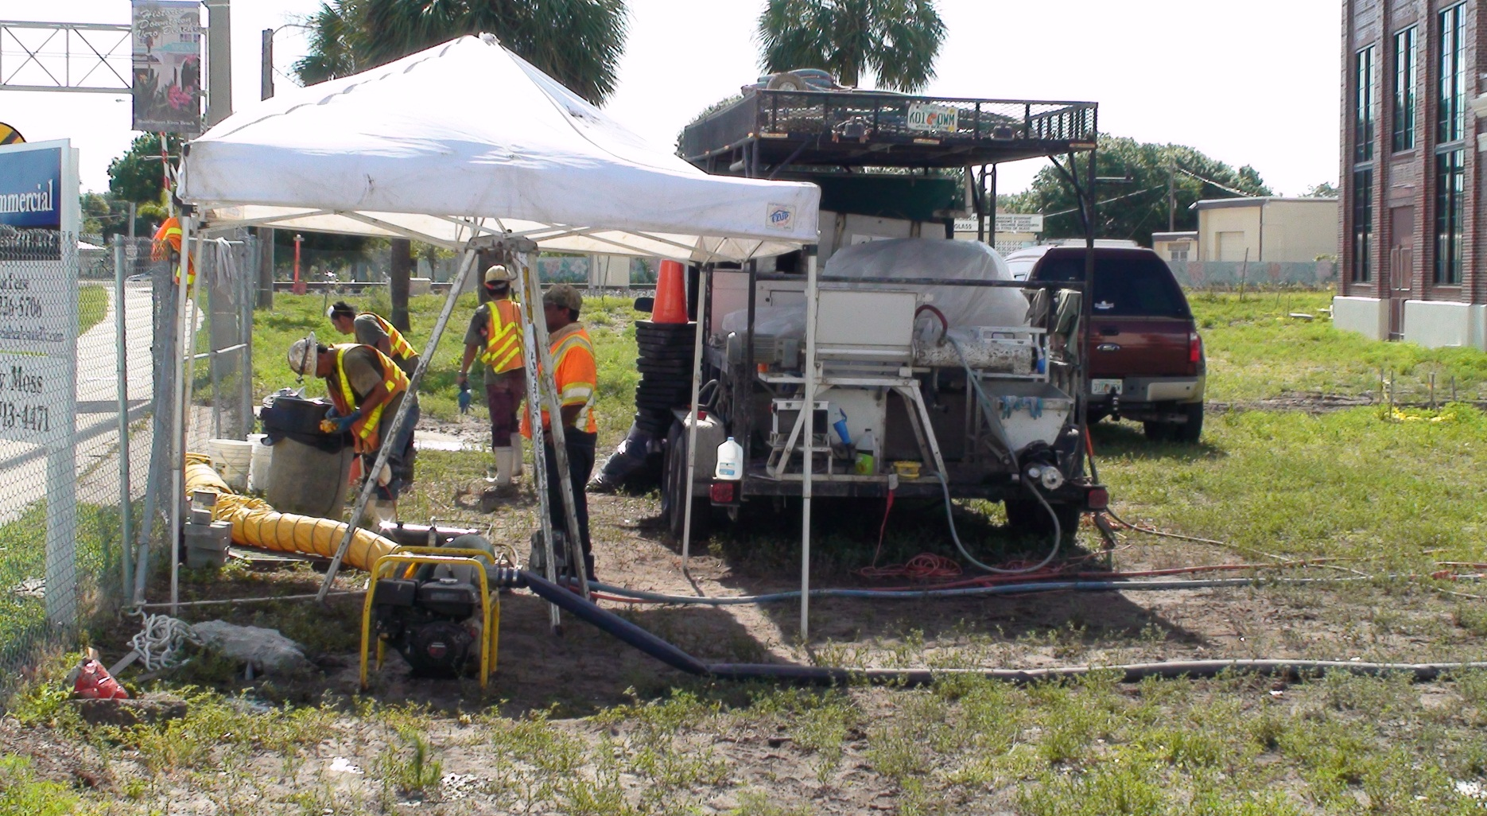
Small Equipment Footprint

Slide 7
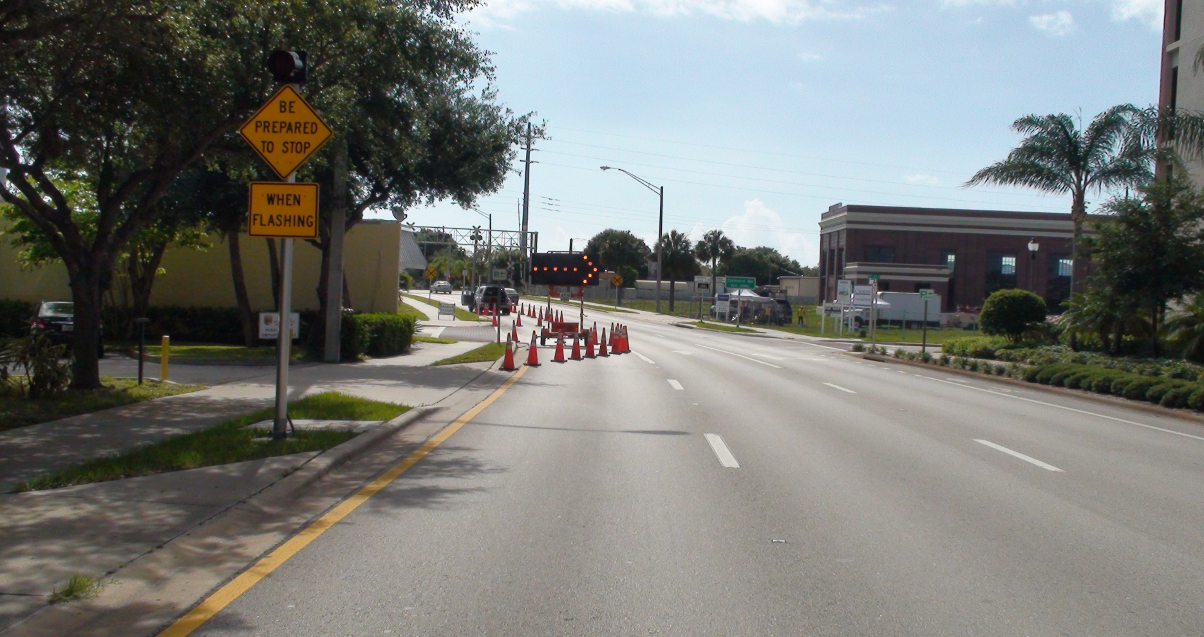
Traffic Control Done Right!

Slide 8
Report Graphics Sample

Slide 9
Report Summary
This report has proven that a 1 inch liner utilizing the Permaform PL-8000 will perform satisfactorily to support soil and hydrostatic pressure based on the depth, type and diameter of the pipe, soil type and level of the ground water as given above.

Slide 10
Third Party Testing
LA Redner Test
Adhesion (ASTM D-4541)
Greenbook 112 day test
Notes:
Confirm the manufacturer is compliant with astm and third party testing

Slide 11
AP/M Success with Manhole Rehab Leads to New ASTM Standard Practice
AP/M personnel were invaluable in the creation of a new ASTM Standard Practice.
ASTMs’ F 36 Committee, Technology and Underground Utilities, recently developed and released , Standard Practice for Installing a Protective Cementitious Liner System in Sanitary Sewer Manholes, F 2551-09.
This practice includes the use of the centrifugally cast concrete lining system.

Slide 12
New ASTM Standard Practice
ASTMs’ F 36 Committee, Technology and Underground Utilities, recently developed, Standard Practice for Applying a Centrifugally Cast Concrete Pipe Liner inside Storm Pipes, WK 26451

Slide 13
MNDOT
MNDOT- featured in Stormwater magazine
“Our district is faced with thousands of deteriorated centerline roadway pipes,” says Ruth Betcher, P.E., hydraulics engineer for the Minnesota Department of Transportation’s (MNDOT) District 6, “and replacing all that pipe is cost prohibitive—and also, citizens don’t welcome detours!”

Slide 14
How Many Times Have You Seen This

Slide 15
Where is the Bottom of the Pipe?

Slide 16
Flowable Fill

Slide 17
First Lining Pass

Slide 18
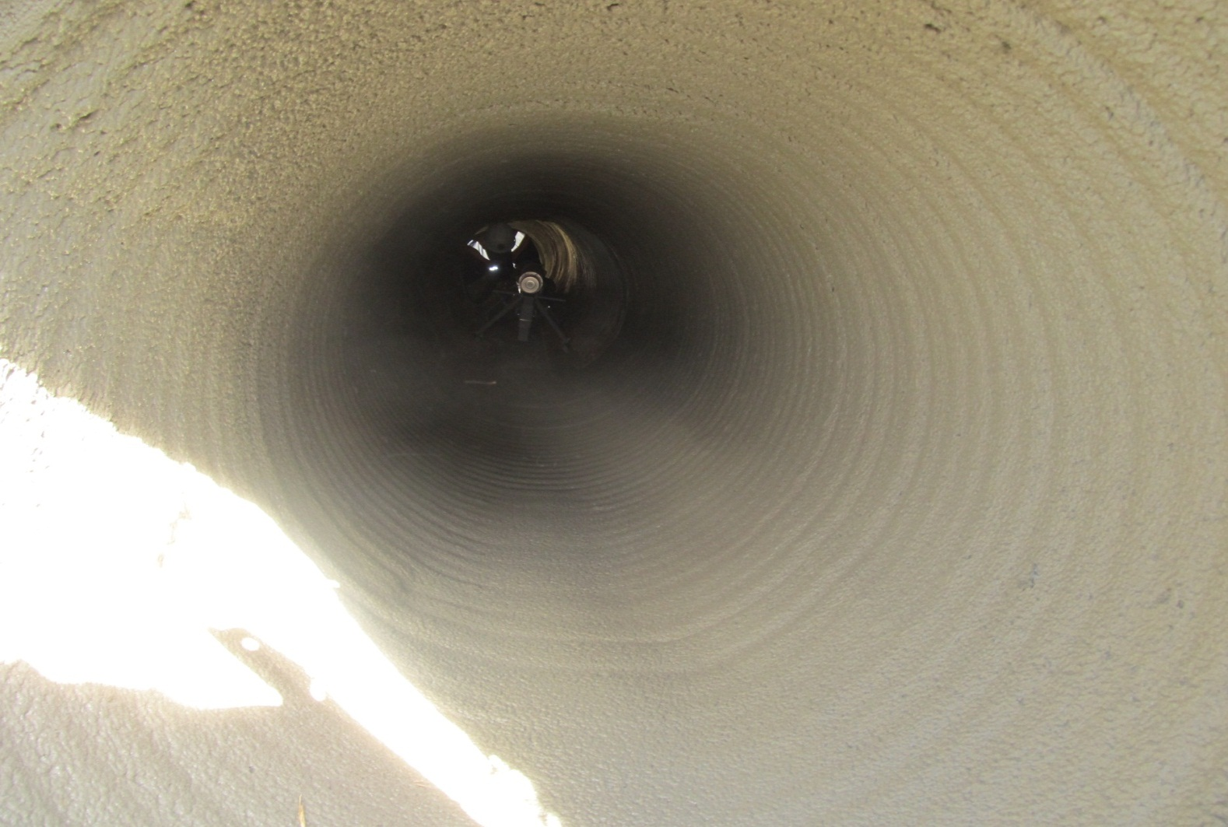
Finished Product

Slide 19
MNDOT
Before
After

Slide 20
Sanitary Sewer Rehabilitation

Slide 21
West Lake, Ohio
Article- UCT magazine
The City of Westlake, Ohio, got an interesting ‘wake up call’ in 2006, when a sanitary sewer interceptor line in nearby City of Lorain failed dramatically. “It forced the evacuation of several dozen homes for months,” says Westlake Director of Engineering Robert P. Kelly, PE, “and we realized we'd better take a closer look at our system.”

Slide 22
West Lake, Ohio
Before
After

Slide 23
Clay County Florida- SR16
Article Published in Stormwater magazine
When Tropical Storm Faye blew across Florida in 2008, stormwater rushed through one of the corrugated steel culvert pipes under State Road 16 in Clay County and began to suck the surrounding soil into the pipe.
"It created a void along the side of the road about 10 feet deep and 20 feet across. You could have put a couple of minivans in this hole," says Spencer Townsend, project manager for the Clay and Nassau counties local sites for Transfield Services North America.

Slide 24
Clay County, Florida
Before
After

Slide 25
Atlantic Beach
Article- Stormwater Solutions July/August 2011
Atlantic Beach is a coastal community of 13,000 people in Duval County, Florida. As the name implies, it has a beach and the nearby ocean affects every aspect of life, including the infrastructure. Atlantic Beach’s biggest subdivision, built in the early 1960s, didn’t really take that into account.

Slide 26
Atlantic Beach, FL
Before
After

Slide 27
Sabine River Authority
Article- Stormwater magazine July/August 2011
The Sabine River Authority (SRA) was created in 1949 to equitably distribute the waters of the Sabine River and its tributaries. As part of this distribution, “We provide surface water to eleven industrial customers, such as Conoco and Louisiana Pigment, for cooling and processing,” says SRA Facility Manager Mike Carr.

Slide 28
Sabine River Authority
Before
After

Slide 29
WARNER ROBBINS, GEORGIA April 2011
CENTRIPIPE CULVERT LINING
UTILITY ASSET MANAGEMENT
REYNOLDS, GA

Slide 30
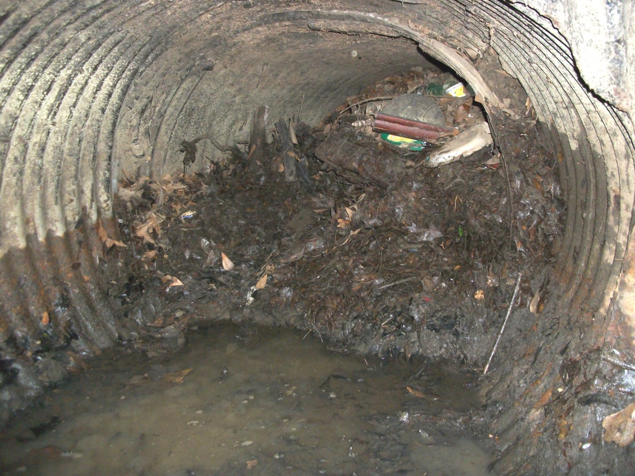

Slide 31
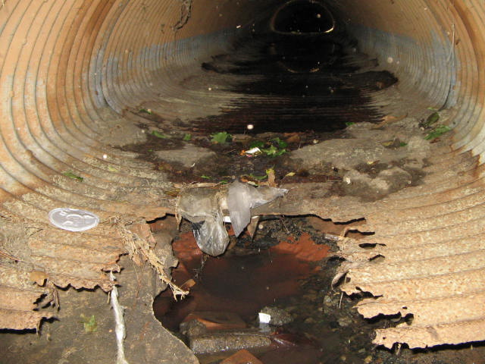

Slide 32
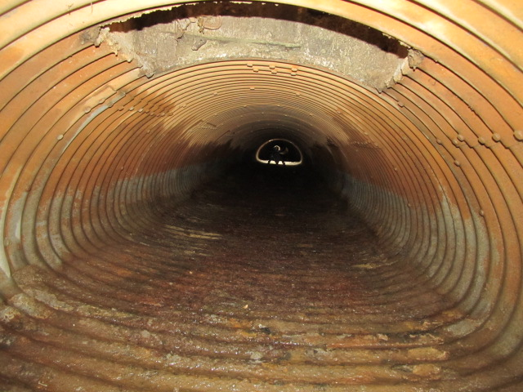

Slide 33
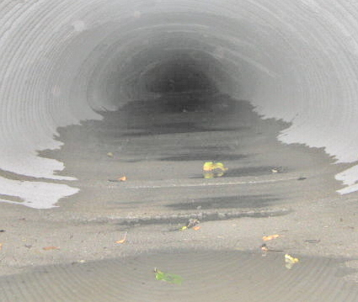

Slide 34
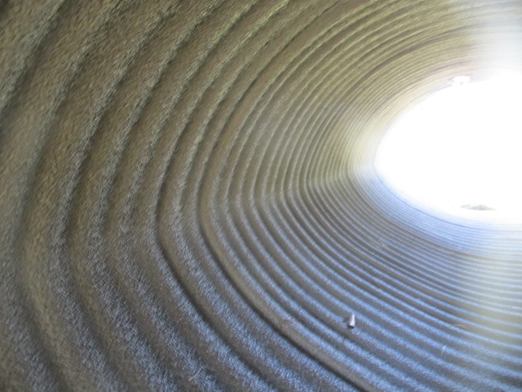

Slide 35
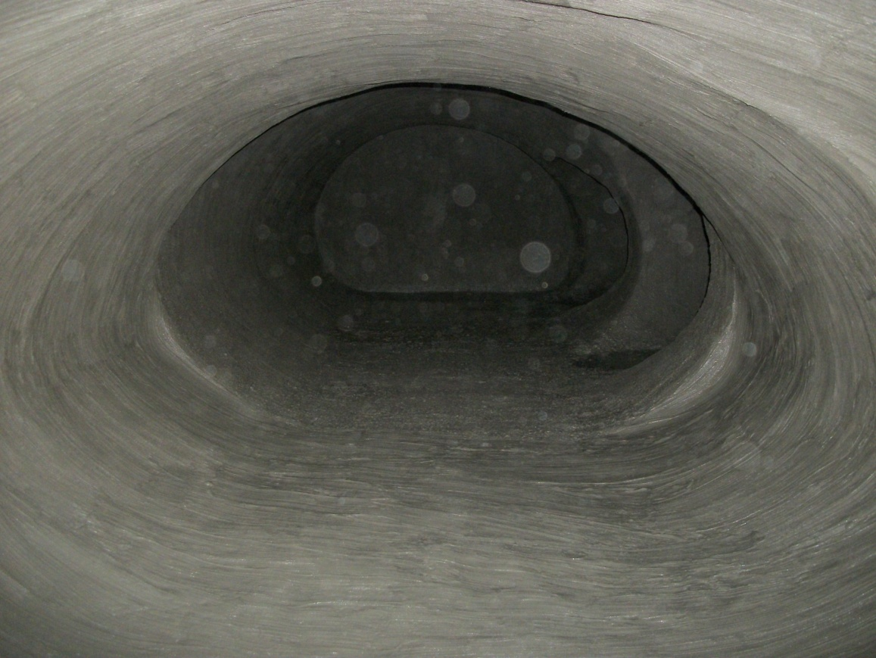

Slide 36
Concrete Pipe Rehabilitation

Slide 37
Cast in Place Structural Product

Slide 38
Centrifugally Cast Concrete Pipe
Cleaned/Cast Wall Rehab
Specialized Equipment

Slide 39
Questions?
AP/M Permaform
800-662-6465
www.permaform.net
AP/M PERMAFORM

