Slide 1
AASHTO Subcommittee on Maintenance
AVL/GPS/Telematics Expert Panel
July 17-21, 2011
2011 AASHTO Subcommittee on Maintenance
Presenter: Mohammed Fotouhi, M.S.E.
mohammed.fotouhi@gmail.com
617.230.9697

Slide 2
Thank You, Erle Potter, P.E., C.E.M.
Topic: AVL/GPS HW, SW, Problem, Solutions!

Slide 3
Presenter Background
Mohammed Fotouhi, M.S.E., Director Public Sector, Telogis, Inc.,
mohammed.fotouhi@gmail.com
  617.230.9697
Have worked with State, County, Municipal officials for over 30 years
Telogis, Inc. is a worldwide leader in provider of GPS/AVL/Telematics Services

Slide 4
Outline
BIG PICTURE
HW/SW Basics
GPS/Wireless/Telematics Connection
Problems in Current Telematics Offerings
Addressing “Standards”
Suggested Next Step
Talk Outline

Slide 5
Your Data/Information World

Slide 6
Data Topology

Slide 7
Uses of Information
Each user of information needs pieces of data depending on its context
Not all users need ALL of the data all of the time
Most data is stored in different locations
Usually, stored data formats are not readily usable for your needs
Users at times need information from separate systems in one place
“Granularity” need for information varies by each users
Time sensitivity of Information varies for each user

Slide 8
Why YOUR Data Needs are Unique
Most of Telematics services target long/short haul trucking or service fleets
Both market segments benefit from standard AVL information: Location, idling, route optimization, basic diagnostics (engine hot, battery low, etc..)
Many of your equipment sit at the yard most of the year.. Snow plows, mowers, etc… not much need for basic GPS!
Your equipment not only need engine, transmission, brakes, etc. maintained (like other fleets), but you also need to monitor booms, lifts, drills, buckets, specialized sensors, and more…
Your specialized monitoring needs need to be addressed in specialized ways
You also outsource your services to private contractors… you need monitoring of their activity

Slide 9
Partial Performance Measurement Metrics
Where and when did we plow?
How much salt/chemicals did we use?
What were the Road/Weather conditions at the time of service?
Where do I send the plow, given weather data?
Am I hitting a vehicle buried in snow?
Which neighborhood is screaming for service?
How do I justify my dispatch decisions? On what data?
What is our Vehicle Replacement Model and why?
What are the contractors’ vehicles doing?
Etc…, …etc,…Etc.

Slide 10
Why Consider Telematics/GPS Equipment
Helps in Performance Measurement Programs by Quantifying Vehicle Operational costs and functions
Increase Safety Through Monitoring of Speed and Driving Habits
Increase efficiency by Reducing/Eliminating Driver Manual Driver Vehicle Log Entry
Help Reduce Carbon Emissions Through Monitoring of Idling, speeding and Better Routing Decisions
Collecting Data for Making Quantifiable Vehicle Utilization Reports
Can Reduce Maintenance Costs
Reduces Fuel Consumption Through Better Monitoring

Slide 11
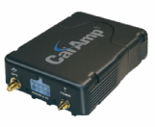


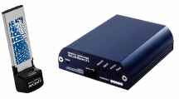
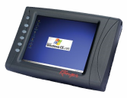
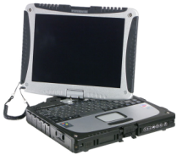
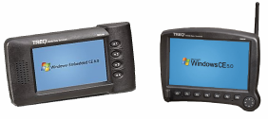
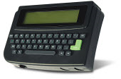
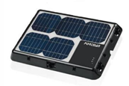
Many Hardware Options

Slide 12
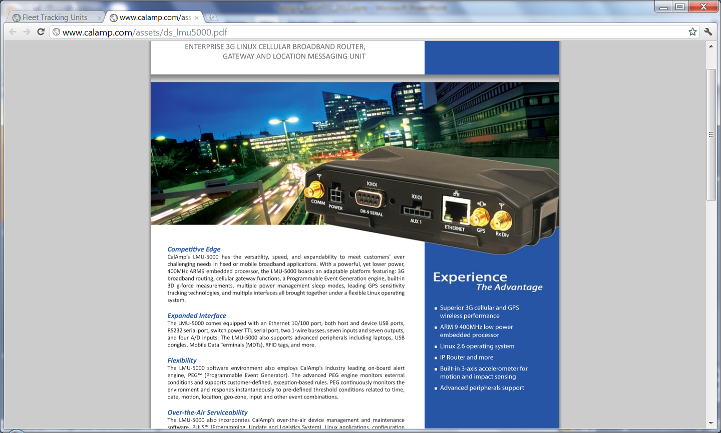
New GPS/Telematics Device

Slide 13
Platforms of JBUS Devices
LINUX Boards
Microsoft Windows Boards
Sensors (RWIS/ESS) (fixed) and mobile (Snow plow) send messages (codes) via Interfaces like the CalAmp LMU-4200

Slide 14
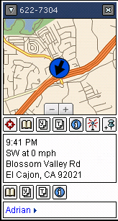
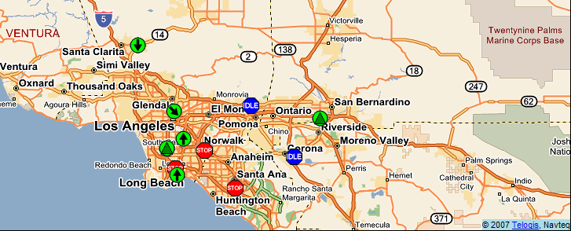
Map View with Fleet Status
Map View in Realtime
Vehicle Location
Vehicle Direction
Status Indicator
Pop-up View for Vehicle Details
Vehicle Status: Idle, Moving, Stopped

Slide 15
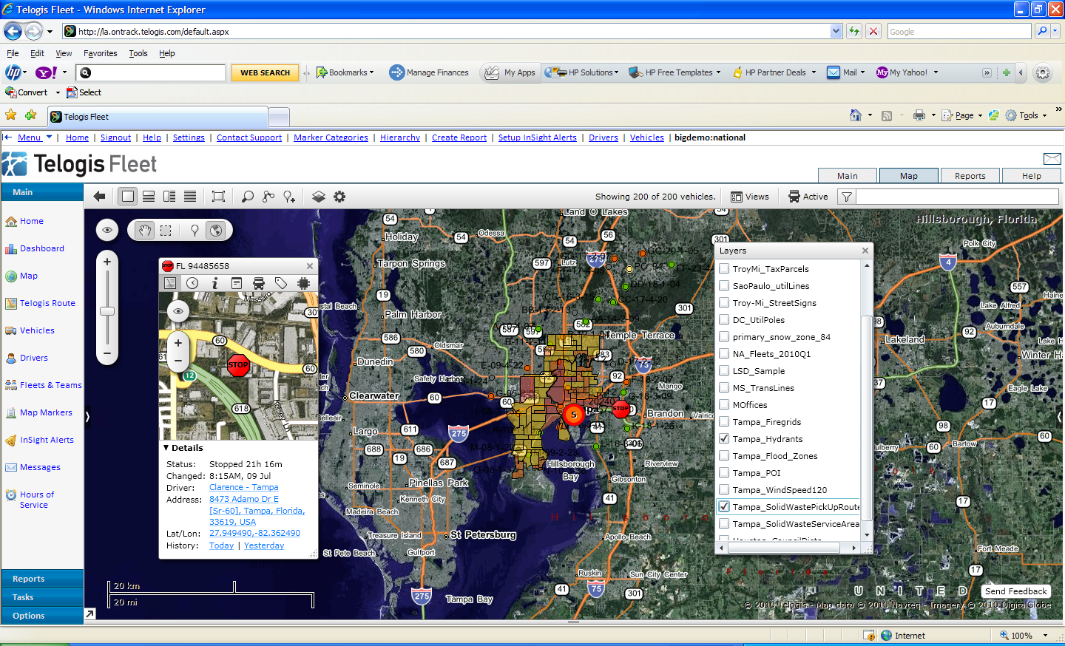

Slide 16
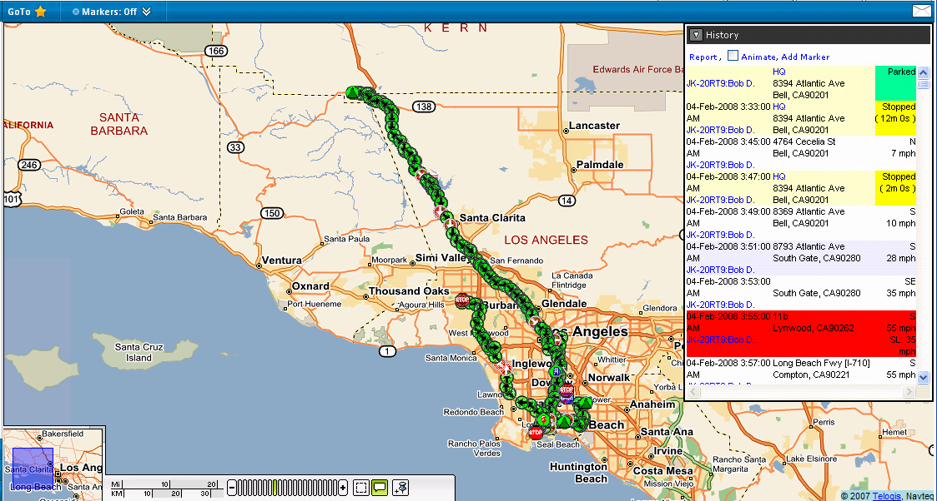
Telogis “Breadcrumb Trail” History
“Breadcrumb Trail” Vehicle History View
Detailed History of Location and Exceptions (2-minute reporting)

Slide 17
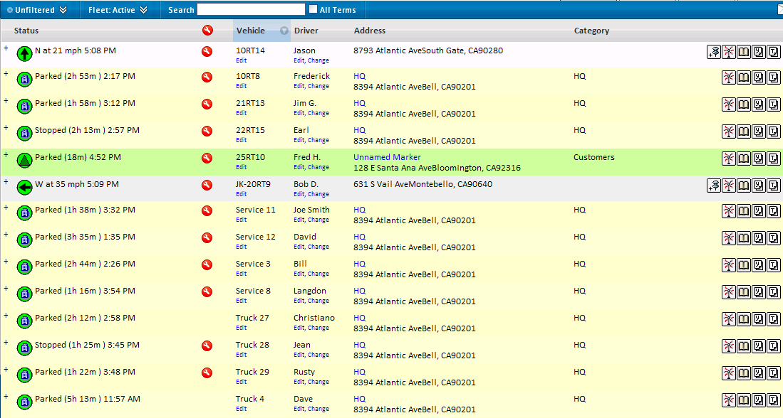
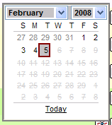
Entire Fleet Status View
Drill Down to History Detail (by Day by Vehicle)
Maintenance Status
Vehicle Location
Vehicle Speed & Direction
Driver Assignment by Vehicle
Type of Location (if at marker)

Slide 18
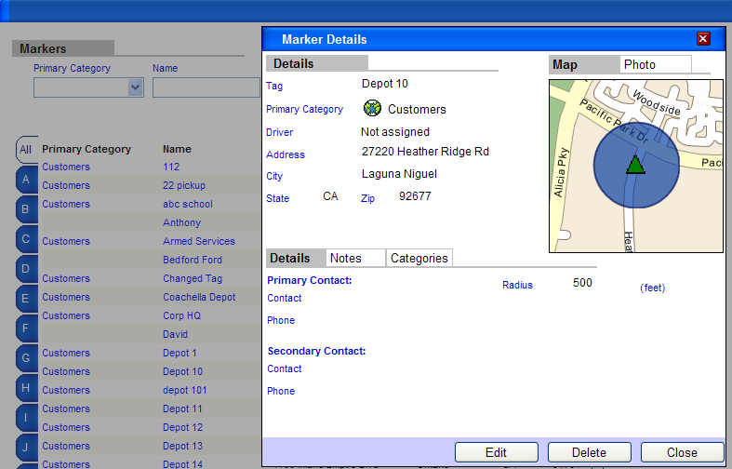
Markers & Geofences
Example Applications:
Alert When Vehicle Leaves Yard Late
Arrives at Customer Late
Marker
Geofence with Adjustable Radius

Slide 19
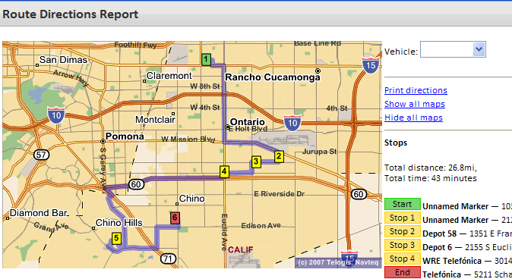
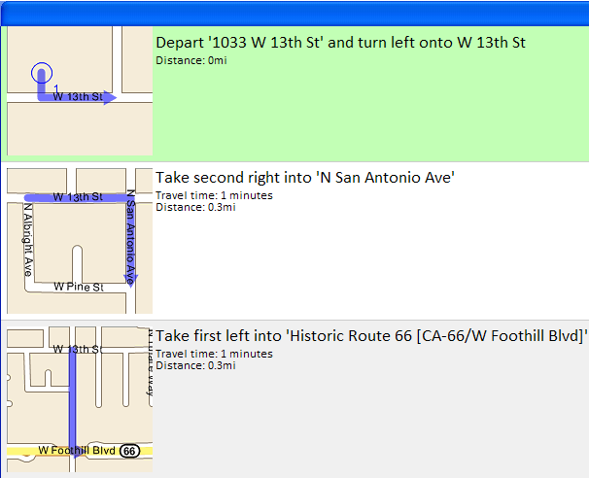
Routing & Directions
Optimized Route
Turn-By-Turn Directions

Slide 20
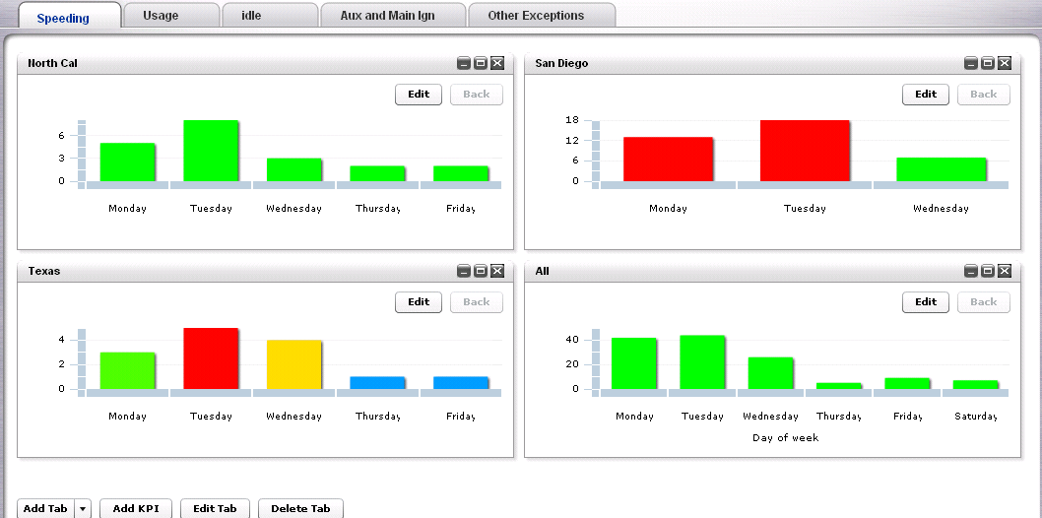
Executive Dashboard
Drill-down by Metric
Easily Customized

Slide 21
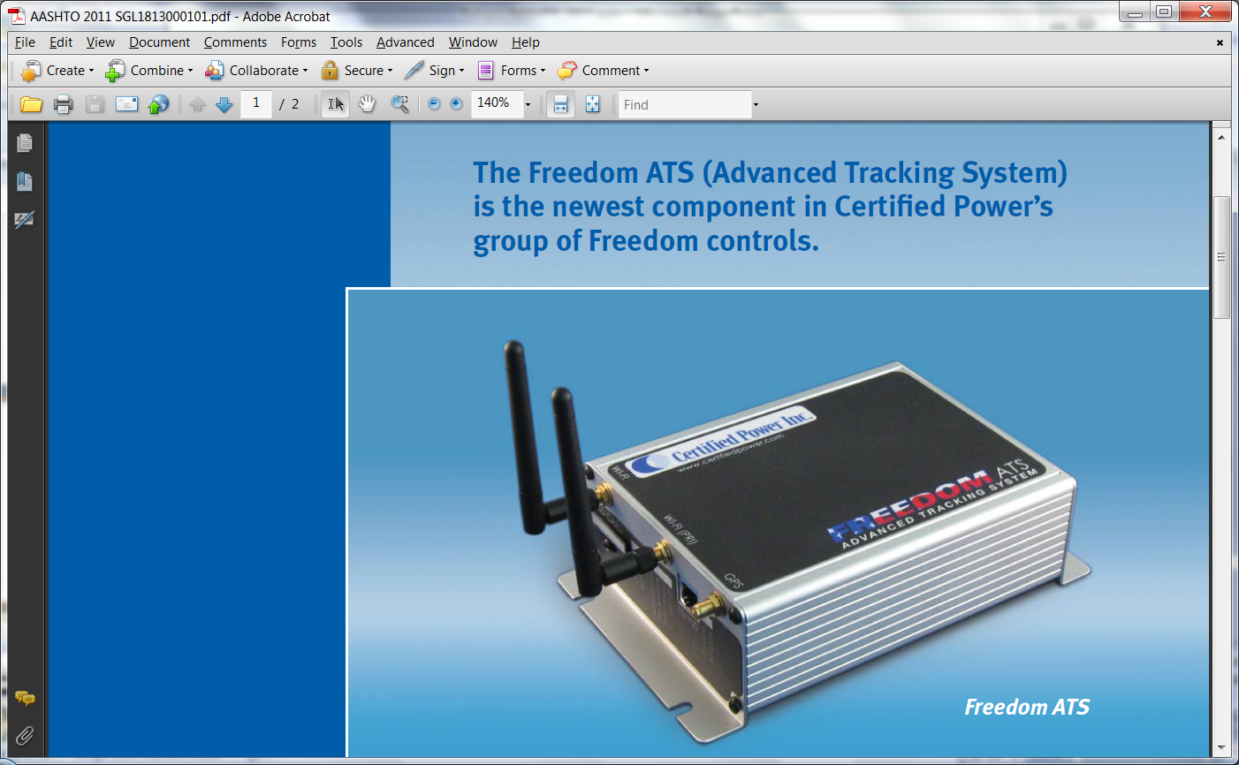
Example of a Device to connect Sensor Data to GPS/AVL Box

Slide 22
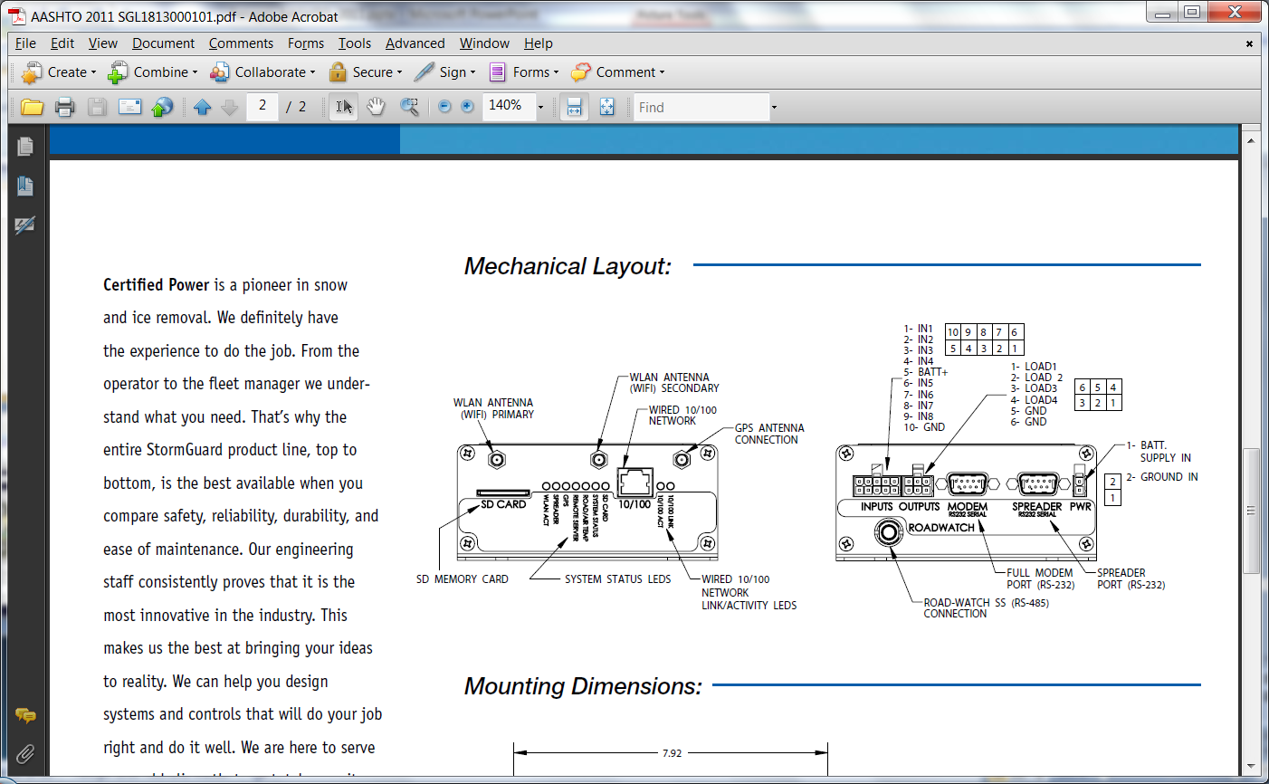
Schematic of the Input and Output ports

Slide 23
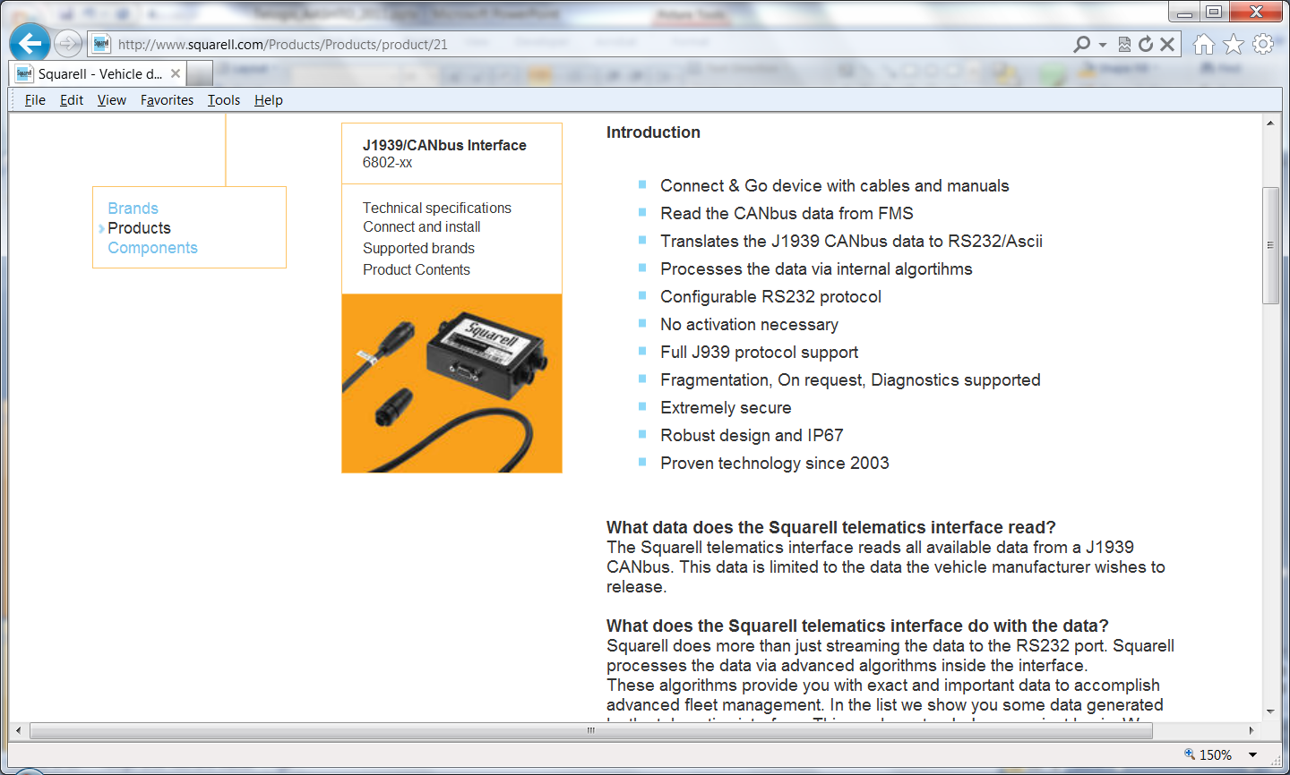

Slide 24
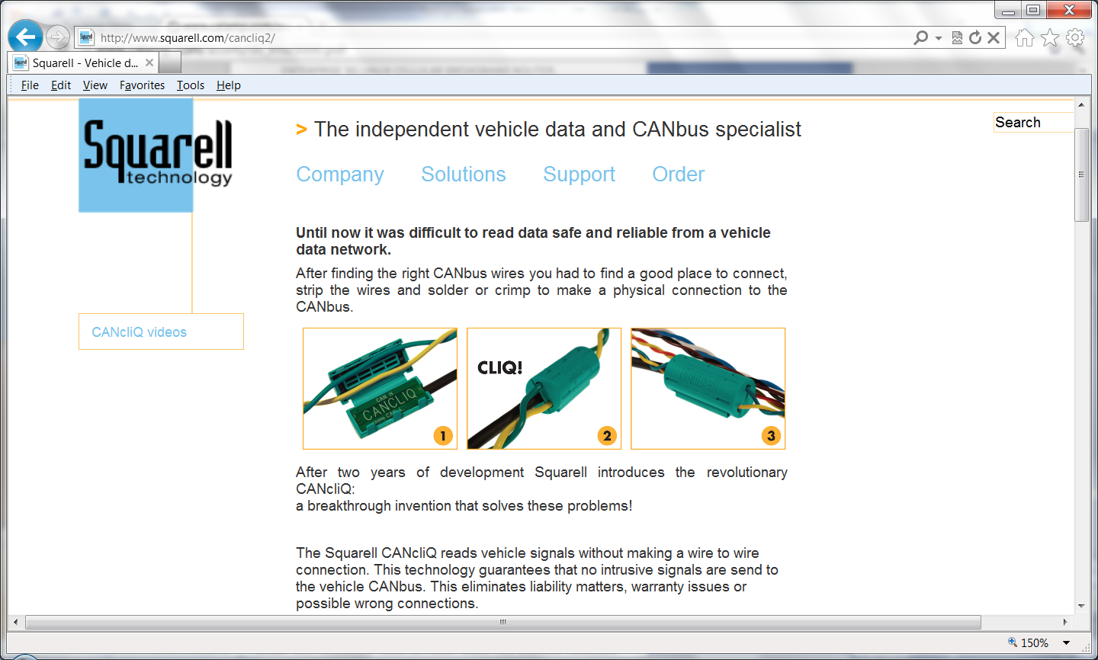

Slide 25
What Does This Mean to You?
NOT Much… Unless you can integrate the data in a meaningful way
All Web Enabled
ANSI XML Interfaces
Browser Compatible

Slide 26
What is Coming
Cheaper and Cheaper Hardware: $100 device being tested by FedEx
Cheaper Wireless Charges: Now $4.00-$7.00 and going down
Vehicle Manufacturers are Talking to AVL Software Vendors
Outsourcing of IT Services in Government
  More use of Internet
  Less in house IT Staff
  Govt. IT staff is deployed to manage software vendor applications
More tools to allow more efficient operations
Better Sensors from Snow Plows to Environmental Sensors
Better Integration of Vehicle Data with other systems:
  Better use of existing GIS data accumulated for the past 20 years
  Maintenance/Work order/Asset Tracking
  Fuel Dispensing Systems
Route Optimization Integrated With Traffic Data

Slide 27
What About Standards?
SAE JBUS Standards – Designed for ODB.. But:
  Manufacturers interpret code differently and you don’t always get the codes you need
AEMP Telematics Data Standards, Released October 2010
  Participants: McFadden & Associates, Caterpillar, John Deere, Volvo, … developed a standard format for the transfer of Telematics data from the providers’ servers to end users!
  But… NOT ALL the data that YOU need! Mostly, AVL type data, miles travelled, cumulative operating hours, etc.
NO standard for sensors, plow up/down, etc!
The users (YOU) are supposed to get the data and do what you want with it

Slide 28
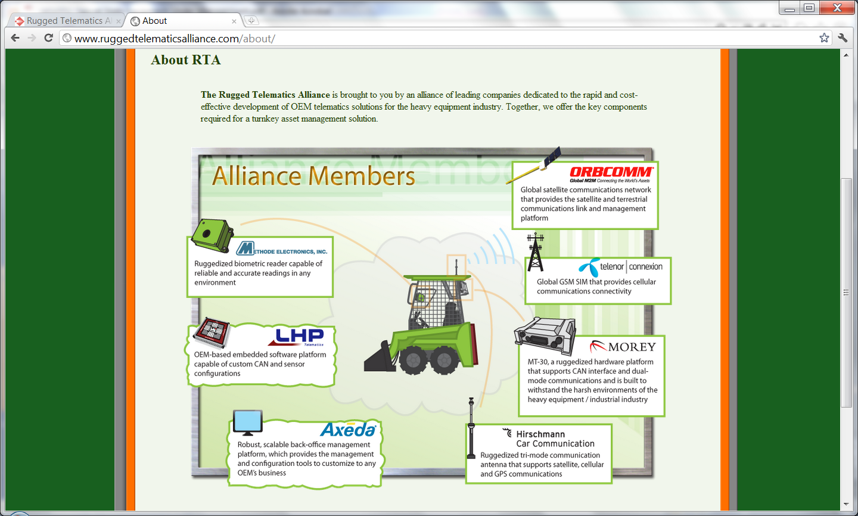
Current Trend: Collaboration

Slide 29
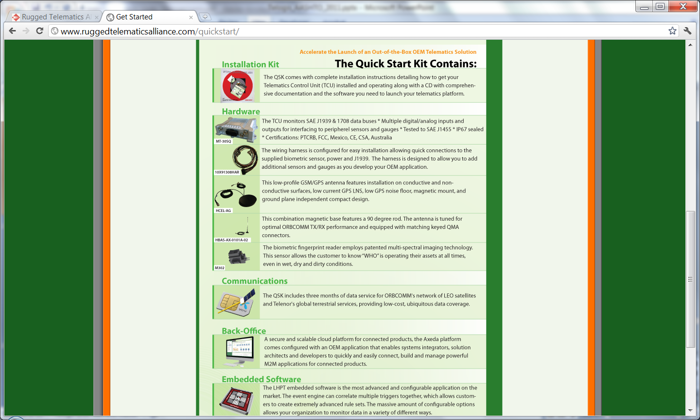
Suggested Committee Standard:
Define What, Where and How you Want it

Slide 30
Proposed AASHTO Data Platform

