Slide 1


Kentucky’s 2026
Seatbelt Survey Results
Erin Lammers-Staats
KENTUCKY TRANSPORTATION CENTER

Slide 2
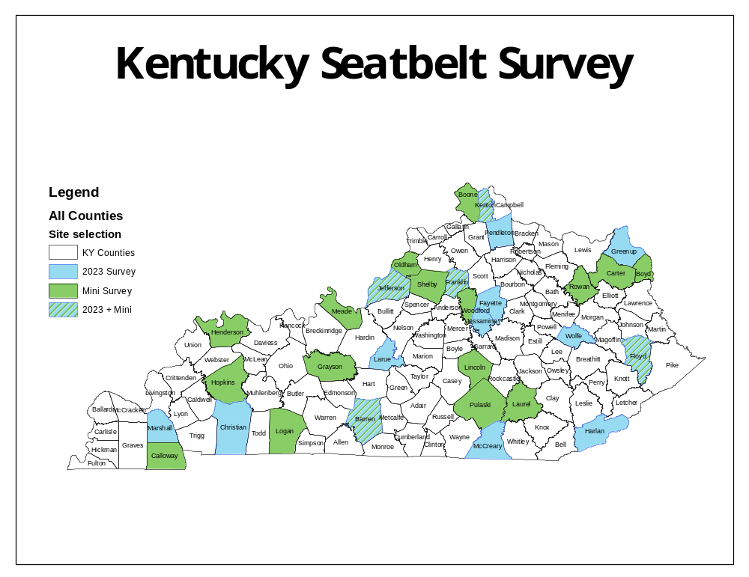
The Survey
Based on NHTSA guidelines and work with UK statistician
Select 15 counties based on fatality data
Randomly select road segments within those counties
Result: 150 road segments for data collection
Counties and sites change every 5 years
Additional control counties
KENTUCKY TRANSPORTATION CENTER
Notes:
Regular counties in blue. Control counties in green.
At least one county per highway district, plus Fayette and Jefferson are always selected.
Road segments include all types of roads, from limited access and arterials to low-volume local roads.
Higher population (in terms of the county or traffic) means higher likelihood of selection.

Slide 3
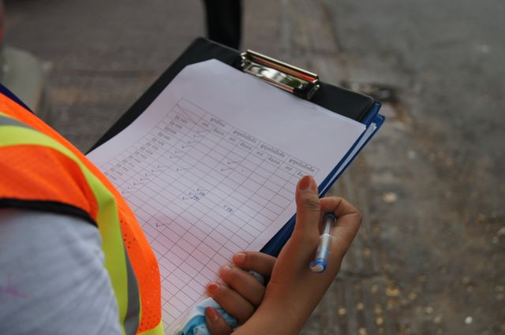
Data Collection
Find safe observation points within
the road segments
UK student data collectors travel to all sites over the course of the summer
Collect data via direct observation
KENTUCKY TRANSPORTATION CENTER

Slide 4
Results*
2026 rate: 85.22%
Sample size: 84,898
Margin of error: 1.04%
Historical trends:
Increased with legislation and education campaigns
Hovering between 85-90% for the last decade
2026’s rate was a 3.3% decrease compared to 2025
*results not certified by NHTSA yet
KENTUCKY TRANSPORTATION CENTER

Slide 5


Occupant Type
Typically, passengers exhibit higher usage rate
than drivers:
86.9% vs 84.9%
Only count front-seat passengers
Vehicle Type
SUVs 89.5%
Cars 85.6%
Vans 85.0%
Pickups 75.0%
No data on commercial/delivery vehicles
KENTUCKY TRANSPORTATION CENTER

Slide 6
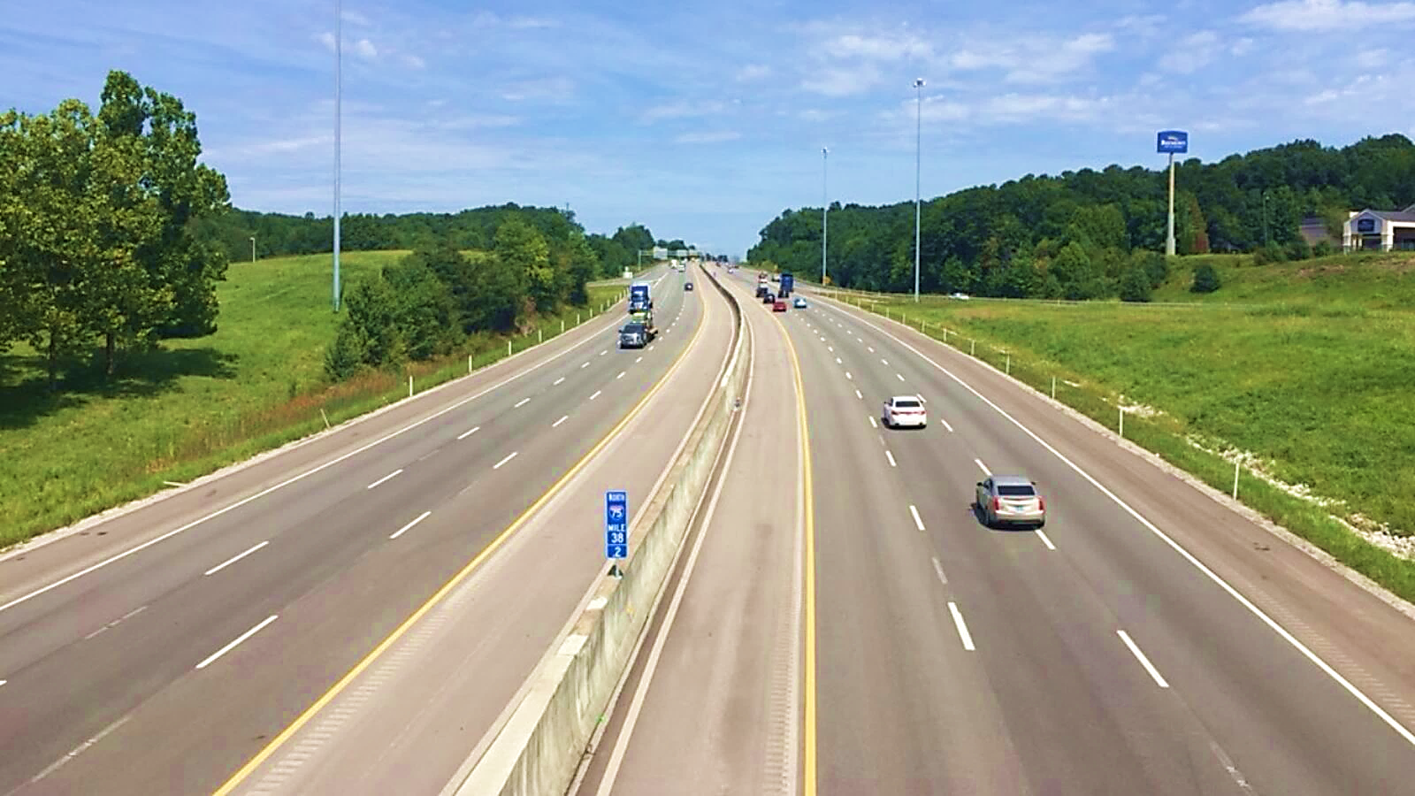
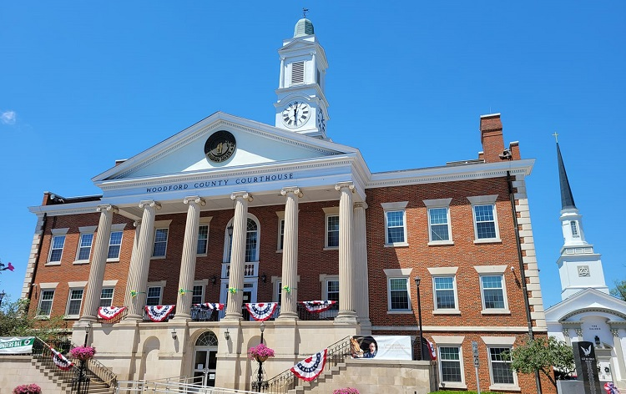
Road Type
More volume = greater seatbelt use
Limited access 89.2%
Arterials 85.0%
Local roads 79.8%
County
Rural counties usually exhibit lower seatbelt use
Floyd, Harlan, McCreary, Pendelton under 80% this year
Only Kenton got above 90%
Sampling does not include all counties
KENTUCKY TRANSPORTATION CENTER

Slide 7
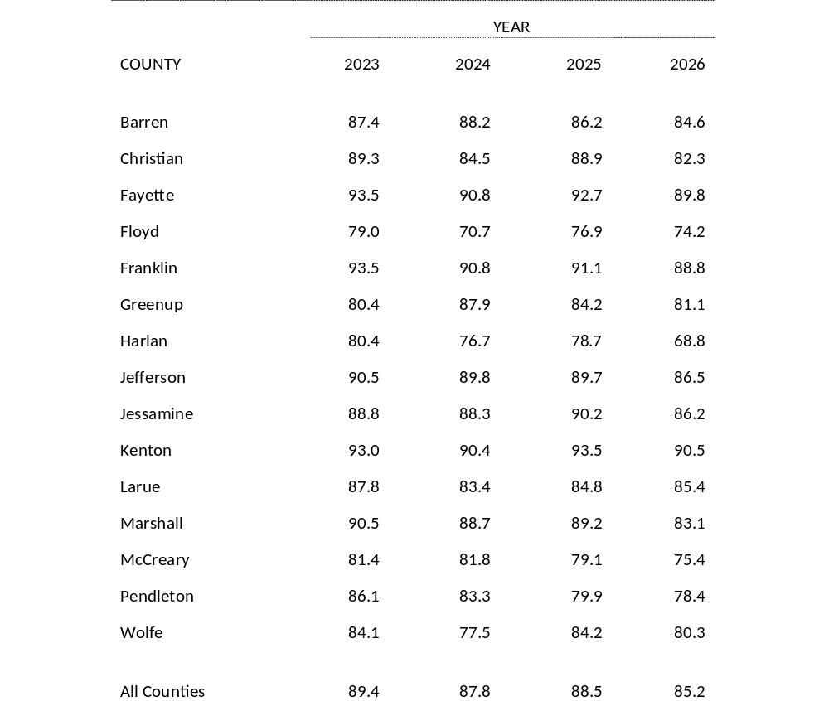
County Data
by Year
KENTUCKY TRANSPORTATION CENTER

Slide 8
Control Sites
Counties and sites change every 5 years
Added “mini” survey (aka control sites) in 2009 to account for redesign years
Support the regular data, offer more insight about rates and trends
21 mini sites throughout state
2026 mini survey rate: 86.2%
Similar decrease to regular survey
KENTUCKY TRANSPORTATION CENTER

Slide 9

Moving Forward
Potential issues
  Tinted windows: high unknown rate
  ATVs
  Safety and availability of data collectors
Regression toward the mean
  Is 90% Kentucky’s realistic maximum?
  Potential for improvement via targeted enforcement, legislation changes, education campaigns
Report available soon
  Published online (search UKnowledge)
  or email erin.Lammers@uky.edu
KENTUCKY TRANSPORTATION CENTER
Notes:
Targeted enforcement: greater police presence in counties with low rates
Legislation changes: ticket costs, eliminating exemptions for farm vehicles
Education campaigns: school conversations, drivers education, public awareness

