Slide 1


Slide 2

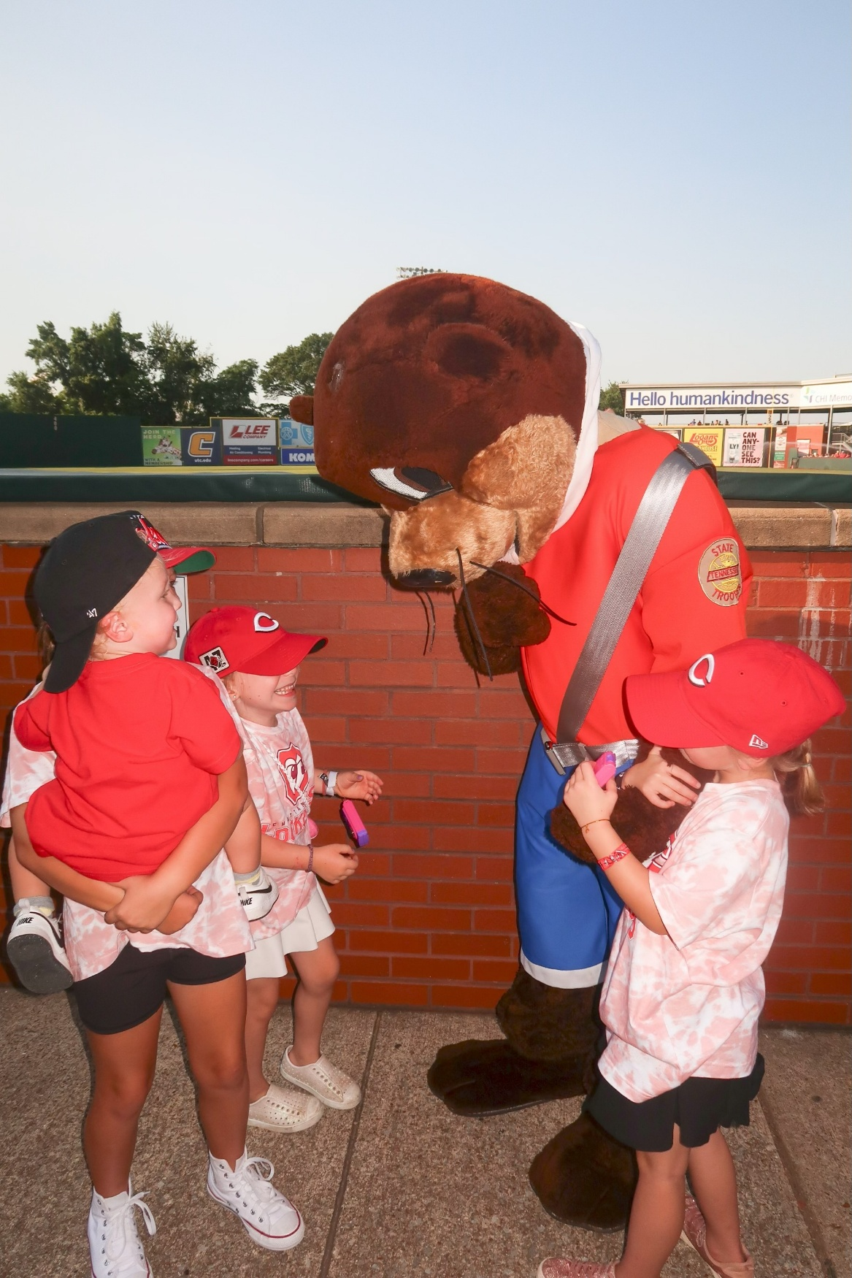

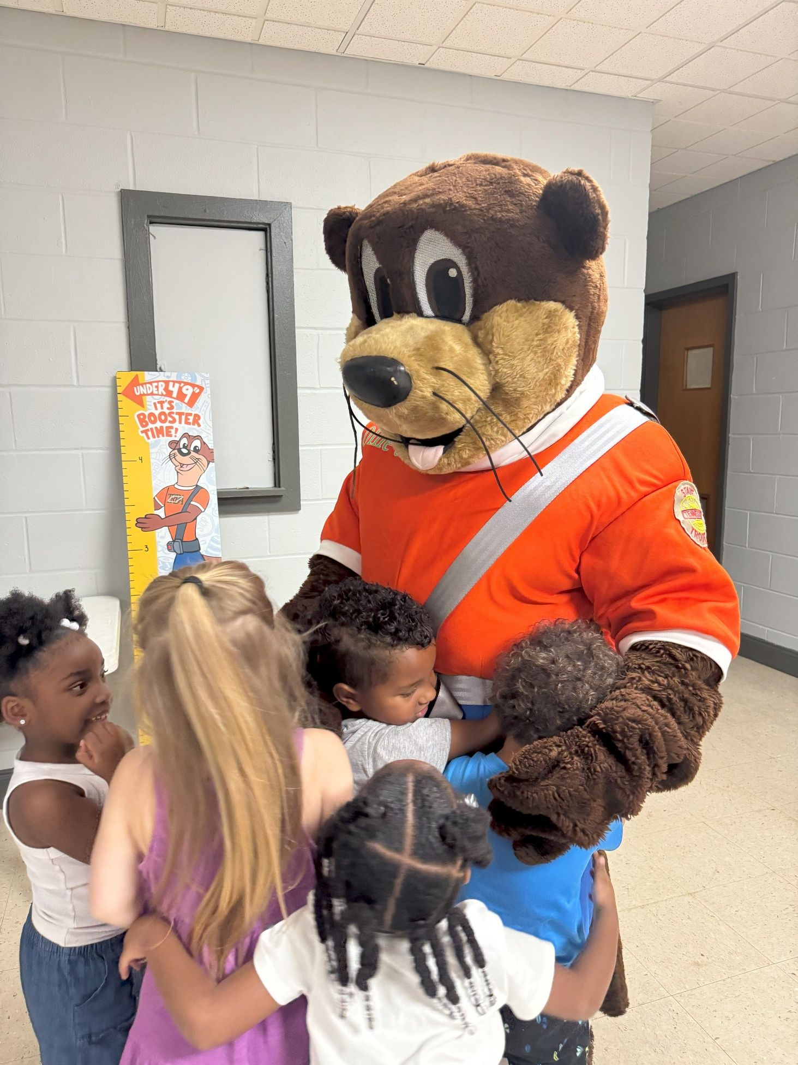
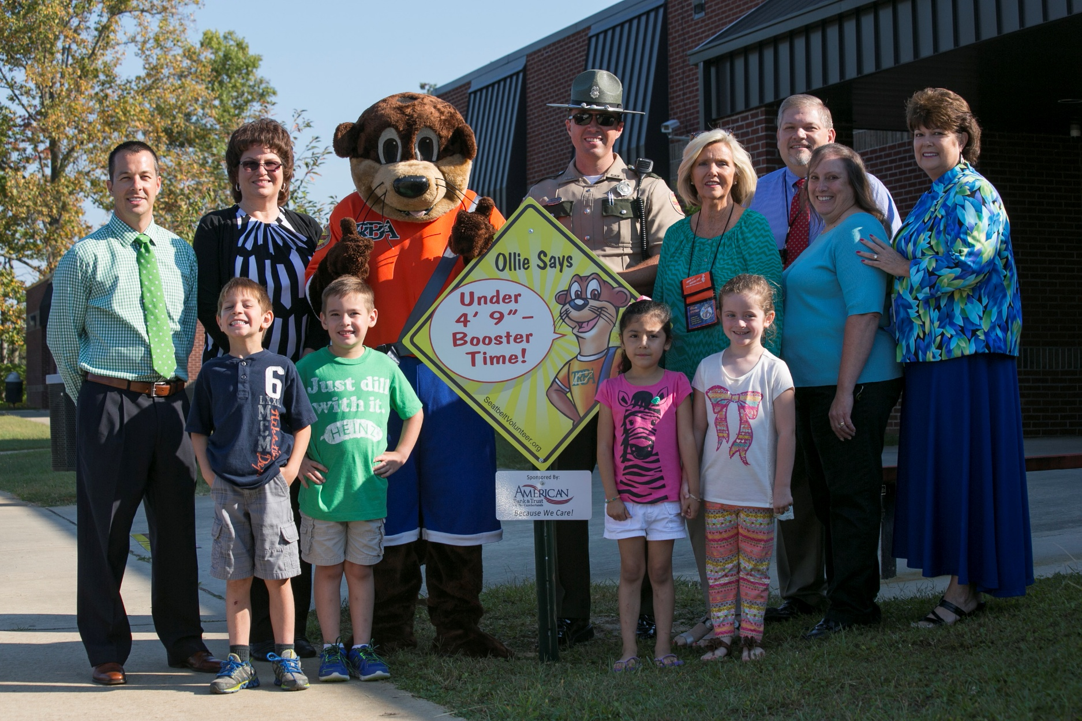

Slide 3
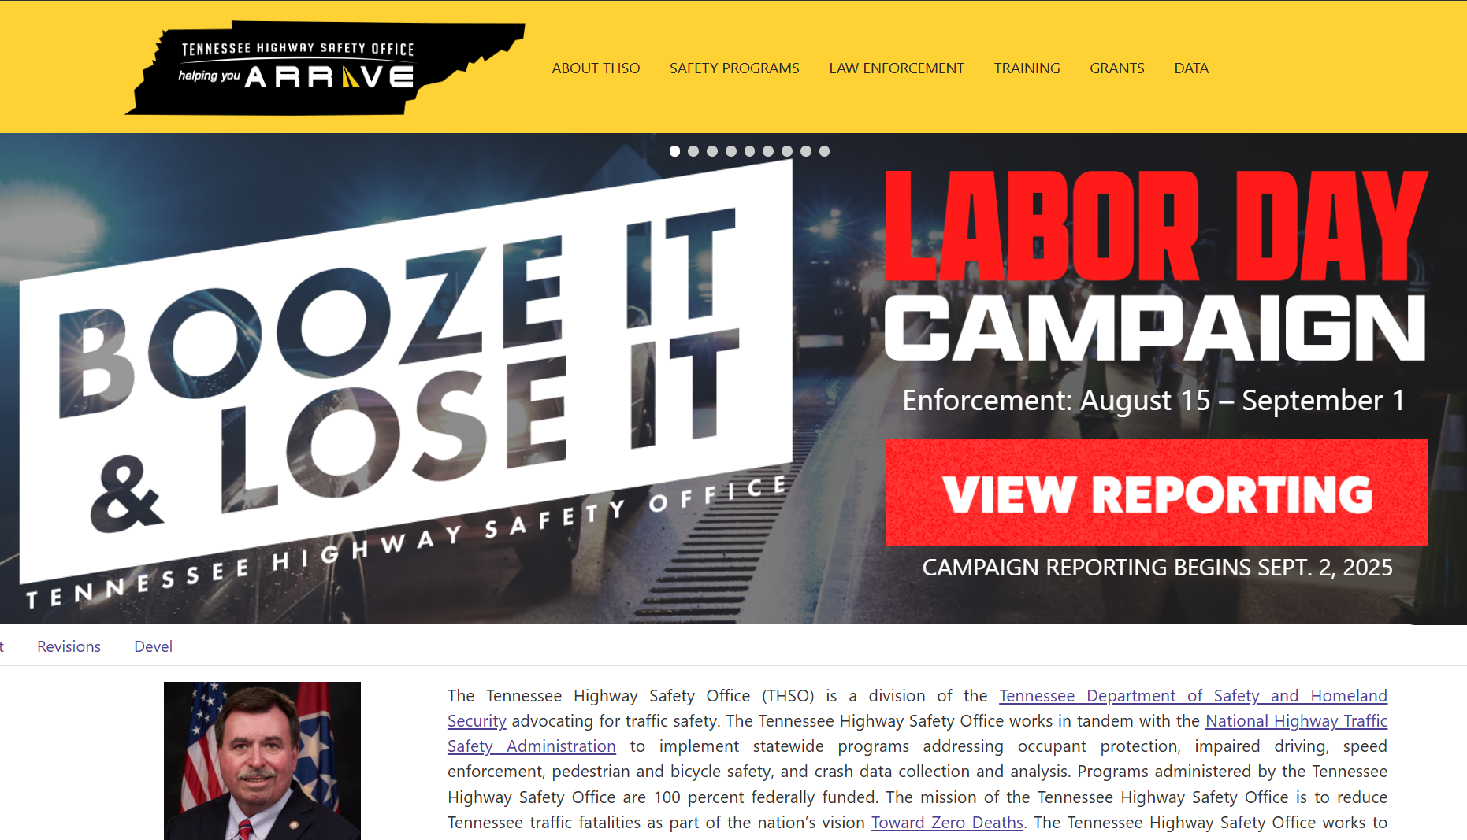

Slide 4
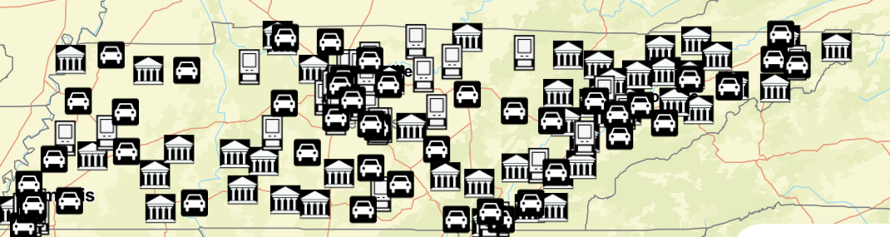
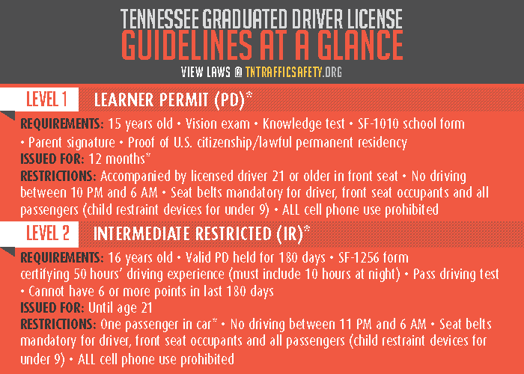
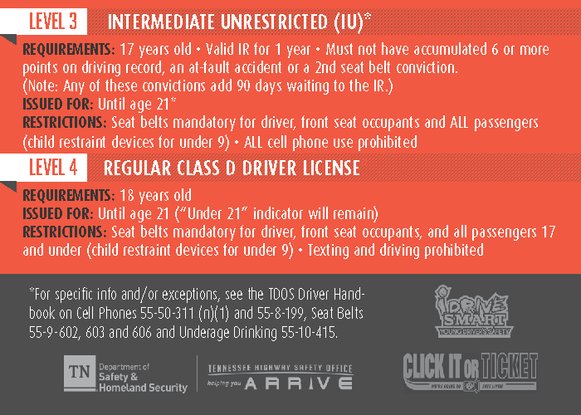

Slide 5

Strengthen GDL Laws.
Educating Law Enforcement on GDL Laws.
Educating Parents on GDL Laws.
Strengthening driver education and training.
Engaging teens in understanding and addressing driving risks.
Garnering consistent media coverage of teen driving.

Slide 6
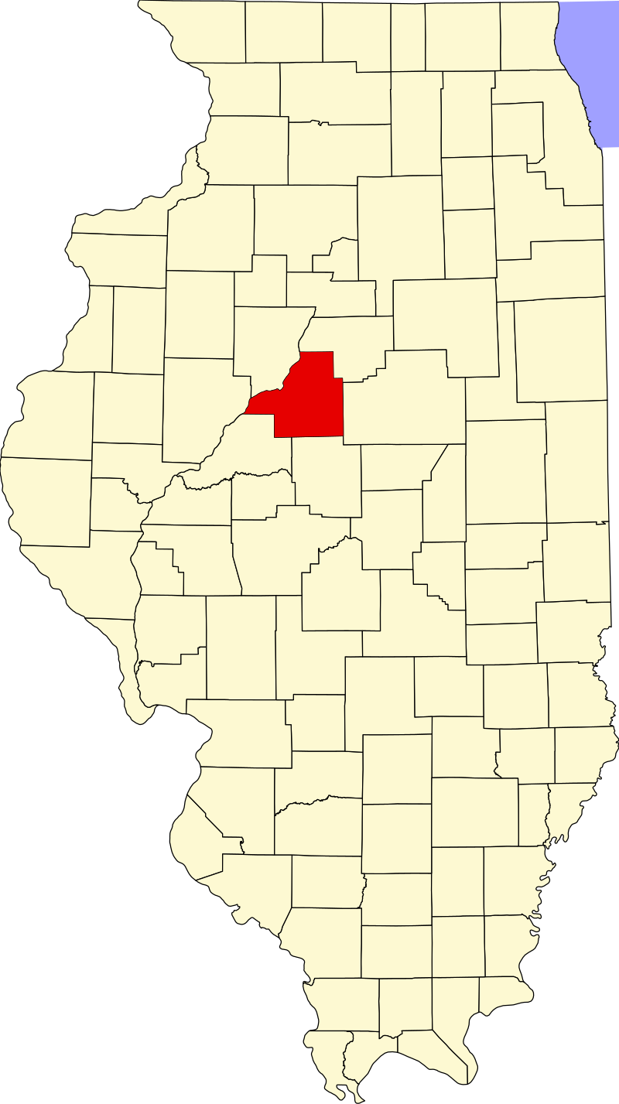
Tazewell County, Illinois
Population: 130,000
15 teenagers died in motor vehicles in 15 months – 2006.
Introduced Operation Teen Safe Driving (OTSD) in 2007.
No teen fatalities until 2011

Slide 7
Making Traffic Safety a “Competition”
The two main visions/goals of Reduce TN Crashes –
Just by doing traffic safety activities, it will help raise the awareness of teens in understanding the risks and the importance of driving safely through high school and the rest of their lives.
Schools and students love competition. There’s banners for every sporting event hanging up in their gyms/auditoriums. Why can’t it be the same for traffic safety?

Slide 8


Slide 9
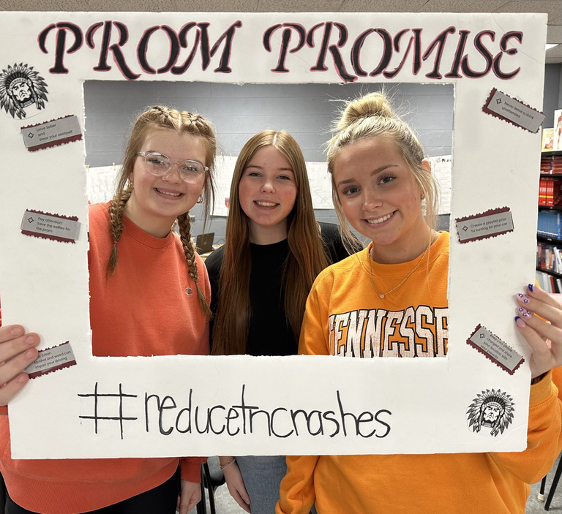
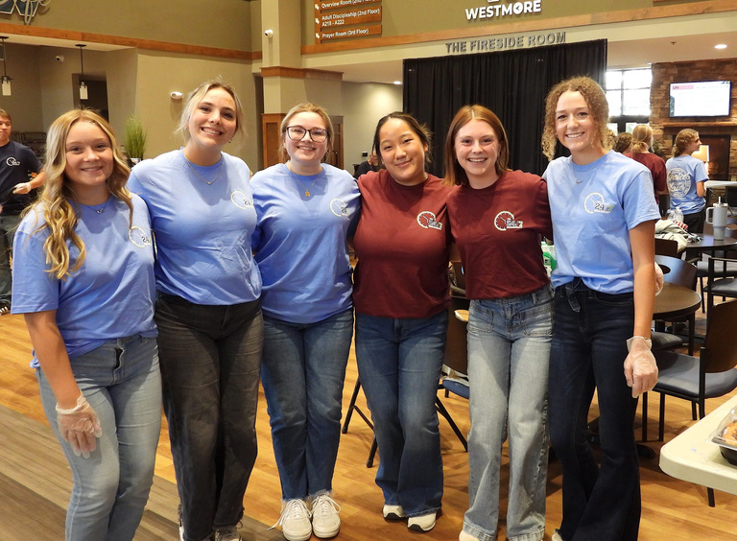
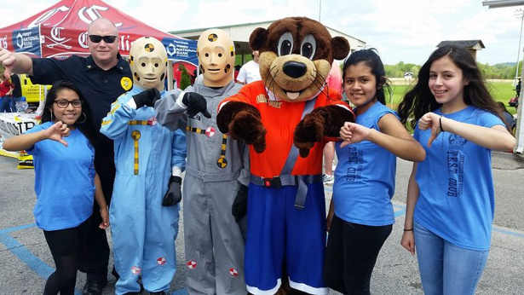
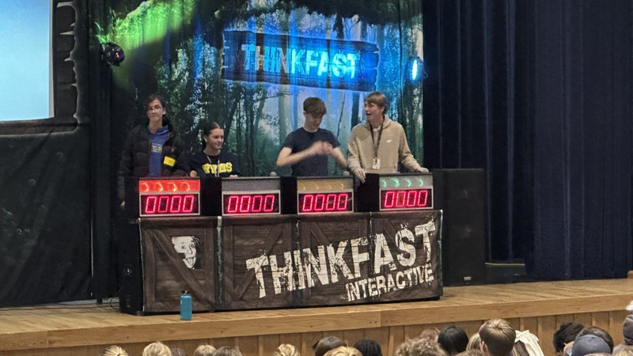
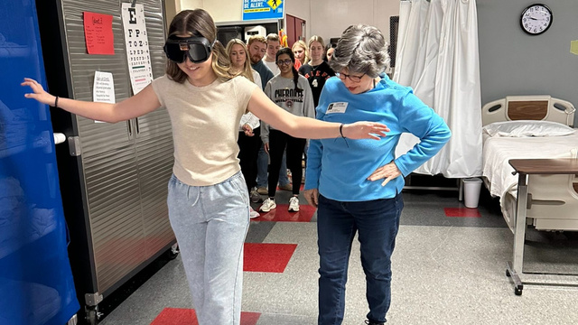
How the Program Works
Activate Your School
Schools submit the activation form at the start of each school year to receive a free kit to jump-start their activities.
2. Complete Activities
Explore the traffic safety activities available on our Activities page and complete an activity that interests your students.
3. Submit Points
Submit photos of the activity being completed and tell us how it went. Work your way to the top of the leaderboard!

Slide 10
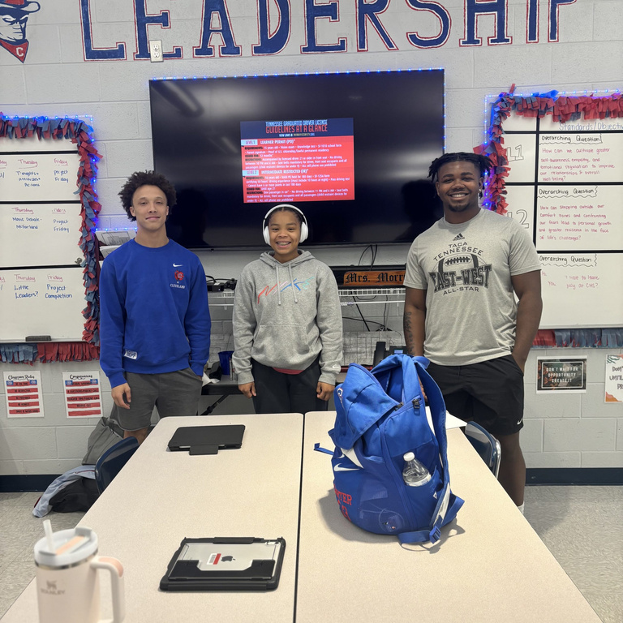
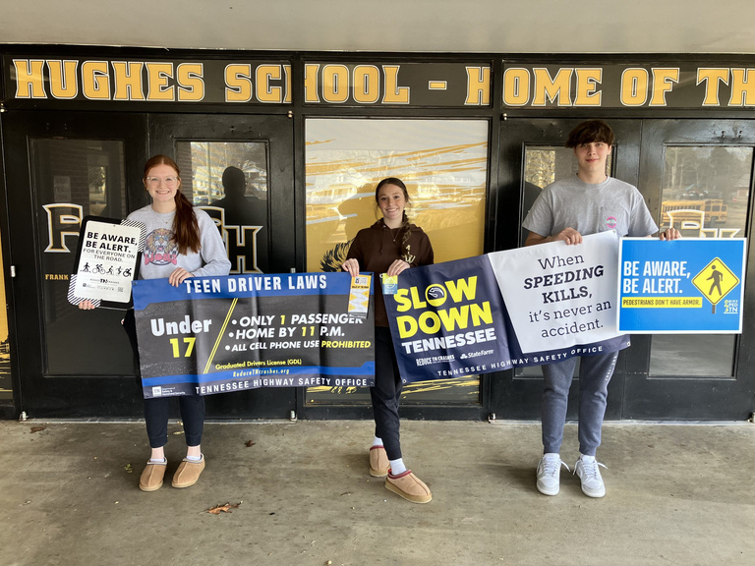
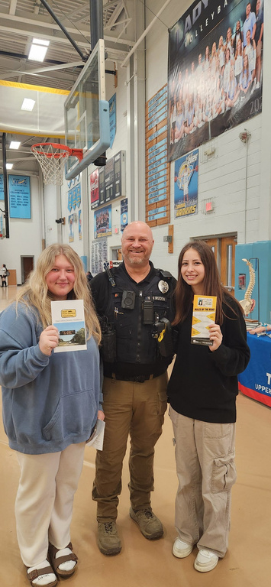

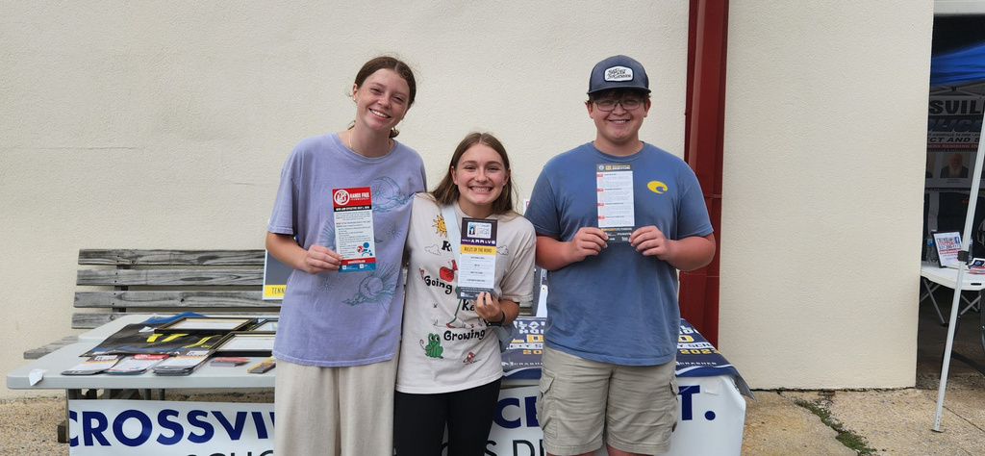
School Kit
Welcome Letter
Reduce TN Year Plan
GDL Wallet Cards and Rack Cards
Slow Down TN Rack Cards
I Don’t Text and Drive Rack Cards
Hands Free TN Rack Cards
Pedestrian Safety Cards
Two Vinyl Traffic Safety Banners
Pedestrian Safety Metal Road Sign
I Care Pledge Poster

Slide 11
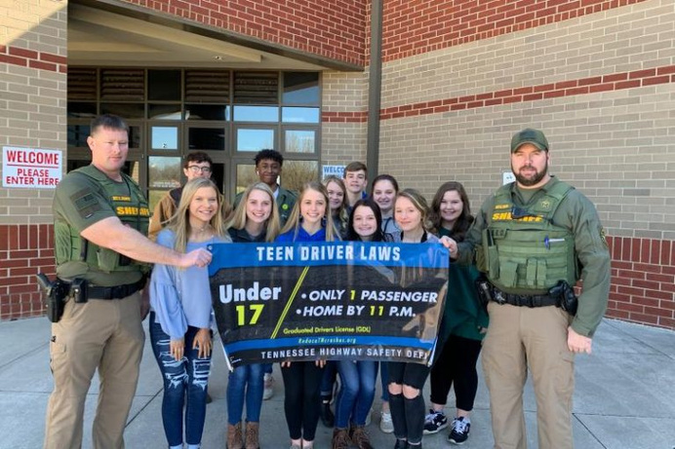
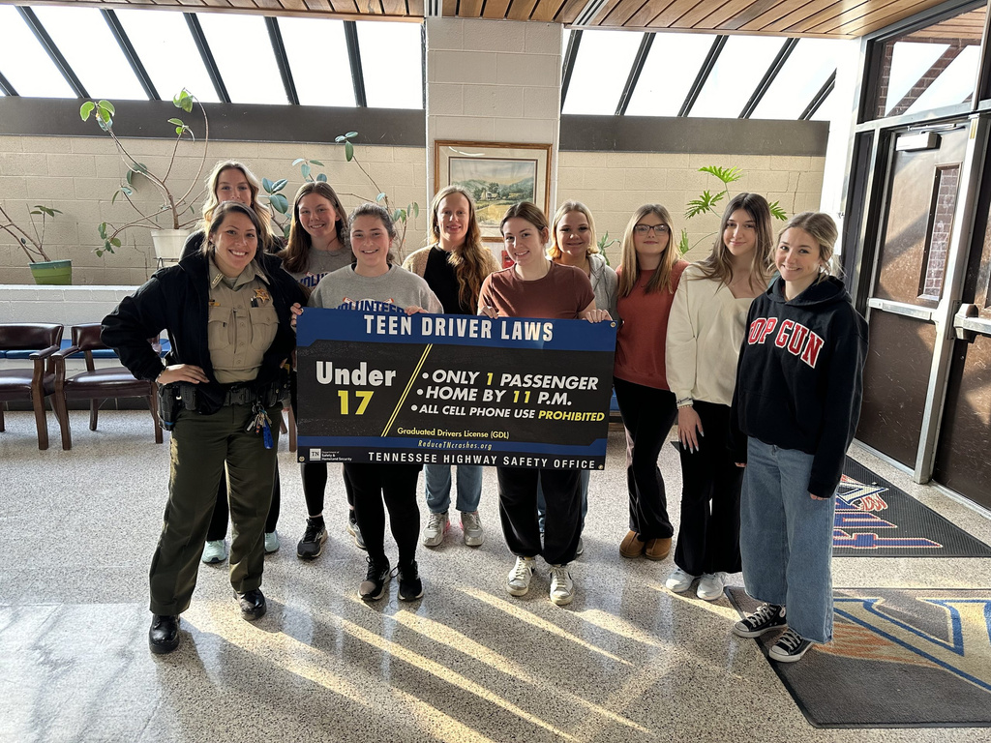
Teen Driver Law Banners
(300 Points)
Schools will activate each year for the program and receive free materials including vinyl banners with traffic safety messaging. Students can then hang the banners up at their school and help educate their peers on the topic.

Slide 12
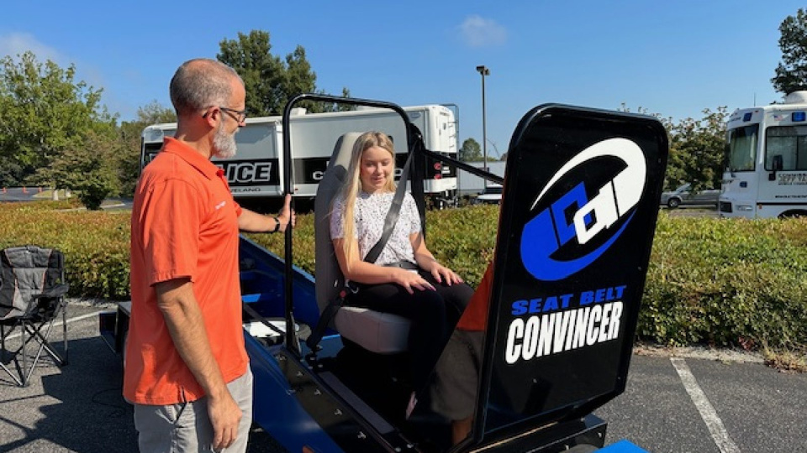
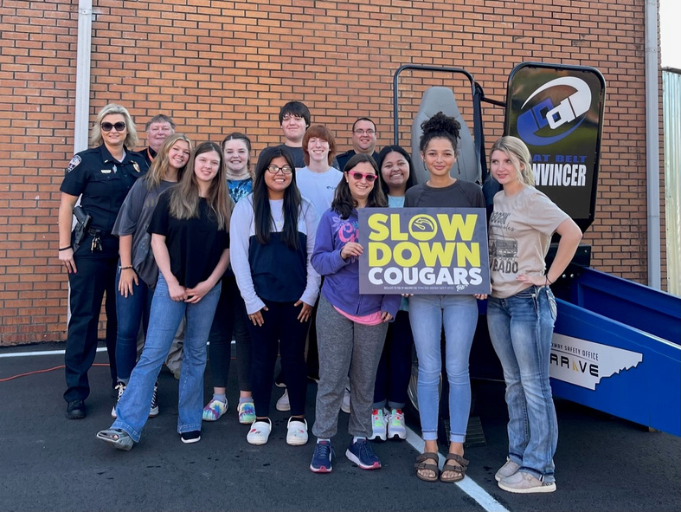
Seat Belt Convincer
(500 Points)
Schools can request to have the Seat Belt Convincer at their school event by contacting the Tennessee Highway Safety Office. The convincer allows a rider to safely experience the force generated during a 5-10 MPH crash. This force shows how effective a seat belt can be in keeping a person in their seat and reducing movement.

Slide 13
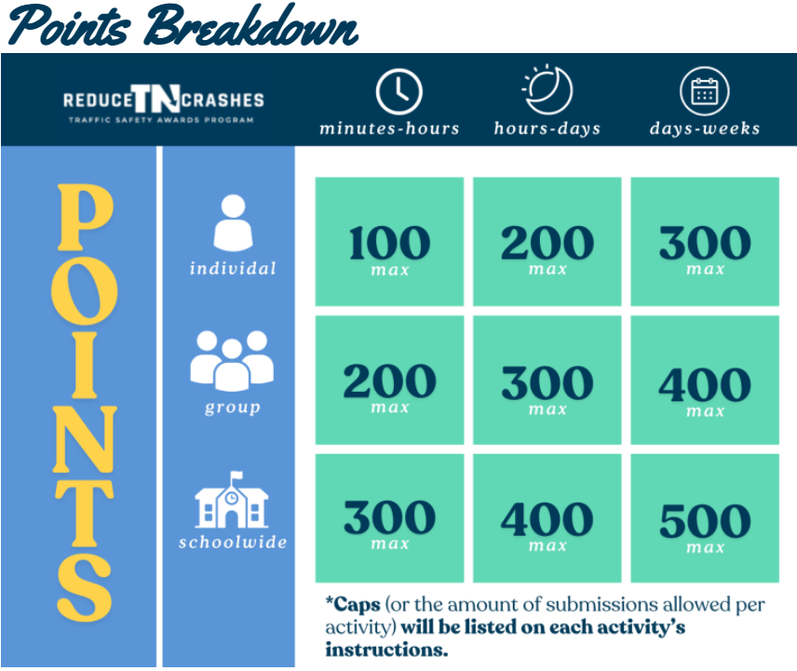

Slide 14

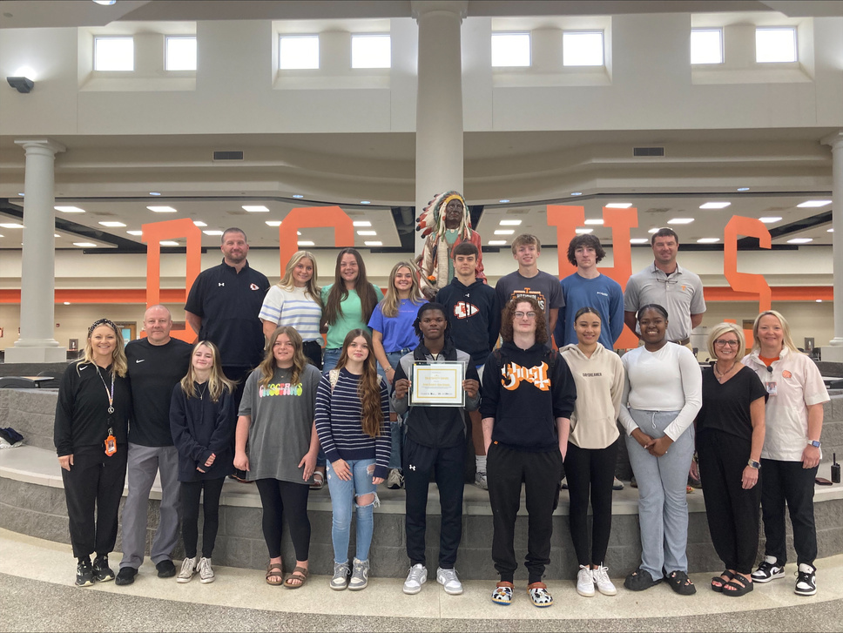
Reduce TN Crashes currently has 66 activities for schools to choose from. We are always looking for more ways to get teens engaged, please reach out if you have an idea for a new activity.
The 2024-2025 school year had 35 schools participate across the state.
16 schools earned Gold Award which means they completed 3,000 points or more in activities.
Schools that earn Gold are eligible for an award from THSO.
Dyer County High School

Slide 15



2024-2025 School Leaderboard
Gold Award
3,000 points or more
Silver Award
1,300-2,900 points
Bronze Award
100-1,200 points
Dyer County High School
Volunteer High School
Walker Valley High School
Science Hill High School
Hampton High School
Wayne County High School
Cleveland High School
Cherokee High School
Bradley Central High School
Stone Memorial High school
Rhea County High School
Cumberland County High School
Sycamore High School
Obion COunty Central High School
Sevier County High School
Van Buren County High School
East Ridge High School
South Fulton High School
Union High School
McMinn County High School
Unaka High School
Copper Basin High School
Hardin County High School
West Greene High School
Monterey High School
Hampshire Unit School
Adamsville High School
Northview Academy
Unicoi County High School
North Greene High School
White House High School
Collinwood High School
South Greene High School
Chuckey Doak High School
Cumberland Gap High School

Slide 16


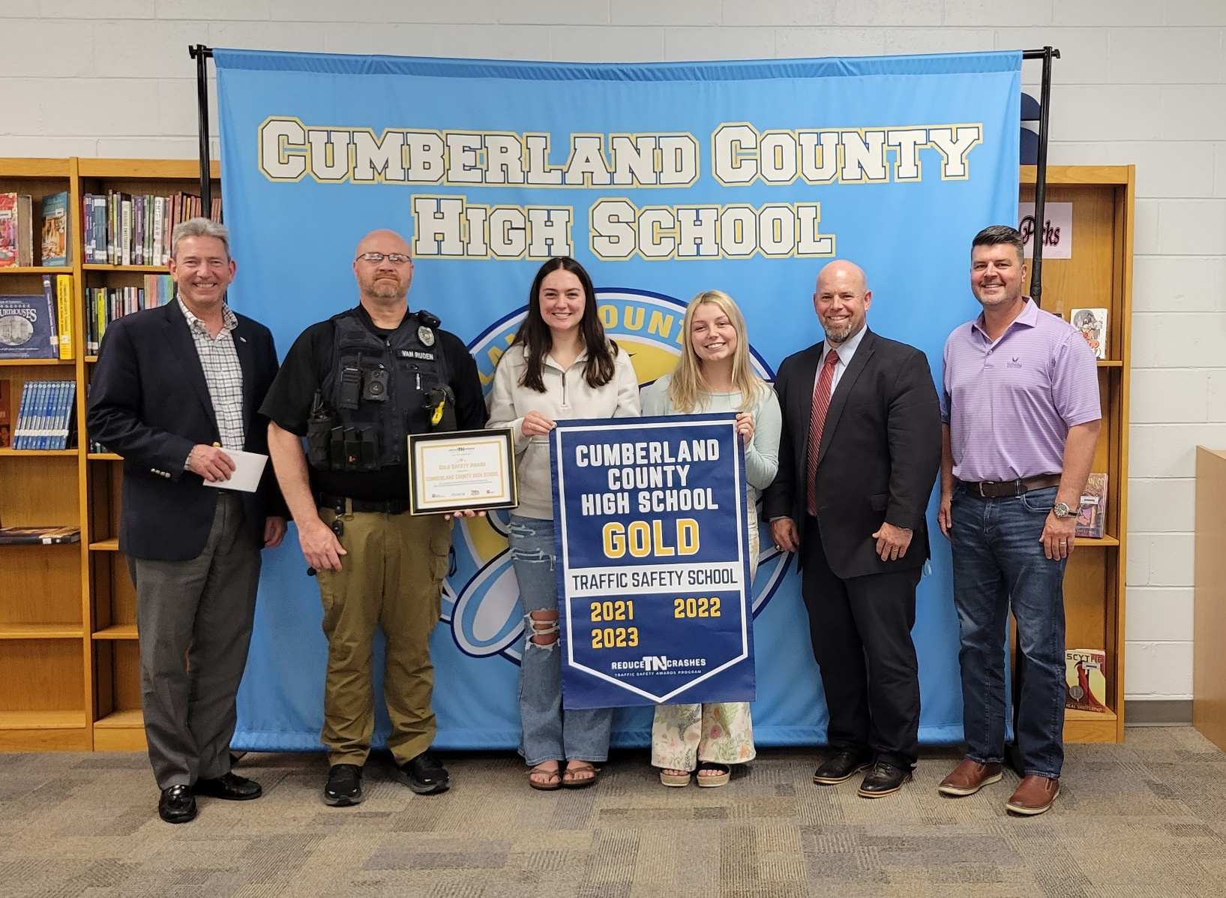

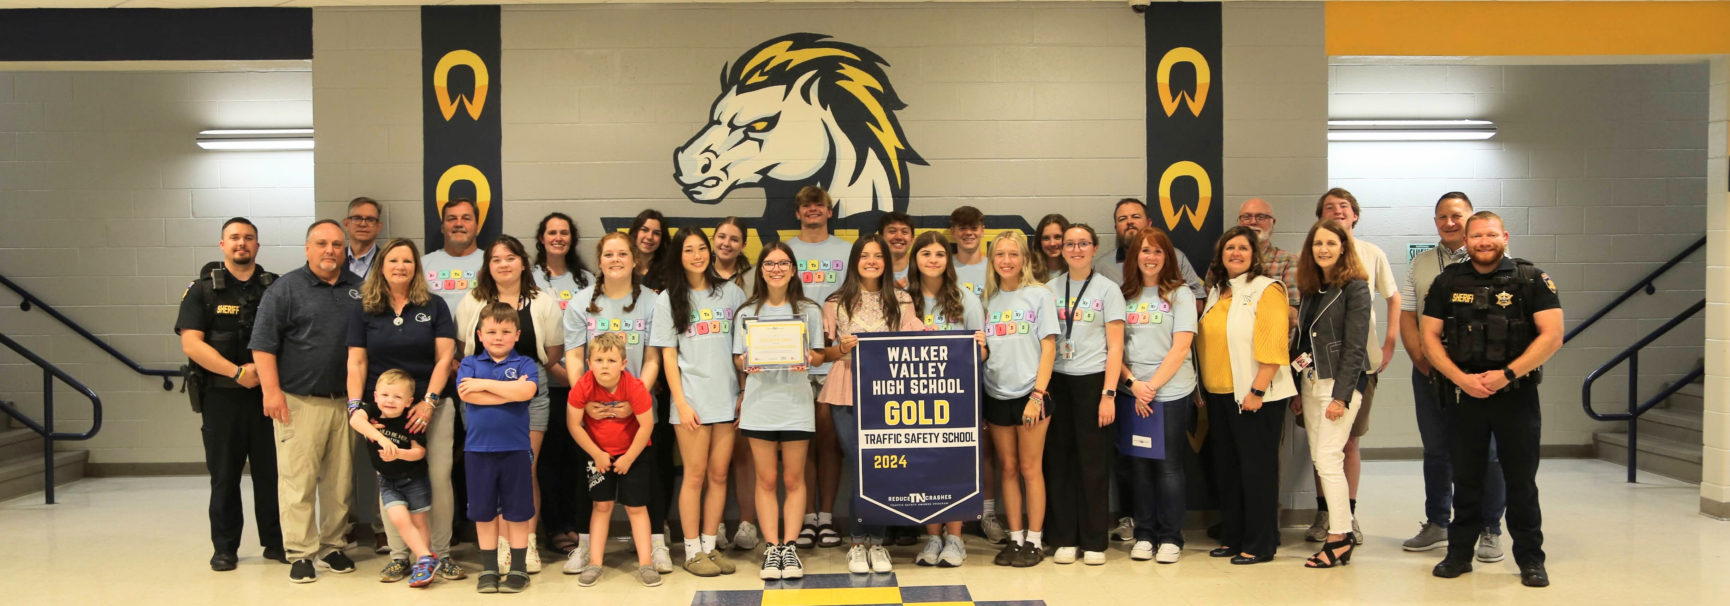

Slide 17



Follow us on Social Media
Reduce TN Crashes
Contact: Ali Knieling
Email: info@reducetncrashes.org
Phone: (931) 372-6383
@reducetncrashes
@ReduceTNCrashes

Slide 18

TN
ROAD
SAFETY
STANDARDS
The TN Road Safety Standards website provides K-12 teachers with custom lesson plans and
state-approved resources aligned with the new occupant protection and road safety standards, making it easier to integrate traffic safety education into the classroom.
TNRoadSafetyStandards.org

Slide 19
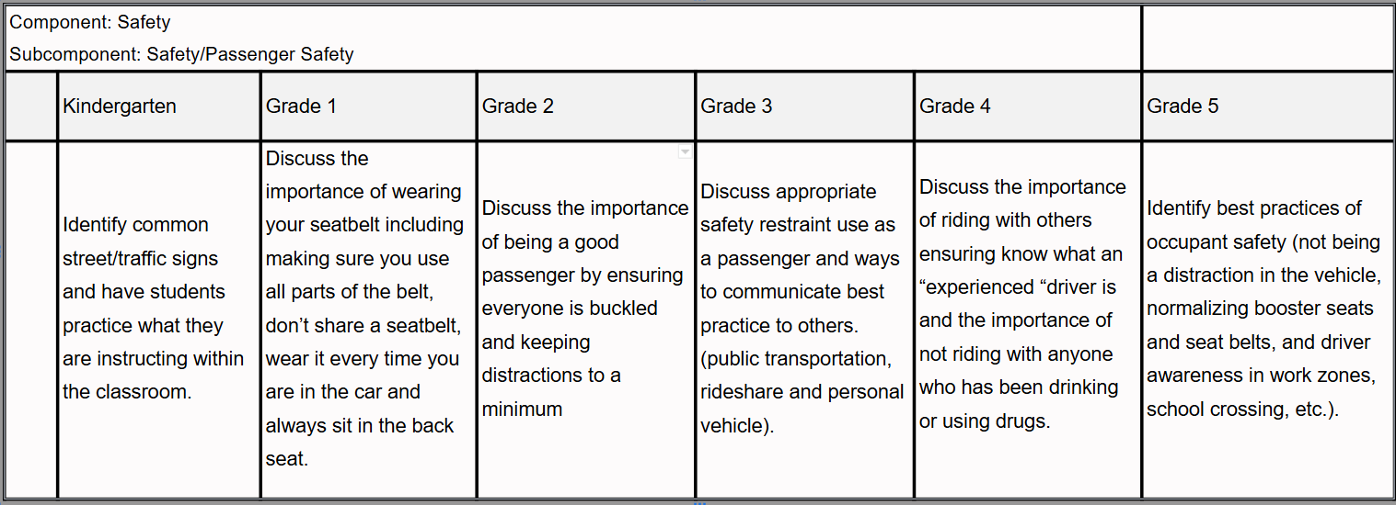
Elementary

Slide 20
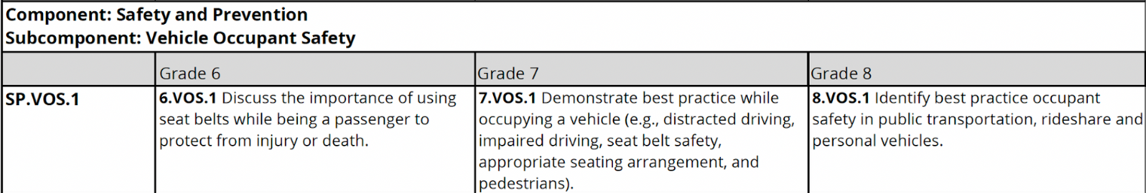
Middle

Slide 21
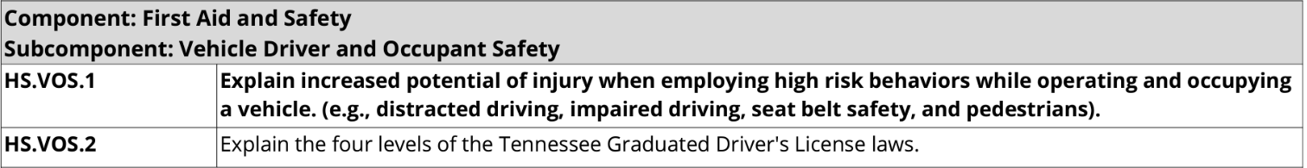
High School

Slide 22
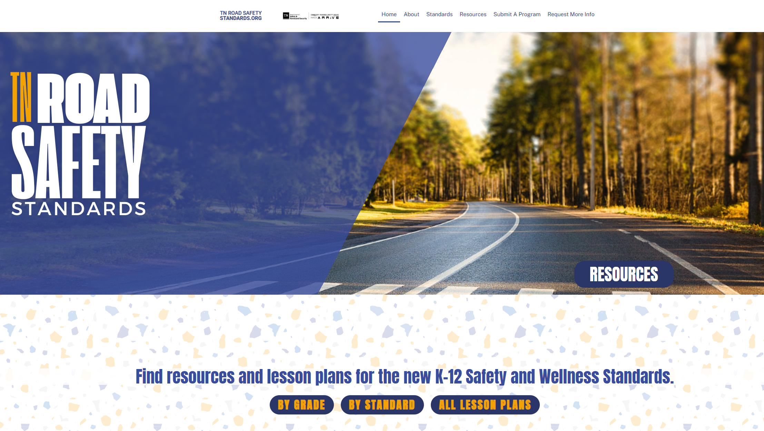

Slide 23
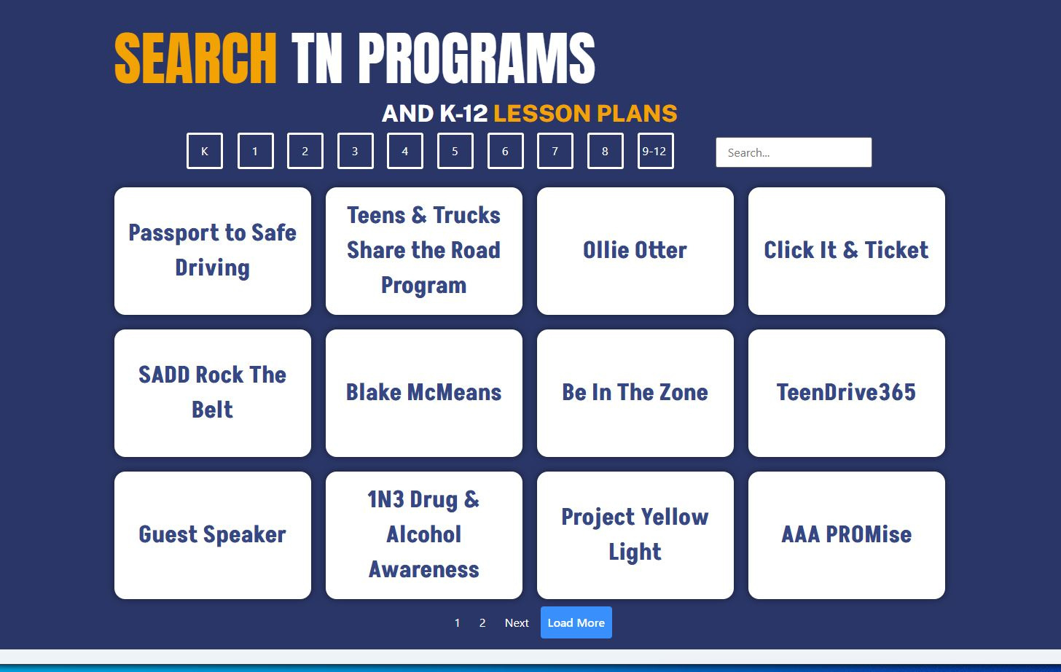
30+ Lesson Plans
on the site!

Slide 24
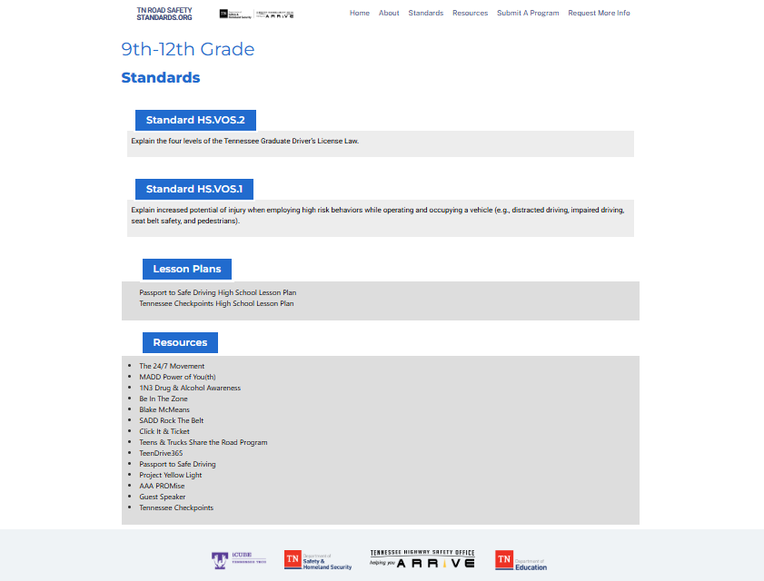

Search by Grade Level and find
the standard, lesson plans, and resources!

Slide 25
Questions?
Joe Powell
jdpowell@tntech.edu
Ali Knieling
aknieling@tntech.edu

