Slide 1

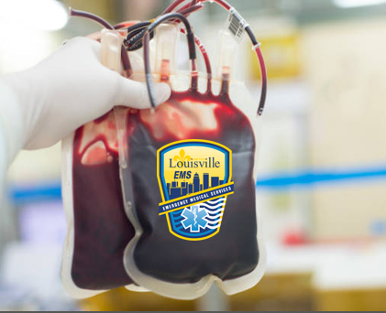



LOUISVILLE METRO EMS
PREHOSPITAL BLOOD PROGRAM
Major Erin Spyrka, BS, MPA, NRP, CP-C
Erin.Spyrka@louisvilleky.gov
502-528-3111

Slide 2
A LITTLE HISTORY……
San Antonio area front runners due to Army Trauma Medical Centers and Army trauma surgeons who had been delivering blood in combat situations in the field since WWII
If it works in the field for the military, why can’t it work in the field for EMS??
First prehospital blood program started in 2018 in South Texas with 18 helicopters and 16 ground ambulances carrying 1 unit each…..
Took the rest of the country a while to catch on….
  Waiting for studies from San Antonio
  Cost prohibitive
  Storage Issues
  Supply

Slide 3
Fast forward a few years….
Formation of the Prehospital Blood Transfusion Coalition
Approximately 250 Ground Ambulance Agencies in the US carrying whole blood and/or blood products
  Still <1% of total agencies
May 2025: Release of 1st Edition of AABB Prehospital Blood Transfusion Standards and Guidelines
Creation of National Whole Blood Academy and National Blood Summit in San Antonio, TX
Many programs throughout the country modeled after the “Big 3”:
  San Antonio FD, DC Fire and EMS, and New Orleans EMS

Slide 4

IF THEY CAN DO IT, WHY CAN’T WE??

Slide 5
DETERMINING THE NEED…
2023
2024
4215 TRAUMA CASES ADMITTED TO UNIVERSITY HOSPITAL
APPROX. 1750 OF THOSE WERE TRANSPORTED BY LMEMS
129 MTP Activations, 583 Level 1 Traumas.
349/1750 RECEIVED BLOOD WITHIN 4 HOURS OF ARRIVAL
1129 LEVEL 1 OR LEVEL 2 TRAUMAS TRANSPORTED TO UL BY LMEMS
304 LEVEL 1 TRAUMAS
OF THE 1129, 206 PATIENTS RECEIVED BLOOD WITHIN 4 HOURS OF ARRIVAL AT UL
18% OF ALL OUR TRAUMA PATIENTS COULD BE CANDIDATES

Slide 6
TRAUMA IN METRO LOUISVILLE
JANUARY 2025
  22 UNITS OF WHOLE BLOOD ADMINISTERED IN ROOM 9 TO PATIENTS THAT ARRIVED VIA LMEMS
  7 TOTAL PATIENTS RECEIVED 22 UNITS
  3 PATIENTS MET INCLUSION CRITERIA FOR FIELD TRANSFUSION, 1 OR 2 ADDITONAL QUESTIONABLE???
  5 GSW, 2 MVC
  4/7, OR 57% OF THE PATIENTS WERE DISCHARGED HOME OR TO REHAB FACILITY

Slide 7

PROJECTED LTOWB USE:
GREATER THAN 200 TIMES PER YEAR!!!
  AND THAT DOESN’T COUNT KIDS!!

Slide 8
COMMUNITY IMPACT
FOR EVERY MINUTE FASTER A BLEEDING PATIENT RECEIVES BLOOD, MORTALITY IS DECREASED BY 2%!!!

Slide 9

LOGISTICS
WHERE WILL WE GET IT?
  PARTNERED WITH AMERICAN RED CROSS TO SUPPLY LOW TITER O WHOLE BLOOD
  NO STOCK KEPT IN LOUISVILLE, COMES FROM MARYLAND HEIGHTS, MO
HOW WILL WE PAY FOR IT?
  CMS REGULATIONS CHANGED JANUARY 1, 2025 TO ALLOW FOR ALS2 CHARGE FOR BLOOD/BLOOD PRODUCT ADMINISTRATION
HOW WILL WE STORE/ADMINISTER IT?
HOW WILL WE DEPLOY IT TO DO THE MOST GOOD FOR THE MOST CITIZENS?
ROTATION OF SHORT DATE BLOOD?
  Agreement with UL Health for rotation of short date blood

Slide 10
LOW TITER O+ WHOLE BLOOD
LOW TITER:
  Screened to ensure low levels of antibodies
  Low levels of antibodies means low levels of past exposures to antigens
LEUKOREDUCED:
  Removal of leukocytes reduces the risk of adverse reactions
  Removal of 99% of white blood cells in the blood
O+
  Can also use O-, but O+ is preferred prehospital due to larger surplus
Whole Blood
  “They’re losing it all, put it all back in”

Slide 11
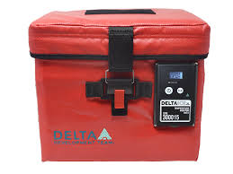
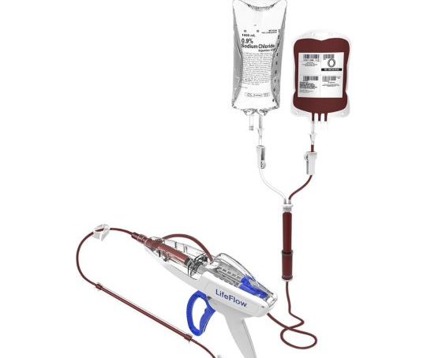
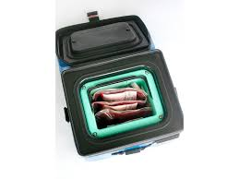
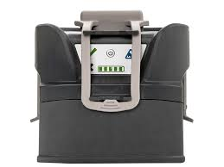
EQUIPMENT
Delta Ice 2L Cooler
LifeFlow Infuser
QinFlow Warrior Lite Warmer

Slide 12
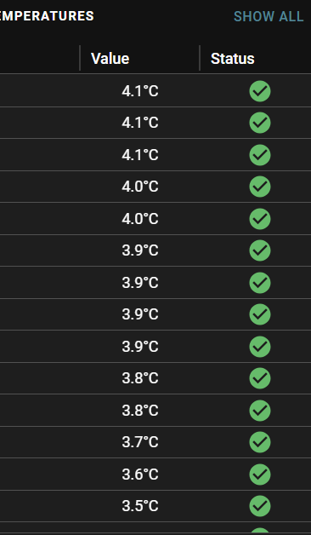
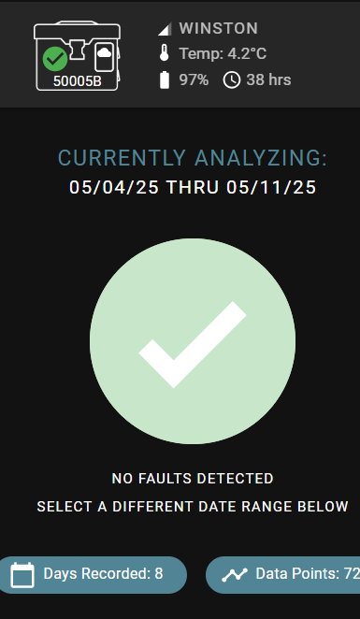
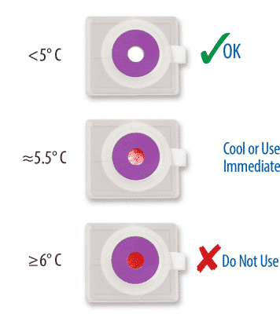
EQUIPMENT: BloodComm & Safe-T-Vu

Slide 13
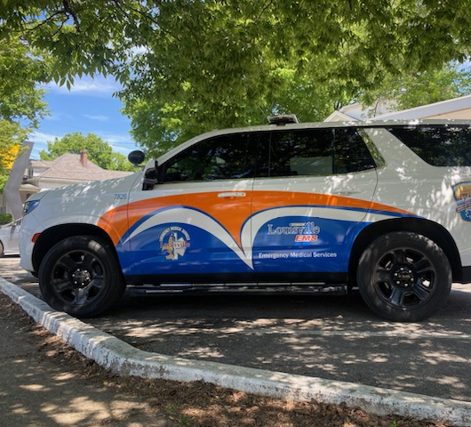
DEPLOYMENT:
SPECIALTY CREDENTIALED PARAMEDICS
2 “FLY CARS”, 24/7
NO PERMANENTLY ASSIGNED STATION
1-2 UNITS OF BLOOD PER CAR

Slide 14
RESPONSE TIMES
Notes:
En Route to On Scene 0:09:33 0:09:35 0:06:42
On Scene to Depart Scene 0:18:50 0:18:36 0:10:39
Depart Scene to At Destination 0:14:27 0:14:16 0:14:12
BLOOD ON SCENE ON AVERAGE OF 6 ½ MINUTES!!!!!!

Slide 15
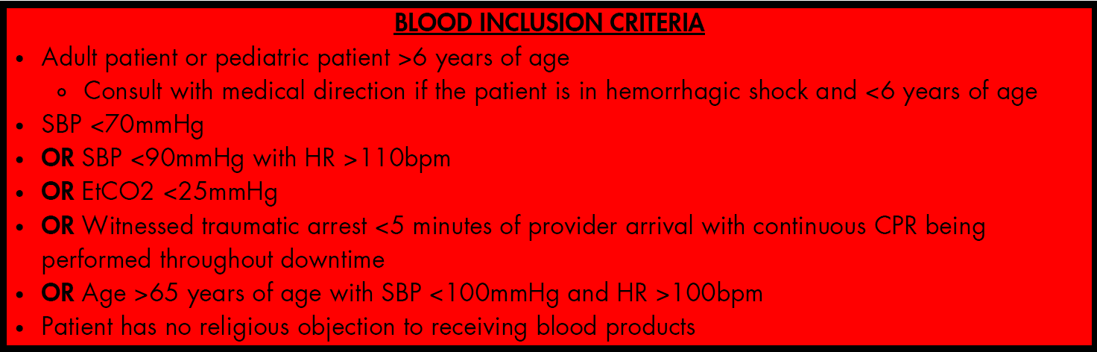
INCLUSION CRITERIA
HEMORRHAGIC STROKE
TRAUMA OR MEDICAL
GREATER THAN 6 YEARS OF AGE (UNDER 6 WITH MEDICAL DIRECTION)

Slide 16
APRIL 11, 2025: THE BIG DAY!!!
FIRST UNIT ADMINISTERED WITHIN 48 HOURS OF DEPLOYMENT
FIRST MONTH: 12 UNITS OF BLOOD INFUSED TO 11 PATIENTS
  ALL TRAUMA, ALL TRANSPORTED TO UNIVERSITY OF LOUISVILLE
  18% BLUNT TRAUMA, 82% PENETRATING
18% FEMALE, 82% MALE PATIENTS
AVERAGE AGE: 42 YEARS

Slide 17


Today…..
41 units of blood administered to 37 patients
94% 24 HOUR SURVIVAL
91% OVERALL SURVIVAL
5 OF 8 PATIENTS FOUND IN TRAUMATIC ARREST RESUSCITATED EN ROUTE TO HOSPITAL
  NO CHANCE OF SURVIVAL PREVIOUSLY

Slide 18
NEW ALTERNATIVES COMING
BLOOD PRODUCTS NEEDED IN RURAL AREAS
  COST AND USE BARRIERS FOR WHOLE BLOOD
COLD STORED LIQUID PLASMA
  SAME STORAGE REQUIREMENTS AS WHOLE BLOOD, MUCH LESS EXPENSIVE
FREEZE DRIED PLASMA
  NEWEST TECHNOLOGY, NOT WIDELY AVAILABLE YET
    LONG SHELF LIFE, COST UNKNOWN

Slide 19
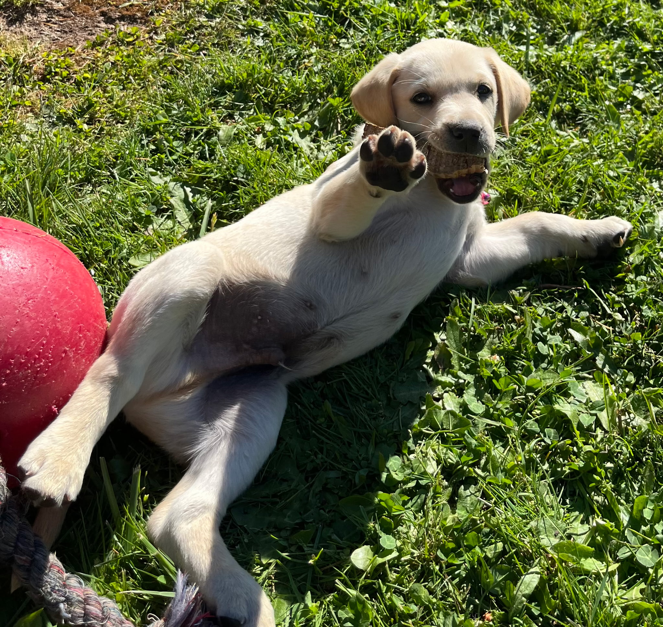
QUESTIONS?

