Slide 1
KTC Seatbelt Study: 2022 Results and 2023 Planning
Erin Lammers-Staats

Slide 2
Description of Study
Purpose: to establish a statewide safety belt usage rate for Kentucky
All states are required to survey annually
Good metric to evaluate driver behavior and safety attitudes
The study covers 150 sites throughout 15 counties
Current sites have been used since 2018
Evaluate data based on driver/passenger, vehicle type, road class, and county

Slide 3
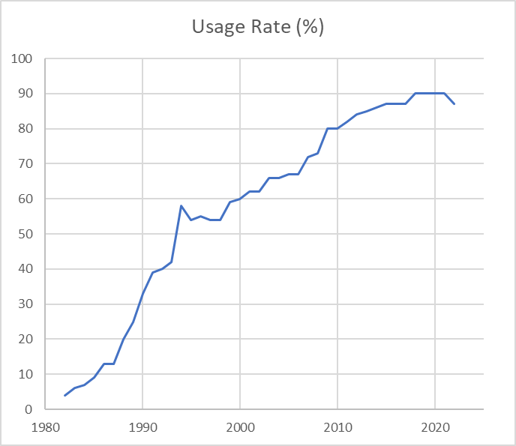
Historical Trends
Survey has been performed since 1982
1994: Secondary enforcement law
2006: Primary enforcement law
Very steady since 2018 but dropped this year

Slide 4
2022 Results
Overall usage rate: 86.72%
3.06% decrease from last year’s 89.78%
Sample size: 66,023– a third lower than pre-pandemic sample sizes

Slide 5
Usage by Road Type & Vehicle Type
Limited access (interstates and freeways) always have highest usage rate
SUVs usually have highest usage rate, while pick-ups always have lowest usage rate

Slide 6
Usage by County
Urban counties have highest usage rates (Kenton, Fayette, Jefferson)
Boyle, Bath, and Floyd had lowest usage rates
14 of 15 counties had lower rate in 2022 than 2021

Slide 7
Conclusions & Recommendations
Usage rate is declining
Likely another example of pandemic-related behavior shifts
Targeted educational campaigns may be helpful

Slide 8
2023 Redesign
Choose new counties
One in each highway district + urban centers
Select specific roads within each county
Weighted based on traffic volumes and road class
Identify safe observation points
Alert local enforcement

Slide 9
2023 Selected Counties
High Five county
Graves
Hopkins
Allen
Larue
Jefferson
Oldham
Campbell
Kenton
Bourbon
Fayette
McCreary
Mason
Breathitt
Jackson
Letcher
Affected by flooding
Affected by flooding

Slide 10
Download 2022 survey results from UKnowledge: https://uknowledge.uky.edu/ktc_researchreports/1757/
Contact: Erin Lammers-Staats erin.lammers@uky.edu (859)218-0379

