Slide 1
SoToxa ORIENTATION, Training, SETUP

Slide 2
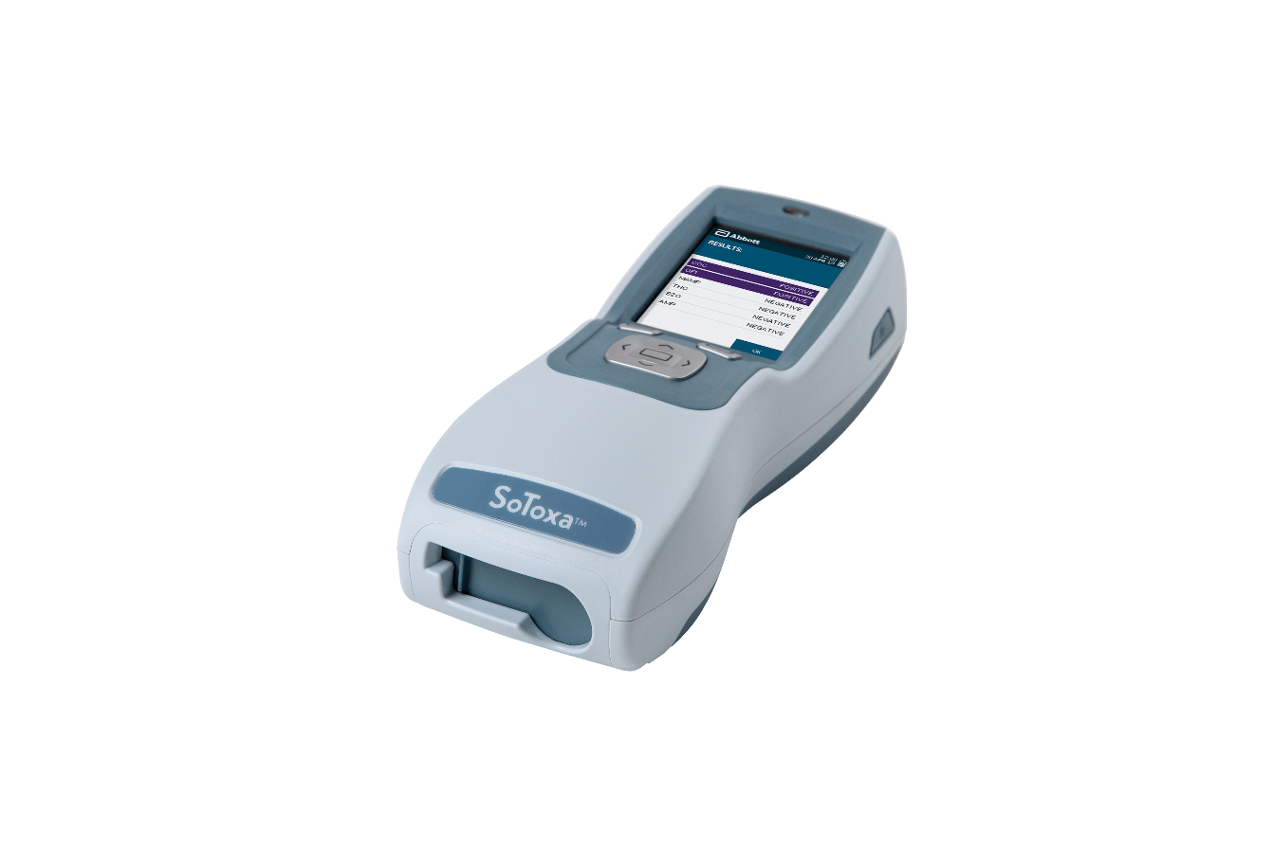
SoToxa™ Mobile Test System
INITIAL SETUP
Notes:
Mark…. Does this after group does their on-hands test from beginning to end.

Slide 3
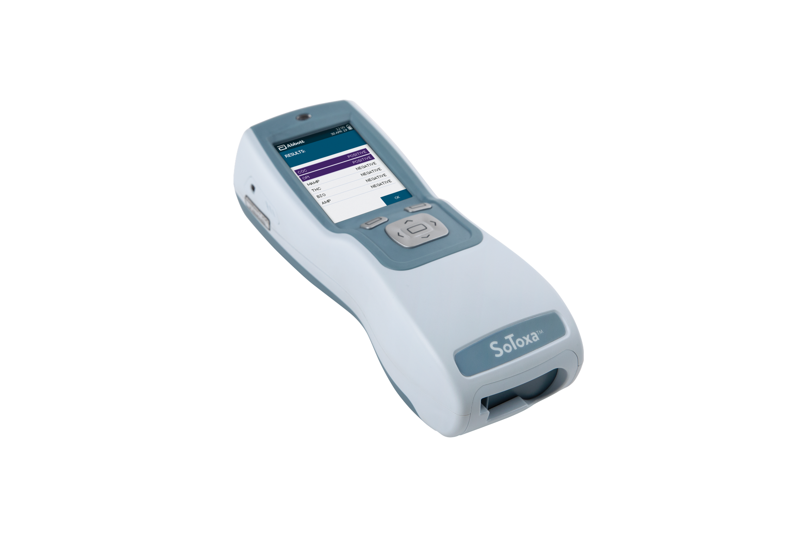
SOTOXA™ MOBILE TEST SYSTEM OVERVIEW
USB CONNECTOR
POWER SUPPLY CONNECTOR
RESET BUTTON
RJ12 PRINTER CONNECTOR
RUBBER FLAP
RIGHT SELECTION KEY
5-WAY NAVIGATION KEY
SD CARD COVER PANEL
SPEAKER
LEFT SELECTION KEY

Slide 4
Quality Control or QC TESTING
QC cartridges act as a tool to confirm:
Camera in the analyzer is aligned.
Internal lighting is correct.
Analyzer is able to correctly interpret the test results.
It is recommended that QC testing is conducted at least once on each day of testing using the NQC and PQC cartridges.

Slide 5
ONLINE USER TRAINING
Online User Training is available from Abbott
REGISTRATION LINK: Use the link below to create a new login.
The password is welcome
http://learningxchange.aleretoxicology.com/group/login/roadside
You may utilize this link after registering with your username and password.
SoToxa™ Mobile Test System

Slide 6
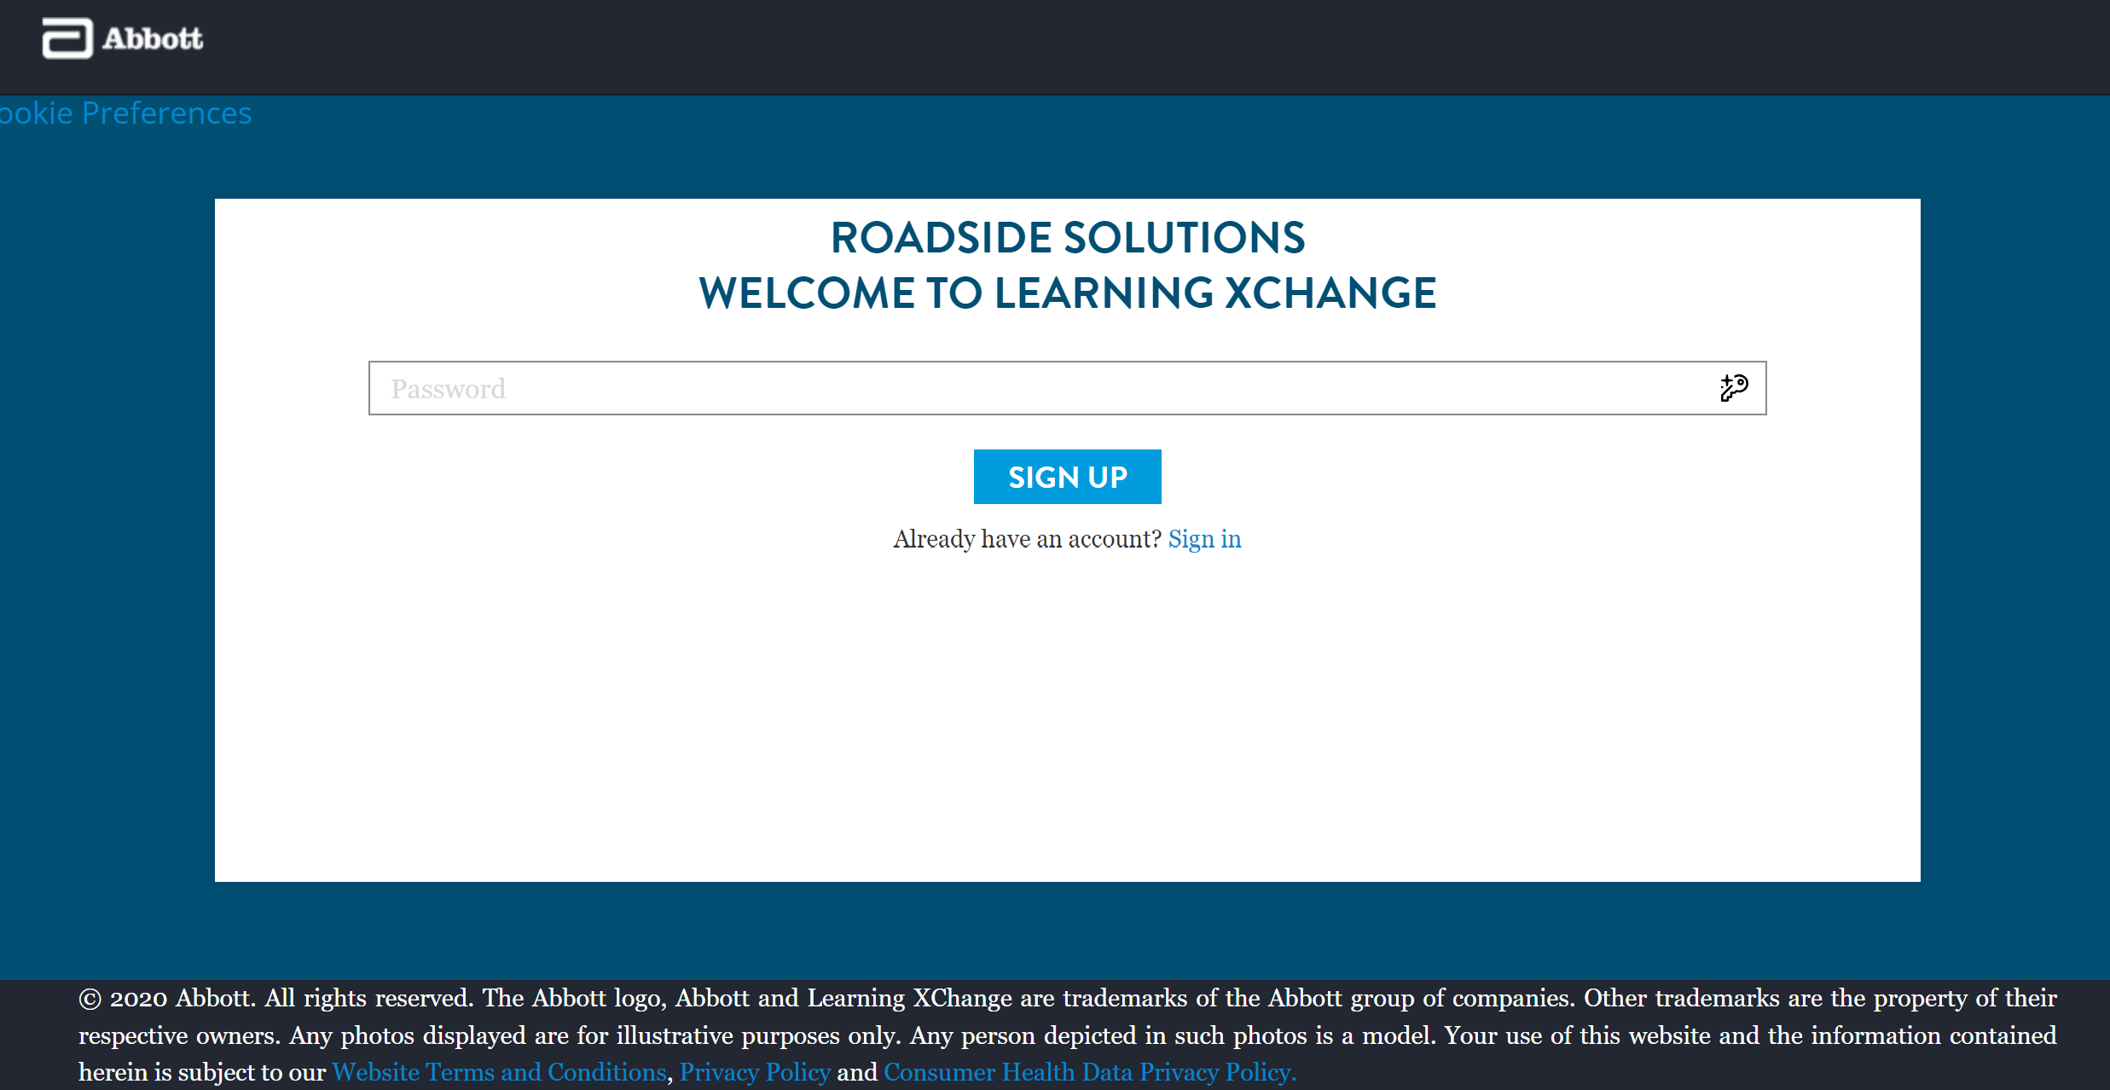
welcome
1st Time Login
Click Sign in after first login and account creation

Slide 7
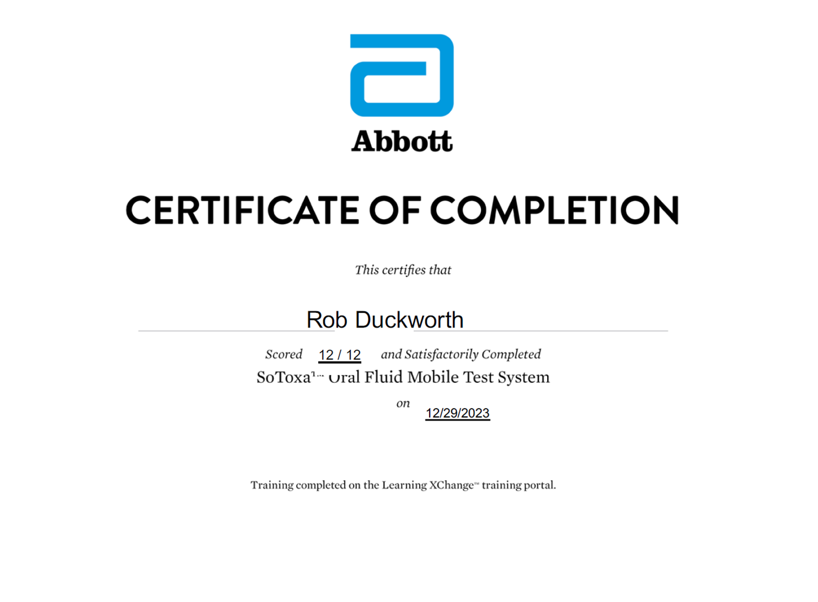
ONLINE USER TRAINING
Upon completion of training, a certificate will be generated and sent to your registered e-mail address as a PDF.
SoToxa™ Mobile Test System

Slide 8
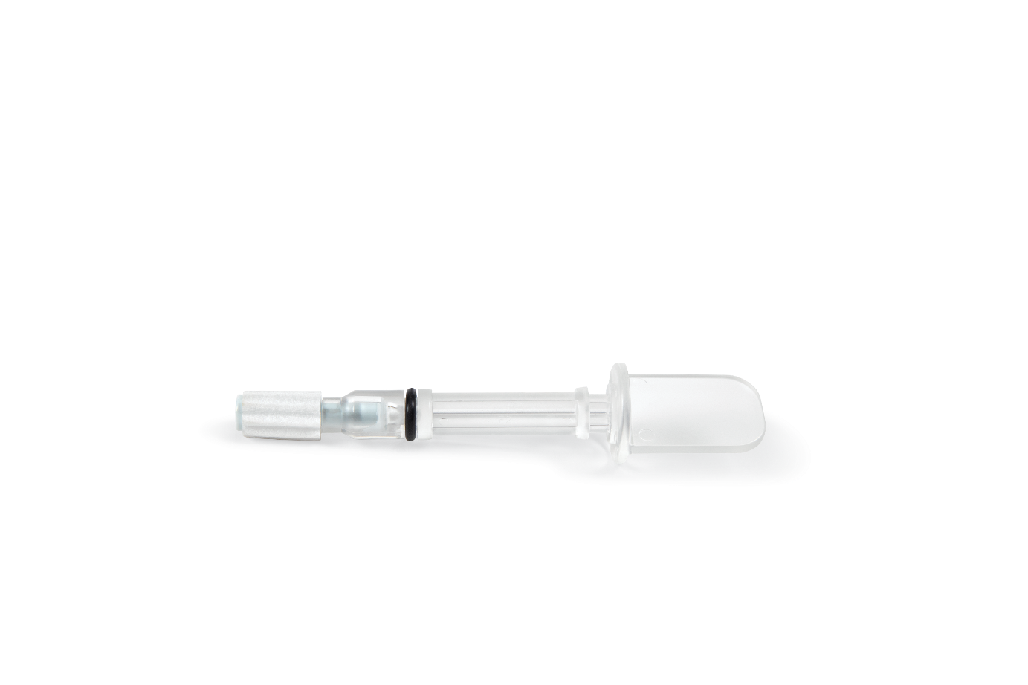
Most Important for Your Success with SoToxa: Visibility of blue on the collector must be present for a successful test. *At a minimum, a portion of the collector must be visibly blue.
If you do not see BLUE, it will not DO!

Slide 9
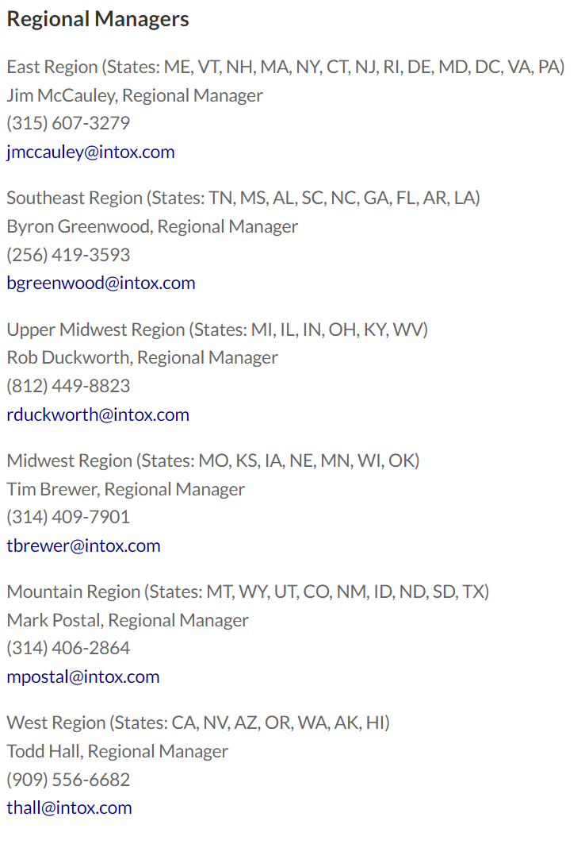
Need assistance or have questions? Contact our team
https://www.intox.com/product/sotoxa-mobile-test-system/

