Slide 1

Rural High Five Seat Belt Program
Lifesavers Conference on Roadway Safety
Long Beach, CA| March 9, 2025

Slide 2
From Iowa to Kentucky!
Iowa in 2014
5 rural counties
3 Es
  Education
  Enforcement
  Engineering
Make funds available for a yearlong implementation.
County Sheriffs work together with State Police
Positive feedback in Iowa
Small decrease in overall crashes
Slight percentage point decrease in unrestrained fatalities

Slide 3

Rural High 5
Multi-disciplinary
Enforcement
Systemic and Behavioral approach
Funding available
Media Events/High School Contacts
Road Safety Assessments
$10k for Sheriff
Networking
Rural Traffic Safety Advisory Board
Seat Belt Enforcement
Education
Engineering
$50k for State
12-month

Slide 4
Rural Traffic Safety Advisory Board
Lifeblood of the program
  State level
  Use available data and influence to recruit counties to participate
  Help organize safety assessments
  Develop program materials
  Available to assist in acquiring support of other traffic safety partners
The RTSAB represented the following agencies/entities:
  Law Enforcement (State Patrol, Law Enforcement Liaisons)
  Kentucky Transportation Cabinet and Office of Highway Safety
  Federal Highway Administration
  University of Kentucky

Slide 5
Program at a Glance
STEP 1: Establish RTSAB
  Select counties for participation
  Determine local stakeholders
  Query data to present locally
  Establish program expectations
  Develop program materials
STEP 2: RTSAB meets with “High 5” Counties
  Set program expectations
  Plan for Roadway Assessment
  County-level and multi-disciplinary planning
  Any training necessary for observations
STEP 3: Program Implementation
  12-month program period
  Meet monthly expectations
  Enforcement
  Education and outreach
  Roadway Assessments
  Seat Belt Observations

Slide 6
Kentucky High Five Timeline

Slide 7
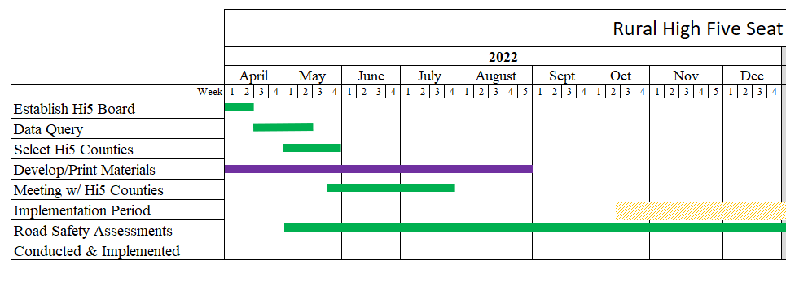
Timeline – First Half

Slide 8
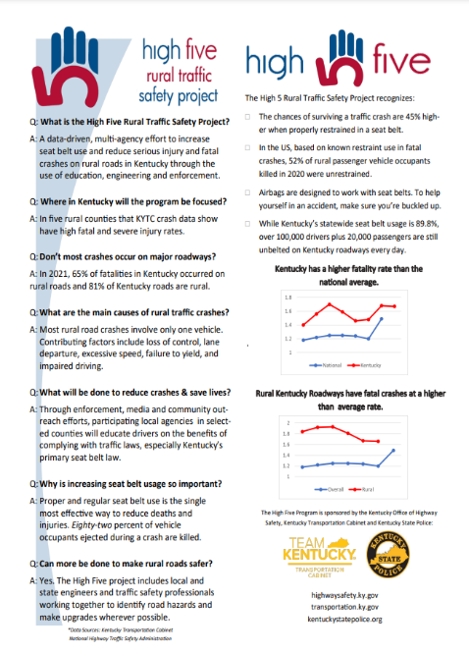
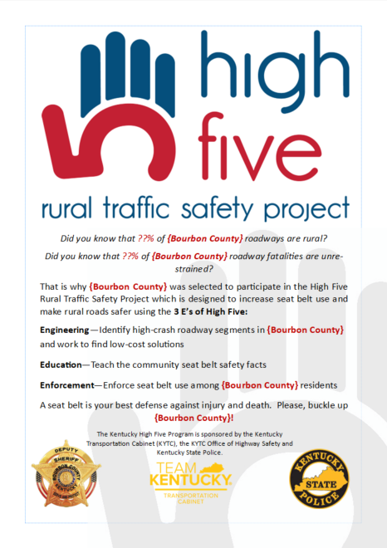
High Five: Education
CSOs and KSP were encouraged to collaborate to plan Hi5 publicity & outreach events/activities.
Program requirements:
Participate in Kickoff Event
Two social media posts per month
Present Hi5 at each High School in the county
Distribute Hi5 info cards at roadside stops
Hang Hi5 posters in public spaces
Conduct four (4) other outreach events

Slide 9
High Five: Enforcement
Each High Five CSO could determine the tactical approach to conduct enforcement and special projects and were asked to collaborate with KSP to coordinate efforts.
Program requirements:
Conduct at least two (2) multi-jurisdictional enforcement projects per month
Issue seat belt citations and/or warnings to violators depending on local policy and officer discretion
Participating law enforcement should hand out informational cards during traffic stops and at any other appropriate times while discussing the disproportionate number of unbelted fatalities on rural roads.

Slide 10
High Five: Engineering
Conduct a Road Safety Assessment
Identify low-cost and no-cost engineering solutions for problem road segments in each High Five county.
  Common examples include upgraded signage, chevrons, rumble strips, brush removal, and drainage culverts.
RTSAB to identify possible funding sources to implement the solutions and provide that information to High Five Counties.
Funds from this project could not be used to complete improvements identified in the audits.
Work together to build bridges

Slide 11
Grant Funding
$100, 000
$50,000 to State Patrol
$10,000 to each of the five counties
Grant funds can be used for:
OT Enforcement
OT Education and Outreach
Observational Seat Belt Surveys
Development and production of materials
NOT paid media

Slide 12


Kentucky’s Rural
“High Five”
Seat Belt Program
Law Enforcements Role

Slide 13
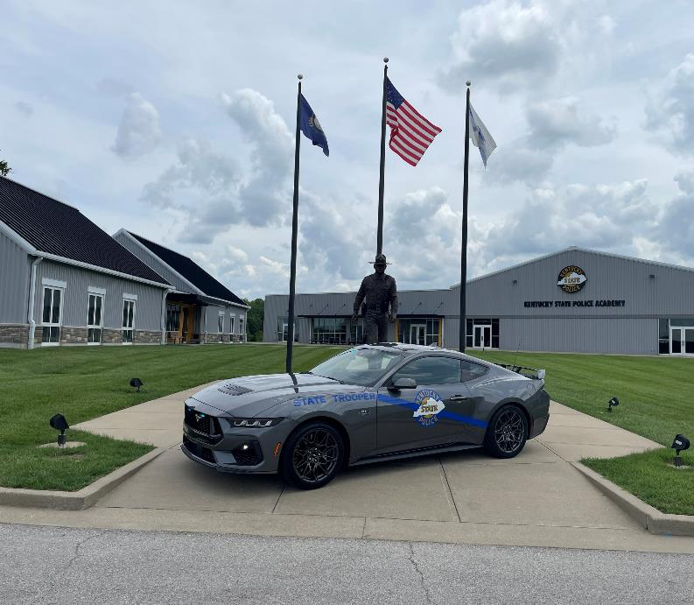
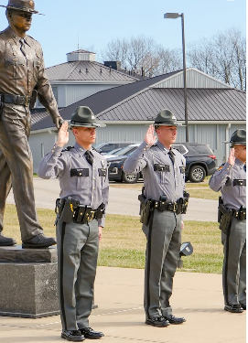
Critical element of Kentucky State Police Training from day one
Mission Driven
Highway Safety:
Commitment to the public we serve

Slide 14
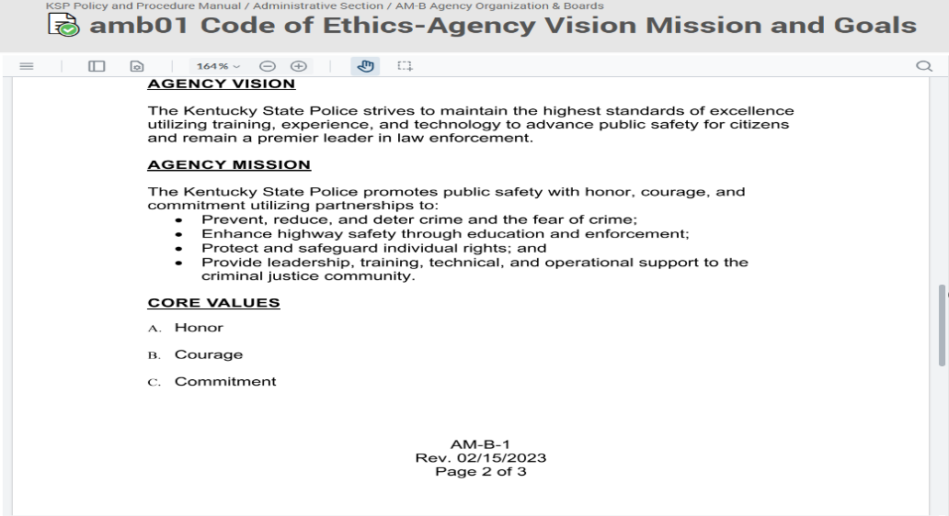
Mission Driven Success:

Slide 15
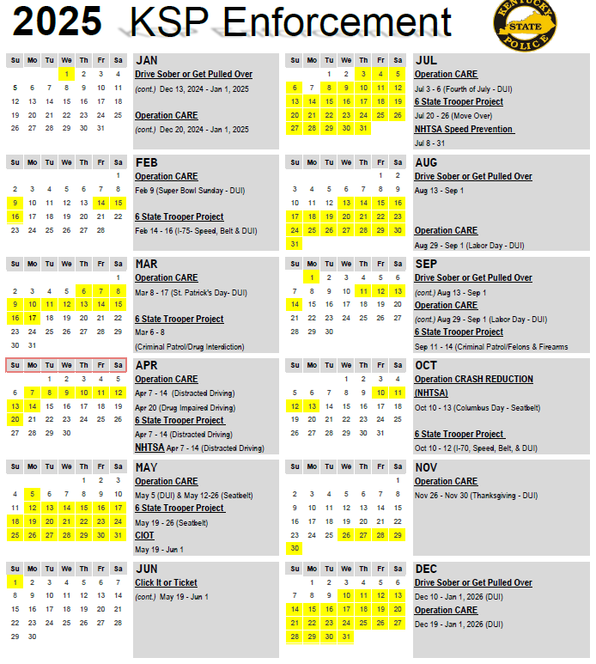
Enforcement Calendar
Pre-Planned Statewide Enforcement (with education)
“High Five”
Targeted Education
(with enforcement)

Slide 16
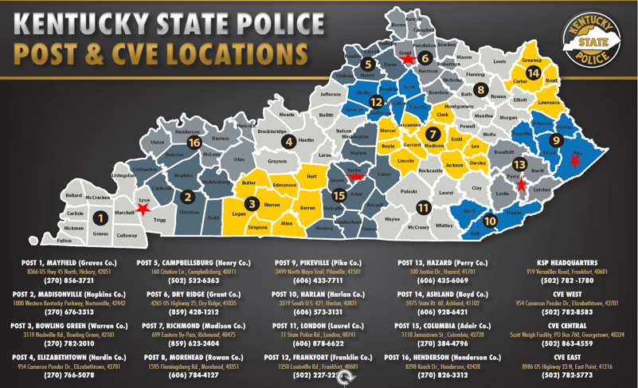
“High Five” KSP Posts:
Post 1 - Lyon Co.
Post 6 - Grant Co.
Post 9 - Pike Co.
Post 13 - Perry Co.
Post 15 – Taylor Co.

Slide 17
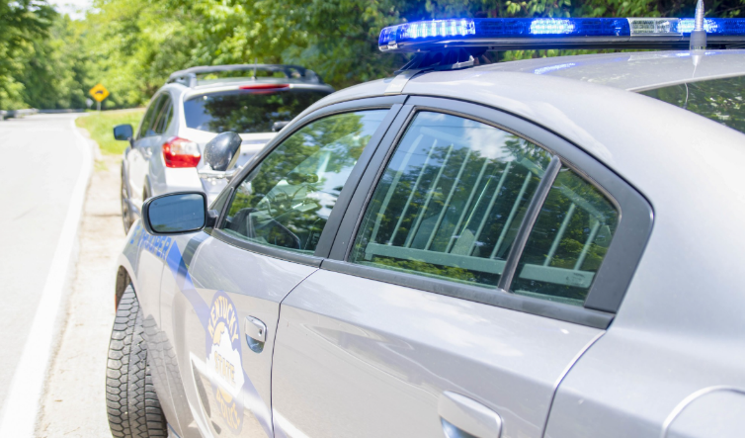
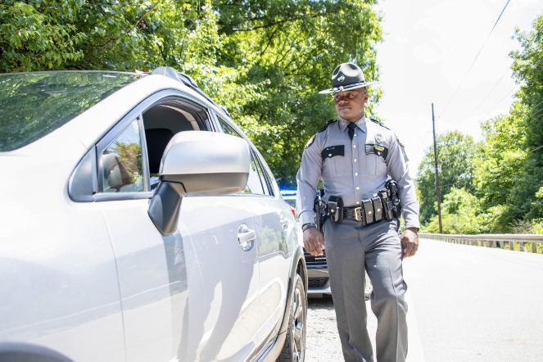
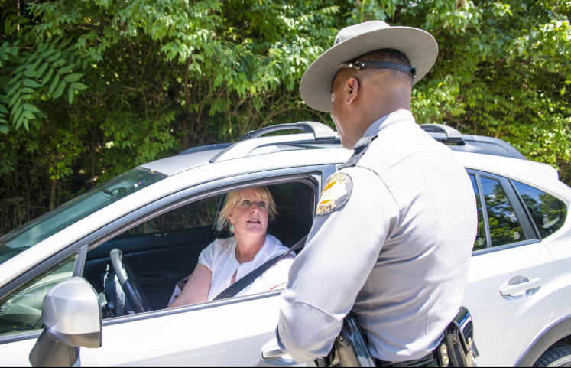
Dangerous Roads
Enforcement saves Lives
So, Does Education!!!
“High Five” - Works

Slide 18
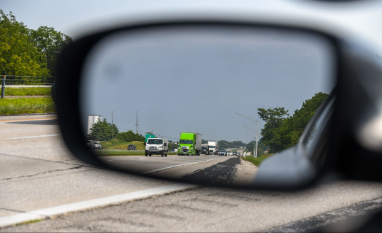
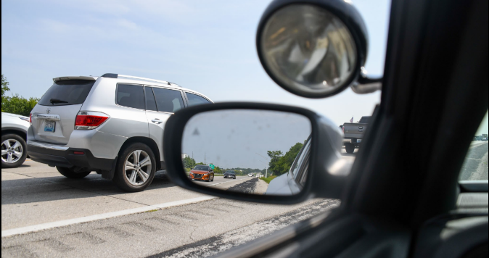
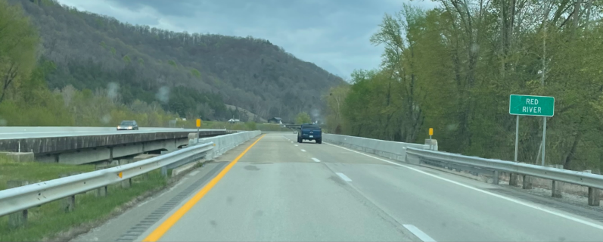
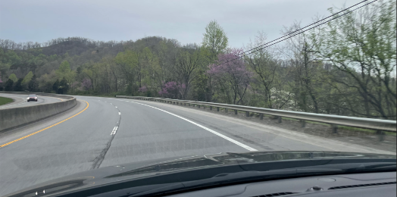
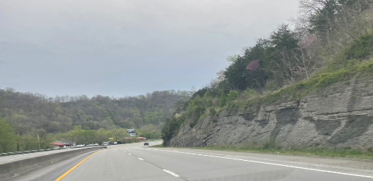
Kentucky’s “High Five” efforts are helping to address low belt use counties, from the flat-lands of Western Kentucky to the mountains of Eastern Kentucky.
Whether traveling a major interstate or a winding county highway the safest drivers are belted drivers and Kentucky Law Enforcement is doing their part.

Slide 19
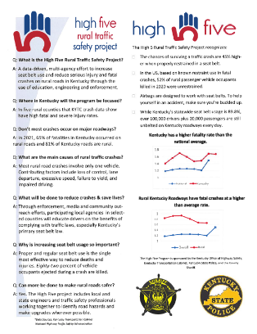
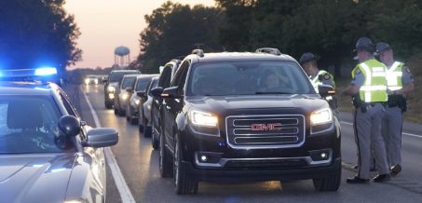
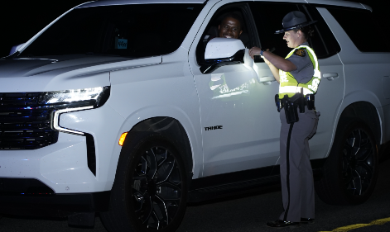
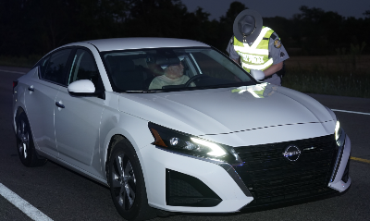
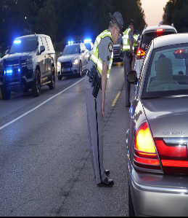
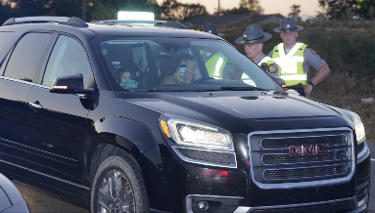
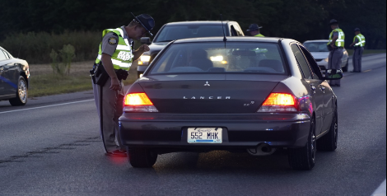
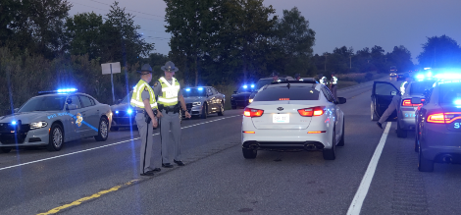
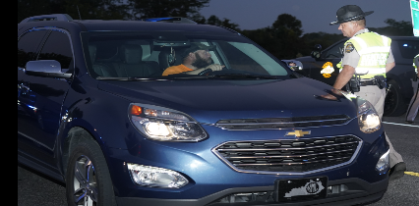
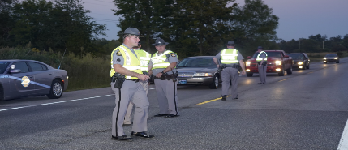
Public Messaging
building
Public Support

Slide 20
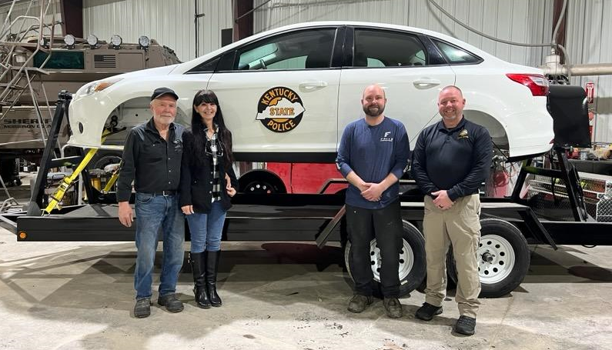
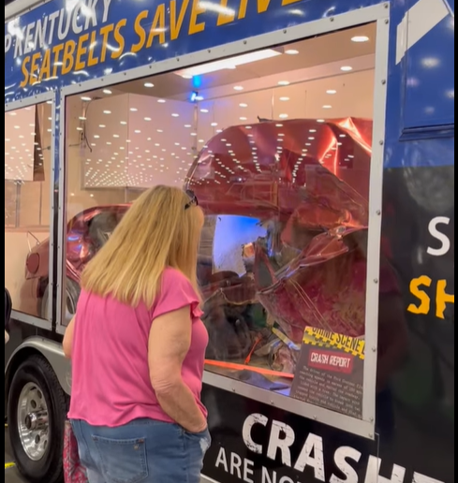
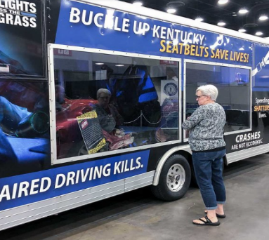
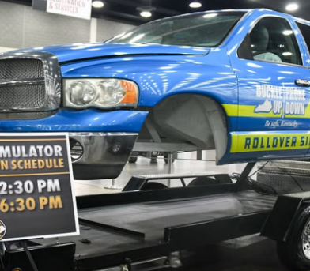
Seeing is:
Believing

Slide 21
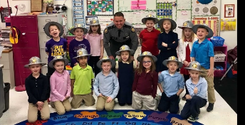
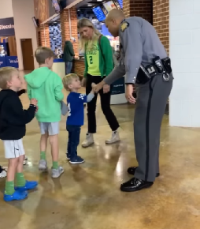

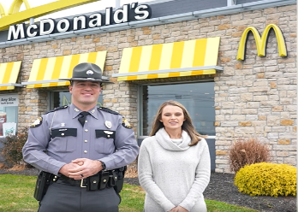
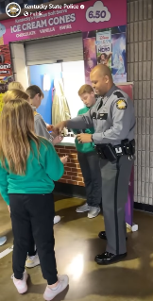
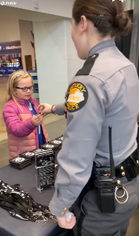


Increasing Belt Use Through Partnerships
State, County, and Local Police Departments
KOHS and National Highway Traffic Safety Administration
Local Schools, Businesses, and events

Slide 22
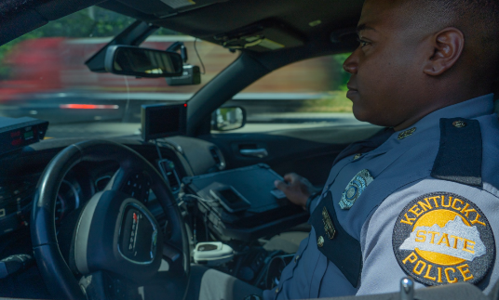
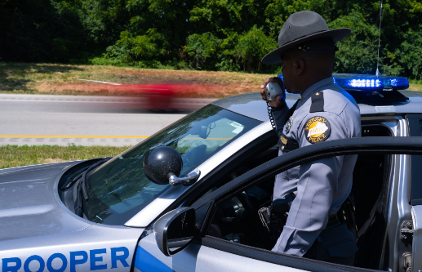
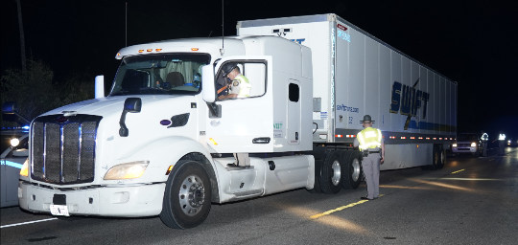
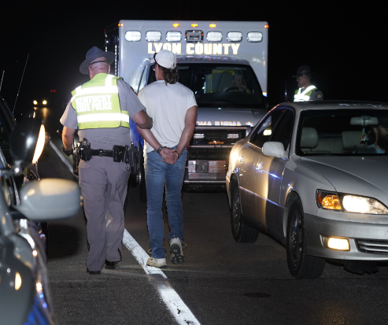
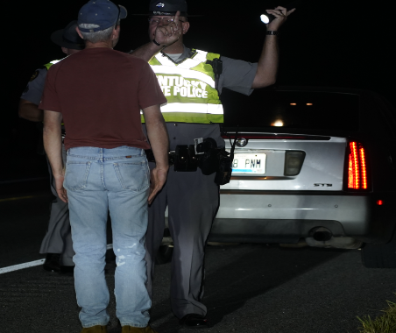
Enforcement building
Public Support

Slide 23
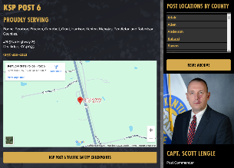

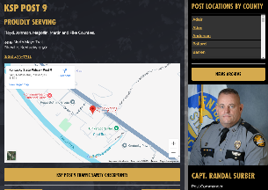
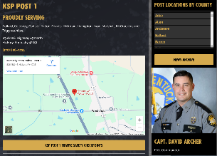
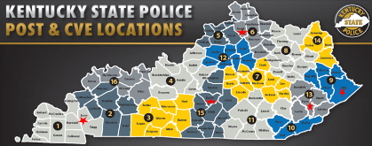


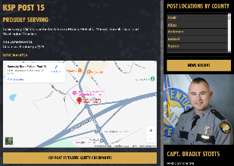
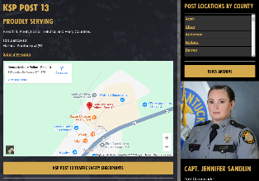


“High Five” Post Commanders & PAOs
Post 1 – Lyon Co.
Post 6 – Grant Co.
Post 9 – Pike Co.
Post 13 – Perry Co.
Post 15 – Taylor Co.

Slide 24

“High Five” Snap-Shot:
Post 9 - Pike Co.
09/27/2024-Trooper Michael Coleman patrolled US 119 and KY 1056 distributing flyers instead of issuing citations.
10/01/2024-Trooper Michael Coleman patrolled the same area, issuing four seatbelt citations and handing out 6 flyers.
10/29/2024-Trooper Matthew Cornett and Deputy Kevin Belcher conducted a safety checkpoint on Meta Highway distributing 10 flyers. Later that day, they joined Trooper Coleman for another checkpoint on KY 319, where 25 flyers were handed out.
01/24/2025-Trooper Michael Coleman and Deputy Kevin Belcher escorted supervisors and engineers from the Transportation Cabinet through high traffic areas in Pike County, as they worked on problem-solving in high-crash zones.
02/04/2025-Trooper Brennan Eckhart and Deputy Kevin Belcher attended a Belfry Highschool basketball game, distributing flyers to attendees.
02/08/2025-Trooper Coleman set up an informational booth at the Appalachian Wireless Arena during the Boat and RV Show, handing out approximately 45 flyers.

Slide 25
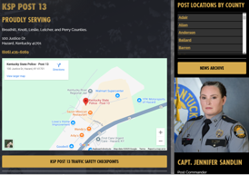
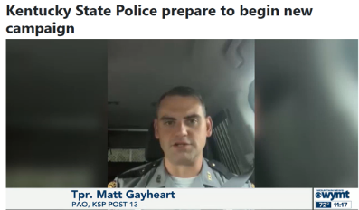
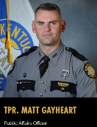

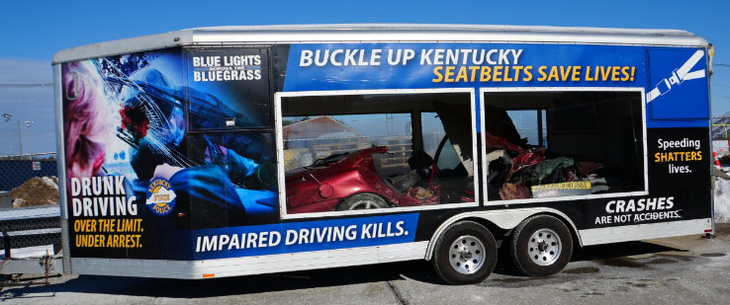


Post 13 – Perry County
“High Five”

Slide 26
Questions?
Thank You
Buckle-Up & Stay Safe!!!
Major Eric J. Walker
East Division Director - Operations
Kentucky State Police Headquarters
919 Versailles Road, Frankfort, KY 40601
Office: (502) 782-1800 | Cell: (502) 330-7834
[eric.walker@ky.gov]

Slide 27

High Five Program RSA Issues List
Speed – (Design speed; speed limit; sight distance; overtaking)
Road alignment and cross section
Intersections
Roadside Issues (Clear zones and crash barriers)
Bridges and culverts
Pavement – (Defects; skid resistance; flooding)

Slide 28

High Five Program RSA Issues List (Cont.)
Lighting and Glare
Signs
Traffic Signals
Marking and delineation
Roadway Users

Slide 29
High Five Program RSA Team Members
Highway Safety Improvement Program – (HSIP)
Engineers / Representation from District Office
Highway Safety Office
Local Law Enforcement
Crash Reconstructionist

Slide 30
High Five RSA Experience From
Lyon County Sheriff
https://transportation.ky.gov/HighwaySafety/Videos/LyonCountyHigh5.mp4

Slide 31
High Five Activity – Requirements
All County Sheriffs Offices conducted some enforcement.
KSP conducted enforcement in each county – both saturation patrols and Checkpoints were used.
All counties conducted Kickoffs and 4 other Publicity & Outreach Events.
Road Safety Assessments were completed in each county – planned to improve process for future.
Some counties posted some social media.
All Law Enforcement handed out educational cards.

Slide 32

Initial High Five Counties

Slide 33
Initial High Five County Stats
Bourbon – Sheriff Asbury
  Bourbon ranks 10th for fatal and serious injury rate miles travelled.
  Bourbon has the 9th highest rate of unbelted fatalities.
  Despite being ranked 57/120 for population (middle of the pack), Bourbon County ranks 31st (top 25%) in total fatalities.
Grayson – Sheriff Chaffins
  Grayson ranks 21st in total fatalities.
  Grayson ranks 32nd for total serious injuries.
  Grayson ranks 33rd in Speed-related collisions and 35th in impaired driving collisions.
Knott – Sheriff Richardson
  Knott ranks 13th in percentage of fatalities that were unbelted.
  Knott ranks a respectably low 81st in total fatalities.
  Knott ranks an even lower 96th for total serious injuries.
Madison – Sheriff Coyle
  Madison ranks 11th for total serious injuries.
  Madison ranks 16th for total fatalities.
  Madison ranks 9th in total collisions and 7th for impaired driving collisions.
Perry – Sheriff Engle
  Perry County ranks 1st for the highest percentage of traffic fatalities that were unbelted.
  Perry County ranks 14th for total fatalities and 24th for total serious injuries.
  Perry County ranks 18th for the rate of fatal and serious injuries per vehicles miles travelled.

Slide 34
High Five Activity – Experience
Flood Recovery events were used for safety messages
Elementary School Bike Giveaways
Local Events – Honeyfest, Art Walk, County Fair, High School Football Game
All Law Enforcement expressed positivity – especially regarding ticketing discretion
Roadway Assessment process to be improved
Reported increase in communication between Deputies and Troopers

Slide 35
Round 2 of High Five Program
Perry – Sheriff Engle
  Perry County ranks 39th in population.
  Perry County ranks 19th in total fatalities.
  Perry County ranks 46th in total collisions.
Lyon – Sheriff White
  Lyon ranks 102nd in population.
  Lyon ranks 46th in speed involved collisions and 69th for total collisions.
  Lyon ranks 72nd in fatalities.
Grant – Sheriff Maines
  Grant ranks 45th in population.
  Grant ranks 18th for unbelted percentage of fatalities.
  Grant ranks 30th in total fatalities and 34th for total collisions.
Pike – Sheriff Scott
  Pike ranks 17th in population.
  Pike ranks 4th for total fatalities.
  Pike ranks 13th in impaired driving collisions and 15th in unbelted percentage of fatalities.
Taylor – Sheriff Benningfield
  Taylor County ranks 42nd for population.
  Taylor County ranks 9th for unbelted percentage of fatalities.
  Taylor County ranks 37th for total collisions.

Slide 36

High Five Round 2

Slide 37
Choosing Initial High Five Counties
FFY2023
  NHTSA and PRG looked for states
    Large portion of rural roads
    Room for improvement in OP
  Kentucky
In each state:
  5 Rural Counties (+ 1 control)
  OP challenges (if possible)
Kentucky
  Built dashboard (HSP modified)
  Candidates across 4 LEL regions

Slide 38
Choosing Initial High Five Pilot States - Kentucky
26th in Length of Public Road System
81% of length of Public Road System is Rural
Traffic Volume in Kentucky is approximately 127M/day
  54% on Rural Roads
Traffic Collisions around 130k/year
  52% on Rural Roads

Slide 39

Choosing Initial High Five Counties - Dashboard
EH

Slide 40

Choosing Initial High Five Counties – Dashboard - Map
EH

Slide 41

Choosing Initial High Five Counties – Dashboard - Data
EH

Slide 42

Choosing Initial High Five Counties – LEL Regions
EH

Slide 43

Choosing Initial High Five Counties – Rural Counties
EH

Slide 44

Choosing Year 2 High Five Counties - Dashboard
EH

Slide 45
High Five – RSA tool
Road Safety Assessment
  Review locations
  Find low-cost improvements
Provide Tool
  Let each county review their data
EH

Slide 46

High Five – Grantee Tool Dashboard - Intro
Choose Their County – Dive Into Their Collision Data
EH

Slide 47

High Five – Grantee Tool Dashboard – First Filters
County
Calendar Year(s)
Collision Severity
  KABCO
County Resident for Unit 1
Land User
Parking Lot
Updating Total
EH

Slide 48

High Five – Grantee Tool Dashboard – Second Filters
Roadway ID
  Count of Collisions
Unit Type for U1
  searchable
Unit Type for U2
  Multiple Selections
EH

Slide 49

High Five – Grantee Tool Dashboard – Map
EH

Slide 50

High Five – Grantee Tool Dashboard – Environment
EH

Slide 51

High Five – Grantee Tool Dashboard – Human
EH

Slide 52

High Five – Grantee Tool Dashboard – Vehicle
EH

Slide 53
How did we do?
Community engagement and involvement was robust
With our feedback from the Hi5 counties, KYTC Executive Management was involved
Unofficially….

Slide 54
Why the success?
Executive Management buy-in
NHTSA support
Team effort including partners
Funding
Long-term thinking…

Slide 55

What’s Next? Version 3.0
HI

Slide 56
Questions/Comments
Drew Chiles, Research Assistant
Preusser Research Group
drew@preussergroup.com
Eric Walker, Major
Kentucky State Police
Eric.Walker@ky.gov
Bill Bell, Executive Director
KYTC KOHS
Bill.Bell@ky.gov
Ryan Fisher, Assistant Director
KYTC KOHS
LawrenceR.Fisher@ky.gov
Ed Harding, Traffic Records
KYTC KOHS
Ed.Harding@ky.gov

Slide 57

THANK YOU!

