Slide 1
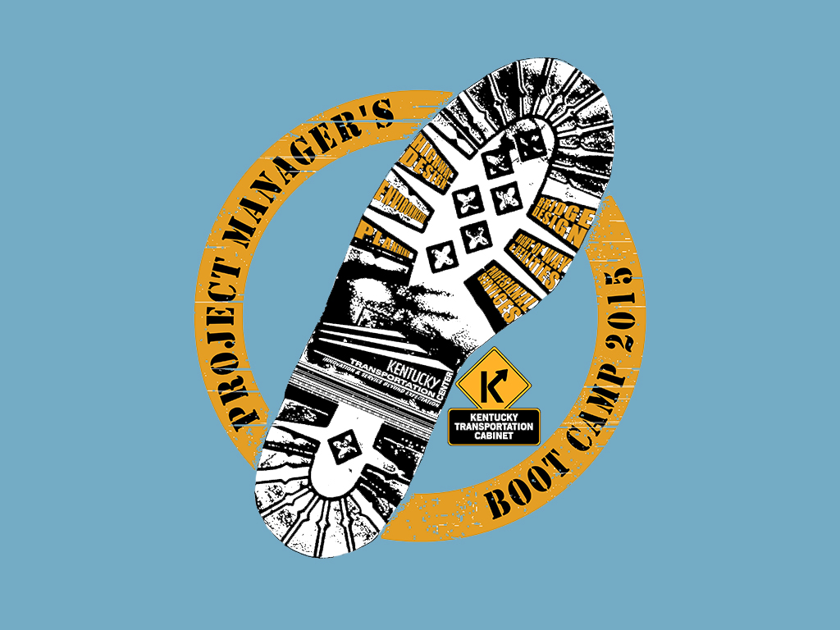

Slide 2
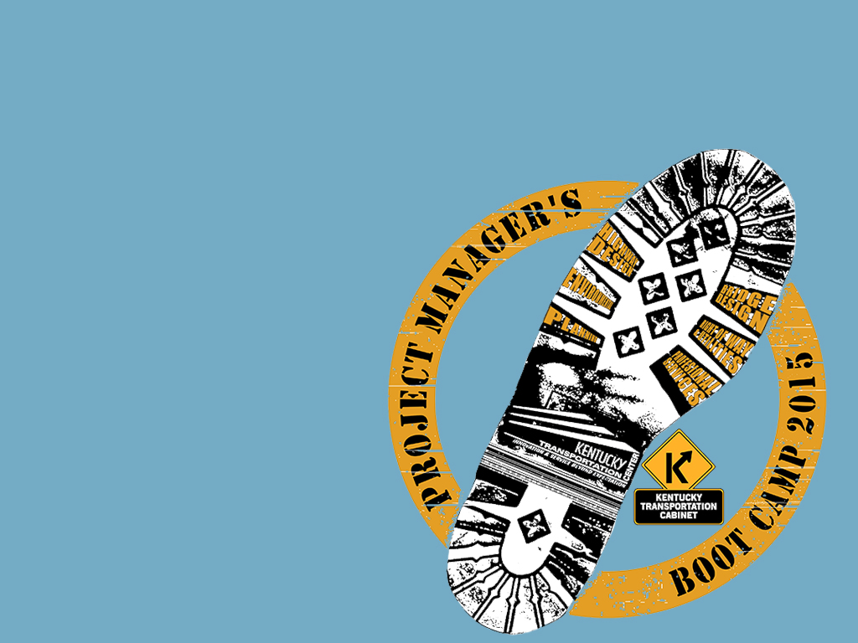
Utility & Rail Coordination in Project Development
Jennifer McCleve
Utilities & Rail Branch Manager

Slide 3
Processes precede our work that we are dependant on.
Schedules sometimes change, delays occur.
Unchanged
Design
R/W
Utilities
Road Construction
Delayed Utilities Start
Delayed R/W Start
Window Narrows
Delayed Final Design Start
Road construction relies on execution of all work prior to ensure their success.
How do we do our part with constraints of budget, time, and resources?

Slide 4
Proposed
Design
Early Utility Coordination
R/W
Road Construction
Final Utility Coordination
Design
R/W
Utilities
Road Construction
Existing

Slide 5
Proposed
Design
Early Utility Coordination
R/W
Road Construction
Final Utility Coordination
At R/W Stage when U phase funding is made available, the utilities should be ready to finalize plans.
During design, we can use D funds to execute engineering service agreements

Slide 6
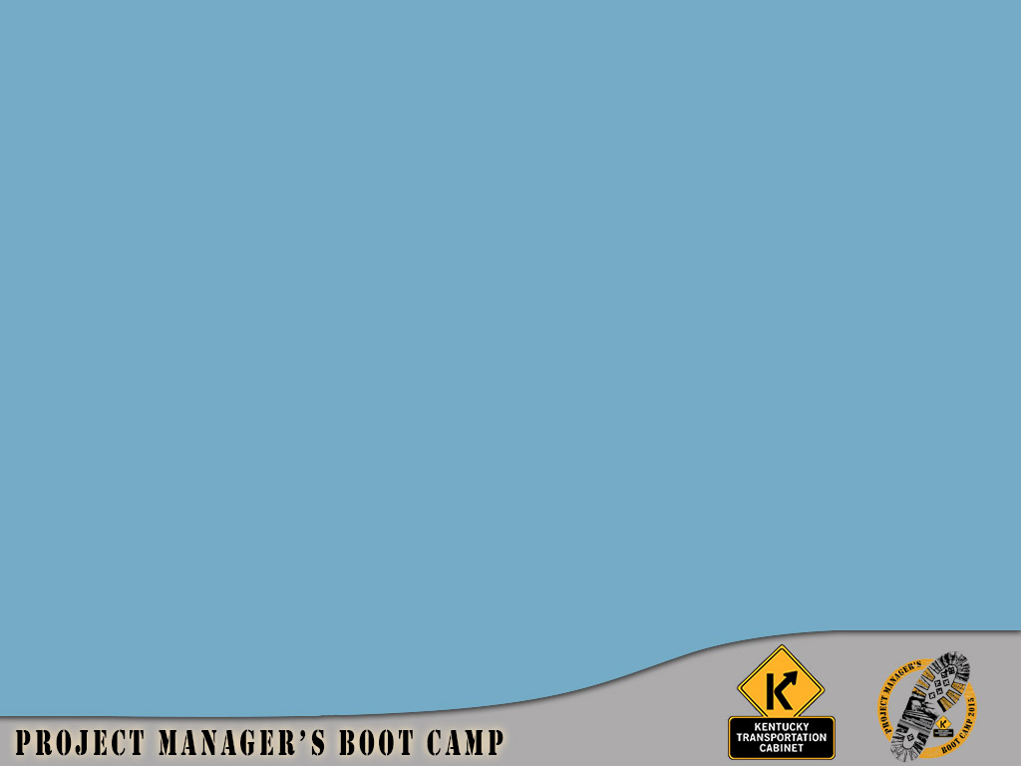
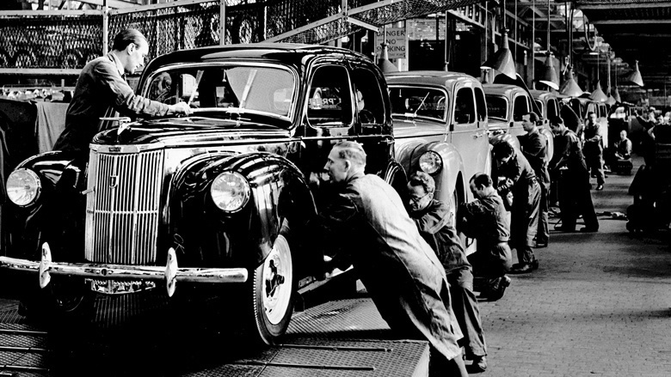
Forget what you know, Henry.
The assembly line doesn’t work here.

Slide 7
KYTC Today…
Phase I
Phase 2
Construction
Design Phases
ROW Phase
Utility Phase
SUE QL D
SUE QL C
Contact Uts
SUE QL B
SUE QL A
Design Ut Relocations
Perform Relocations
KYTC Future…
Notes:
Gather utility information
Consult companies
Identify conflicts
Develop a plan to move or avoid
HER’ES HOW WE’VE DONE IT…….
AND HERE’S THE TASKFORCE PROPOSAL.
YOU’LL SEE THAT IN TDAY’S PHASE I DESIGN, WE ARE LOOKING FOR SOME EARLY COMMMUNICATION WITH THE UTILITY COMPANIES IN THE AREA. THE CONSULTANT SHOULD BE IDENTIFYING WHAT COMPANIES ARE THE AREA, GETTING SOME BASE LOCATION DATA ON THOSE FACILITIES, AND CONSIDERING THOSE LOCATIONS WHEN LAYING OUT THEIR ALIGNMENTS.
IN TODAYS PHASE II DESIGN, WE ARE PROPOSING MORE INTENSIVE REVIEWS WITH THE UTILIITIES INVOLVED, ACCURATE LOCATION OF FACILITIES POTENTIALLY BEING IMPACTED BY THE DESIGN, AND A LAYOUT OF THE UTILITY RELCOATIONS NEEDED. IN SOME CASES, WE CAN VERY WELL COME OUT OF PHASE II WITH UTILITY RELOCATION PLANS.
THIS PARADIGM SHIFT GIVES US MORE DATA EARLIER, TO MAKE GOOD DESIGN DECISIONS, AND TO BEGIN THE UTILITY PHASE WITH A LOT OF THE GROUNDWORK ALREADY DONE.
WITH R/W MOVING FASTER AND EARLIER TOO, WE CAN POTENTIALLY BEGIN RELOCATION CONSTRUCTION MUCH EARLIER.

Slide 8
Final Design
Effective Tools
  The current utility agreement typically is for design and relocation
  A separate agreement for engineering would allow for engineering work to begin earlier.
  We assume 15% to cover engineering for the U fund. So we simply move 15% to D from U.

Slide 9
Final Design
Effective Tools
  Offer for the road designer to perform the utility design.
  Especially 100% reimbursable, i.e. Municipalities
  The relocation design must remain under the review and approval of the owner, the Utility.

Slide 10
Final Design
Effective Tools
  Early materials agreements

Slide 11
Utility Responsibilities
Post Early Coordination
Reserve the U phase for final relocation design and relocations

Slide 12
Utility Responsibilities
Post Early Coordination
  Conflict validation
  Finalize estimates
  Develop final plans
  Develop relocation agreements
  Relocation construction
  Develop Utility Clearance Notes
  Deliver specs

Slide 13
Final Design
Effective Tools
KYTC contractors in many cases have experience in utility construction.
We would like to offer to contract out the utility construction within the road project.
We have many companies and districts doing so now.

Slide 14
Railroad Coordination
Things to do
Acquire right of entry
Coordinate plan review with RR companies
Coordinate flagging to protect RR facilities
Ensure that Cabinet contractors perform to standards (proper insurance & construction techniques)

Slide 15
Railroad Coordination
Steps to take
Approval of plans/proposal
Permission to enter property
Contractor insurance
Flagging services
Work to be scheduled in advance
AT LEAST 2 weeks prior to work

Slide 16
Railroad Coordination
Deliverables
Railroad agreement
Parcel acquisition
Rail notes for proposal
Reimbursement for services

Slide 17
Contacts
Central Office Support Services
Utilities & Rail Branch Manager
Jennifer McCleve (502) 782-4944
Area Utility Coordinators:
Districts 1, 2 3 David Otte (502) 782-5072
Districts 4, 5, 6 Tom Capshaw (502) 782-4937
Districts 7, 8, 9 Sean Johnson (502) 782-4936
Districts 10, 11, 12 Dianah Waller (502) 782-4954
Statewide Rail Coordinator
Allen Rust

Slide 18
Success Stories and Lessons Learned
from
District 5 Projects

Slide 19
Utility Success
Let us Help you Help us
Early Utility Involvement
Utility Coordination by Roadway Contractor

Slide 20
Utility Success
Let us Help you Help us
Design Consultant Design for Facilities
Roadway Contractor Relocate Facilities

Slide 21
Utility Success
Early Involvement
Define Necessary Easements
Avoid Existing Facilities
Avoid Proposed Facilities

Slide 22
Utility Success
Coordination by Roadway Contractor
Roadway Work During Utility Relocation
Contractor Responsible for Coordination
For Information Only Utility Relocation Plans

Slide 23
Feedback from first PM Boot Camp Session:
How can utilities assist PMs?
Training on Utility Relocation Requirements & Tricks
Templates of Example Successes (Bullitt County proposal, notes, rfp)
Complete separate utility design & relocation agreements
Preliminary Utility Plans for Joint Inspection
Earlier Utility Plans
Design Utility Plans Submittals

Slide 24
Feedback from first PM Boot Camp Session:
How can utilities assist PMs?
Communication
KURTS Write to Preconstruction
Automatic Email Notifications (e.g. KURTS)
Tracking of RR Approval Status
Electronic Invoice Submittals
Plan Delivery Dates for Utility Designs

