Slide 1
InRoads SS4 Upgrade
Troy Woodyard, PE - KYTC
Kyle M. Chism, PE - Parsons

Slide 2
Agenda
Troy
  History
  Upgrade Logistics
  Overview of Changes in the New Software
Kyle
  Live Demo of New Software Features

Slide 3
History
KYTC has been pursuing this upgrade for several years
The last year has been spent overhauling and testing the CADD standards
Primary involvement
  KYTC Central Office Technical Support Branch
  KYTC Central Office Developmental Branch
  Parsons
  CAD Productivity
  Bentley

Slide 4
Beta Release
http://transportation.ky.gov/CADD-Standards/Pages/CADD-Standards-%28InRoads-SS4-Beta%29.aspx

Slide 5
Workspace(s)
KYTC employee workspace(s) will be handled through ProjectWise.
Consultants will need to maintain 2 workspaces locally.
  SS2 Existing Workspace
  SS4 Workspace of the Future!
SS2 Workspace will cease to be developed
SS2 Workspace will continue to be utilized for survey
SS4 Workspace will receive regular updates

Slide 6
Versions – Currently Recognized
Microstation 8.11.09.714 or later
InRoads SS2 8.11.07.xxx
InRoads SS4 8.11.09.87x or later

Slide 7
A New Way to Think
InRoads Data and MicroStation Graphics>Microstation Data
InRoads Corridor Modeling>OpenRoads Modeling
InRoads Feature and InRoads Alignment > Linear Geometry ?!?!?!?
Design Intent ?!?!?!?!

Slide 8
InRoads Data and MicroStation Graphics>Microstation Data
Data is stored in the .dgn and attached to the MicroStation Elements
No more viewing data … the data is already viewed

Slide 9
InRoads Corridor Modeling>OpenRoads Modeling
Corridor Modeling is still available
  Point Controls
  Superelevation
  Parametric Constraints
Enhanced Clipping
Enhanced Site Style Modeling
  Terrain Models
  Linear Templates
  Surface Templates

Slide 10
InRoads Features and InRoads Alignments > Linear Geometry ?!?!?!?
The lines are blurred.
You can do surface feature things to alignments, and alignment things to surface feature things.
Site style modeling is easy… and remembers DESIGN INTENT!?!?

Slide 11
DESIGN INTENT!?!?
It’s not what you draw, but how you draw it.
Civil Ruled Features vs lines
Civil Data and Graphics are no longer separated

Slide 12
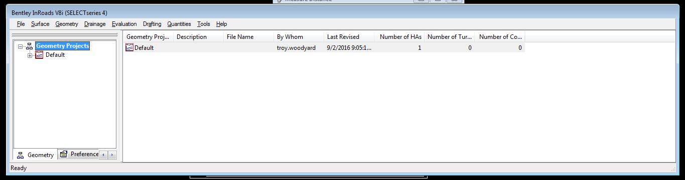
Limitations
Legacy Commands remain necessary
  Survey
  Production Profile Creation
  Storm and Sanitary/SUDA
  Specialized tools
    Right of Way Metes and Bounds
    Hydrology and Hydraulics add-in
  No “Update Cross-Sections” – No SS2 Cross-sections
  Future Release is promised to fix many issues

Slide 13
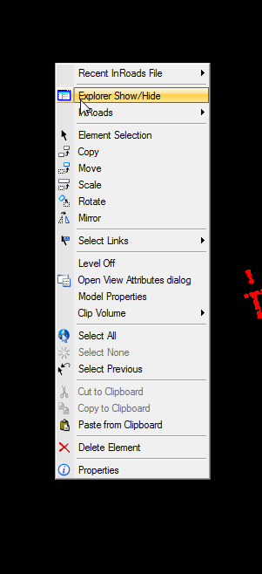
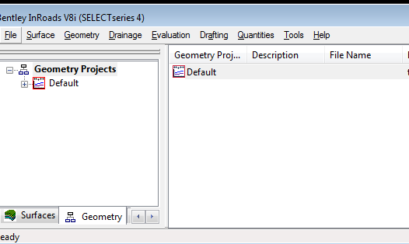
Legacy Commands
Most main functionality remains
  DTM
  ALG
  S&S (suite only)
  XIN
No Roadway Designer or Template Library

Slide 14
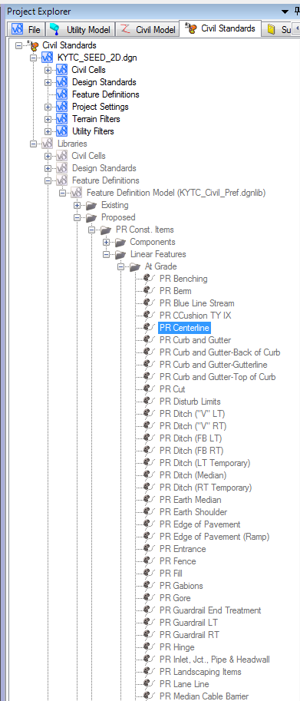
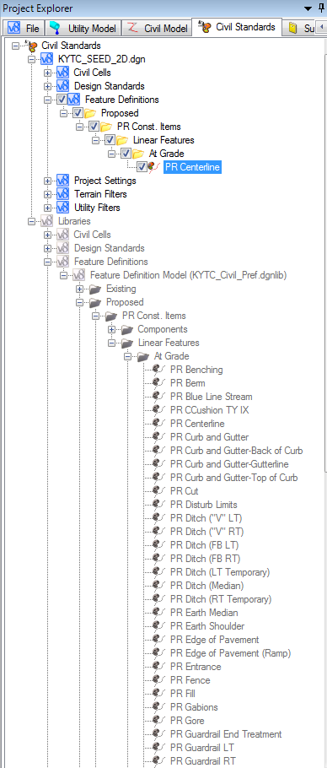
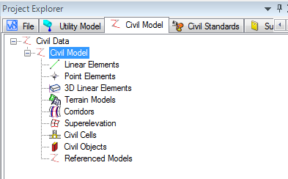
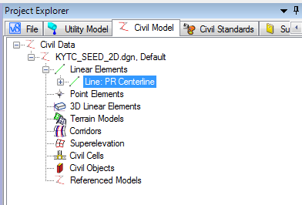
InRoads Explorer > Project Explorer
Stores Active File Data and Reference File Data
Stores Active File preferences and Workspace .dgnlib preferences
  Use a new seed file every time.
  DON’T COPY FILES
  MAKE SURE TO USE A NEW SEED FILE.

Slide 15
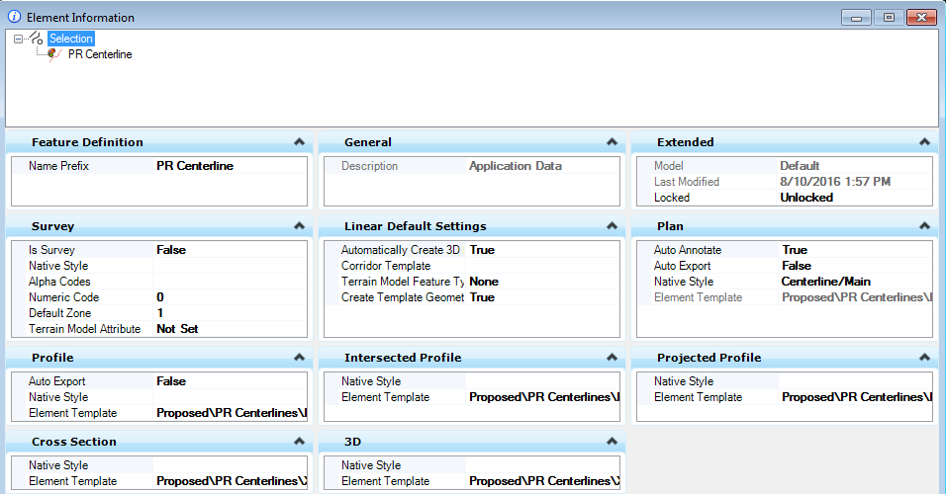
InRoads Style > Feature Definitions
What something is…

Slide 16
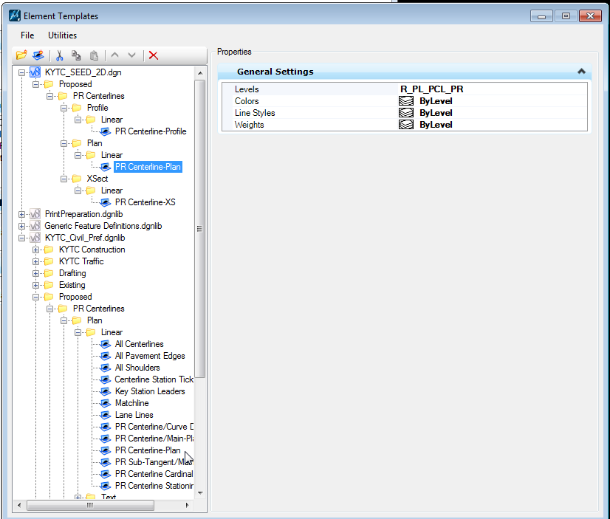
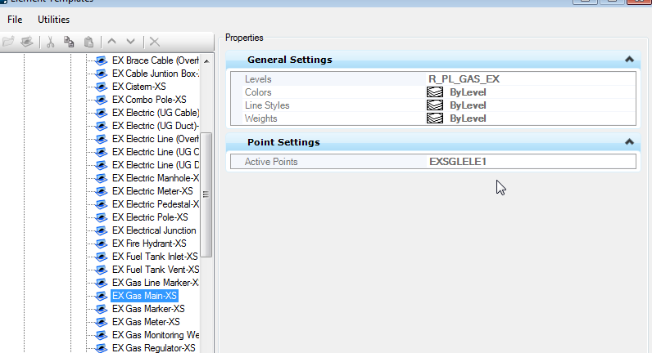
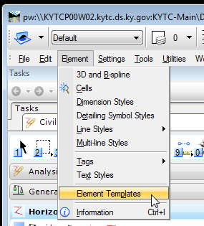
InRoads Named Symbology>Element Template
What something looks like…

Slide 17
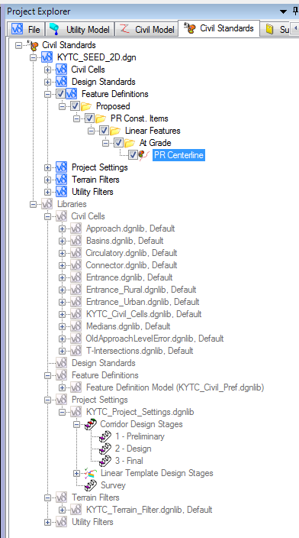
InRoads XIN>.dgnlib
InRoads XIN>.dgnlib
InRoads XIN>InRoads XIN ?!?!

Slide 18
InRoads DTM>Terrain Model
Can move back and forth between the 2 types
DTM still required for profiles
No DTM or Terrain is required for volumes. Volumes based on components.
Updated XIN must be used for DTM to Terrain Model translation to preserve levels.
No Corridor is required for a terrain model… you are free to use MicroStation meshes or linear geometry to create the terrain model.

Slide 19
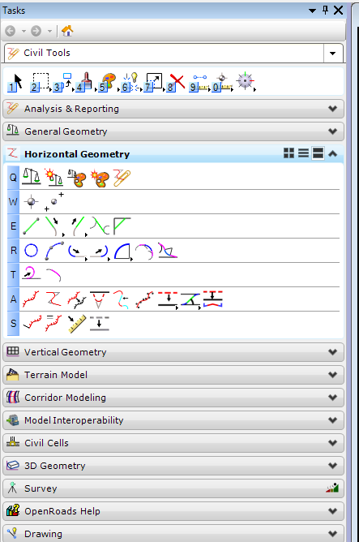
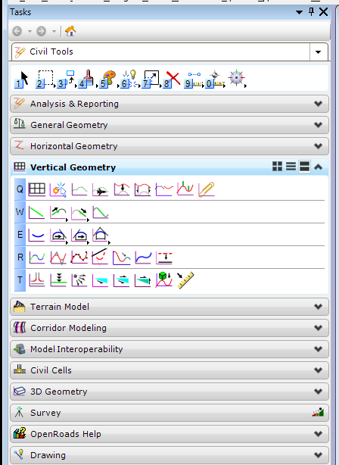
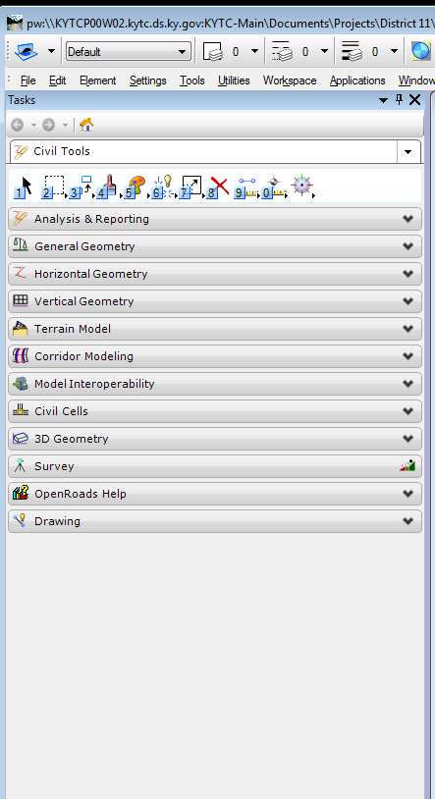
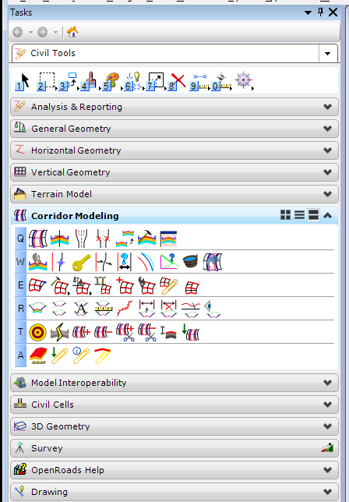
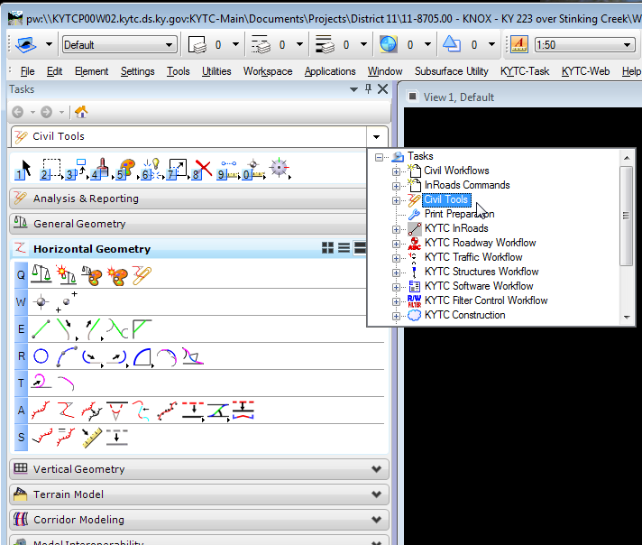
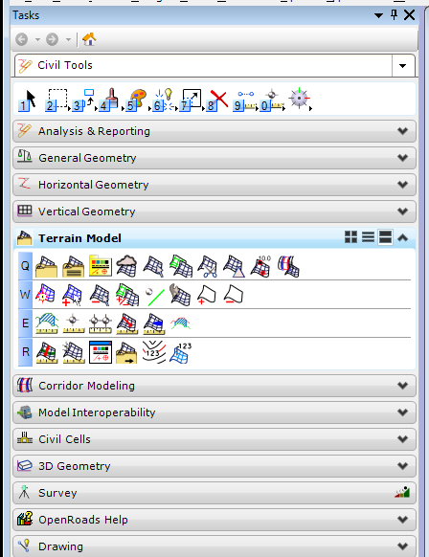
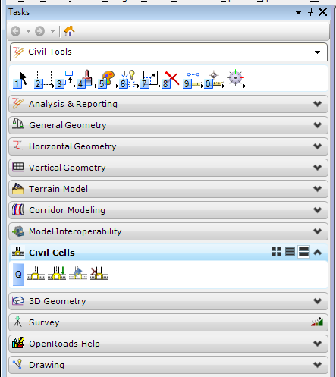
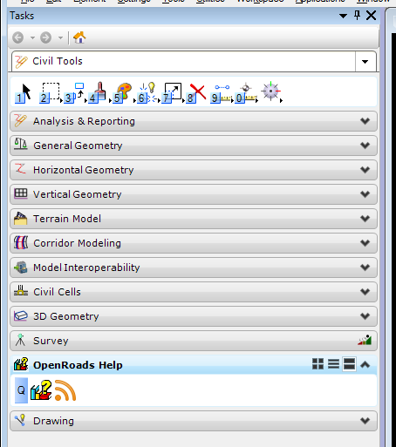
New Places to Find Things
InRoads Horizontal Alignment>Horizontal Geometry
Inroads Vertical Alignment>Vertical Geometry
InRoads DTM>Terrain Model
InRoads Roadway Designer>Corridor Modeling
  Template Library … BE CAREFUL! DON’T USE SS2 .itl
Civil Cells
New Help Menu

Slide 20
LIVE DEMO TIME!

