Slide 1
All-Electronic Tolling

Slide 2
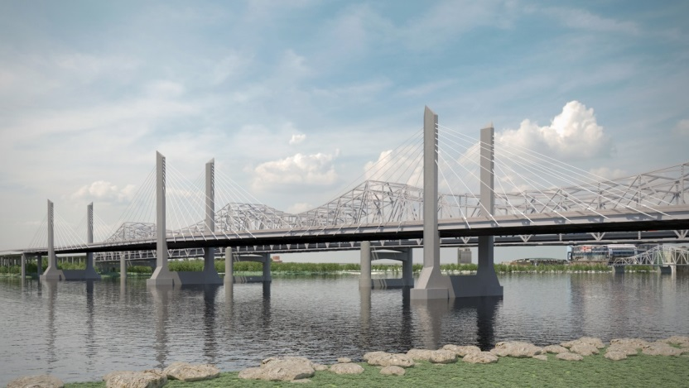
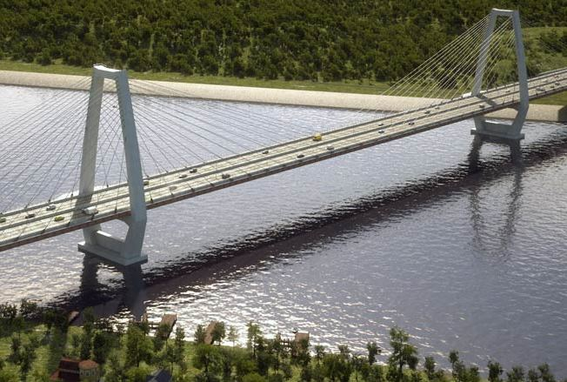
Ohio River Bridges Project
One project, two bridges
$2.3 billion project
KY lead on Downtown Crossing
IN lead on East End Crossing
Substantial completion late this
year
Improving safety and mobility
Creating new opportunities

Slide 3
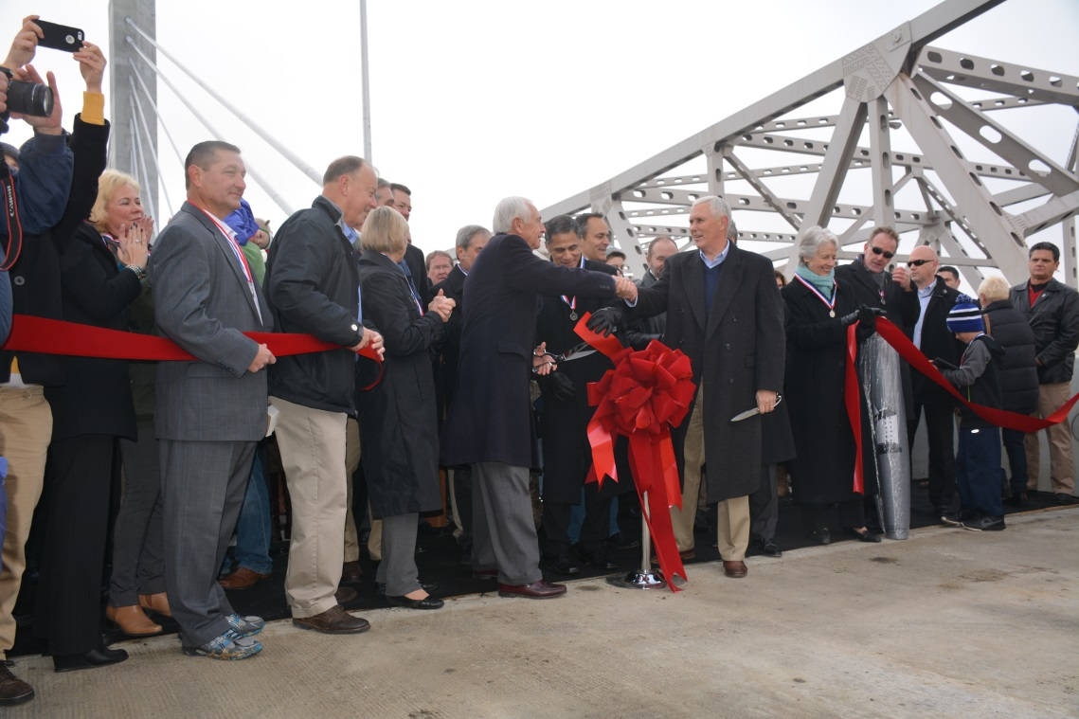
Transforming Our Region
Projected economic impact of
$87 billion over the next 30 years
Anticipated 15,000 new jobs
Improving economic competiveness
Uniting the region
Designated by Congress as one
of 13 projects of national importance
Project is not possible without tolling

Slide 4
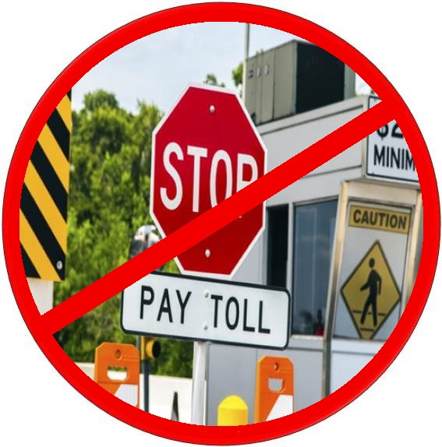
Introducing RiverLink
All-electronic tolling
No toll booths
No coin machines
No lines
No stopping
Fast, easy, efficient and fair
Tolling will start in late 2016

Slide 5
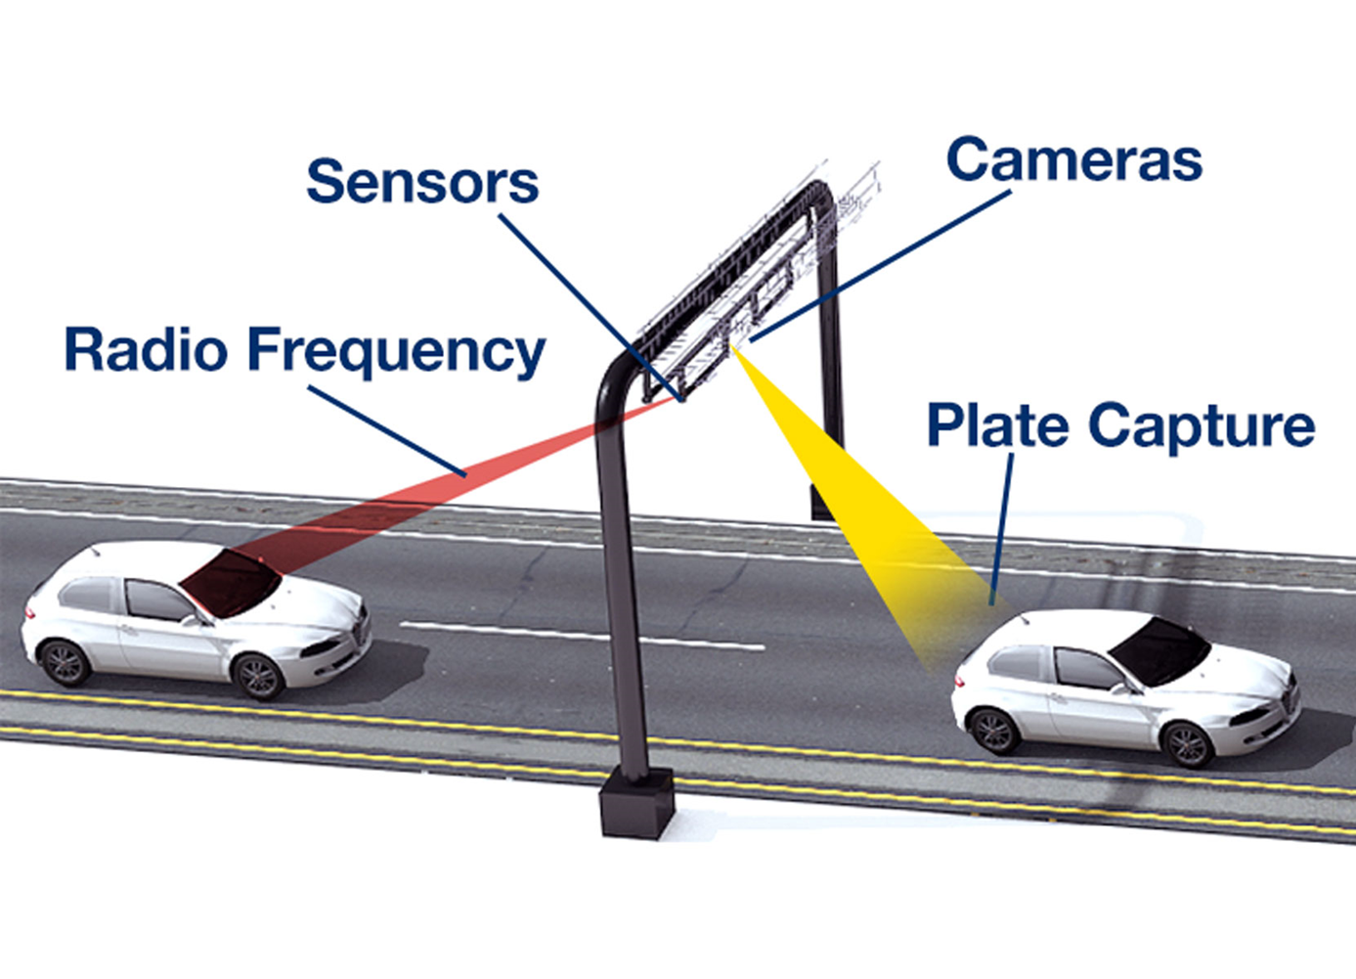
How it Works
Cameras and sensors in place
Sensors read transponders,
tolls deducted from accounts
Cameras capture license plates
Bills sent to drivers without
prepaid accounts

Slide 6
How Much it Costs

Slide 7
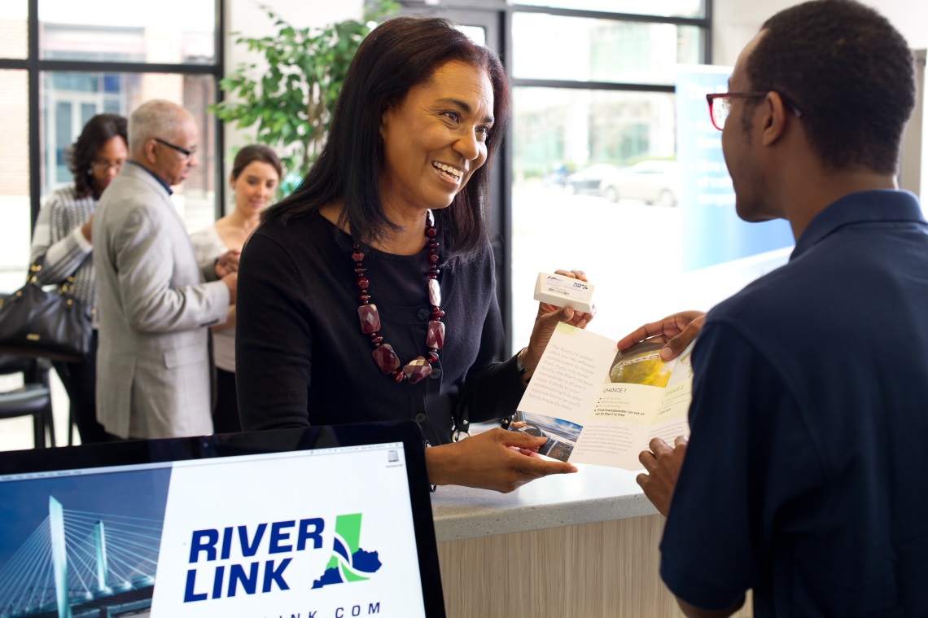
Transponder
Transponder = lowest toll rates
Prepaid account
Sensors recognize transponder
Appropriate toll deducted from
prepaid account
Offers greatest convenience

Slide 8
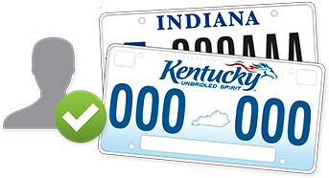
Registered Plate
Prepaid account
Can open later this year
License plate recognized
Toll deducted from account
Rates are higher than with a
transponder
Higher administrative costs

Slide 9
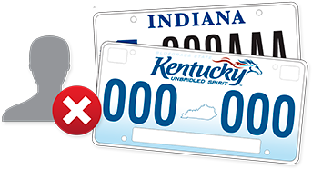
No Prepaid Account
No transponder
No registered plate
License plate photographed on
each crossing
Invoice sent in the mail to
registered owner
Highest rates due to increased
administrative costs

Slide 10
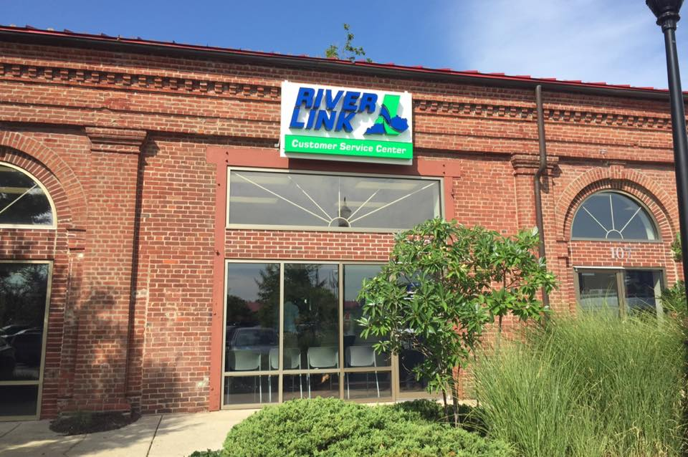
Opening a RiverLink Account
Set up a personal account
Online, RiverLink.com
By phone, 855-RIV-LINK
In person, customer service center
Commercial account
Calling 855-RIV-LINK is easiest
and fastest
In person with fleet information

Slide 11
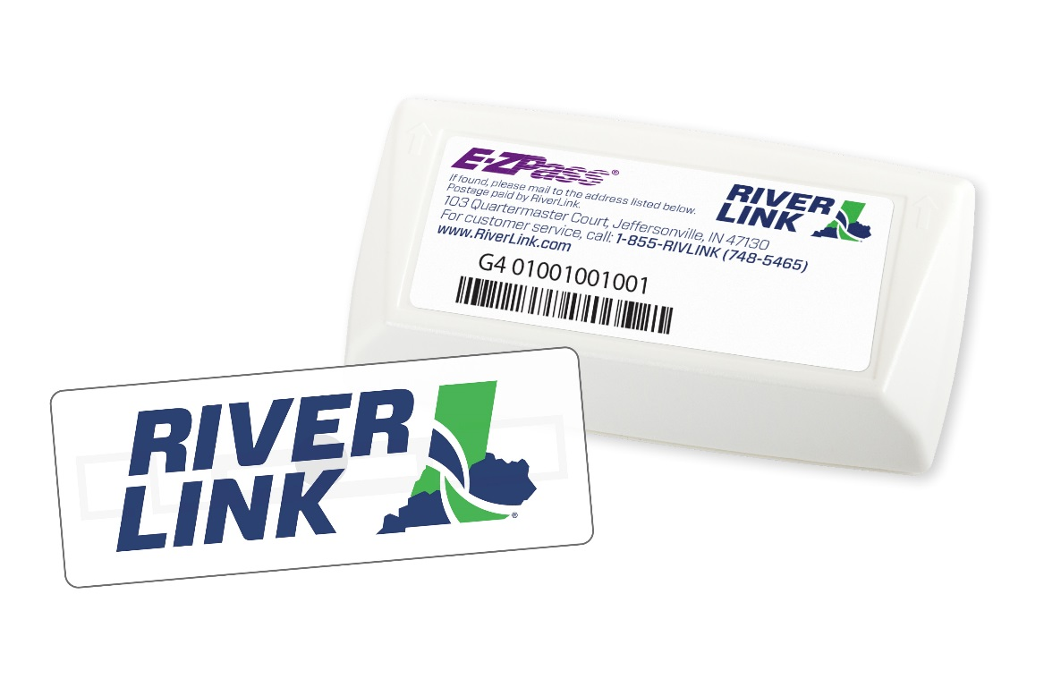
Information Needed
For each vehicle on your account:
Make
Model
Year
Color
License plate number
Minimum balance
Transponder choice (two options)

Slide 12
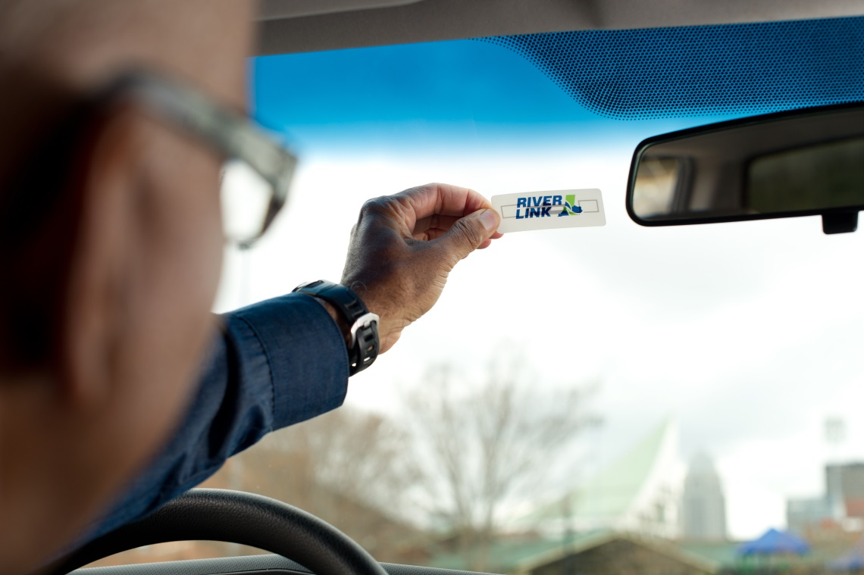
RiverLink Local Transponder
Local use only
Adheres to the windshield
Non-transferable
First one is FREE
One free/registered vehicle
Will receive when setting up account

Slide 13
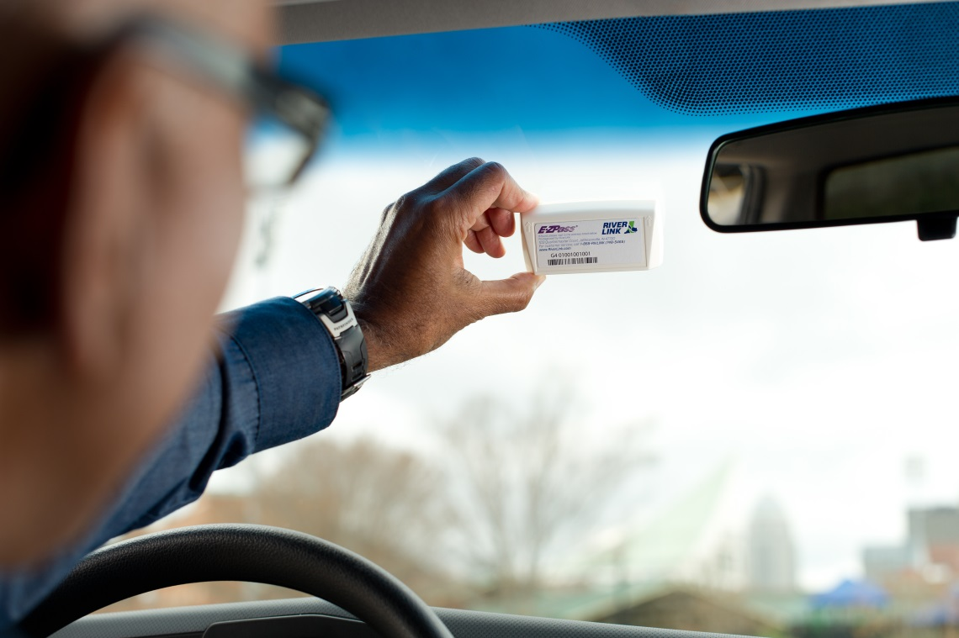
RiverLink E-ZPass Transponder
Works in all 16 E-ZPass states
Mounted to the windshield
Portable from vehicle to vehicle
registered to one account
Cost = $15/transponder
Will be distributed later this year,
well in advance of start of tolling

Slide 15
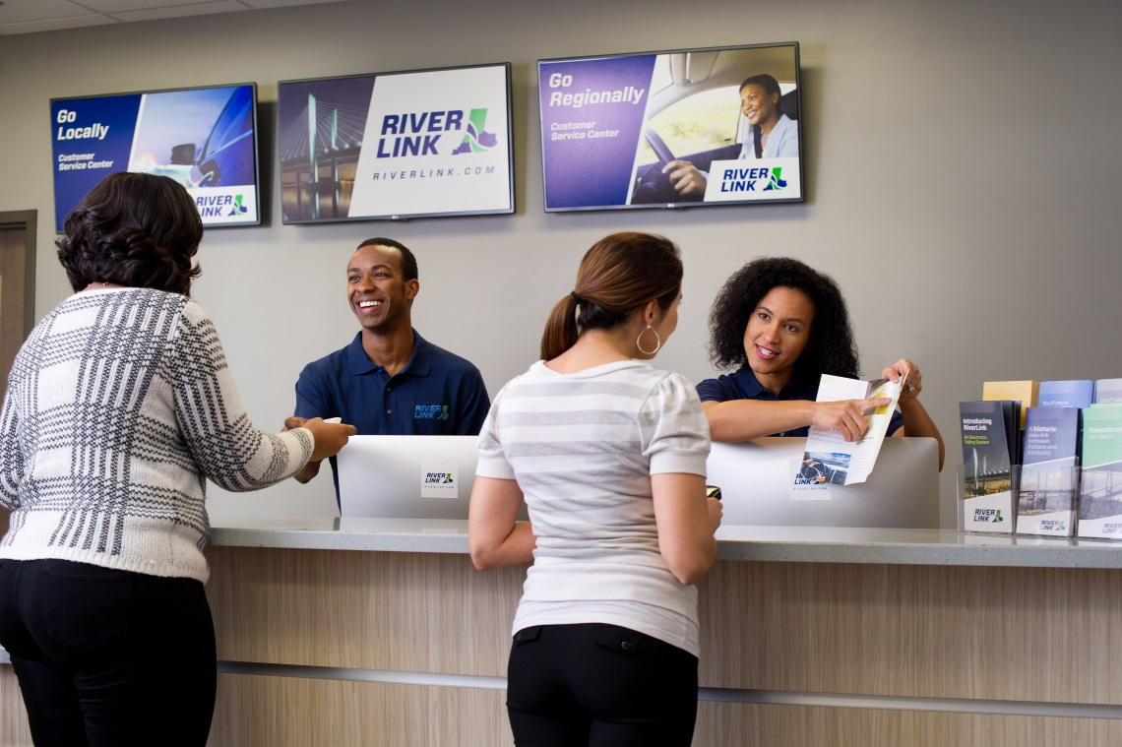
Personal Account
Minimum balance to open an
account = $20
Up to four vehicles
One free RiverLink local
transponder/vehicle
Frequent-user discount available
Set up automatic recharge or
low balance reminder

Slide 16
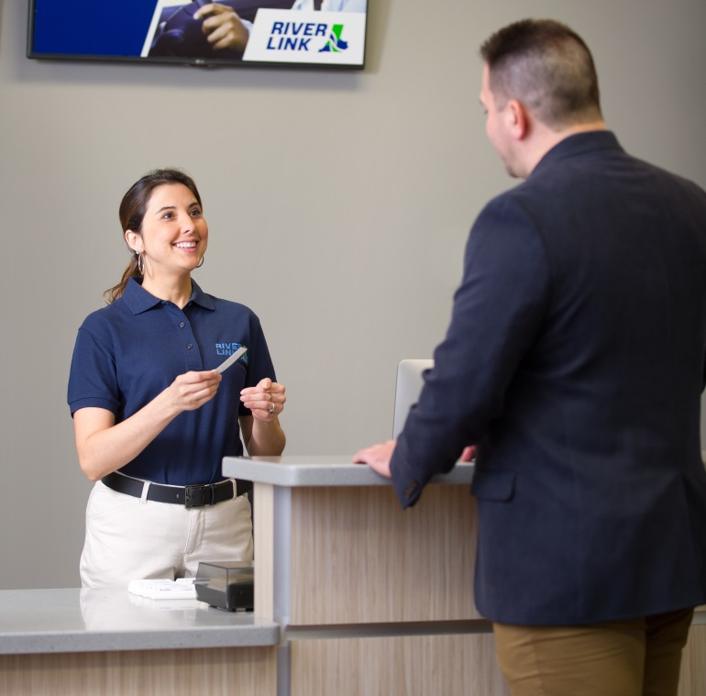
Commercial Account
Minimum balance to open an
account = $20/vehicle
Set up by phone or in person
Minimum of five vehicles, no maximum
Free RiverLink local transponders
Specialized customer service
representatives
No frequent-user discount

Slide 17
Frequent-User Discount
40 crossings in a calendar month
per transponder
Must have RiverLink transponder
Discount is automatic
Appears as $40 credit on bill
Each additional trip that month is $1
Only applies to drivers in passenger
vehicles with personal accounts

Slide 18
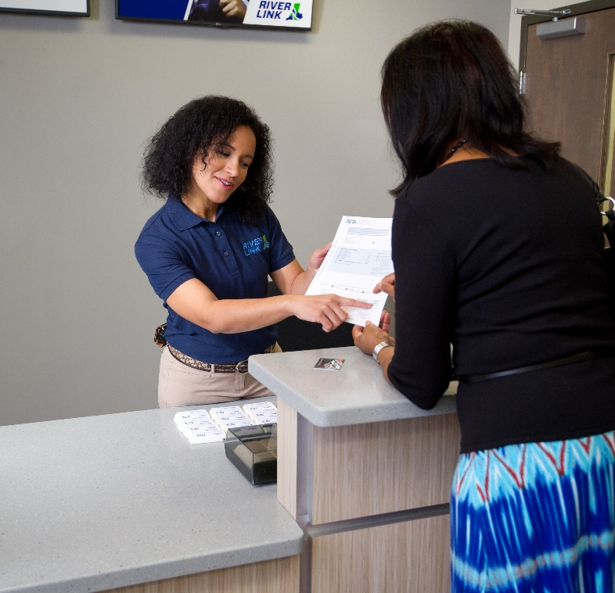
Invoices and Fees
Signage will notify drivers of tolls
Initial bill is only the amount of tolls,
no fees
Second bill, $5 administrative fee
Third bill, $25 violation fee added
After 3 months, placed in collection
status with $30 collection fee
Registration hold is possible

Slide 19
Options for Drivers
Tolled Bridges
Abraham Lincoln Bridge
East End Bridge
Improved Kennedy Bridge
Non-Tolled Bridges
Clark Memorial Bridge
Sherman Minton Bridge
Non-Tolled Options
TARC
Ticket to Ride

Slide 20
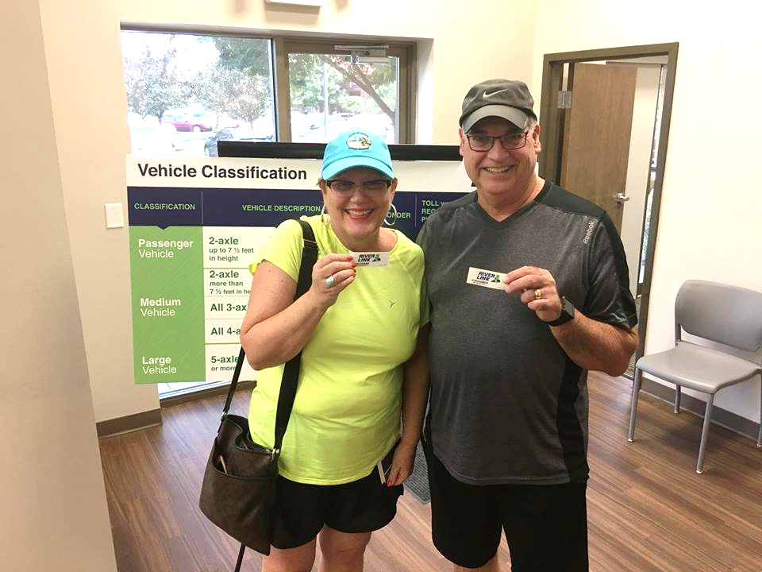
Next Steps
Set up your account
RiverLink.com
855-RIV-LINK
Customer service centers
400 East Main St. (Louisville)
103 Quartermaster Ct. (Jeffersonville)
Get your transponder
Tolling begins late 2016

Slide 21
Questions?

