Slide 1

Transportation Engineering: Moving people & Goods Safely
Presentation by:
On Month Day 2022

Slide 2
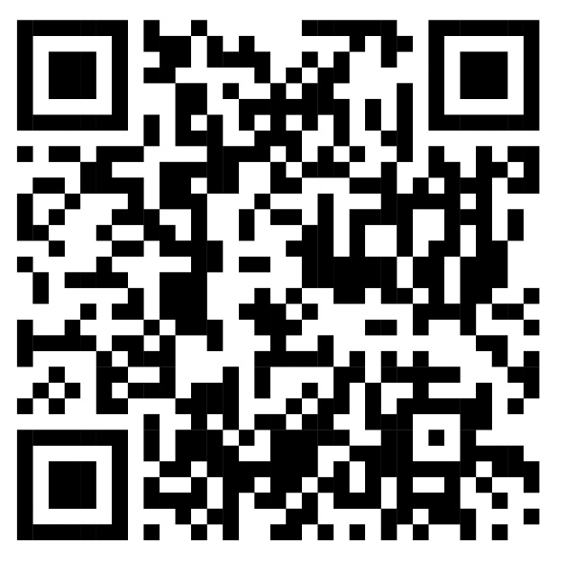

An education initiative by the Kentucky Transportation Cabinet

Slide 3

Transportation Engineers
It’s about moving people and things safely.
Engineers plan roads, railways, airports and ports.
They design sign, signals and traffic systems.
The goal is safe, fast and smooth travel

Slide 4
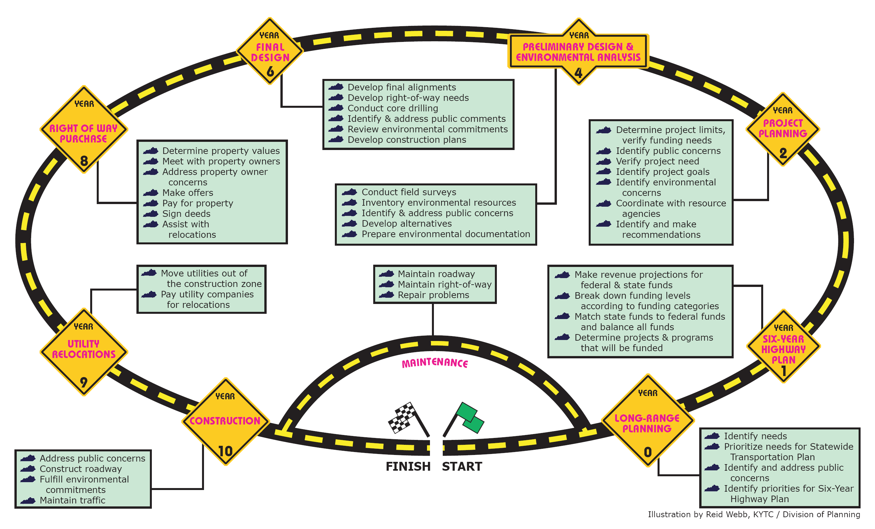
Transportation Projects
Development & Delivery Process
Engineering Process
Idea
Planning
Design
Construction
Maintenance

Slide 5
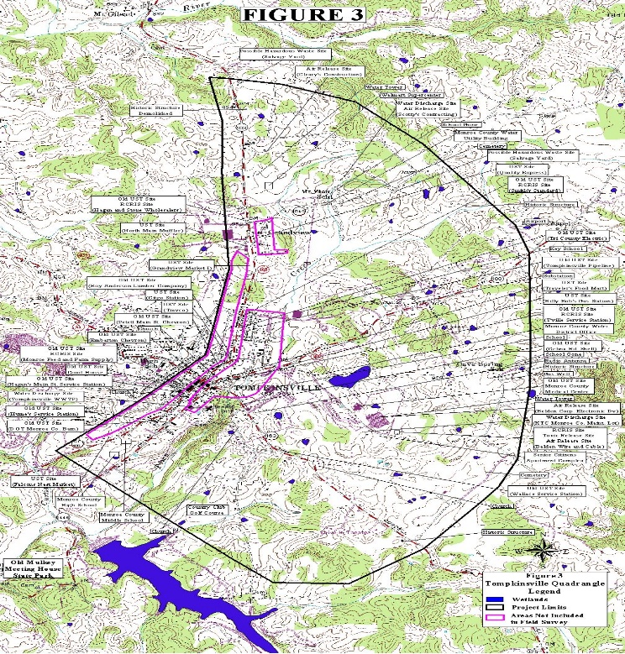
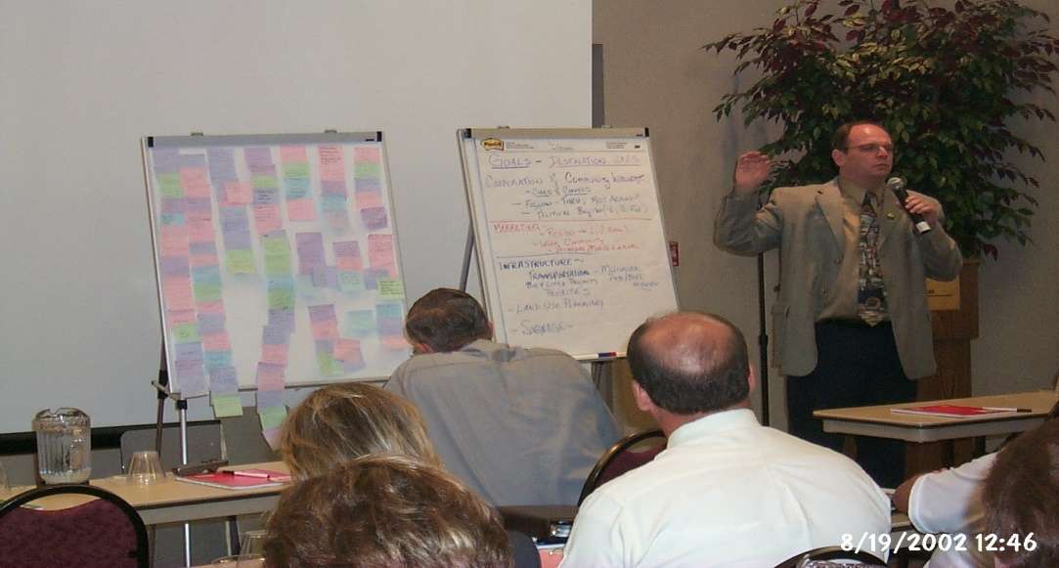
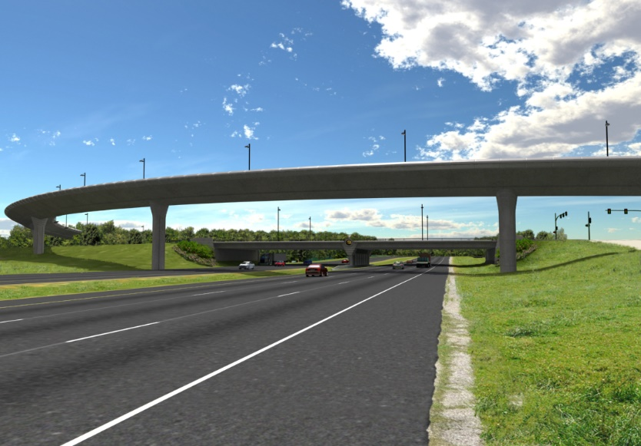
Project Development: Planning
Find Problem areas that need Improvement
Collect Public Input
Set Criteria for the design

Slide 6

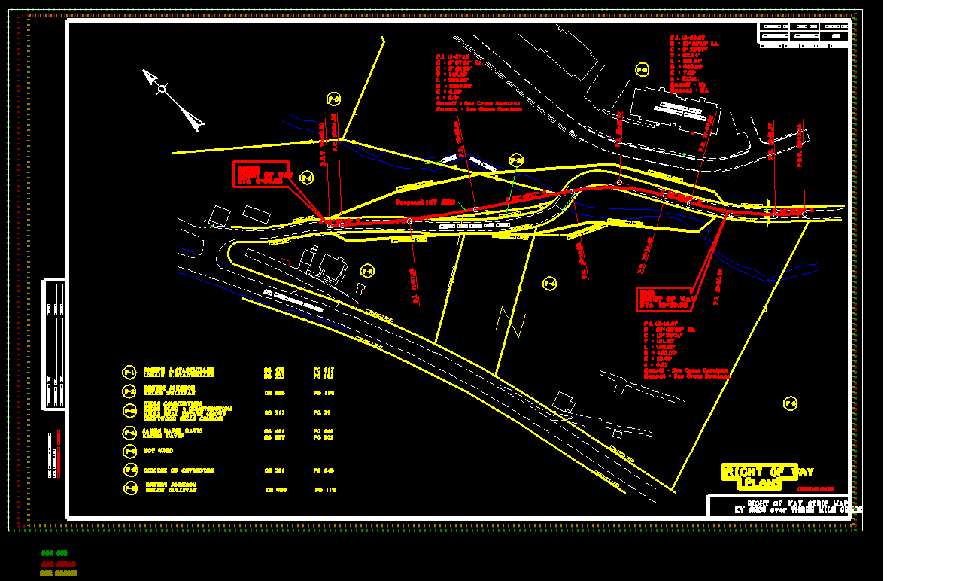
Project Development: Design
Draw plans for roads & Bridges
Think about Traffic, speed and safety
Use software for design curve and lanes

Slide 7
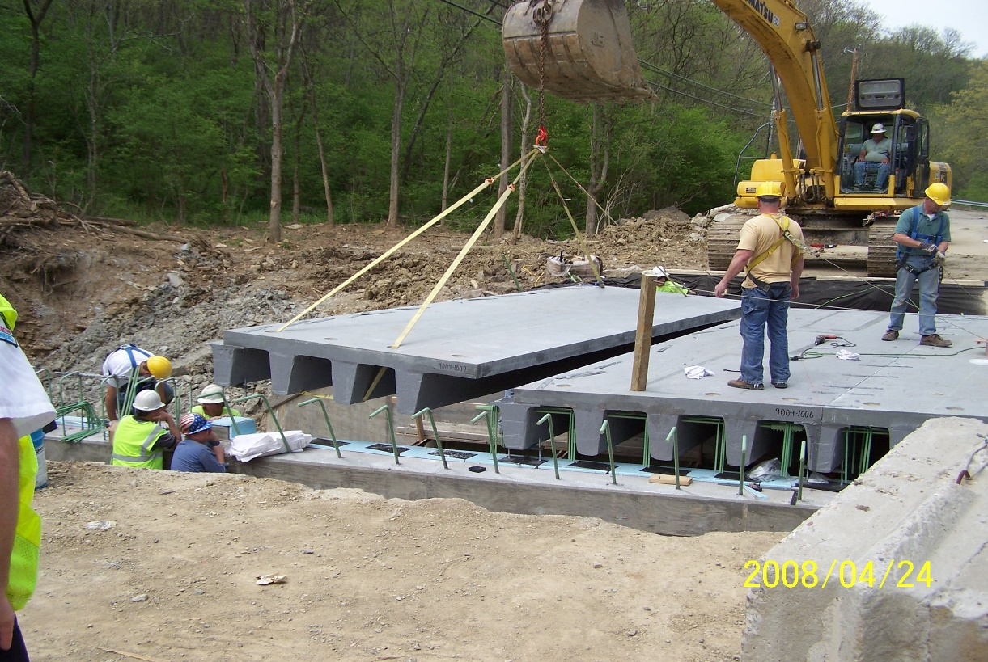
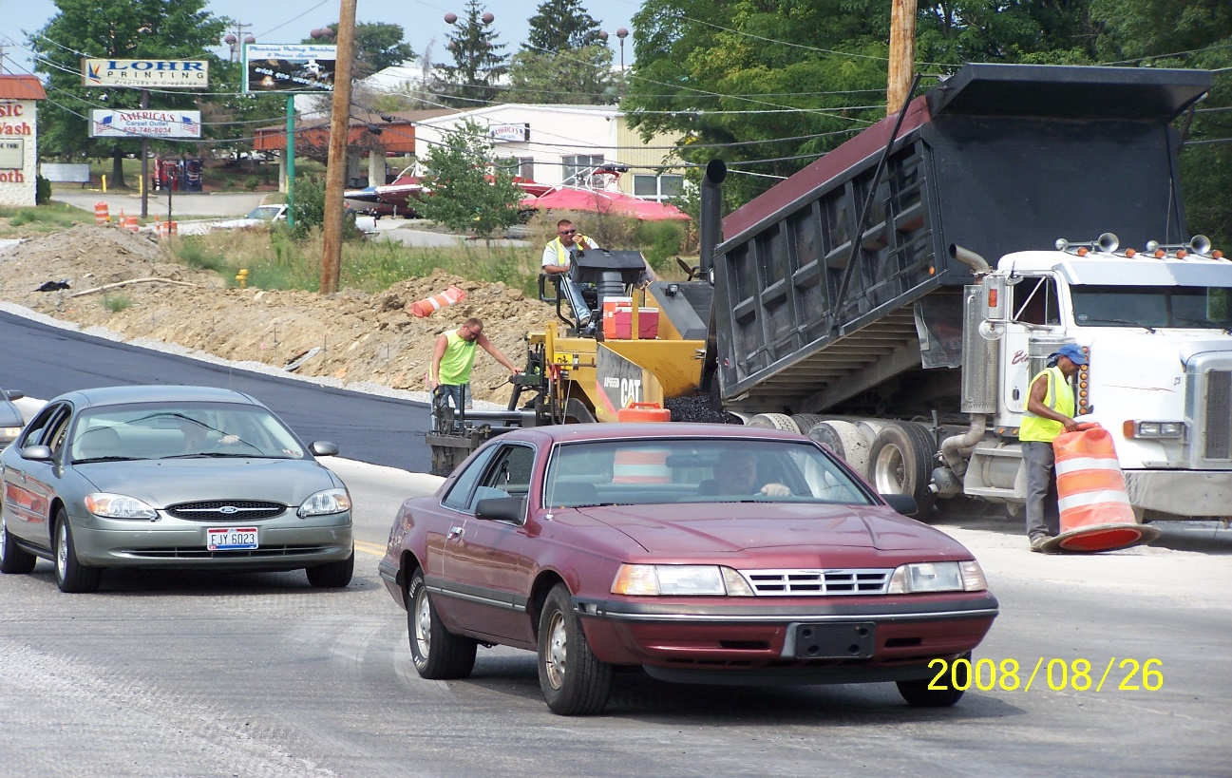
Project Delivery:
Construction
Workers And Machines Build the project
Engineers check everything is right
Safety rules are followed
Step by step, it starts to take shape

Slide 8
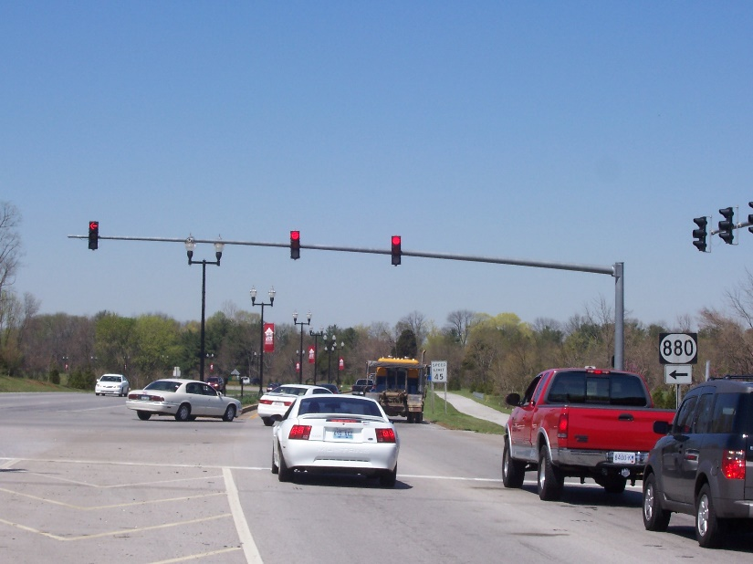

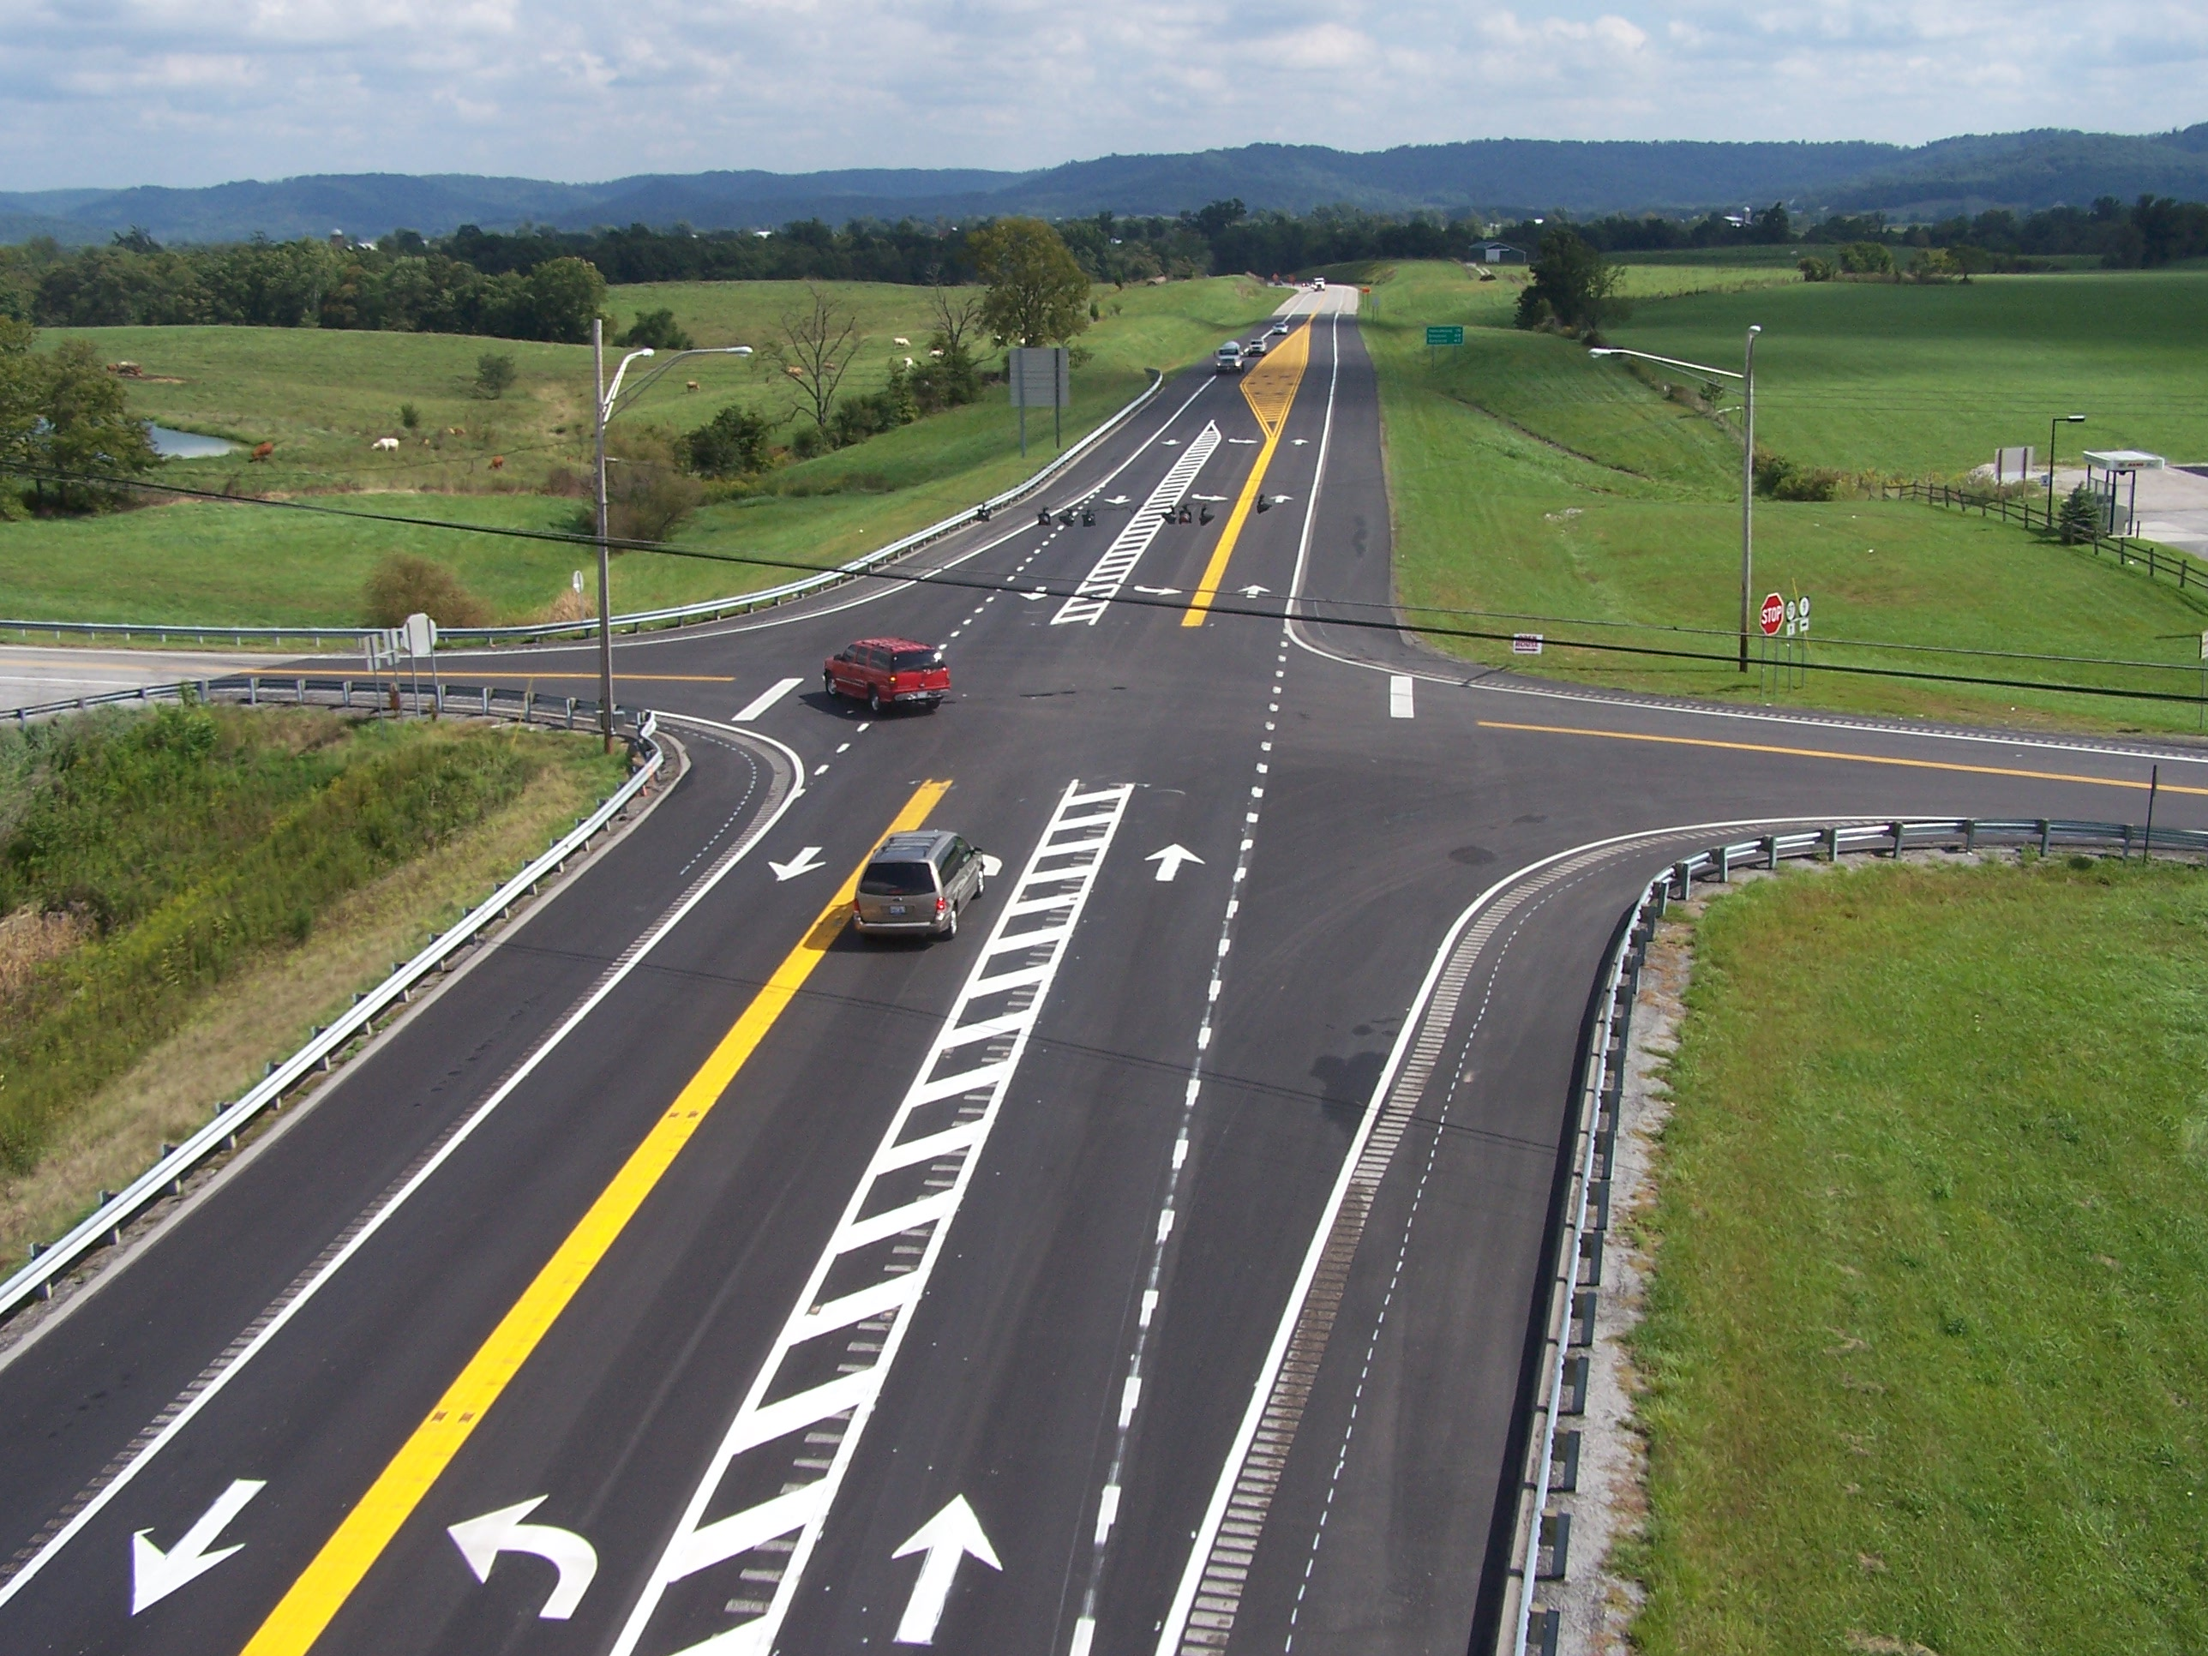
PROJECT PRESERVATION:
TRAFFIC
Takes care of the users of the system using signs, signals, and striping.

Slide 9
The Perfect Storm as a Perfect Opportunity?
RETIREMENTS
NEW SKILL REQUIREMENTS
SMALLER HIRING POOL
Notes:
Experts warn that there is a crisis looming in the 21st Century Workforce because of the lack of young people entering the Science, Technology, Engineering, Mathematics (STEM) careers.

Slide 10
Why do we do what we do?
SERVICE
Helping people travel safely and on time
Help Communities improve and grow
Work with people
ENJOY PROBLEM SOLVING WORK & LEARNING NEW THINGS
PERSONAL BENEFITS
Travel—a career in transportation takes you places, literally.
A Decent Wage
Job Security (We will always be moving)

Slide 11
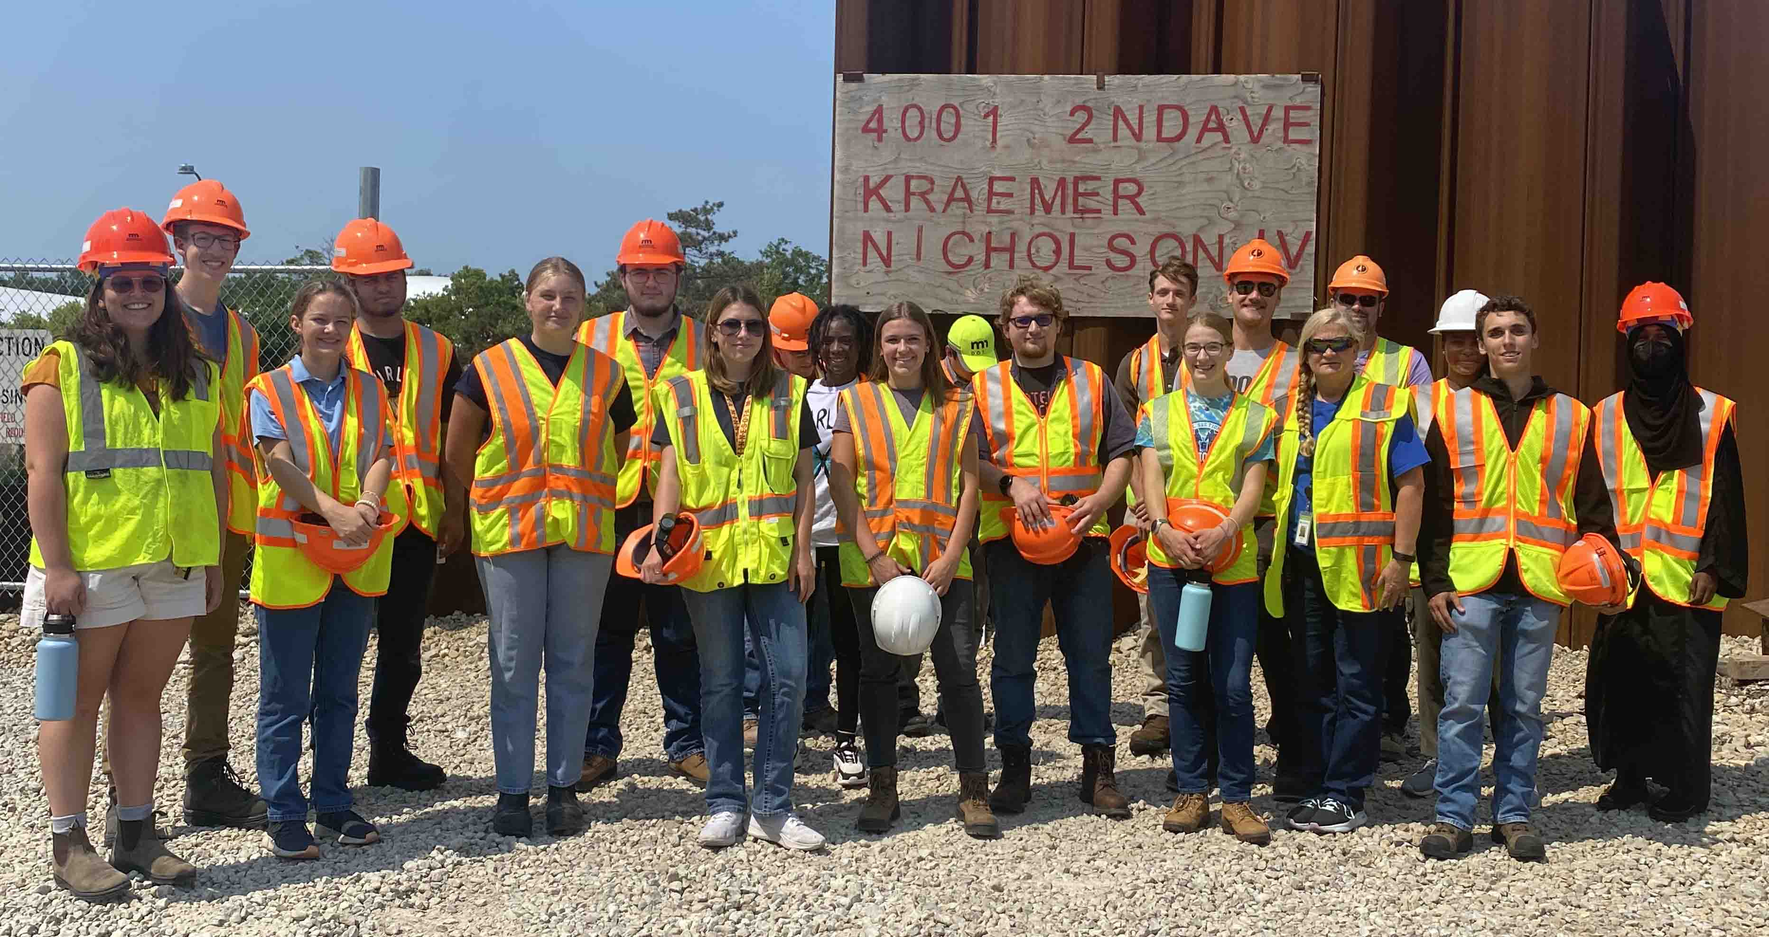
The Future Face of Transportation Engineering
Can you picture yourself among these future Engineers?

Slide 12

Becoming A Civil Engineer
ABET ACCREDITED SCHOOL (UK, UL, WKU)
30 SCHOOL HOURS (MASTERS)
FE EXAM
PE EXAM
4-YEAR DEGREE (BACHELORS)

Slide 13
SAMPLE CURRICULUM
FRESHMAN
SOPHOMORE
Fall Semester | Hours
Calculus I | 4.0
Writing I | 3.0
Chemistry I | 3.0
Intro. to CE | 3.0
Computer Graphics | 3.0
Fall Semester | Hours
Physics I & Lab | 5.0
Calculus III | 4.0
Statics | 3.0
Computer Science | 3.0
University Studies | 3.0
Spring Semester | Hours
Calculus II | 4.0
Writing II | 3.0
Chemistry II | 3.0
University Studies | 3.0
University Studies | 3.0
Spring Semester | Hours
Calculus IV | 3.0
Physics II & Lab | 5.0
Surveying | 4.0
Transportation Eng. | 3.0
Thermodynamics I | 3.0

Slide 14
SAMPLE CURRICULUM
JUNIOR
SENIOR
Fall Semester | Hours
Intro. To Construction | 3.0
Fluid Mechanics I | 3.0
Soil Mechanics | 3.0
Deformable Solids & Lab | 4.0
Elementary Geology | 4.0
Fall Semester | Hours
CE Systems | 3.0
Hydrology | 3.0
Design Electives | 4.0
CE Elective | 3.0
University Studies | 3.0
Spring Semester | Hours
Materials | 3.0
Structural Mechanics | 3.0
Seminar (Ethics) | 1.0
Fluid Mechanics II | 3.0
Water Quality | 3.0
University Studies | 3.0
Spring Semester | Hours
Structural Elective | 3.0
CE Elective | 3.0
CE Elective | 3.0
University Studies | 3.0
University Studies | 3.0
Dynamics | 3.0

Slide 15
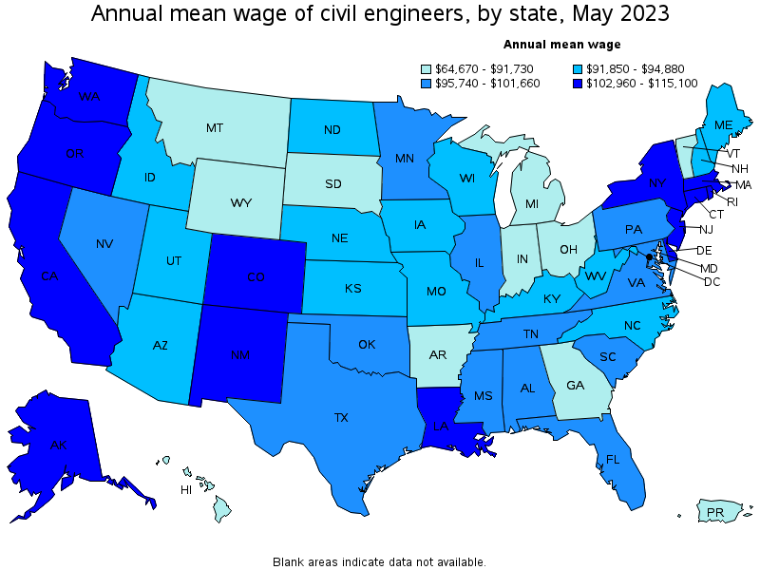
CIVIL ENGINEER SALARY INFORMATION

Slide 16

Civil Engineering Scholarship Program

Slide 17
PARTICIPATING SCHOOLS
UNIVERSITY OF KENTUCKY
UNIVERSITY OF LOUISVILLE
WESTERN KENTUCKY UNIVERSITY
KENTUCKY STATE UNIVERSITY

Slide 18

SCHOLARSHIP HISTORY
Since 1948
1,800 Scholarships
$14 Million

Slide 19
WHAT’S IT WORTH?
80 Scholarships
$7,200 for Freshman/Sophomore per semester
$7,600 for Junior/Senior per semester
Up to $59,000 !!

Slide 20
QUALIFICATIONS
Kentucky residents
Graduate of an accredited kentucky high school (or hold a GED)
Meet the admission requirements of their chosen university

Slide 21
CONDITIONS OF SCHOLARSHIP
Work one year full-time for the Cabinet for each year that you are on Scholarship
Maintain GPA 2.5 on 4.000 scale
Maintain 12 hours/semester and complete 30 total hours each school year

Slide 22
HOW DO I APPLY?
Fill out an application
Copy of transcript
Copy of official ACT score report
2 letters of recommendation 1) Counselor or Principal; 2) Math teacher
Submit application
*You must apply separately to University

Slide 23
THANK YOU!

Slide 24
KYTC.KEEN@ky.gov
transportation.ky.gov/Education/Pages/KEEN.aspx

