Slide 1


STRAW TOWERS
ENGINEERING IDEAS

Slide 2
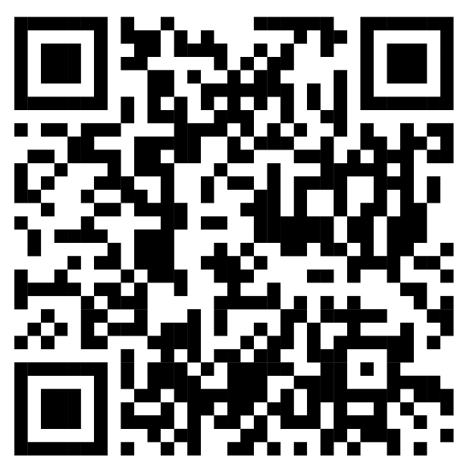

An education initiative by the Kentucky Transportation Cabinet

Slide 3




ENGINEERS ARE PROBLEM SOLVERS
Use Technology to solve problems
Think Creatively to build new things
Use math, science, and computers
All engineers use similar problem-solving steps

Slide 4
THE ENGINEERING PROCESS
IDENTIFY
DEFINE
SOLVE THE PROBLEM
ANALYZE
DESIGN
REFINE
Identify the issue faced. In detail.
Document the issue and factors that impact it.
Study the issue. Make sure you understand causes.
Come up with multiple solutions. We call them alternatives.
Test the alternatives. Finds benefits and costs.
Choose a solution and implement it!

Slide 5
TYPES OF ENGINEERS
Civil
Chemical
Electrical
Computer
Industrial
Mechanical
Aeronautical

Slide 6
TYPES OF CIVIL ENGINEERS
Structural
Transportation
Geotechnical
Environmental
Water resources
QUIZ COMING!

Slide 7
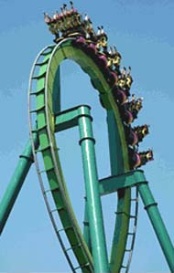
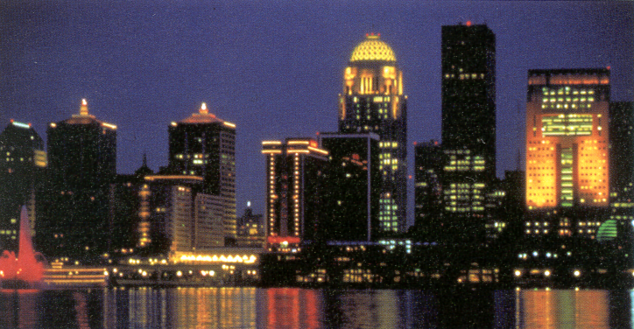
WHO DOES THIS?
BUILDINGS
BRIDGES
STRUCTURAL ENGINEER

Slide 8
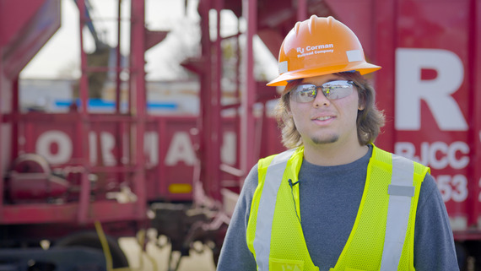
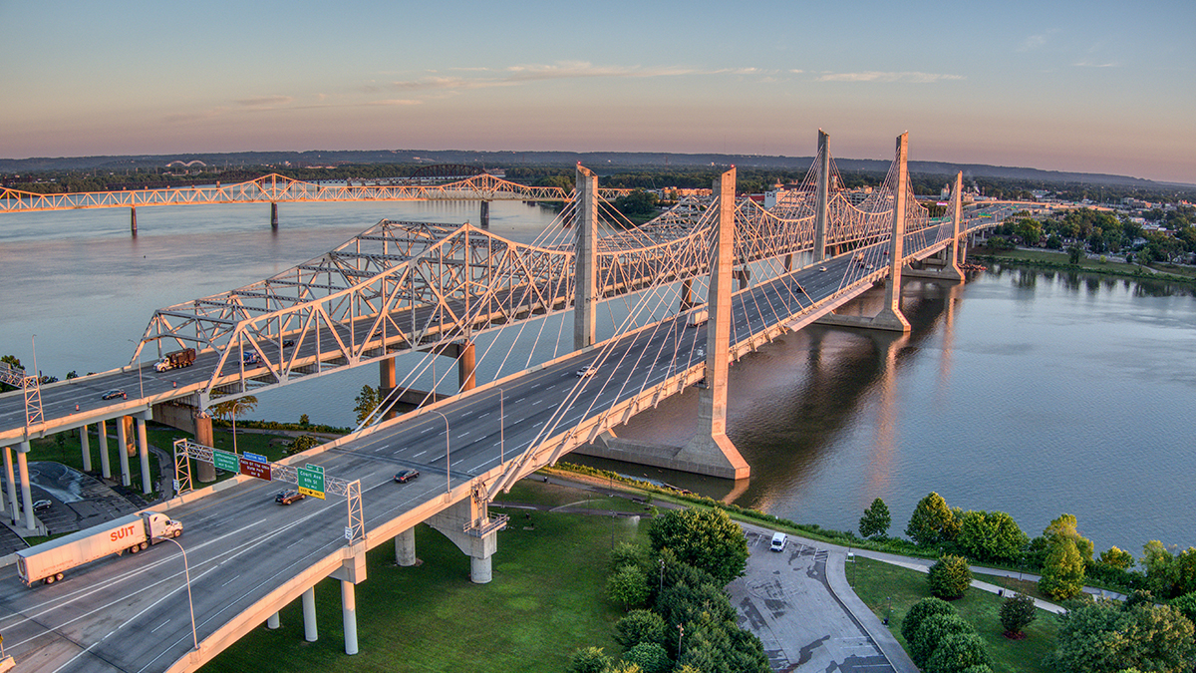
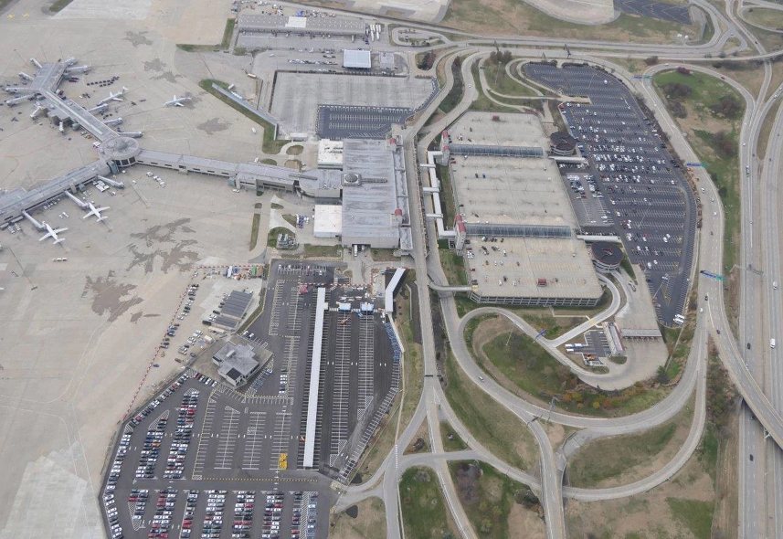
WHO DOES THIS?
ROADS
AIRPORTS
TRANSPORT- ATION ENGINEER

Slide 9
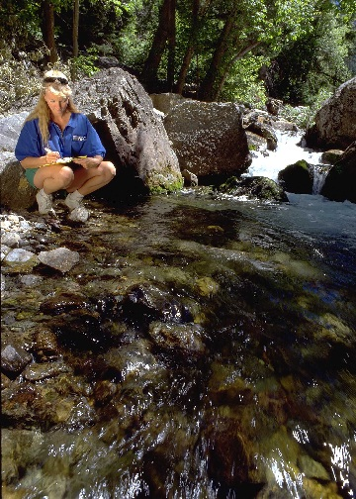

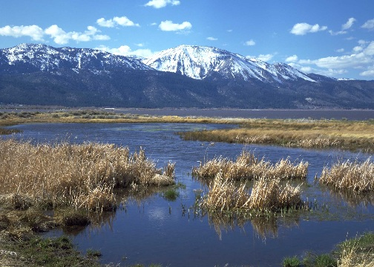
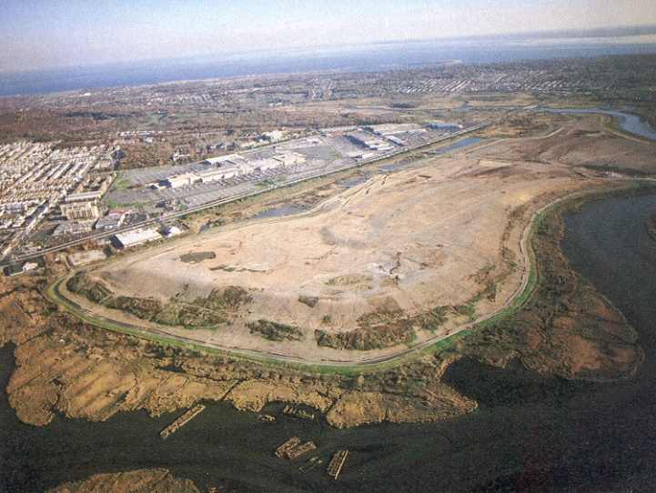
WHO DOES THIS?
NATURAL RESOURCES
SPECIES
ENVIRON- MENTAL ENGINEER

Slide 10
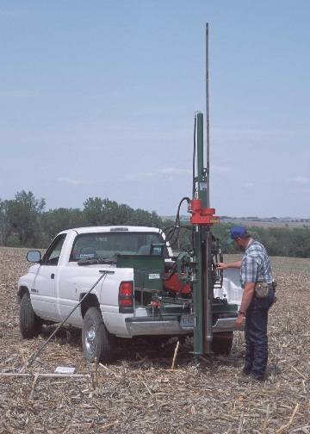

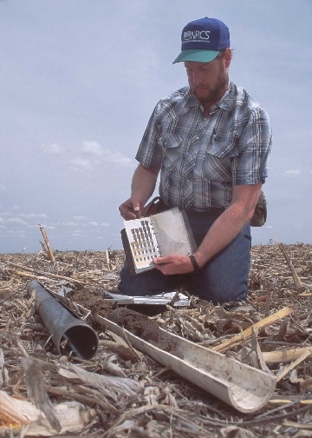
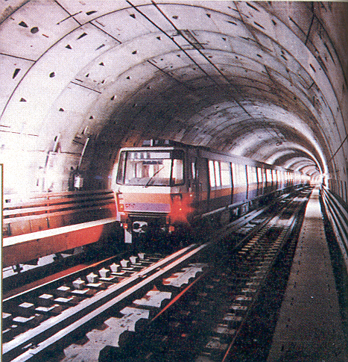
WHO DOES THIS?
SOIL
FOUNDATIONS
GEO-TECHNICAL ENGINEER

Slide 11
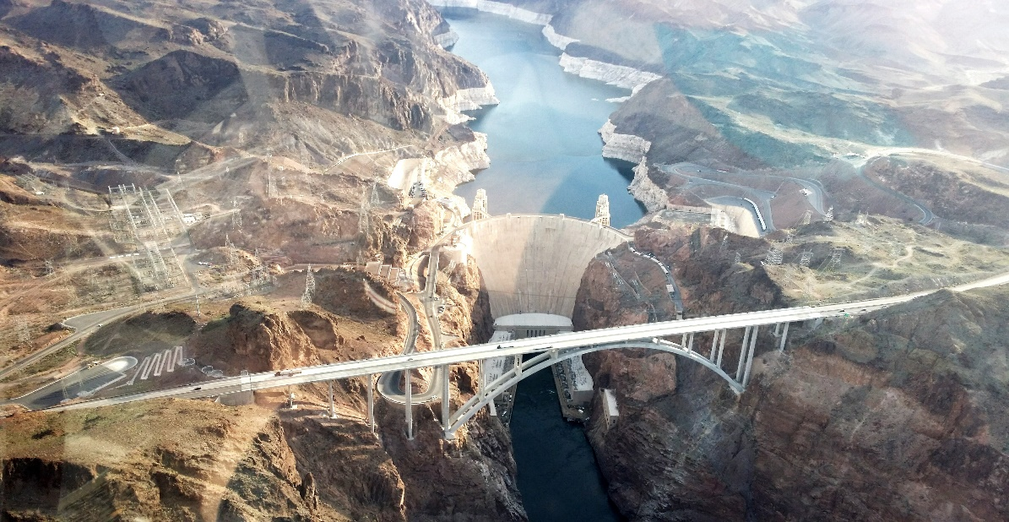
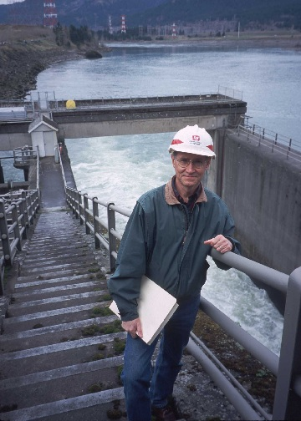
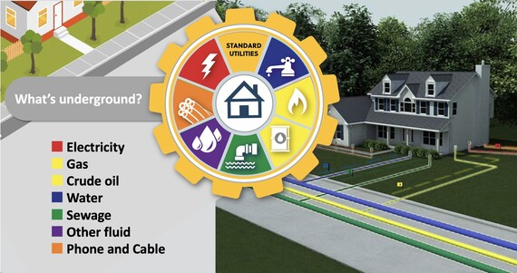
WHO DOES THIS?
TRANSPORT
TREATMENT
WATER RESOURCE ENGINEER

Slide 12
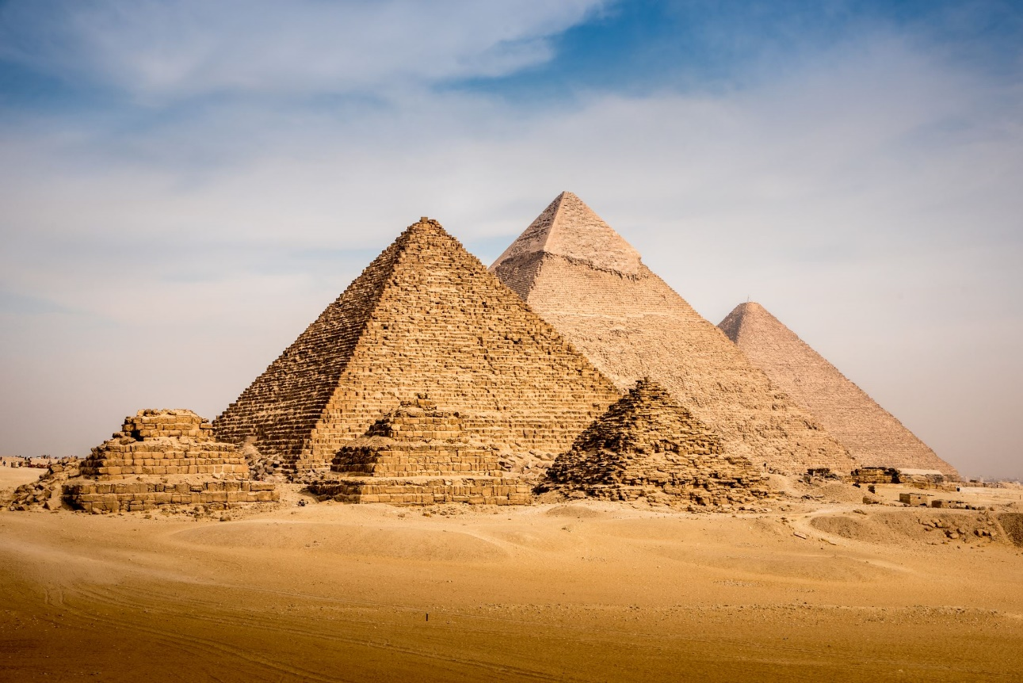
HISTORY OF STRUCTURAL ENGINEERING
Structural engineering dates back to 27th century B.C.
THE PYRAMIDS!

Slide 13
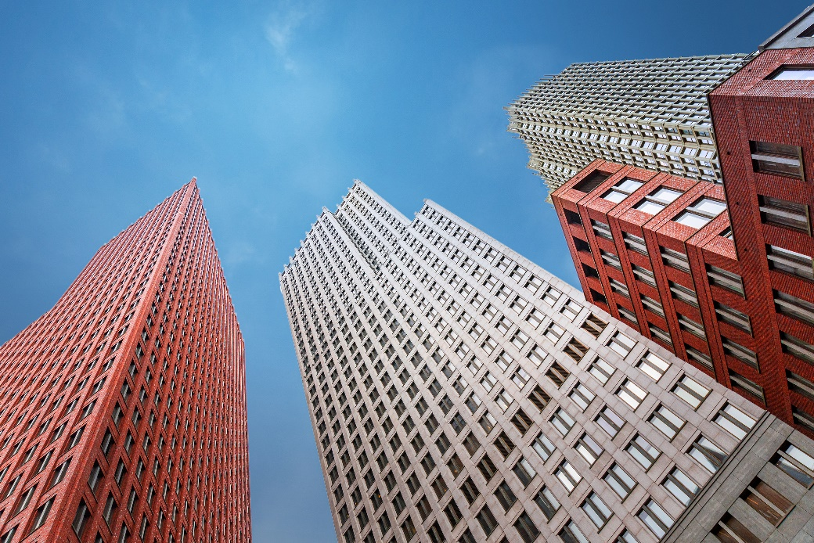
HISTORY OF STRUCTURAL ENGINEERING
In the late of 19th and earlier of 20th centuries….
The modern science revolution advanced structural engineering tremendously.

Slide 14

HISTORY OF STRUCTURAL ENGINEERING
In 1889…
The Eiffel Tower was built by Gustave Eiffel and Maurice Koechlin.

Slide 15
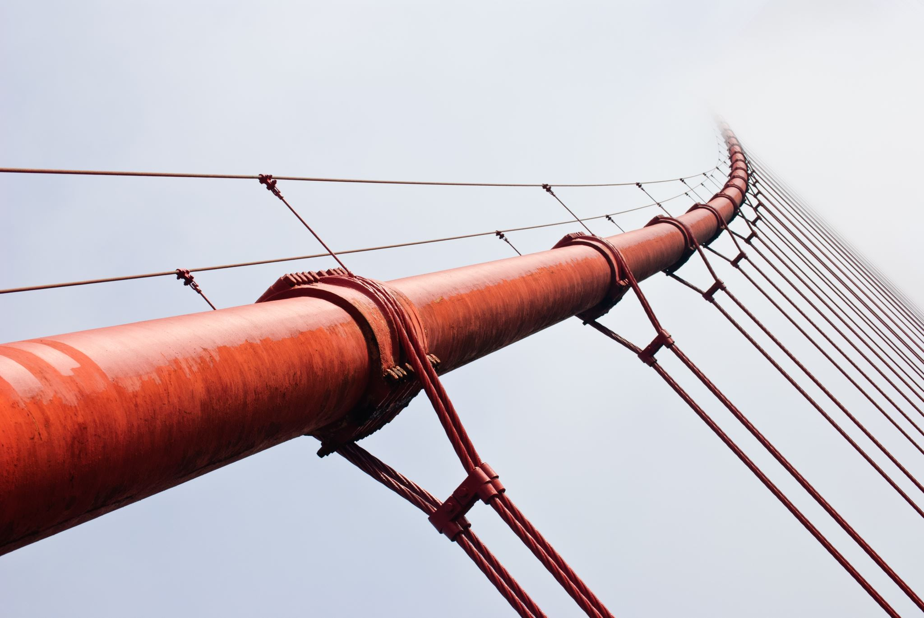
WHAT IS STRUCTURAL ENGINEERING
Deals with the design of structural systems.
Structures must support & resist loads.

Slide 16


WHAT IS STRUCTURAL ENGINEERING
A structural engineer is involved in the design of:
Buildings
Nonbuilding structures where integrity is a matter of safety and reliability.

Slide 17
STRUCTURAL ENGINEERING DESIGN
Safety: Structures don’t collapse without warning
Serviceability: Ease of use, example minimize floor vibration
Movement: Comfort of use, Building sway can’t result in discomfort for occupants

Slide 18
STRUCTURAL ENGINEERING DESIGN
Structural engineers MUST EFFICIENTLY use:
Funds
Material
Goal

Slide 19
EQUILIBRIUM: Sum of Forces = 0
Loads
Forces
Moment
Torsion
The force exerted on a surface or body
An external factor which can change the state of rest or state of uniform motion of an object
The turning ability of force, that can rotate an object
The twisting of an object due to an applied torque

Slide 20
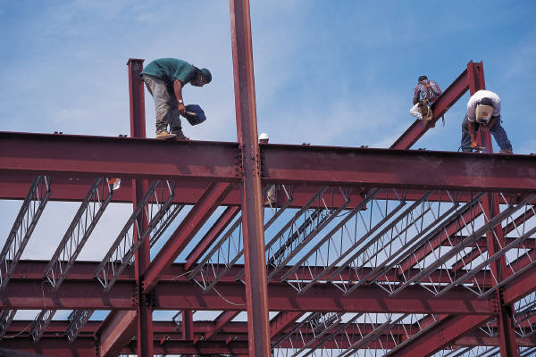

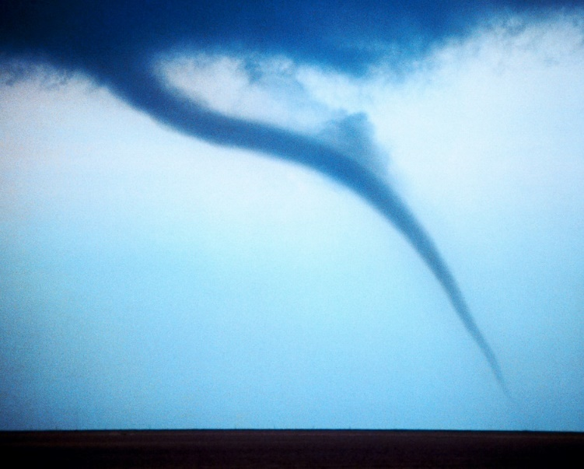
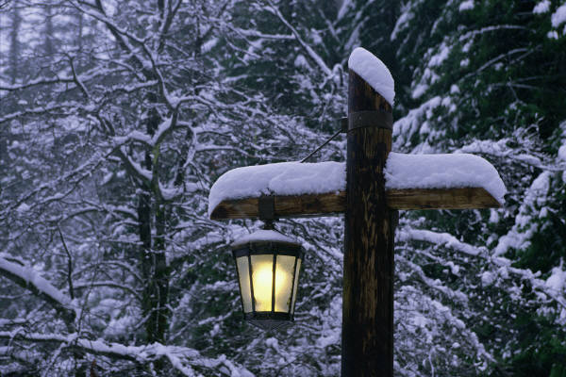
LOADS: Force exerted on a surface or body
Dead Loads
Live LoadsDead Loads
Live Loads
Wind Loads
Snow Loads
Wind Loads
Snow Loads
Dead Loads
Live Loads
Wind Loads
Snow Loads

Slide 21
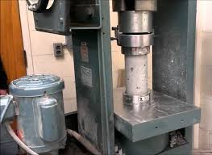
AXIAL LOADS
Compression
pushing or shortening
Tension
pulling or elongating

Slide 22
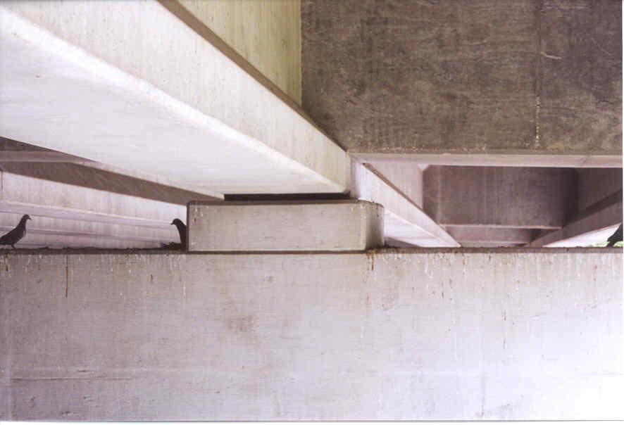
FORCES: External factor which can change the state of rest or state of motion of an object

Slide 23

MOMENTS: Turning ability of force, force that can rotate an object
Summation of Moments
Σ M=0
Moment = Force * Distance

Slide 24
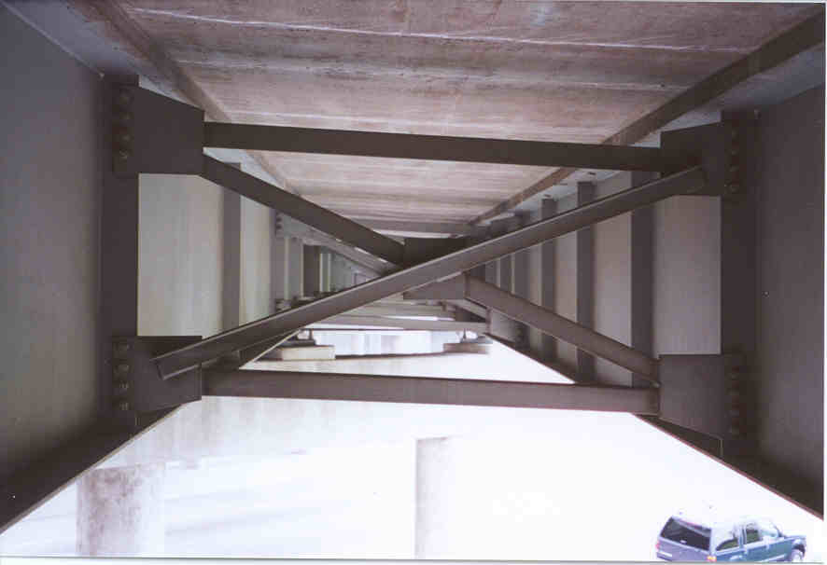
TORSION: Twisting of an object due to an applied torque
Produced when a beam is subjected to loads which cause it to buckle and roll.
Diaphragms are inserted to eliminate torsion.

Slide 25
​BUILDING TOWERS
A structure;
A tall man-made building;
Always (and usually much) taller than they are wide;
Built to take advantage of their height;
Either free standing or part of a larger structure.
A tower is….
Notes:
Play video if there is a good internet connection.

Slide 26
​BUILDING TOWERS
EXAMPLES
To enhance views: tourist towers, air-traffic Control
To increase potential energy: water towers
To enhance communications: lighthouse, bell towers, clock towers
As support: bridge towers
To access tall or high objects: launch towers
As art: Eiffel tower
For recreation: rock climbing towers
To save ground-level space: skyscrapers
To increase strategic advantage: watch towers
Towers….
Notes:
Play video if there is a good internet connection.

Slide 27
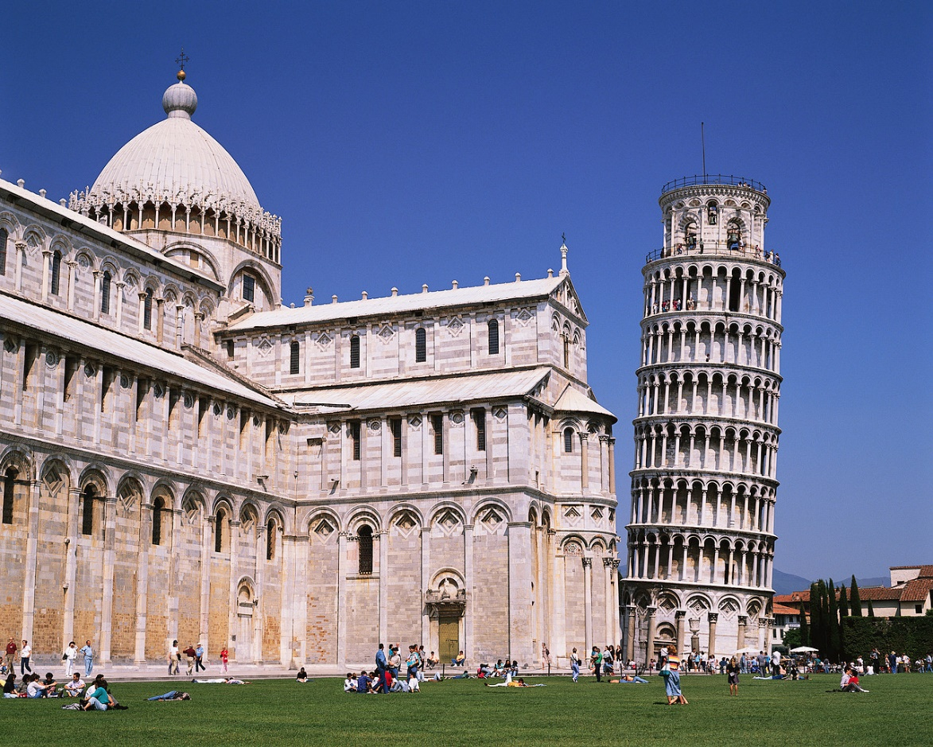
​BUILDING TOWERS – Leaning Tower of Pisa
Built from 1173 until 1372 and in Pisa, Italy.
When the tower had reached its third story the works ceased because it had started sinking into the ground.
The tower remained thus for 90 years.
Leaning Tower can be reached by mounting the 294 steps.
Unfortunately, even today it continues to sink very slowly.
It sinks about 1 mm. every year.
Notes:
Play video if there is a good internet connection.

Slide 28
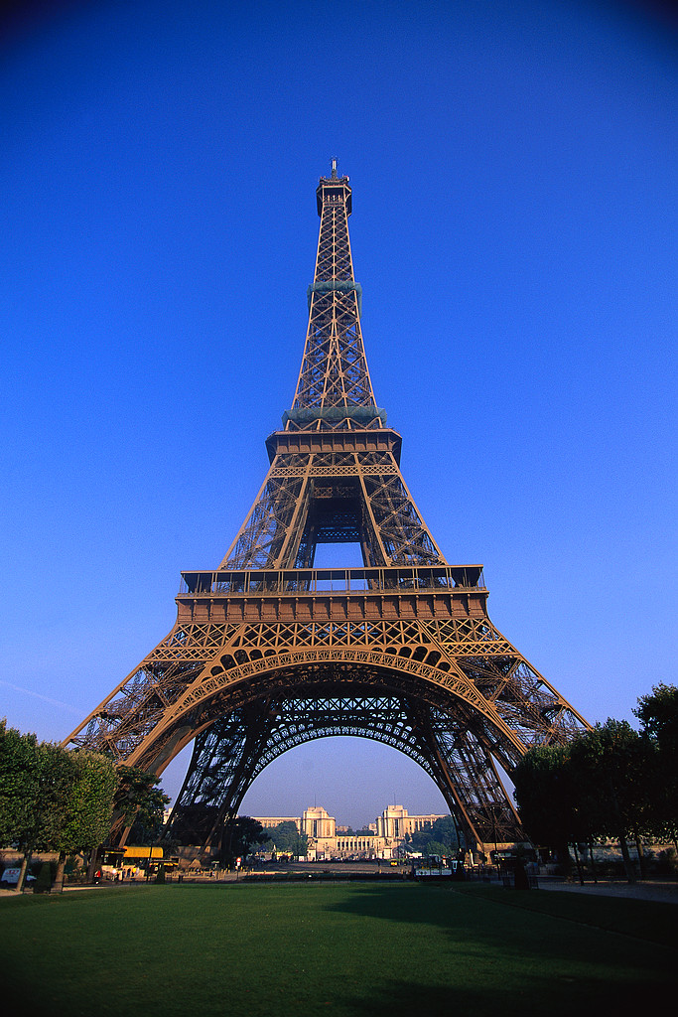
​BUILDING TOWERS – Eiffel Tower
Designed by A. G. Eiffel and erected for the Paris exposition of 1889.
The tower is 984 ft (300 m) high.
Consists of an iron framework supported on four masonry piers, from which rise four columns uniting to form one shaft.
Notes:
Play video if there is a good internet connection.

Slide 29
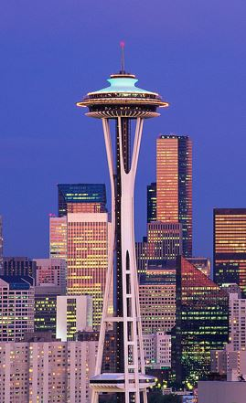
​BUILDING TOWERS – Space Needle
Edward E. Carlson, chairman of the 1962 World's Fair in Seattle, originally had an idea for erecting a tower with a restaurant at the top as part of the World's Fair celebration.
Notes:
In 1961, a 120’ by 120’ plot was bought.
The earthquake stability of the Space Needle was ensured when a hole was dug 30 feet deep and 120 feet across.
The foundation is almost 6,000 tons and 250 tons of reinforcing steel in the base.
The structure is bolted to the foundation with 72 bolts, each bolt is 30’ long.
The top dome was perfectly balanced so that the restaurant could rotate with the help of one tiny electric motor, originally 1 hp.
It was completed in April 1962 at a cost of $4.5 million.

Slide 30
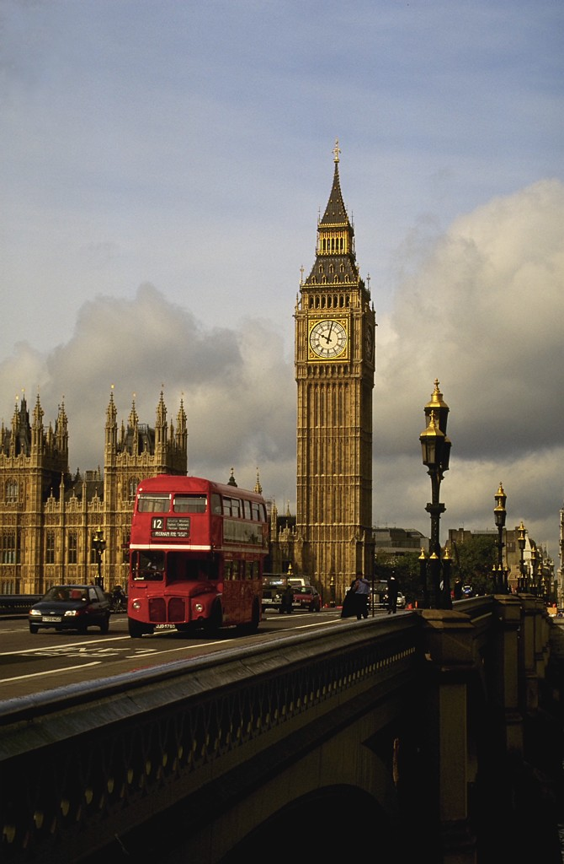
​BUILDING TOWERS – Tower of London
The White Tower was built 1078 by Gundulf, bishop of Rochester; the exterior restored by Sir Christopher Wren.
The home of Big Ben is ancient fortress in London, England
Now used mainly as a museum
it was a royal residence in the Middle Ages.
Later it was a jail for illustrious prisoners.
The Tower is enclosed by a dry moat.
Notes:
Play video if there is a good internet connection.

Slide 31
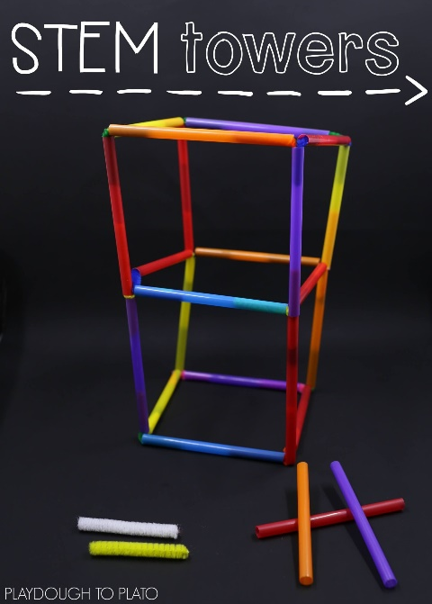
TIME TO BUILD
A TOWER
MATERIALS
Straws
Scissors
4 inches of Tape
Straw Tower Engineers Worksheet
https://youtu.be/VuX_27HvHpU
Credit: https://www.teachengineering.org/activities/view/ucd_straw_tower_activity1

Slide 32
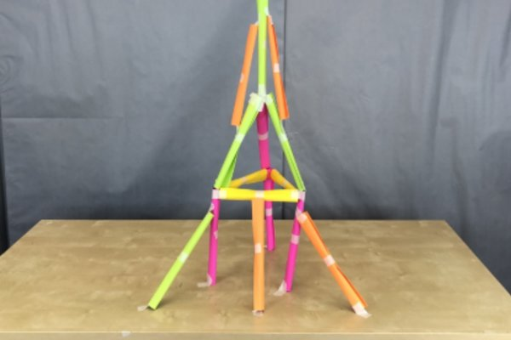
RULES
Build the tallest tower using only straws.
Engineering Team of 2-4 students.
Use only the provided materials.
Engineers have 30 minutes to build their towers.
Towers may be rebuilt any number of times during the construction period.
Towers must be free standing.
Straws may be bent or fitted inside each other, but they may not be cut.
Judges measure tower height and number of unused straws.
Complete the worksheet to develop a design.
Tape can only be used at joints.
Towers….
Credit: https://www.teachengineering.org/activities/view/ucd_straw_tower_activity1
Notes:
Play video if there is a good internet connection.

Slide 33
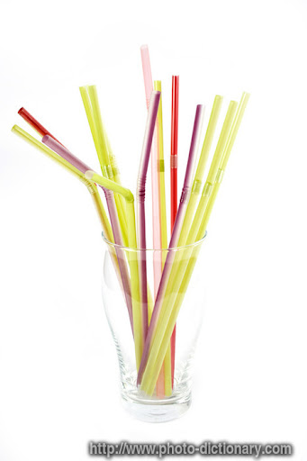
You have 30 minutes... keep in mind
Load
Balance
Foundation
IDENTIFY
DEFINE
SOLVE THE PROBLEM
ANALYZE
DESIGN
REFINE

Slide 34
TIME TO BUILD
A TOWER
AWARDS
In the case of a tie, the tower using the fewest straws wins.
Judges measure tower height and number of unused straws.
Awards are given for the tallest towers.
https://youtu.be/VuX_27HvHpU
Credit: https://www.teachengineering.org/activities/view/ucd_straw_tower_activity1

Slide 35
What did you learn?
What happened?
What would you change?
Questions?

Slide 36
KYTC Scholarships
Visit our scholarship page to download an application and learn more.
Deadline to apply is February
https://transportation.ky.gov/Education/Pages/default.aspx
https://youtu.be/lebpjYJXpVA?si=2Dgr9sKwUZGWNUFK
Scholarship Promo
Notes:
Being selected for a KYTC scholarship is a very rewarding accomplishment. Each year,20 to 30 new students are selected from an average of 75+ applicants and theselection process is quite competitive. GPA and ACT scores are taken into consideration; however, there are other factors that are just as, or more, important.Here are a couple of tips to make an application stand out from the pack and gain aninterview:
The essay doesn’t have to be long, but we want to know why the studentwants to work for KYTC when they graduate, not just why they want to be anengineer or engineering technologist. These programs are a pipeline for KYTCengineers and technologists, and we are looking for students who arecommitted to working for us when they graduate.
The student may not have paid work experience, but volunteer activities, sports(and positions held), club activities and any leadership positions should belisted. We are looking for future engineers who know how to work well withothers and have the potential to be great employees.
Students can begin working on their application now. Don’t wait until the last minute.Visit our scholarship page to download an application and learn more about theselection process.
Deadline to apply is February 1, 2023.

Slide 37


KYTC.KEEN@ky.gov
transportation.ky.gov/Education/Pages/KEEN.aspx

