Slide 1

Is Engineering for Me?
Presentation by:
On Month Day 2022

Slide 2


An education initiative by the Kentucky Transportation Cabinet

Slide 3

Why Become an Engineer ?
Engineers are problem solvers.
Use tools and technology to solve problems.
Be Creative and think outside the box.
Use math, science and computers
All engineers share smart ways of working

Slide 4


Why become an engineer?
JOB SATISFICATION
VARIETY OF CAREER OPPORTUNITIES
CHALLENGING WORK
INTELLECTUAL DEVELOPMENT
OPPORTUNITIES TO BENEFIT SOCIETY
AVENUES TO EXPRESS YOUR OWN CREATIVITY
OPPORTUNITIES TO UNDERSTAND HOW THINGS WORK

Slide 5
The Engineering Process:
IDENTIFY and
define a problem
Implement
Solution
ANALYZE
the problem
Propose solutions
Select and Design
preferred solution

Slide 6
Types Of Engineers
Civil
Chemical
Electrical
Computer
Industrial
Mechanical
Aeronautical

Slide 7

Types Of Civil Engineers
STRUCTURAL
TRANSPORTATION
GEOTECHNICAL
ENVIRONMENTAL
WATER RESOURCES

Slide 8
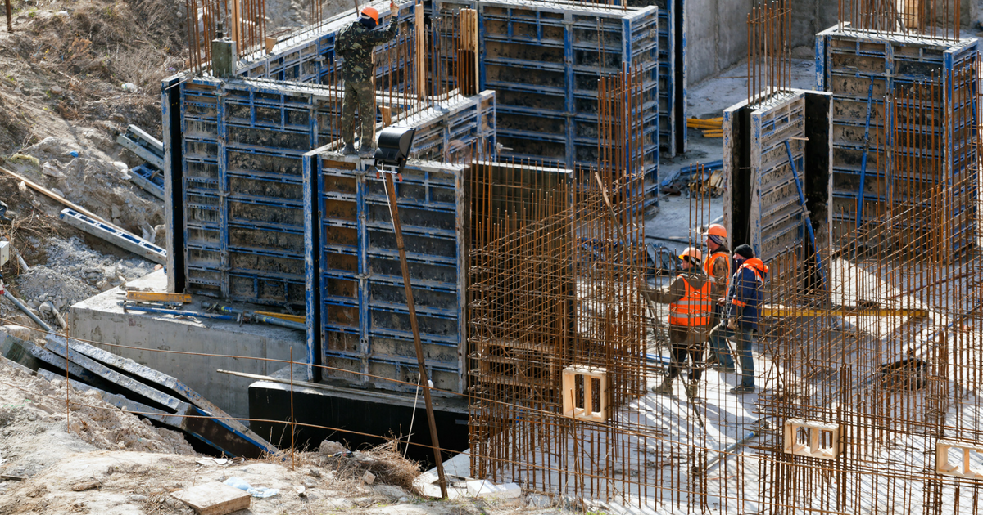
Structural Engineering

Slide 9
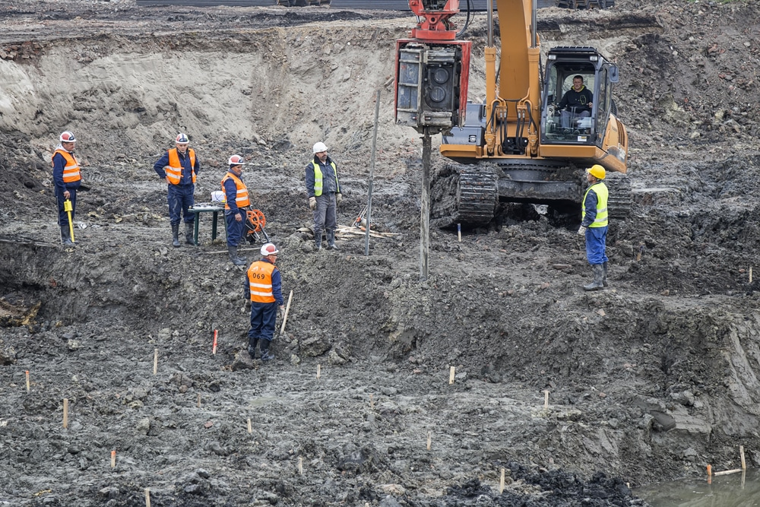
Geology
Roacks & soil Foundations
Material Science
Mechanics
Geotechnical Engineering

Slide 10
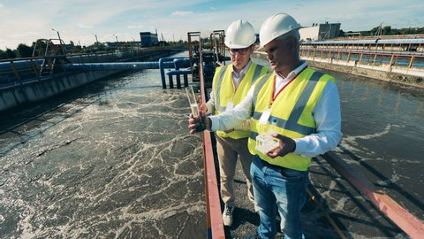
Waste Treatment
Air & Water Purification
Pollution Reduction
Green Engineering
Environmental Engineering

Slide 11
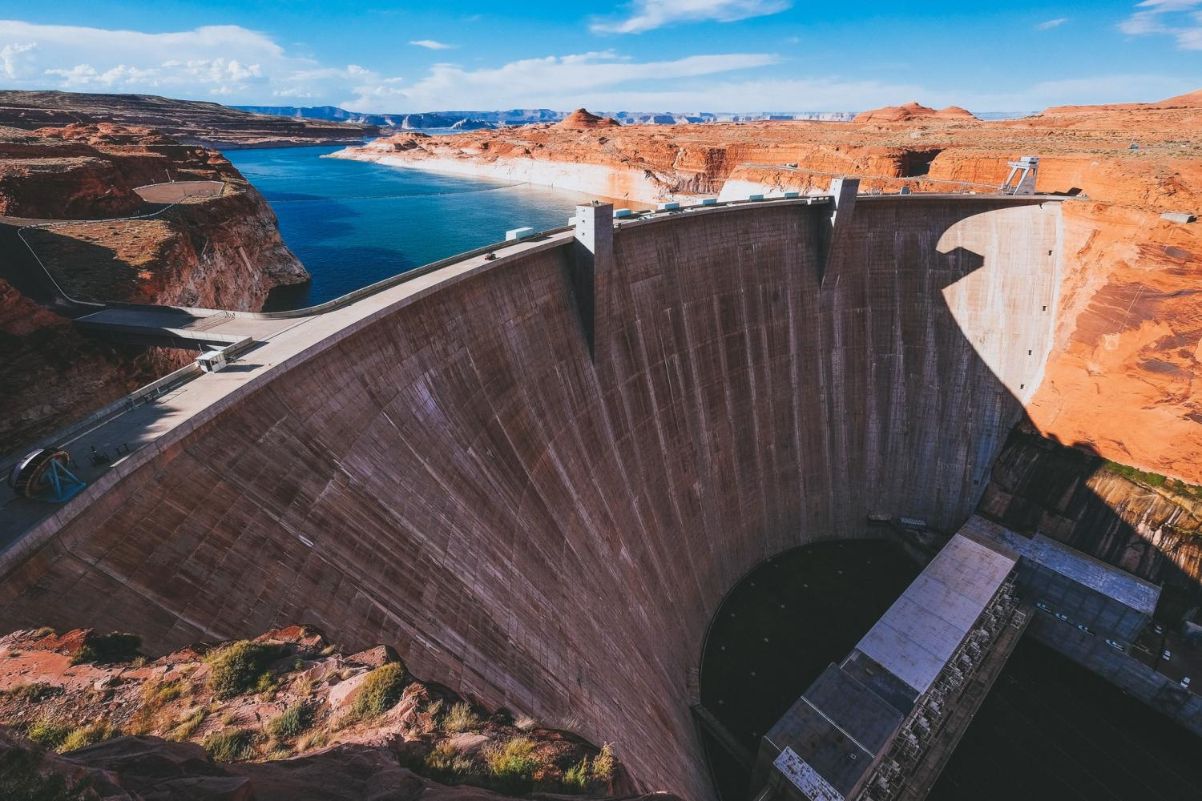
Drainage Facilities
Canals
Pipelines
Water distribution system
Hydraulic Engineering

Slide 12
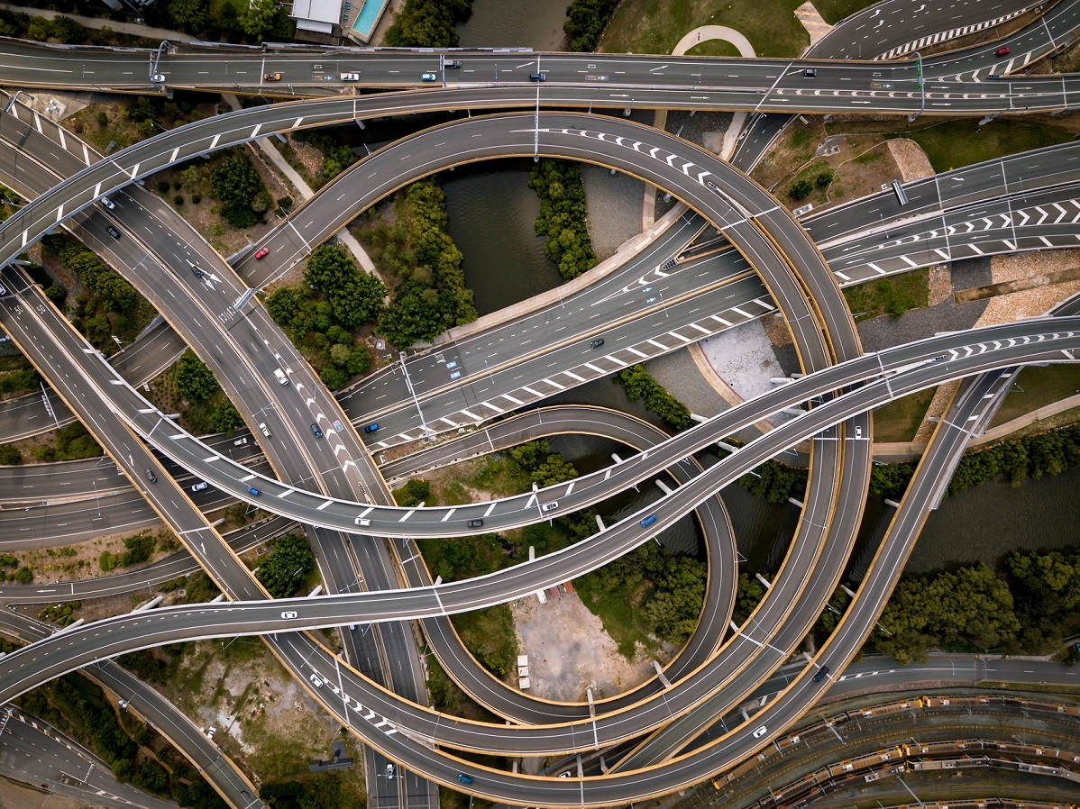
Roads
Rail
Airports
Traffic
Transportation Engineering

Slide 13

Becoming A Civil Engineer
ABET ACCREDITED SCHOOL (UK, UL, WKU)
30 SCHOOL HOURS (MASTERS)
FE EXAM
PE EXAM
4-YEAR DEGREE (BACHELORS)

Slide 14
SAMPLE CURRICULUM
FRESHMAN
SOPHOMORE
Fall Semester | Hours
Calculus I | 4.0
Writing I | 3.0
Chemistry I | 3.0
Intro. to CE | 3.0
Computer Graphics | 3.0
Fall Semester | Hours
Physics I & Lab | 5.0
Calculus III | 4.0
Statics | 3.0
Computer Science | 3.0
University Studies | 3.0
Spring Semester | Hours
Calculus II | 4.0
Writing II | 3.0
Chemistry II | 3.0
University Studies | 3.0
University Studies | 3.0
Spring Semester | Hours
Calculus IV | 3.0
Physics II & Lab | 5.0
Surveying | 4.0
Transportation Eng. | 3.0
Thermodynamics I | 3.0

Slide 15
SAMPLE CURRICULUM
JUNIOR
SENIOR
Fall Semester | Hours
Intro. To Construction | 3.0
Fluid Mechanics I | 3.0
Soil Mechanics | 3.0
Deformable Solids & Lab | 4.0
Elementary Geology | 4.0
Fall Semester | Hours
CE Systems | 3.0
Hydrology | 3.0
Design Electives | 4.0
CE Elective | 3.0
University Studies | 3.0
Spring Semester | Hours
Materials | 3.0
Structural Mechanics | 3.0
Seminar (Ethics) | 1.0
Fluid Mechanics II | 3.0
Water Quality | 3.0
University Studies | 3.0
Spring Semester | Hours
Structural Elective | 3.0
CE Elective | 3.0
CE Elective | 3.0
University Studies | 3.0
University Studies | 3.0
Dynamics | 3.0

Slide 16
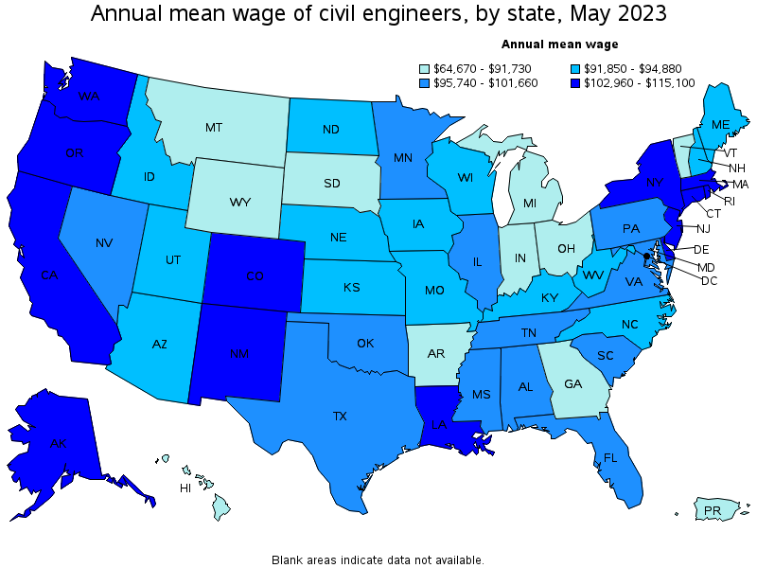
CIVIL ENGINEER SALARY INFORMATION

Slide 17

Civil Engineering Scholarship Program

Slide 18
PARTICIPATING SCHOOLS
UNIVERSITY OF KENTUCKY
UNIVERSITY OF LOUISVILLE
WESTERN KENTUCKY UNIVERSITY
KENTUCKY STATE UNIVERSITY

Slide 19

SCHOLARSHIP HISTORY
Since 1948
1,800 Scholarships
$14 Million

Slide 20
WHAT’S IT WORTH?
80 Scholarships
$7,200 for Freshman/Sophomore per semester
$7,600 for Junior/Senior per semester
Up to $59,000 !!

Slide 21
QUALIFICATIONS
Kentucky residents
Graduate of an accredited kentucky high school (or hold a GED)
Meet the admission requirements of their chosen university

Slide 22
CONDITIONS OF SCHOLARSHIP
Work one year full-time for the Cabinet for each year that you are on Scholarship
Maintain GPA 2.5 on 4.000 scale
Maintain 12 hours/semester and complete 30 total hours each school year

Slide 23
HOW DO I APPLY?
Fill out an application
Copy of transcript
Copy of official ACT score report
2 letters of recommendation 1) Counselor or Principal; 2) Math teacher
Submit application
*You must apply separately to University

Slide 24
THANK YOU!

Slide 25
KYTC.KEEN@ky.gov
transportation.ky.gov/Education/Pages/KEEN.aspx

