Slide 1

SAFERoad
Solutions
A guide to roadway designs
Presentation by:
On
Notes:
You don’t have to be a genius to be an engineer, but people who become engineers like math, science, and problem solving.

Slide 2


An education initiative by the Kentucky Transportation Cabinet

Slide 3
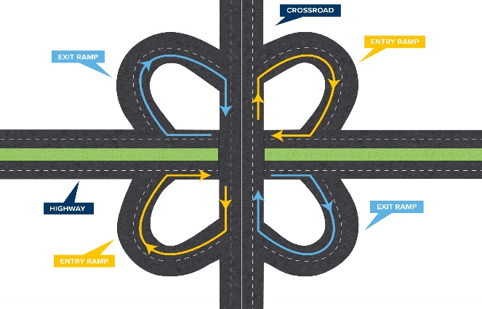
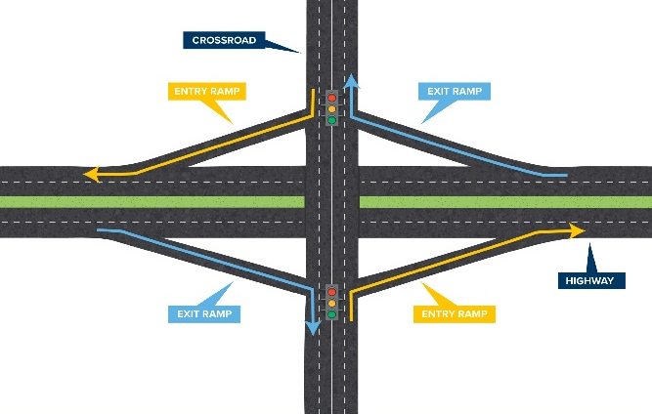

INTERCHANGES – Cloverleaf & Diamond
When to use
Connecting two roadways that do not have a high left-turn volume.
Cloverleaf are typically used in rural environments with low traffic volumes & minimal weaving.
When NOT to use
Should not be used on roadways with high traffic volumes.
Cloverleaf interchanges should not be used in areas with frequent large vehicle traffic. Some larger vehicles have trouble navigating smaller cloverleaf turns.
Notes:
FYI - WEBPAGE - https://transportation.ky.gov/saferoadsolutions/Pages/default.aspx
Cloverleaf and diamond interchanges are common types of interchanges, making them hig​hly recognizable to road users. Both are grade-separated junctions that connect freeways with other roads, with minimal impacts to vehicle speed and movement.​
When to use
Connecting two roadways that do not have a high left-turn volume.
​Cloverleaf are typically used in rural environments with low traffic volumes & minimal weaving.
When NOT to use
Should not be used on roadways with high traffic volumes.
Cloverleaf interchanges should not be used in areas with frequent large vehicle traffic. Some larger vehicles have trouble navigating smaller cloverleaf turns.

Slide 4
INTERCHANGES
Benefits
Efficiency
interchanges keep traffic moving and allow for traffic to flow between major roadways and crossroads.
Familiarity
cloverleaf and diamond interchanges are the most common type of interchanges, which makes them highly recognizable and increases motorists' level of comfort while driving. ​
Notes:
Benefits
Efficiency – interchanges keep traffic moving and allow for traffic to flow between major roadways and crossroads.
Familiarity - cloverleaf and diamond interchanges are the most common type of interchanges, which makes them highly recognizable and increases motorists' level of comfort while driving. ​

Slide 5
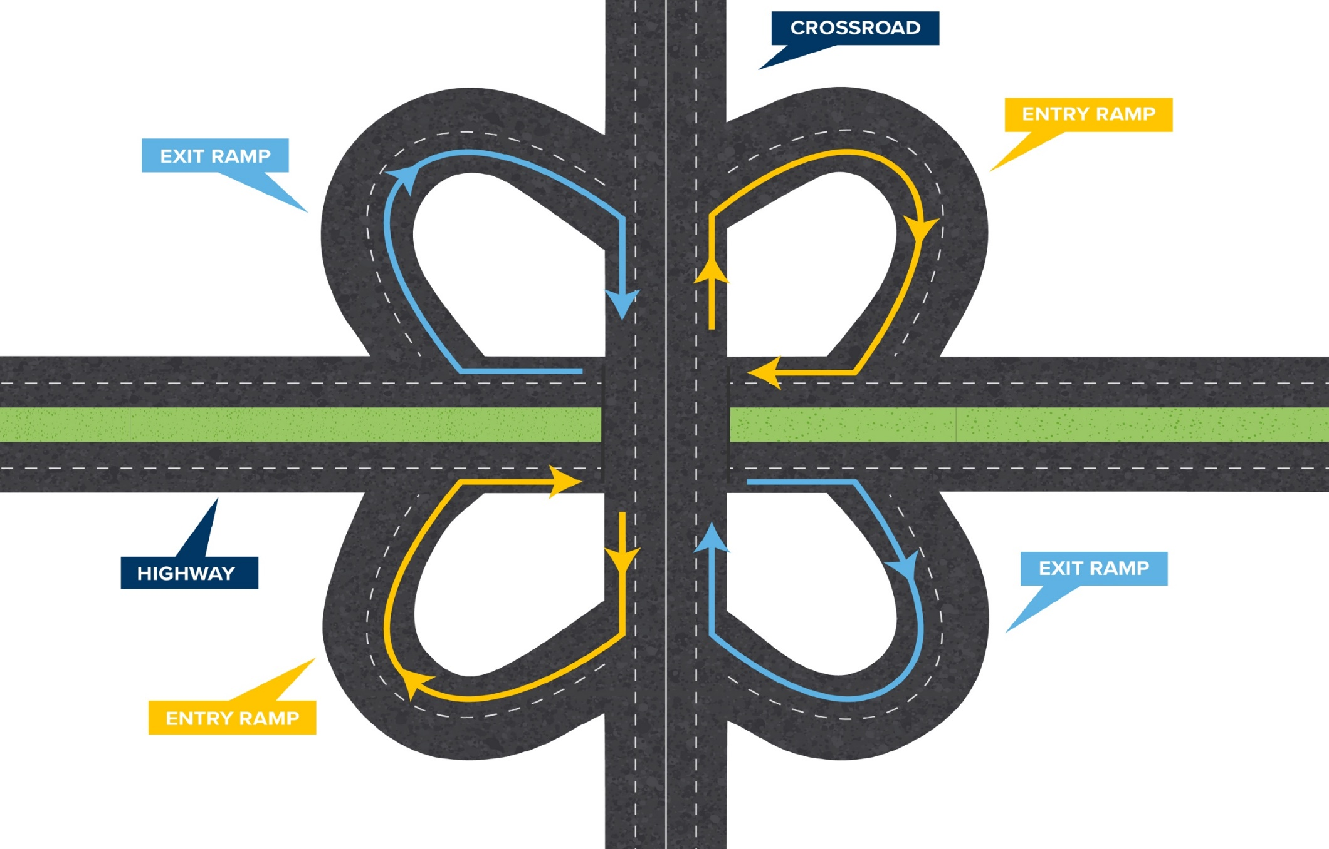

INTERCHANGES - Cloverleaf
Notes:
A cloverleaf interchange is a four-leg interchange that uses loop ramps to accommodate left-turning movements. Interchanges with all four loops are referred to as “full cloverleafs" and all others are referred to as “partial cloverleafs".
Play YouTube video if your connection is good. (Vdeo on slide #10, if able to use)

Slide 6
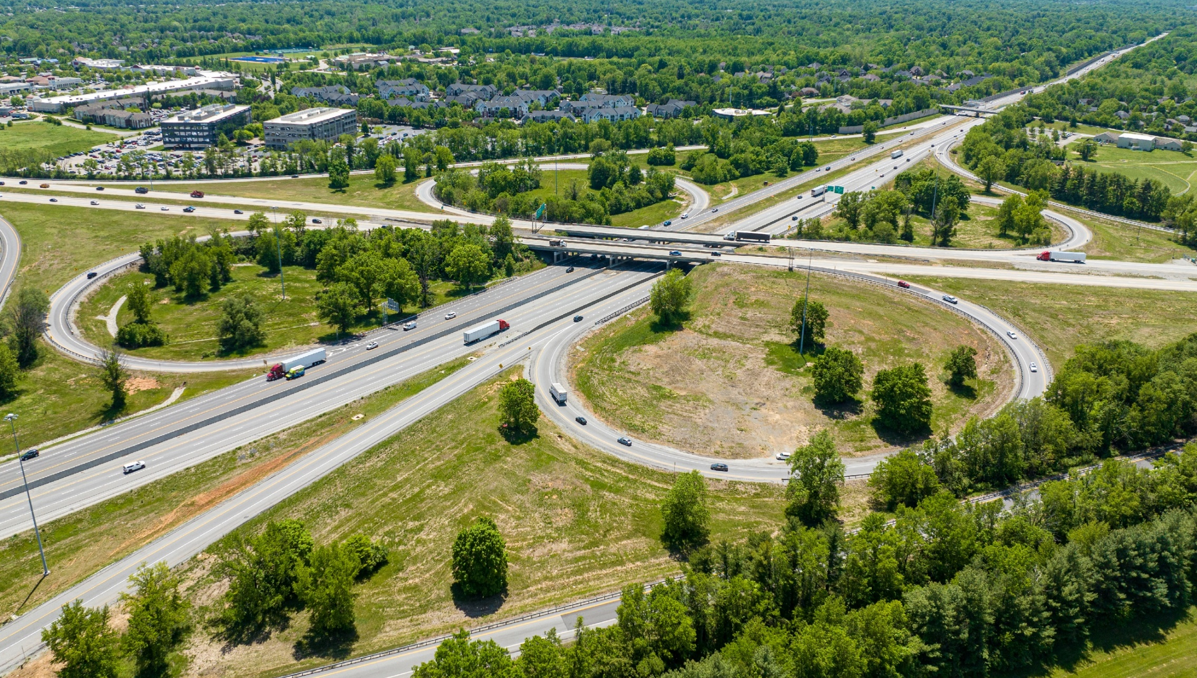
INTERCHANGES - Cloverleaf
Notes:
A cloverleaf interchange is a four-leg interchange that uses loop ramps to accommodate left-turning movements. Interchanges with all four loops are referred to as “full cloverleafs" and all others are referred to as “partial cloverleafs".
Play YouTube video if your connection is good. (Vdeo on slide #10, if able to use)

Slide 7

INTERCHANGES - Diamond
Notes:
A diamond interchange has two intersections, two diagonal entry ramps and two diagonal exit ramps. This interchange will oftentimes have traffic signals to control vehicle flow and safety.
Variations of the diamond interchange include:
Tight Urban Diamond Interchange
Single Point Urban Interchange (next set of slides after video)
Double Crossover Diamond Interchange​ (next set of slides after single point)

Slide 8
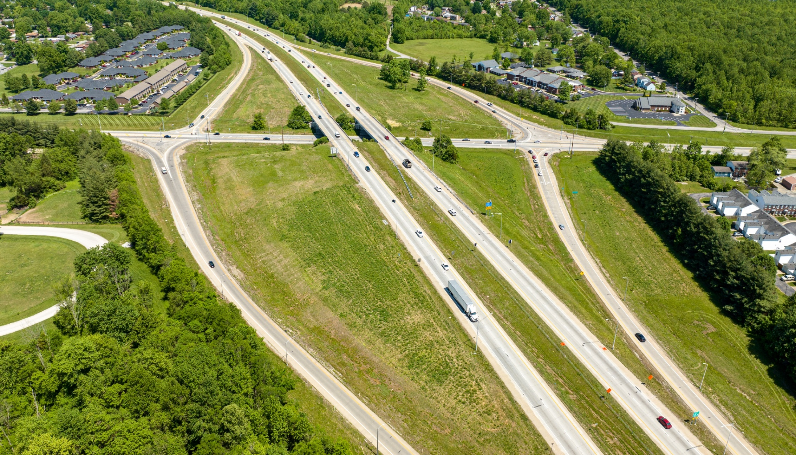
INTERCHANGES - Diamond
Notes:
Here is an example of a diamond exchange.

Slide 9
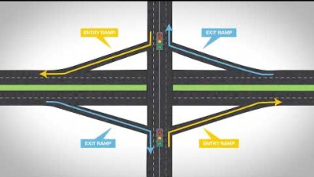
Cloverleaf & Diamond VIDEO
Notes:
Play video if there is a good internet connection.

Slide 10
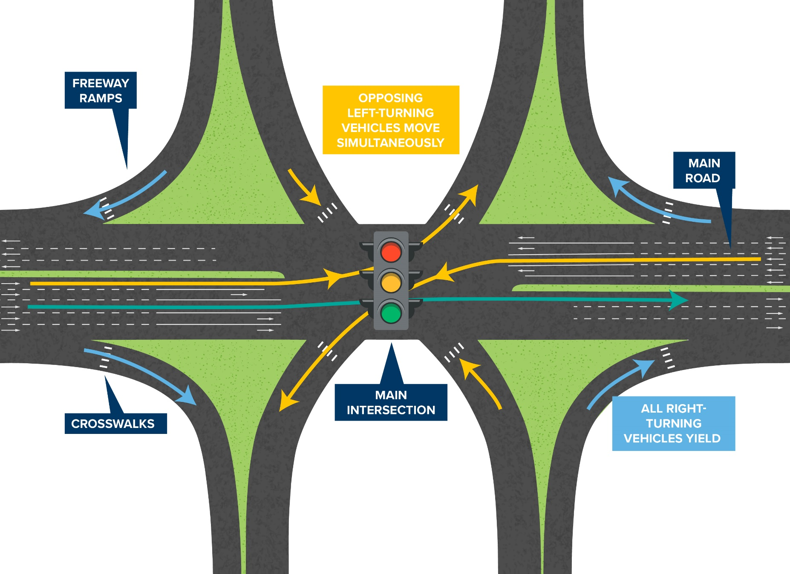
​​SINGLE-POINT URBAN INTERCHANGE
Notes:
A Single-Point Urban Interchange (SPUI) is a grade-separated highway interchange where a single signalized intersection controls traffic flow.
The design allows for left-turning vehicles coming from opposing directions to turn simultaneously, without crossing paths. This enhances safety by reducing the number of places where vehicles cross paths and improves efficiency by allowing more vehicles to drive through the intersection during a signal cycle.
The SPUI (pronounced SPOO-EE) can be designed as an overpass or an underpass. It consists of:
​one signalized intersection,
a main road, and
four freeway ramps that all begin or end at the single, signalized intersection.
How to use a SPUI
All vehicle traffic within a SPUI should follow traffic signals and signs.
Pedestrians in SPUIs should follow crosswalks and bicyclists may use pedestrian paths or follow the flow of traffic.
In a SPUI, traffic signals at the main intersection control the flow of traffic for all left-turning and straight-forward moving vehicles. Yield or stop signs guide all right-turning vehicles.

Slide 11
​​SINGLE-POINT URBAN INTERCHANGE
Benefits
​Enhanced safety – vehicles cross paths at only one location.
Increased efficiency— traffic signals operate in three phases increasing “green light” time.
Increased capacity – Allows for left turns to occur simultaneously and at higher speeds.
Fewer traffic signals – Channels traffic into one intersection.
Reduced right-of-way impacts – Smaller footprint than conventional interchanges,
Notes:
Benefits
​Enhanced safety – vehicles cross paths at only one location within a SPUI, which reduces the risk of potential vehicle crashes as compared to a conventional intersection.
Increased efficiency— traffic signals at SPUIs operate in three phases as opposed to four phases at conventional interchanges, which increases “green light” times and reduces delays.
Increased capacity – the SPUI design allows for left turns to occur simultaneously and at higher speeds, which increases the number of vehicles that can travel through the intersection.
Fewer traffic signals – the SPUI channels traffic into one intersection, as opposed to two intersections like in a conventional interchange. Fewer intersections mean fewer traffic signals, which also means fewer delays for drivers.
Reduced right-of-way impacts – SPUIs have a smaller footprint than conventional interchanges, which reduces the impact on the environment and nearby businesses and residences.

Slide 12
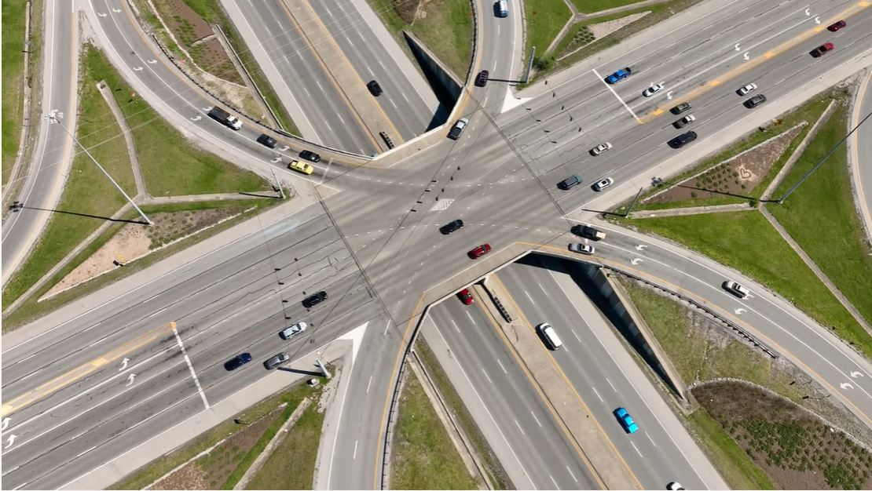
​​SINGLE-POINT URBAN INTERCHANGE
Notes:
In a SPUI, traffic signals at the main intersection guide all left-turning and straight-forward moving vehicles. Vehicles turning right are guided by stop or yield signs, away from the main intersection.
SPUIs are also known as:
​Urban Interchanges
Single Point Interchanges (SPI)
Single Point Diamond Interchanges (SPDI)
US 60/KY 4 Intersection in Fayette County

Slide 13
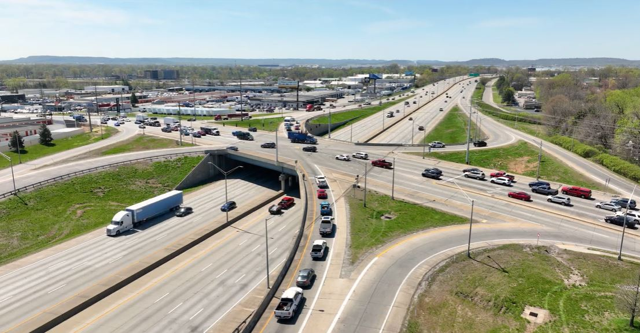
​​SINGLE-POINT URBAN INTERCHANGE
Notes:
When to use a SPUI
A SPUI design is effective for interchange locations with:
​high left turning traffic volumes
a need for increased vehicle capacity
limited space for construction
KY 864/I-264 intersection in Jefferson County

Slide 14
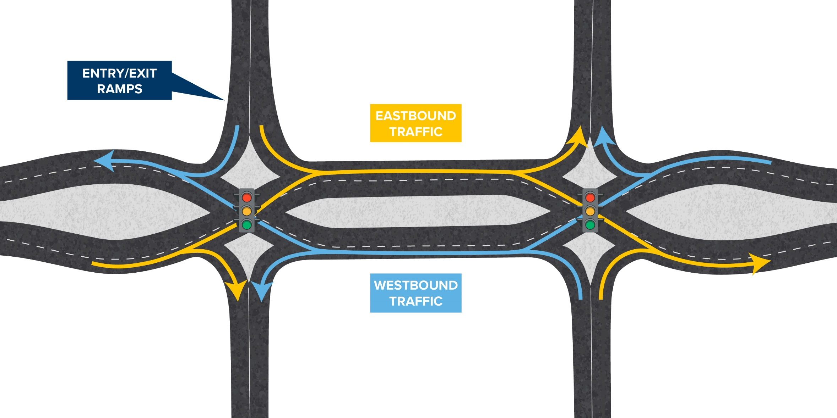
​DOUBLE CROSSOVER DIAMOND INTERCHANGE
Notes:
​A Double Crossover Diamond (DCD) is an interchange with two signalized intersections, where traffic between the intersections crosses over to the left side of the roadway. As vehicles exit the interchange, they return to the right side of the road.
How to use a DCD
Motorists on the main road turning right within a DCD, merge onto a freeway ramp just like a conventional interchange. Motorists on an exit ramp also turn and merge right like at a conventional interchange.
Motorists on the main road traveling straight or turning left within a DCD, follow lane markings and traffic signals to cross to the left side of the main road. They can then turn left onto the freeway ramp or cross back over to the right side of the main road to continue to travel straight through the intersection.
When turning left from an exit ramp, motorists stay on the left side of the main road and travel through the intersection before moving to the right side of the main road.
Pedestrians will encounter multiple marked crosswalks and can use them to safely navigate the interchange.
Cyclists, depending on their level of comfort, may navigate the intersection using designated vehicles and/or pedestrian paths if those are offered.

Slide 15
​DOUBLE CROSSOVER DIAMOND INTERCHANGE
Safety
Reduces wrong-way entries to ramps,
Number of times opposing traffic crosses paths
Potential number of crash points for vehicles
Slows down drivers
Efficiency
Fewer traffic signal phases
Easier access to the highway
Does not cross opposing traffic
Cost effective
Can improve traditional interchanges by reconfiguring existing lanes and intersections at a lesser cost.
Benefits
Notes:
Benefits
​Safety — DCDs reduce wrong-way entries to ramps, the number of times opposing traffic crosses paths and the potential number of crash points for vehicles. They also reduce speeds, so if crashes do occur then they are less severe.
Efficiency — DCDs operate with fewer traffic signal phases, which increases the volume of traffic and decreases delays. The design also provides motorists with easier access to the highway without having to cross opposing traffic.
Cost effective – Rather than building new lanes or bridges, a DCD design can improve traditional interchanges by reconfiguring existing lanes and intersections at a lesser cost.

Slide 16
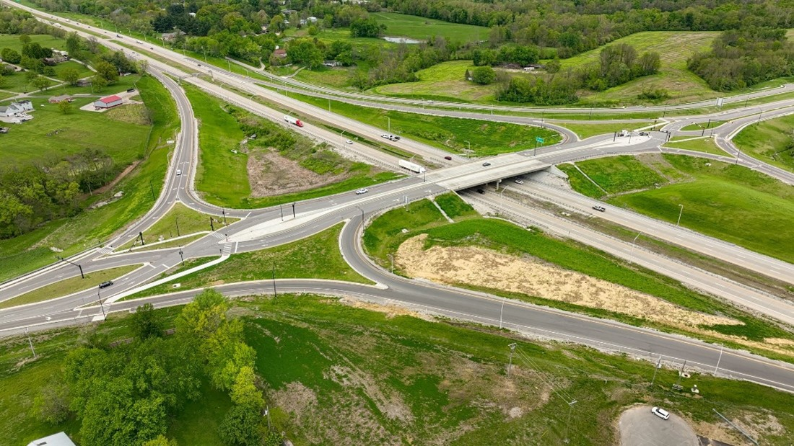
​DOUBLE CROSSOVER DIAMOND INTERCHANGE
Notes:
This design allows for vehicles to turn left onto and off freeway ramps without stopping or crossing opposing lanes of traffic. Right turns on and off freeway ramps occur either before or after the crossover intersections.
A DCD can be either an overpass or underpass depending on need.
Clear lane markings and signage at DCDs help safely guide motorists through the interchange, even those who are inexperienced in driving through DCDs.
A DCD is also known as:
A Diverging Diamond Interchange (DDI)
When to use a DCD
DCDs should be used to reconfigure conventional intersections that have high traffic volumes and crash frequencies and need a cost-effective solution.

Slide 17
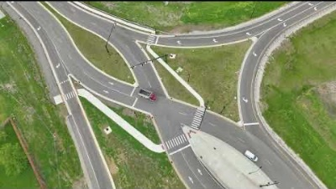
​DOUBLE CROSSOVER DIAMOND INTERCHANGE - Video
Notes:
Play video if there is a good internet connection.

Slide 18
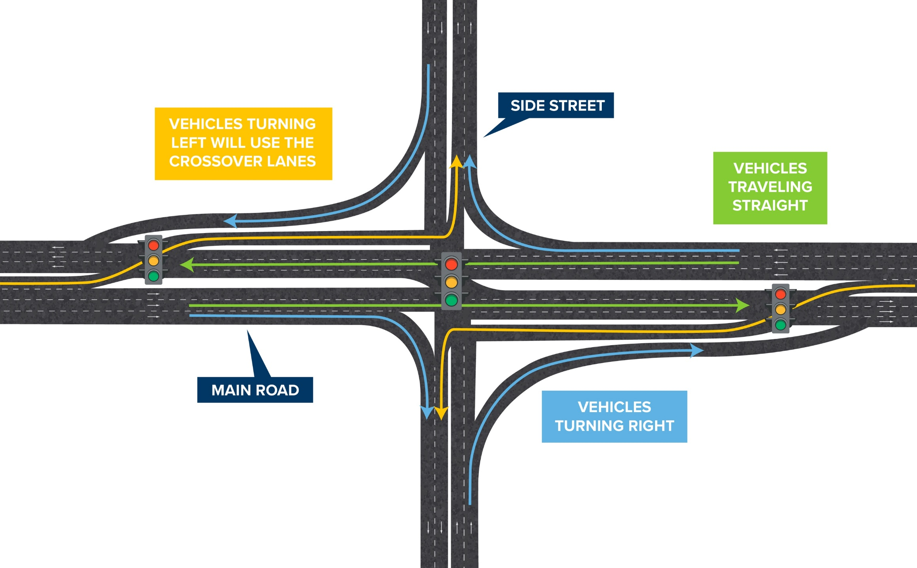
CONTINUOUS FLOW INTERSECTION (CFI)
Notes:
​​​CONTINUOUS FLOW​ - A Continuous Flow Intersection (CFI) is an effective design solution to improving traffic safety and flow at high-volume, conventional intersections. It alters the way vehicles turn left on the main road by diverting left-turning traffic into crossover lanes ahead of the main intersection.
A CFI shifts left-turning traffic to the outside edges of the road, which allows for through traffic to proceed at the same time vehicles are turning left. That means more vehicles can travel through the intersection during a green light.
Right-hand turns are a little different, too. They are offset, functioning more like a highway ramp, and exiting cars merge into the flow of traffic.
CFIs can be designed to serve motorists coming from two sides of an intersection or four, if necessary.
How to use a CFI
All vehicle traffic should follow traffic signals and signs.
Pedestrians in CFIs should follow crosswalks and directional signage. Bicyclists may use pedestrian paths or follow the flow of traffic.
In a CFI configuration, motorists start their left turn several hundred feet before the intersection; they enter a bay that is protected (often by a landscaped traffic island or concrete barrier) instead of just marked lanes and proceed to the left of oncoming traffic.

Slide 19
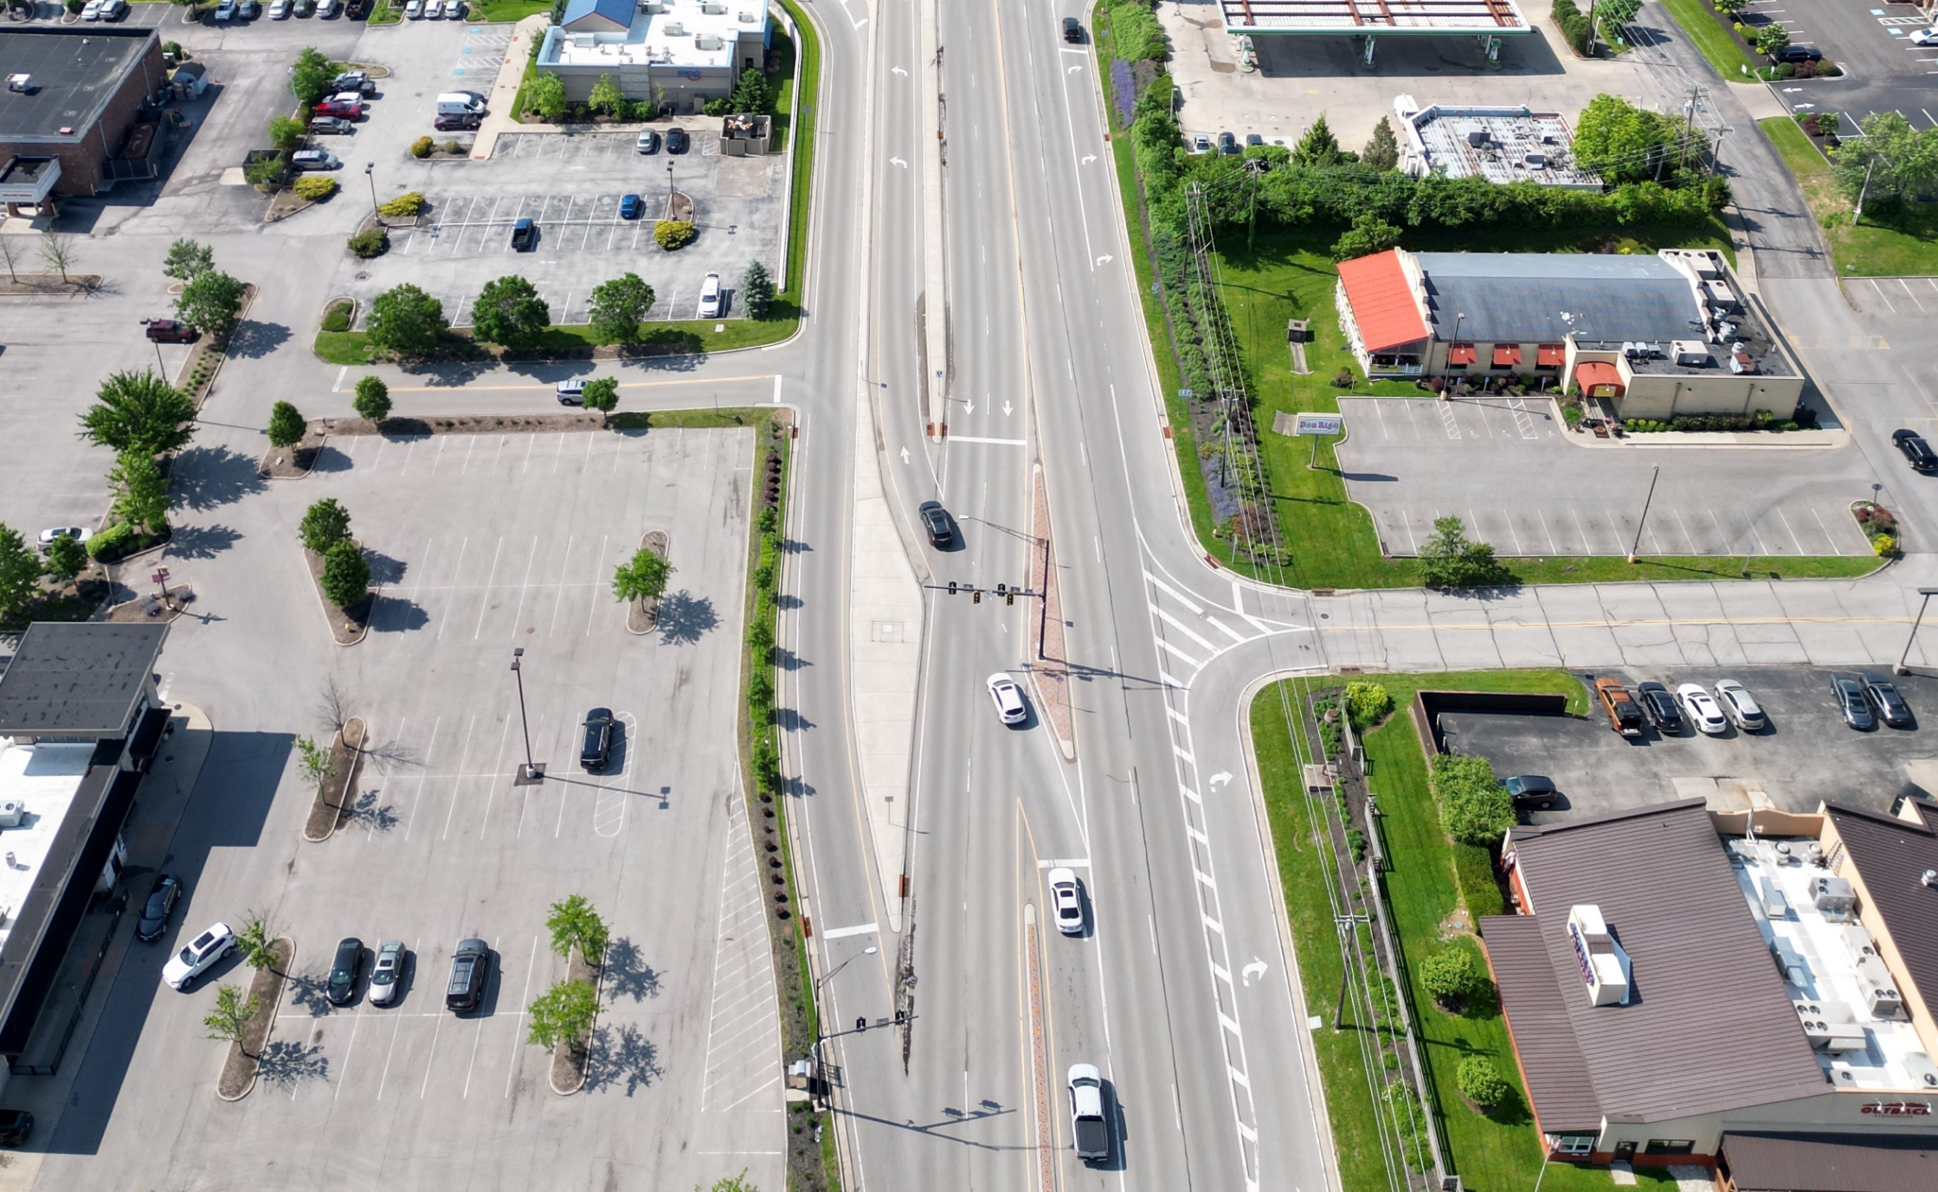
CONTINUOUS FLOW INTERSECTION (CFI)
Notes:
CFIs are also known as:
Displaced left-turns
When to use a CFI
CFIs are effective solutions for intersections with:
high and increasing traffic volume,
an above-average incidence of crashes, and
​motorists who must wait through several signal phases to turn.
​CFIs have a large footprint, so they are not good for locations with limited space. They are also not effective designs for locations with high rates of pedestrian traffic

Slide 20
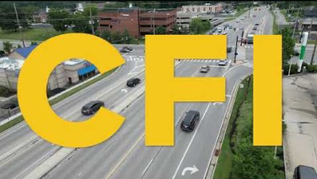
CFI Video
Notes:
Play video if there is a good internet connection.

Slide 21
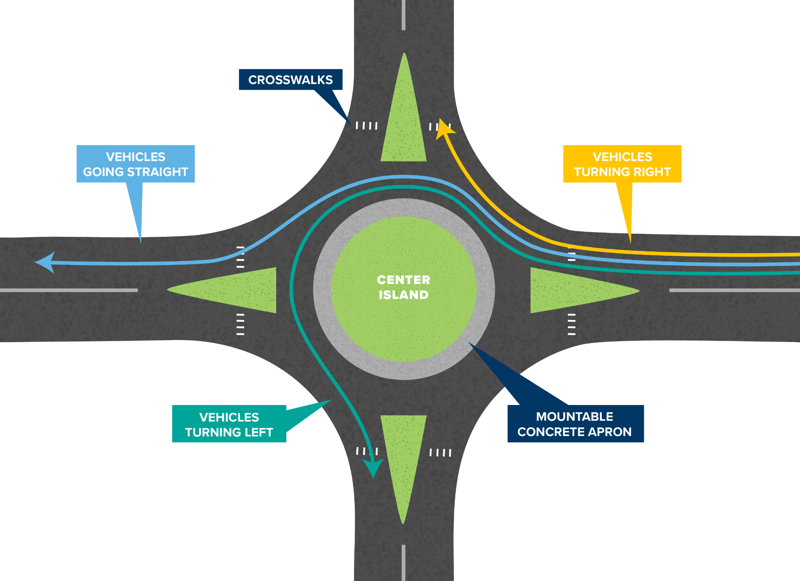
ROUNDABOUT
Notes:
A roundabout is a one-way circular intersection in which traffic moves counterclockwise around a center island. Roundabouts do not have traffic signals or stop signs, which allows for continuous traffic flow and increased vehicle capacity.

Slide 22
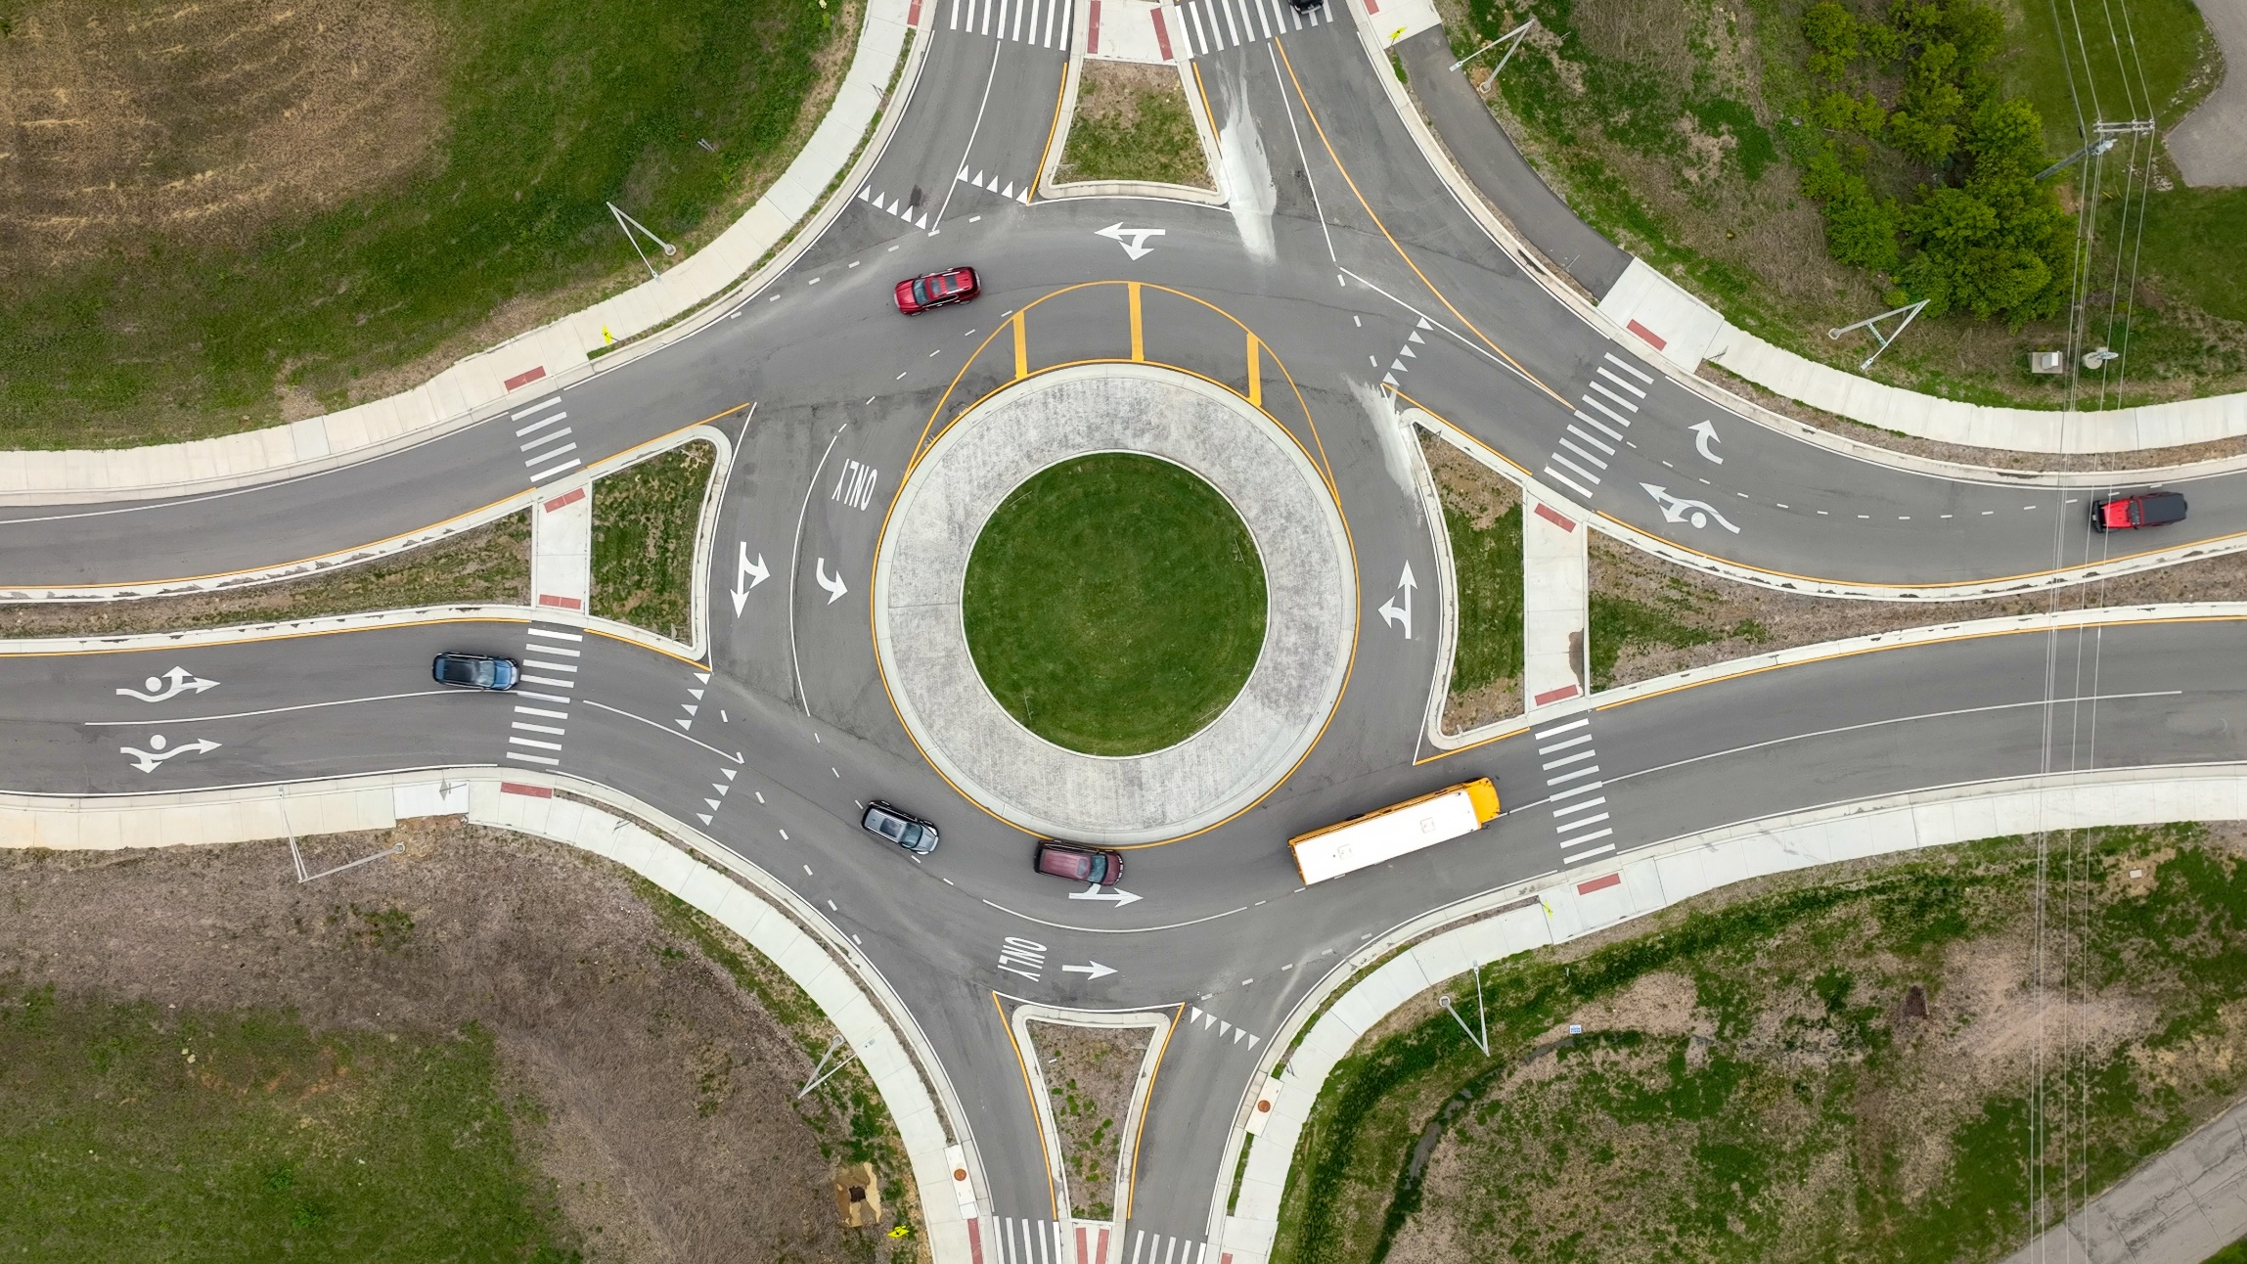
ROUNDABOUT
Notes:
A roundabout is a one-way circular intersection in which traffic moves counterclockwise around a center island. Roundabouts do not have traffic signals or stop signs, which allows for continuous traffic flow and increased vehicle capacity.

Slide 23
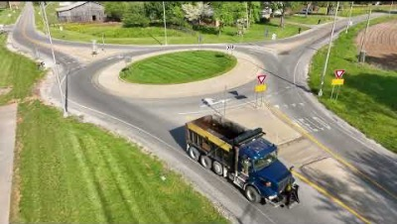
ROUNDABOUT - Video
Notes:
Play video if there is a good internet connection.

Slide 24
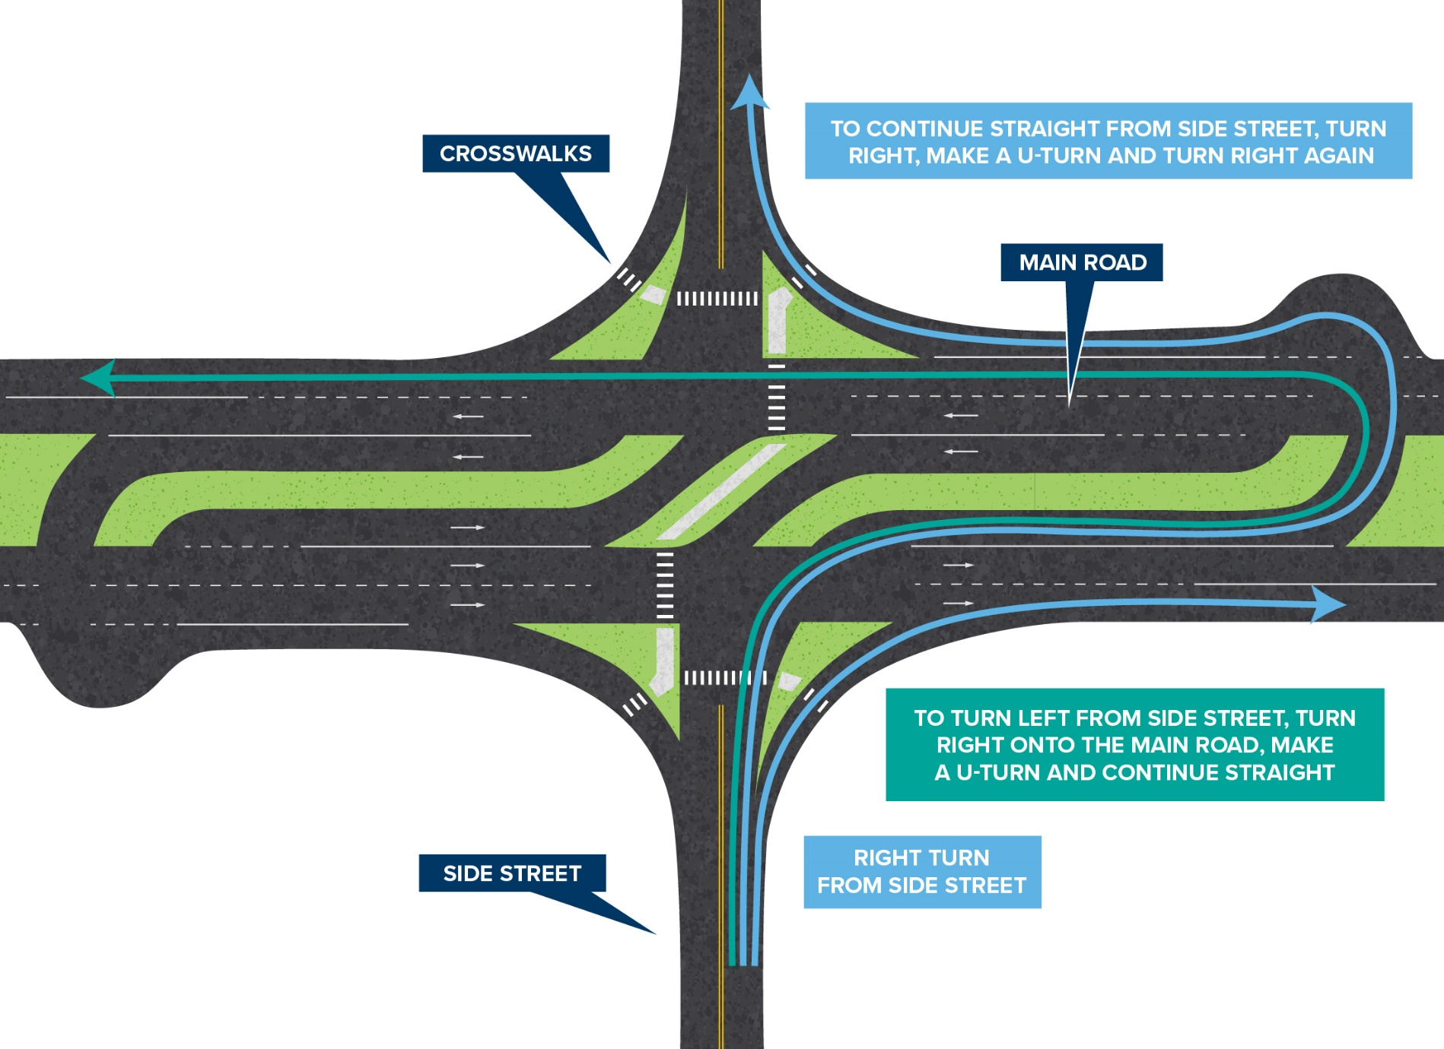
​​​​RESTRICTED CROSSING U-TURN (RCUT)
Notes:
A Restricted Crossing U-Turn (RCUT) is a four-lane highway intersection design consisting of one main intersection and two median crossover intersections.
How does an RCUT work?
When approaching an RCUT from the main road, drivers can continue straight or make a left/right turn
When approaching from side streets, drivers start by making a right turn
​After turning right, drivers can continue straight or enter the left turn lane to make a U-turn through the median
After making a U-turn, drivers can complete their desired movement through the intersection
​Pedestrians follow crosswalks
Bicyclists use pedestrian paths or follow the traffic law

Slide 25
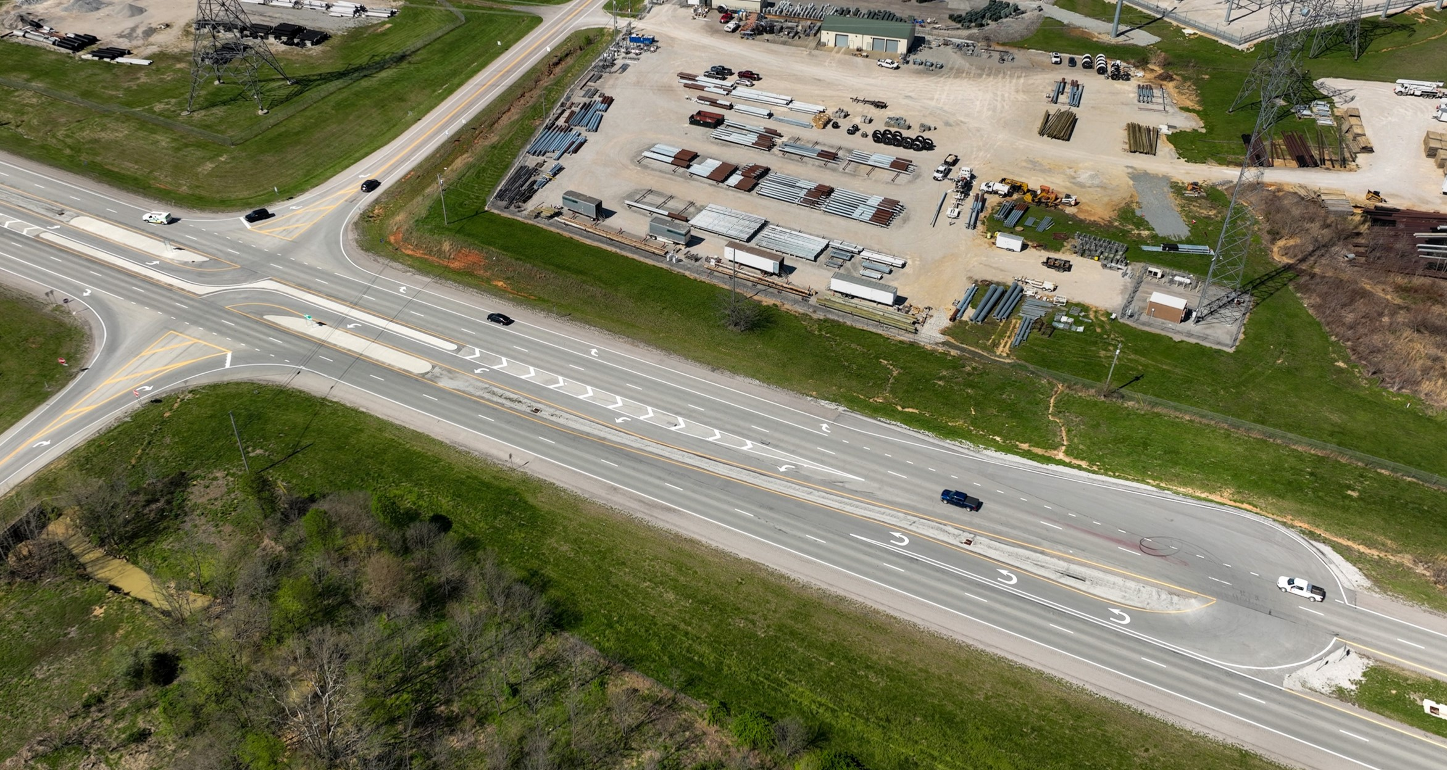
​​​​RESTRICTED CROSSING U-TURN (RCUT)
Notes:
A Restricted Crossing U-Turn (RCUT) is a four-lane highway intersection design consisting of one main intersection and two median crossover intersections.
This one is Ring Road/Bacon Creek Road intersection: Hardin County
When can an RCUT be used?
RCUTs are most effective when an intersection has:
​Median-divided highways
​Heavy through and left-turn traffic volumes on the main road
​​Low through and left-turn traffic volumes on side streets

Slide 26
​​​​RESTRICTED CROSSING U-TURN (RCUT)
Enhanced safety
Motorists only focus on one direction of oncoming traffic at a time, making the intersection safer and easier to navigate.
Increased efficiency
Fewer traffic lights and stops when compared to a standard intersection.
More capacity
Each direction operates independently by creating two one-way streets to decongest the flow of traffic.
Benefits
Notes:
Benefits of a RCUT
What are the benefits of an RCUT?
Enhanced safety – Motorists only focus on one direction of oncoming traffic at a time, making the intersection safer and easier to navigate.
Increased efficiency – The RCUT design has fewer traffic lights and stops when compared to a standard intersection, resulting in shorter wait times for motorists. ​
More capacity – Each direction of an RCUT operates independently by creating two one-way streets to decongest the flow of traffic.

Slide 27
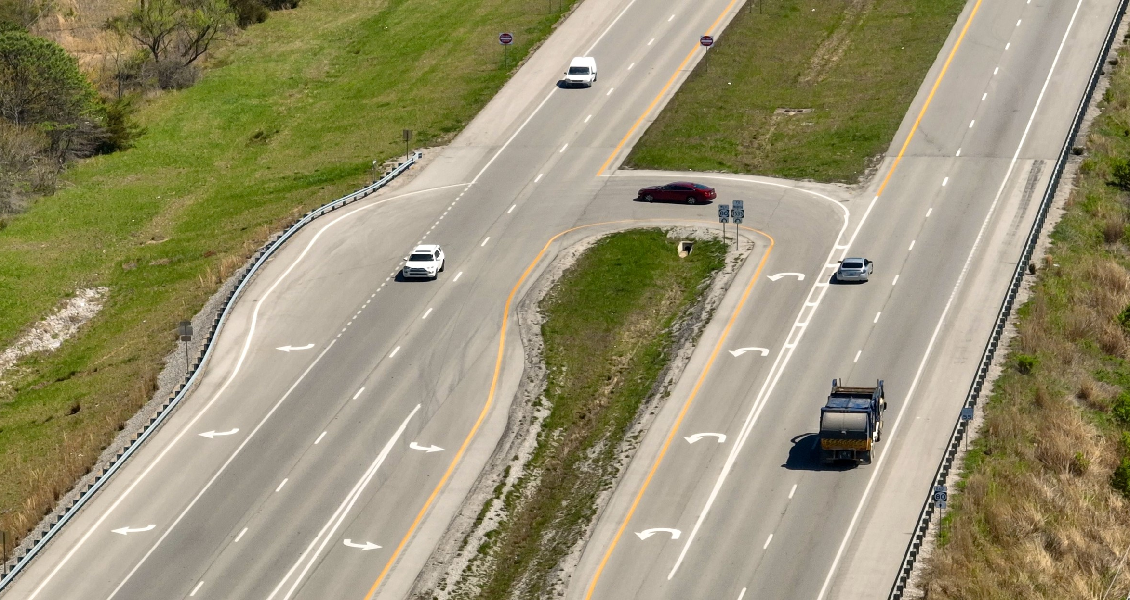
​​​​RESTRICTED CROSSING U-TURN (RCUT)
Notes:
This one is KY 80/KY 1535: Laurel County

Slide 28
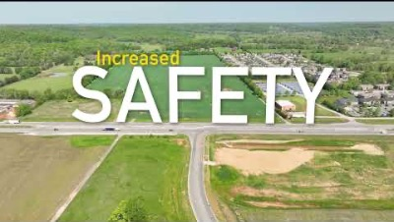
​​​​RESTRICTED CROSSING U-TURN (RCUT) - Video
Notes:
Play video if there is a good internet connection.

Slide 29
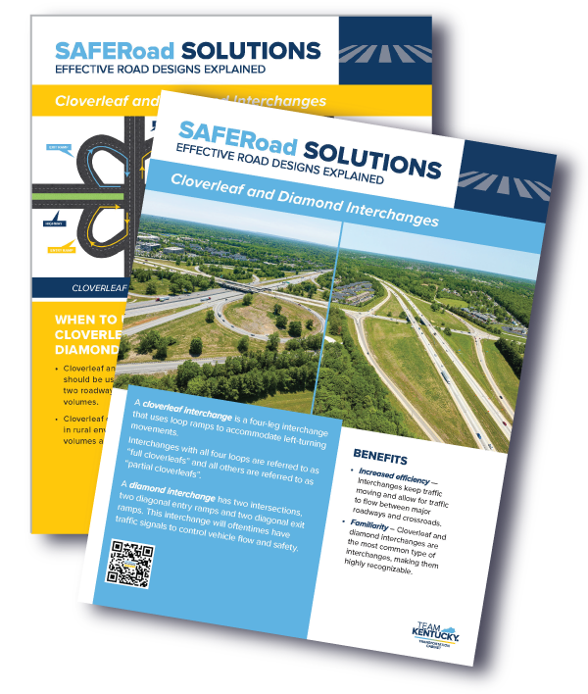

Download Fact Sheets for each road configuration at transportation.ky.gov/saferoadsolutions
Notes:
Each road configuration has a fact sheet on its webpage. Website has many more road configurations than what is in this presentation plus new ones are in the works.

Slide 30
Questions?

Slide 31


KYTC.KEEN@ky.gov
transportation.ky.gov/Education/Pages/KEEN.aspx

