Slide 1


KEEN: Igniting a Spark for Future Engineers
Kyle McMahon, KEEN Statewide Coordinator

Slide 2

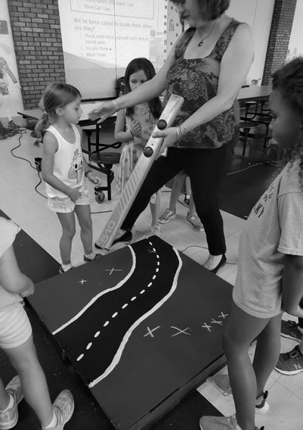
What is KEEN?
Kentucky Engineering Exposure Network (KEEN)
Created in 1990 to improve the presentation and speaking skills of KYTC employees
Designed to introduce youth to the world of engineering in a fun and creative way
  Variety of age-specific presentations and activities for K-12
Managed and guided by a board of 12
  KEEN Coordinators located in Central Office and each Highway District

Slide 3
What Does KEEN do?
Community Outreach
  Partnership with schools and youth organizations to provide classes and activities in the STEM field
  Participation at high school and college career fairs
  Promotion of KYTC educational programs:
      Civil Engineering Scholarship
      Civil Engineering Technology Scholarship
      Minority Internship Program
      Transportation Mechanic Apprenticeship Program

Slide 4
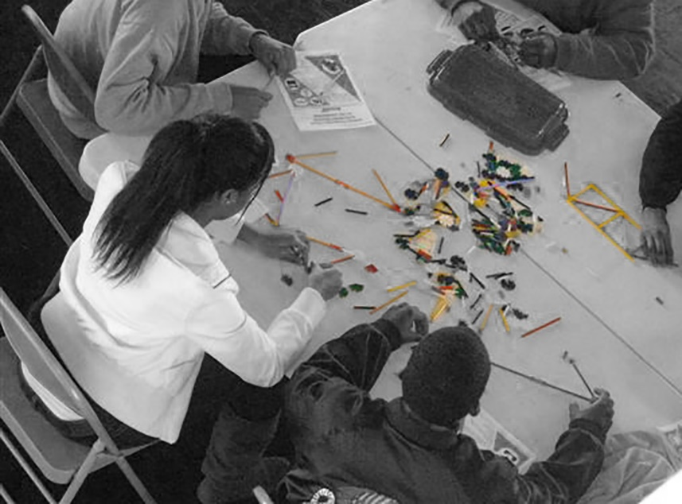
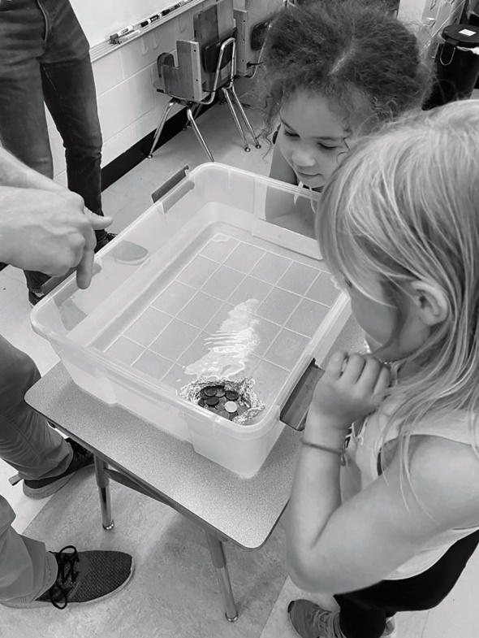
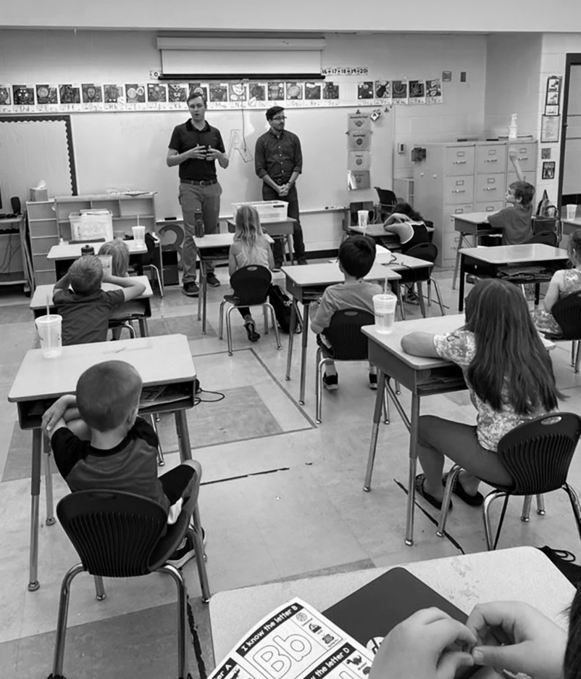
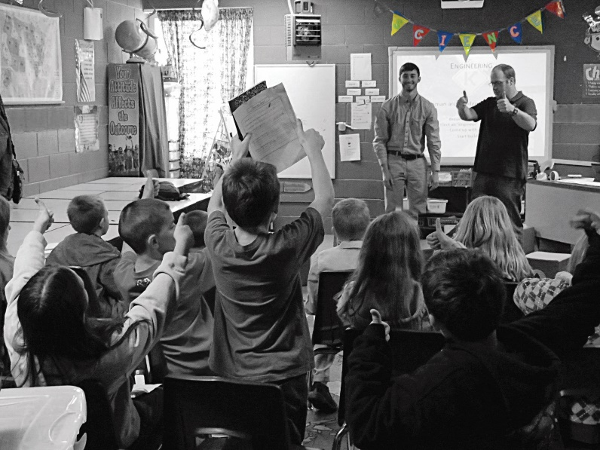
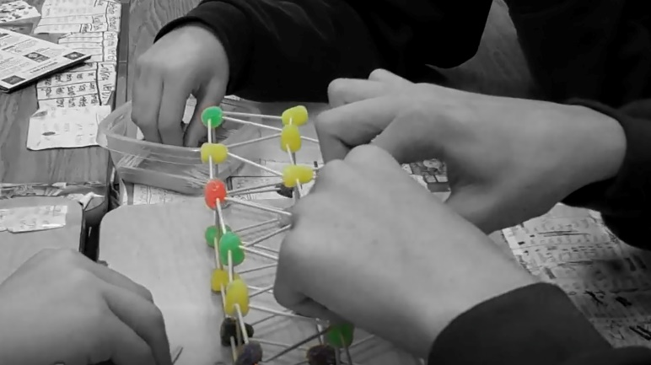
Grade School Presentation Creations

Slide 5
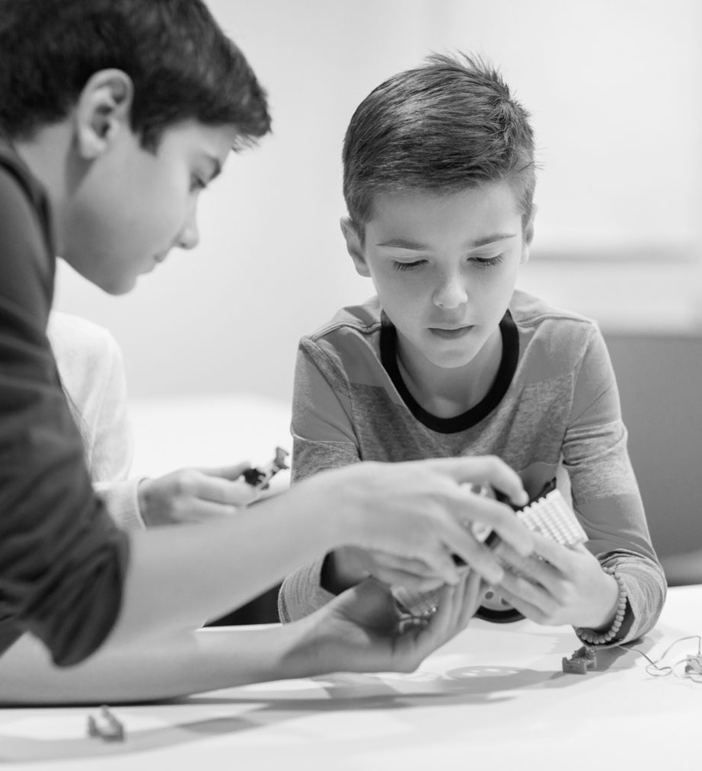
What is KEEN’s Vision?
Inject new excitement to KEEN
Increase the number of presentations in the schools
Create more awareness of the scholarship programs
Develop new class content and recruitment opportunities

Slide 6

What is KEEN’s Vision?
Provide innovation for new tools such as online engineer games and video library
Launch a statewide bridge-building competition to stimulate engagement
Coordinate engineer clubs for interaction
Increase program marketing
  Videos, social media, webinars

Slide 7


How Can You Help?
Facilitate a presentation
  Contact your District’s KEEN Coordinator
  Contact Form is at the conference
Collaborate to create new presentations
Spread the word

Slide 8

Help us ignite the engineering spark in children

Slide 9



Slide 10

CONTACT INFORMATION
Kyle McMahon, EIT II
KYTC District 6 Design
KEEN Statewide Coordinator
421 Buttermilk Pike
Covington, KY 41017
(502) 564-5966
kyle.mcmahon@ky.gov

