Slide 1

CIVIL ENGINEERING: Building the world around Us
Presentation by:
On Month Day 2022

Slide 2


An education initiative by the Kentucky Transportation Cabinet

Slide 3

Railroads
Highways
Bridges
Water works
Mass Transit
Sewers
Tunnels
Building
Dams
River Navigation
Irrigation Canals
Power Plants
Shipping Canals
Traffic Control
Industrial Plant
Towers/Lines
Airport Runways
Terminals
Skyscrapers,.etc
Transmission
Civil Engineering : The Backbone of Our Communities

Slide 4
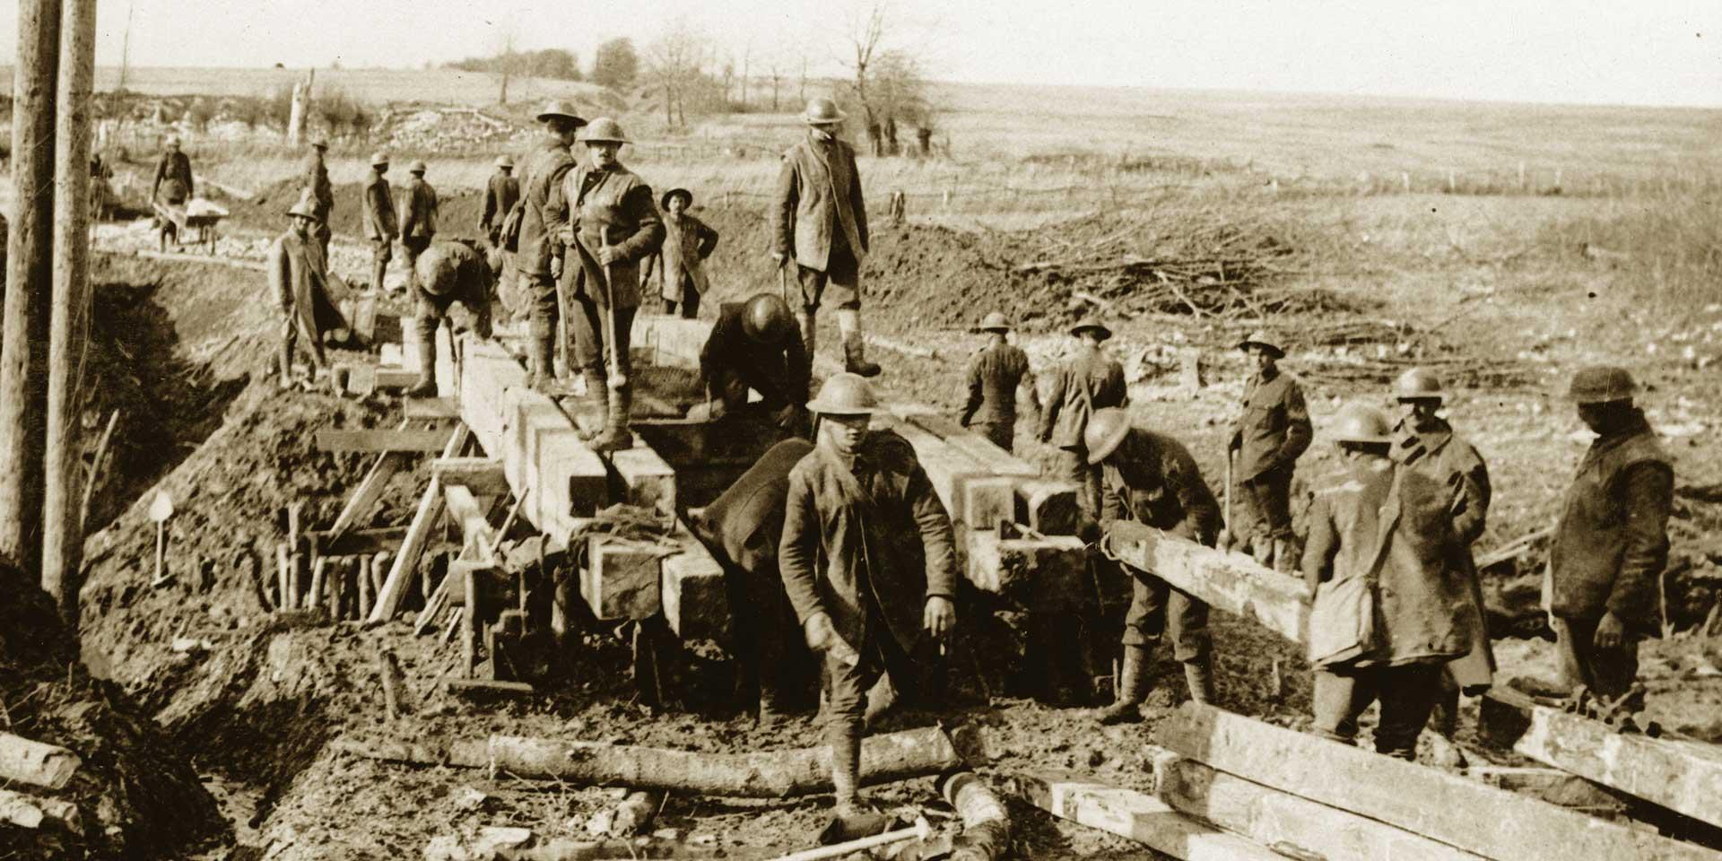
History
Beginning , Engineers not for war
Started in France
Built roads and Bridges
First Step of Modern Engineering

Slide 5
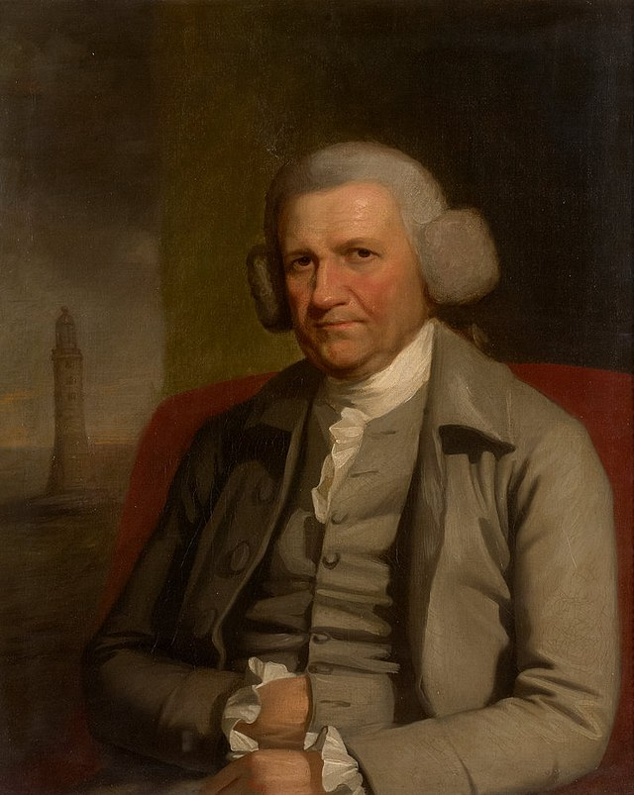
First “Civil Engineer” – John Smeaton (1761) , an Englishman
Civil Engineers saved more lives than Doctors in History
Like Development of clean water and sanitation systems

Slide 6
Rise Of Civil Engineering In Kentucky
First Engineering Graduate from Bacon (Georgetown)College In 1840
Civil engineering Degree established, Fall of 1886
First Civil Engineering Degree Received from A&M College (UK) in 1890
Henry H White
State College (UK)
John Wisley Gunn of Lexington

Slide 7

CE Student Organization
Chi Epsilon – Civil Engineering honorary
ASCE (American Society of Civil Engineers)
AGC (Association of General Contractors)
ARTPA (American Road and Transportation Builders Association)
ITE (Institute of Transportation Engineers)
KSPE (Kentucky Society of Professional Engineers – section of the National Society of Professional Engineers (NSPE))

Slide 8
Transportation
Water Resources
Structural
Construction
Bridge design
Environmental
Geotechnical Urban Planning
What Do Civil Engineers Specialize In?

Slide 9

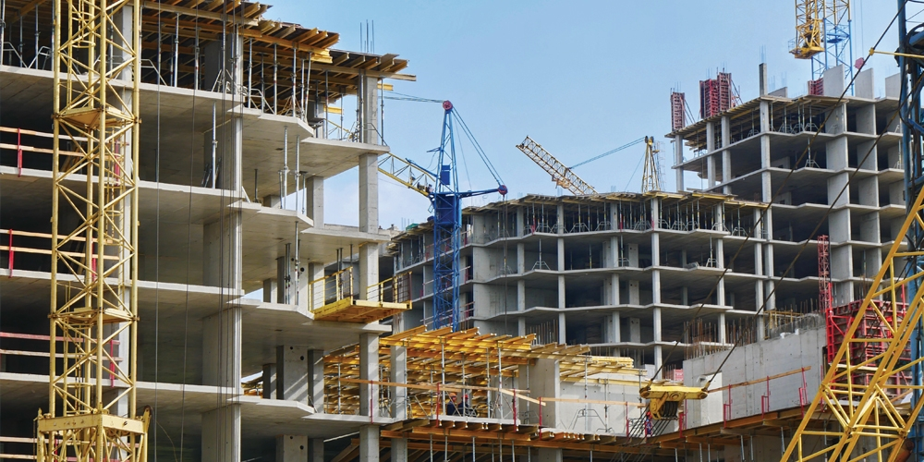



Construction Engineering
Planning
Building
Supervising
Completion

Slide 10
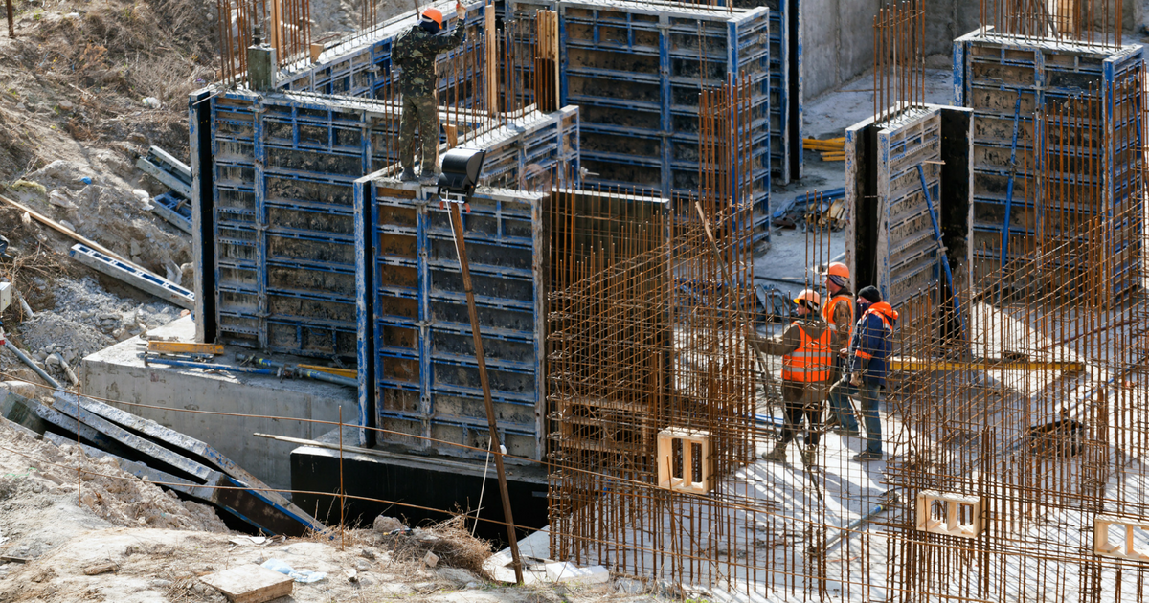
Structural Engineering

Slide 11
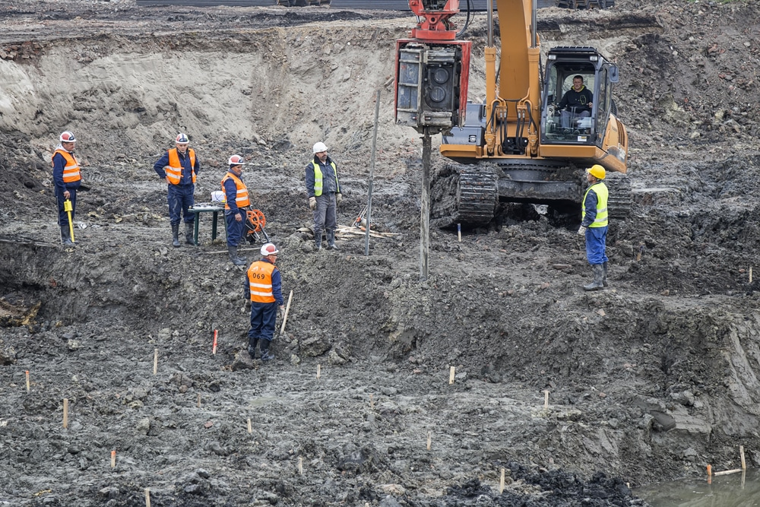
Geology
Roacks & soil Foundations
Material Science
Mechanics
Geotechnical Engineering

Slide 12
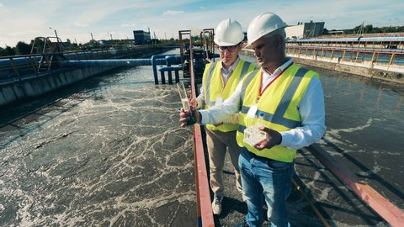
Waste Treatment
Air & Water Purification
Pollution Reduction
Green Engineering
Environmental Engineering

Slide 13
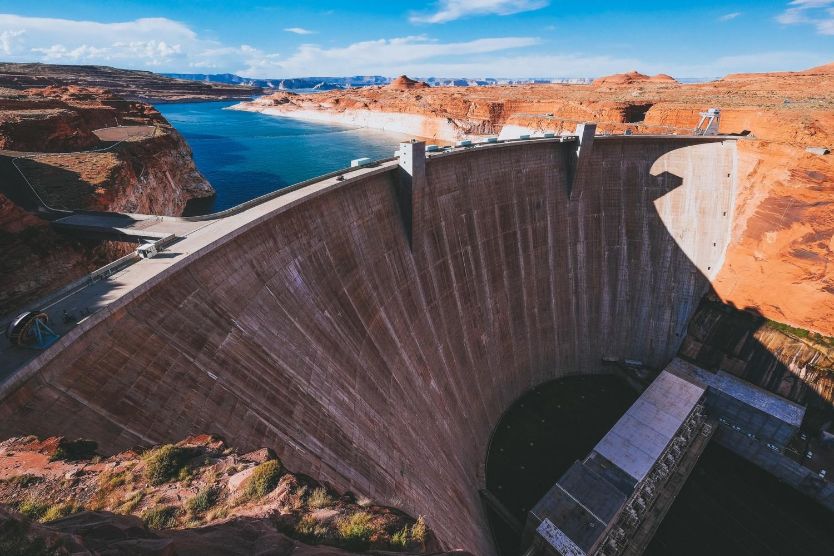
Drainage Facilities
Canals
Pipelines
Water distribution system
Hydraulic Engineering

Slide 14

Topographic
Boundary
Construction
Hydrographic
SURVEYING

Slide 15
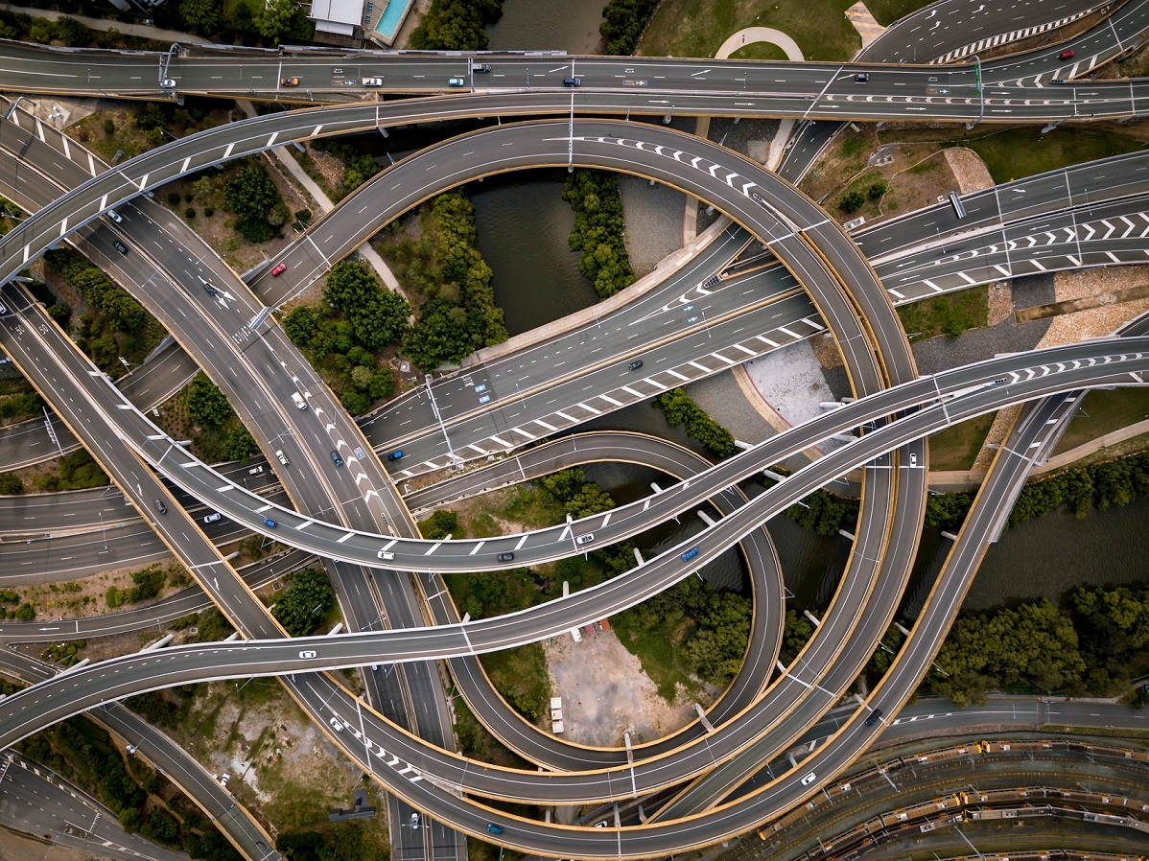
Roads
Rail
Airports
Traffic
Transportation Engineering

Slide 16
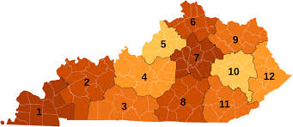
DEPARTMENT OF HIGHWAYS
Offices of Highway Districts 1-12
OFFICE OF EXECUTIVE DIRECTOR
Administrative
Human Resources Section
Fiscal Section
Pre-Construction
Design supervisor section
Construction Branch
Operation Branch
Traffic Branch
Planning Branch
Right of Way Section
Construction Supervisor Section
Material Section
Maintenance Supervisor Section
Equipment Supervisor Section
Traffic Supervisor Section

Slide 17
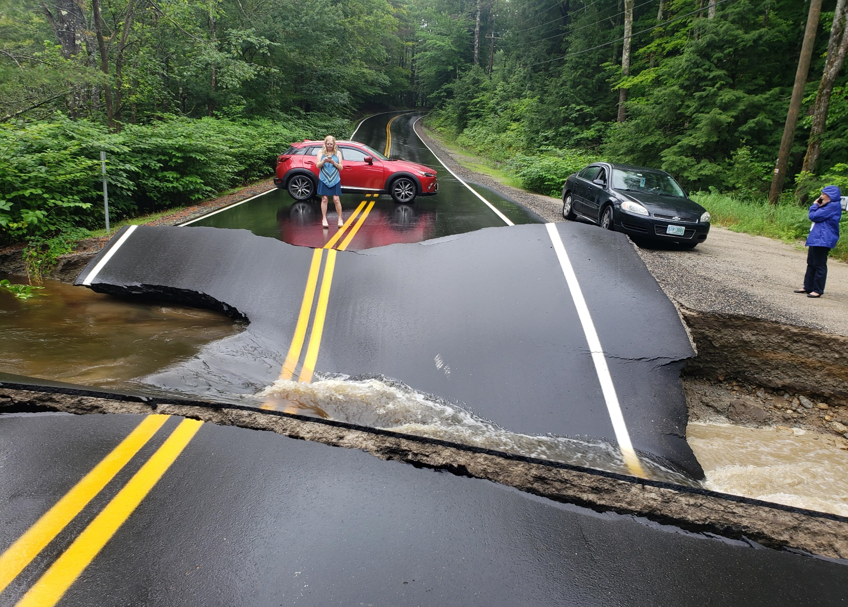
SEE A NEED?
Problem Noticed
Community Concern
Safety Issue

Slide 18

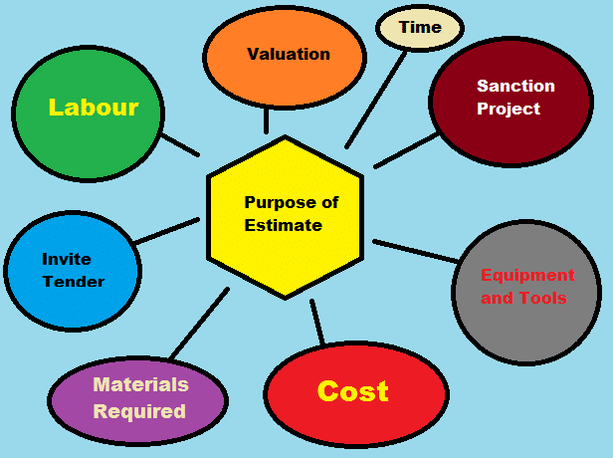
PLANNING STAGE
Planning Stage
Site Study
Teamwork
Budgeting

Slide 19
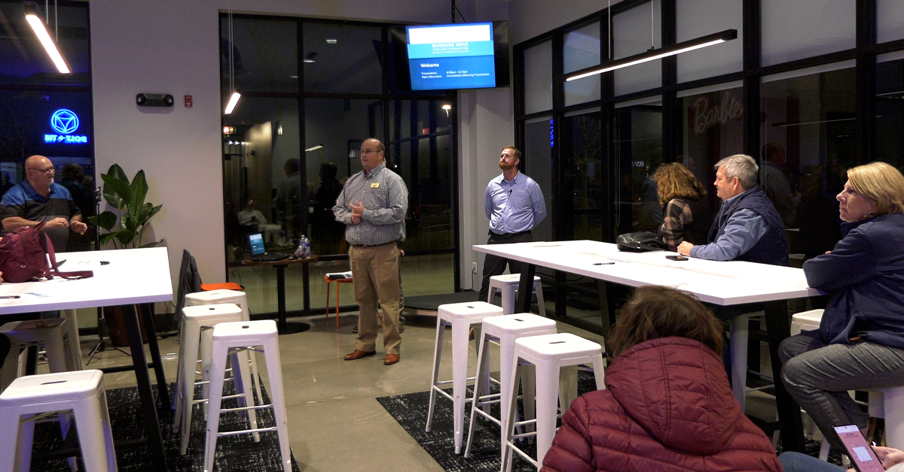
PUBLIC MEETING
Community Feedback
Questions
Concerns
Approval

Slide 20
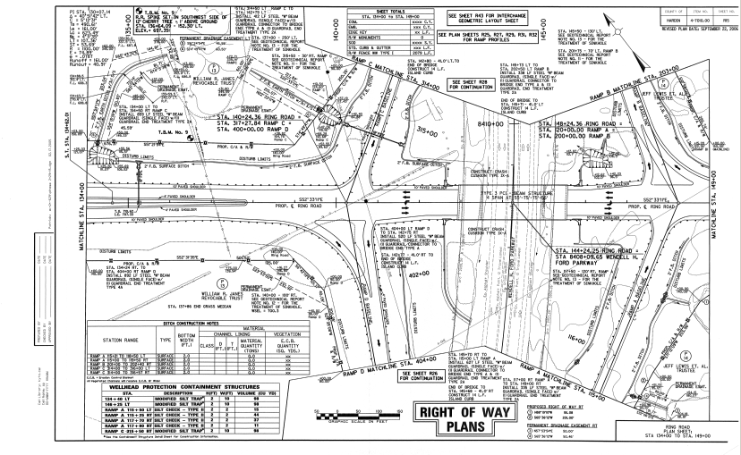
DESIGN STAGE
Draw plans to show how the problem is going to be fixed
Engineers draw how things will look.
Choose the best material
Do math to keep it safe.
Use software to design

Slide 21
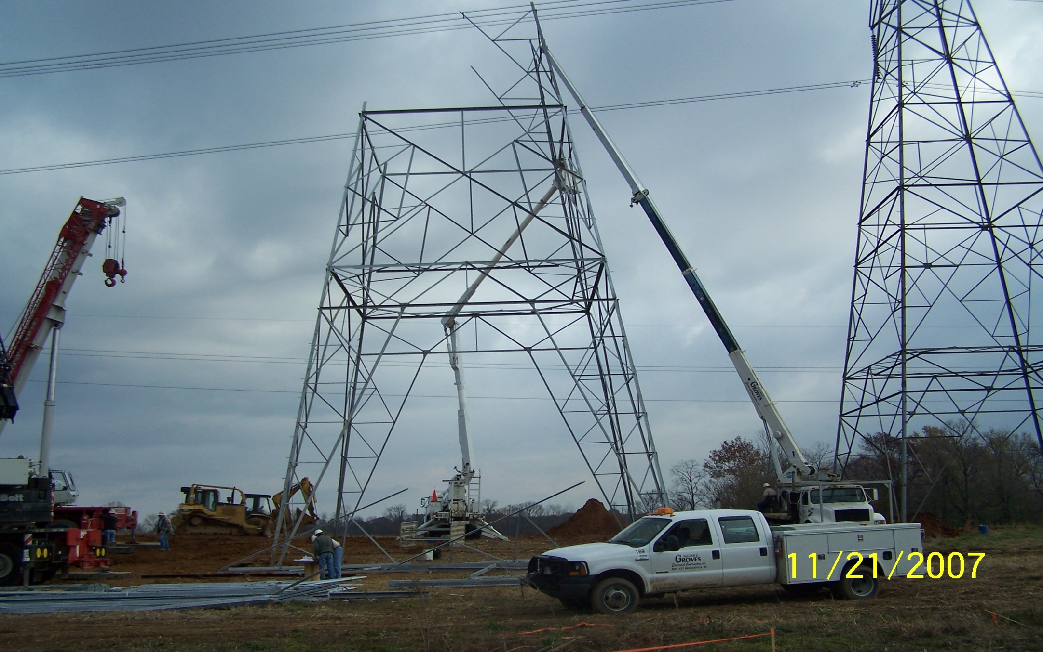
MOVING UTILITIES

Slide 22
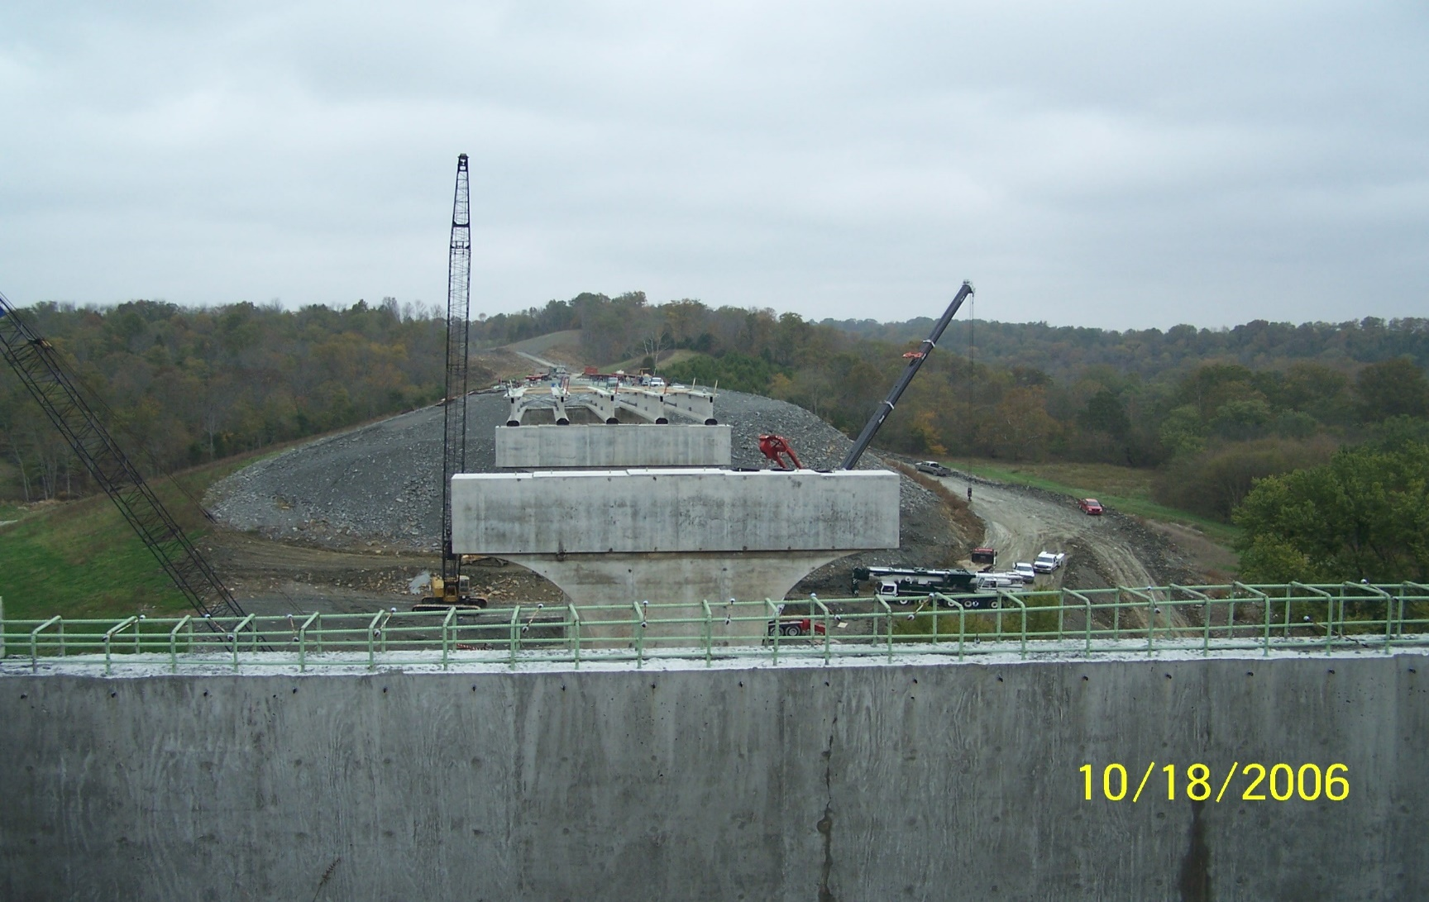
Workers And Machines Build the project
Engineers check everything is right
Safety rules are followed
Step by step, it starts to take shape
CONSTRUCTION STAGE
Follow the plans from design to build the solution to the problem

Slide 23
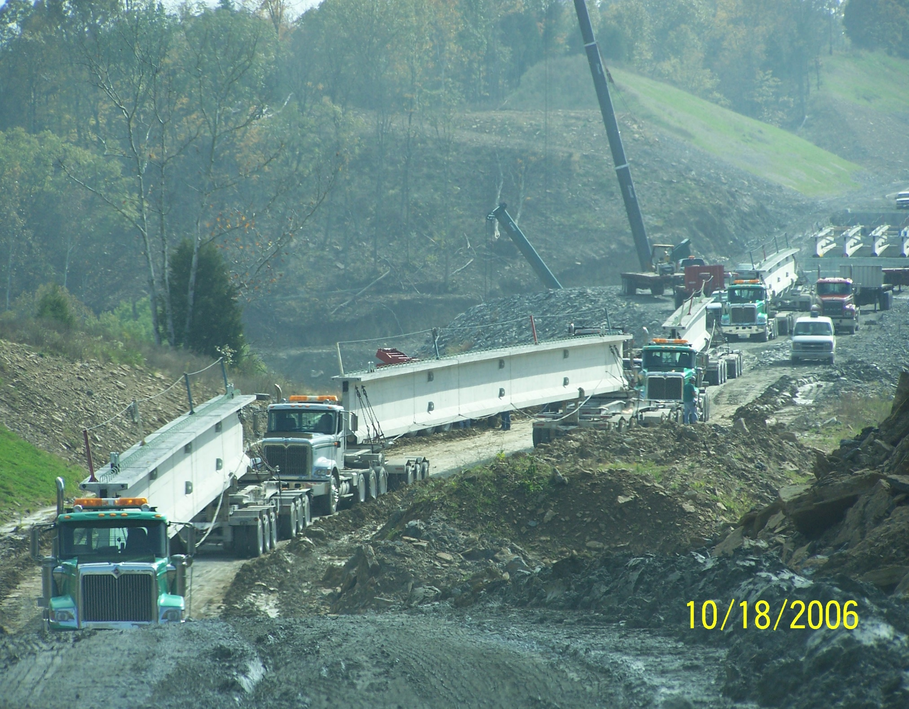
CONSTRUCTION STAGE

Slide 24
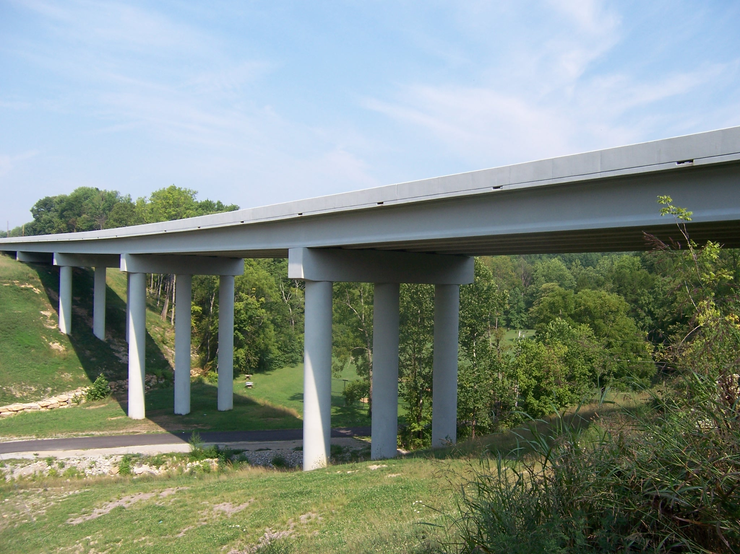
Construction
Finished Project
Inspection
Ready to use
Open to public

Slide 25
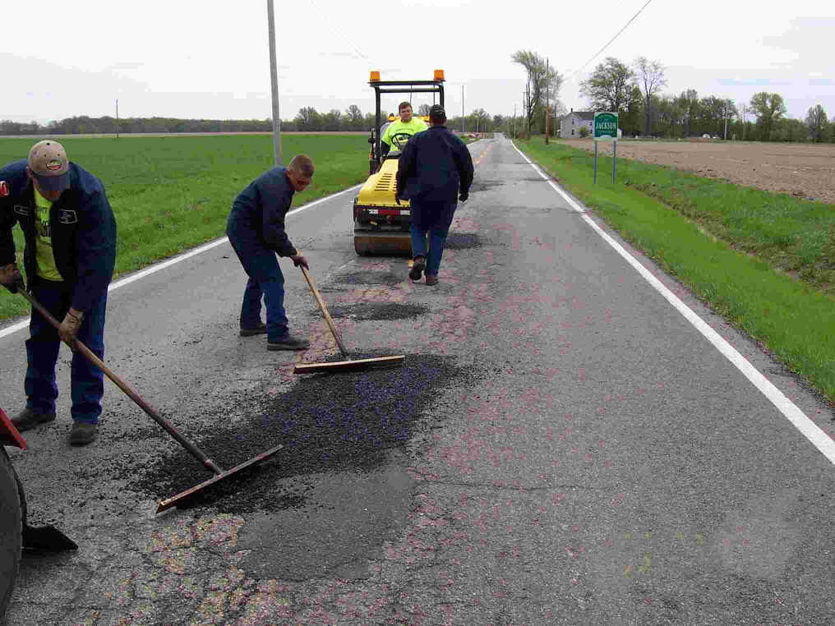
MAINTENANCE
Repairs
Inspections
Long-term care
Engineer Checkups

Slide 26
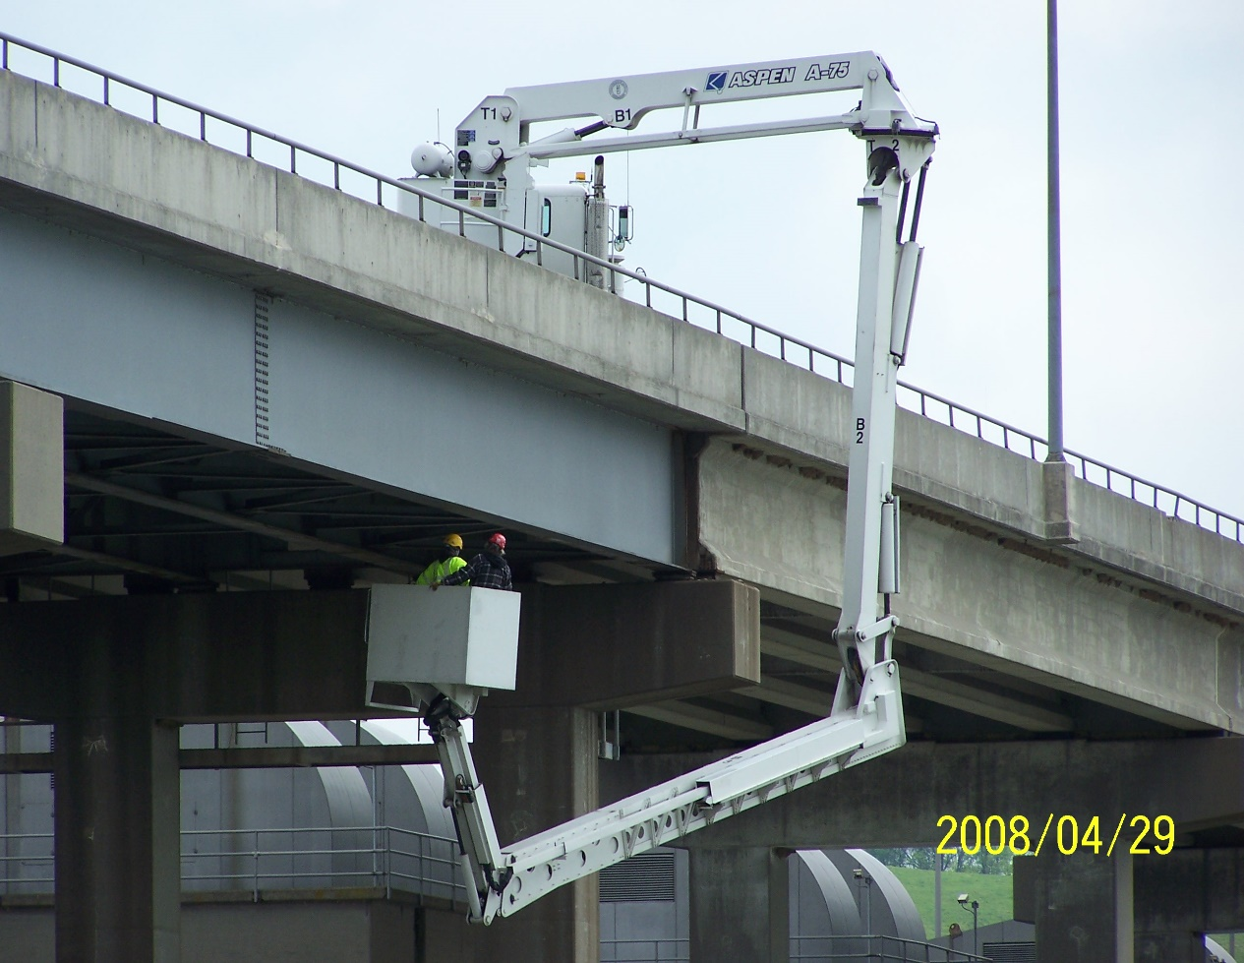

Road bridge repairs almost complete
Inspection and Maintenance of Large Bridge

Slide 27
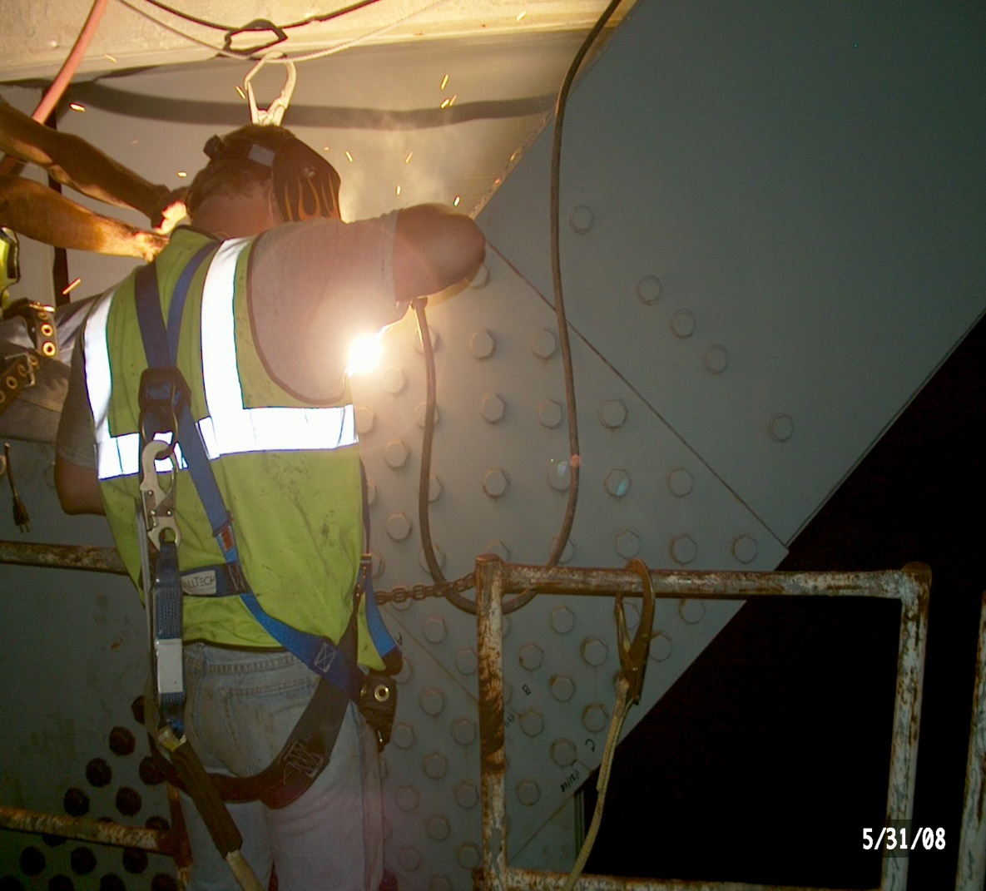
Rehabilitation
“Fixing what’s worn out”
Old structures get weak over time.
Engineer plan how to fix them.
Broken parts are replaced or repaired
It helps the structure last longer

Slide 28
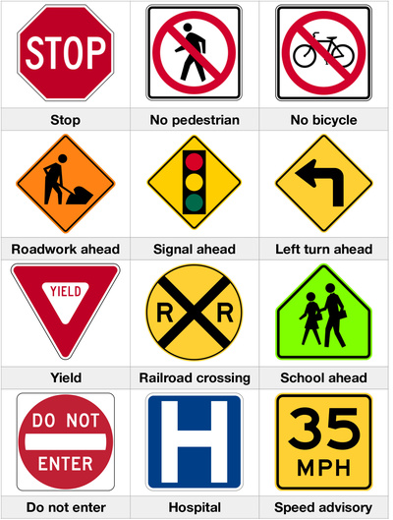
Road Traffic Safety Signs

Slide 29
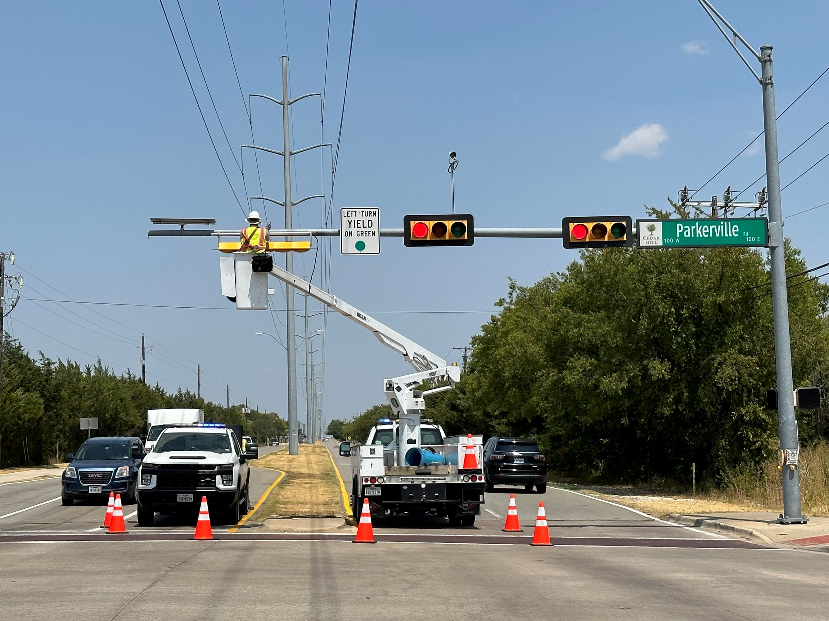
Traffic Signals Repair

Slide 30
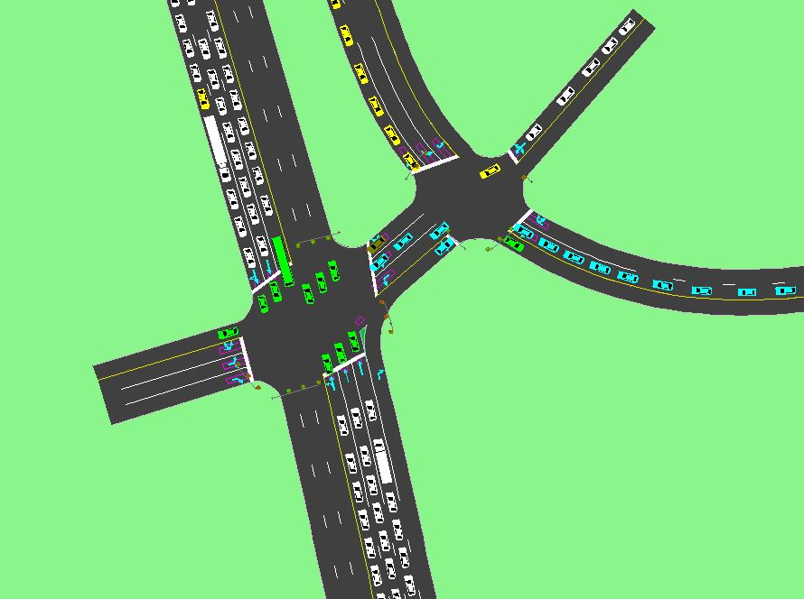
traffic simulation

Slide 31
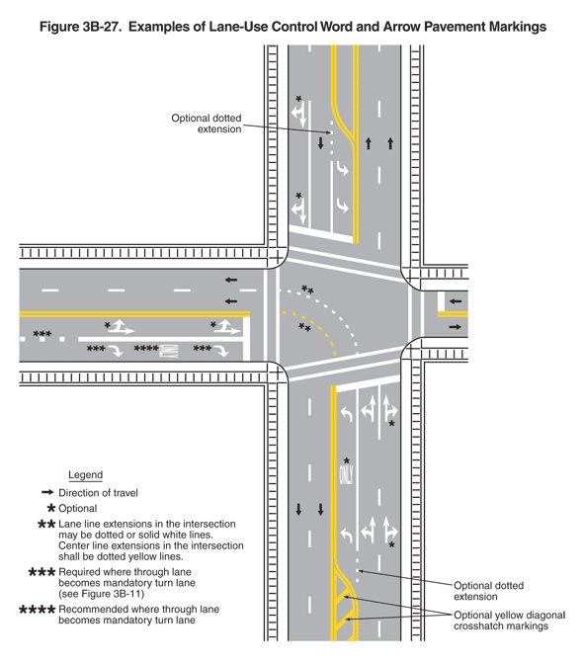
Lane-Use Control Word and Arrow Pavement Markings

Slide 32
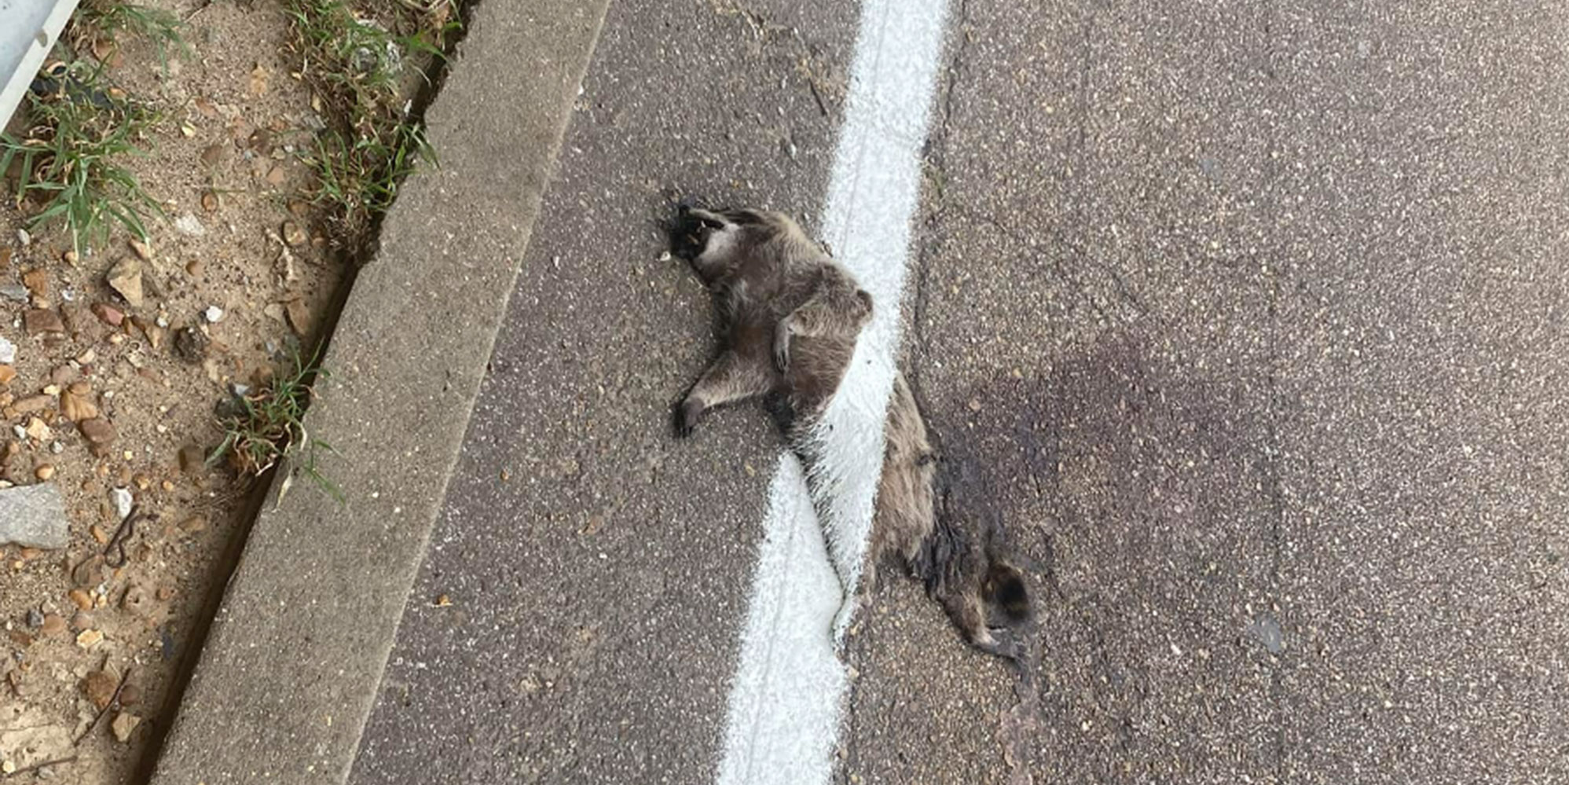
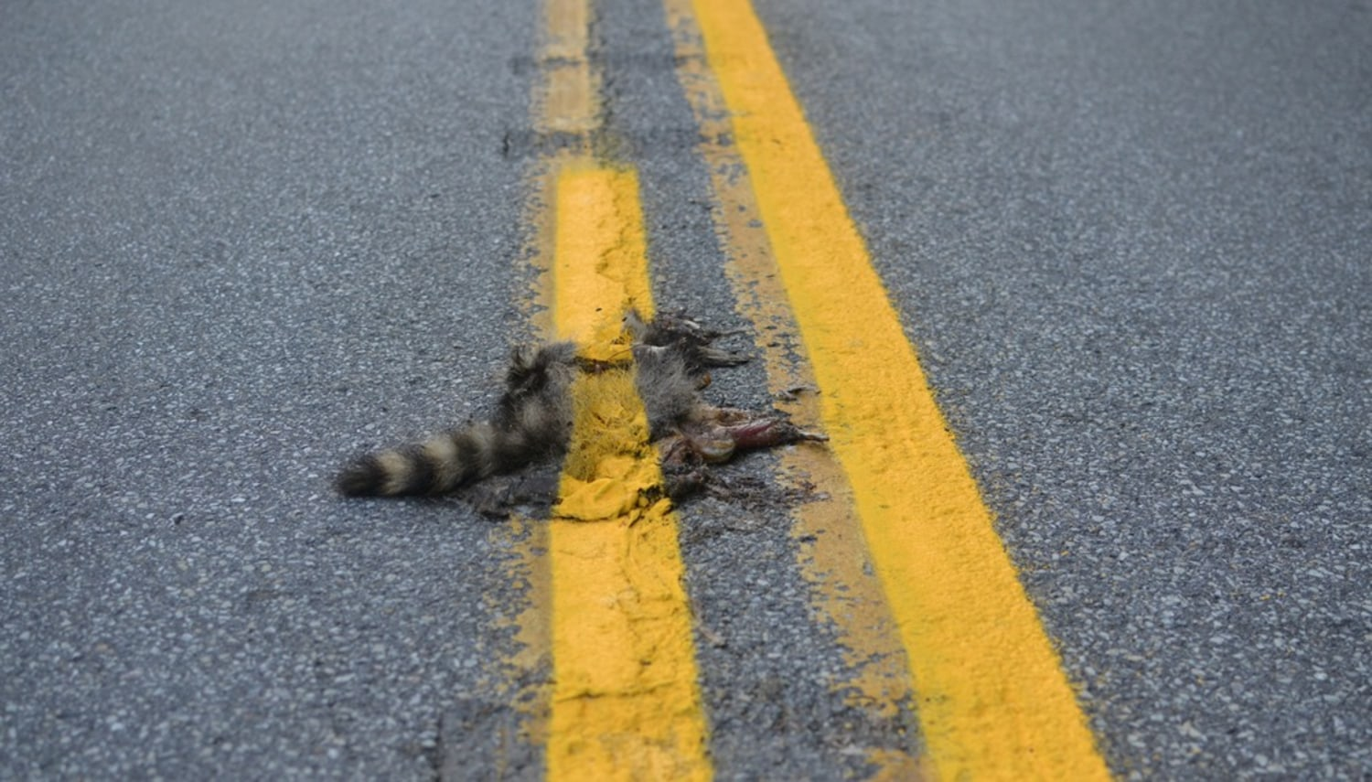
Road Crew Paints stripe Over Dead Animals

Slide 33

Becoming A Civil Engineer
ABET ACCREDITED SCHOOL (UK, UL, WKU)
30 SCHOOL HOURS (MASTERS)
FE EXAM
PE EXAM
4-YEAR DEGREE (BACHELORS)

Slide 34
SAMPLE CURRICULUM
FRESHMAN
SOPHOMORE
Fall Semester | Hours
Calculus I | 4.0
Writing I | 3.0
Chemistry I | 3.0
Intro. to CE | 3.0
Computer Graphics | 3.0
Fall Semester | Hours
Physics I & Lab | 5.0
Calculus III | 4.0
Statics | 3.0
Computer Science | 3.0
University Studies | 3.0
Spring Semester | Hours
Calculus II | 4.0
Writing II | 3.0
Chemistry II | 3.0
University Studies | 3.0
University Studies | 3.0
Spring Semester | Hours
Calculus IV | 3.0
Physics II & Lab | 5.0
Surveying | 4.0
Transportation Eng. | 3.0
Thermodynamics I | 3.0

Slide 35
SAMPLE CURRICULUM
JUNIOR
SENIOR
Fall Semester | Hours
Intro. To Construction | 3.0
Fluid Mechanics I | 3.0
Soil Mechanics | 3.0
Deformable Solids & Lab | 4.0
Elementary Geology | 4.0
Fall Semester | Hours
CE Systems | 3.0
Hydrology | 3.0
Design Electives | 4.0
CE Elective | 3.0
University Studies | 3.0
Spring Semester | Hours
Materials | 3.0
Structural Mechanics | 3.0
Seminar (Ethics) | 1.0
Fluid Mechanics II | 3.0
Water Quality | 3.0
University Studies | 3.0
Spring Semester | Hours
Structural Elective | 3.0
CE Elective | 3.0
CE Elective | 3.0
University Studies | 3.0
University Studies | 3.0
Dynamics | 3.0

Slide 36
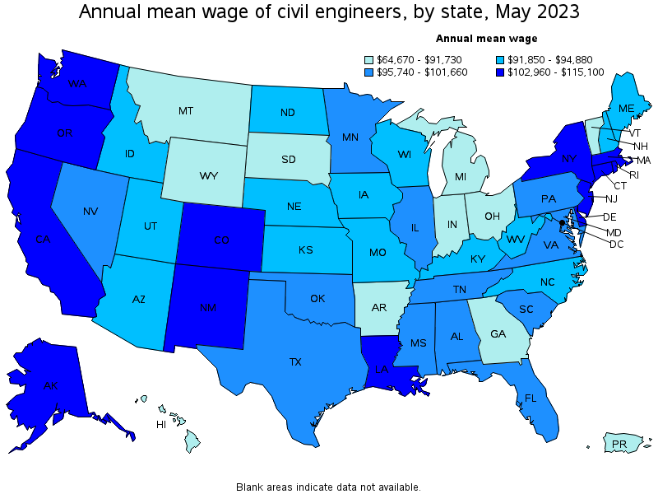
CIVIL ENGINEER SALARY INFORMATION

Slide 37

Civil Engineering Scholarship Program

Slide 38
PARTICIPATING SCHOOLS
UNIVERSITY OF KENTUCKY
UNIVERSITY OF LOUISVILLE
WESTERN KENTUCKY UNIVERSITY
KENTUCKY STATE UNIVERSITY

Slide 39

SCHOLARSHIP HISTORY
Since 1948
1,800 Scholarships
$14 Million

Slide 40
WHAT’S IT WORTH?
80 Scholarships
$7,200 for Freshman/Sophomore per semester
$7,600 for Junior/Senior per semester
Up to $59,000 !!

Slide 41
QUALIFICATIONS
Kentucky residents
Graduate of an accredited kentucky high school (or hold a GED)
Meet the admission requirements of their chosen university

Slide 42
CONDITIONS OF SCHOLARSHIP
Work one year full-time for the Cabinet for each year that you are on Scholarship
Maintain GPA 2.5 on 4.000 scale
Maintain 12 hours/semester and complete 30 total hours each school year

Slide 43
HOW DO I APPLY?
Fill out an application
Copy of transcript
Copy of official ACT score report
2 letters of recommendation 1) Counselor or Principal; 2) Math teacher
Submit application
*You must apply separately to University

Slide 44
THANK YOU!

Slide 45
KYTC.KEEN@ky.gov
transportation.ky.gov/Education/Pages/KEEN.aspx

