Slide 1

Bridge Building :
How Engineers Connect the World
Presentation by:
On Month Day 2022

Slide 2


An education initiative by the Kentucky Transportation Cabinet

Slide 3
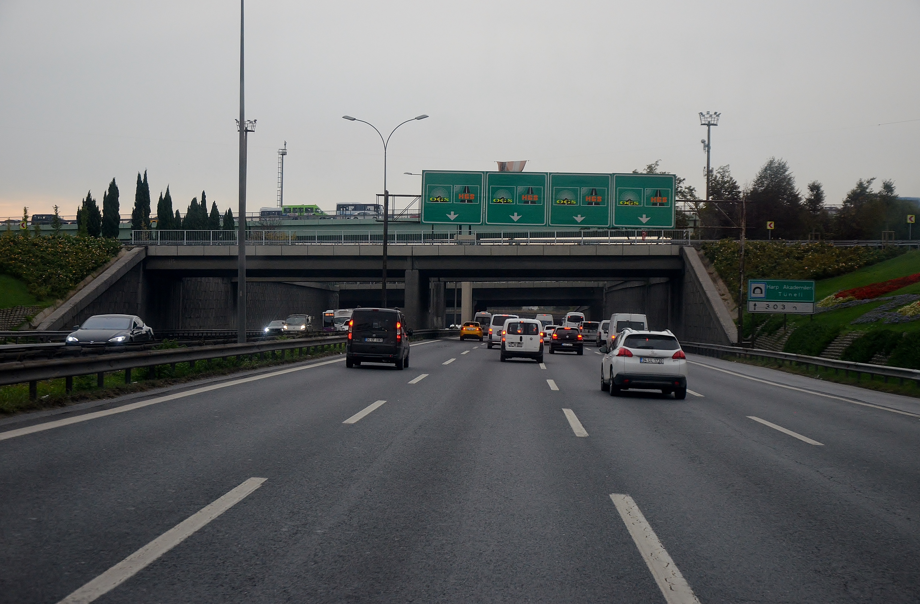
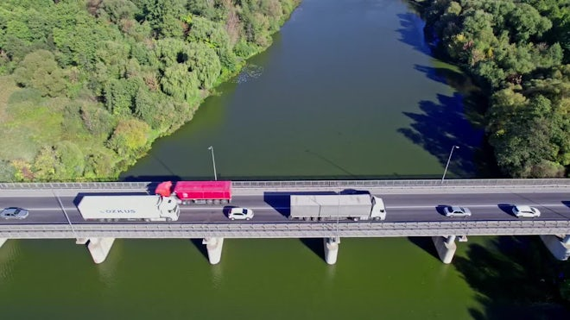
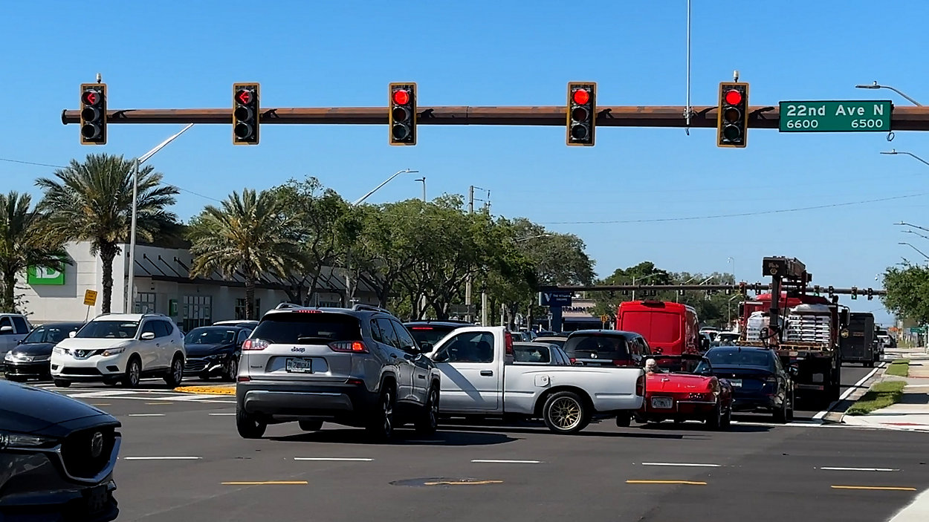
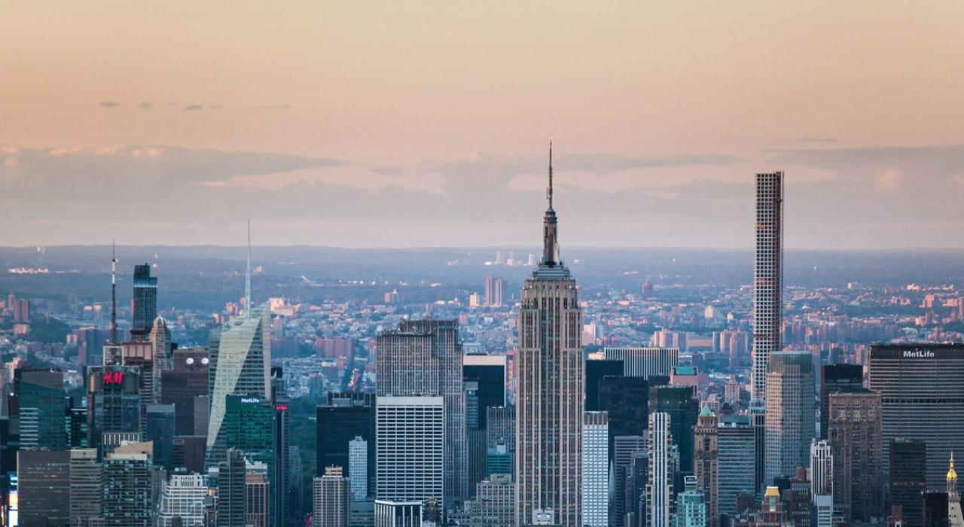
Engineering in our Everyday Lives
Roads & Highways
Bridges
Traffic Signals
Buildings
Helping us to get to school and work
Crossing rivers and highways
Engineered to manage traffic safely
Designed to be safe and strong

Slide 4
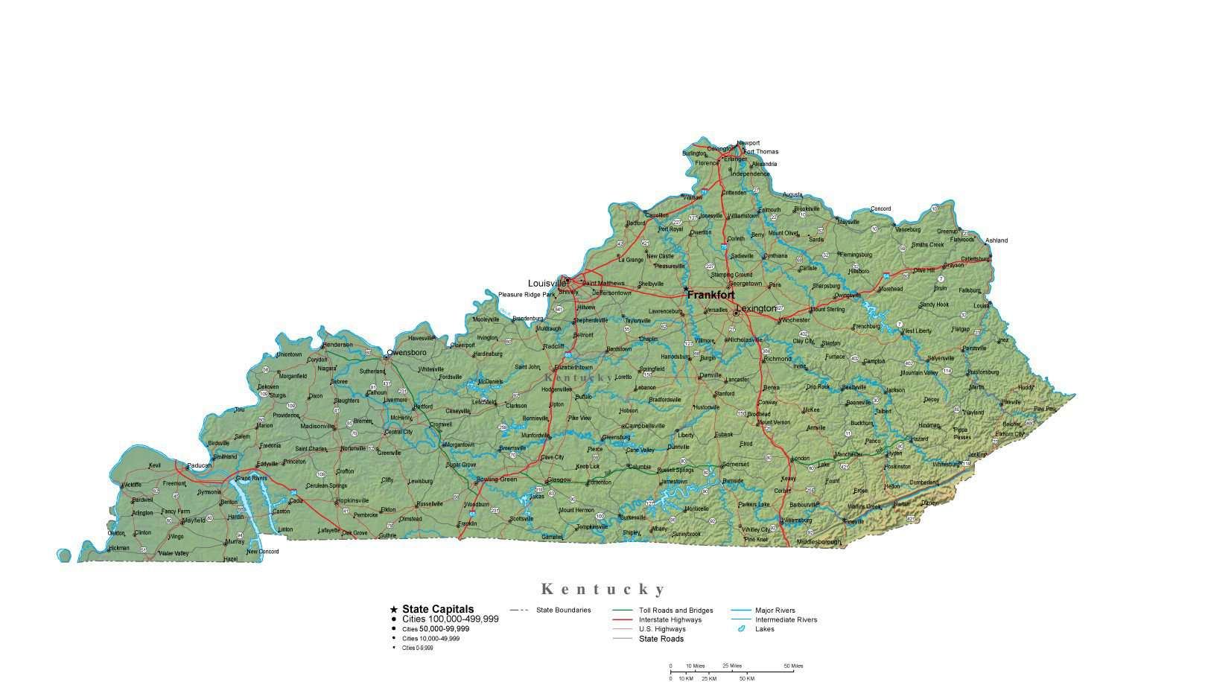
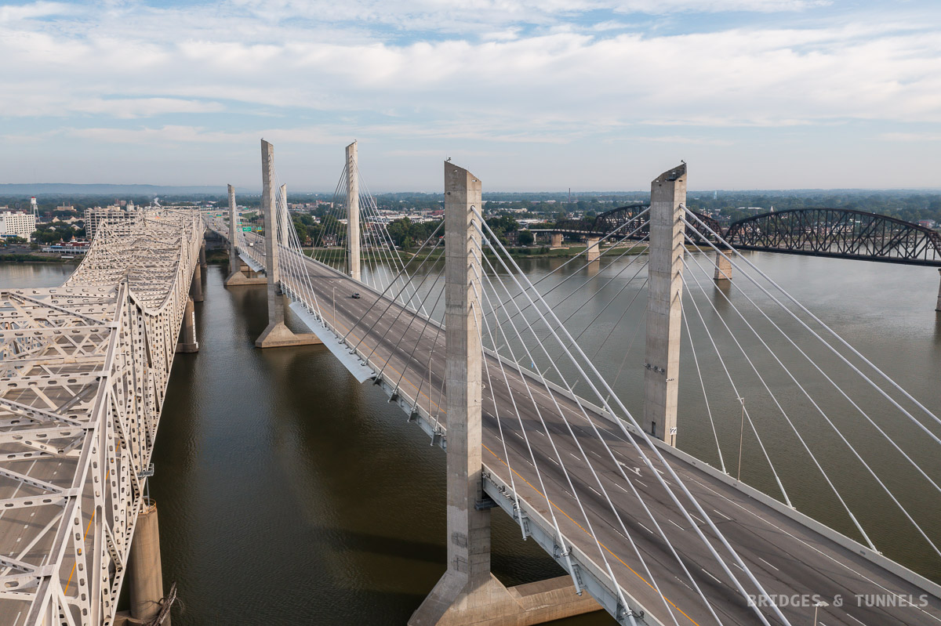
Transportation Cabinet
Team that builds and maintains roads and bridges.
Civil Engineers work on :
1. Planning
2. Designing
3. Inspection
They help keep travel safe, smooth, and strong

Slide 5


Balancing Act
Compression
How Bridges Handle Forces ?
Wind/Weather
Weight
Tension

Slide 6
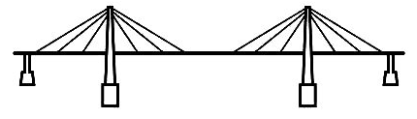
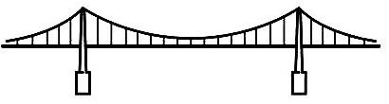
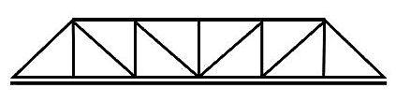
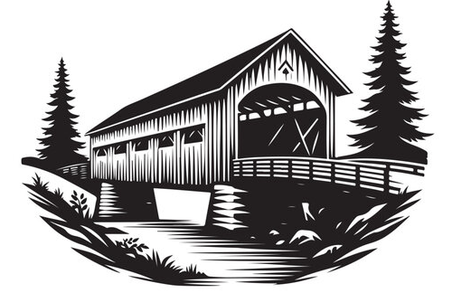
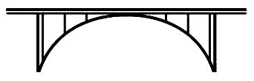

Different Types of Bridges
Cable-stayed bridge
Truss bridge
Suspension bridge
Covered bridge
Beam bridge
Arch bridge

Slide 7
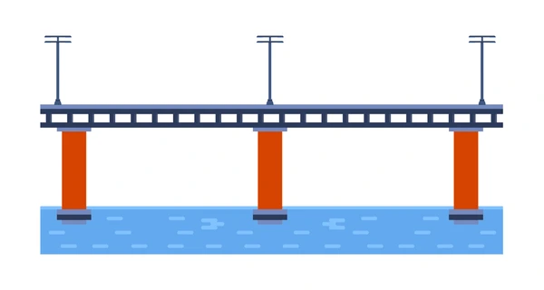
A straight , flat bridge that rets on two ends.
Used for short distance, over small rivers, roads or railways
Types :
1. Steel Beam Bridge
2. Concrete Beam Bridge
Beam Bridge

Slide 8
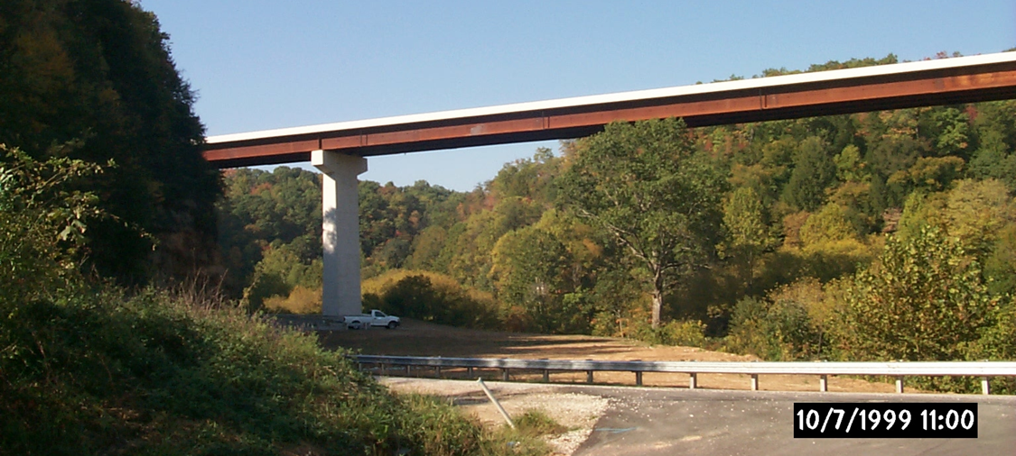
Steel I- Beam Bridge
KY 32 Bridge over Little Sandy River in Elliott Co.

Slide 9
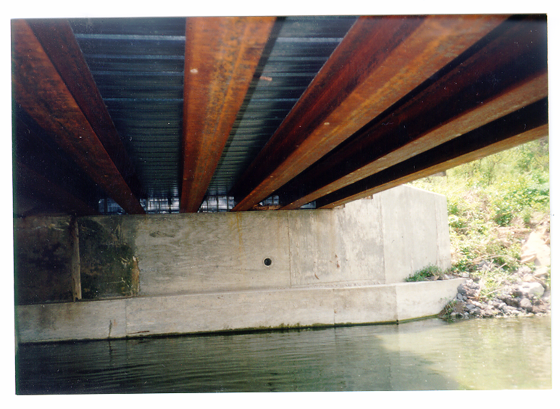
Steel I- Beam Bridge

Slide 10
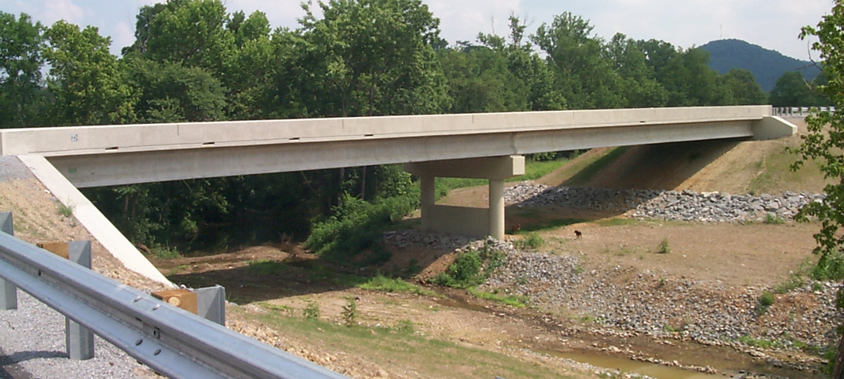
Concrete Beam Bridge
Bridge in Fleming County.

Slide 11
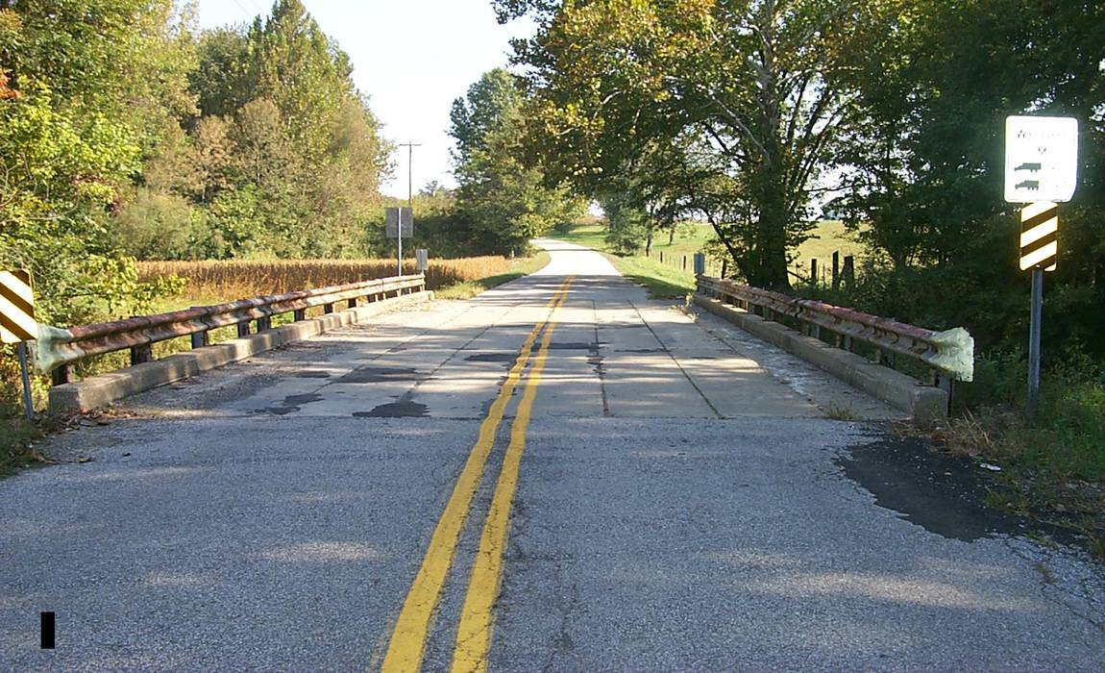
Concrete Beam Bridge
Hancock County

Slide 12
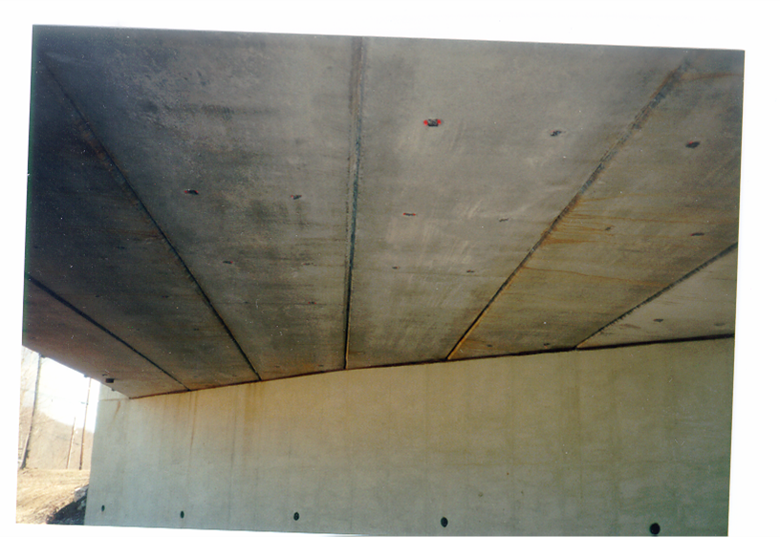
Concrete Beam Bridge

Slide 13
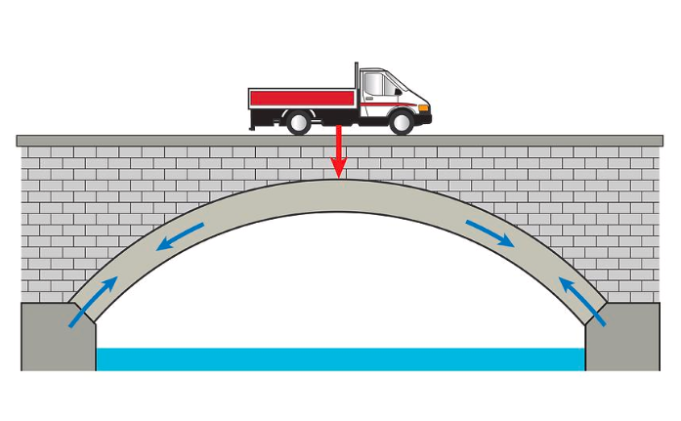
Bridge with a curved shape underneath
Best for crossing valley or rivers with natural support
Spreads the weight outwards to the ends of the bridge
Arch Bridge

Slide 14
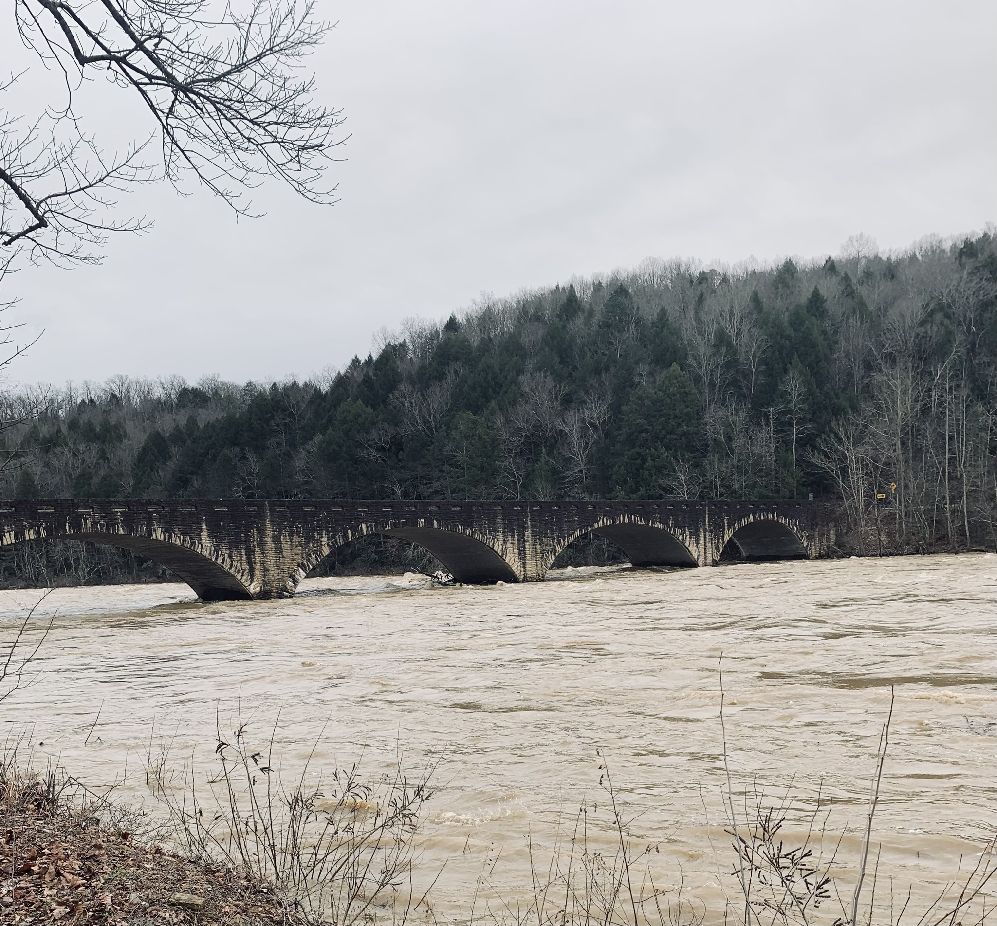
Constructed in 1953, across the Cumberland river
It was designed by R.R. Dawson of Bloomfield, Kentucky
Cumberland Arch Bridge

Slide 15
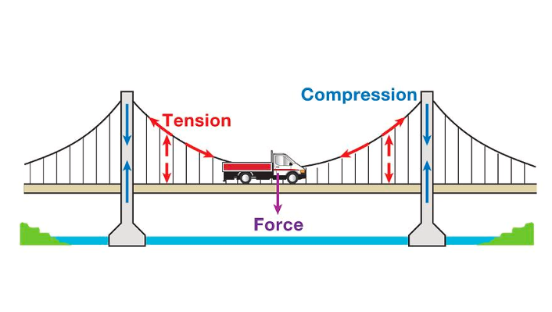
Suspension Bridge
A bridge with overhead cables supporting its roadway.
One of the oldest of engineering forms.
Constructed by primitive people using vines for cables and mounting the roadway directly on the cables
Cables carry the weight of the bridge

Slide 16
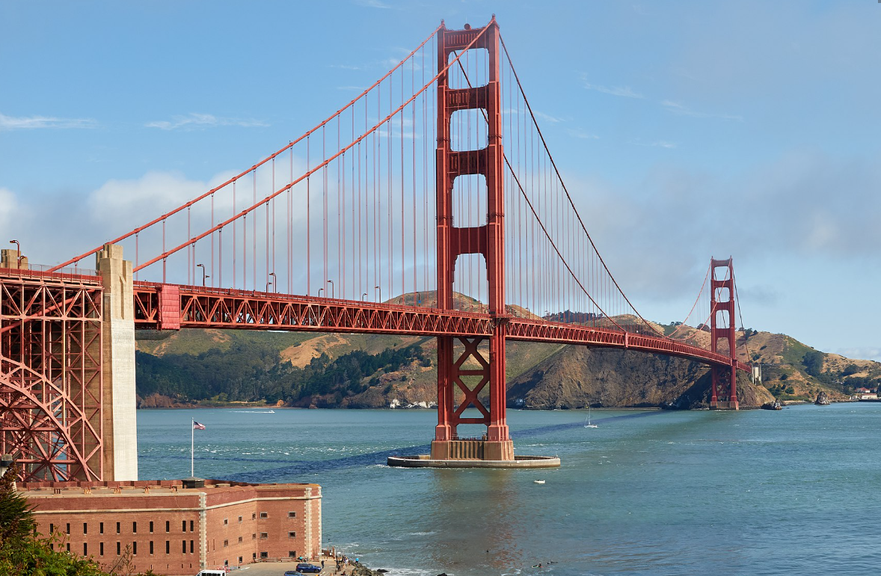
Suspension Bridge
Golden Gate Bridge, San Francisco

Slide 17
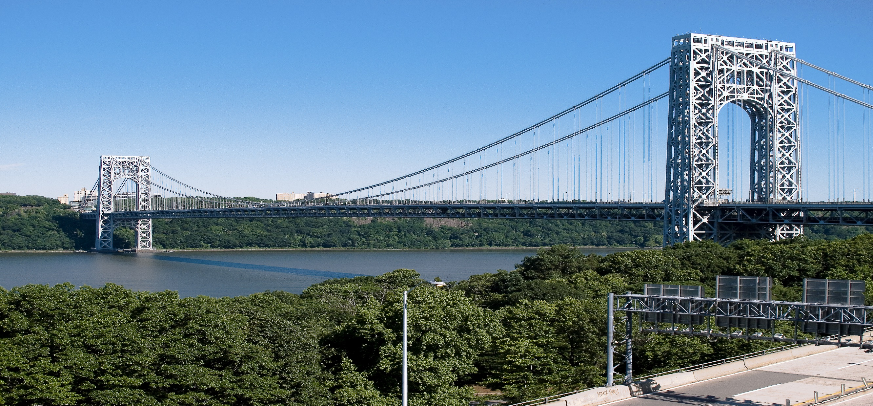
Suspension Bridge
George Washington Bridge over the Hudson River.

Slide 18
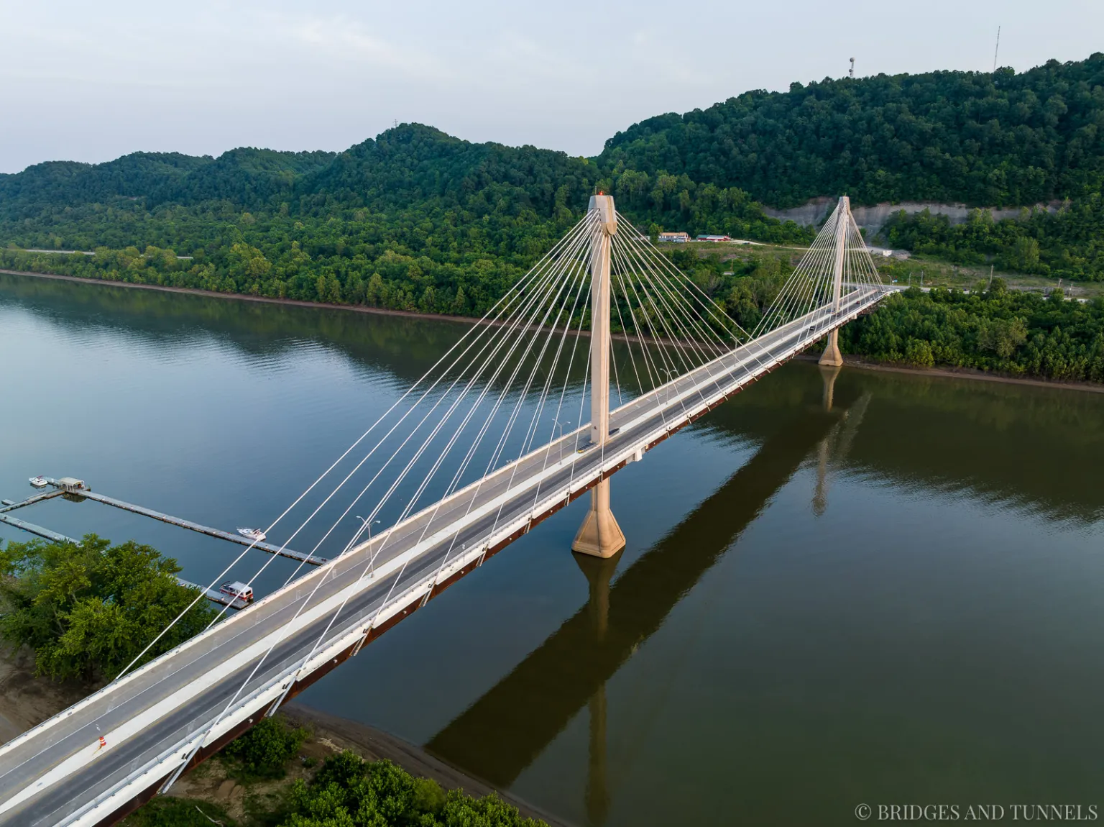
Suspension Bridge
Suspension bridge across the Ohio River at South Shore, KY.

Slide 19
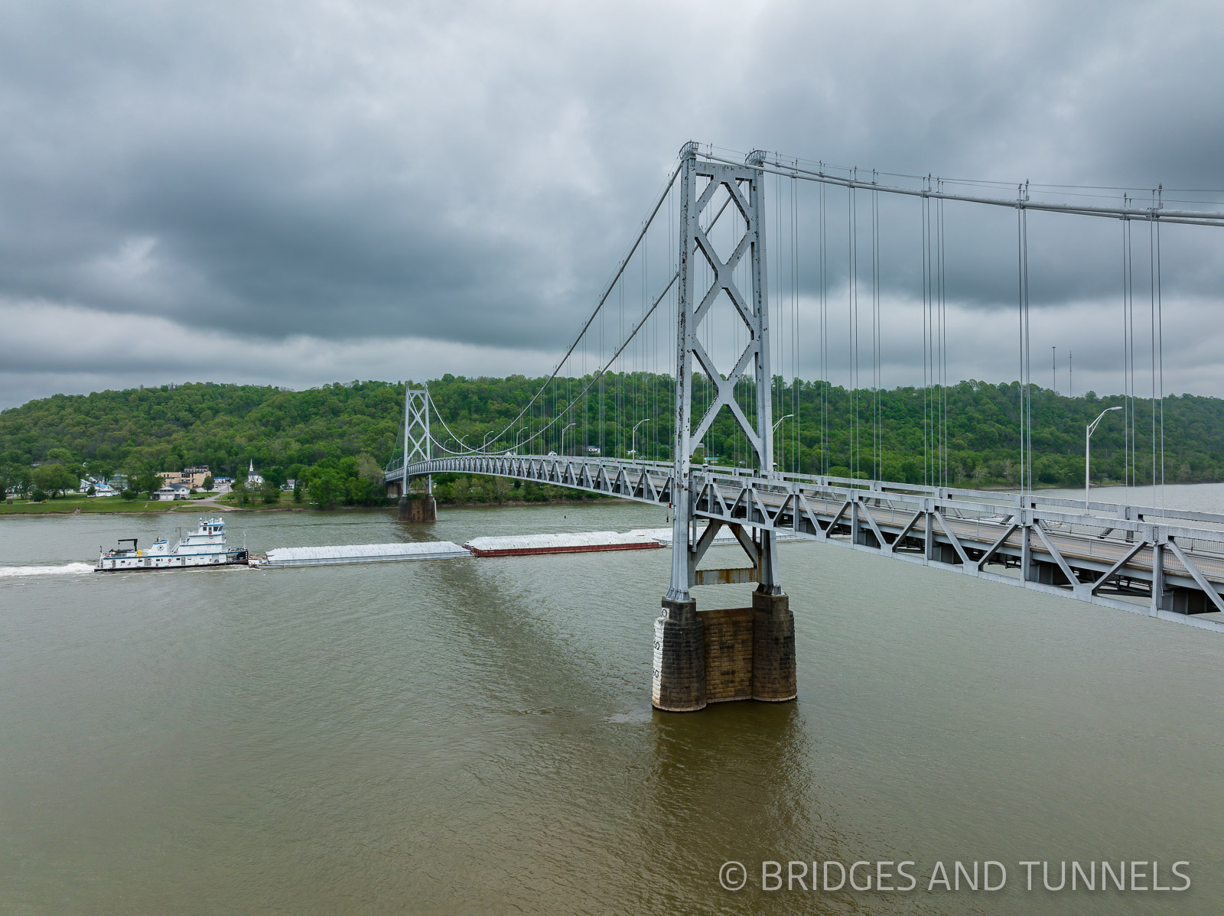
Suspension bridge Maysville, KY

Slide 20
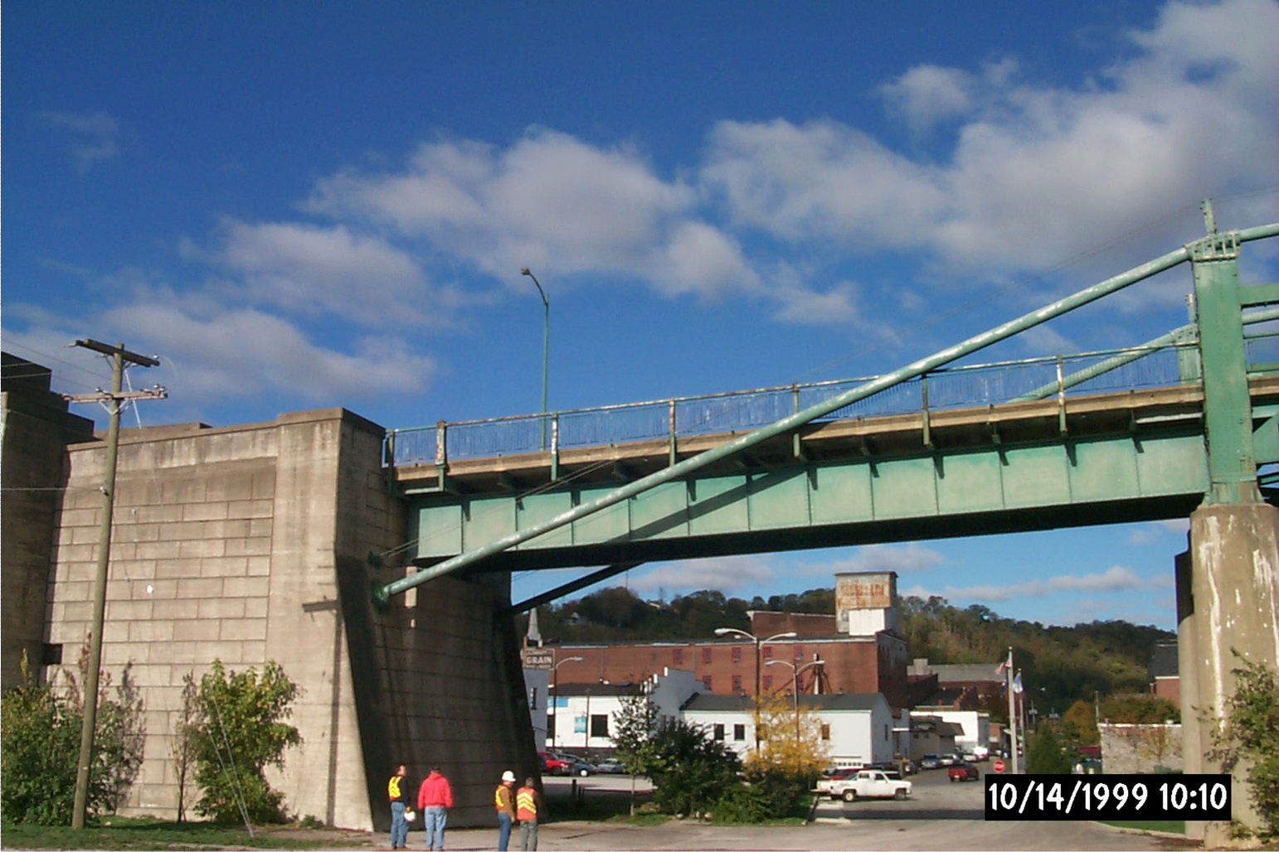
Suspension Bridge
Bridge Anchor

Slide 21
Cable-Stayed Bridge
Follows the cantilever method
The Tower is built, one cable and a section of the deck are constructed in each direction.
Process repeated until deck section meet in the middle where they are connected
The ends are anchored at the abutments.

Slide 22
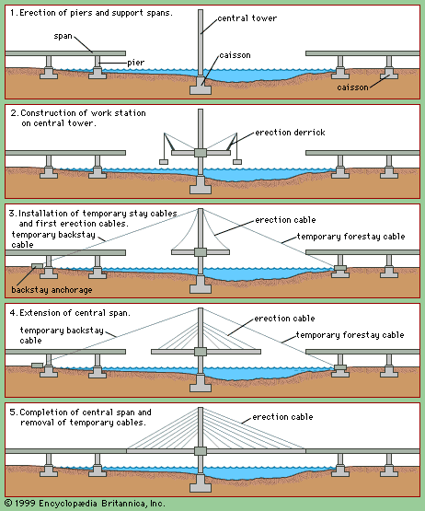
Cable-Stayed Bridge

Slide 23
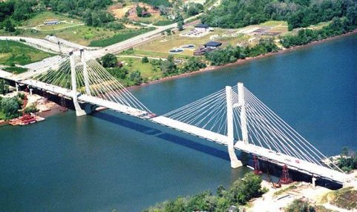
Cable-Stayed Bridge
Cable-Stayed bridge across the Ohio River at Maysville, KY.

Slide 24
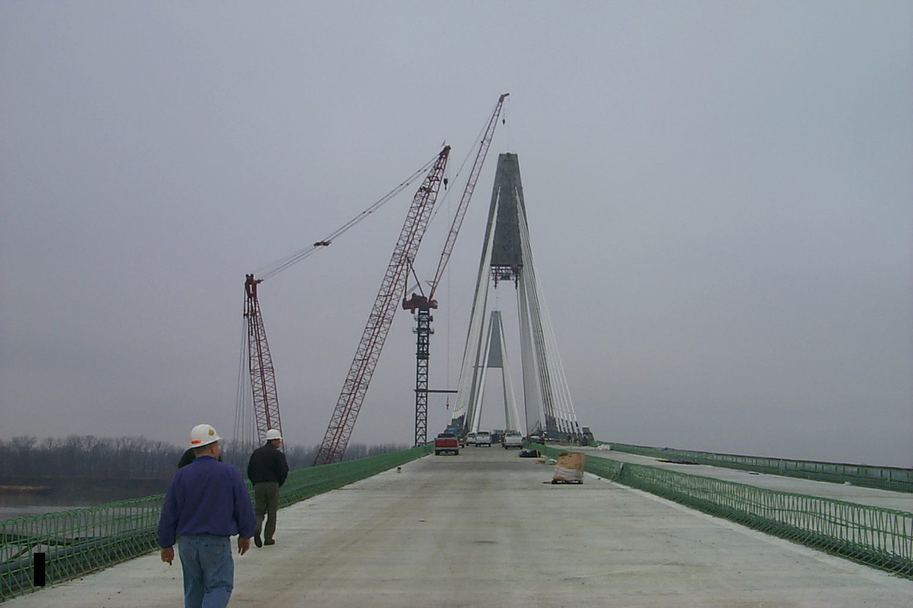
Cable-Stayed Bridge
View looking North at KY Tower.

Slide 25
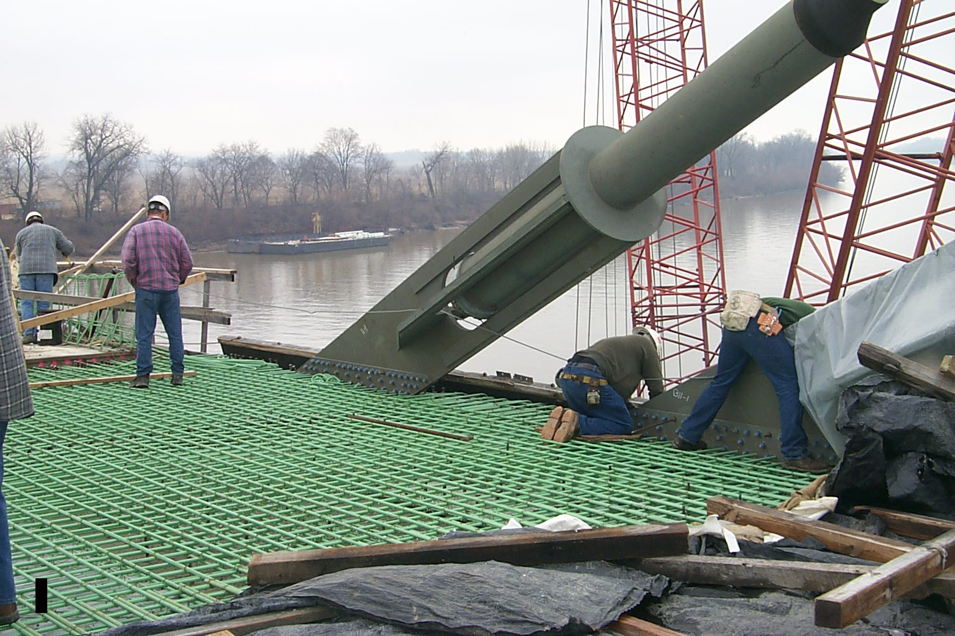
Cable-Stayed Bridge
Stay Pipe Anchor – Ready for Deck pour

Slide 26
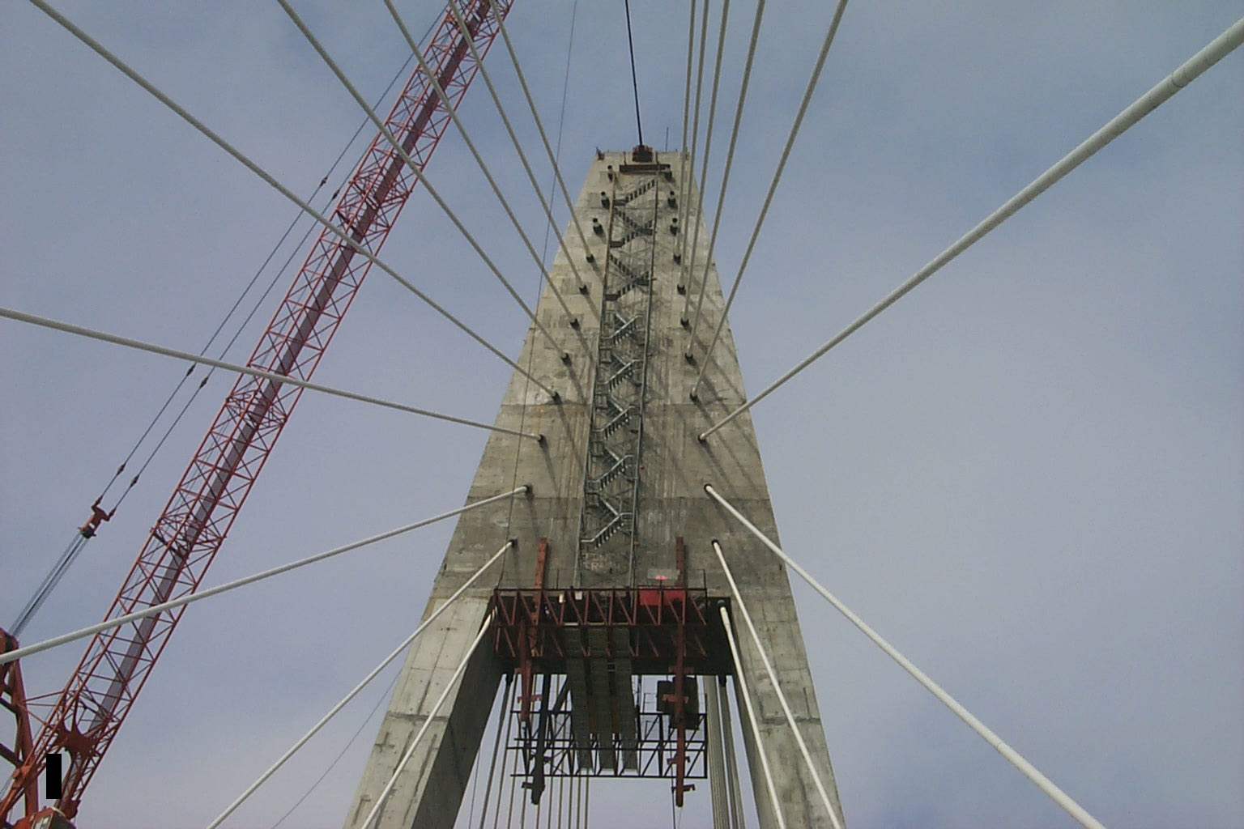
Cable-Stayed Bridge
South face of KY Tower

Slide 27
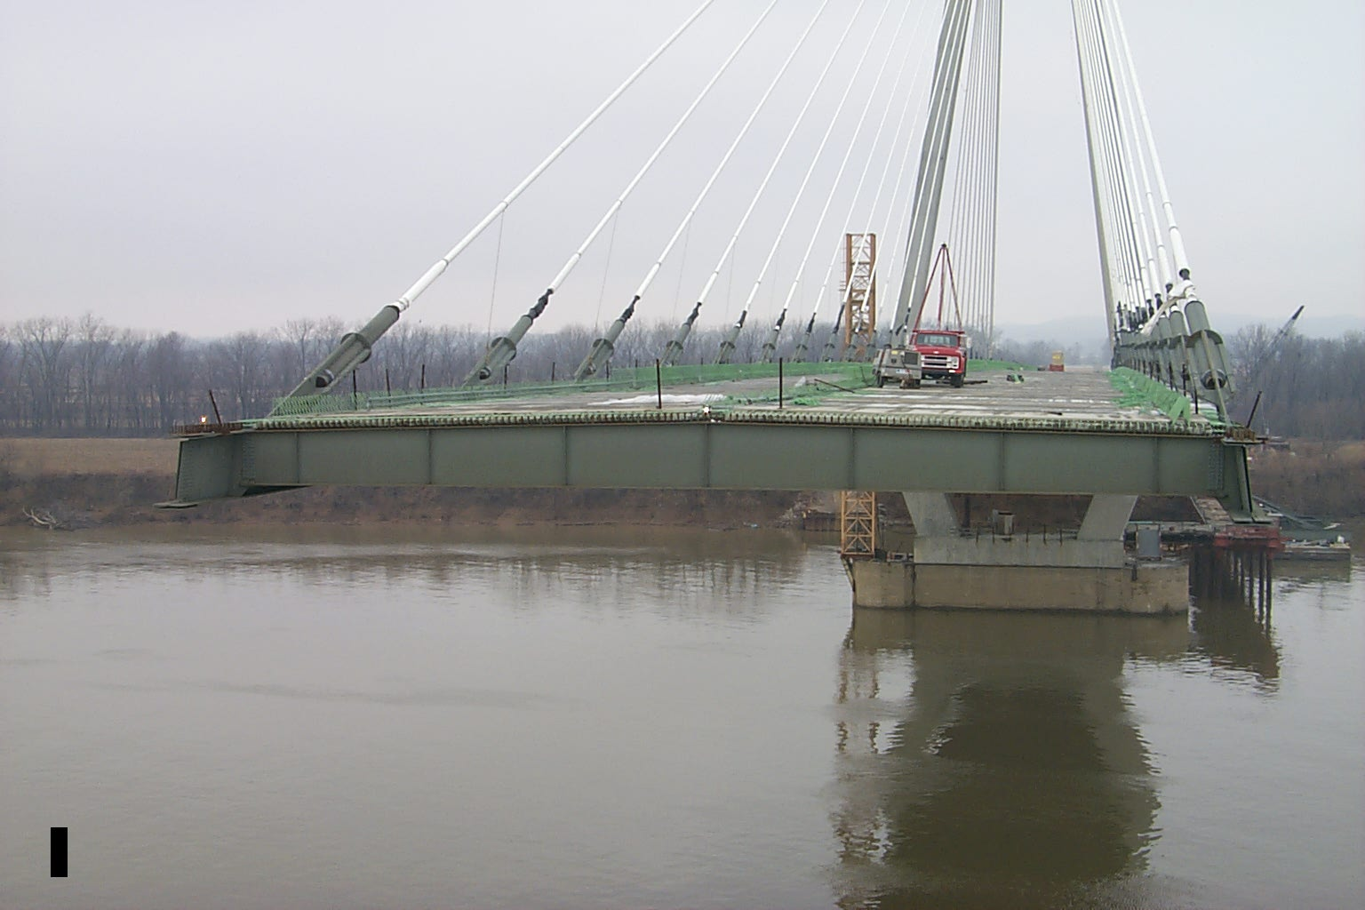
Cable-Stayed Bridge
Final 120’ span – Looking North.

Slide 28
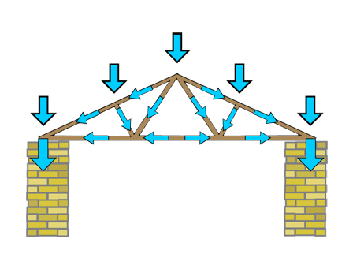
Truss Bridge
A bridge made od connected triangles- usually from steel or iron or timber.
Triangle are super strong shapes, they don’t bend easily.
Used for railroads, highways.

Slide 29
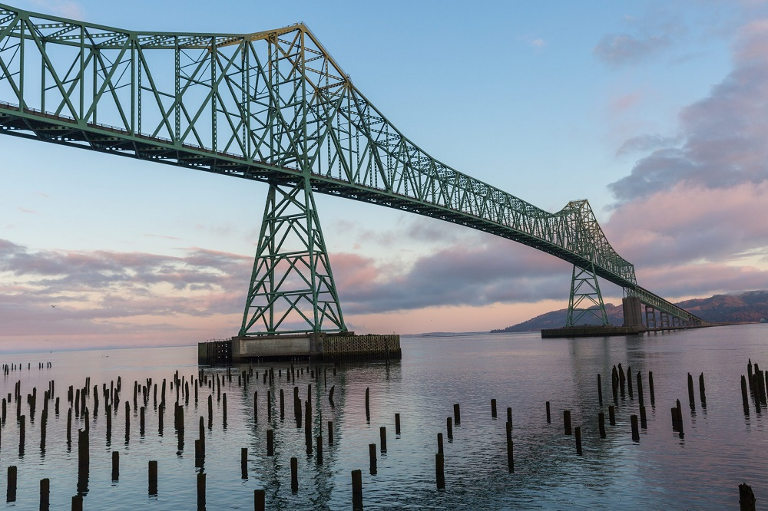
Truss Bridge
Astoria Bridge over the Columbia River, Oregon.

Slide 30
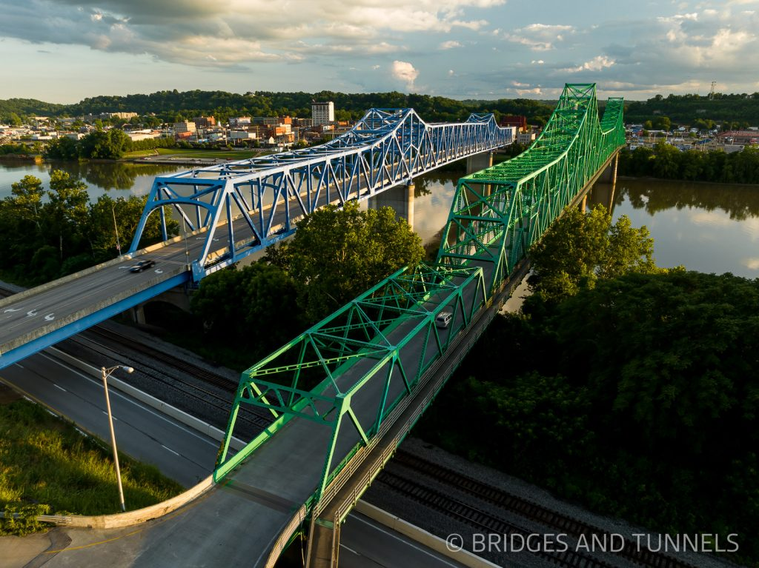
Truss Bridge
13th Street Bridge over Ohio River at Ashland, KY.

Slide 31
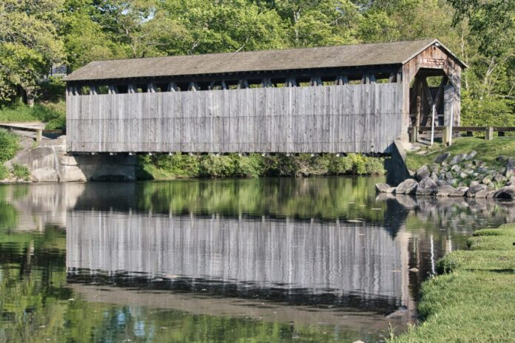
Covered Bridge
Wooden bridge with roof and sides that covers the structure.
These structures carrying a roadway over a river or other obstacle, popular in folklore and art
The structure protects the wooden beams underneath from rain, snow, and sun

Slide 32
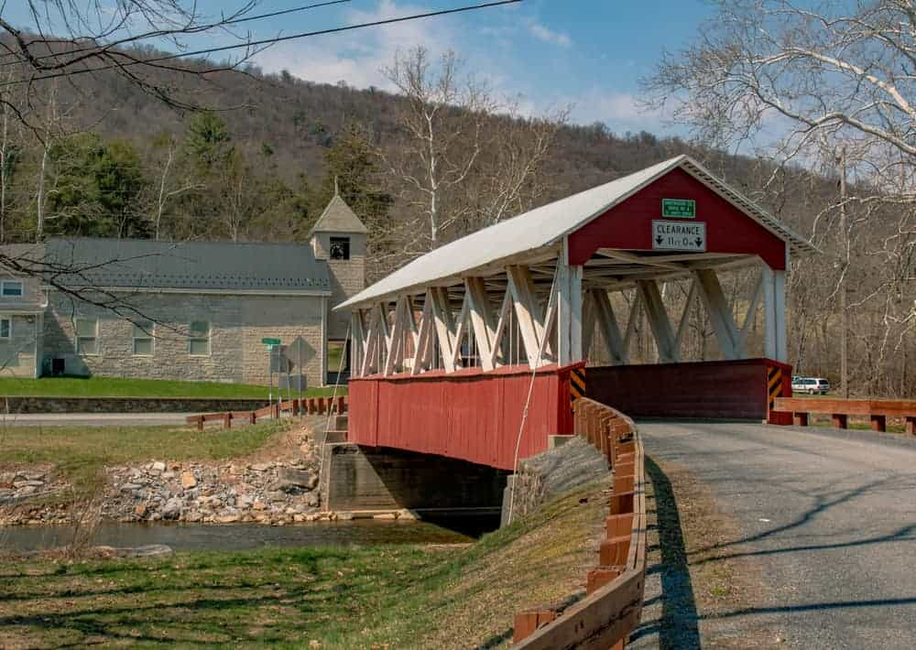
Covered Bridge
Covered Bridge, Mount Union, PA.

Slide 33
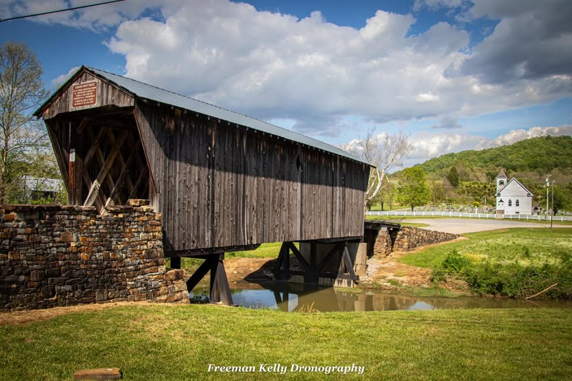
Covered Bridge
Goddard Covered Bridge, Fleming Co.

Slide 34
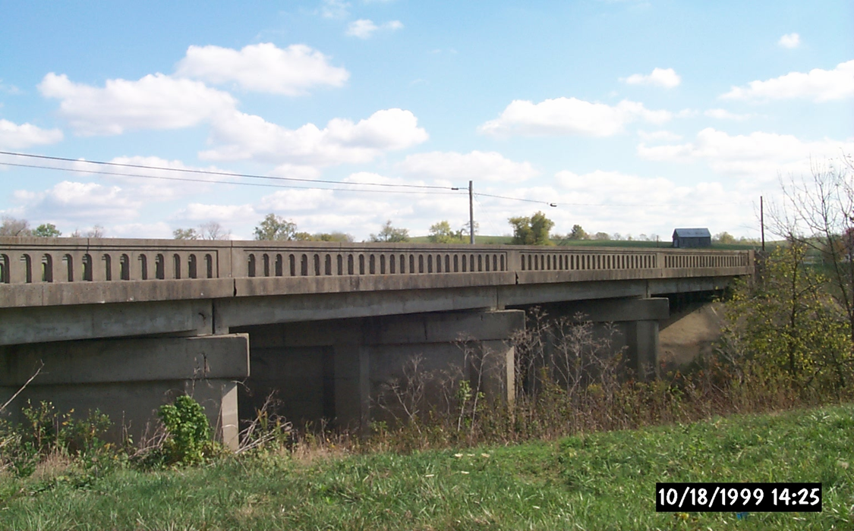
RCDG Bridge
RCGD stands for Reinforced concrete girder design – a bridge made with concrete beams strengthen by steel bars.
Concrete handles compression
Steel bars inside handles tension
Very durable
Used in highways, overpasses and urban interchanges
Fleming County

Slide 35
THANK YOU!

Slide 36
KYTC.KEEN@ky.gov
transportation.ky.gov/Education/Pages/KEEN.aspx

