Slide 1

WHY DO BOATS FLOAT?
Aluminum boats & Archimedes principle
Presentation by:
On Month Day 2022

Slide 2


An education initiative by the Kentucky Transportation Cabinet

Slide 3
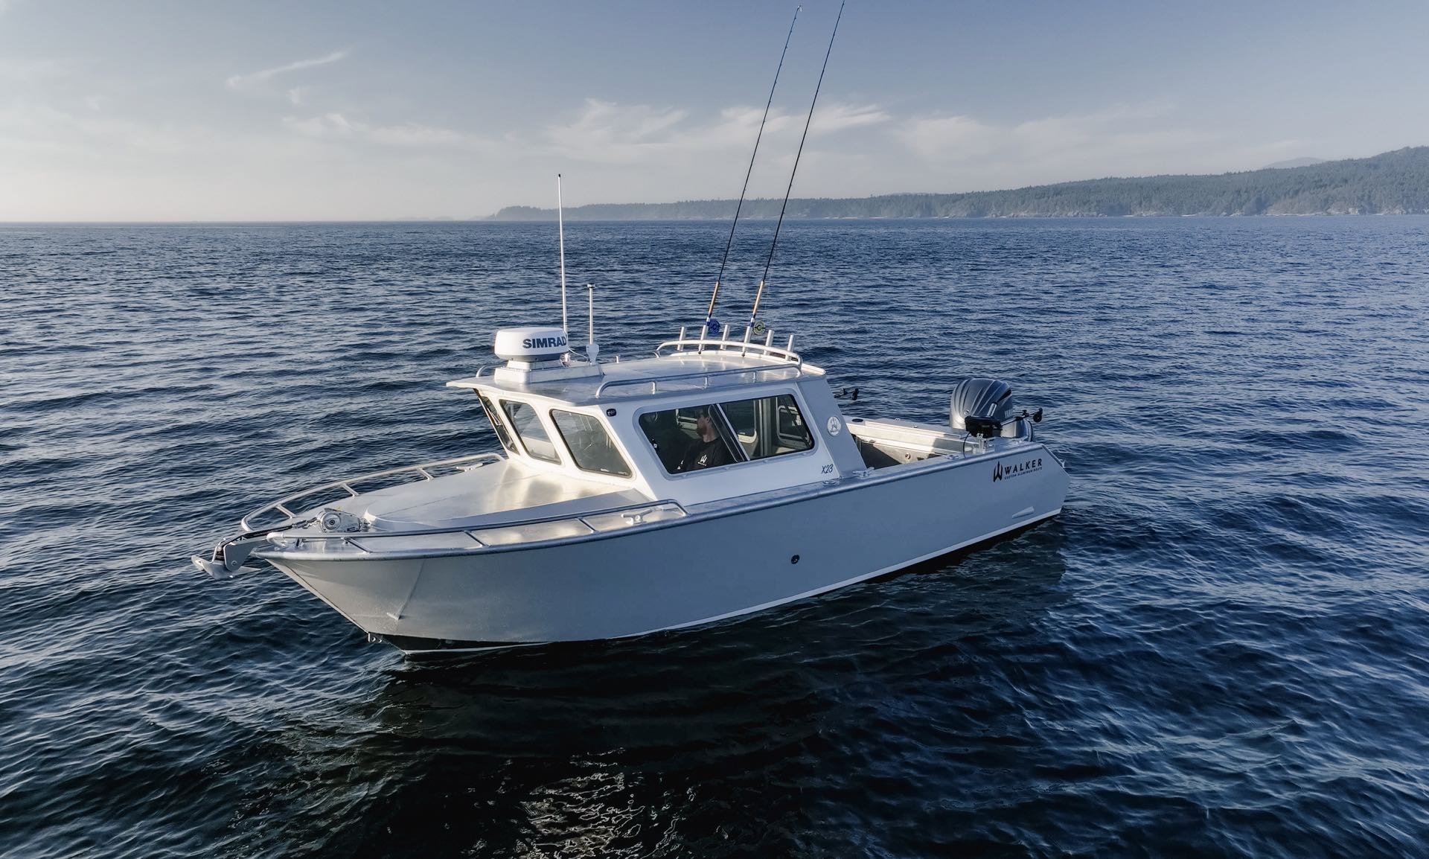
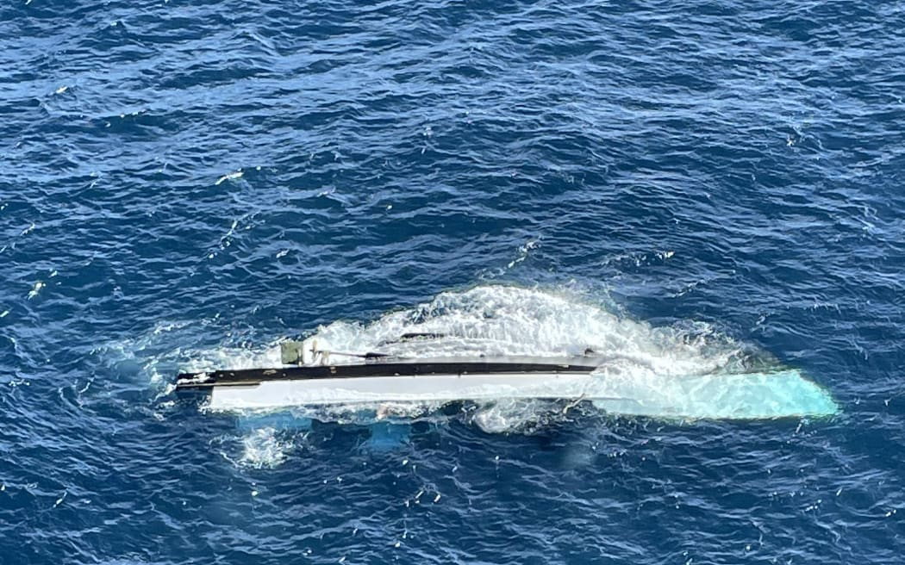
What Is Buoyancy?
Buoyancy is the upward force from water that makes things float
It depends on weight, volume and density

Slide 4
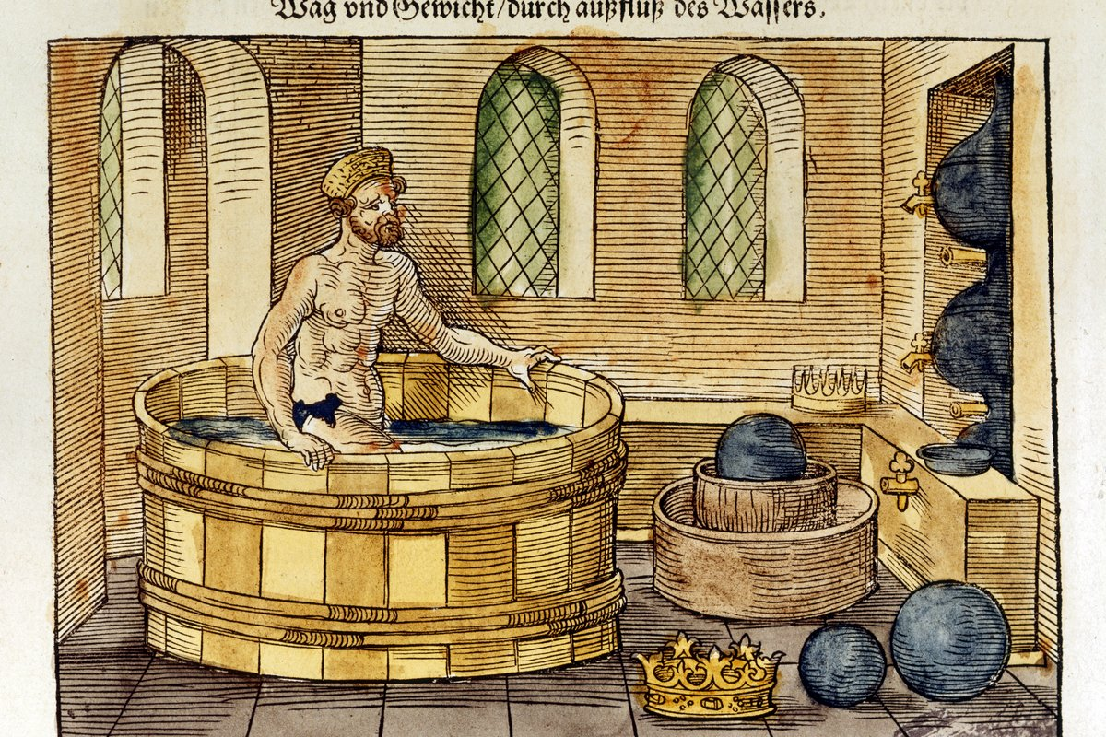
Archimedes “ Eureka!” Moment
Archimedes discovered buoyancy over 2000 years ago
He noticed water rises when you step in!
The more water you push out, the bigger the upward force
That’s how he figured out why things float!

Slide 5
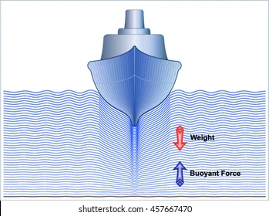
How Boats use Buoyancy
Boats spread their weight over a large area
This helps them push more water away
The more water they push , the more they float
That’s why shape matters just as much as weight.

Slide 6
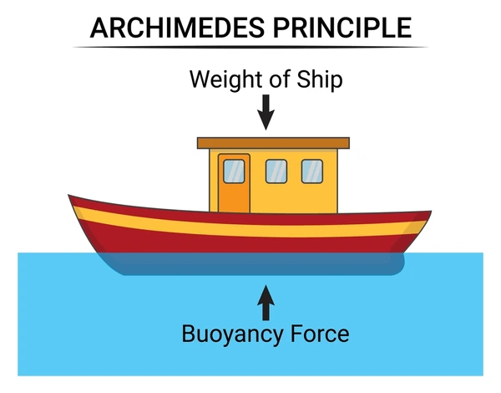
The Buoyancy Formula
Buoyancy Force
= Density * volume * gravity
If this Force is Greater than the boat’s weight, it floats!

Slide 7
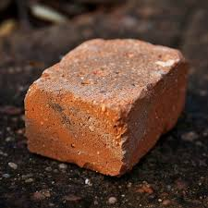
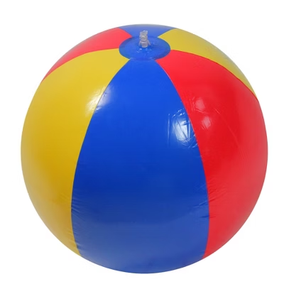

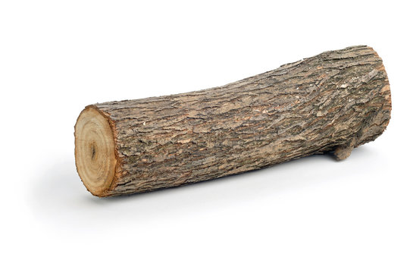
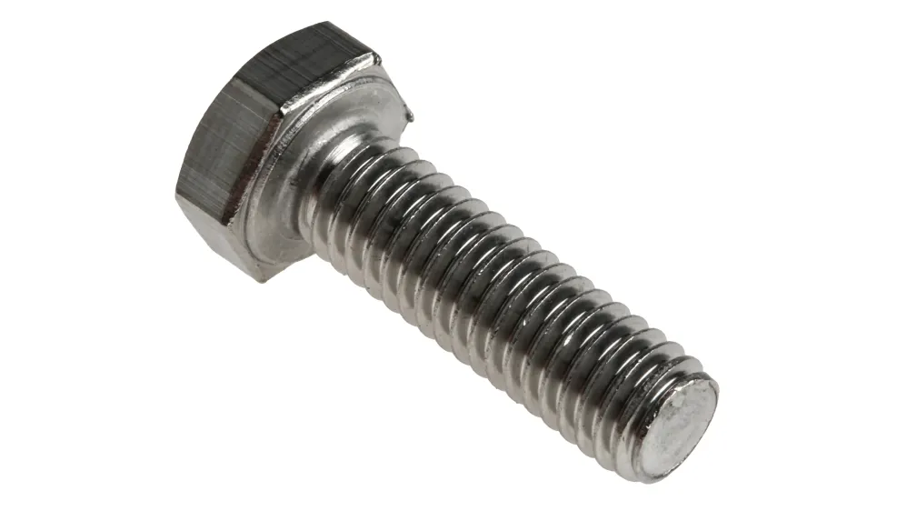
Sink or Float ?
A
B
C
E
D

Slide 8
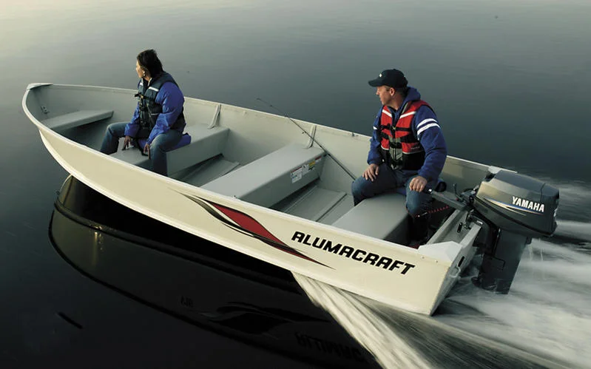
Why Aluminum Boats?
Aluminum is light but strong
It doesn’t rust and last longer in water
Boat shape helps spread weight to push more water
That’s why aluminum boats float so well!

Slide 9
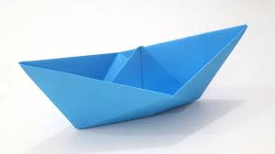
Try This!
Make your own mini boat with paper.
Float it in a tub of water
Add coins one by one , how many can it carry before it sinks?
Test your design, Change the shape and try again!

Slide 10
THANK YOU!

Slide 11
KYTC.KEEN@ky.gov
transportation.ky.gov/Education/Pages/KEEN.aspx

