Slide 1

AERODYNAMICS
Presentation by:
On Month Day 2025

Slide 2


An education initiative by the Kentucky Transportation Cabinet

Slide 3
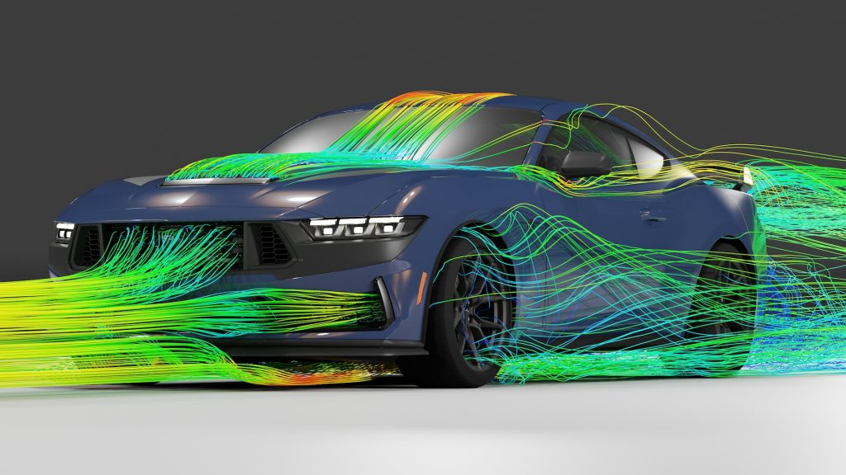
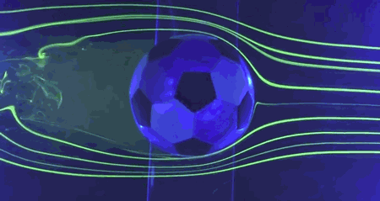
What Makes Things Fly ?
An Introduction to Aerodynamics
Study of how air moves around things.
It helps flying, driving and sports

Slide 4
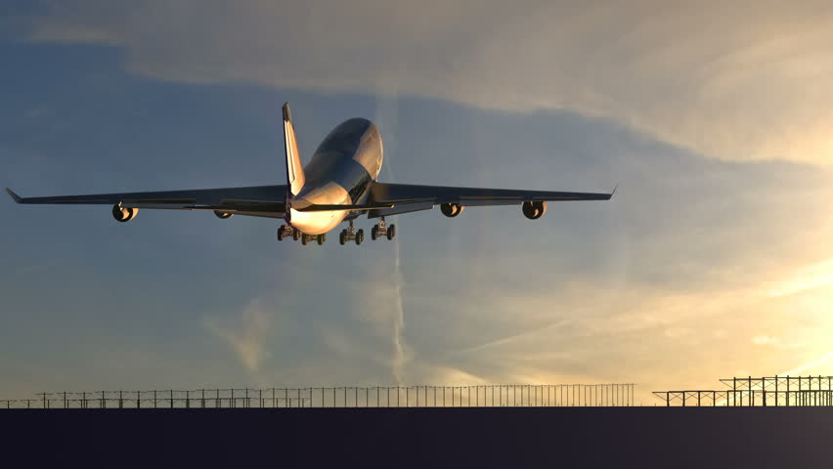
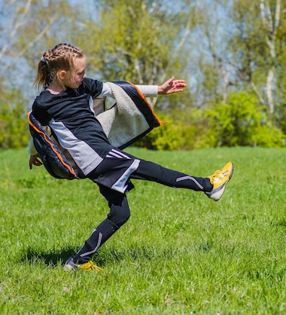
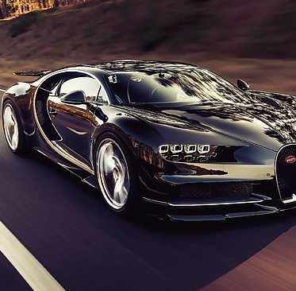

Why Is Aerodynamics Important ?
Notes:
It helps Airplanes fly smoothly
It makes Cars go faster and save fuel
It lets Balls curve in sports
It helps rockets Launch into space

Slide 5
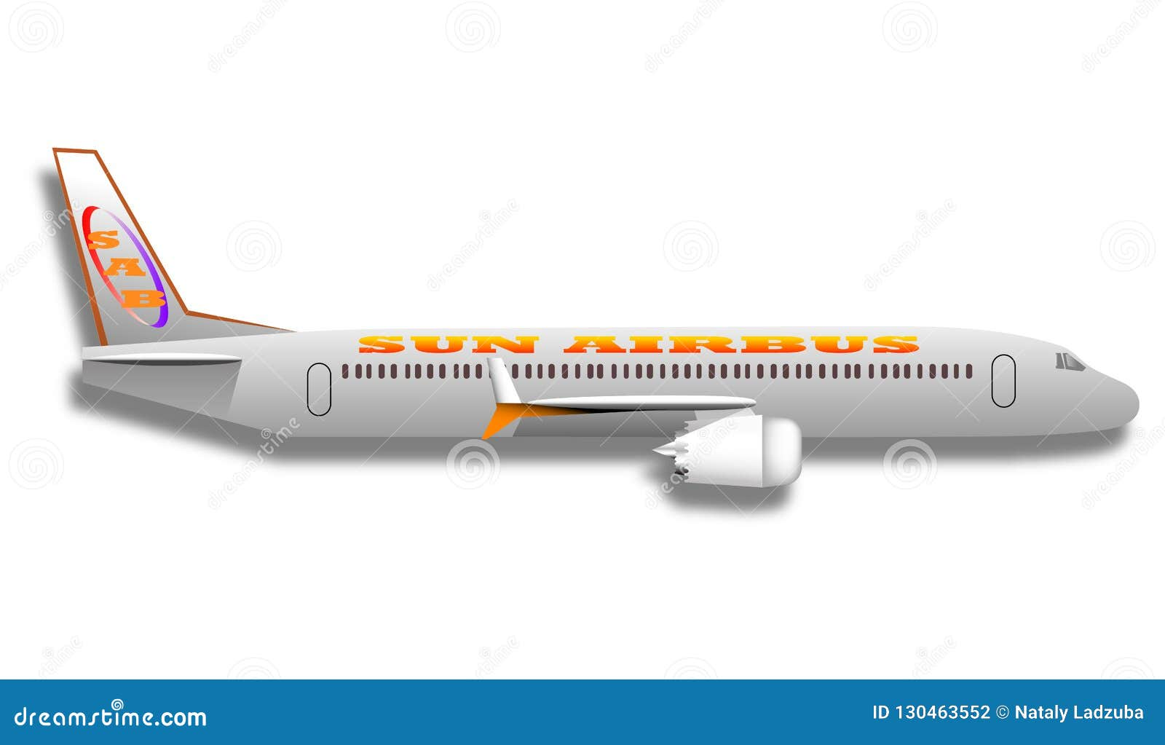

The 4 Forces That Makes Things Fly
Lift
Drag
Thrust
Weight
Notes:
Similar to Plane, Every object has to deal with four forces.
Lift – pushes it up, fighting gravity
Weight (gravity) – pulls it down
Thrust is the power that moves it forward – like a car engine
Drag – air resistance that tries to slow it down
All forces must balance for a plane to fly properly, similar to cars, balls, rockets..

Slide 6
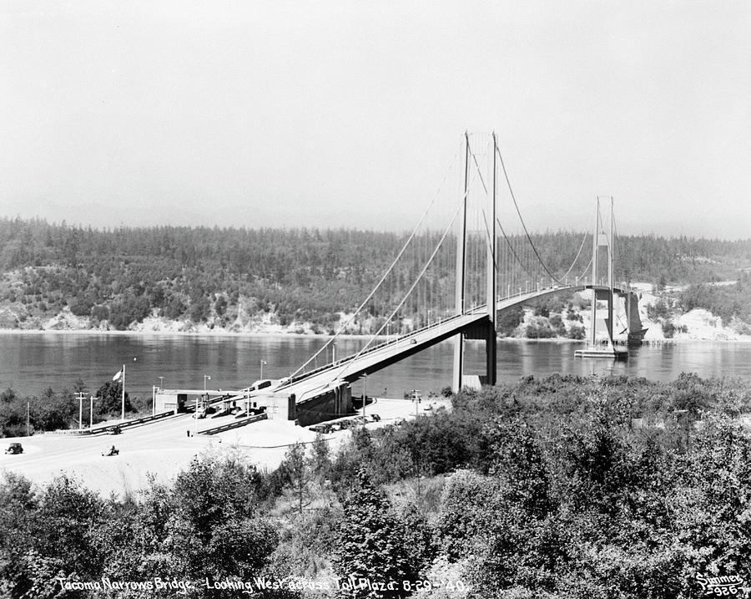
Do Bridges Need Aerodynamics ?
The first Tacoma Narrows Bridge opened to traffic on July 1, 1940.

Slide 7
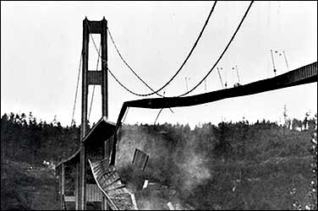
Its main span collapsed into the Tacoma Narrows four months later on November 7, 1940, at 11:00 AM
Notes:
Why did this happen if bridge wasn’t moving?
Air moves around the bridges too. If they are not designed to handle it, things can go very wrong

Slide 8






Identify and define the problem
Analyze the problem
Design and propose solutions
Refine your proposal
solution to your initial problem
Fail
Notes:
In general this is a flow chart of the steps engineers follow in solving problems.
First, you identify and define your problem
Second, you analyze the problem
Third you design and propose solutions
Forth you refine your proposal
5) And after going through this process you have hopefully found a solution to your initial problem.

Slide 9
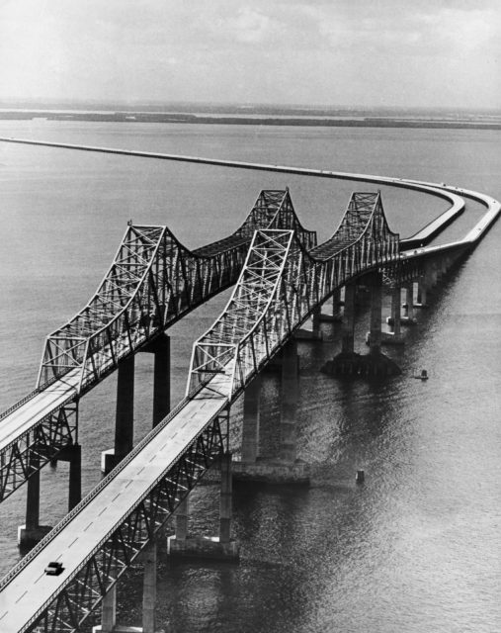
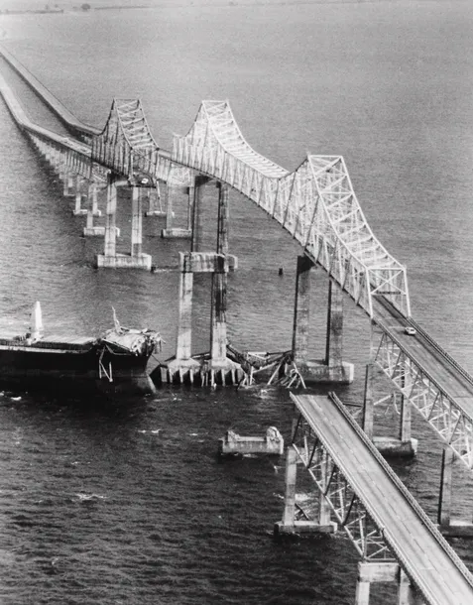
If you were there.. What would you Do ?
Sunshine Skyway Bridge (Florida , 1980)
Before the Disaster
After The Disaster
Notes:
This disaster happened because a large ship hit the support pillar during a storm with very low visibility. The engineers hadn’t expected that a ship this size could drift off course in such a bad weather , and there were no barriers or early warning systems in place to stop it.
Because of this, a whole section collapsed and several cars fell into the bay.
Question To Students
Imagine you’re an engineer. You are working on this bridge.. And once stormy morning a cargo ship crashes into a support.
Part of the bridge collapses. People were driving over it just minutes before.
What went wrong? How do you prevent in the future?
Let’s think like engineers- what would you do ?

Slide 10




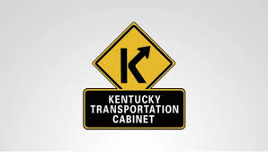




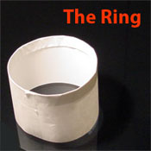

Paper Plane Challenge
Let’s Test Aerodynamics!

Slide 11


Winner ?

Slide 12
THANK YOU!

Slide 13
KYTC.KEEN@ky.gov
transportation.ky.gov/Education/Pages/KEEN.aspx

