Slide 1

GEOMETRY IN ENGINEERING:
Presentation by:
On Month Day 2023
Notes:
You don’t have to be a genius to be an engineer, but people who become engineers like math, science, and problem solving.

Slide 2

An education initiative by the Kentucky Transportation Cabinet

Slide 3
Engineers are
PROBLEM SOLVERS
Use technology to solve problems
Rely on creativity and academic skills
Use math, science, and computers
Even though the tasks can be different from each other, engineers use common methods to solve their problems.
Notes:
You don’t have to be a genius to be an engineer, but people who become engineers like math, science, and problem solving.

Slide 4


THE ENGINEERING PROCESS:
Select & Design
Preferred solution
SOLVE THE
PROBLEM
Propose
solutions
Analyze
the problem
Identify and
define a problem
Notes:
In general this is a flow chart of the steps engineers follow in solving problems.
First, you identify and define your problem
Second, you analyze the problem
Third you design and propose solutions
Forth you refine your proposal
5) And after going through this process you have hopefully found a solution to your initial problem.

Slide 5

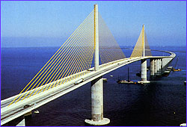
M A T H !!!
Geometry in Engineering & in the Real World
Notes:
Who doesn’t like math? Or Doesn’t think they are good at math? Or even sits in this class everyday thinking “When will I ever need to use this in life?
All of you use math everyday, including geometry, most people have no idea.
Things from walking up the stairs in your house or your porch to driving a car and almost everything in between requires math. ***Talk about doing calcs in head to know how far to step, tie into geometry (Shape of legs, balance)***

Slide 6
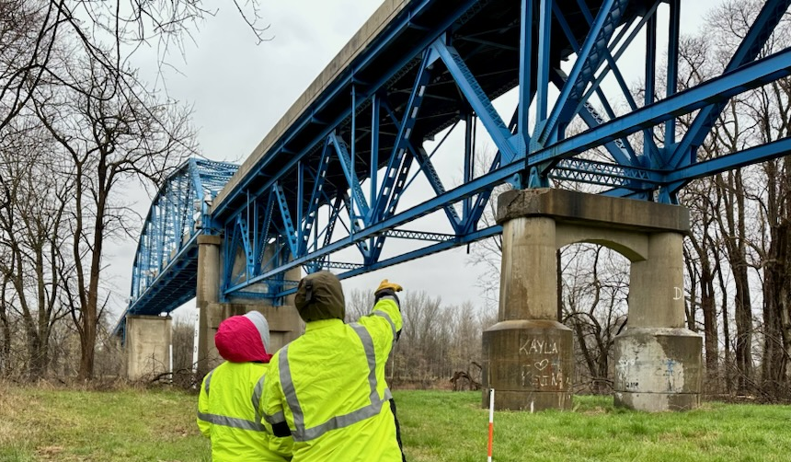
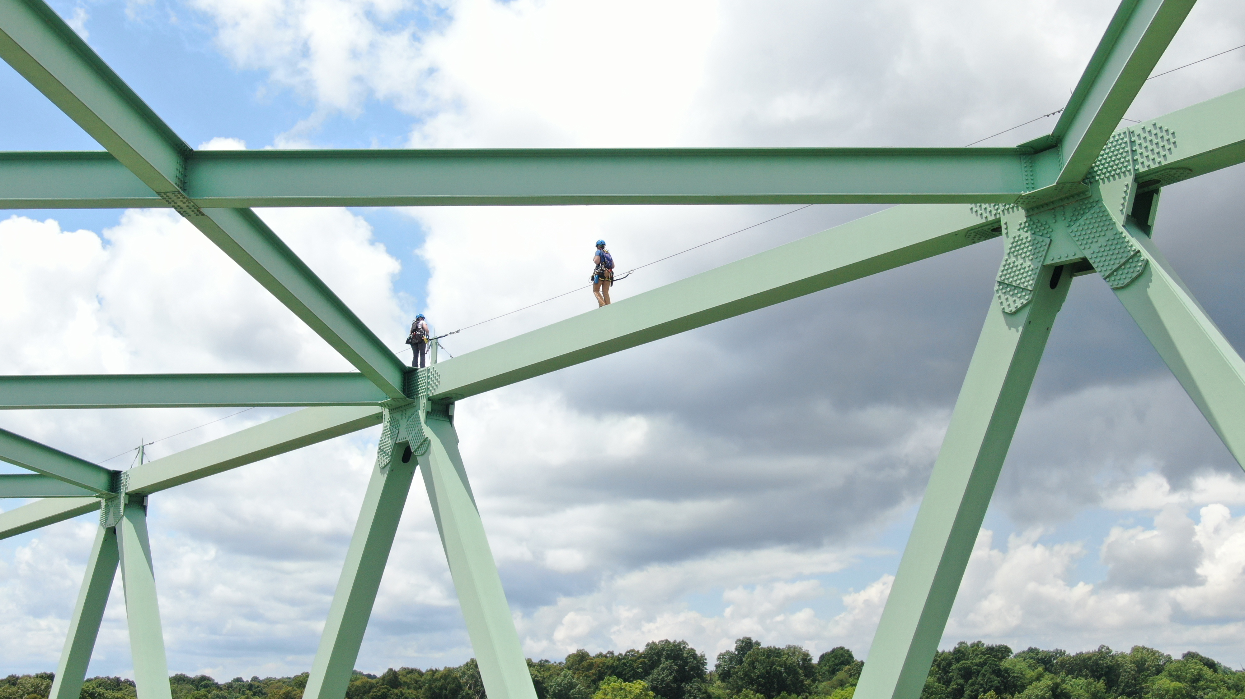
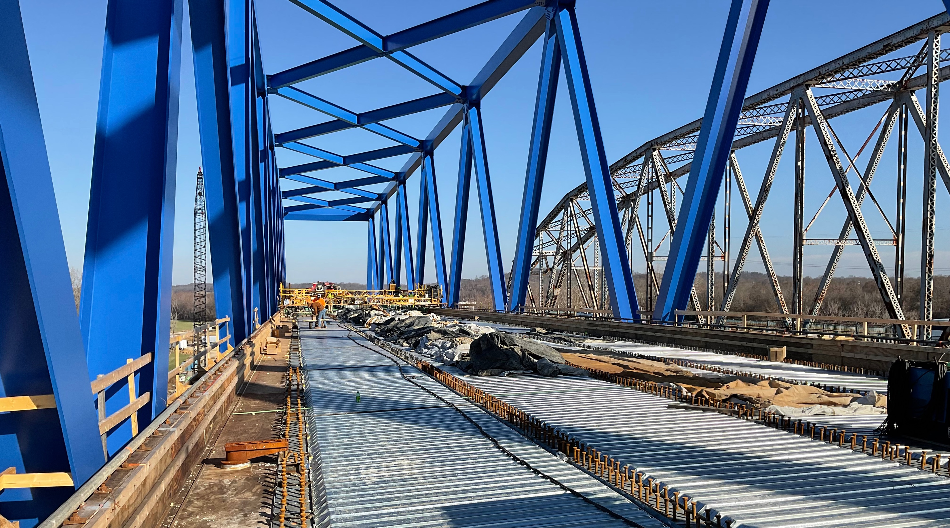
Geometry
The Mathematical Study of Shapes

Slide 7
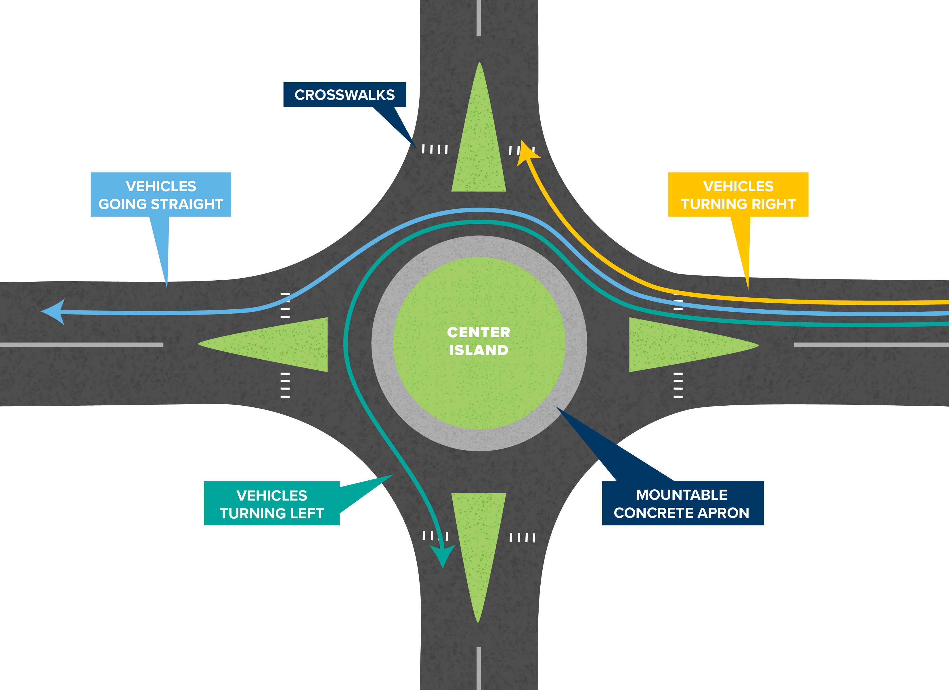
CIRCLES
Circles in Engineering
Roundabouts
Notes:
improve safety.
Promote lower speeds and traffic calming.
Reduce conflict points.
Lead to improved operational performance.
Meet a wide range of traffic conditions because they are. versatile in size, shape, and design.

Slide 8
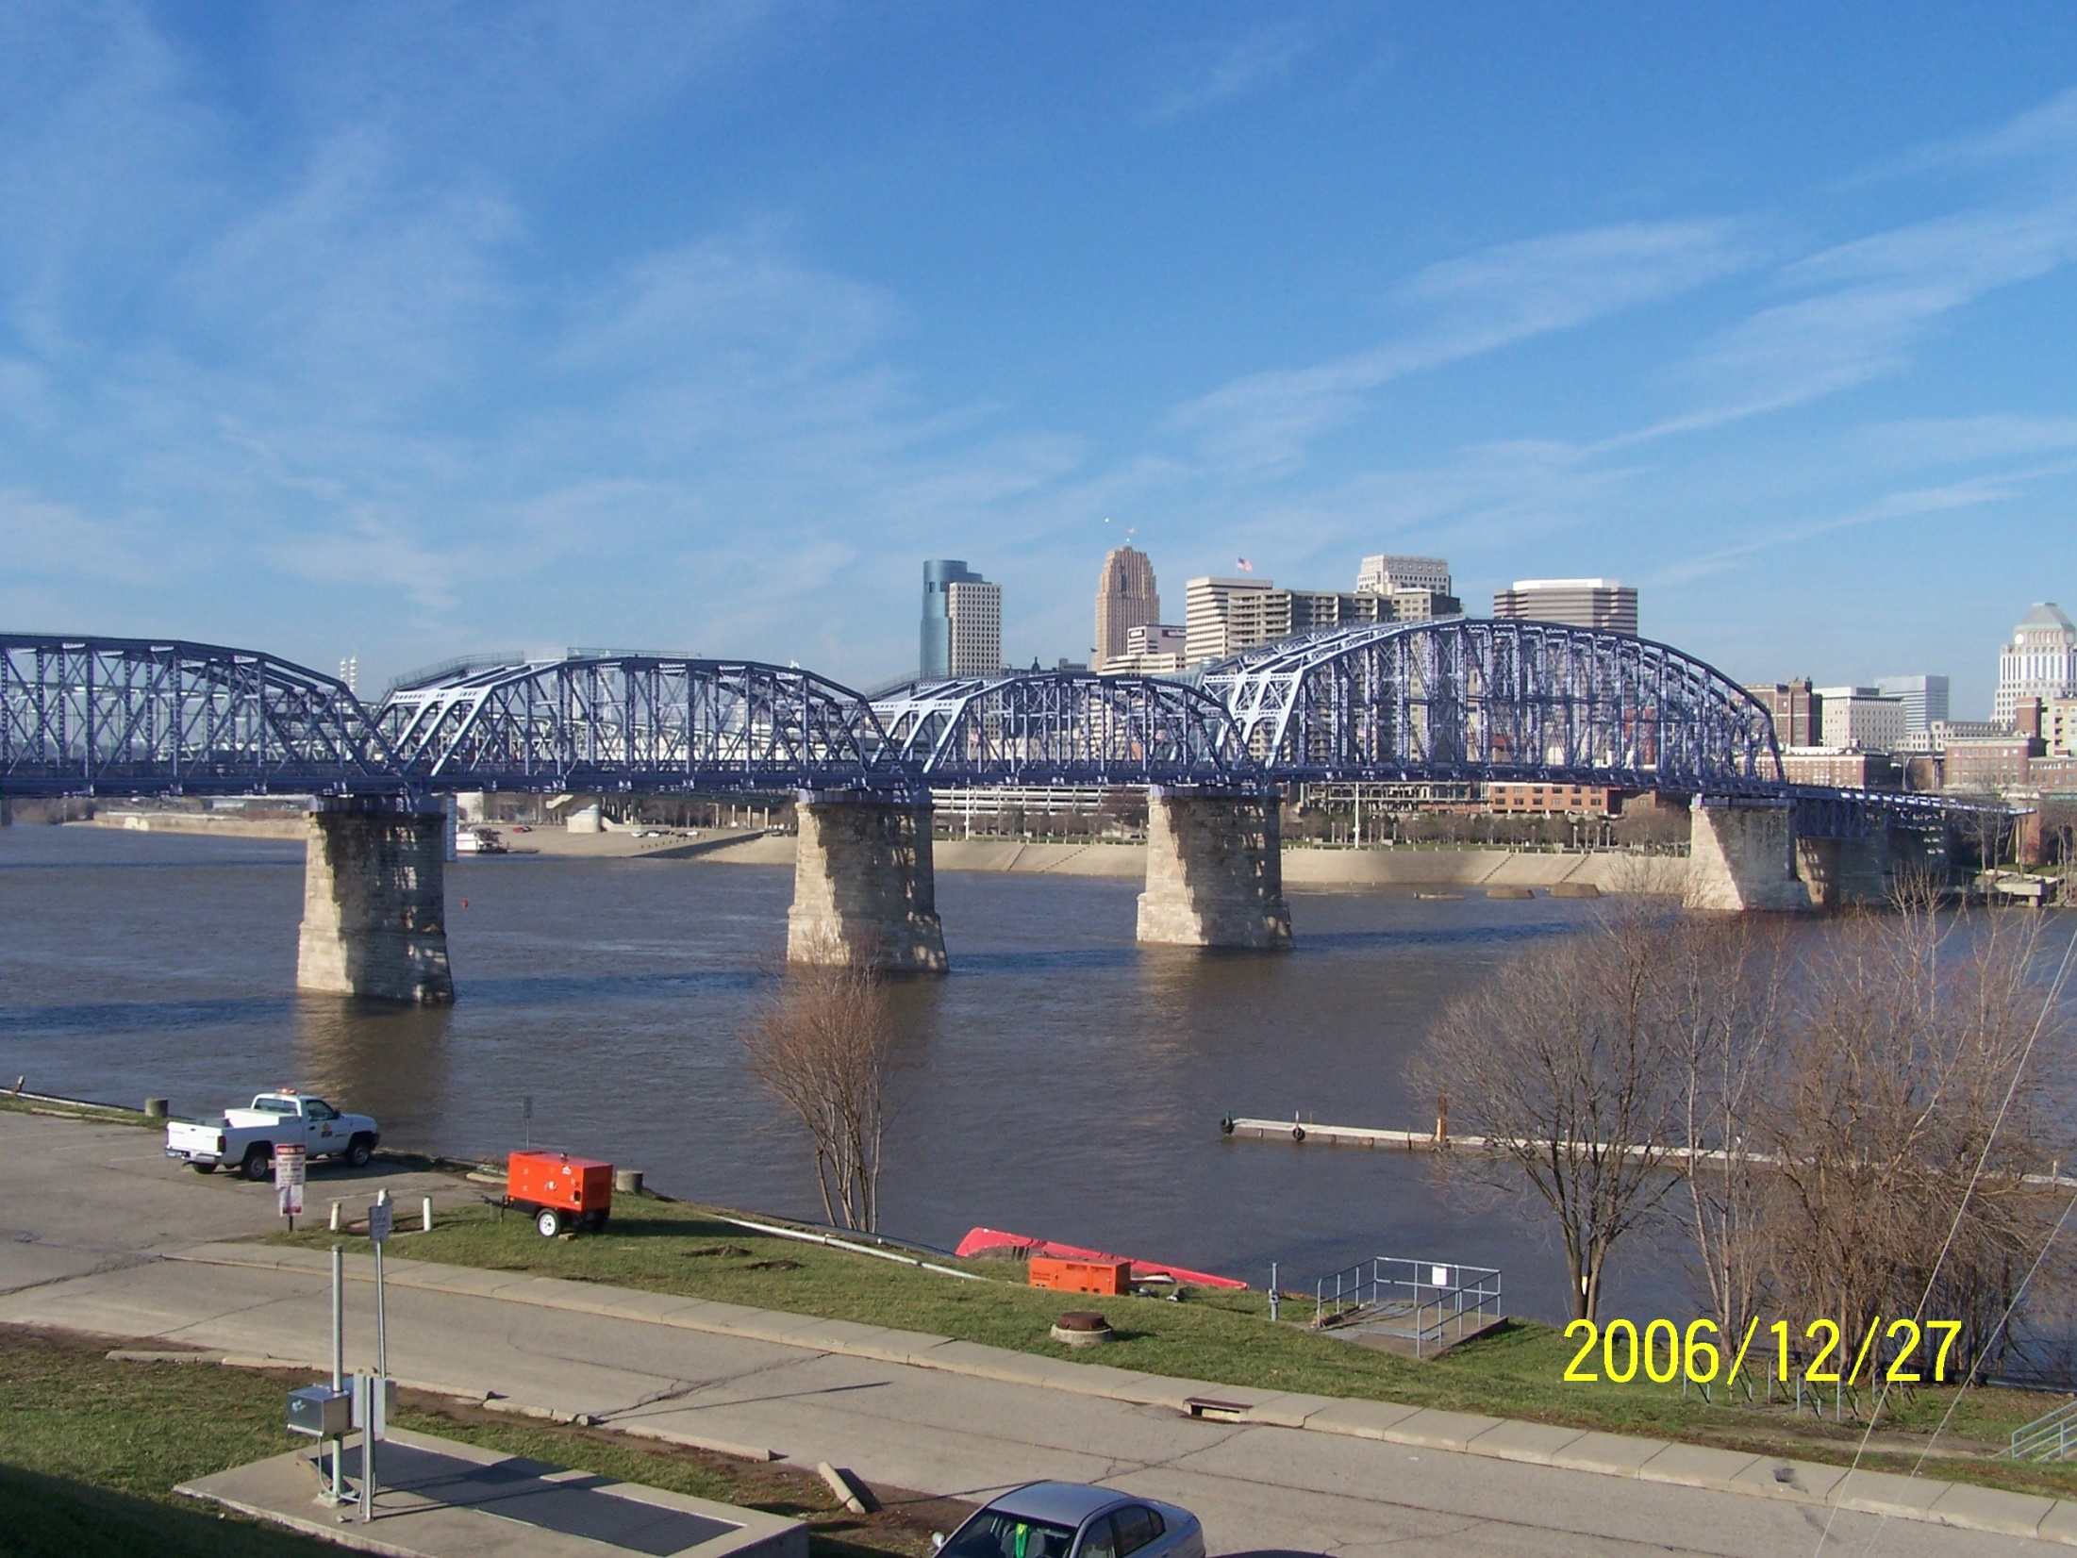
TRIANGLES
Triangles in Engineering - Roundabouts
PURPLE PEOPLE BRIDGE –
Newport, KY - Cincinnati, OH
2,670 ft pedestrian only built in 1872
Notes:
Truss Bridge.
Triangles running the full span of the bridge. We use triangles because they are the strongest shape. When weight is placed anywhere on them, it is evenly distributed to all 3 sides.

Slide 9
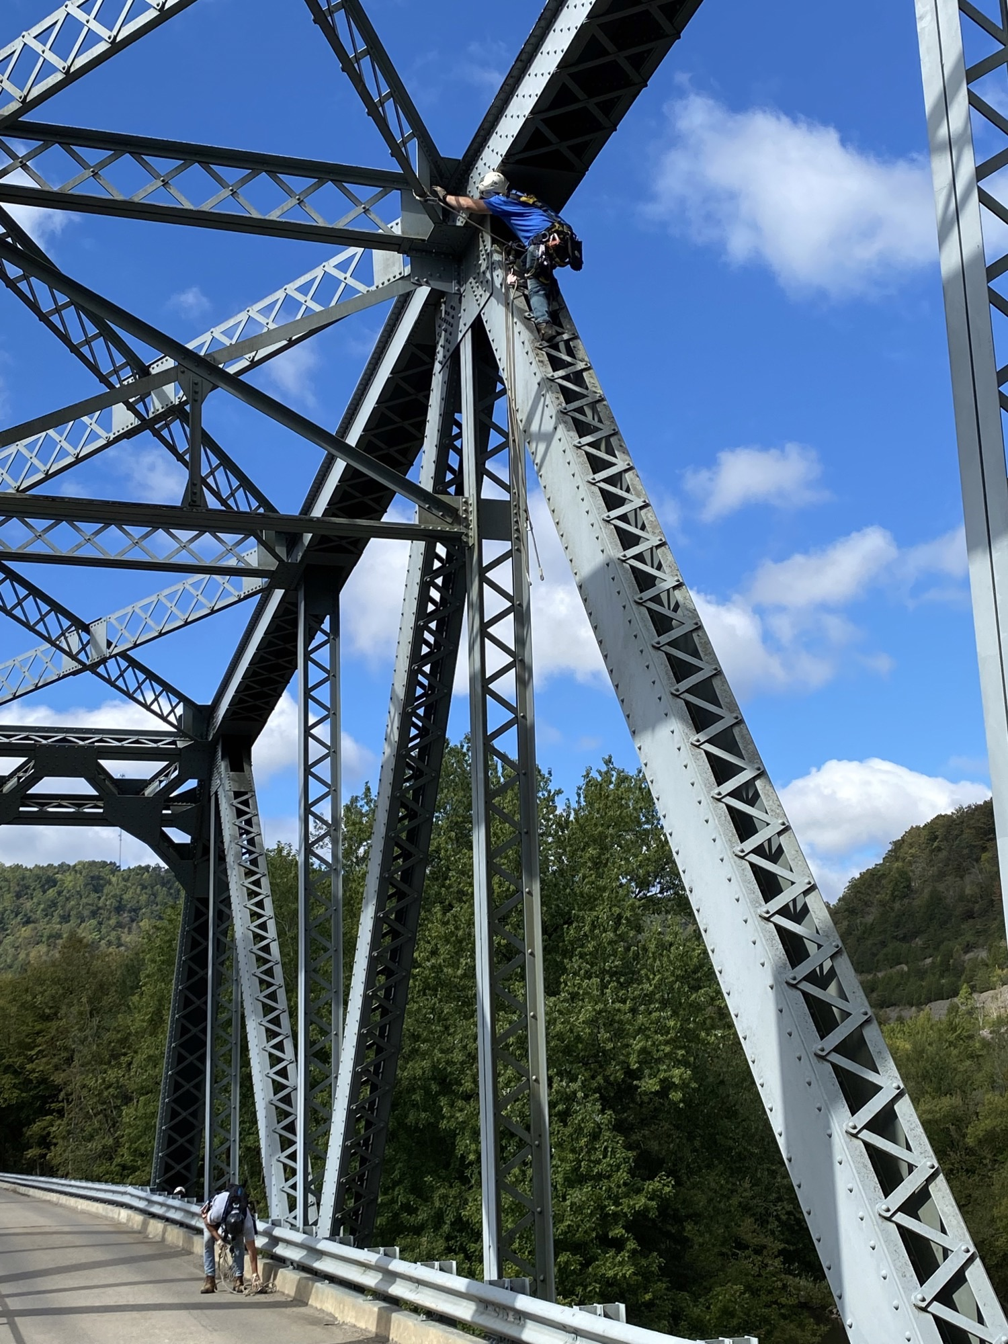
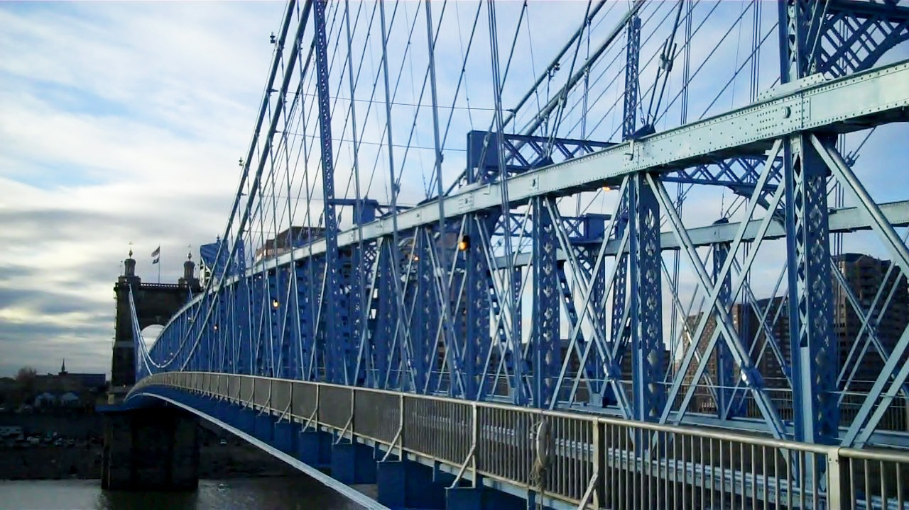
TRIANGLES
Triangles in Engineering - Roundabouts
Notes:
Truss Bridge.
Triangles running the full span of the bridge. We use triangles because they are the strongest shape. When weight is placed anywhere on them, it is evenly distributed to all 3 sides.

Slide 10
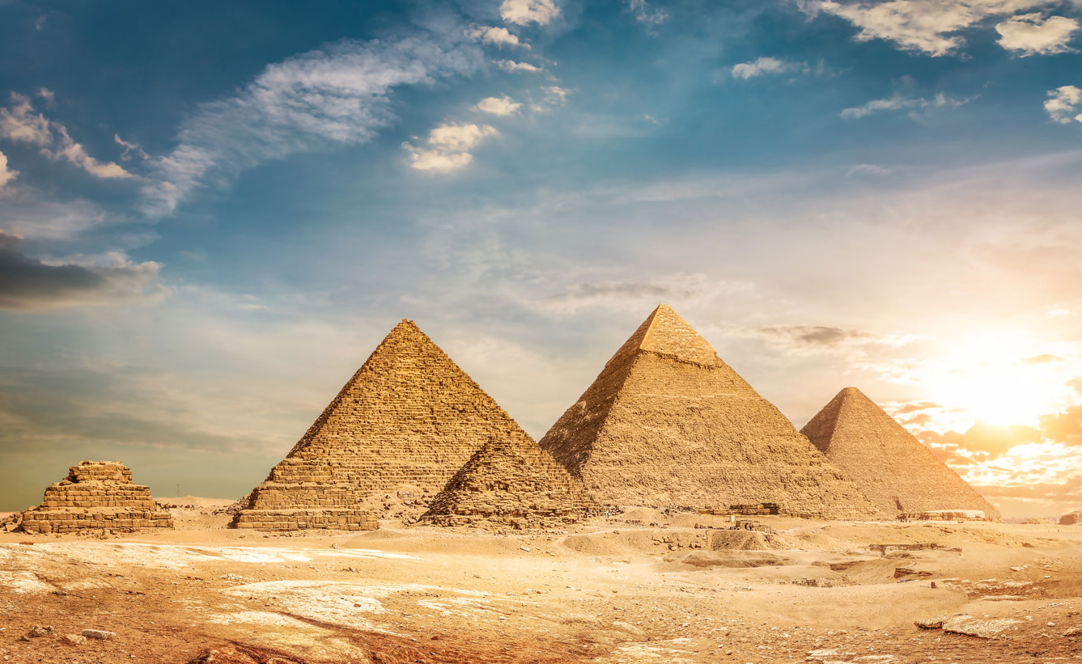
PYRAMIDS
The Great Pyramid of Giza is the oldest of the Seven Wonders of the Ancient World that still standing.
Estimated 20 years to build by 20,000 to 30,000 people.
Angled more than 51 degrees
481 feet tall
Perimeter of the base (four sides) = 756 feet
Each stone weighs 2.5 (5,000 lbs) to 15 U.S. tons
Around 2.3 million stone blocks
A total mass of 6.5 million U.S. tons
How did they do that?
Notes:
Early engineers accomplished some great feats. The Egyptian pyramids are truly an astonishing work of engineering skill.
For more than four thousand years they were the tallest buildings in the world. The sides are oriented to the
four cardinal points of the compass, with the four sides of the base
being as much as 755 feet. They rose at an angle of more than 51
degrees to an original height of 481 feet. They were constructed
using more than 2,300,000 stones weighing as much as 2.5 tons (5,000 lbs)
each. Even in today’s world, that would be quite an accomplishment.

Slide 11
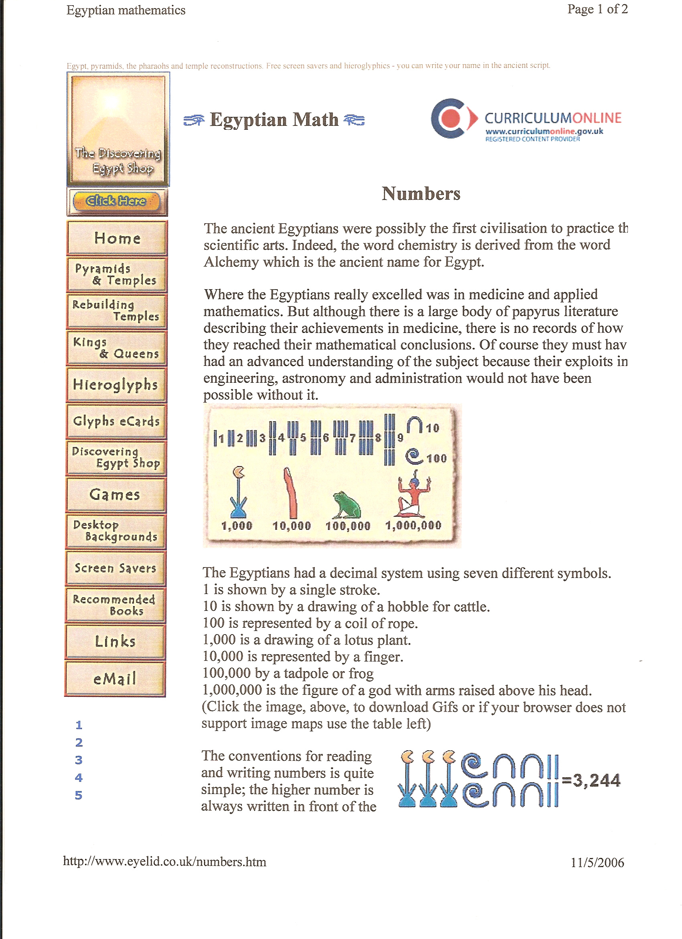
PYRAMIDS
Egyptian Number System
3,244

Slide 12
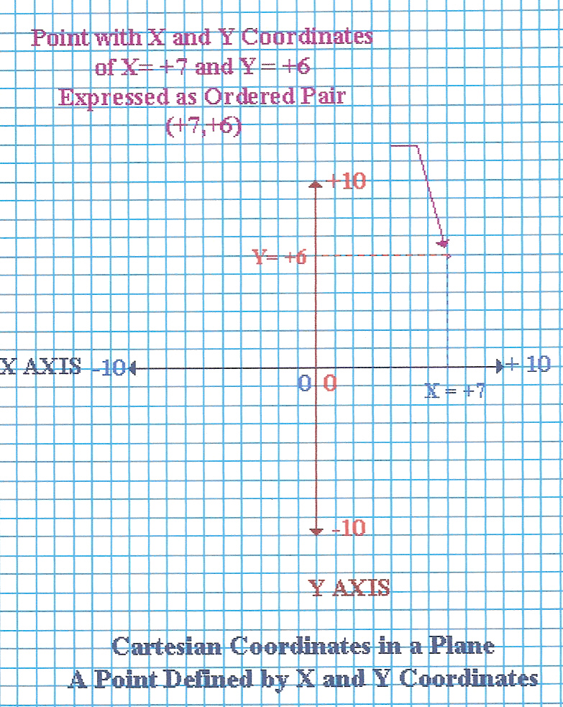
Coordinates
A Mathematical
Mapping
System
COORDINATES
A Mathematical Mapping System

Slide 13
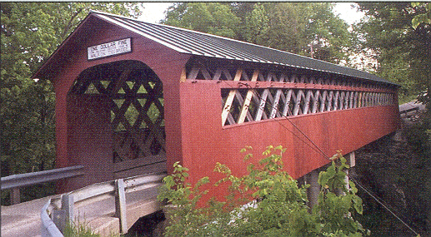
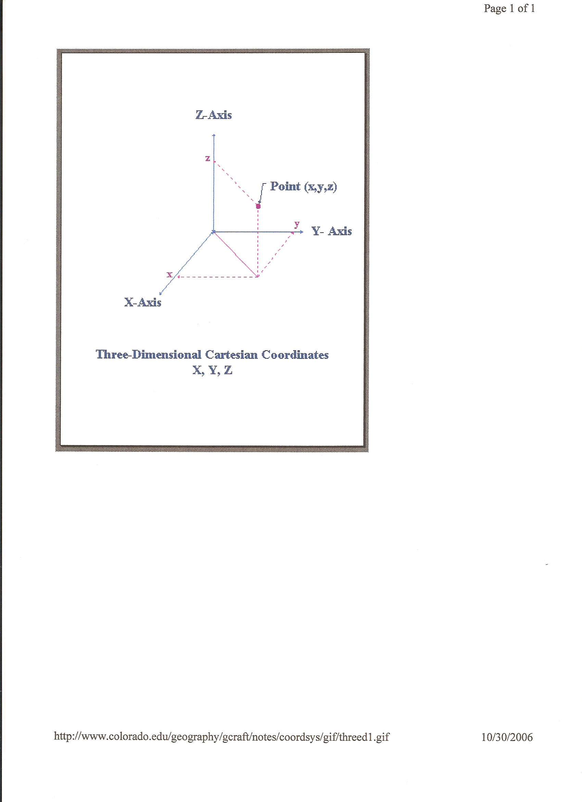
3-D
COORDINATE SYSTEM
Three-Dimensional Cartesian Coordinate Systems

Slide 14
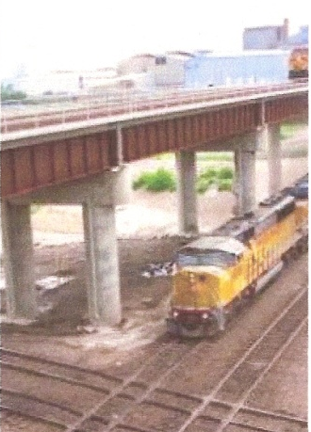
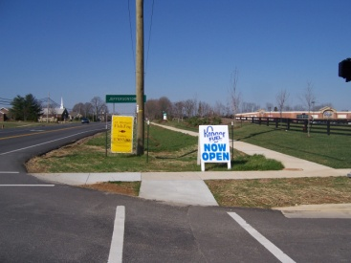
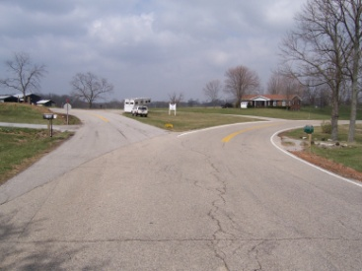
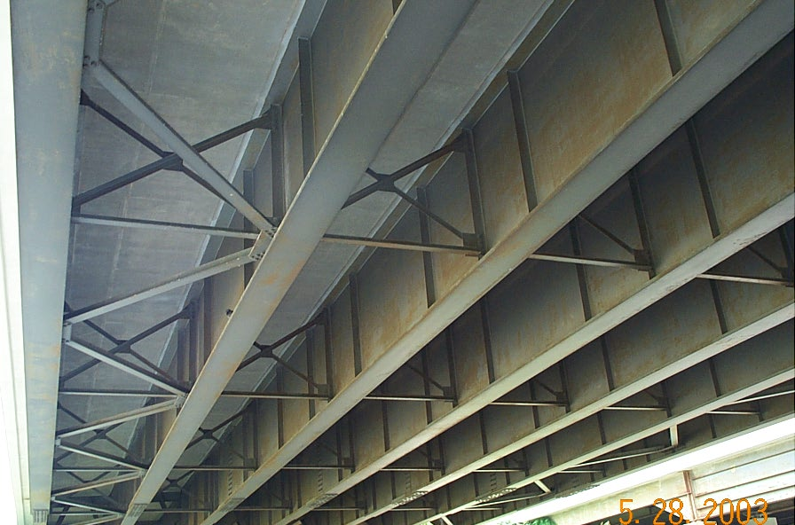
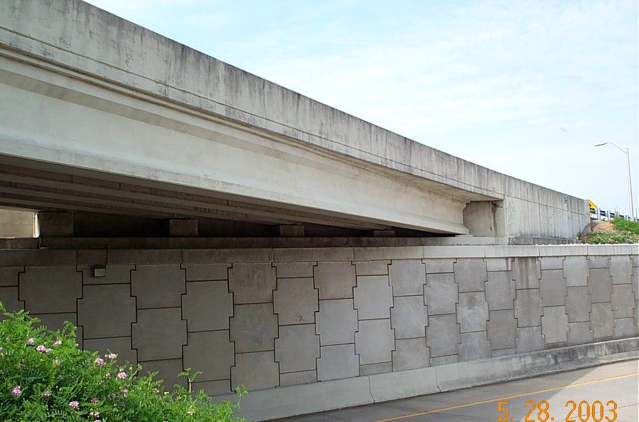
PARALLEL LINES
in Engineering
Roadways and Sidewalks
Bridges
Prestressed Concrete “I” Beams
Steel Girder Beams
Railroads

Slide 15
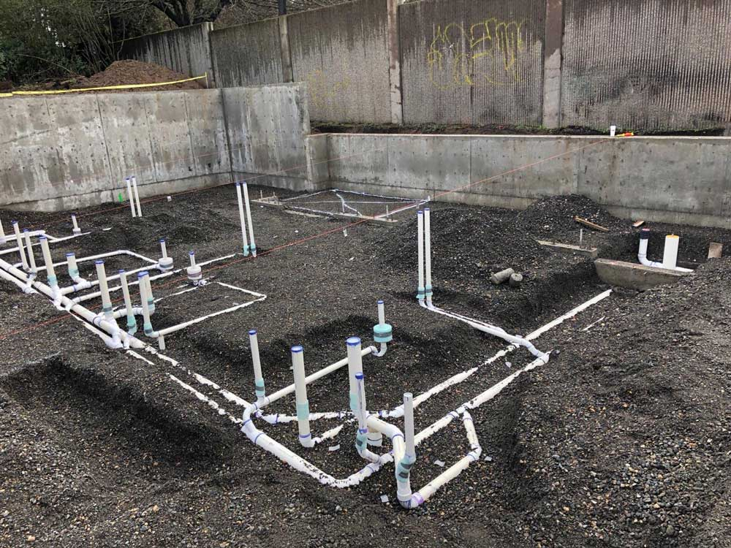


CAREERS
Careers with heavy emphasis on geometry.
Engineer
Construction Worker
Pilot
Math Teacher
Interior Designer
Plumber
Fashion Designer
Game Developer
Surveyor
Architect

Slide 16
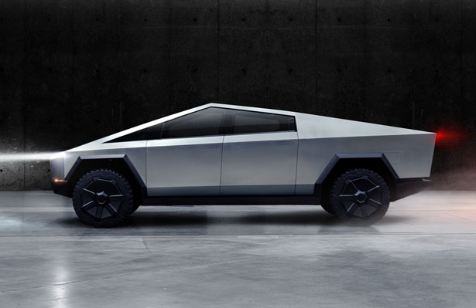
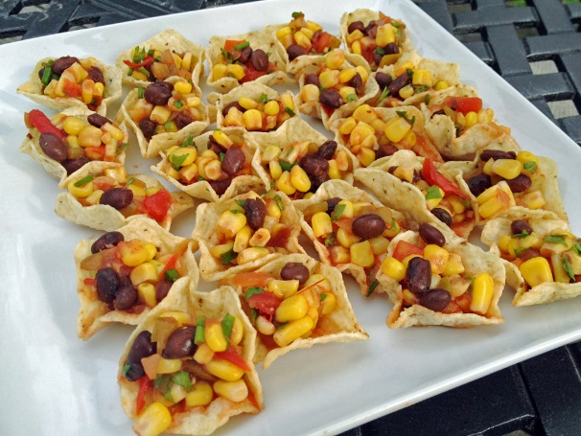
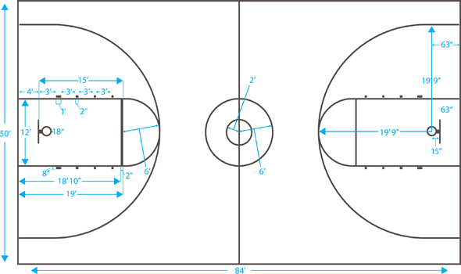

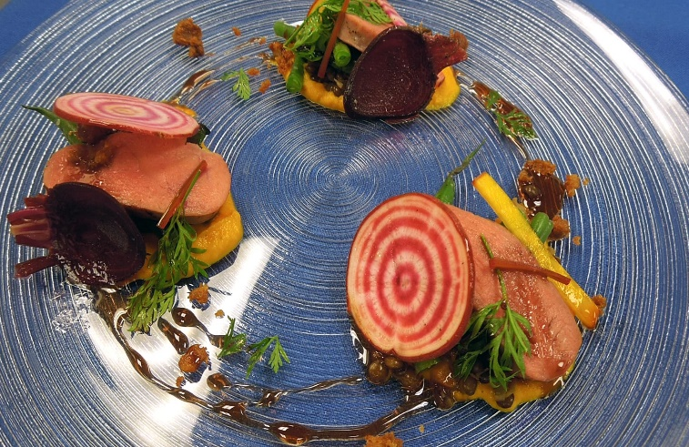
Geometry is everywhere around you
Sports
Food
Cars
Wrapping Presents
Concerts

Slide 17
THANK YOU!

Slide 18
KYTC.KEEN@ky.gov
WEBSITE: transportation.ky.gov/Education/Pages/KEEN.aspx

