Slide 1

High School
UNDERGROUND UTILITY DAMAGE PREVENTION
Locating Utilities
Presentation by:
On Month Day 2022

Slide 2

An education initiative by the Kentucky Transportation Cabinet

Slide 3


in partnership with:

Slide 4
What are utilities?
Occupying road right of way
Locating utilities before excavating
Utilities layout
Utilities test equipment

Slide 5

What are utilities?
○ Electricity
○ Gas
○ Crude oil
○ Water
○ Sewage
○ Other fluid
○ Phone and Cable
*Conveyed to or for the public, for compensation
Kentucky Revised Statute KRS 278.010

Slide 6
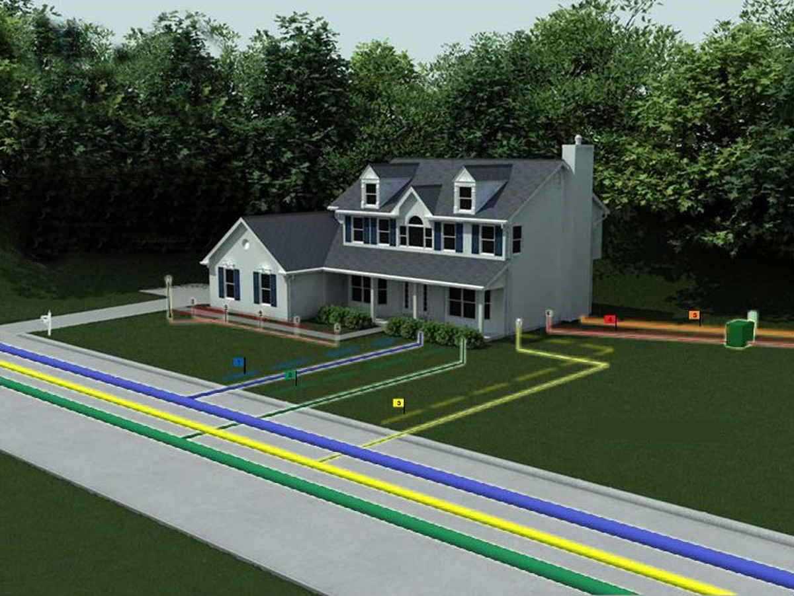
Why are utilities in a row?
Utilities may construct and maintain lines in the road right-of-way
They can’t interfere with the road
The Department of Highways regulates access via a permitting process
If the lines interfere with the road, the utility has to relocate or remove it
Kentucky Revised Statute KRS 416-140

Slide 7
NAME THAT UTILITY

Slide 8
Name that Utility

Slide 9
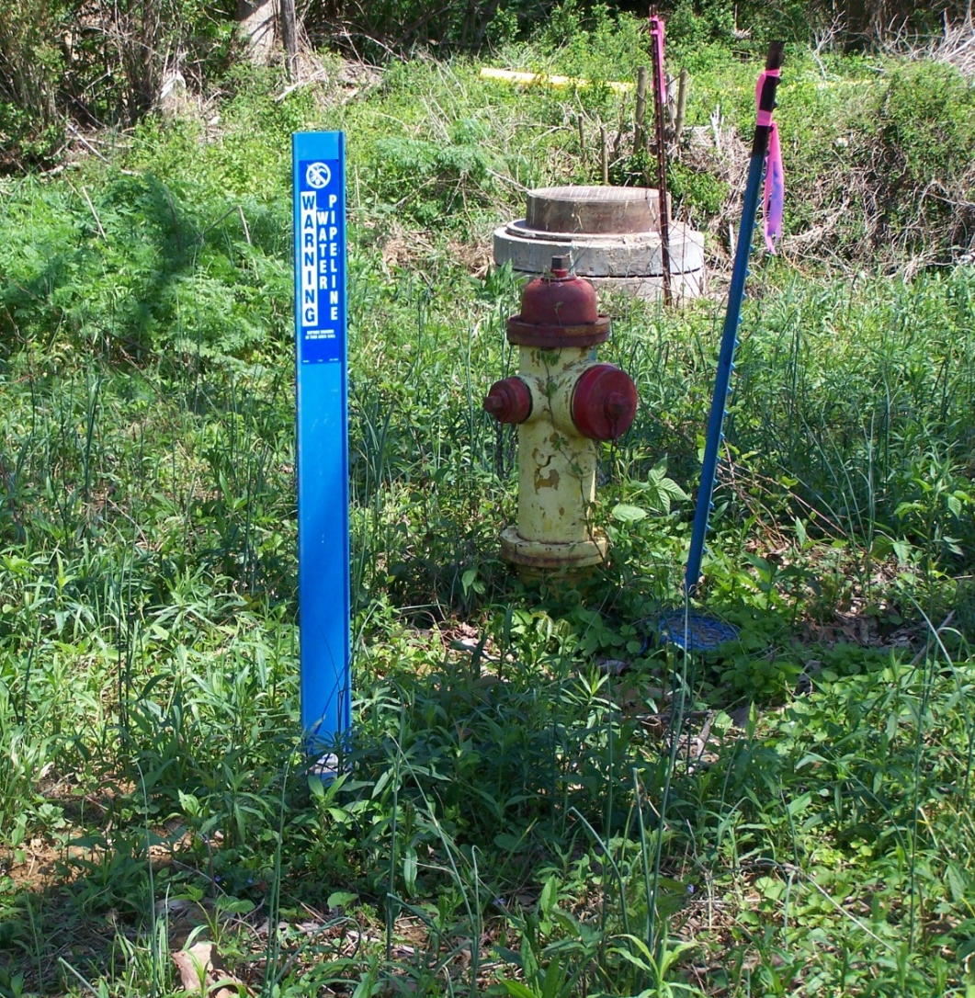
Name that Utility

Slide 10


Name that Utility
WATER
SEWER

Slide 11
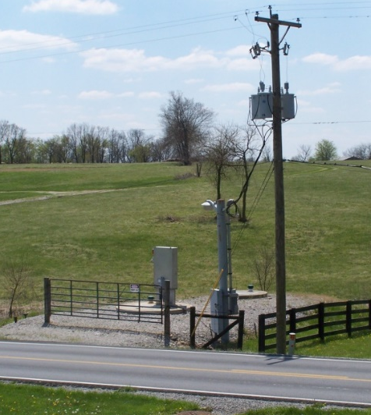
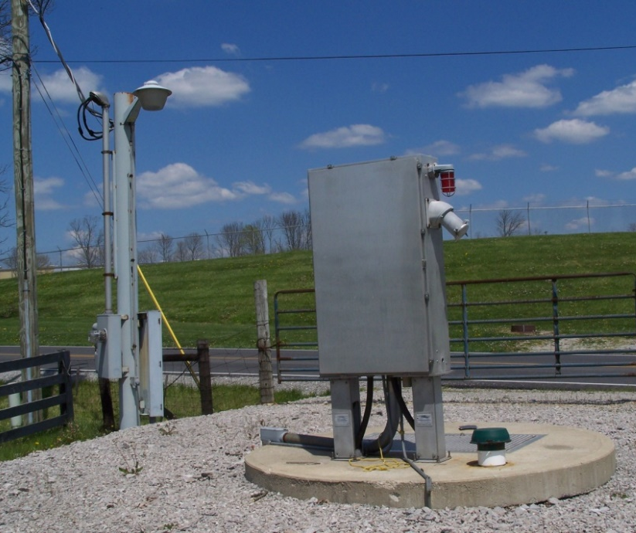
Name that Utility

Slide 12
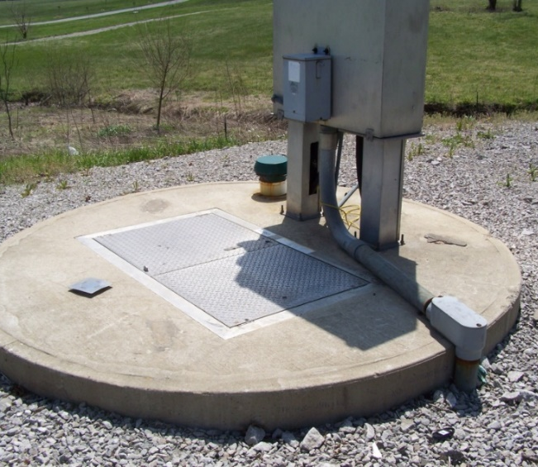
Name that Utility
SEWER PUMP STATION

Slide 13
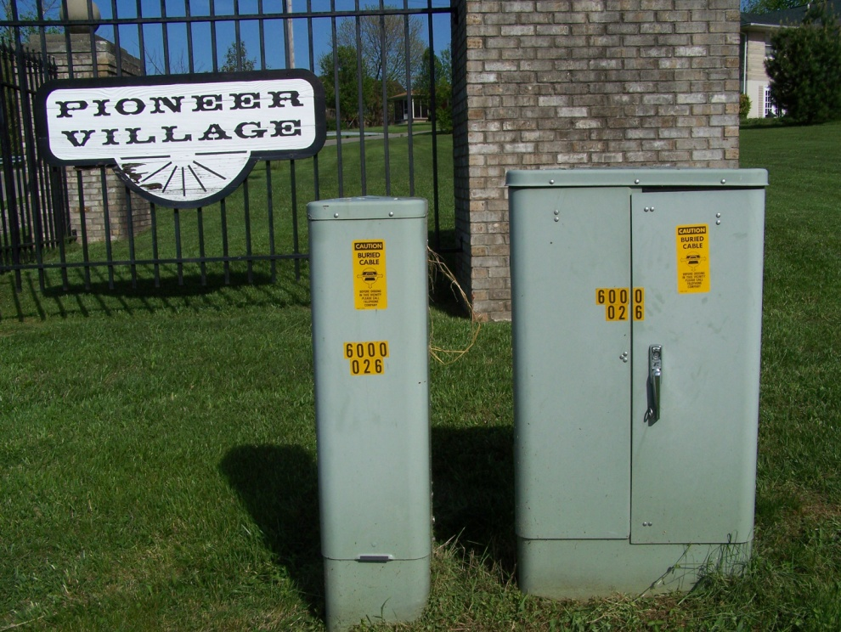
Name that Utility

Slide 14

Name that Utility
TELECOMMUNICATION (UNDERGROUND PHONE)
PEDESTALS

Slide 15
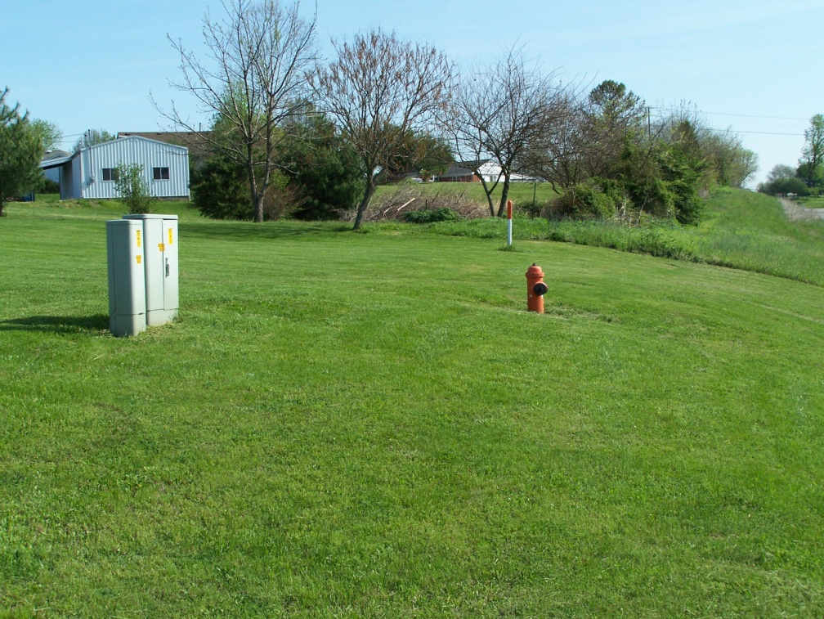
Name that Utility

Slide 16
Name that Utility
TELECOMMUNICATION (UNDERGROUND PHONE)
WATER FIRE HYDRANT
UG FIBER OPTIC

Slide 17
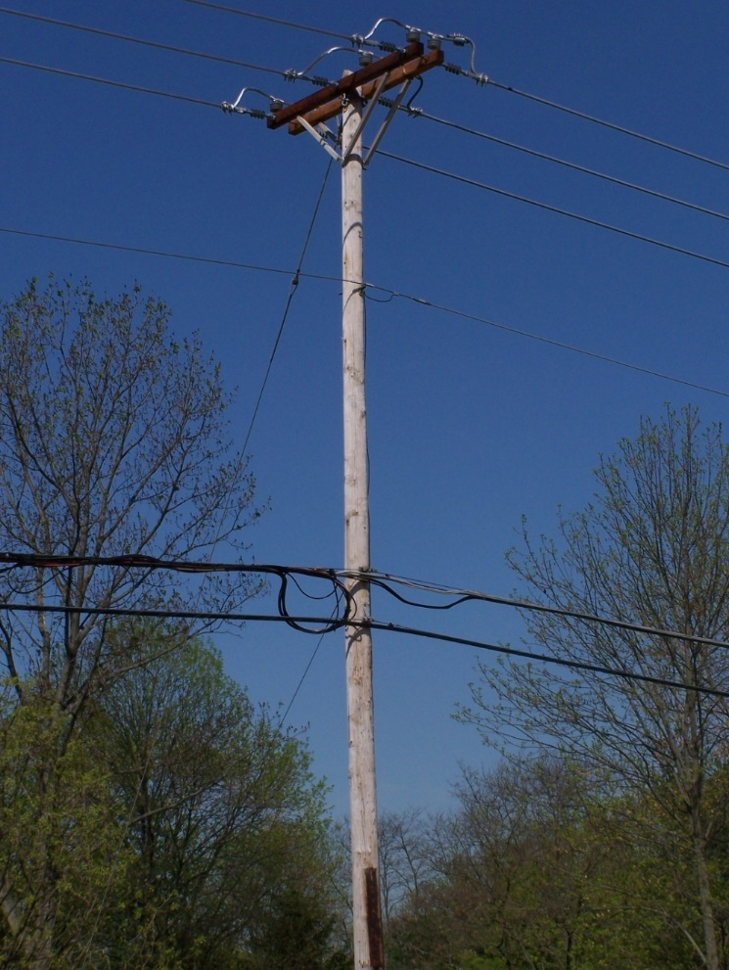
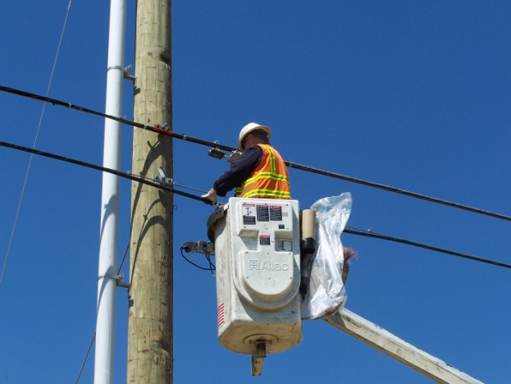
Name that Utility

Slide 18

Name that Utility
AERIAL POLE ROUTE
ELECTRIC
CATV W/ SLACK
TELECOMMUNICATION (PHONE)

Slide 19
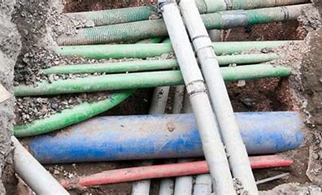
Locating utilities before excavating
Locating underground utilities is becoming more of a challenge as the amount and variety of underground lines increase.
As the ground under our feet becomes more congested, it’s vital to identify the location of utilities to ensure safety and reduce cost.

Slide 20


Locating utilities before excavating
CAMBY IND, NEAR INDIANAPOLIS

Slide 21
Locating utilities before excavating
DALLAS FORT WORTH TX AREA

Slide 22
Locating utilities before excavating
SAN ANTONIO, TX

Slide 23
What are the common underground utility location methods?
Ground penetrating radar
Hydro excavation
Electromagnetic utility locating

Slide 24
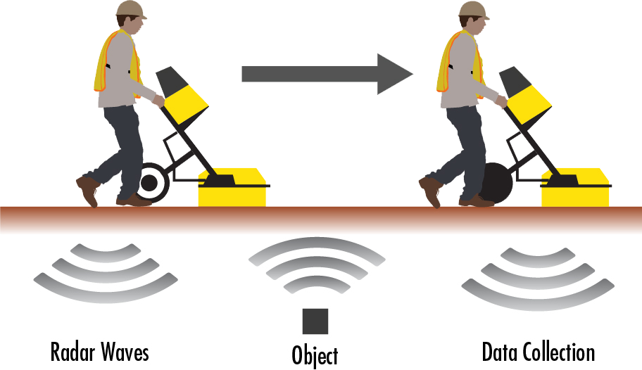
Ground Penetrating Radar

Slide 25
Ground Penetrating Radar
Uses high frequency pulses
Radio waves are emitted into the ground
Underground utilities deflect the radio wave back up
Requires experience and training

Slide 26
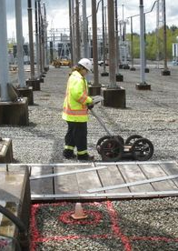
Ground Penetrating Radar
Best imaging solution for both metallic and non-metallic targets
Both position and depth can be found
Detects changes in underground conditions by reflecting off any disturbance:
  Wet soil
  Rocks
  Metal
  Plastic

Slide 27
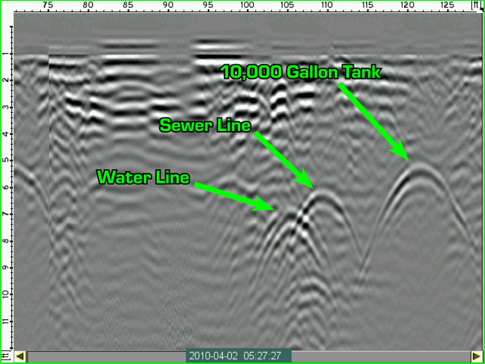
Ground Penetrating Radar
Limitations:
  Some soils like shale or clay
  Only for shallow utilities
  Dense soil
  Crowded utilities

Slide 28
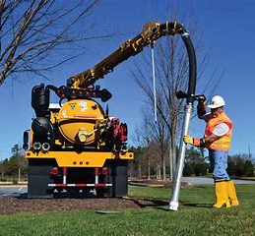
Hydro or Vacuum Excavation (potholing)
Fast and non-destructive
High pressure air or water is used to break up the soil,
Soil is then vacuumed into a tank
Precisely locates the utility but only at this specific location
*Also known as potholing, hydro-digging, hydro-trenching or soft digging

Slide 29
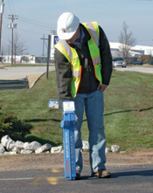
Electromagnetic Utility Locating
Most common method
Generates an electromagnetic signal
Commonly used to detect gas, electric, telephone, cable, propane, water, sewer, storm and irrigation lines

Slide 30
Electromagnetic Utility Locating
Limitations:
Cannot locate plastic, concrete, clay or other non-ductile pipes
Doesn’t perform well beyond the depth of 10-15 feet

Slide 31
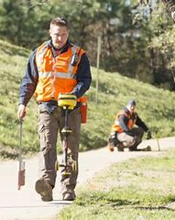
How Electromagnetic Locating Works
Two parts: a transmitter and a receiver
The transmitter places a “signal” onto the line then
The signal is located with the receiver
The signal placed on the line is an electromagnetic frequency

Slide 32
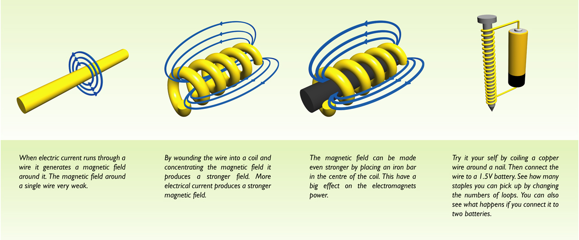
How Electromagnets Work

Slide 33
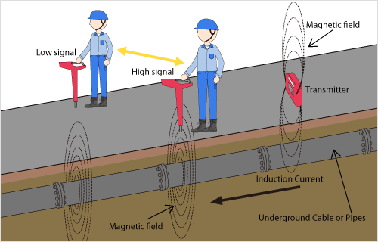

Slide 34
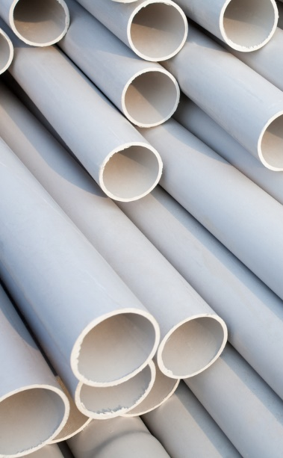
Pipe Types
Plastic Pipe:
  PVC (polyvinyl-chloride) is a type of plastic pipe. It is a commonly used pipe for drain and water lines. It’s strong, untouchable by chemicals, and seems to last forever!

Slide 35
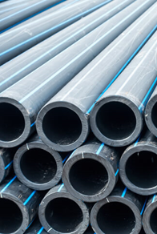
Pipe Types
HDPE high density polyethylene pipe:
  HDPE pipe is commonly used for sewer and storm water. It is more durable than standard PVC pipe and has become a popular material for underground piping systems.
https://www.acmeplastics.com/what-is-hdpe

Slide 36
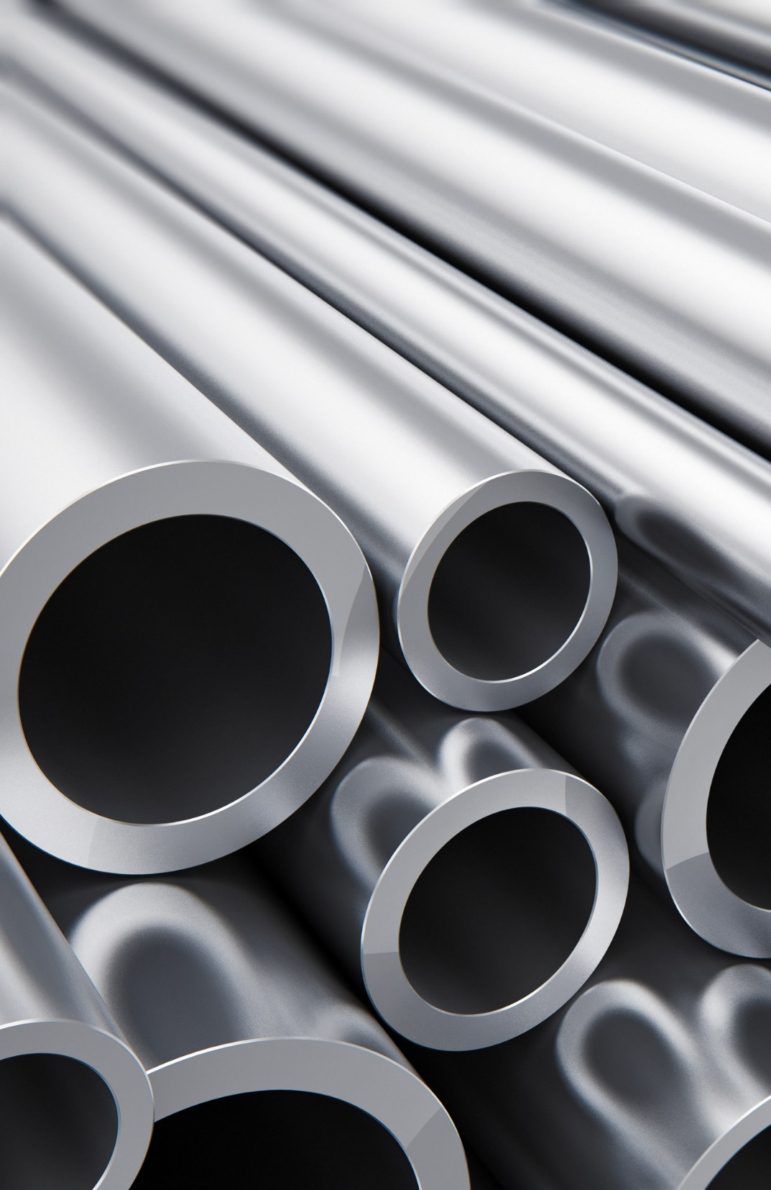
Pipe Types
Steel:
  Steel pipe is strong, and can be used to transport liquids and gases including water. It can have a useful lifetime of about 50 years.

Slide 37
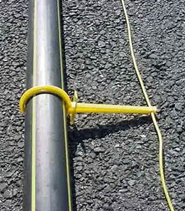
Electromagnetic Utility Locating
Utility lines like gas lines are generally constructed plastic pipe.
So, tracer wire is run alongside or on top of the pipeline to make the line “locatable.”

Slide 38
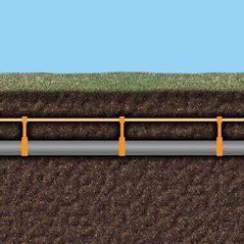
Electromagnetic Utility Locating
In these situations by having access to the system (e.g. a tracer wire box), a current can be induced on the tracer wire and the tracer wire can be located.

Slide 39
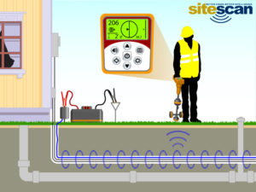
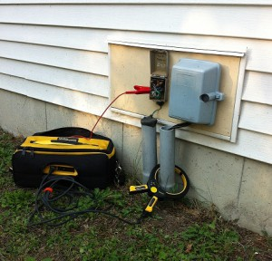
Electromagnetic Utility Locating

Slide 40

DIG SAFE KENTUCKY!
2 business days before you dig, call
811
Or (800) 752-6007
www.Kentucky811.org

Slide 41
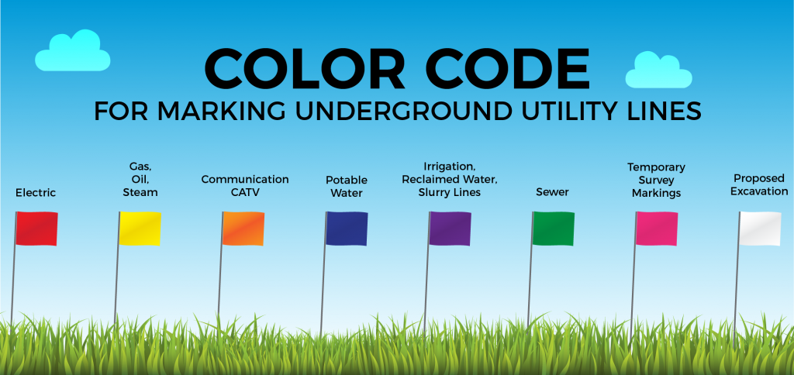
Locating utilities

Slide 42
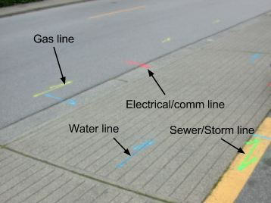
Locating utilities

Slide 43
Ways to induce field
Connect to the metal tracer wire
Connect to the metal facility
Lay the transmitter over the line and induce signal onto it

Slide 44
Ways to induce field
First two methods are best, but require us to actually be able to touch the facility.
Connect to the metal tracer wire
Connect to the metal facility
Lay the transmitter over the line and induce signal onto it

Slide 45
Ways to induce field
Last method puts signal onto everything in the ground and is imprecise, but sometimes the only option.
Connect to the metal tracer wire
Connect to the metal facility
Lay the transmitter over the line and induce signal onto it

Slide 47
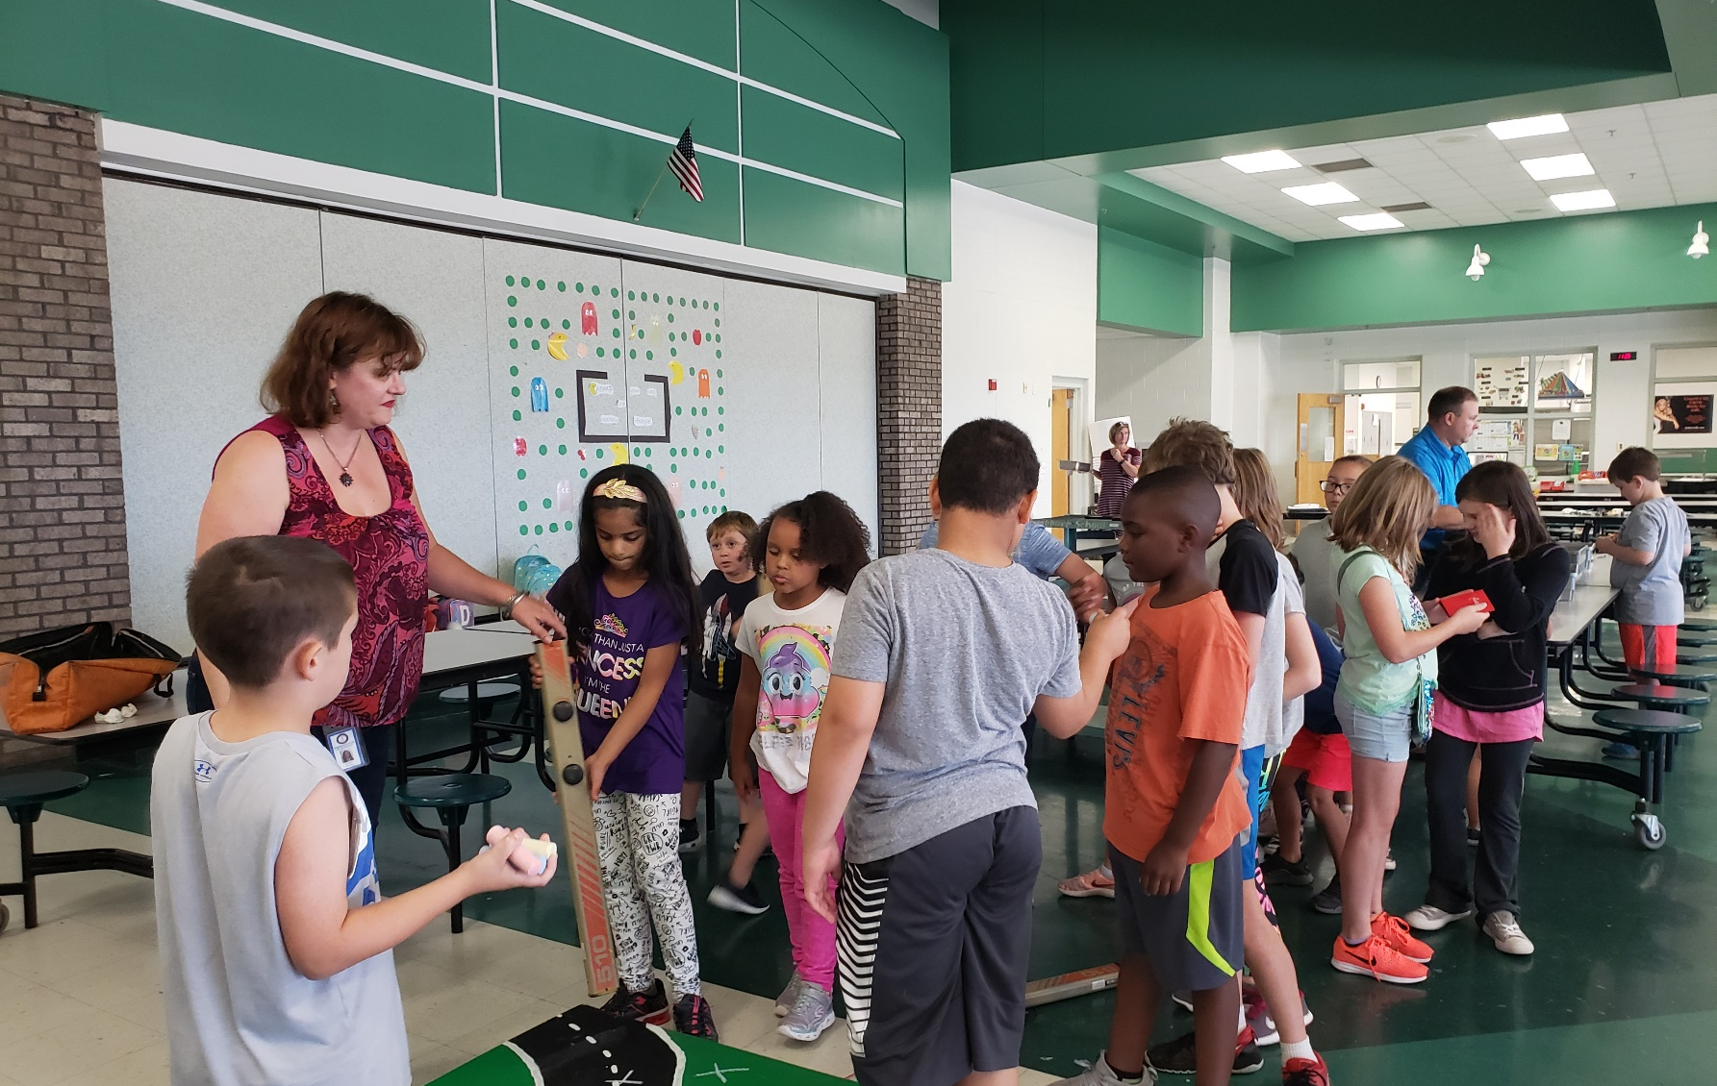
Time to be locators!

Slide 48
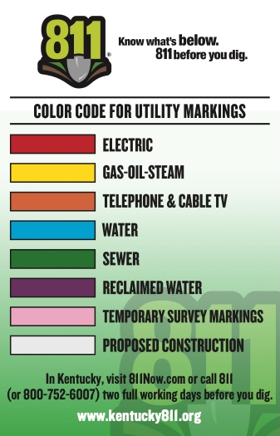
Time to be locators!
There are three lines in the project area:
  Schedule 40 PVC Water Line
  Polyethylene (PE) Sewer Line
  Steel Gas Line

Slide 49
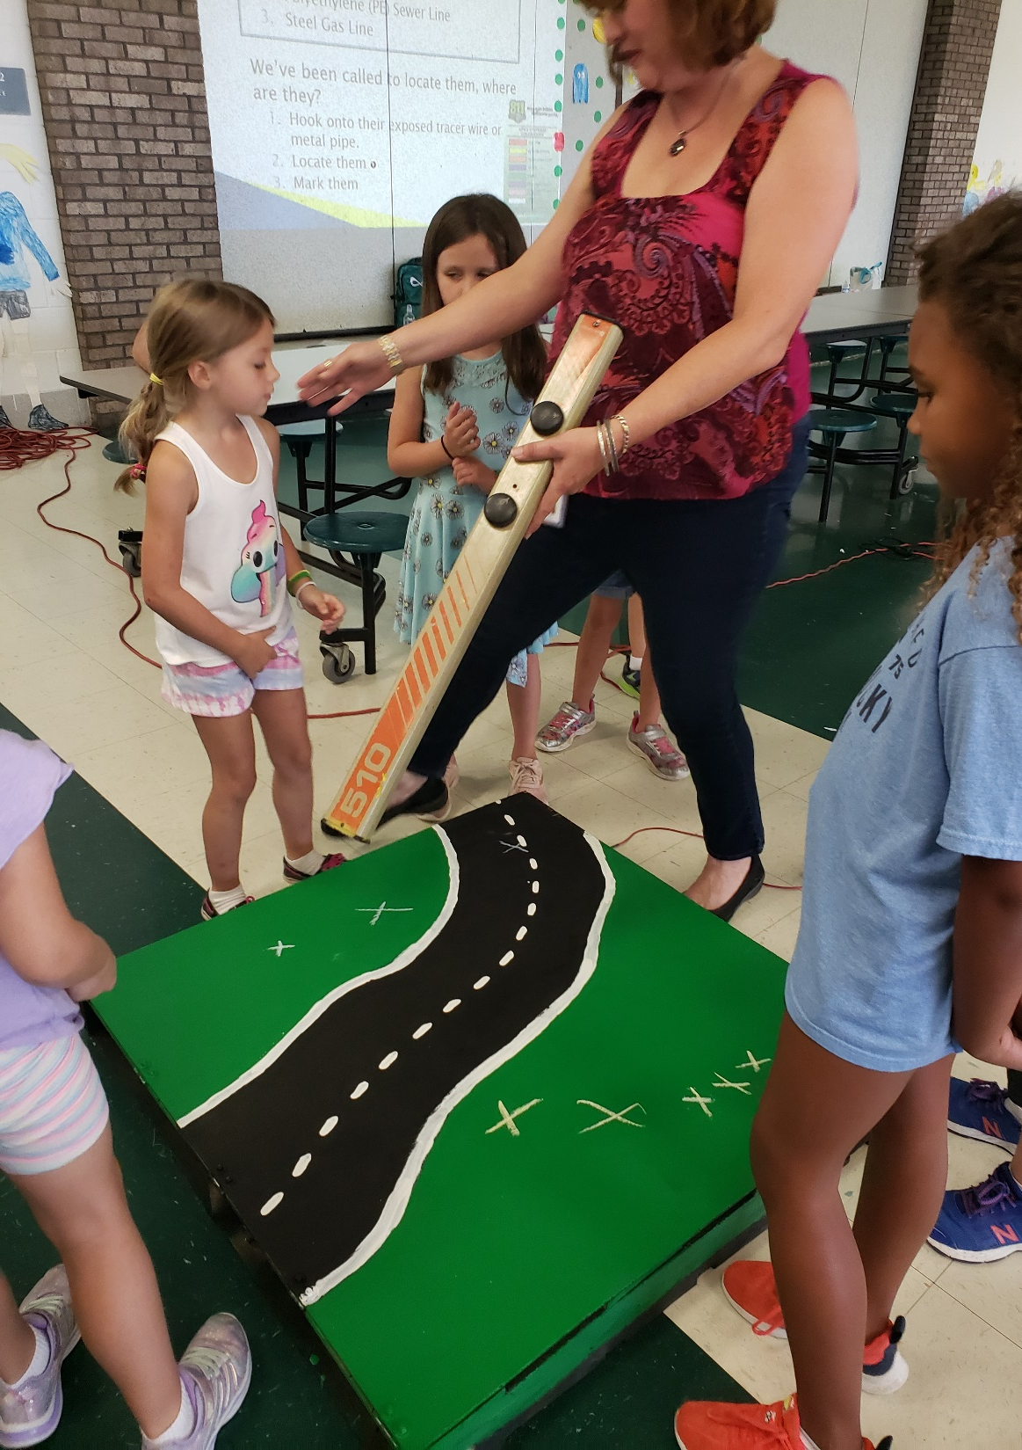
Time to be locators!
We’ve been called to locate them, where are they?
  Hook onto their exposed tracer wire or metal pipe
  Locate them
  Mark them

Slide 50
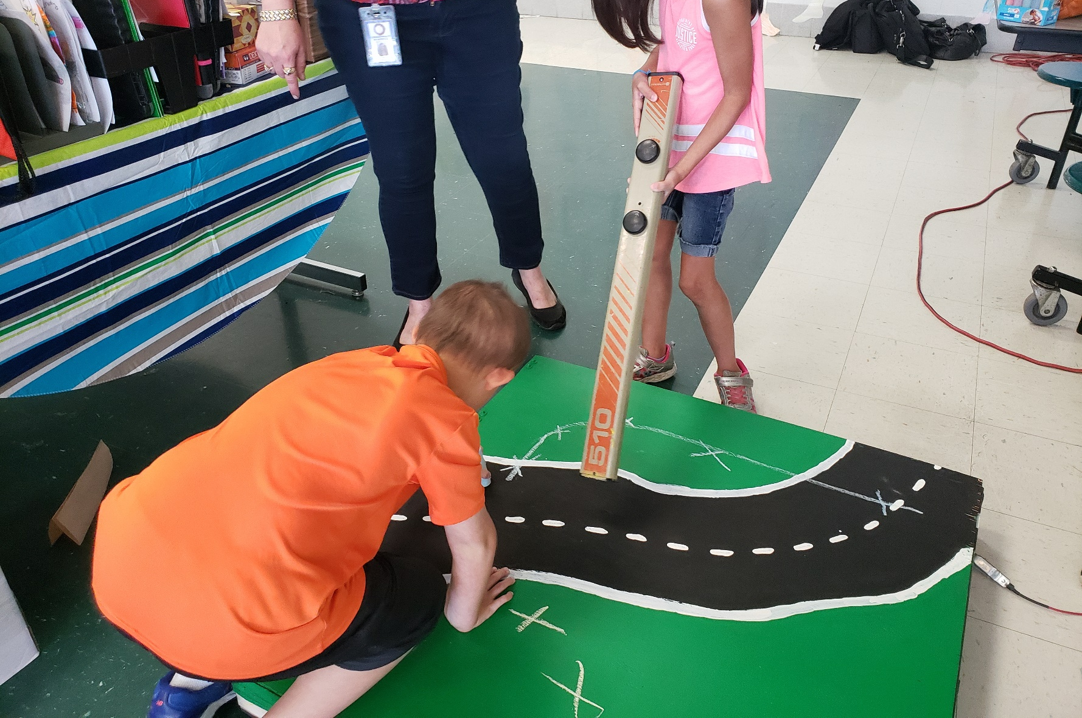

Slide 51
THANK YOU!

Slide 52

in partnership with:
KYTC.KEEN@ky.gov
transportation.ky.gov/Education/Pages/KEEN.aspx

